Slide 1
NETS 2023
Using the reporting tool
Notes:
Standard title slide

Slide 2
Key changes to the 2023 NETS reporting tool
Look and feel – a new design:
A change to the look and feel of the pages with a simpler filter pane on the right of each page.
The introduction of a contents page to help with navigation.
The inclusion of the ‘working out’ of the survey such as indicator mapping, benchmark groupings, scoring conventions and calculations.
Ability to clear filters on any page.
Simplified language.
The introduction of a ‘hover’ information button which explains each page.
New ways to view the data:
New page to view trust level data by indicator.
Ability to undertake more filters.
A new provider page which enable education providers to see question level results for their placements.
All professional branching questions included.
Inclusion of PCNs under provider organisation pages
Inclusion of sexual safety responses.

Slide 3
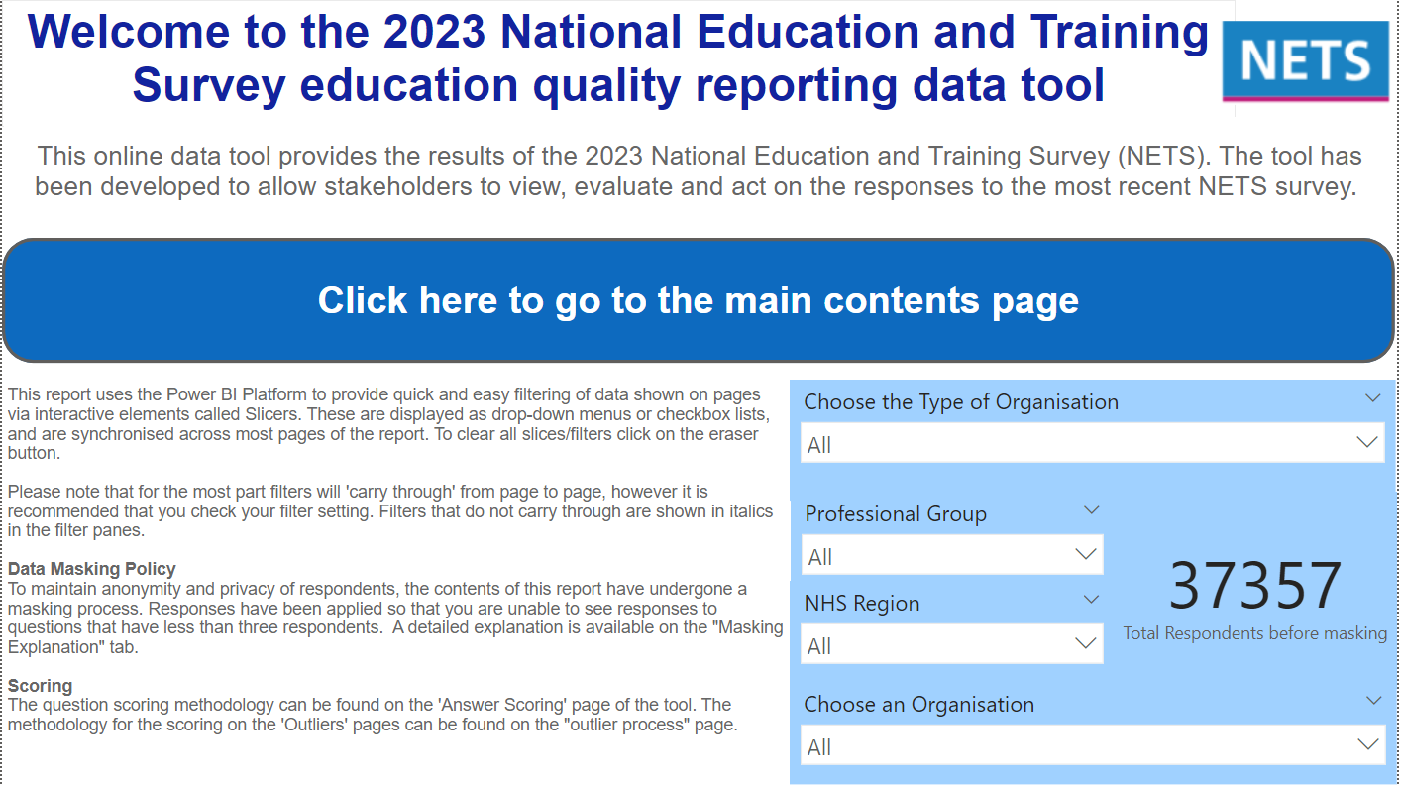
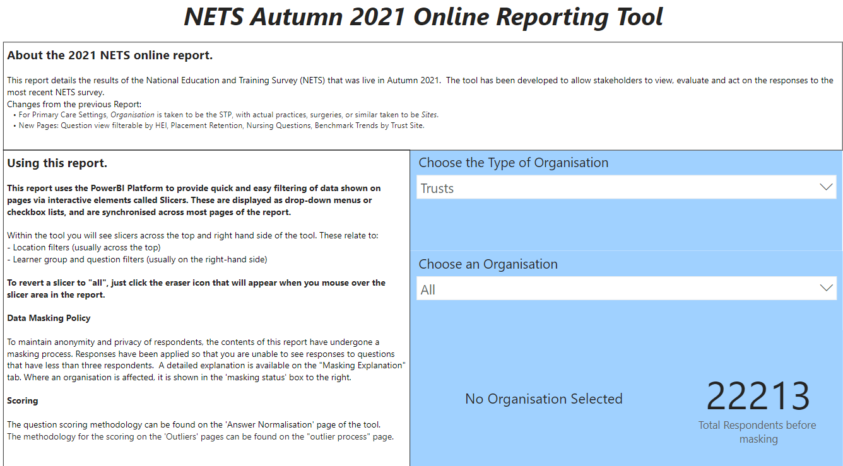
Welcome page
The welcome page has been updated to follow NHS branding, given a more visually professional presentation and (in addition to the previous filters) now includes two new filters for professional group and NHS region.
Previous version

Slide 4
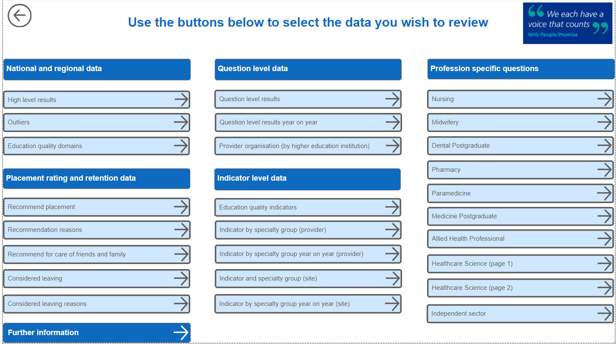
NEW contents page
A new contents page has been included this year, this will enable users to find, select and navigate reporting pages. Reports have been categorised into five key areas:
National data
Question level
Indicator level
Professional branching
Placement rating and retention
A further information button is included.
To go to a page, simply click.

Slide 5
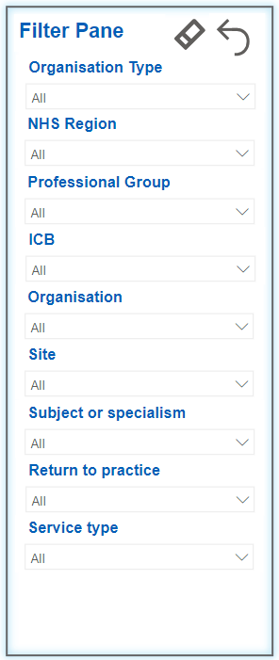
NEW navigation: filters
To apply a filter e.g., professional group, click on the filter icon in the top right-hand side of each page.
Select using the arrows on the right-hand side of each filter
To clear all filters, click the eraser button.
To close the filter pane, click the back button.

Slide 6
NEW navigation: information
You can find more information about each page, the data it is showing and any benchmark colour coding. To do this hover your mouse over the information button.

Slide 7
NEW navigation: return to main menu
To return to the main contents page, click the back button at the bottom left-hand side of each page.

Slide 8
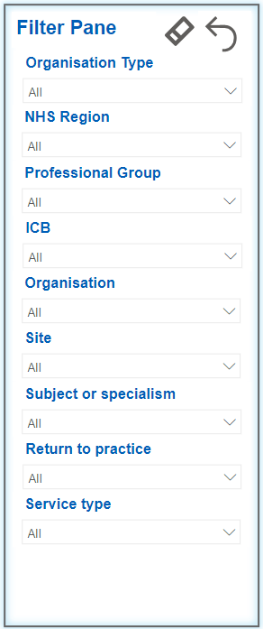
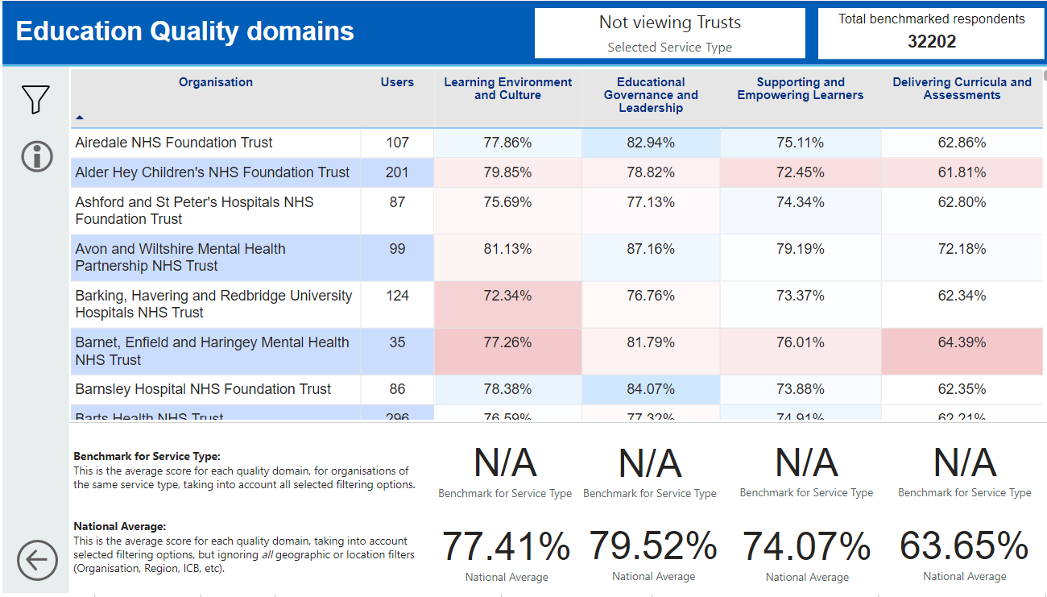
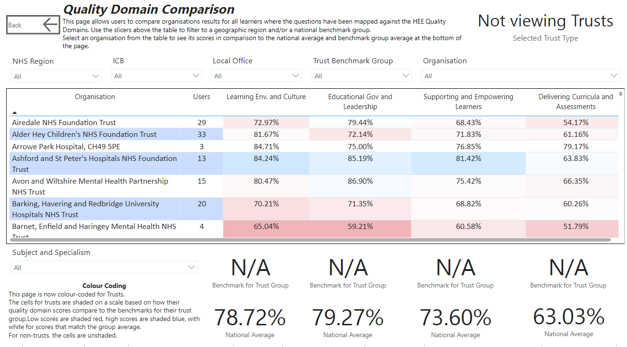
Education quality domains
The education domains page has been redesigned to make it easier to read, with a new look and feel. Users can filter in several ways shown to the left. A new feature has been added which enables users to sort results alphabetically or by result/score (high to low and vice versa) shown below.
Previous version
To sort the results by education quality domain or organisation use the arrow button.

Slide 9
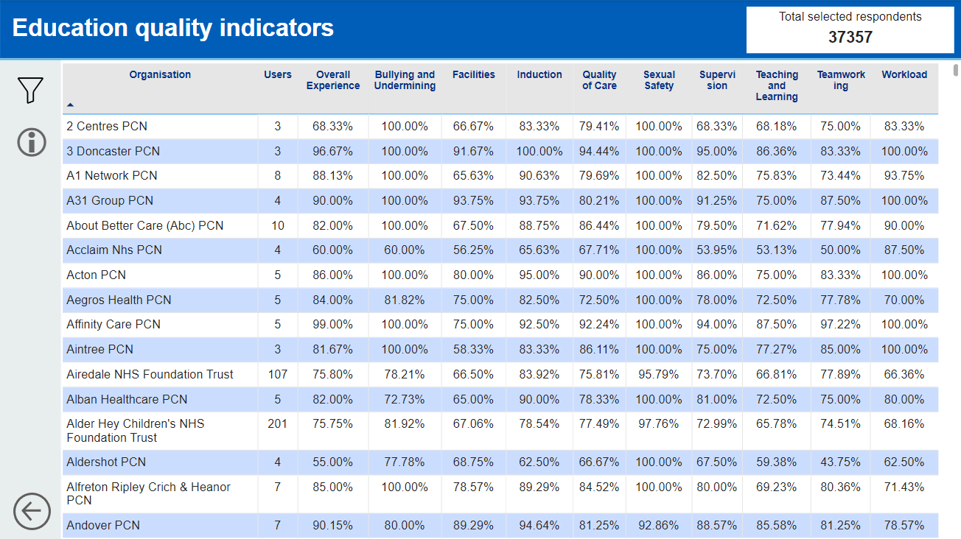
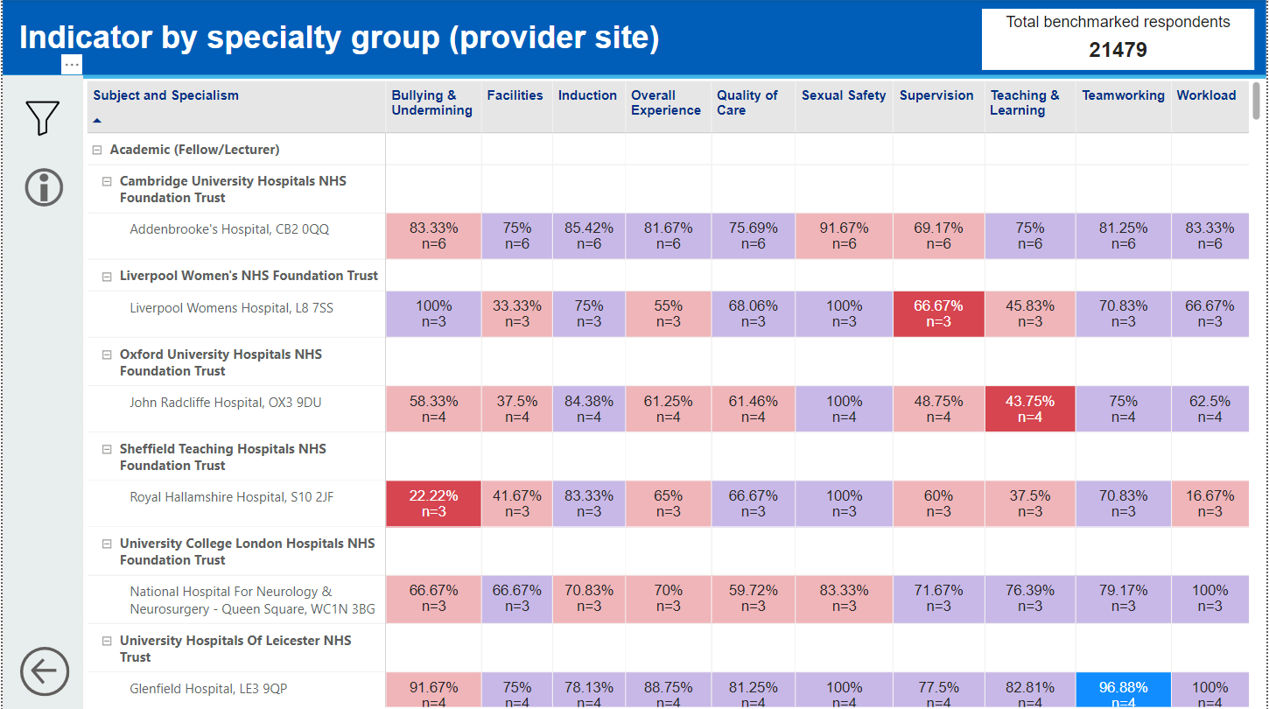
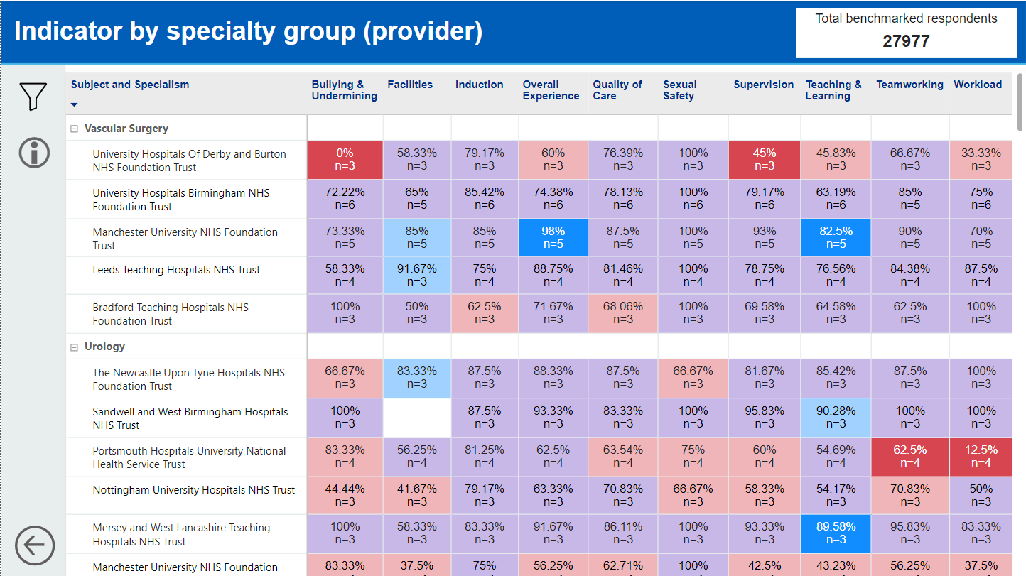
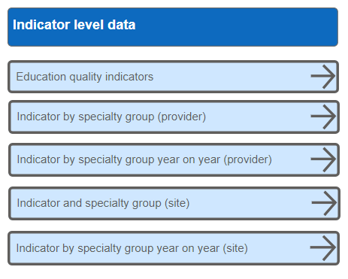
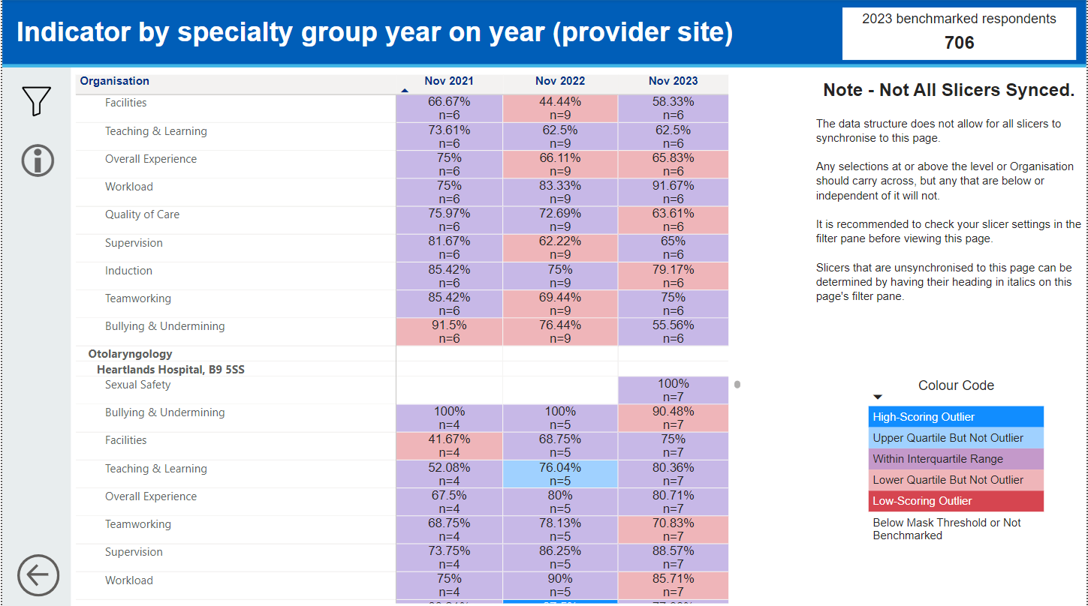
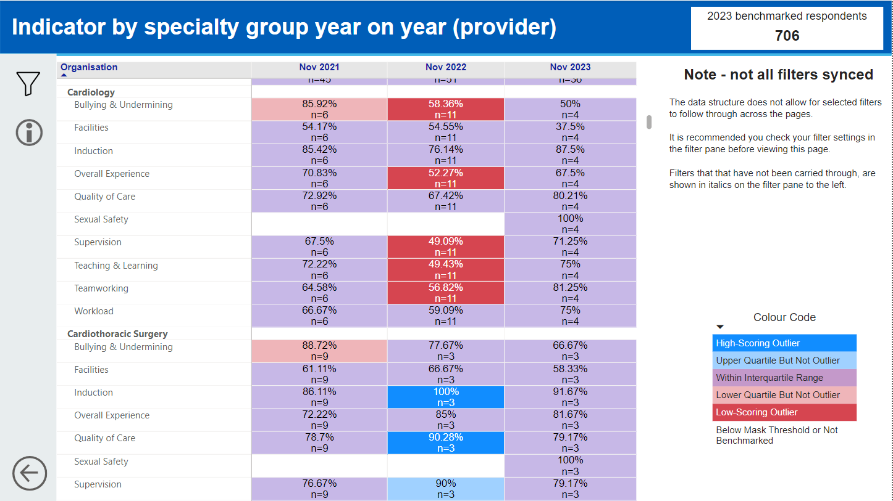
Education quality indicator
There are a number of ways to view the NETS results by education quality indicator; by organisation, site/GP practice, profession, specialty etc...
The main contents page navigates the user to these pages.

Slide 10
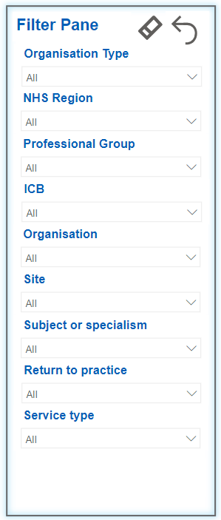
NEW education quality indicator
This is a new page. It shows trust level data for each indicator. Users can filter in several ways shown to the left.
A feature has been added which enables users to sort results alphabetically or by result/score (high to low and vice versa) shown below.
To sort the results by indicator or organisation use the arrow button.

Slide 11
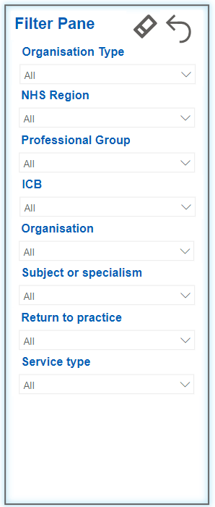
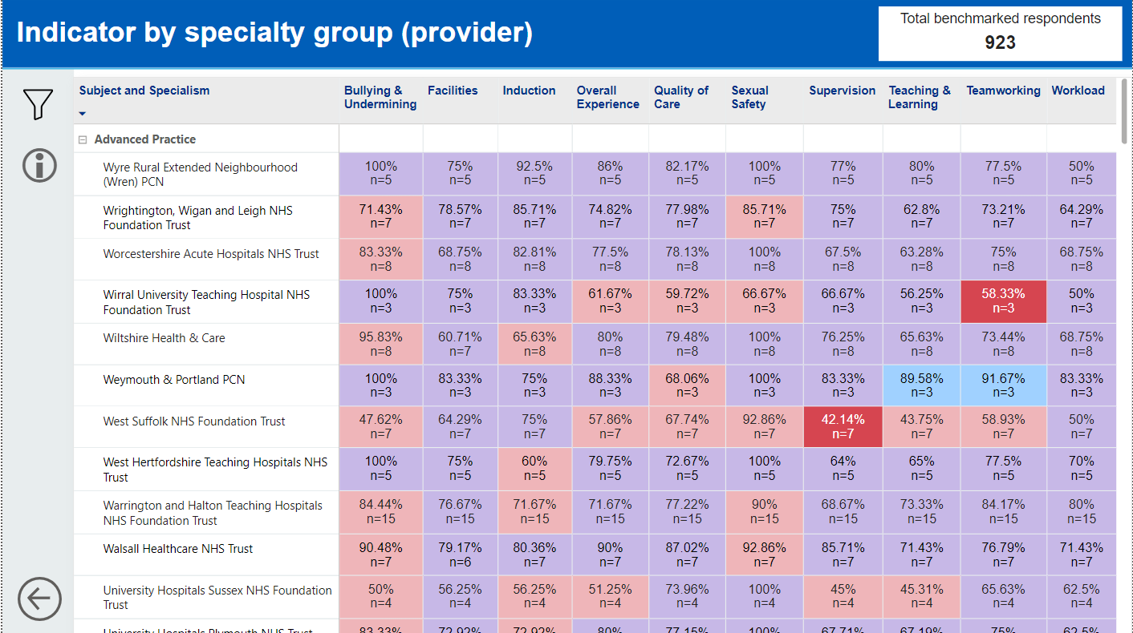
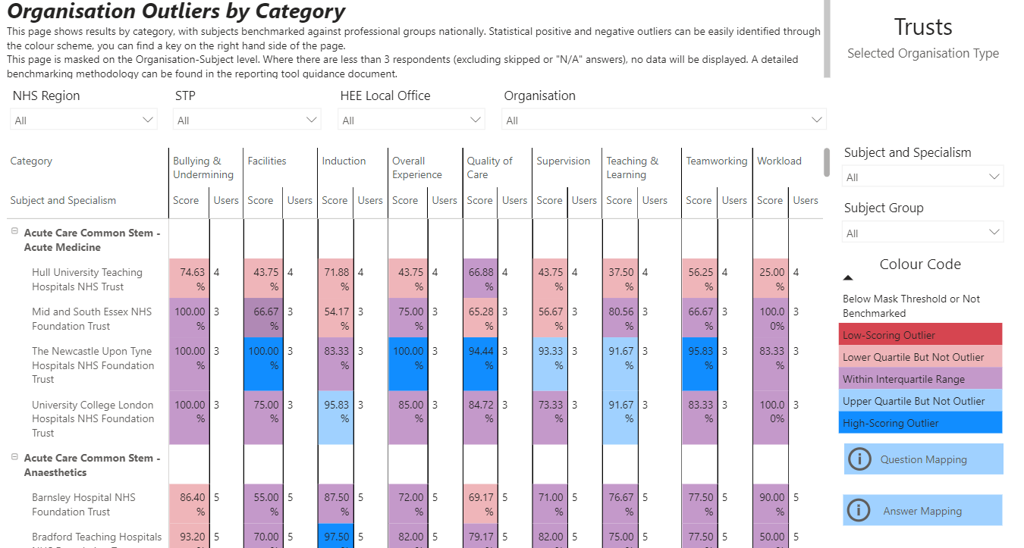
Specialty group/profession by provider
The indicator by provider and specialty group has been redesigned to make it easier to read, with a new look and feel. Users can filter in several ways shown to the left.
Previous version

Slide 12
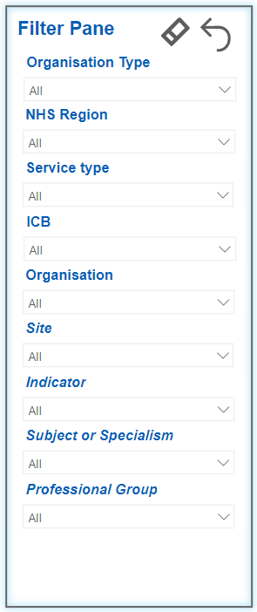
Year on year indicator trend data
This page shows trust level data by specialty/ professional group for each indicator over three years. Users can filter in several shown to the left.
Two new pages are now available, one for Trust/ICB level data and one at site/practice level.

Slide 13
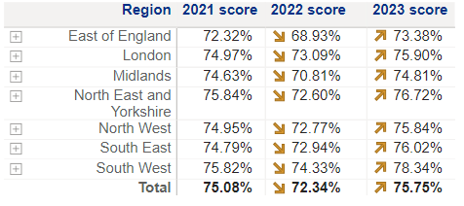
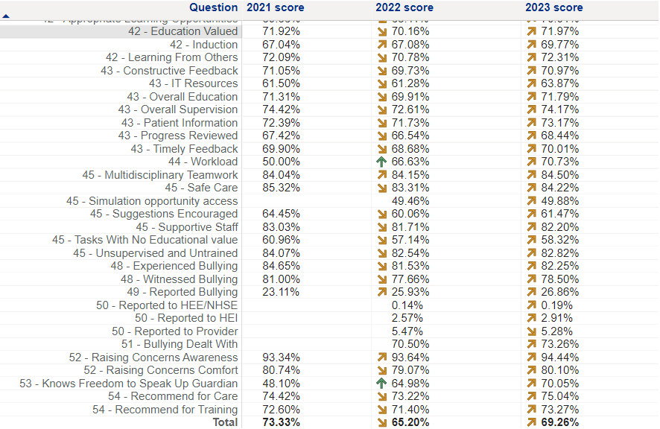
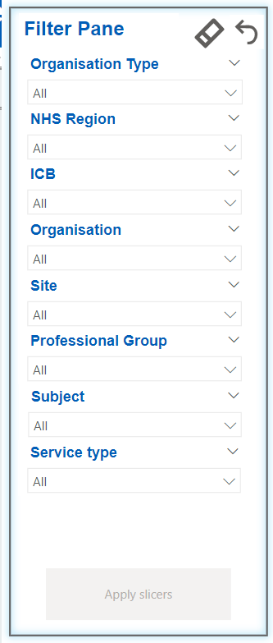
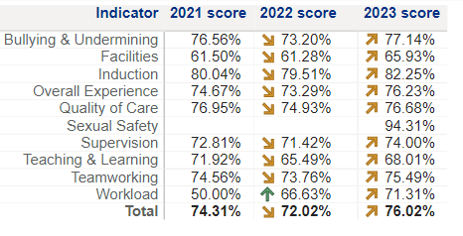
NEW year-on-year trend data
New for this year are a suite of new pages, providing a simple to use visual (with trend directional arrows) which show results over three years at regional, indicator and question level.

Slide 14
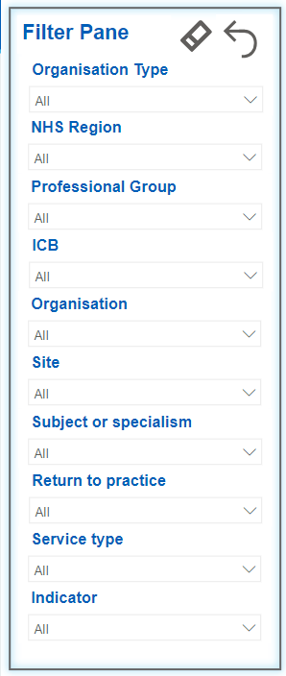
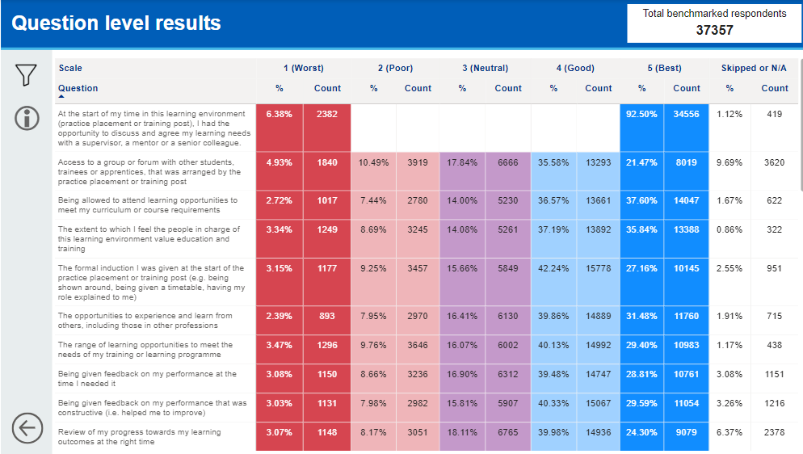
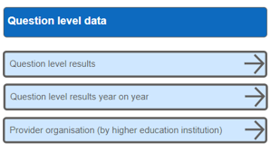
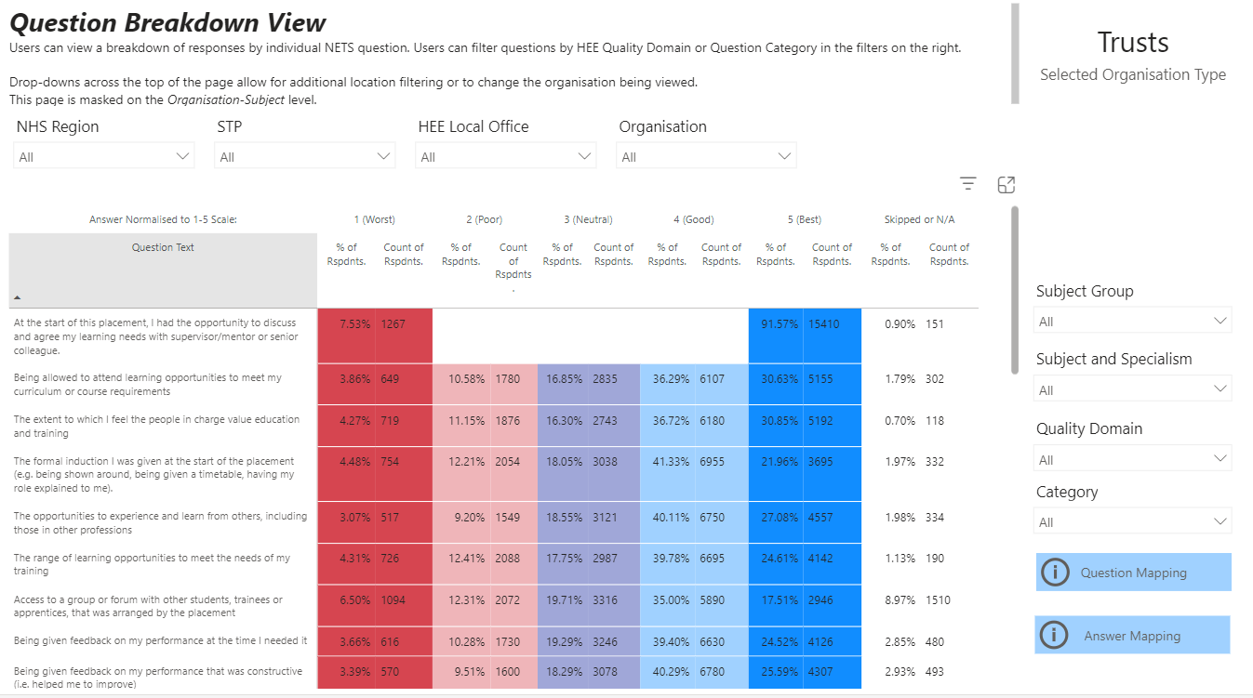
Question level data
The question level results page has been redesigned to make it easier to read, with a new look and feel. Users can filter in several ways shown to the left including by HEI and year on year.
Previous version

Slide 15
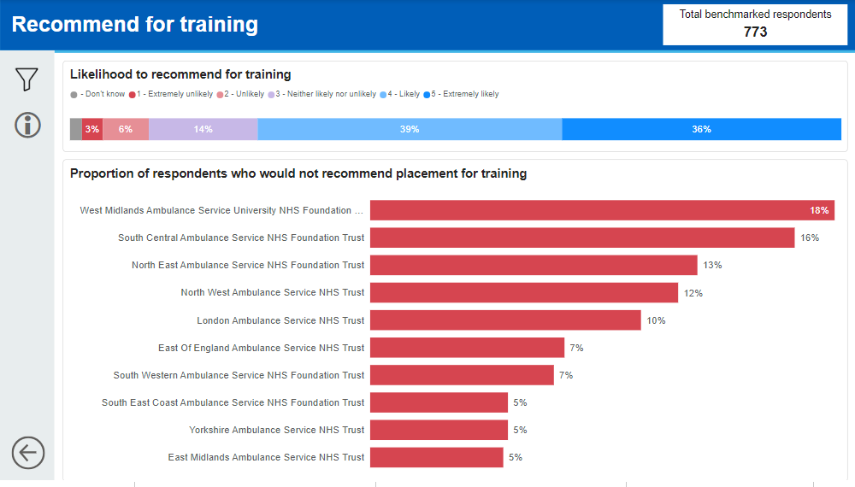
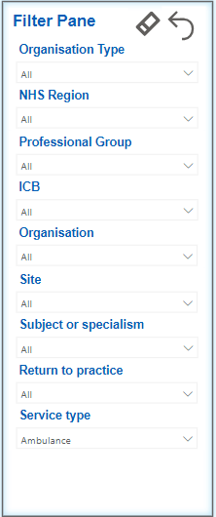
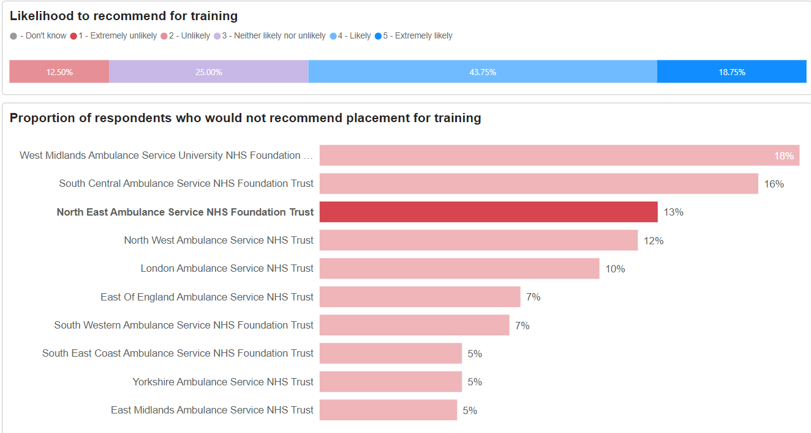
NEW recommend and retention pages
This is a new page and provides users with a simple to use visual showing the recommend for training, recommend for care and considered leaving questions. Users can filter in several ways shown to the left.
The top bar displays the average score of all organisations selected.
Click on an organisation to see only their results in full.

Slide 16
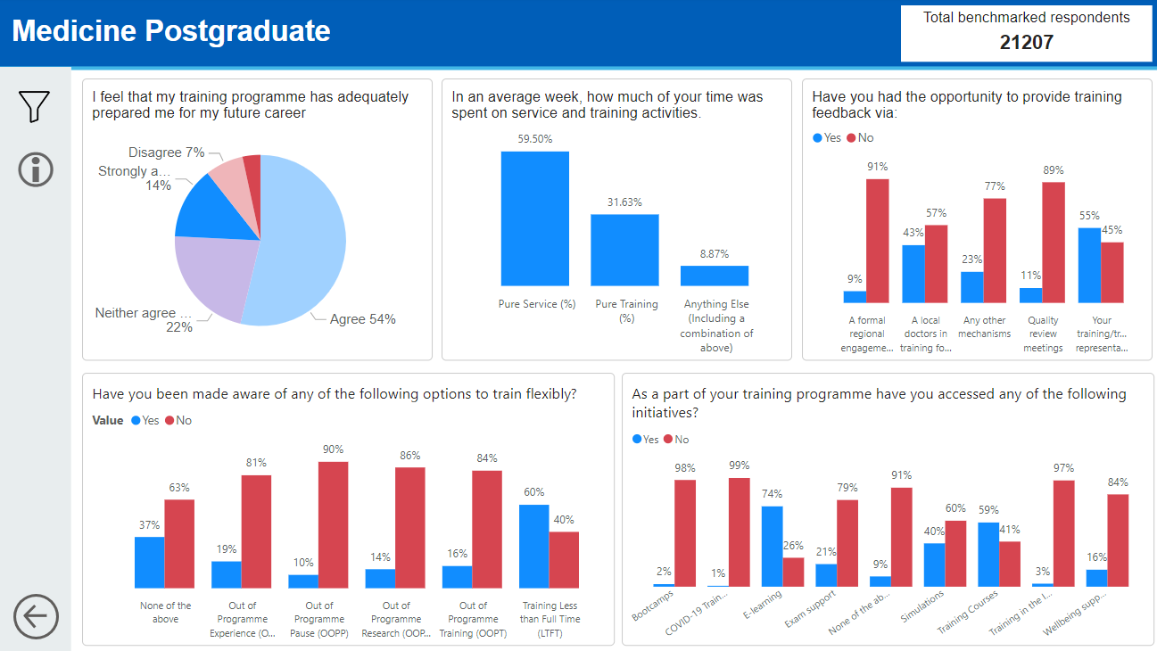
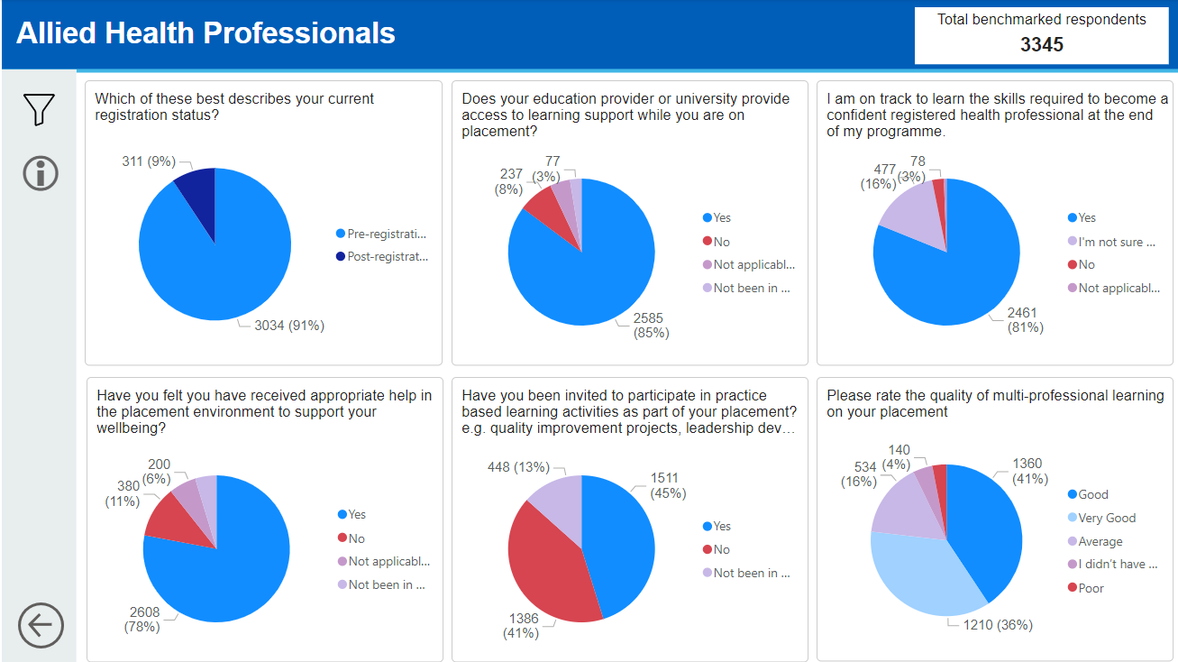
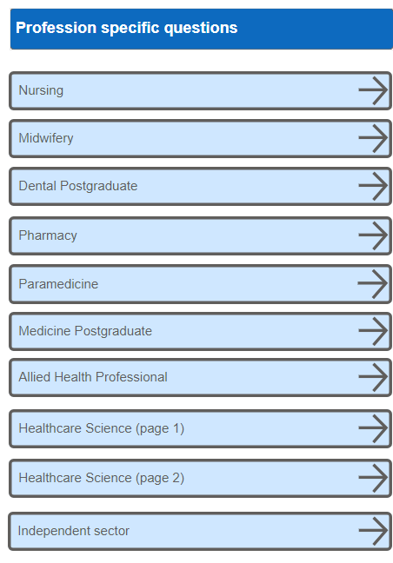
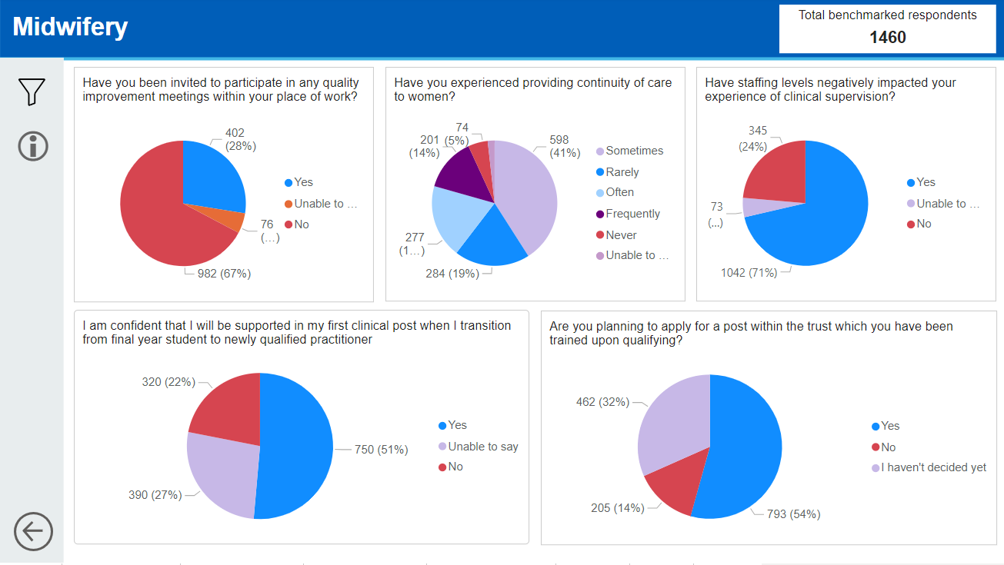
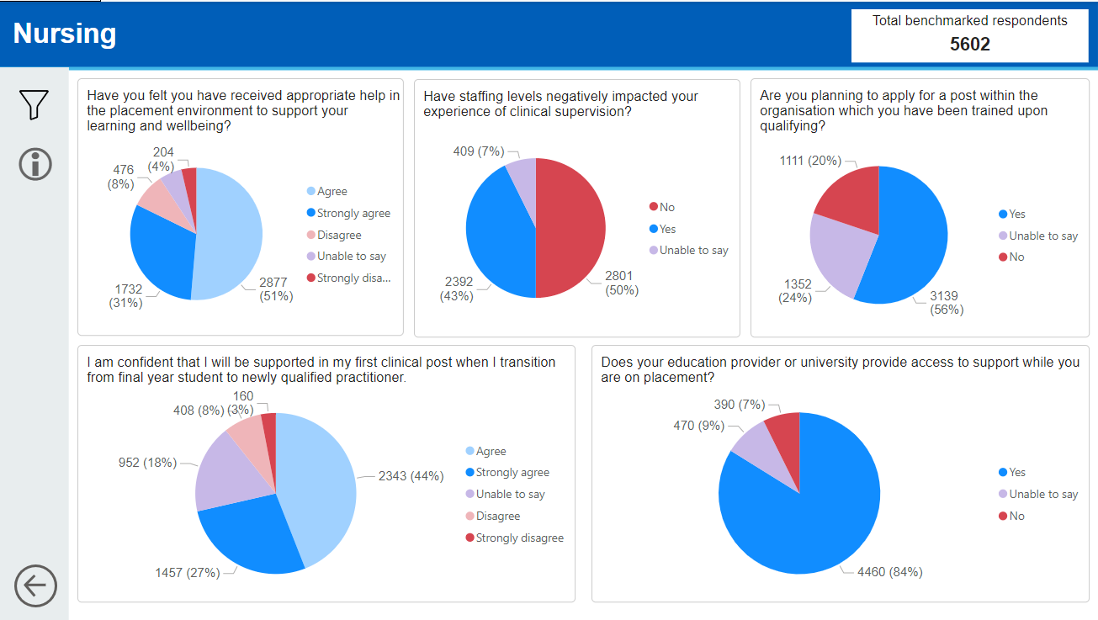
NEW branching questions
A suite of new pages have been added which show the results for the profession specific branching questions.

Slide 17
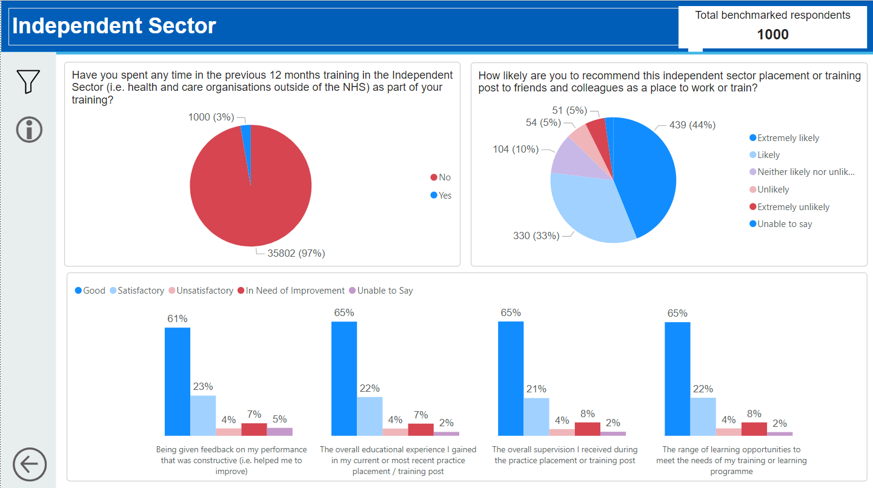
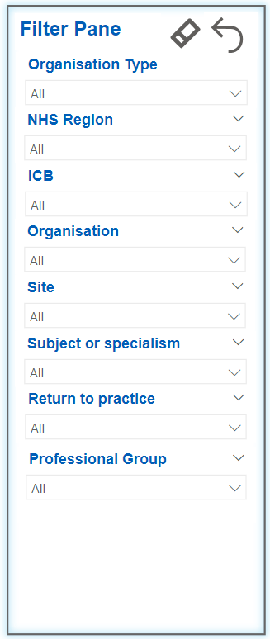
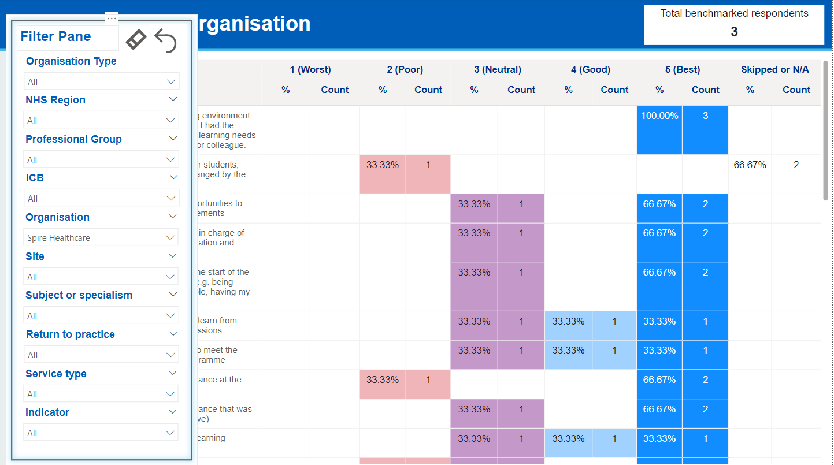
NEW independent sector
Where a learner has selected an independent sector organisation as their main placement, this information is also filterable throughout all ‘normal’ pages by selecting an independent sector organisation (shown below).
A new page (above) has been developed which shows the specific questions learners are asked about their independent sector experience (where their main placement is NHS but spend time training at an independent sector organisation). Users can filter in several ways, also shown above.

Slide 18
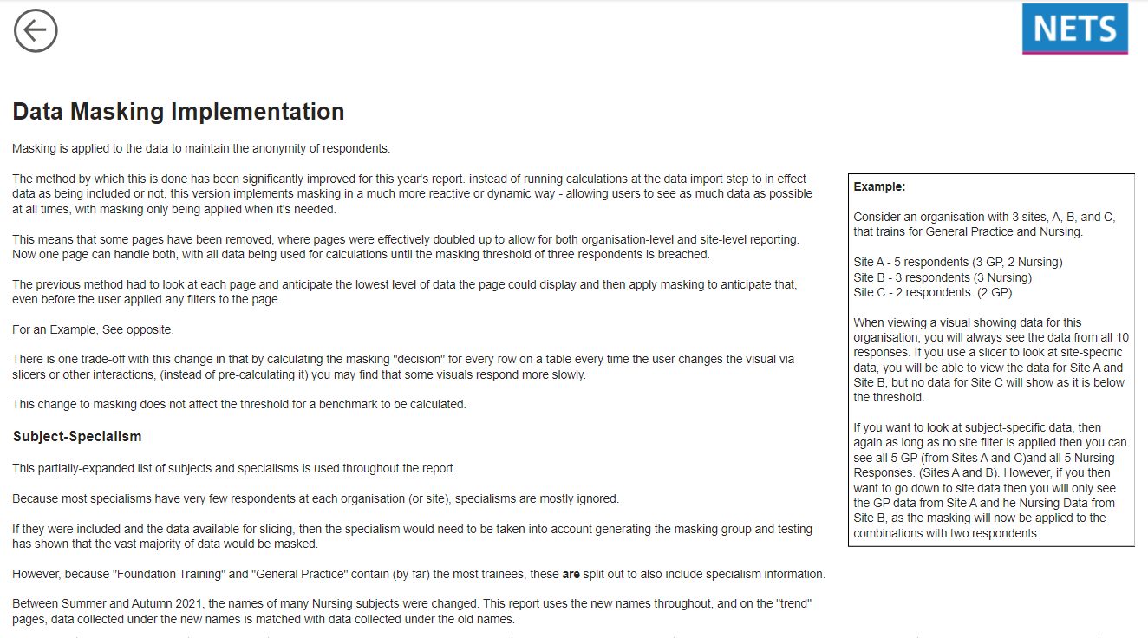
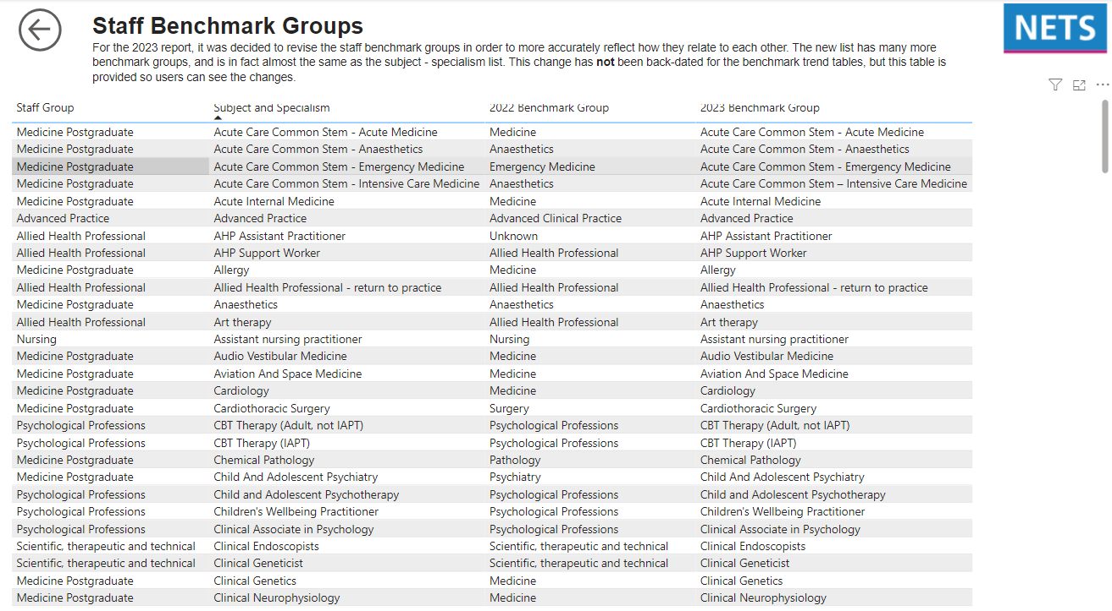
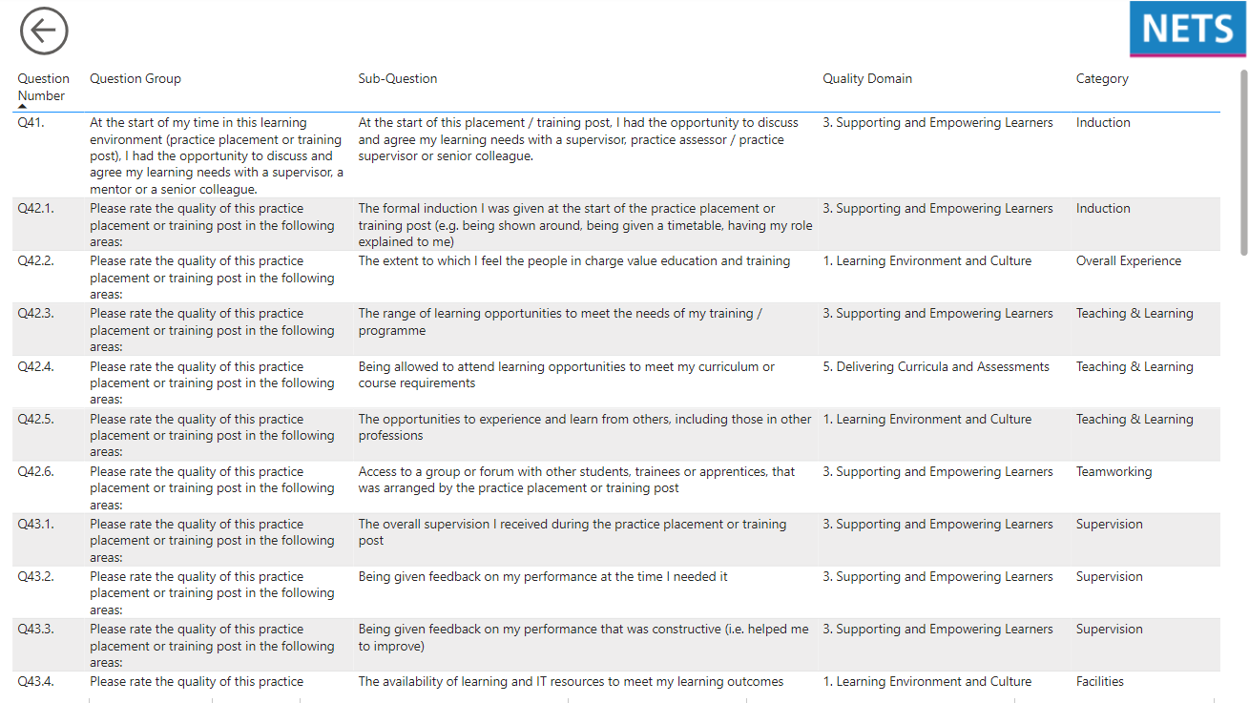
NEW our calculations
This year a suite of new pages have been included which describe how the report works, including the underlying calculations, scoring conventions, question categorisations and benchmark groupings.

