Slide 1
Systemwide approach to Support MSW Competency, Education and Career Development Framework Implementation
Lucy Johnson – HEE Regional Clinical Lead midwife
– Midlands

Slide 2
Aim….
Collaboration…
Across the region to create a standardised approach
For widerteam work to support implementation
Seeking LMNS oversight to support change and sustain
Working together

Slide 3
What will enable us to grow?
The evidence from the forthcoming report will determine what educational provision is required to support full implementation
- whilst all organisations remain publicly committed to:
Undertake learning needs assessments and create development plans to enable implementation of the framework for their MSW workforce
HEE regional maternity leads, and Fellows will be supporting implementation plans
Train future MSWs in line with the requirements of the framework
Assignment to a redefined electronic staffing record (ESR)

Slide 4
100% uptake of the HEE bid offer to scope the current workforce. 100% response, which will be collated and reported upon to the systems - MSW education and training and how they are deployed in the Midlands will be identified
MSW standardisation across the Midlands through collaborative working (4 deliverables identified so far – Regional JD, skills passport, agreed training package, care certification)
Raising the profile of the MSW workforce

Slide 5
Regional Working group
To support our current and future MSW workforce to be aligned to the National MSW Framework, the HEE regional team supported the Midlands to develop a working group with members from all 11 LMNSs to:
Create a collaborative approach to reduce the gaps and identify appropriate training to support education needs
The Midlands working group provided support and advice during the initial data collect and continues to support the implementation phase

Slide 6
Working Group Structure
TORs
Agenda
Minutes to communicate to:
All working group members for each Trust
All HOMs/DOMs
LMNS leads
Sub – groups are created as required to work through matters arising

Slide 7
Next steps :
Support each system through promoting and utilizing the working group to network and have a collaborative approach to ensure Framework implementation continues post phase 1 data collection
Each system to identify the appropriate individual MSWs (those mapping to level 3/4 of the framework) in anticipation of allocating the revised ESR code to identify this workforce
To establish region wide agreement on an implementation programme to professionalise and better utilize the Role of Maternity Support Worker across the Midlands using the Maternity Support Worker Competency, Education and Career Development Framework”.

Slide 8
Deliverables 1-4
The working group identified 4 key deliverables:
1. Adopt newly refined job descriptions for the roles of Maternity Care assistants (House keeper within the framework) and MSWs i.e.., from band 2 to band 4 as developed and approved Regional Working Group and the regional HOM/DOMs | 2.Introduce a regional skills passport | 3. Develop a standard regional training package and development pathway to include access to fundamentals skills training | 4. Ensure all existing MSWs have the required care certificate

Slide 9
Progress of deliverables 1 & 2
Document | Status | Next Steps | Anticipated Time Frame
Band 3 JD | Working group reviewed JD from HEE tool kit and others previously job matched at band 3 to develop a Regional JD that aligns to the framework. System wide agreement sort | Trusts to apply local document format and Job match internally | Each Trust is at various stages regarding recruitment and review of current JDs, a primary review will be required in Jan 2022 with LMNS oversite and set time frames
Band 2 JD | Working group reviewed JD from HEE tool kit and others previously job matched at band 2 to develop a Regional JD that aligns to the framework. System wide agreement sort | Trusts to apply local document format and Job match internally | Each Trust is at various stages regarding recruitment and review of current JDs, a primary review will be required in Jan 2022 with LMNS oversite and set time frames
Band 4 JD | NW London Pilot site are currently looking at band 4 roles JD/PS and plan to share widely when available. Working group currently reviewing local band 4 JDs – e.g., clinical support trainer roles | Identify who plan to employ band 4 MSWs What does that look like? Share example band 4 JDs where the exist | Trusts are predominantly concentrating on level 2 and level 3 therefore the timeframe is not yet anticipated, however the review process will commence by December 2021
Skills passport | Subgroup are currently building a standard passport for the region based on passports from other Trusts that have been aligned to the framework | Circulate to working group/HOMs/DOMS/LMNS for comment and approval. Launch agreed copy for local formatting and utilisation | Anticipated turn around December 2021. for LMNS oversight to support utilization

Slide 10
Progress of deliverables 3 & 4
Key point | Progress | Next steps | Anticipated Time frame
3. Develop a standard regional training package and development pathway/ Access to Senior Healthcare Apprenticeship/ Access to fundamental skills training (maths and English) as required | Whilst there has been attempts to review training packages within the working party local views are still required. Information has been shared across the system regarding best practice and appropriate training packages for level 3 training/level 4 Access to fundamental training has been shared via the working group Gap training is being addressed Working group want to design a standardised annual update MSW training programme | Trusts to speak with providers to support training and procurement arrangements to identify MSW training plans and pathway for level 3 senior healthcare apprenticeship and level 2 support worker and where applicable level 4/5 training. Ensure gaps in training have been closed A subgroup to review the content and timetable for an appropriate MSW annual update | By *** 50% of all Trusts will have an identifiable training package for level 3 MSW training or closed any existing gaps to support progression 100% will have a plan to access existing training capacity for level 2 training Level 4/5 training for the region will have been identified but anticipated to be required by a minimum number of staff Annual update programme to be ready for review by December 2021
4. Ensure all existing MSWs have the required care certificate | Each area has now scoped the workforce and can identify those who require care certification. This is being achieved through local arrangements, for example ELearning for health care certificate/ self certification route/inhouse training | Care certification is part of the MSW mapping process, therefore on completion of data collection each Trust should arrange care certification to be arranged locally within each Trust | 100% of all existing MSWs will have completed care certification by January 2022

Slide 11
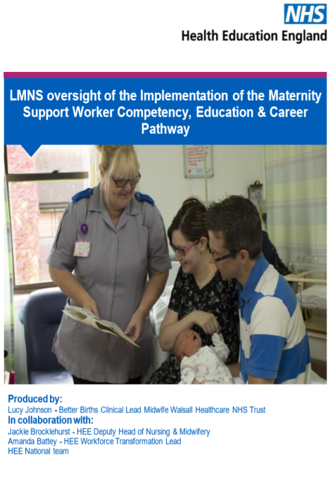
LMNS
LMNS oversight is required to ensure commitment for implementation of the MSW framework continues:
Ensuring that the training requirements identified are being implemented ideally through apprenticeships where required
That staff are trained and signed off against the framework within a specific timescale
Bank and agency MSW staff meet the framework requirements against the role for which they are employed.
(Recruitment and retention could be affected in Trusts who are not following implementation and there could be migration of the workforce into bordering areas and LMNS who are providing those opportunities).

Slide 12
LMNS Presentation:
DRIVERS
Objective of this session
ACTIONS
CURRENT STATE

Slide 13
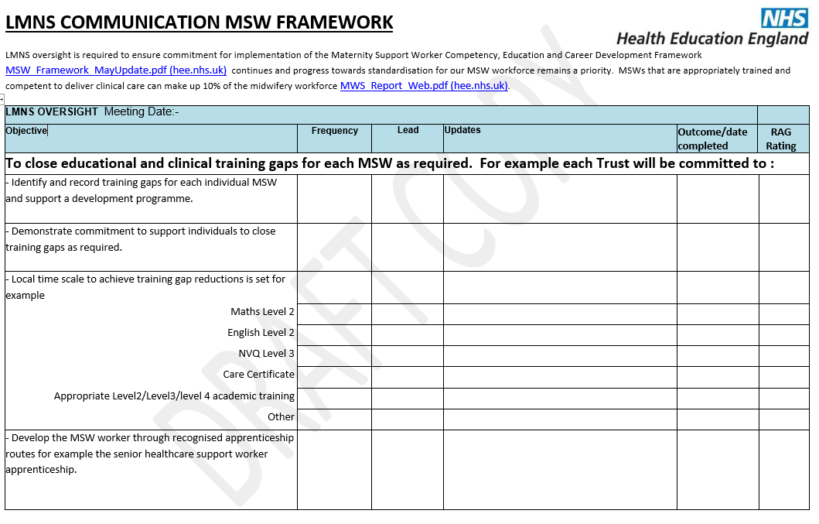
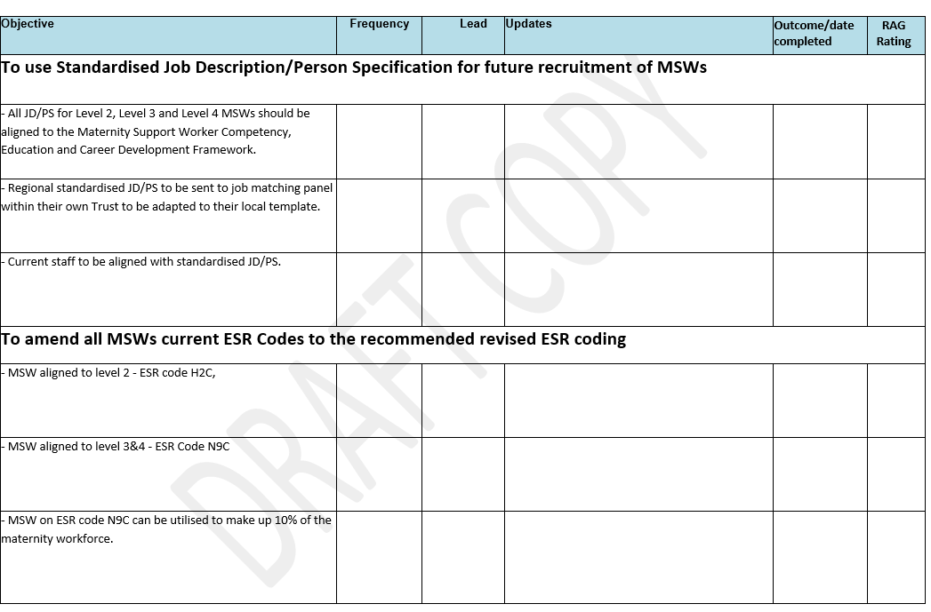
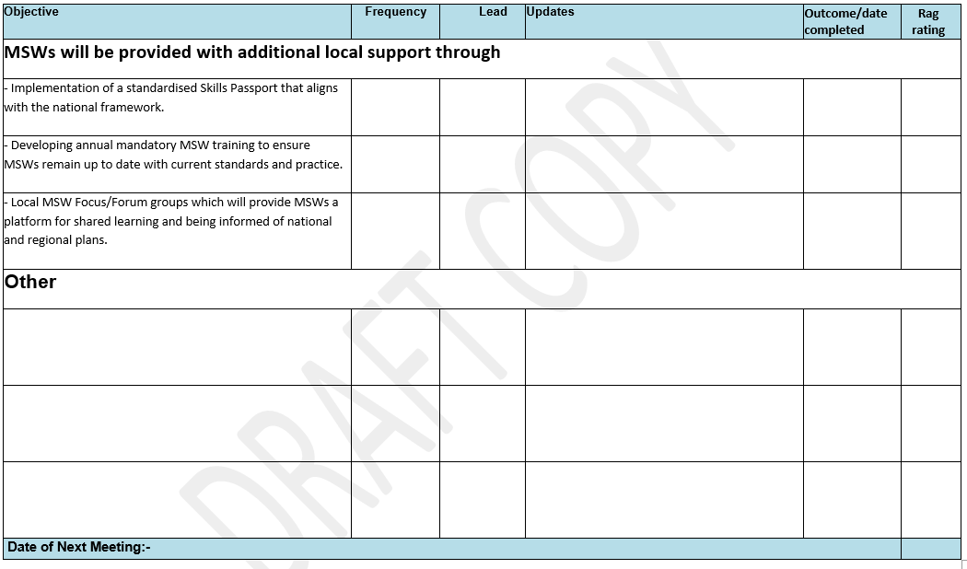

Slide 14
LMNS to take the workforce with them on the journey
Whilst undertaking this work some unrest could have unintentionally been caused amongst the MSW workforce if they perceived to be under review, therefore we need to consider:
MSW involvement
Focus groups
Keep midwives informed of the developing MSW role
Good communication is essential
Organisational change may be required to determine new structures of band 2, 3, and 4 workforces and the role and aspects they deliver may change following training.
Supporting MSWs with continued professional development is the employees’ responsibility.
Through the use of apprenticeships, experienced MSWs may also wish to train as midwives; an LMNS that supports a ‘grow your own’ philosophy will also have an approach that addresses midwifery workforce supply

Slide 15
Distributing, sharing and promoting the Maternity Support Worker Competency, Education and Career Development Framework
Engaging with the senior workforce to ensure the standardisation of the MSW workforce is high on their agenda
Providing a catalogue of webinars for the MSWs to have a platform of there

Slide 16
Raising the profile…
Celebration Webinar for Maternity Support Workers
Opportunity to celebrate the role of MSWs. The event was a new platform for MSWs and included:
Information from the Lead Midwife from Health Education England about priorities for Maternity Services and how MSWs can help support that delivery,
Hearing from several different MSWs about their role (what they like about it, how they got there, what’s challenging),
Hearing about different options for development in the role,
Identifying the challenges within their own role and how they may overcome them,
A chance to network with other MSWs. Plan to repeat quarterly at present.

Slide 17
Webinar outcome
100 + attendees between Midlands and East of England (unable to identify specific MSW attendees)
To continue with MSW engagement through offering future MSW webinars/support
Definite interest for development opportunities – enquiries about level 3 and level 4 training
Presentations and recordings available on the HEE website

Slide 18
Any questions…
?
Please feel free to share these slides

