Slide 1

Welcome to AHP Workforce Webinar 3
Dietetics, Dramatherapists & Paramedics
25 September 2020
Paula Breeze
National AHP Clinical Fellow
@breeze_paula
#AHPFaculty
Paula.breeze@hee.nhs.uk
@NHSHealthEdEng #AHPFaculty

Slide 2
Purpose of the webinars
Follow up to the successful AHP Faculty virtual showcase that took place on the 15th July.
AHP Faculties provide the infrastructure to enable system wide collaboration to address AHP workforce challenges and to maximise opportunities
Part of the support that we want to give to the faculties is to deliver a series of 5 webinars with the following aims:
To provide Chief/lead AHPs with up to date AHP workforce
information and data
2) To enable them to have informed conversations with their HR
Directors and senior stakeholders to raise awareness, promote
value and optimise AHP skill utilisation within the system

Slide 3

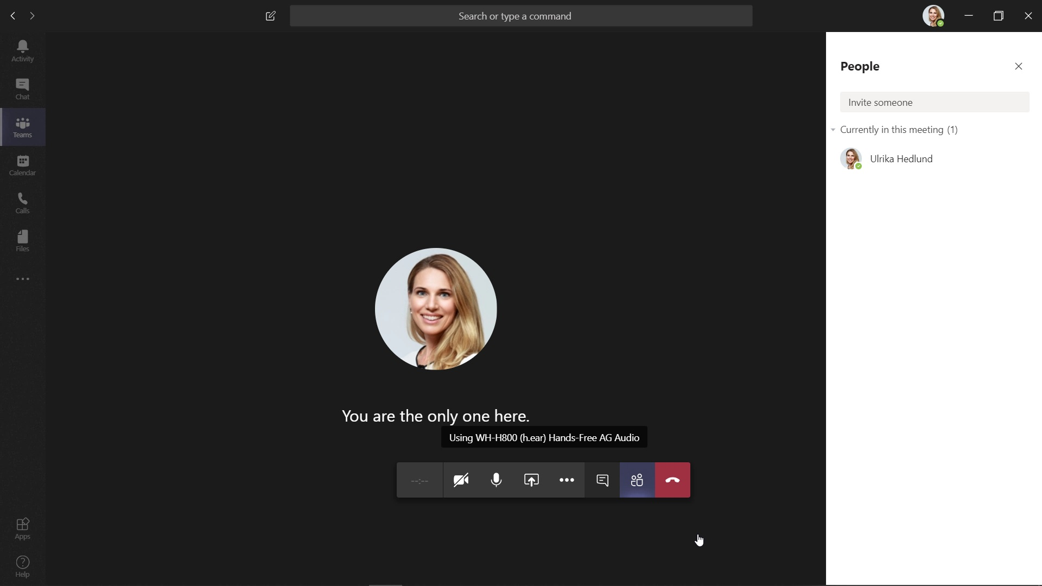
House Keeping
This Webinar will be recorded for future reference
Please switch your cameras off.

Slide 4
Today’s Plan
Dietetics
Workforce Data
British Dietetic Association (BDA)
Dramatherapists
Workforce Data
British Association Of Dramatherapists (BADth)
Paramedics
Workforce Data
College of Paramedics
Discussion

Slide 5

Dietetics
Shagufta Khan
National Workforce Planner

Slide 6
HCPC – Registration Data
HCPC regulate the 14 AHPs along with the General Council for Osteopaths.
Art, Music and Drama therapists are grouped together as are Diagnostic and Therapeutic Radiographers
@NHS_HealthEdEng #insertcampaignhashtag

Slide 7
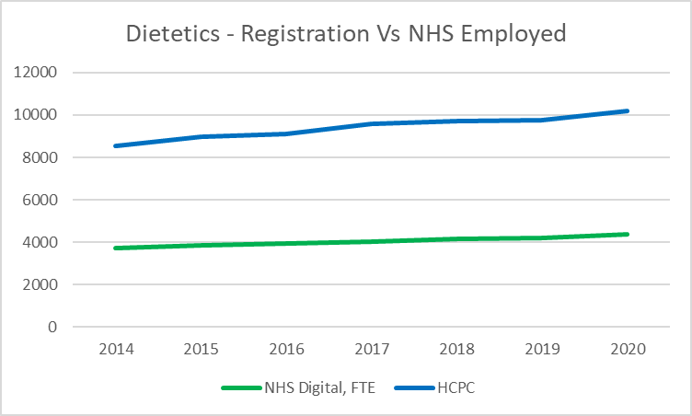
Dietetics – Registration Data Vs Employed (NHS Digital)
Dietetics registrants increased by c.1679 (19%) between 2014 and 2020. This represents a solid growth in the region of 3% per year.
In August 2020, there were 9,693 registrants – 29 fewer dietitians on the register then on end 2018/19, please note movement on register changes from month to month. As at April 2020 there were 10,207 Dietitians on the HCPC register.
Majority of registrants do not work in the NHS in England. This will reflect registrants working elsewhere in the UK and abroad, as well as high employment in other sectors outside the NHS, including the food industry.

Slide 8
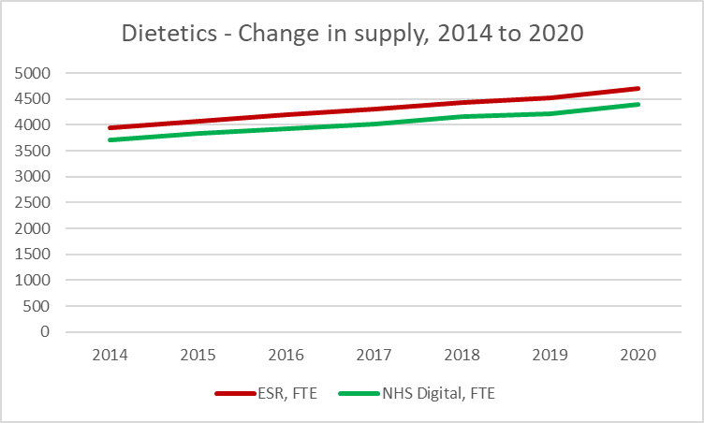
Dietetics – Historic Supply Trends
We use both published NHS Digital data and data from ESR Data Warehouse
There are some differences, with latter numbers being higher – we typically count all employed staff, NHS Digital count ‘frontline only’ and so do not count all staff. However, the trends are largely the same.
Both sources confirm growth in the order of 3% per year. Growth has been comparable to the register

Slide 9
Flow analysis – summary
Overall, numbers grew by 2.7% per year between 2015 and 2020
UK joiners have largely remained stable at c.350 per year; in 2019/20 there were 374 UK joiners
International Recruits have largely remained stable at c.100 per year, but went up to 127 in 2019/20
Leaver rates fell from 7.1% in 2015-16 to 6.0% in 2019-20, suggesting success of retention efforts

Slide 10
Local Workforce Data (wte) – By Region

Slide 11
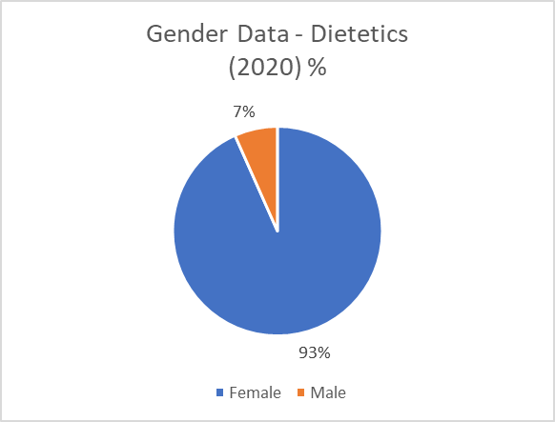
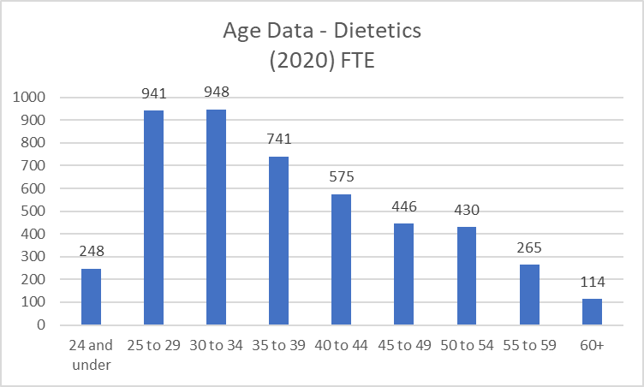
Gender and Age Information
Dietetics workforce is predominately female (93%)
Age profile information for the profession shows a younger workforce than seen for many AHP professions.
  Only 17% in the age band of 50+ (809 WTE).
The evidence suggests no immediate risk of workforce supply issues due to an ageing workforce.

Slide 12
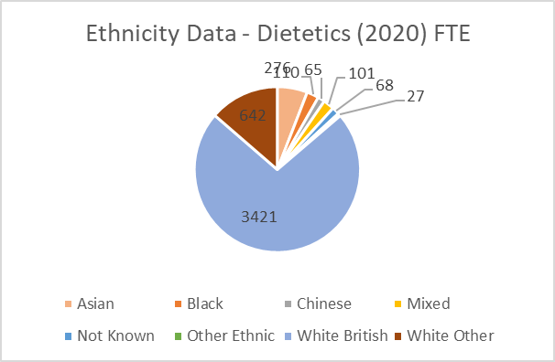
Ethnicity & Nationality Information
Ethnicity
Ethnicity data suggests 72% of the workforce are White British
Ethnicity data shows at least 10% of the workforce are from Asian, Black, Chinese or Other Ethnic backgrounds
Nationality
The % of staff with non-UK nationality increased from 11% to 14% between 2014 and 2020 of the workforce. In March 2020, this represented c.645 out of c. 4,700 of the workforce
London by far has the greatest dependence on non-UK nationals – 24% of the workforce in 2020. EoE also has higher than average numbers, at 17%
Most common nationalities other than UK are: Irish (254 in 2020), Australian (58) and South African (44)

Slide 13
Summary of Future Trends
All else equal, we would expect supply to grow by about 3% per year
Pre-Covid, we would have expected demand to grow at about 1-2% per year
However, we are aware of additional demand required within primary care as part of 26k expansion under LTP, as well as existing challenges around placement availability, especially in London. Growth likely also to come with increased Government attention to managing obesity
Therefore, while cautiously optimistic, need to ensure we can still responding to changing demands

Slide 14
Dietetics workforce summary
Largely stable profession – 3% growth per year for a number of years, both in NHS and wider sector
Young age profile
Higher international recruitment around London and East of England which may suggest some capacity issues in those regions
Largely optimistic forecast given stability but need to be aware of capacity challenges and increasing demand from primary care and Government policy

Slide 15

Dietitians
Menna Wyn-Wright - Education Policy Manager

Slide 16
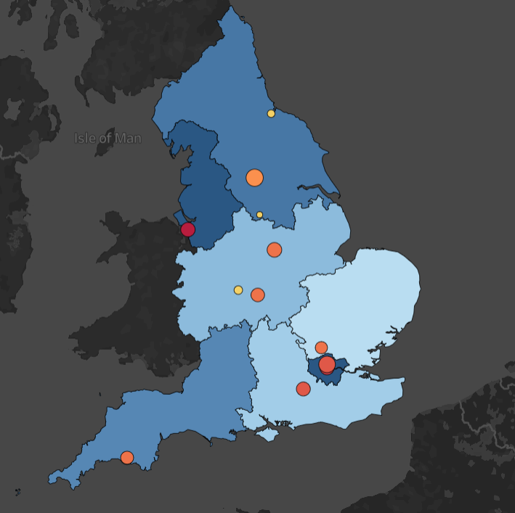
Statistics
Around 10,000 HCPC registered dietitians (July 2020)
79% of HCPC registered members are BDA members
18 HEIs delivering dietetic courses at undergraduate and postgraduate level
New courses in the pipeline
Around 200 BDA dietetic support workers

Slide 17
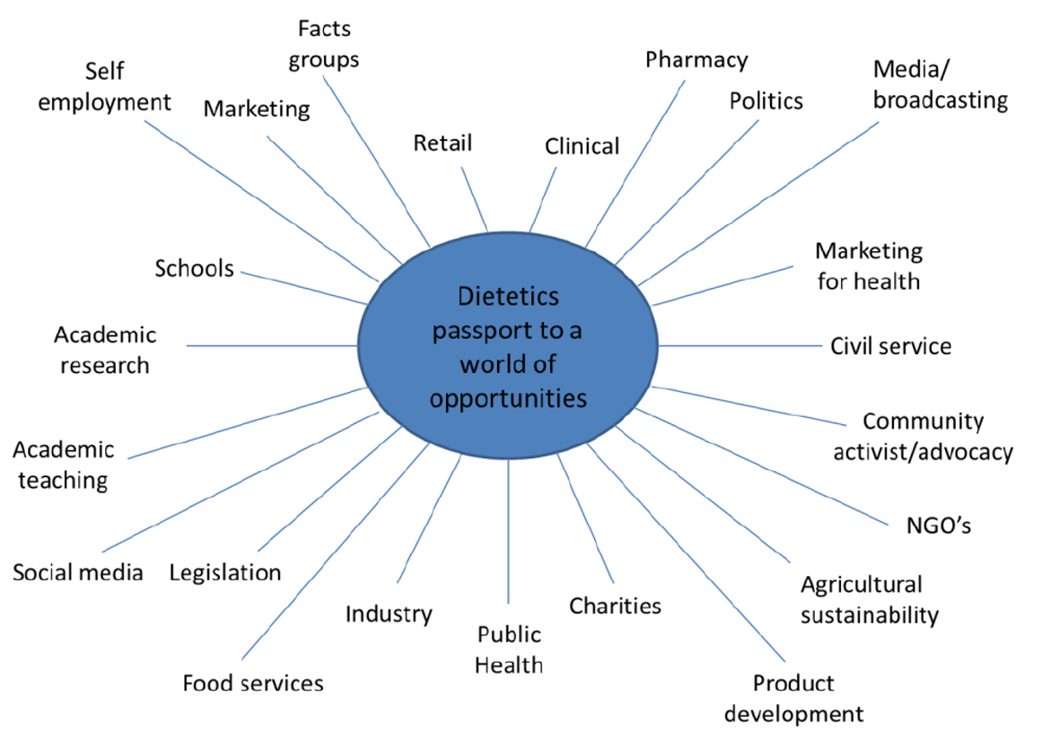
Dietitians are the only qualified
health professionals, helping people make informed and practical choice about food, based on the science of nutrition
Acknowledgement to Mary Hickson at University of Plymouth

Slide 18




Workforce and Development
Demand
Practice based learning
Preceptorship
Role Diversity
Demand Practice-Based Training New Roles
Learning

Slide 19

What do we need ……
Prioritise dietetic practice-based learning and graduate jobs
Increase careers and recruitment
Understand the profound positive future impact of dietetic services
Not to forget the increasing demand for services e.g. obesity Mental Health eating disorders

Slide 20
Dietitians can teach other professionals how to optimise the dietetic aspects for their care across all specialities

Slide 21
Dramatherapists
Tom Speller
Deputy Head of Workforce Planning

Slide 22
HCPC – Registration Data
HCPC regulate the 14 AHPs along with the General Council for Osteopaths.
Art, Music and dramatherapists are grouped together as are Diagnostic and Therapeutic Radiographers
@NHS_HealthEdEng #insertcampaignhashtag

Slide 23
Arts Therapists – Registration Data Vs Employed (NHS Digital)
Arts therapists (art therapists, music therapists, dramatherapists) tend to be counted together, both in terms of registration and ESR
The number of arts therapists increased sharply between 2014 and 2020, by c. 1160, or 32%. This represents strong growth in the order of 5% per year
In August 2020, there were 4,461 registrants – a n increase of 29 (0.6%) on end 2018/19, which suggests growth may be slowing down
A comparison of registrant and ESR data demonstrates that the majority of registrants do not work in the NHS in England. This will reflect registrants working elsewhere in the UK and abroad, as well as high employment in other sectors, notably education, the third sector, charities and private practice
Arts Therapists form a very small profession within the NHS. Numbers in the NHS are under 500 FTE.

Slide 24
Arts Therapists and Drama Therapists – Historic Supply Trends
We use both published NHS Digital data and data from ESR Data Warehouse
There are some differences, with latter numbers being higher – we typically count all employed staff, NHS Digital count ‘frontline only’ and so do not count all staff. However, the trends are largely the same – and the latter approach is the only method for picking out art therapists specifically
All sources confirm growth in the region of 3-4% per year in the NHS for arts therapists – slightly slower than the register but solid growth nonetheless
In terms of dramatherapists* specifically, numbers are extremely small in the NHS and have largely remained since 2017 at about c. 25 FTE – 5-6% of the arts therapist workforce.
Given small numbers (which limits what we can sensibly report), we will focus most of remaining analysis on arts therapists as a whole, with additional insights specific to drama therapists as appropriate.
*Defined as arts therapists (S0H, S1H, S6H, SAH) with the following job roles: Drama Therapist, Drama Therapist Manager, Drama Therapist Specialist Practitioner

Slide 25
Flow analysis – arts therapists summary
Overall, numbers increased by about 3-4% per year
Growth in UK joiners has increased from c. 15 per year to 35 in 2019-20
Growth in international supply has averaged about 5 FTE per year since 2015; peaking at 10 FTE in 2019-20. Numbers generally are small
Leaver rates have dropped from 7.1% in 2017-18 to 5.5% in 2019-20 – need to be aware though of small ‘n’
For dramatherapists – small (< 5 FTE) joiners and leavers per year, virtually no international recruitment

Slide 26
Arts Therapists Workforce Data (wte) – By Region
Notes:
Drama Therapists – about ¾ in London and commuter belt (EoE, SE)

Slide 27
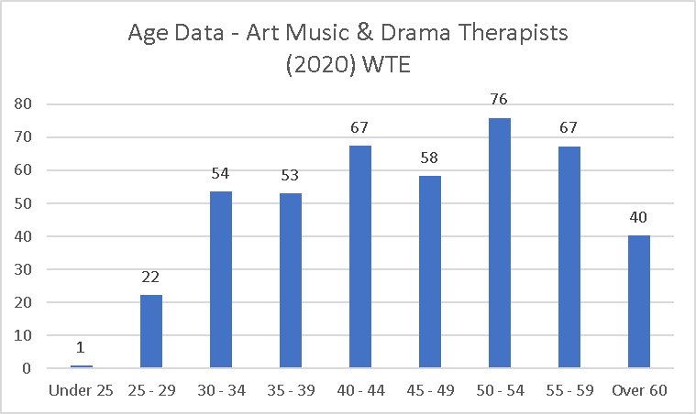
Arts Therapists Gender and Age Information
Arts Therapists workforce is predominately female (93%)
Age profile information for the profession shows a slightly older workforce than seen for many AHP professions.
  41% in the age band of 50+ (183 WTE).
The evidence suggests some risk of workforce supply issues due to an ageing workforce, but needs to be balanced by fact most tend to start in their 30s given PG qualification.
Dramatherapists – half aged over 50, < 5 under 35. 87% women

Slide 28
Arts Therapists Ethnicity & Nationality Information
Ethnicity
Ethnicity data shows that 77% of the Art, Music and Drama Therapy workforce are White British.
Colleagues from Asian, Black and Chinese backgrounds make up only 4% of the workforce.
Dramatherapists: < 5 from BAME backgrounds
Nationality
The % of staff with non-UK nationality increased from 7 to 12% between 2015 and 2020. In March 2020, this represented c.50 out of c.440 of the workforce
London by far is the largest employer of non-UK nationals, with 17% of all AMD therapists non-UK nationals
Most common nationalities other than UK are: Irish (11), American (6) and Greek (5)
Dramatherapists: < 5 non-UK, all in London

Slide 29
Arts Therapists - Summary of Future Trends
All else equal, we would expect solid supply growth within the profession based on observed trends – with the caveat that numbers are small and therefore potentially more subject to fluctuations
While we might have expected similar levels of demand growth pre-Covid, it is likely need for these professionals will increase considerably, not least given requirements for mental health and psychological therapies – of which arts therapists will need to respond. Hence both a challenge and an opportunity for the profession
Investment in this profession will therefore continue to be necessary
Dramatherapists: small numbers, very stable profession, hardly any join/leave (so ‘succession planning’ more appropriate than ‘workforce planning’). May be challenge if increase in demand post-Covid as envisaged

Slide 30
Workforce summary
Significant proportions of Arts Therapists – and indeed Art Therapists - employed outside NHS in England
Significant increase in registrant and gradual increase of current workforce numbers in recent years
Overall, prognosis is reasonably positive, given history of solid growth – but will need to respond to increased demand for mental health and psychological therapies
Any increase in demand offers both a challenge and an opportunity for the profession – and particularly for dramatherapy, where numbers have remained small and stable and very few join/leave NHS services. Possible shift needed from succession to workforce planning

Slide 31
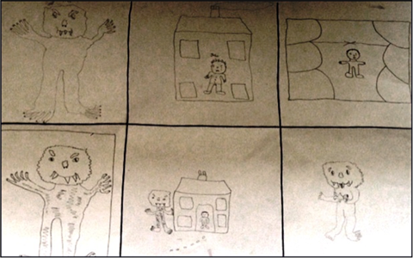
Dramatherapy
Clare Hubbard
NHS sub-committee convenor, BADth
Arts Therapies Lead, Adult Mental Health, HPFT

Slide 32
Dramatherapists
“Dramatherapists are both clinicians and artists that draw on their knowledge of both theatre/drama and therapy to use performance arts as a medium for psychological therapy.” (https://www.england.nhs.uk/ahp/role/#drama)
Dramatherapy makes use of metaphor to create distance from difficult feelings and experiences. Engagement in an “as if” reality opens up possibilities for safe and contained ways of understanding, approaching and negotiating past and present personal difficulties and emotions.
“Dramatherapy is being physical and representing how you feel in that way rather than saying it. By representing things I know it makes it easier to deal with.” (NHS dramatherapy service user)
https://www.nice.org.uk/sharedlearning/dramatherapy-in-early-intervention-in-psychosis
https://www.nice.org.uk/sharedlearning/dramatherapy-group-for-adults-living-with-psychosis
@NHS_HealthEdEng #insertcampaignhashtag

Slide 33
Where dramatherapists work
Data from BADth workforce survey 2017, from 266 full member responses
In the NHS:
Mental health services – adults, children, older adults, dementia, EIP, forensic
Learning disabilities and autism services
Bereavement and end of life care
Addictions/eating disorders
Rehabilitation
AfC Job banding:
Entry Level 6
Arts Therapist 7
Arts Therapist Principal 8A – 8B
Head of Arts Therapies 8C – 8D
Arts Therapies Consultant 8C-8D

Slide 34
Looking forward
Working with HEIs and employers to get the apprenticeship off the ground.
Commissioners/managers thinking outside the box for psychological interventions
Leadership and career progression in line with other professions – lead, consultant and advanced practitioner posts
Developing the dramatherapists’ role in prevention and keeping people well.
Building the evidence base.

Slide 35
Paramedics
Tom Speller
Deputy Head of Workforce Planning - MMD

Slide 36
HCPC – Registration Data
HCPC regulate the 14 AHPs along with the General Council for Osteopaths.
Art, Music and Drama therapists are grouped together as are Diagnostic and Therapeutic Radiographers
@NHS_HealthEdEng #insertcampaignhashtag

Slide 37
Paramedics – Registration Data Vs Employed (NHS Digital)
Paramedic registrants in the UK increased by c. 7,950 (37%) between 2014 and 2020. This represents high growth in the region of 5.4% per year
In August 2020, there were 29,760 registrants – a 7% increase on end 2018/19, suggesting number of paramedic registrants continues to grow strongly.
A large number of registrants do not work in the NHS in England. This will reflect registrants working elsewhere in the UK and abroad, as well as high employment in other sectors, including increasingly in primary care.

Slide 38
Paramedics – Historic Supply Trends
We use both published NHS Digital data and data from ESR Data Warehouse
There are some differences, with latter numbers being slightly higher – we typically count all employed staff, NHS Digital count ‘frontline only’ and so do not count all staff. However, the trends are largely the same.
Both sources confirm growth in the order of 4% per year. Growth has been slower than the register

Slide 39
Flow analysis – summary
Overall numbers between 2014 and 2020 increased by about 4% per year, with growth > 6% per year since 2017
UK new Joiners have increased sharply. New joiners increased from Joiners from c.530 to c.1,100 between 2014-15 and 2019-20; joiners from within NHS increased from c.630 to c.1100. A lot of growth driven sharply by expansion in training places
International Recruitment has also increased sharply: from c. 140 per year in 2014-15 to c.365 in 2019-20
Increase stronger among non-EEA than EEA
Leaver Rates have dropped from 6.5% in 2017-18 to 5.7% in 2019-20

Slide 40
Local Workforce Data (wte) – By Region

Slide 41
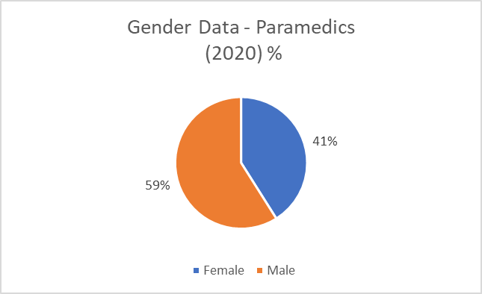
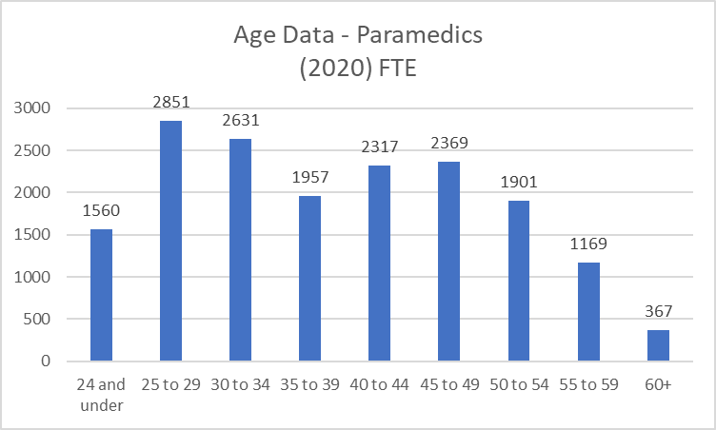
Gender and Age Information
Paramedic workforce is predominately male (59%) – unusual for an NHS profession outside medicine/dentistry
Age profile information for the profession shows a good spread of the workforce amongst the different age bands.
  Only 20% in the age band of 50+ ( 3,438 WTE).
  41% (7042) of the workforce 30 years or under.
The evidence suggests no immediate risk of workforce supply issues due to an ageing workforce.

Slide 42
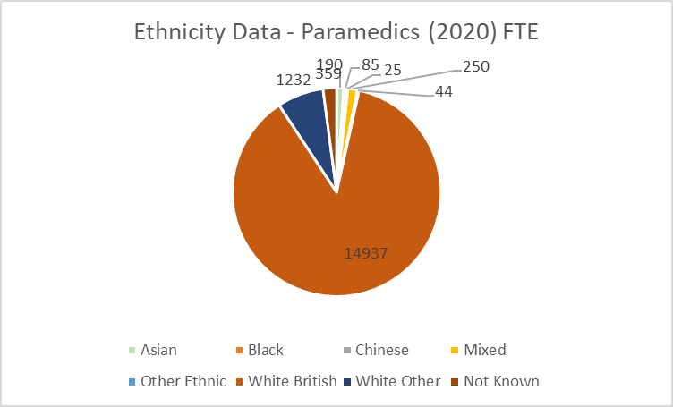
Ethnicity & Nationality Information
Ethnicity
Ethnicity data suggests 87% of the workforce are White British
Ethnicity data shows at least 2% of the workforce are from Asian, Black, Chinese or Other Ethnic backgrounds
Nationality
The % of staff with non-UK nationality has increased sharply, from 1% of the workforce in 2014 to 7% of the workforce in 2020. In March 2020, this represented c. 1,256 out of c. 17,122 of the workforce
London by far has the greatest dependence on non-UK nationals – 27% of the workforce in 2020.
Most common nationalities other than UK are: Australian (651 FTE in 2020), Polish (195) and Irish (152)

Slide 43
Summary of Future Trends
All else equal, we would expect supply growth to be solid, of order of 5-6% per year, especially given expansion in training places through PEEP programme
Pre-Covid, we would have expected growth in demand to be about 4%, in line with wider A&E trends
However, post-Covid it is likely A&E demand may be affected upwards, and we also know that under the LTP proposals are for at least 2,500 additional paramedics in primary care which will increase demand further
This means that while all else equal the evidence seems positive, the challenge will be maintaining response to demand, not just in acute but also in primary care settings

Slide 44
Paramedics workforce summary
Very strong growth in recent times, especially since 2017 where it has been running at > 6% per year. Reflective of expansion of training under PEEP programme
Increasingly younger workforce, and increasingly international – non-UK nationals made up 7% of workforce in 2020, versus 1% in 2014
Very high dependence on international recruitment in London – close to 3 in 10 from overseas, especially from Australia
High future growth in supply expected, so likely optimistic forecast – will need to meet constant of A&E demand and new demand from primary care

Slide 45

Paramedics
Kirsty Lowery-Richardson
Workforce Transformation Lead (WYH HCP)
Associate Dean - HEE
Kirsty.lowery-richardson@hee.nhs.uk
@Kirsty_LLR

Slide 46

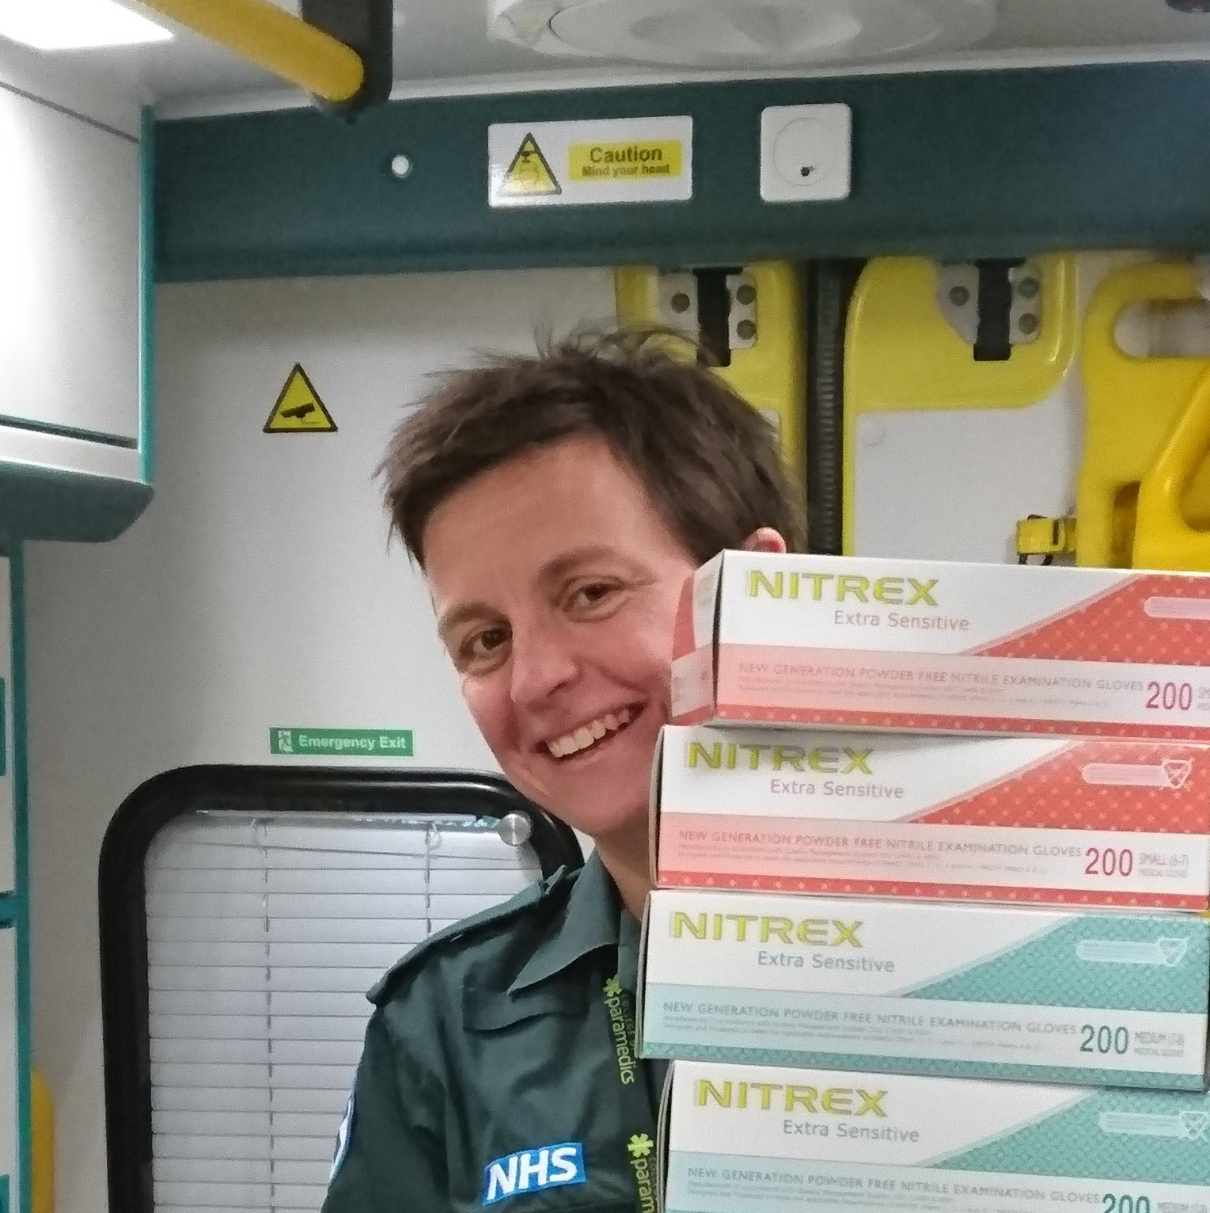


@lizharrisFCPara
Liz Harris
Head of Professional Standards

Slide 47

‘The potential contribution that a well educated and highly trained paramedic workforce can make to healthcare through its unique field of practice that intersects healthcare, social care, public health and public safety has yet to be fully understood.’
August 2013
The ‘PEEP’ report

Slide 48
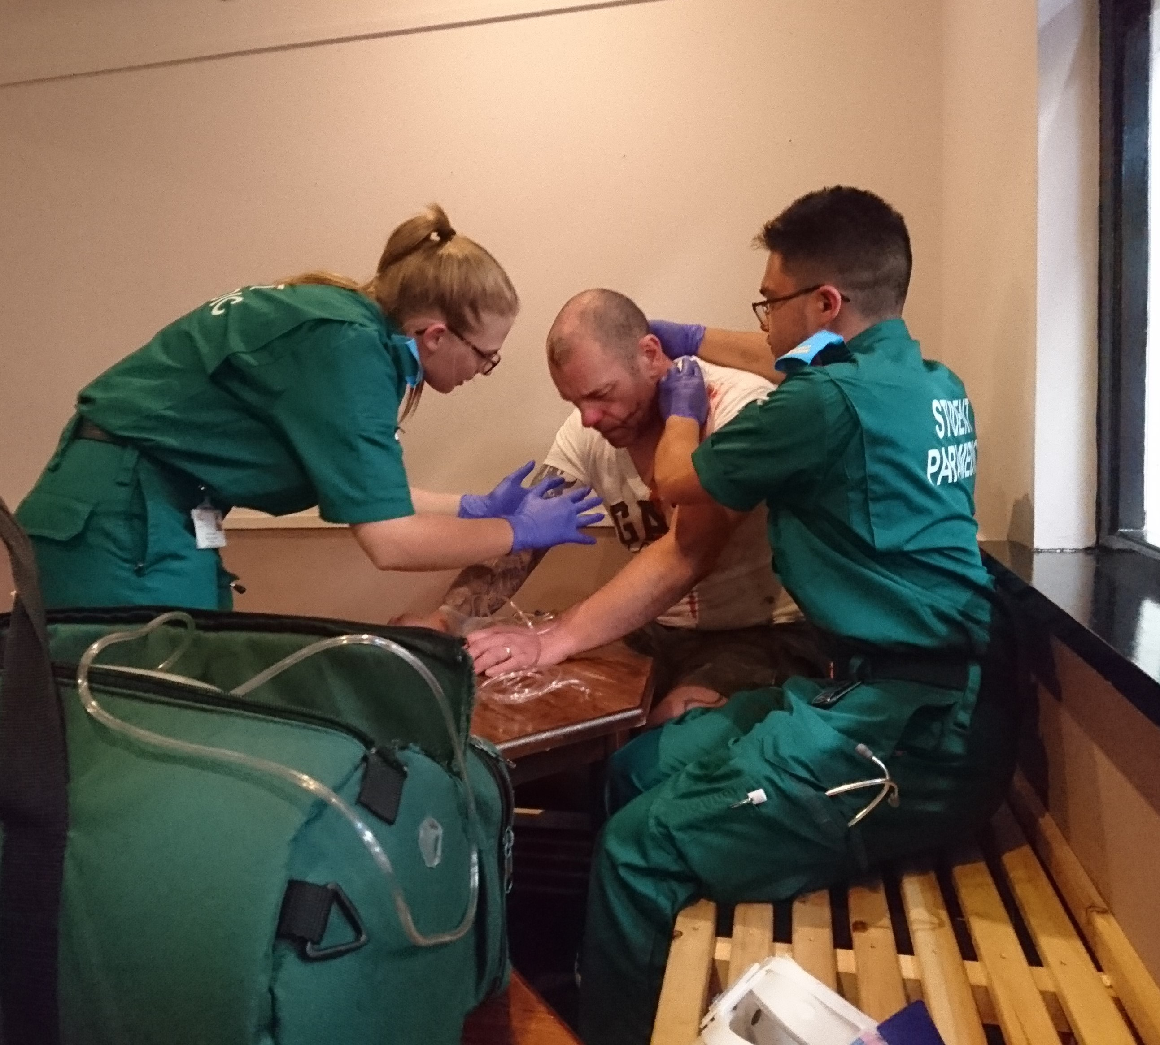
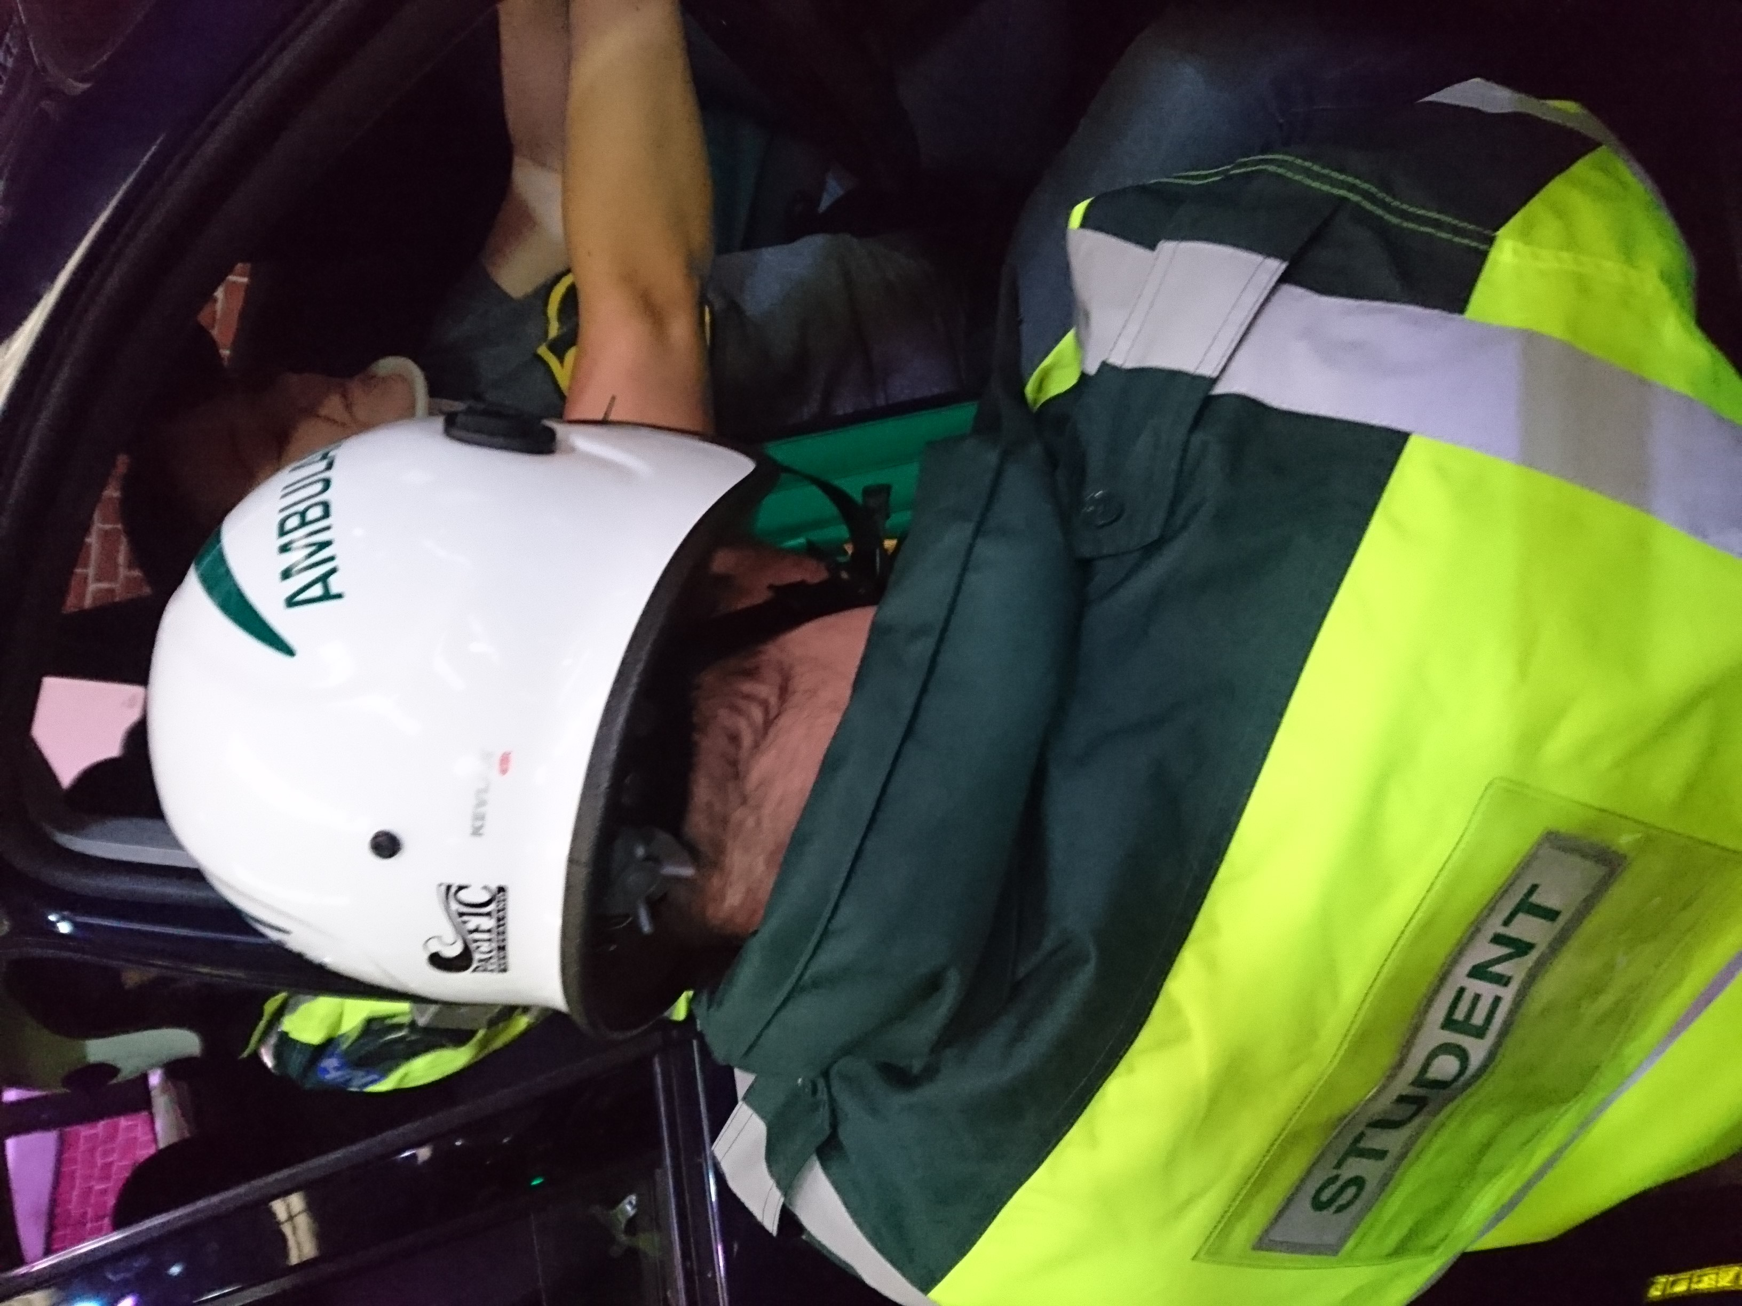


Clinical Placement provision challenges
Inequity in funding for 2nd degree Student Paramedics
Standardisation of Education / Curriculum Guidance

Slide 49




Factors affecting the retention of paramedics within the Ambulance Service workforce – KEY THEMES
CAREER AND DEVELOPMENT OPPORTUNITIES
SATISFACTION AND WORK EXPERIENCES
MANAGEMENT ISSUES
PAY AND BENEFITS

Slide 50


Slide 51
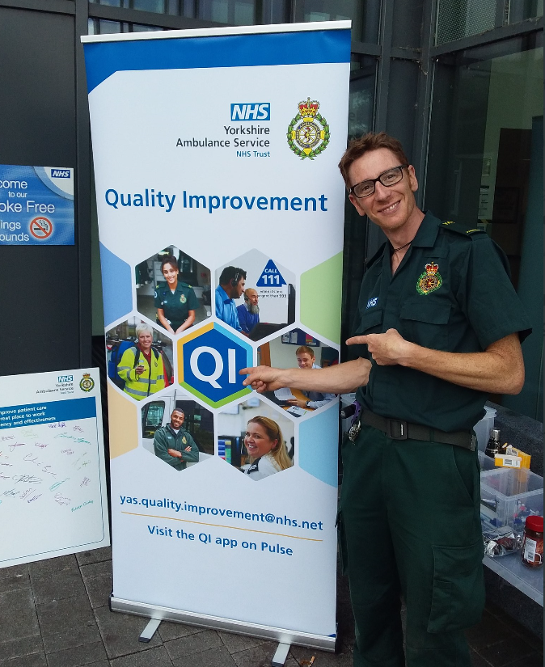
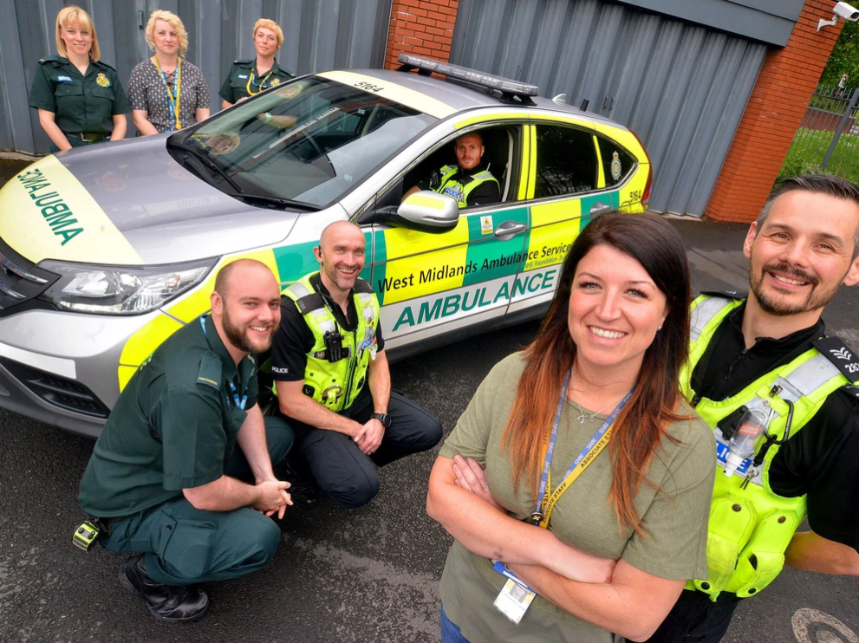
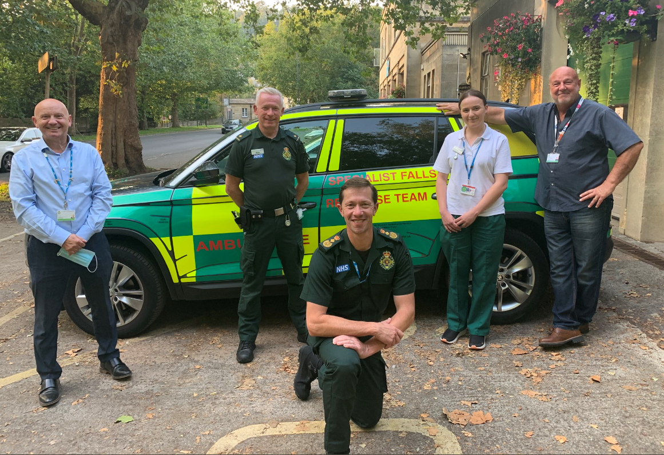
Rapid Falls Service
@BathFalls
Mental Health Response
@TriageWMP
Quality Improvement
@CarlBetts_YASQI
Collaboration Partnership Innovation

Slide 52


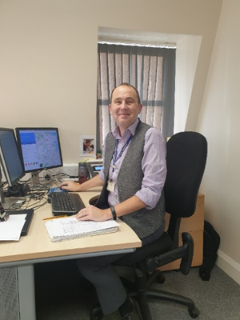
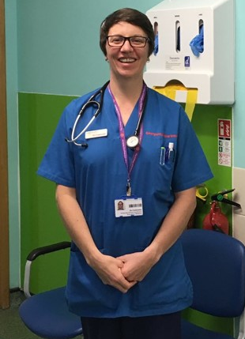

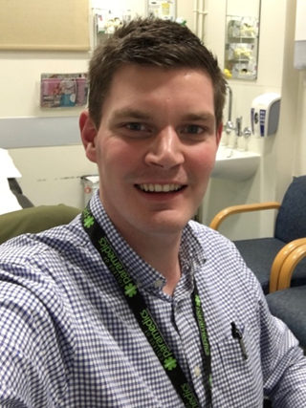
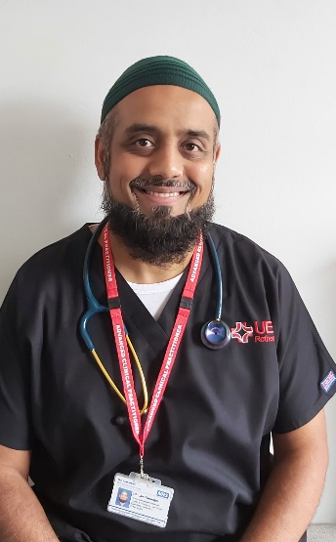
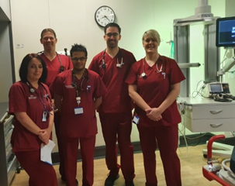
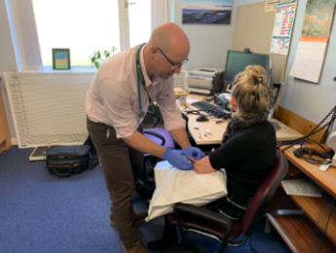
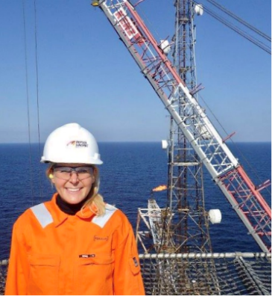

Advanced Practice

Slide 53

Legislation change to allow paramedic independent prescribing from 1st April 2018
Currently approx.700 paramedic prescribers with HCPC annotation
Paramedic Prescribing

Slide 54

Paramedic research has grown rapidly over the last decade and the paramedic profession’s research potential has become visible and valuable to academic and healthcare institutions.
Research

Slide 55


Slide 56

Discussion
Time for you all now to ask any further questions to any members of the team.
Please put your hand up or type your question in the comments box

Slide 57

Your Feedback Please
Q. What else do you want to know about the AHP workforce?
Please enter your comments in the chat box

