Slide 1

Welcome to AHP Workforce Webinar 4
Speech & Language Therapists, Music Therapy & Prosthetics & Orthotics
29 September 2020
Paula Breeze
National AHP Clinical Fellow
@breeze_paula
#AHPFaculty
Paula.breeze@hee.nhs.uk
@NHSHealthEdEng #AHPFaculty

Slide 2
Purpose of the webinars
Follow up to the successful AHP Faculty virtual showcase that took place on the 15th July.
AHP Faculties provide the infrastructure to enable system wide collaboration to address AHP workforce challenges and to maximise opportunities
Part of the support that we want to give to the faculties is to deliver a series of 5 webinars with the following aims:
To provide Chief/lead AHPs with up to date AHP workforce
information and data
2) To enable them to have informed conversations with their HR
Directors and senior stakeholders to raise awareness, promote
value and optimise AHP skill utilisation within the system

Slide 3

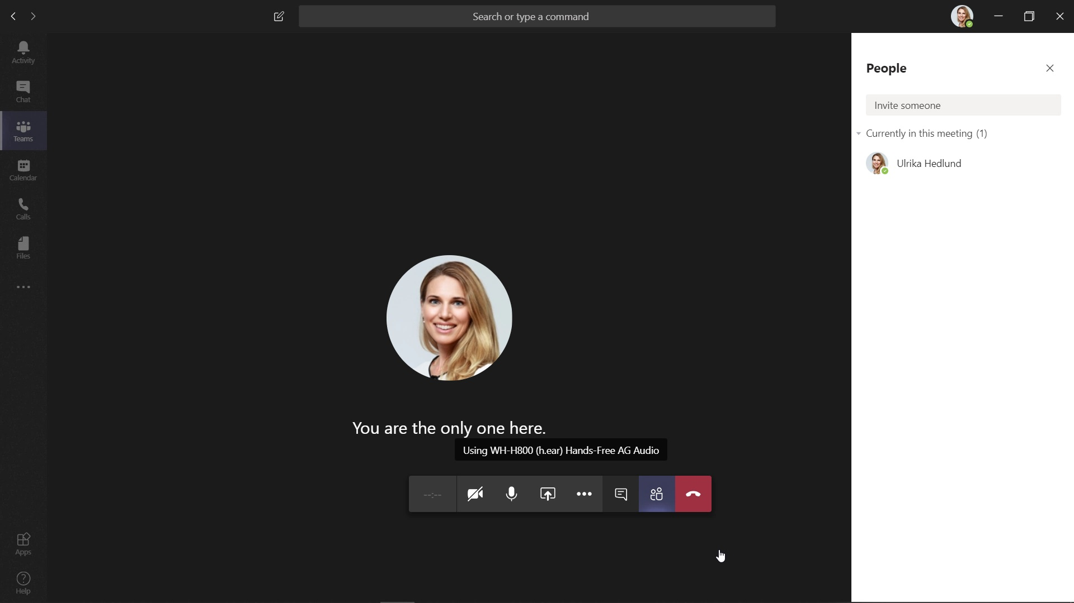
House Keeping
This Webinar will be recorded for future reference
Please switch your cameras off.

Slide 4
Today’s Plan
Speech & Language Therapists
Workforce Data
Royal College of Speech & Language Therapy
Music Therapy
Workforce Data
British Association for Music Theraphy
Prosthetics & Orthotics
Workforce Data
Orthotics Service -Yeovil
Discussion

Slide 5

Speech & Language Therapy
Shagufta Khan
National Workforce Planner

Slide 6
HCPC – Registration Data
HCPC regulate the 14 AHPs along with the General Council for Osteopaths.
Art, Music and Drama therapists are grouped together as are Diagnostic and Therapeutic Radiographers
@NHS_HealthEdEng #insertcampaignhashtag

Slide 7
S&LT – Registration Data Vs Employed
(NHS Digital)
Speech & Language Therapy (S&LT) registrants increased by c.1,580 (10.5%) between 2014 and 2020. This represents solid growth in the region of 2% per year
In August 2020, there were 16,572 registrants – a decrease of 23 registrants on end 2018/19, which may suggest registrations have not grown as quickly more recently.
Majority of registrants do not work in the NHS in England. This will reflect registrants working elsewhere in the UK and abroad, as well as high employment in other sectors.

Slide 8
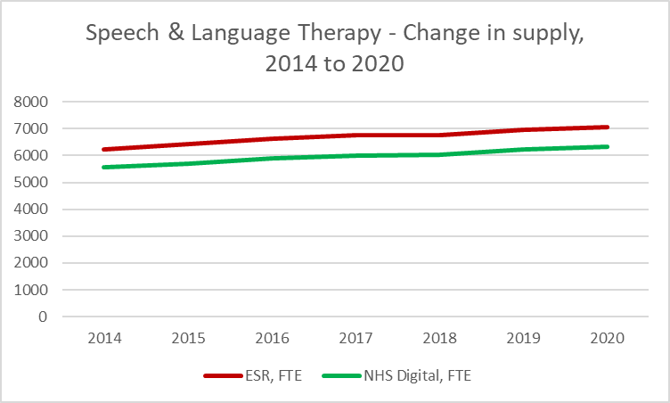
Speech & Language Therapy – Historic Supply Trends
We use both published NHS Digital data and data from ESR Data Warehouse
There are some differences, with latter numbers being higher – we typically count all employed staff, NHS Digital count ‘frontline only’ and so do not count all staff. However, the trends are largely the same.
Both sources confirm growth in the order of 2% per year. Growth has largely followed the register.

Slide 9
Flow analysis – summary
Overall numbers between 2014 and 2020 increased by about 2% per year
UK new Joiners have largely remained between 600-650 FTE but increased to 673 FTE in 2091-20; joiners from within NHS have remained at about 70 FTE per year. Reflects largely stable commission numbers
International Recruitment has largely remained stable – at c. 85-90 FTE per year
Leaver Rates have dropped from 8.9% in 2017-18 to 6.9% in 2019-20; leaver rates higher than other AHPs

Slide 10
Local Workforce Data (wte) – By Region

Slide 11
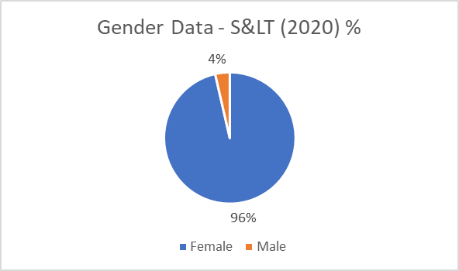
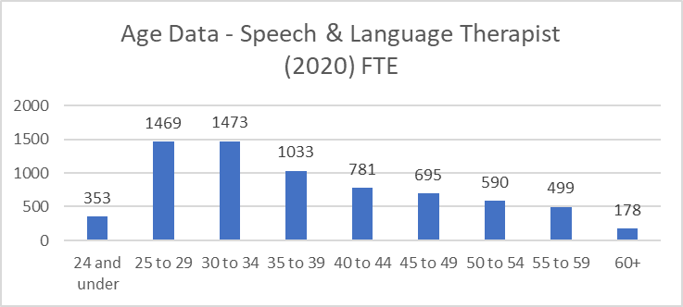
Gender and Age Information
Speech & Language Therapy workforce is predominately female (96%)
Age profile information for the profession shows a young workforce:
  Only 18% in the age band of 50+ (1,267 WTE)
  46% aged under 35 (3,305 FTE)
The evidence suggests no immediate risk of workforce supply issues due to an ageing workforce.

Slide 12
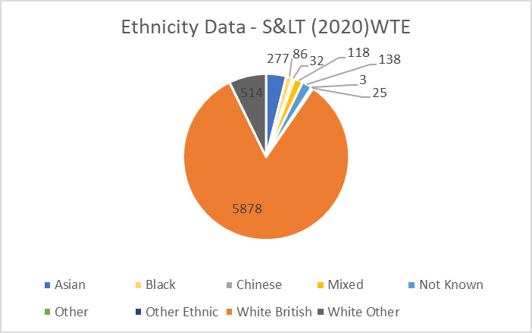
Ethnicity & Nationality Information
Ethnicity
Ethnicity data suggests 83% of the workforce are White British
Ethnicity data shows at least 6% of the workforce are from Asian, Black, Chinese or Other Ethnic backgrounds
Nationality
The % of staff with non-UK nationality has largely remained stable, at 6-7% of the workforce. In March 2020, this represented c. 488 out of c. 7,071 FTE of the workforce
London by far has the greatest dependence on non-UK nationals – 15% of the workforce in 2020. EoE and the SE also have higher than average numbers
Most common nationalities other than UK are: Irish (191 FTE in 2020), Australian (65 FTE) and American (32 FTE).

Slide 13
Summary of Future Trends
All else equal, we would expect supply growth to of order of 1.5-2% per year
Pre-Covid, we would have expected growth in demand to be at similar levels
However, post-Covid it is likely demand could be shifted upwards, not least as part of Covid rehabilitation
This means that while all else equal the evidence seems positive and the profession stable, the challenge will be ensuring we can continue to respond to growing demand

Slide 14
Speech & Language Therapy workforce summary
Very stable profession – solid growth of c. 2% per year on both the HCPC register and in the NHS
Increasingly younger workforce
Higher dependence on international recruitment in London – 3 in 20 from overseas, compared to 1 in 20 elsewhere
Steady growth in demand and supply expected; challenge to ensure likely growing demand is met

Slide 15
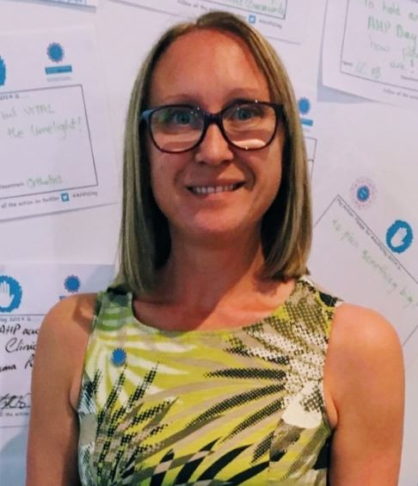


Health Education England
South West Region
Head of Allied Health Professions
@@carrie_biddle
Carrie.Biddle@hee.nhs.uk

Slide 16

Speech and Language Therapy
Judith Broll
Director of Professional Development, RCSLT
Notes:
Thanks Carrie – wonderful person etc
Intro myself
SLT for over 25 years –
clinical specialism in adult neuro dysphagia , but moved into MDT managements and AHP STP lead role before starting as Dir of Prof Development at RCSLT just under a year ago.
Having had the opportunities to not only practise but also be engaged with wider AHP workforce has opened new horizons , and given me the opportunity to gain deeper understanding and contexutalise SLT role within the AHP family –and how ,especially in light of CV19 working with colleagues while shining a light on specific professional skills has been invaluable

Slide 17
SLT context
30 + specialist clinical areas
SLTs recognised on the Shortage Occupation List (Home Office)
COVID 19- raised profile of profession , extending clinical opportunities
Widespread transformation in service/ training delivery
@NHS_HealthEdEng
Notes:
Approx 17,000 RCSLT members across 4 nations covering wide clinical range – more SLTs not reg
Challenges around lack of critical mass to lobby, eg– low incidence hi need care groups
Deliver services from cradle to grave, and across health ,education , justice, social care, private etc
SLTs shortage occupation – new courses coming on line but support and advocacy for the profession in leadership roles (esp in children services ) are being eroded.
Funding higher banded clinical leaders enhance services both for professional and service users
However , due to the holistic communication expertise of SLTs, I would suggest that SLTs, once they find their voices , make excellent leaders –both within the profession and in other roles- as Carrie is a shining example.
The People Plan is a potentially excellent vehicle to support leadership development roles for the profession.
CV19 lining has raised the profile of SLTs role /worth not only with MDT colleagues but also within the profession and the media
Increase in enquiries about becoming a SLT
– allowing us the opportunity to raise our profile and extend /expand roles , not only within initial acute phases (eg ICS (intensive care soc) rehab guidelines has identified and specific SLT pathway) but also around endoscopy scoping, patient advocacy, ACP roles, etc
Widespread transformation of service delivery and training delivery - supporting the LTP around service redesign – both around skill mix reviews , location and method of service delivery (eg telehealth) - this work pre- COVID, and has increase at pace during this current working environment.
Link to resources for rehab, telehealth & placements NB free access to website for students

Slide 18
Workforce Challenges
SLT Shortages
Attracting to the profession / pipeline
Placement capacity issues – clinical hours
Career development routes/ opportunities
Dysphagia competence of SLT students/ NQPs
Current limitations
Filling vacancies in specialist clinical areas – eg secure and justice settings.
@NHS_HealthEdEng
Notes:
SLT Shortages as previously mentioned, heightened, in light of redeployment around COVID – not having enough adequately trained clinicians to deliver acute care (eg FEES , trachy), and some children services were temporarily paused, leading to health inequalities and compromising their future prospects – often have lost 6/12 of therapy at crucial developmental points which will adversely impact their opportunities in adult life.
Attracting to the profession/pipeline- recognition for the need to diversify as a profession, as well as expand, RCSLT is working with HEE and in house to look at career development opportunities- looking at school STEM work as well as within the wider AHP agenda. Plus considering mature students/ post COIVD job realignment as an excellent pools for SLT recruits
Placement capacity issues – 575 hours clinical placement – need to make them count – need a flexible system to support this- request for clinical placement coordinators , more placement hours to accommodate increase student numbers
career development routes –more B5/6 posts to support starting SLTs,
–requires opportunity and leadership- RCLST are working on leadership mentors , supporting the diversity agenda
Lack of protected time and funding for SLTs towards research and/or developing clinical academic careers – support CPD is built into job plans
Dysphagia competency of NQPs – UK is the only country in the English speaking world who does not competency train SLTs – this omission has been highlighted with COVID 19, more on that later
Current limitations - not having prescribing rights, not able to train as AMHPs (approved mental health professional) or AMCPs – (approved mental capacity professional) and these impact on ACP roles in some – but not all instances
Filling vacancies – looking at creative placements esp in hard to recruit to areas

Slide 19
Opportunities
New training courses
Continue to develop SLT workforce
COVID 19 – offered opportunities around extended roles
Dysphagia competences project
New ways of working
@NHS_HealthEdEng
Notes:
19 HEIs across the UK run SLT UG & PG courses – with increase in courses, there is a need for additional placements- - more of this later
New courses - Starting up at UCLAN and Huddersfield are in talks about a new course
Continue to develop SLT workforce
Support SLTs to work at the top of their licence and have a support behind that to ensure excellent service delivery and allow professional innovation and pushing boundaries
So..
SLT Apprenticeship courses are accredited and the first one is starting next year (essex).
Request to consider SLT apprenticeship courses commissed at ICS level with HEI? – it is anticipated to open up the accessibility and diversity of the profession.
Also looking at the whole profession –including competencies for the essential support workers, how to support career choices within the profession , including ACP, Consultant roles , Clinical academic roles, as well as investigating Primary Care SLT roles (FCP) , to not only support the PCN/ICS / LTP agendas but continue to adapt to the changing needs of the services and patient need.
Service delivery has changed for all of us – and SLT have embraced teletherapy both for patients and as part of UG/PG training – the caveat being we are very aware of the limitations and needs individualising - written clear telehealth guidelines which are also being used by other professions, as well as telepractise guidelines for HEIs- referencing Sim and non face to face as legitimate alternatives to face to face contact for at least part of their teaching hours.
COVID extended roles- mentioned before- we need to establish skills that are learnt while working in CV ward eg NGT passing/ tracheal suctioning- how – or if these are skills to be retained within the profession –or seen as short term
Dysphagia competencies – very exciting to future proof the profession and , with support from HEE, RCSLT , in collaboration with HEIs and clinicians is starting a National change management journey to have dysphagia competent NQPs ready by 2024- if not earlier in some places
New ways of working - having worked in an STP ,I can see the potential of different ways of working , including Place based learning opportunities for UG/PG students and apprenticeship models, as well as along patient pathways , I understand this is already starting to happen in some areas, and I can see this might be a useful model to investigate further. uni and multidisciplinarry.

Slide 20
Developments
SIM
Telehealth
Clinical placement expansion through innovation, to increase capacity
Dysphagia competencies – international alignment
Expanding the diversity of the profession
Engaging with external bodies eg BBC Resources – The Box , CAUK
@NHS_HealthEdEng
Notes:
Simulation offer to be embedded in UG training programmes- including bid around the dysphagia competencies work to support alignment of training nationally
Telehealth - just keeps growing – for us all
New expanding clinical placements work along with all the other innovations mentioned previously
DG compts – will be a profession changing piece of work- over due
Diversification
External bodies –tiny happy people w BBC, Government – service users , PBs, service user organisations

Slide 21

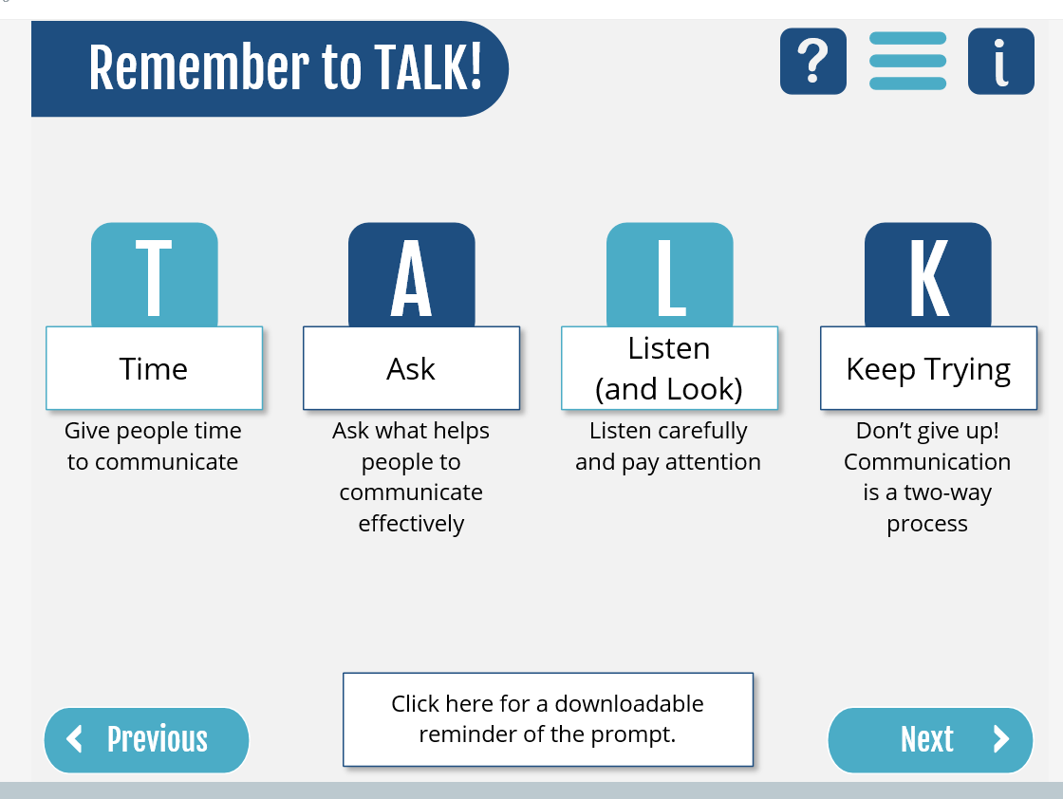
Resources
RCSLT COVID-19 guidance including for rehab
RCSLT telehealth guidance
The Box
Communication Access UK
https://www.rcslt.org/members/lifelong-learning/leadership​
@NHS_HealthEdEng
Notes:
CAUK - Launching in November
In partnership with the Stroke Association, the Motor Neurone Disease Association , Headway – the brain injury association, Communication Matters, the National Network of Parent Carer Forums, the Makaton Charity, the Business Disability Forum and Disability Rights UK.

Slide 22
Music Therapists
Tom Speller
Deputy Head of Workforce Planning

Slide 23
HCPC – Registration Data
HCPC regulate the 14 AHPs along with the General Council for Osteopaths.
Art, Music and Drama therapists are grouped together as are Diagnostic and Therapeutic Radiographers
@NHS_HealthEdEng #insertcampaignhashtag

Slide 24
Arts Therapists – Registration Data Vs Employed (NHS Digital)
Arts therapists (art therapists, music therapists, dramatherapists) tend to be counted together, both in terms of registration and ESR
The number of arts therapists increased sharply between 2014 and 2020, by c. 1160, or 32%. This represents strong growth in the order of 5% per year
In August 2020, there were 4,461 registrants – a n increase of 29 (0.6%) on end 2018/19, which suggests growth may be slowing down
A comparison of registrant and ESR data demonstrates that the majority of registrants do not work in the NHS in England. This will reflect registrants working elsewhere in the UK and abroad, as well as high employment in other sectors, notably education, the third sector, charities and private practice
Arts Therapists form a very small profession within the NHS. Numbers in the NHS are under 500 FTE.

Slide 25
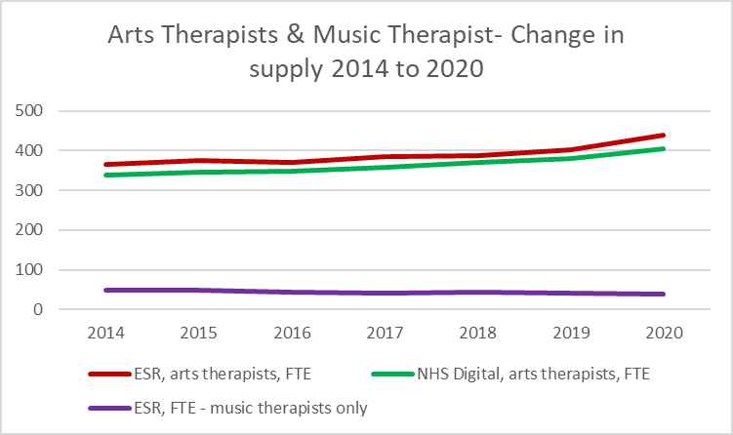
Arts Therapists and Music Therapists – Historic Supply Trends
We use both published NHS Digital data and data from ESR Data Warehouse
There are some differences, with latter numbers being higher – we typically count all employed staff, NHS Digital count ‘frontline only’ and so do not count all staff. However, the trends are largely the same – and the latter approach is the only method for picking out art therapists specifically
All sources confirm growth in the region of 3-4% per year in the NHS for arts therapists – slightly slower than the register but solid growth nonetheless
In terms of Music therapists* specifically, numbers are extremely small in the NHS and have dropped from 48 FTE in 2014 to 38 FTE in 2020 – 9-10% of the arts therapist workforce.
Given small numbers (which limits what we can sensibly report), we will focus most of remaining analysis on arts therapists as a whole, with additional insights specific to music therapists as appropriate.
*Defined as arts therapists (S0H, S1H, S6H, SAH) with the following job roles: Music Therapist, Music Therapist Manager, Music Therapist Specialist Practitioner

Slide 26
Flow analysis – arts therapists summary
Overall, numbers increased by about 3-4% per year
Growth in UK joiners has increased from c. 15 per year to 35 in 2019-20
Growth in international supply has averaged about 5 FTE per year since 2015; peaking at 10 FTE in 2019-20. Numbers generally are small
Leaver rates have dropped from 7.1% in 2017-18 to 5.5% in 2019-20 – need to be aware though of small ‘n’
For music therapists – small (< 5 FTE) joiners and leavers per year, virtually no international recruitment, more have tended to leave than join

Slide 27
Art Therapists Local Workforce Data (wte) – By Region
Notes:
Music Therapists – about 4/5 in London and commuter belt (EoE, SE)

Slide 28
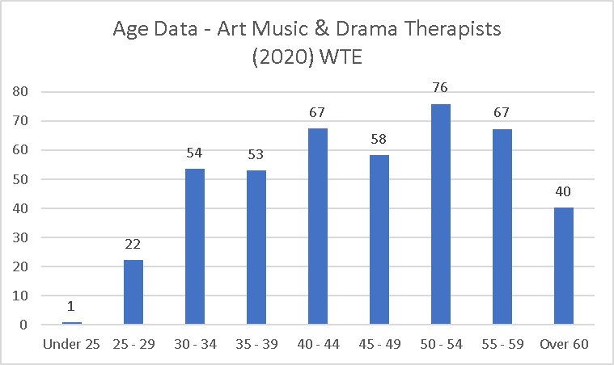
Gender and Age Information
Arts Therapists workforce is predominately female (93%)
Age profile information for the profession shows a slightly older workforce than seen for many AHP professions.
  41% in the age band of 50+ (183 WTE).
The evidence suggests some risk of workforce supply issues due to an ageing workforce, but needs to be balanced by fact most tend to start in their 30s given PG qualification.
Drama Therapists – 37% over 50, < 10 under 35. 79% women

Slide 29
Ethnicity & Nationality Information
Ethnicity
Ethnicity data shows that 77% of the Art, Music and Drama Therapy workforce are White British.
Colleagues from Asian, Black and Chinese backgrounds make up only 4% of the workforce.
Music Therapists: < 5 WTE from BAME backgrounds
Nationality
The % of staff with non-UK nationality increased from 7 to 12% between 2015 and 2020. In March 2020, this represented c.50 out of c.440 of the workforce
London by far is the largest employer of non-UK nationals, with 17% of all AMD therapists non-UK nationals
Most common nationalities other than UK are: Irish (11), American (6) and Greek (5)
Music Therapists: < 10 non-UK, all in London and commuter belt

Slide 30
Summary of Future Trends
All else equal, we would expect solid supply growth within the profession based on observed trends – with the caveat that numbers are small and therefore potentially more subject to fluctuations
While we might have expected similar levels of demand growth pre-Covid, it is likely need for these professionals will increase considerably, not least given requirements for mental health and psychological therapies – of which arts therapists will need to respond. Hence both a challenge and an opportunity for the profession
Investment in this profession will therefore continue to be necessary
Music Therapists: small numbers, numbers falling, generally few join/leave (so ‘succession planning’ more appropriate than ‘workforce planning’). Numbers falling, may be challenging if increase in demand post-Covid as envisaged

Slide 31
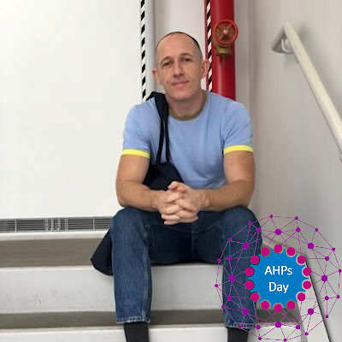
Stephen Sandford
Lead for Allied Health Professionals
Music Therapist
East London NHS Foundation Trust

Slide 32


Music Therapy
Jonathan Cousins-Booth
Chair – British Association for Music Therapy

Slide 33
Current Context
Music Therapists are psychological clinicians that use music to improve mental health, self-expression and quality of life. They work across all ages with groups and individuals.
Masters Degree (2 Years Full Time)
AHP and Psychological Therapy
Often Several Part Time Jobs
14% of Music Therapists Employed by NHS*
*2017 BAMT Workforce development survey
@NHS_HealthEdEng @MusicTherapyUK

Slide 34
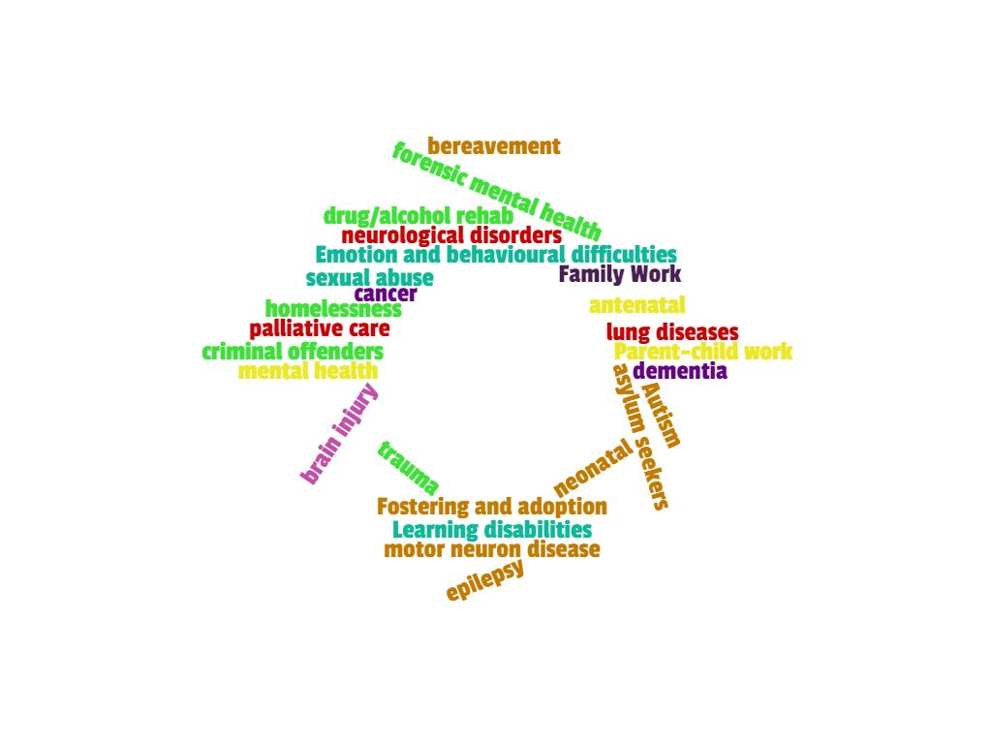
Music Therapy Workforce
@NHS_HealthEdEng @MusicTherapyUK

Slide 35
Key Challenges
Create equitable service availability
Fully utilise the vast transferable skill set of music therapists
Further develop training funding opportunities
@NHS_HealthEdEng @MusicTherapyUK

Slide 36
Opportunities
Wider Entry Routes
COVID – 19 Specific
Pulmonary Rehab
Psychological Support
(Service Users & Staff)
Palliative Care
Bereavement Support
Advanced Practioner Role
Fully appreciate the diverse range of Music Therapy
@NHS_HealthEdEng @MusicTherapyUK

Slide 37
Take Home Message for AHP Leads
Service users highly rate and value arts therapies. Improving access to these will improve service user outcomes.
Psychological support goes beyond inpatient mental health settings. Innovative service design can see music therapy used to its full potential.
Arts therapists are creative thinkers, leaders and facilitators. How would those skills fit into the next AHP role you advertise?
@NHS_HealthEdEng @MusicTherapyUK

Slide 38
Prosthetics & Orthotists
Tom Speller
Deputy Head of Workforce Planning

Slide 39
HCPC – Registration Data
HCPC regulate the 14 AHPs along with the General Council for Osteopaths.
Art, Music and Drama therapists are grouped together as are Diagnostic and Therapeutic Radiographers
One of the smallest professions regulated by the HCPC
A single figure for both Prosthetists and Orthotists provided here
@NHS_HealthEdEng #insertcampaignhashtag

Slide 40
Prosthetists & Orthotists – Registration Data Vs Employed (NHS Digital)
Prosthetists and Orthotists only recently received its own unique NHS ESR occupational code in 2019 (S*I) – therefore no officially recorded numbers prior to then. Also need to note possible miscoding – orthotists sometimes counted as orthoptists (not the same thing)
Continuous improvement in ESR therefore key
Register grew by 100 between 2015 and 2020 -
In September 2020, there were 1105 registrants – a 0.3% or 4 registrants increase on end 2018/19, suggesting slow growth
Vast majority of registrants do not work in the NHS in England. This will reflect registrants working elsewhere in the UK and abroad, as well as the majority being employed in the private sector.
Notes:
Tom - NHS Digital data available from 2019 onwards only.

Slide 41
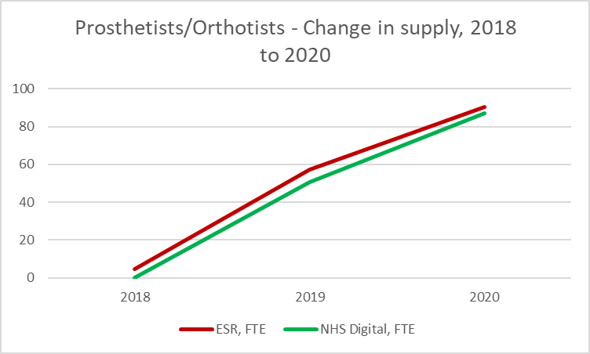
Prosthetists/Orthotists – Historic Supply Trends
We use both published NHS Digital data and data from ESR Data Warehouse
There are some differences, with latter numbers being higher – we typically count all employed staff, NHS Digital count ‘frontline only’ and so do not count all staff. However, the trends are largely the same.
ESR & NHS Digital data available from end 2018 onwards for this profession.
Both sources confirm growing NHS numbers in England; however numbers are small and exponential growth reflects addition to ESR and gradual changes in coding

Slide 42
Flow analysis
Insufficient data to analyse flows in any detail – numbers only recorded for last two years; any growth likely to reflect new use of the code
Growth on the register was by 100 between 2015 and 2020 – suggesting numbers grow by about 2% per year, in line with a number of other AHPs

Slide 43
Local Workforce Data (wte) – By Region
Notes:
Tom - Data from 2018 onwards only- since profession got its occupation code

Slide 44
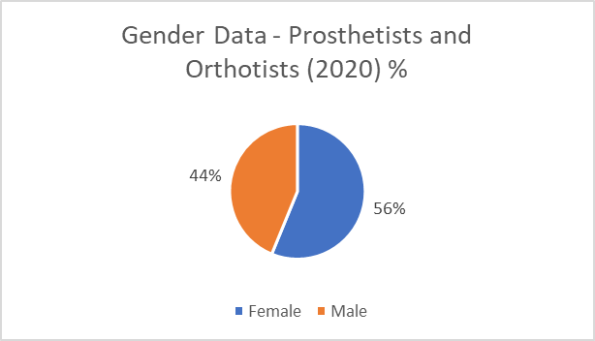
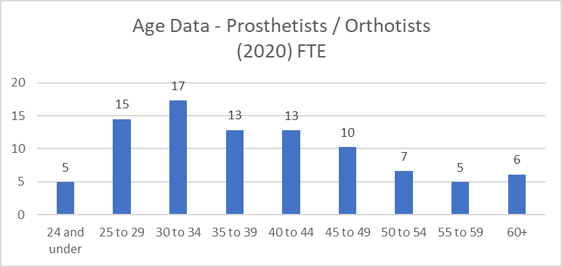
Gender and Age Information
Prosthetists and Orthotist workforce is predominately female (56%)
Age profile information for the profession shows a younger workforce than seen for many AHP professions.
  Only 20% in the age band of 50+ ( 18 WTE)
  40% under age 35 (37 FTE).
The evidence suggests no immediate risk of workforce supply issues due to an ageing workforce.

Slide 45
Ethnicity & Nationality Information
Ethnicity
Ethnicity data suggests 72% of the workforce are White British
Ethnicity data shows at least 10% of the workforce are from Asian, Black or Other Ethnic backgrounds
Nationality
The % of staff with non-UK nationality is at 10% of the workforce. In March 2020, this represented c. 9 out of c. 90 of the workforce
Midlands has the most non-UK nationals, with 5 out of the 9 non-UK nationals working there
Most non-UK staff in the NHS tend to be from the EEA
Notes:
Tom – Re the Nationality line graph, the numbers WTE are so small that it appears drastic. In 2018 there were only 5wte in total of which 1 wte was from a non UK nationality!

Slide 46
Prosthetist and Orthotist Summary
Vast majority work outside NHS; prosthetists and orthotists only visible on ESR since 2019
In the NHS, future trends largely unknown as previously an invisible workforce – once new occupation codes embed and based on register, growth in supply of order of 2% per year is probably sensible
However, supply challenges include only one provider of pre-registration training in England (Salford), number of private providers in financial distress as result of Covid, and removal from shortage occupation list last year
Demand likely to increase due to ageing population, possibly by same amount as register if not more
Challenge therefore to increase both visibility and viability of this workforce

Slide 47
Prosthetics and Orthotics
29th September 2020
Juliet Sturgess BSc Pros/Orth MBAPO
Orthotist and Orthotics Service Manager Yeovil District Hospital NHS Foundation Trust
Working with Health Education England on #AHPApprenticeships

Slide 48
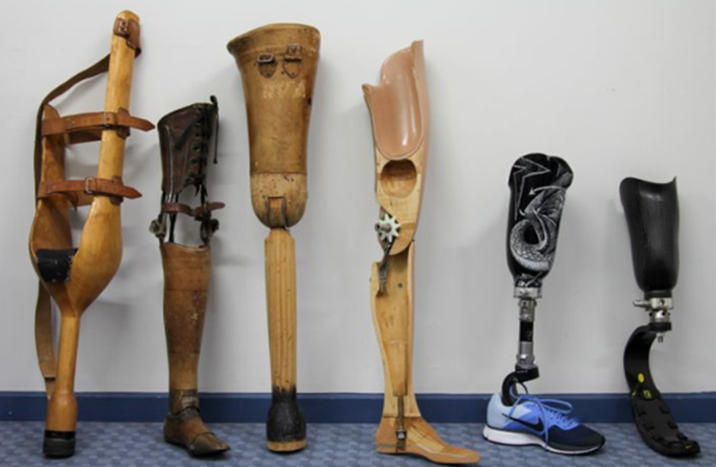

How we think
Innovation
Invention
@NHS_HealthEdEng

Slide 49

How we work
Very exquisite profession
Services often contracted
Stand alone clinics and MDT working
Horizon scan for technologies and products
We understand the human body and engineering

Slide 50

What we contribute
We think differently
Keep people living independently
Huge impact on wider health economics
Work across acute and community settings

Slide 51

Ways to help us grow
Increase the profile
Use new training routes
Include us in service planning
Help us maintain our skill mix
Help restart our services

Slide 52

Discussion
Time for you all now to ask any further questions to any members of the team.
Please put your hand up or type your question in the comments box

Slide 53

Your Feedback Please
Q. What else do you want to know about the AHP workforce?
Please enter your comments in the chat box

