Slide 1

Welcome to AHP Workforce Webinar 5
Diagnostic Radiography, Therapeutic Radiography and Osteopathy
30 September 2020
Paula Breeze
National AHP Clinical Fellow
@breeze_paula
#AHPFaculty
Paula.breeze@hee.nhs.uk
@NHSHealthEdEng #AHPFaculty

Slide 2
Purpose of the webinars
Follow up to the successful AHP Faculty virtual showcase that took place on the 15th July.
AHP Faculties provide the infrastructure to enable system wide collaboration to address AHP workforce challenges and to maximise opportunities
Part of the support that we want to give to the faculties is to deliver a series of 5 webinars with the following aims:
To provide Chief/lead AHPs with up to date AHP workforce
information and data
2) To enable them to have informed conversations with their HR
Directors and senior stakeholders to raise awareness, promote
value and optimise AHP skill utilisation within the system

Slide 3

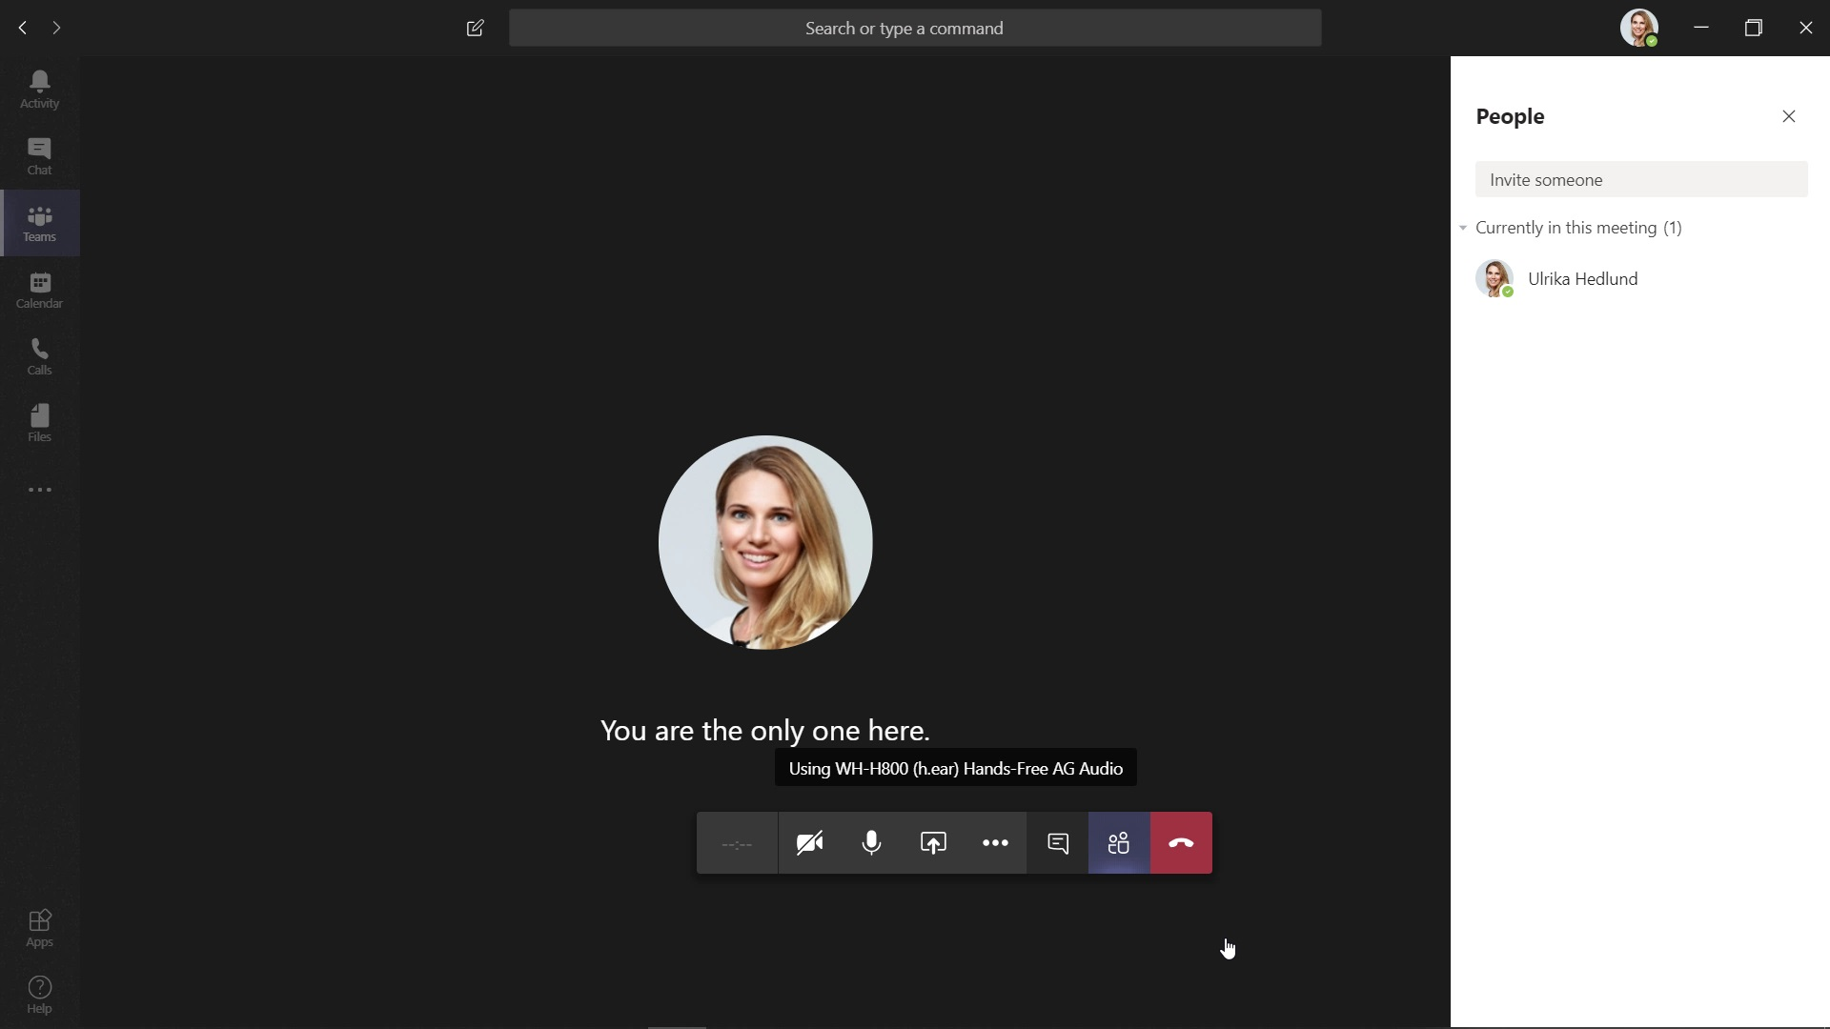
House Keeping
This Webinar will be recorded for future reference
Please switch your cameras off.

Slide 4
Today’s Plan
Diagnostic Radiography
Workforce Data
Society & College of Radiographers
Therapeutic Radiography
Workforce Data
Society and College of Radiographers
Osteopathy
Workforce Data
The Institute of Osteopathy
Discussion

Slide 5
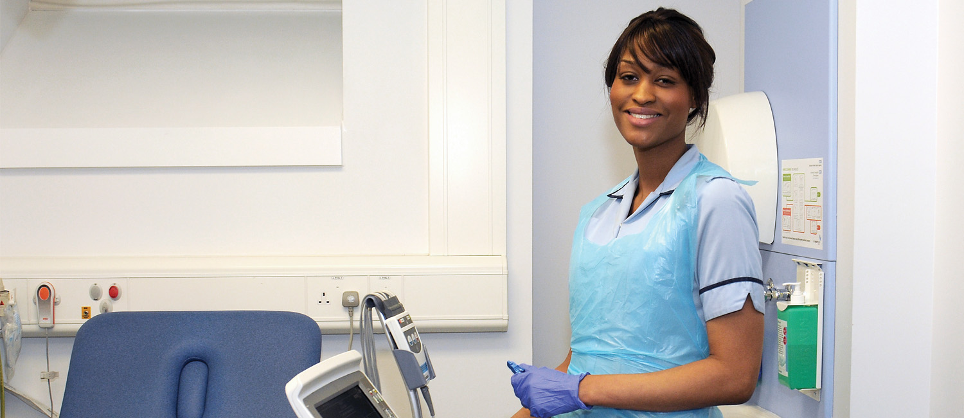
Diagnostic Radiography
Shagufta Khan
National Workforce Planner

Slide 6
HCPC – Registration Data
HCPC regulate the 14 AHPs along with the General Council for Osteopaths.
Highlighted columns includes diagnostic radiographers and therapeutic radiographers, who are both counted together as ‘radiographers’
@NHS_HealthEdEng #insertcampaignhashtag

Slide 7
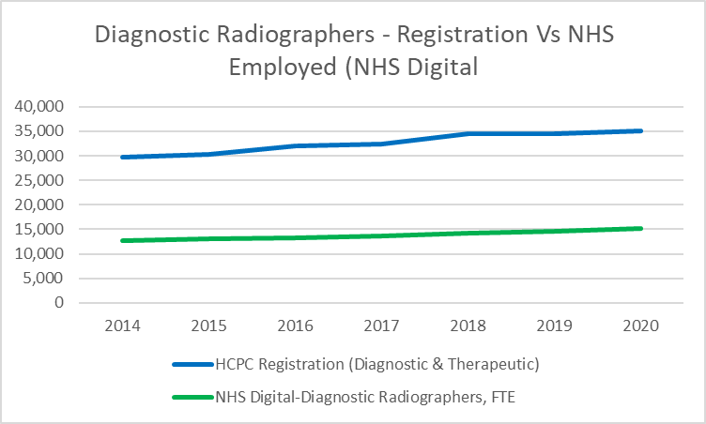
Diagnostic Radiographers – Registration Data Vs Employed (NHS Digital)
Radiography (D&T) registrants increased by c. 5,216 (17.5%) between 2014 and 2020. This represents solid growth in the region of 2.9% per year
In August 2020, there were 36,078 registrants (D&T) – a 4.6% increase on end 2018/19, suggesting growth is steadily increasing.
The NHS is just one of the many employers of radiography registrants. This will reflect registrants working elsewhere in the UK and abroad, as well as those working in therapeutic radiography. A number will also work in other sectors.

Slide 8
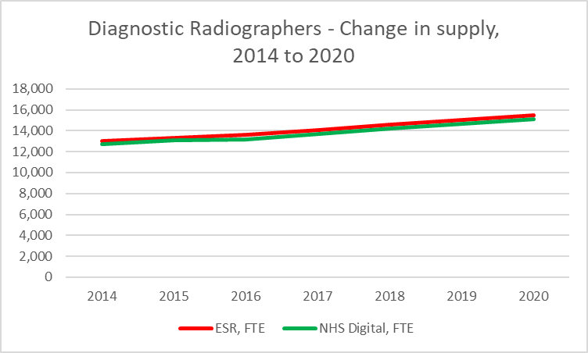
Diagnostic Radiography – Historic Supply Trends
We use both published NHS Digital data and data from ESR Data Warehouse
There are some differences, with latter numbers being higher – we typically count all employed staff, NHS Digital count ‘frontline only’ and so do not count all staff. However, the trends are largely the same.
Both sources confirm growth in the order of 3% per year. Growth has been comparable to the register

Slide 9
Flow analysis – summary
Overall numbers between 2014 and 2020 increased by about 3% per year
UK new Joiners increased from 943 FTE in 2014-15 to 1104 FTE in 2019-20, as result of some expansion of training places
International Recruitment increased sharply: from c. 210 per year in 2014-15 to c.472 in 2019-20
Increase stronger among non-EEA than EEA
Leaver Rates have been at 6.0% since 2017-18

Slide 10
Local Workforce Data (wte) – By Region

Slide 11
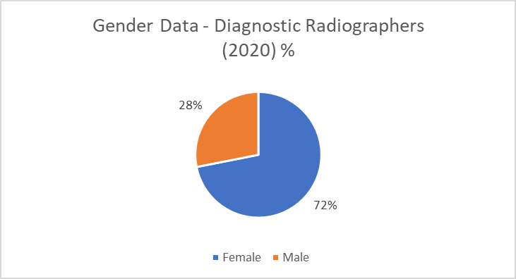
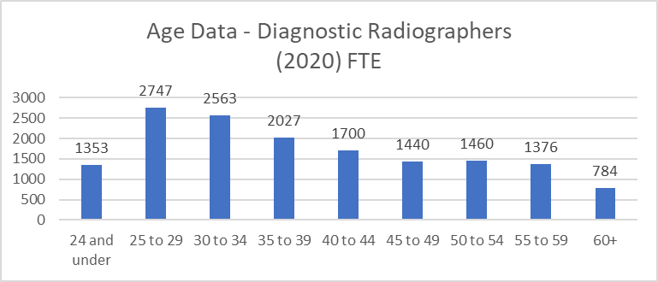
Gender and Age Information
Diagnostic Radiography workforce is predominately female (72%)
Age profile information for the profession shows a relative young age distribution across the different age bands.
  26% of workforce under the age of 30yrs.
  23% in the age band of 50+ (3,620 WTE).
The evidence suggests no immediate risk of workforce supply issues due to an ageing workforce.

Slide 12
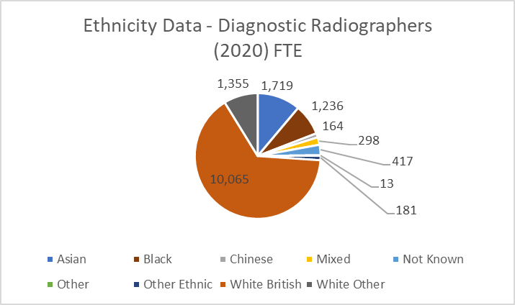
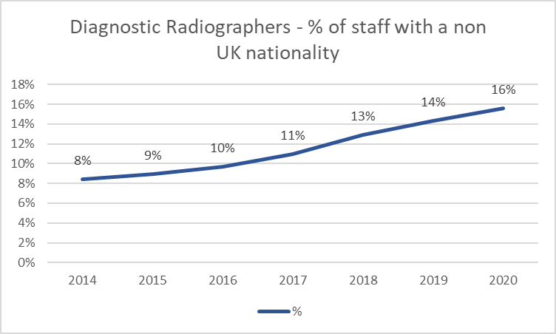
Ethnicity & Nationality Information
Ethnicity
Ethnicity data suggests 65% of the workforce are White British
Ethnicity data shows at least 21% of the workforce are from Asian, Black, Chinese or Other Ethnic backgrounds.
Nationality
The % of staff with non-UK nationality increased sharply from 8% of the workforce in 2015 to 16% by March 2020. In March 2020, this represented c. 2,407 out of c.15,450 WTE of the workforce
London and the South East have the greatest dependence on non-UK nationals – 24% of the workforce in 2020. While London has long had over 20%; the non-UK population has grown sharply in the South East.
Most common nationalities other than UK are: Irish (334 in 2020), Portuguese (280) and Italian (240).

Slide 13
Summary of future trends
All else equal, we would expect supply growth to be solid, of order of 3% per year
Pre-Covid, we would have expected growth in demand to be about 1-2% per year
However, we know demand is likely to go up considerably as a result of increased demand for cancer services, with the Richards Review recommending far more radiographers
This means that while the supply of this profession is likely to grow solidly, more is likely to be needed to meet demand for cancer services

Slide 14
Diagnostic Radiography summary
Solid growth in supply, both on the register and in the NHS workforce; we expect this to continue
Sharp increase in joiners, particularly in international recruitment
Close to 1 in 4 staff in London and the South East have non-UK nationality, suggesting possible capacity issues
Significant challenge of future demand, particularly from Richards Review and likely increased demand for cancer services

Slide 15

Diagnostic Radiographers
Sue Johnson
Professional Officer (Clinical Imaging)
Society and College of Radiographers

Slide 16
Diagnostic Radiographer
Manage equipment and environments: radiation protection, safety & quality control
screening, diagnosis, treatment monitoring
Work in a team
take diagnostic images
clinical practitioners, managers, leaders, researchers, educators, advisors, regulators
Advanced and consultant practitioner roles
Patient centered care: prioritisation, flow, justification, optimisation, escalation
Notes:
Everyone knows that diagnostic radiographers take images, many people know that some radiographers provide formal reports on those images or perform minimally invasive interventional procedures under imaging control,
Not many people though fully recognise the range of roles or the complexity of skill and knowledge needed to be a diagnostic radiographer, delivering 24 hour services in the NHS
Diagnostic Radiographers use a vast amount of clinical and technical knowledge for every examination drawing on anatomical, pathological, physiological, technical, scientific and regulatory knowledge for each specific pathway of care or health setting.
Unlike TR, DR do not only work in cancer services, but across all urgent, emergency and elective pathways from prenatal imaging to the grave and sometimes beyond with forensic imaging. We Screen, diagnose, treat and monitor a wide range of patient conditions.
People see an intersection between TR and DR based on a piece of equipment such as a CT/MR scanner but is really important to recognise that the equipment is a tool and the 2 disciplines use the tools for different purposes. The background knowledge, education and training is completely different and although the skill of image acquisition may be the same the underpinning knowledge to do that in context of the care pathway is not.
Diagnostic Radiographers manage the flow of patients through patient prioritisation, justification and authorisation of exposures aiming to maximise capacity and minimise delays while keeping the patient at the centre. They take responsibility for quality and safety of the modalities they use and the environments in which they use them. That is safety through providing appropriate patient care, plus managing the environment and the equipment though regulatory compliance and applying robust QA programmes.
They also lead on service innovation and developing new pathway models, DR’s take responsibility for their element of the pathway ensuring that patients are signposted to next steps escalating urgent or unexpected findings as needed and providing a high standard of compassionate care in a highly technical environment .
The most frequently used modality is still traditional radiography. This remains a primary diagnostic tool and the skills of radiographers in delivering this element of the service alongside imaging in operating theatres and wards, supporting interventional procedures and general fluoroscopy shouldn’t be forgotten against the higher profile of MR, CT and US.

Slide 17
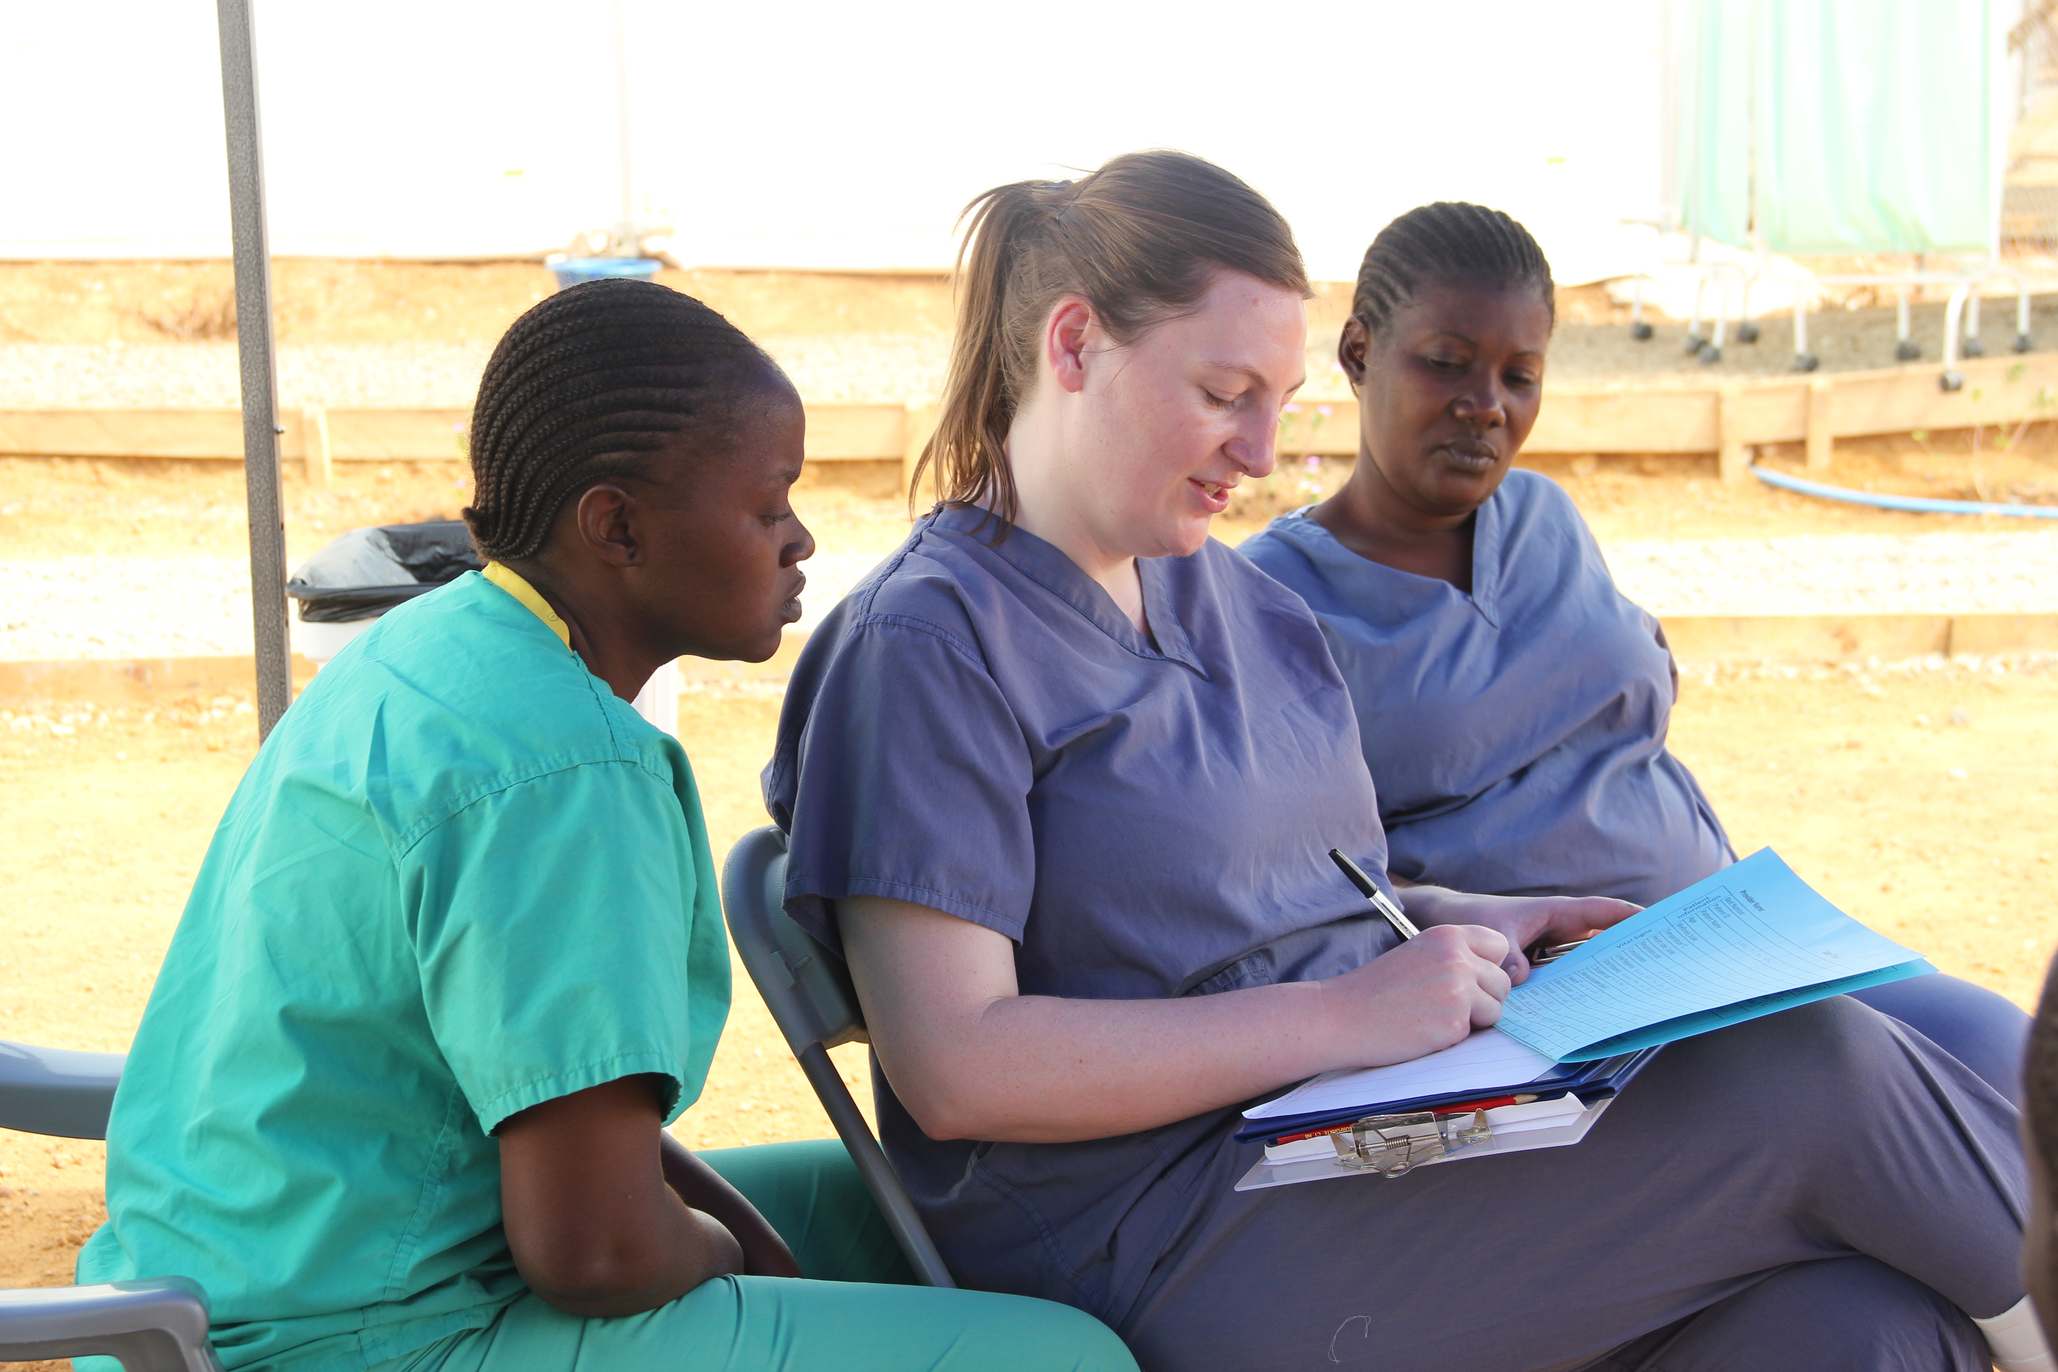
Key issues
Workforce development and growth
  Careers escalator with education that meets the needs of service
  Education routes that flow from 1 role to the next
  Support for clinical departments as learning environments
  Support for CPD
  New programmes, standards and models
@NHS_HealthEdEng #insertcampaignhashtag
Notes:
Diagnostic radiographers work in teams with the support workforce of radiographic assistants having an important role in supporting patient flow and supporting the care for patients before, during and after examinations. They have really shown their value and have come into their own with Covid safe working, aiding patients through the pathways, providing improved infection control through intensive equipment cleaning regimes and assisting radiographers using heavy equipment and delivering services in full PPE.
Some RA’s successfully progress to an assistant practitioner role, performing radiographic examinations under the direction of a registered radiographer.
Where APs are fully embedded in service design, rosters and workforce planning, their contribution to 24/7 service delivery can be significant. .
However many departments don’t use AP’s for various reasons. For small departments segmenting the workforce by role can inhibit service delivery, in others unfortunately there is still a reluctance to recognise the role of this part of the workforce and for others finding a suitable education route proves impossible. The AP Scope of practice developed by the SCoR is due for review with a more enabling focus at its core. The skills and knowledge to meet regulatory requirements for using x-ray equipment are rigorous and specific and only a few HEI s have managed to map their Foundation degrees to the assistant practitioner apprenticeship requirements with funding for other education pathways being no longer available.
Finding the next step up the ladder to registered radiographer is even more challenging and again really does need addressing if we are serious about growing our workforce through different pipelines.
There is scope for improved recruitment, development and retention across the workforce if we can get the careers escalator right. I am on record as saying that the radiography escalator doesn’t stop at every floor It functions differently in every region and even across adjacent services . If we want to capitalise on those capable and wanting to progress then this has to be fixed with a specific focus on radiographic skills. In addition departments need access to practice educators and new learning environments including simulation have to be nurtured.
The HCPC standards of proficiency are currently being revised alongside the SoR ECF . Both of these will provide the foundation for the future. Flexible but firm enough to support professional growth and adaptable enough to meet ever changing service and patient need.
Radiographic Practitioners on qualification must have a range of skills to meet current and future service need across the multiple pathways of care; Skills that are ready for honing and developing. With enough support staff radiographers can use their skills to maximum potential providing the enhanced, advanced and consultant roles that can help to transform service delivery. Funding CPD, both time and money, remains a significant challenge. Radiographic practice is far from static and radiographers have a long history of successfully adopting and adapting to new technologies but need to update their skills, knowledge and behaviours to do so safely - I think we were agile before the term was ever coined!

Slide 18
Key messages
Growing and developing the support workforce has potential to deliver a very positive impact
Need the skills escalator to work
  for all levels of practice
  In all areas, between and across networks
Understand we do much more than simply ‘acquire’ or ‘report’ images
  Not defined by a modality
  Skills are much broader than the equipment we use as our tools
Are at the forefront of digital technologies
  Adapt and adopt is in our DNA
Bring the care, communication and human interaction into the systems however complex or ‘clever’ they become
@NHS_HealthEdEng #insertcampaignhashtag
Notes:
Increasing the support workforce could bring quick wins on capacity and efficiency while building the plan to grow the registered workforce through new and emerging pipelines
However for that to happen we need the skills escalator to work properly for all levels of practice, between and across geographic areas.
The proposed imaging networks as they develop should help to maximise education opportunities and support planning of the workforce
Technological solutions including AI are already available and will continue to evolve. providing access to better and quicker diagnosis, reduced radiation doses and examination times.
Radiographers are already adapting to their impact, honing skills in assessing new technologies and embedding them into practice,
Recruitment and retention depends upon offering a varied career. While many opportunities can be seen in the future, the challenge is to make the opportunities a reality. We have spent years talking about this, we really do need action to match the fine words.

Slide 19
Therapeutic Radiography
Tom Speller
Deputy Head of Workforce Planning

Slide 20
HCPC – Registration Data
HCPC regulate the 14 AHPs along with the General Council for Osteopaths.
Registration data counts diagnostic radiographers and therapeutic radiographers together as ‘radiographers’ – possible challenges around knowing exact split/visibility, and need for other sources
@NHS_HealthEdEng #insertcampaignhashtag

Slide 21
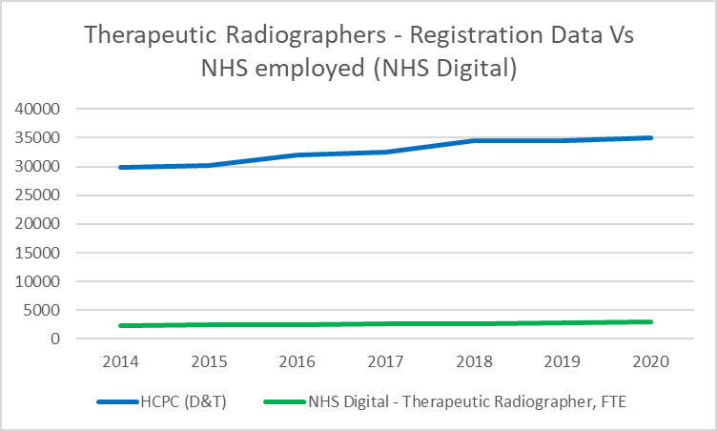
Registration Data Vs Employed (NHS Digital)
Radiography registrants increased by 5,216 (17.5%) between 2014 and 2020. This represented solid growth in the region of 2.9% per year. In August 2020, there were 36,078 radiography registrants – a 4.6% increase on end 2018/19, suggesting growth is steadily increasing
A small percentage HCPC registrants in radiography do not work in the NHS in England as therapeutic radiographers. A lot will be in diagnostic radiography, and some will work outside England (e.g. rest of UK). There is also some employment in other sectors, although as next slide shows, for therapeutic radiography such numbers are small.
Notes:
Tom
Smaller workforce then Diagnostic radiography – within the NHS
NHS Digital data shows for 2014 = 2,291 wte, for 2020 = 2,958 WTE
For 2020 NHS employed 15,450 Diagnostic Radiographers compared to only 3,077 (wte) Therapeutic Radiographers

Slide 22
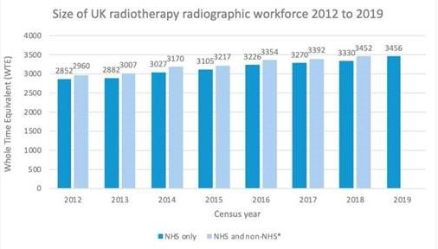
Therapeutic Radiographers - UK
SCoR census data suggests therapeutic radiographer numbers in the UK grew by 21% between 2012 and 2019
Growth in the NHS was by 2.7% per year; in all sectors it was 2.6% per year
Numbers outside NHS in UK small – about 120 in 2018

Slide 23
Therapeutic Radiographers – Historic Supply Trends
We use both published NHS Digital data and data from ESR Data Warehouse
There are some differences, with latter numbers being higher – we typically count all employed staff, NHS Digital count ‘frontline only’ and so do not count all staff. However, the trends are largely the same.
Both sources confirm growth in the order of 4.8% per year; however that is highly skewed by recoding in 2019-20 (from DR to TR) which meant growth was 8.1%. Between 2014 and 2019, growth was more like 3.6% per year, slightly faster than the register, and slightly faster than the SCOR’s census
Notes:
Tom -
NHS Digital data for Therapeutic Radio shows for 2014 = 2,291 wte, for 2020 = 2,958 WTE
For 2020 NHS employed 15,450 Diagnostic Radiographers compared to only 3,077 (wte) Therapeutic Radiographers
This is a small profession so small increase in numbers = larger percentages
Diagnostic Radiography 3% increase per year, Therapeutic Radiography 4.8% increase per Year.

Slide 24
Flow analysis – summary
Overall numbers between 2014 and 2019 increased by about 4% per year
Growth of 8.1% (231 FTE) in 2019-20 largely driven by about 100-120 WTE recoded from DR to TR (so not true growth)
UK new Joiners have largely remained solid at 230-245 WTE per year, rising to 263 FTE in 2019-20
International Recruitment increased sharply in 2019-20: from c. 40 WTE per year to 63 in 2019-20
Leaver Rates dropped to 5.7% in 2019-20 from 6.3% the previous year

Slide 25
Local Workforce Data (wte) – By Region

Slide 26
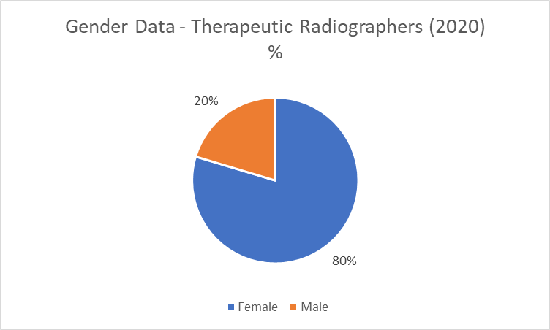
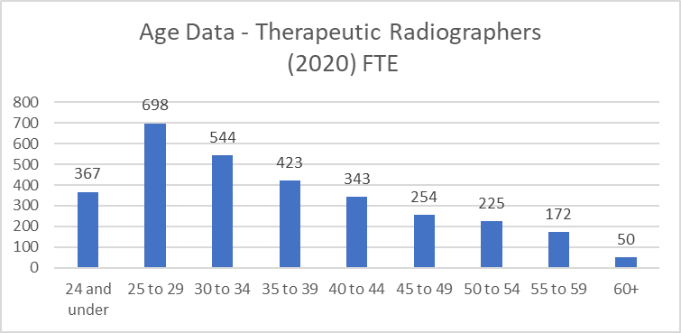
Gender and Age Information
Therapeutic Radiography workforce is predominately female (80%)
Age profile information for the profession shows a young workforce.
  35% of workforce under the age of 30yrs (1,065 WTE)
  15% in the age band of 50+ (447 WTE).
The evidence suggests no immediate risk of workforce supply issues due to an ageing workforce.

Slide 27
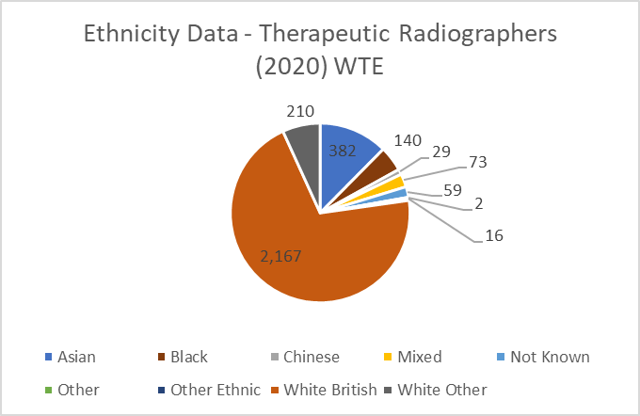
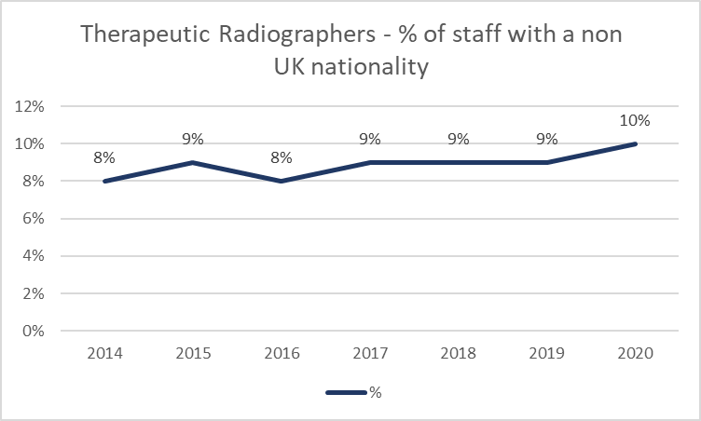
Ethnicity & Nationality Information
Ethnicity
Ethnicity data suggests 70% of the workforce are White British
Ethnicity data shows at least 18% of the workforce are from Asian, Black, Chinese or Other Ethnic backgrounds.
Nationality
The % of staff with non-UK nationality has increased from 8 to 10% of the workforce. In March 2020, this represented c. 297 out of c.3097 WTE of the workforce
London and its commuter belt employ the most non-UK nationals – South East 16% in 2020, EoE 15%, London 13%
Most common nationalities other than UK are: Irish (87 in 2020), Indian (29) and Portuguese (25).

Slide 28
Summary of Future Trends
All else equal, we would expect supply growth to be solid, of order of 4% per year
Pre-Covid, we would have expected growth in demand to be about 1-2% per year
However, we know demand is likely to go up considerably for a range of reasons, including growth in cancer and screening/imaging services as highlighted by recent CRUK report
This means that while the supply of this profession is likely to grow solidly, more will be needed to meet demand for cancer services and a range of other areas

Slide 29
Therapeutic Radiography workforce summary
Solid growth in supply, both on the register and in the NHS workforce; we expect this to continue
Joiners have largely remained steady until 19-20 where they increased
Split between London and commuter belt (higher dependence on IR) and rest of England
Significant challenge of increased activity for cancer services and other areas, as well as need for service transformation

Slide 30
Therapeutic Radiographers
Spencer Goodman
Professional Officer - Radiotherapy
Society and College of Radiographers

Slide 31
Background
Radiotherapy is a core treatment option for people diagnosed with cancer ¹
  Over 50% of patients with cancer will receive radiotherapy at some point in their cancer pathway
  Cancer incidence is rising
Cancer Research UK – Full Team Ahead: Understanding the UK non-surgical cancer treatment workforce, 2017 Available at: http://www.cancerresearchuk.org/about-us/we-develop-policy/our-policy-on-cancer-services/non-surgical-cancer-treatments-workforce
Notes:
Radiotherapy is a core treatment option for people diagnosed with cancer and the provision of high quality equitable care is the priority for therapeutic radiographers working with the multidisciplinary team.
Therapeutic Radiographers comprise over 50% of the workforce within the radiotherapy service and work closely with Clinical Oncologists and Medical Physicists, and other professional groups across the wider cancer care pathway.

Slide 32
Workforce challenges
What is Radiotherapy & who are Therapeutic Radiographers ?
Therapeutic radiographers play a vital and changing role in the delivery of radiotherapy services. They are extensively involved at all stages of the patient’s radiotherapy journey and the only healthcare professionals qualified to plan and deliver radiotherapy
Pipeline
Practitioner - Enhanced - ACP – Consultant
Notes:
Evidenced changes in skill mix will implicate therapeutic radiographers working at advanced and consultant levels of practice, in turn adding a significant need for postgraduate training
New ways of working & delivering care
Context around complexity
Advanced Practitioner (AP) roles numerous and well stablished
Postgraduate education
Alignment to ACP Framework
Growth in practice educators and clinical academic roles to support the required growth in the workforce
Simulation equipment to support the required growth in clinical training capacity for both pre-and post-registration education and training
Post registration Continuing Professional Development and formal Masters/ Doctoral level education and training to support workforce transformation

Slide 33
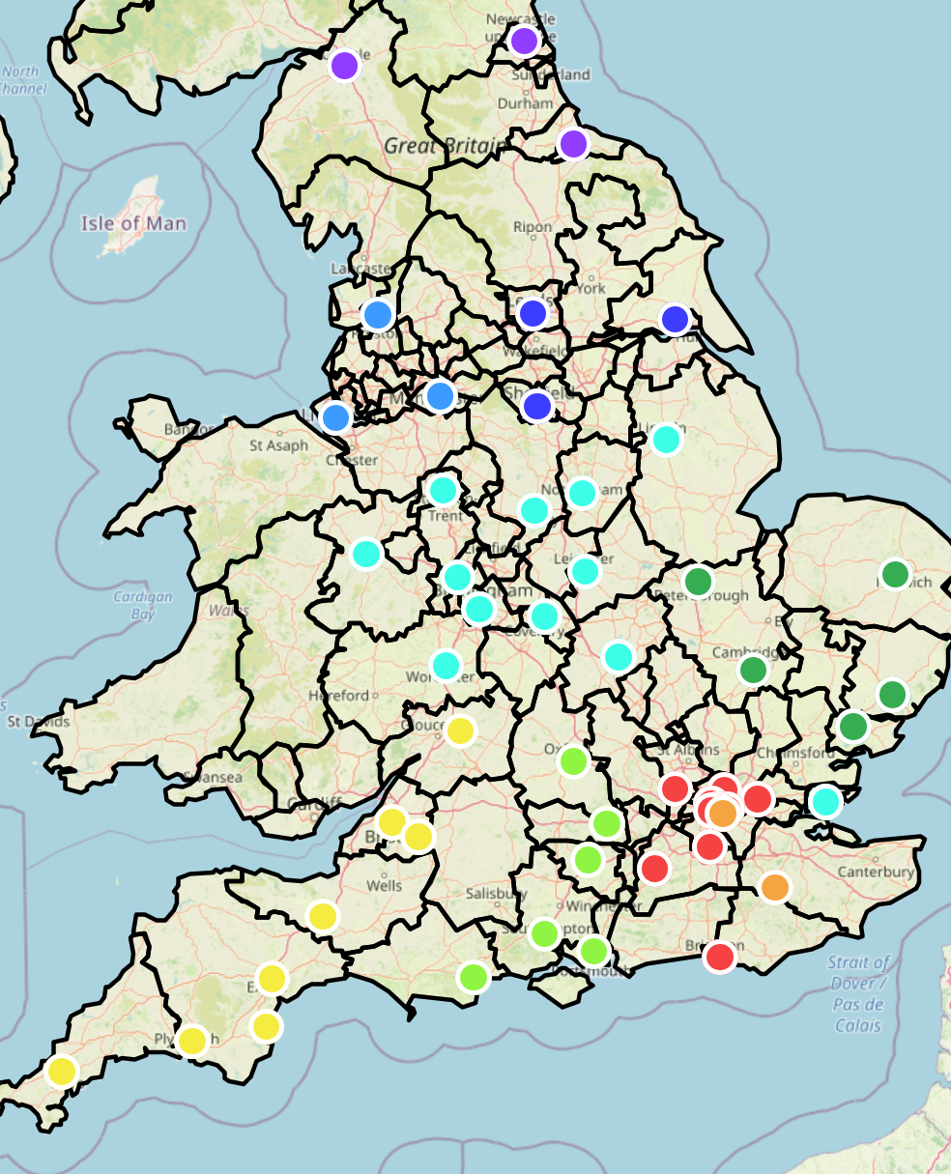
Key areas for workforce development and growth
‘Adult External Beam Radiotherapy Services delivered as part of a Radiotherapy Network’
Separate service specs for:
Paediatric Radiotherapy
Proton Beam Radiotherapy
Brachytherapy
Intracranial SRS/SRT services
Cancer Services - Patient Pathway Care
Community roles
Prehabilitation
Treatment review – independent prescribing
Late effects service
Notes:
Overview of new and embedded roles
Non silo’d care across the whole care pathway

Slide 34


  How you can address the workforce challenges
Core supply & workforce transformation
HEE TRAD project and loco-regional specific activity shared across all stakeholders – RePAIR recommendations
Notes:
There is scope for improved recruitment, development and retention across the workforce
We need a core increase in numbers but also enable multi-professional working and support
HEE Radiotherapy RePAIR project - England
Although there is valuable data and experience from the UK devolved countries, due to the scope of this project the focus will be England, to include NHS oncology centre and higher education providers.
Learning from RePAIR as a legacy project has been identified as a mechanism to support departmental leads and associated stakeholders and one component of ensuring there are sufficient Therapeutic Radiographers to meet future demand in line with the Cancer Workforce Plan.
Project outcomes: Alignment of recruitment and retention activity across multiple stakeholders:
To map the progress of implementation of the RePAIR recommendations into practice across the eleven England Operational Delivery Networks (ODN)
From this develop further use of the toolkit / exemplars based on the findings to support student recruitment and retention which can be utilised to support other services fully implementing the RePAIR recommendations.
Aligned to RePAIR outcomes, embed Partnership working of clinical services and approved education providers via Therapeutic Radiography champion roles to cover England.
These roles will also enable resource alignment for national work on recruitment and retention with other key stakeholders..
COVID-19, seek to understand the relevance of the findings from RePAIR to the new ways of working for pre-registration education and training that are being implemented within Oncology

Slide 35
Osteopathy
Tom Speller
Deputy Head of Workforce Planning

Slide 36
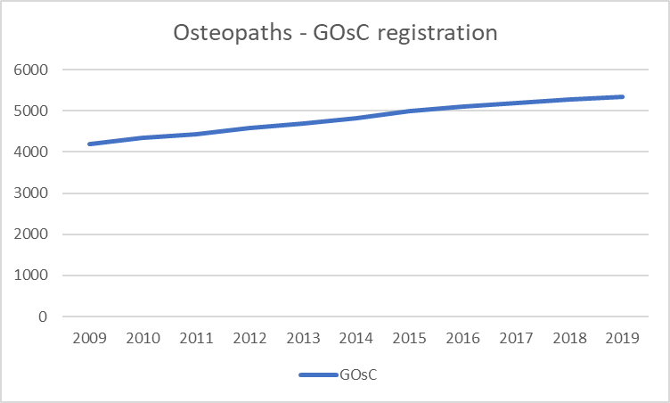
GOsC – Registration Data
General Osteopathic Council regulate Osteopaths (whose data is cited here). This is significant are osteopaths are NOT regulated by HCPC
Register has grown by 1,147 between 2009 and 2019. This represents 27% growth in registrations, or 2.7% growth per year
5,456 on the register in January 2020
@NHS_HealthEdEng #insertcampaignhashtag
Notes:
Tom
I have taken data from individual annual reports. I question whether it is our place to interpret this data?

Slide 37
NHS Digital/ ESR Data
No data available on NHS Digital as this profession currently has no unique ESR Occupational code
Identifiable numbers on ESR are minimal:
  < 5 FTE in 2020 in terms of Job Title
  < 10 FTE in 2020 in terms of Job Role (‘Osteopath’)
Institute of Osteopathy estimate of 3-5% in NHS (which would suggest more like 150-300 HC); if true then suggests a number hidden in other occupation codes/job roles/titles suggesting visibility an issue (and therefore potential may not be fully realised)
Either way, NHS data too small and uncertain to provide any meaningful analysis/comparisons

Slide 38
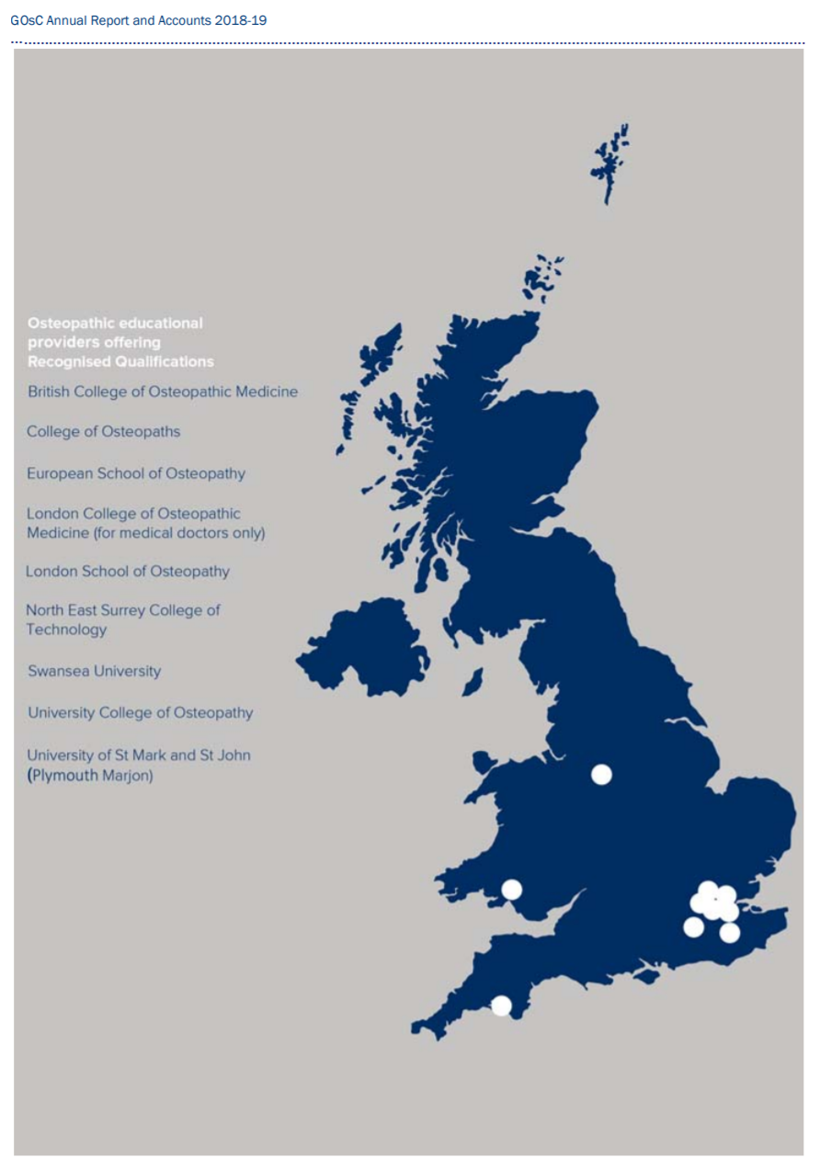
Educational Providers
9 course providers located mainly in the south of England around London, with roughly 250 graduating per year
Possible challenge of geographic spread, with roughly 50% mature students who tend to ‘stick’ in their local area
Map/ information taken from Annual Report and Accounts 2018-19. GOsC

Slide 39
Workforce data
Very small trackable workforce in NHS (estimate between 5 and 10 FTE) – a number (up to 300) hidden elsewhere, majority work in private practice, and > 80% patients fund their own treatment
Mainly found in S*X occupation code in NHS
Largest NHS employers in South East and South West regions, not surprising this is where most of osteopathy educational providers are located.
Evidence suggests slightly more men than women in NHS; on register slightly more women than men, 51:49 split (2,773 women, 2,683 men)
Majority of osteopaths are aged between 31 and 50 so fairly balanced profession in terms of age profile

Slide 40
Osteopathy – Workforce Summary
Solid growth in the profession of about 2-3% per year, based on the register – all else equal would expect that to continue
Slightly more women than men (51:49), and most aged 31 to 50 so balanced age profession
Virtually invisible in the NHS (estimate < 10 FTE, at best tiny fraction) – reflects fact that main setting is private practice, and that those in NHS are likely to be hidden elsewhere (with Institute of Osteopathy suggesting up to 5% in NHS)
Demand likely to increase as result of ageing population and increased demand from a wide range of services as part of a multidisciplinary team… so meeting demand will remain challenge

Slide 41

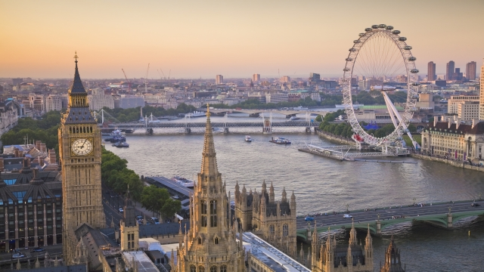

Laura Leadsford
Head of Allied Health Professions HEE London - Twitter @Moosie67Laura and email: laura.leadsford@nhs.net

Slide 42

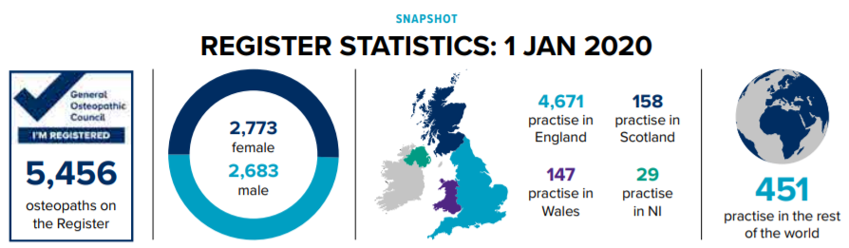
Osteopathy and the NHS workforce
Matthew Rogers
Head of Professional Development

Slide 43
“Osteopaths use a range of techniques which focus on releasing tension, improving mobility and optimising function in those we care for, together with exercise, education and self-management advice to help patients manage pain, keep active and so far as possible, maintain general health¹”
@NHS_HealthEdEng #insertcampaignhashtag

Slide 44
NHS workforce supply
25% of osteopaths volunteered to support NHS during COVID
iO survey suggests over 70% of osteopaths would like to work for the NHS
@NHS_HealthEdEng #insertcampaignhashtag

Slide 45
NHS workforce demand
NHS Long Term Plan identifies significant workforce capacity issues in NHS
Primary care is under strain
25 – 30% of GP case load relates to MSK
Increasing AHP support (inc. osteopaths) in primary care may be a solution
First Contact Practitioner osteopath pilot demonstrates that osteopaths can provide safe and effective FCP services in primary care²
@NHS_HealthEdEng #insertcampaignhashtag

Slide 46

Barriers and challenges¹
Awareness of osteopathy amongst NHS employers is low
Administrative barriers
NHS student placements
@NHS_HealthEdEng #insertcampaignhashtag

Slide 47
References
The role of osteopaths as AHPs within the NHS report: https://www.iosteopathy.org/wp-content/uploads/2020/07/Role-of-Osteopaths-as-AHPs-in-the-NHS.pdf
Quality in Osteopathic Practice report: https://www.iosteopathy.org/osteopathy/research-and-reports/
FCP osteopath report: https://www.iosteopathy.org/wp-content/uploads/2020/09/Evaluation-of-MSK-FCPO-osteopath-service-interim.pdf
Osteopathic Impact Reports on the iO website: https://www.iosteopathy.org/osteopathy/research-and-reports/
@NHS_HealthEdEng #insertcampaignhashtag

Slide 48

Discussion
Time for you all now to ask any further questions to any members of the team.
Please put your hand up or type your question in the comments box

Slide 49

Your Feedback Please
Q. What else do you want to know about the AHP workforce?
Please enter your comments in the chat box

