Slide 1



Accelerated Preceptorship:
My Effective Practice
For Newly Qualified Practitioners and Healthcare Professionals on Temporary Register

Slide 2

Session Objectives
By the end of this session you will:
Understand what resilience is and how it helps you to practice effectively
Understand your stressors and protective factors
Develop strategies for building your resilience and effectiveness
Determine your resilience goals
Know how to look after yourself and others as you transition into your new role on the temporary register

Slide 3

Helping you across the flaky bridge
What is the flaky bridge?
The National RePAIR programme refers to the flaky bridge as being the period of transition from being a final year student to taking up employment as a newly qualified practitioner
It may also apply to the transition period for those who are returning to practice too
You will need to build your resilience to cross the flaky bridge and be effective in your practice

Slide 4
Definition
Resilience is the process of adapting well in the face of adversity (e.g. trauma, tragedy, threats or significant sources of stress) = “stressors”
It means "bouncing back" from difficult experiences and developing ourselves
Resilience is also connected to performance and contributes to being able to complete tasks to a high standard = effectiveness
Physical
Mental
Emotional
Your state

Slide 5
The Research
Significant research in mid-1970’s regarding children who grew up in adverse circumstances
  While many children found to exhibit destructive behaviours, lowered achievement and emotional / behavioural problems, large majority did not:
  30% didn’t exhibit destructive behaviours = resilient
Recent research has also shown similar results in adults that have experienced traumatic events
Resilience factors:
  Personal factors – innate resilience
  Social factors – resilience skills can be learned and developed
Resilience can grow or decline over time depending on the interactions taking place between a person and their environment, and between risk (stressors) and protective factors in that person’s life

Slide 6
Stressors
Some stressors are immediate due to their ‘shock effect’
Others are more chronic in nature – these long-term stressors reduce resilience by causing fatigue, loss of confidence and loss of self efficacy
Resilient people bounce back quicker from acute stress and learn to change their equilibrium so they suffer less from long term stress
Interpersonal discord (immediate) | Overload (long term)
Adverse events (immediate) | Uncertainty (medium term)

Slide 7
Stressors
Exercise 1:
Think about the four main categories of stress:
How would you rank them in terms of importance for your own stress levels?
For the most important category for you, complete the sentence “X stresses me because…..”
On a scale of 1 -10, how stressed do you feel by this factor:
  At the moment
  As an average over the last month
Question: What stressors have or may occur as you cross the flaky bridge and transition into your new role?

Slide 8
Stressors
It is helpful to understand why you have been ‘triggered’ by an event (stressor) – one way to do this is to understand how the event ‘stopped you’
Most ‘triggers’ are caused by a ‘stopped process’ e.g. they:
  stopped you doing something that was important to you
  stopped you from saying something that you needed to express
  stopped you from getting your needs met
        May affect how effective you can be
      It is important to find out what was ‘stopped’ so that you can find an alternative means of doing, saying or getting your needs met

Slide 9
Stressors
Exercise 2 :
Think about a recent time when you felt relatively upset. Do you know what triggered it? How long did you stay upset? What brought you out of it? Do you even know?
Consider the cause (event / stressor) that caused you to be upset. Did the event leave you with a ‘can’t do’, a ‘can’t say’ or a ‘can’t get my needs met’? Try and focus on how it affected you.
Depending on your ‘stopped process’, consider the following questions:
  How might you do the thing you want to do anyway?
  How could you find a way to say what you want to anyway?
  How might you find a different way to get your needs met?

Slide 10
Protective Factors
Protective factors are your support mechanisms.
We can build protective factors that enable us to reduce the negative impact of stressors and support positive change
Exercise 3 :
Think about a time when you have overcome a stressor, what helped you overcome this? Was it talking to others, going for a run, was it reflecting on the situation etc.?
What protective factors do you think will help you cross the flaky bridge and transition into your new role?

Slide 11
Factors in Resilience
The primary factor in resilience is having caring and supportive relationships, e.g. family members, friends, work colleagues, peers, supervisors etc.
Relationships that create trust provide role models and offer encouragement and reassurance to help bolster your resilience
Several additional factors are associated with resilience, including:
  The capacity to make realistic plans and take steps to carry them out
  A positive view of yourself and confidence in your strengths and abilities
  Skills in communication and problem solving
  The capacity to manage strong feelings and impulses
All of these are factors that you can develop.

Slide 12
The Locus Control
Locus of control refers to a person’s belief system regarding the causes of his or her experiences and the factors to which that person attributes success or failure
  Those with an internal locus of control believe that the things that happen to them are greatly influenced by their own abilities, actions, or mistakes.
  Those with external locus of control feel that other forces—such as random chance, environmental factors, or the actions of others—are more responsible for the events that occur in their life.
Genetic factors may influence your locus of control, as well your childhood experiences
Researchers have identified several areas in which one’s locus of control appears to affect outcomes (educational, social, health etc.)
Research suggests that those with a more internal locus of control are more successful, healthier, and happier

Slide 13
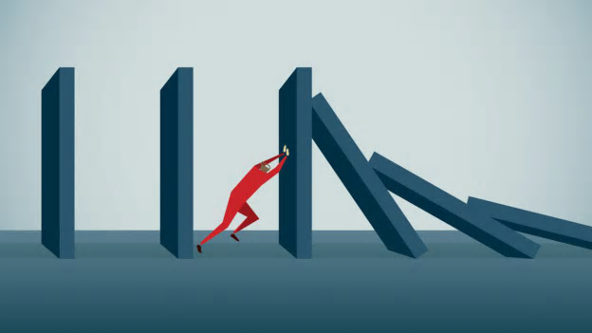
Building Resilience
Developing resilience is personal
Building resilience for one person may not work for another person
You may use different strategies depending on your background, culture, experiences etc.

Slide 14
Strategies for Building
Resilience
Make connections – good relationships are important. Accepting help and support from others will strengthen your resilience
Avoid seeing issues as insurmountable – stressful events will occur, but you can change how you interpret and respond to them. Take each step at a time.
Accept that change is inevitable – especially in the current COVID-19 climate. You may not be able to control the change, but you can control how you respond to it
Move toward your goals – develop realistic goals (it is best to keep these goals small and easy to achieve) – ask yourself “what’s one thing I can achieve today that helps me move in the direction I want to go?”
Take decisive actions – act on adverse situations as much as you can, rather than detaching from situations

Slide 15
Strategies for Building
Resilience
Look for opportunities of self-reflection – you will learn from your challenges and experiences and this will help you to develop and grow in your role
Nurture a positive view of yourself – develop confidence in your skills and abilities. Find things that you did well or are improving on
Keep things in perspective – try to keep issues / experiences in broader context – try not to blow out of proportion
Maintain a hopeful outlook – an optimistic outlook will enable you to be open to new learning experiences. Don’t be too hard on yourself.
Take care of yourself – pay attention to your needs and feelings. Speak to others, do things you enjoy and find relaxing, exercise and eat well, take regular breaks at work, use the well being spaces and resources in your organisation. Support your own well being. Learn to recognise how you respond to stress so that you pause before feeling overwhelmed.

Slide 16


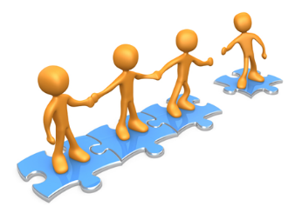
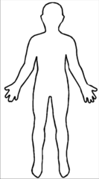
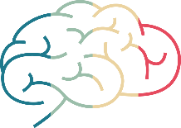
The 5 domains of resilience
Purpose
Create a sense of purpose for your role and areas you are passionate about
Self
Appreciate your strengths and build positive self-esteem
Connections
Create good working relationships and make connections with colleagues
Body
Prioritise your physical well-being when transitioning into your new role and build a healthy lifestyle
Mind
Cultivate a positive mind to learn

Slide 17
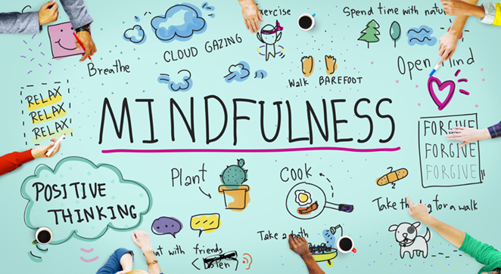
Mindfulness
Resilience goes hand in hand with mindfulness
Mindfulness is simply paying attention to what you are doing as you are doing it and how you are feeling = effectiveness
Research has shown mindfulness meditation can:
  Rewire your brain
  Increase mental flexibility
  Help you adapt to stressful situations

Slide 18
Mindfulness
Poor Mindfulness Skills
Strong Mindfulness Skills
Mindful mode, responding with awareness
Thoughts concern the present
Strong attentional control
We enjoy life’s pleasures
Perceiving without judgement – being aware of things without labelling them, ‘non-conceptual knowing’
Able to step back and observe emotions
We realise our potential
An attitude of openness, curiosity and acceptance
Autopilot mode, reacting with habit
Thoughts concern re-living the past and projecting into the future
Poor attentional control
Taking life’s pressures for granted
Placing judgement on perceptions – labelling things as good/bad, right/wrong
Driven by emotions
We neglect our potential
A limiting attitude

Slide 19
How to practice
Mindfulness
Breathing techniques – Follow The Breath Guy on Instagram, Flourish App
Guided Meditation – Calm App, Insight Timer,
Podcasts – The Mindful Kind
Unmind App (free) - mental health platform for NHS staff to proactively improve their mental wellbeing. Helps you to manage your personal mental health needs, including stress, sleep, coping, connection, fulfilment and nutrition: nhs.unmind.com/signup
Sleepio App (free)- clinically-evidenced sleep improvement programme that is fully automated and highly personalised, using cognitive behavioural techniques to help improve poor sleep: sleepio.com/access
Daylight App (free): provides help to people experiencing symptoms of worry and anxiety: trydaylight.com/access
Headspace App (free): mindfulness and meditation resources to help reduce stress, build resilience and aid better sleep:
www.headspace.com/nhs

Slide 20
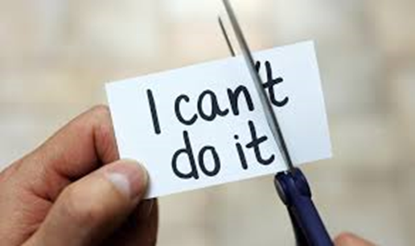
Goal setting
Resilient people are pro-active
Having clear goals on what to learn, do or achieve will enable effective action
Setting goals can make you feel more in control of your life by helping you to:
  Track your progress
  Direct your focus
  Increase self confidence
  Rethink set-backs
  Improve time management
  = effectiveness

Slide 21
Goal setting
Question: What are your goals? What do you want to achieve in the next six weeks? How will you get there?
These could include setting goals on what competencies / skills to achieve
These may be goals around confidence and crossing the flaky bridge
These goals could also be within your personal life to help your mental health
Please use the AP learning objective template if useful

Slide 22
Supporting your resilience at work
Take regular breaks and recharge
Pay attention to your signs of physiological hyperarousal “stress” and use your protector factors to manage stress
Be compassionate and kind to those around you that may be less resilient
It is important to seek out clinical supervision when you need it
  Establish peer support mechanisms
  Ask for help when you need it
Organisations should have in-house provisions, such as OH, well-being advisors and psychological support

Slide 23
Final thought:
Remember – this situation is unprecedented; it is okay to not be okay

Slide 24
References
The Road to Resilience – American Psychological Association
The RePAIR Toolkit: https://www.hee.nhs.uk/our-work/reducing-pre-registration-attrition-improving-retention
Self-care during the covid-19 pandemic - British Medical Journal, March 2020
https://www.supporttheworkers.org/briefing-notes/resilience
British Psychological Society Covid 19 Staff Wellbeing Group

Slide 25
Acknowledgments
Jules Marchant, Therapy Practice Development Lead, Guy’s and St Thomas’ NHS Trust, and Health Education England RePAIR Fellow
Catherine DesForges, Head of Education and Development for AHPs, Royal Free London NHS Trust
Desiree Cox, Preceptorship Project Manager, CapitalNurse
Pan-London Mental Health Allied Health Professionals Preceptorship Programme by Oxleas NHS Foundation Trust

