Slide 1
Accelerated Preceptorship: My Clinical Practice
For Newly Qualified Practitioners and Healthcare Professionals on Temporary Register

Slide 2
Session Objectives
By the end of this session you will:
Know how to work safely
Understand the principles of risk management
Understand how to raise concerns

Slide 3
Working safely
As with clinical practice, there are core principles that underpin safe practice
Maintain health, safety and security practices within your setting
Maintain a safe and clean environment
Dispose of clinical and non clinical waste appropriately
Minimise the risk of spreading infection by cleaning, disinfecting and maintaining environments
Perform hand hygiene to prevent the spread of infection
Clean, disinfect and remove spillages of blood and other body fluids to minimise the risk of infection
Minimise the risk of spreading infection by cleaning, disinfecting and storing care equipment appropriately
Use personal protective equipment (PPE) to prevent the spread of infection
Safely dispose of healthcare waste, including sharps, to prevent the spread of infection

Slide 4
Working safely
Recognise and work within the limits of your competence
accurately identify, observe and assess signs of normal or worsening physical and mental health in the person receiving care
make a timely referral to another practitioner when any action, care or treatment is required
ask for help from a suitably qualified and experienced professional to carry out any action or procedure that is beyond the limits of your competence
take account of your own personal safety as well as the safety of people in your care
complete the necessary training before carrying out a new role.

Slide 5
Working safely
Be open and candid with all service users about all aspects of care and treatment, including when any mistakes or harm have taken place
act immediately to put right the situation if someone has suffered actual harm for any reason or an incident has happened which had the potential for harm
explain fully and promptly what has happened, including the likely effects, and apologise to the person affected and, where appropriate, their advocate, family or carers
document all these events formally and take further action (escalate) if appropriate so they can be dealt with quickly.

Slide 6
Working safely
Always offer help if an emergency arises in your practice setting or anywhere else
only act in an emergency within the limits of your knowledge and competence
arrange, wherever possible, for emergency care to be accessed and provided promptly
take account of your own safety, the safety of others and the availability of other options for providing care

Slide 7
Working safely
Raise concerns immediately if you believe a person is vulnerable or at risk and needs extra support and protection
take all reasonable steps to protect people who are vulnerable or at risk from harm, neglect or abuse
share information if you believe someone may be at risk of harm, in line with the laws relating to the disclosure of information
have knowledge of and keep to the relevant laws and policies about protecting and caring for vulnerable people

Slide 8
Working safely
Advise on, prescribe, supply, dispense or administer medicines within the limits of your training and competence, the law, our guidance and other relevant policies, guidance and regulations
prescribe, advise on, or provide medicines or treatment, including repeat prescriptions (only if you are suitably qualified) if you have enough knowledge of that person’s health and are satisfied that the medicines or treatment serve that person’s health needs
keep to appropriate guidelines when giving advice on using controlled drugs and recording the prescribing, supply, dispensing or administration of controlled drugs
make sure that the care or treatment you advise on, prescribe, supply, dispense or administer for each person is compatible with any other care or treatment they are receiving, including (where possible) over-the-counter medicines
take all steps to keep medicines stored securely
wherever possible, avoid prescribing for yourself or for
anyone with whom you have a close personal relationship.

Slide 9
Working safely
Be aware of, and reduce as far as possible, any potential for harm associated with your practice
take measures to reduce as far as possible, the likelihood of mistakes, near misses, harm and the effect of harm if it takes place
take account of current evidence, knowledge and developments in reducing mistakes and the effect of them and the impact of human factors and system failures (see the note below)
keep to and promote recommended practice in relation to controlling and preventing infection
take all reasonable personal precautions necessary to avoid any potential health risks to colleagues, people receiving care and the public

Slide 10
Working safely
Exercise 1:
Think about your role and describe how you maintain health, safety and security practices within your setting
List any potential harm associated with your practice or setting
What measures can you take to reduce harm

Slide 11
Risk Management
Risk management is the process of identifying risks, undertaking risk assessments, and implementing preventive, mitigation and control policies to reduce the level of risk, thereby minimising the incidence of harm.
Identify the risk
What could go wrong?
How could it happen?
What would be the effect?
Analyse the risk
How often is the risk likely to occur?
How severe would the effect be?
What would the cost be?
Control the risk
How do you eliminate the risk?
How do you avoid the risk?
How do you make the risk less likely?

Slide 12
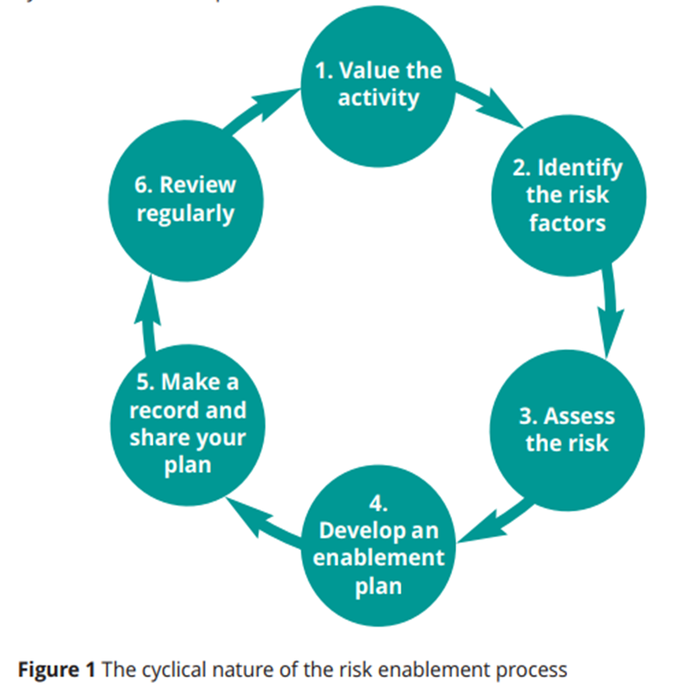
Positive Risks
A Positive risk is when taking a risk achieves positive outcomes; taking a risk in
order to benefit.
The term ‘positive’ is not about the risk, but about the outcome of taking a risk (RCOT, 2018).

Slide 13
Risk Management
1. Value the activity
Look at the value and benefit of carrying out the activity or task, especially from the viewpoint of your patient.
What will be gained occupationally, physically, psychologically and socially?
2. Identify the risk factors
Look at every aspect of the activity or task
Are there any factors which could possibly create risk?
3. Assess the risk
What is the likelihood of the risk occurring?
Who is at risk and how?
What would the possible harm be if an incident occurred?
Look to see if there are any controls already in place. Is any data available from relevant past incidents?

Slide 14
Risk Management
4. Develop an enablement plan
Develop a plan for the activity or task which manages the risk to an acceptable level.
Look at the risk factors and how these might be managed to reduce, avoid or eliminate the risk altogether so that the desired positive outcome is achieved without harm.
Look at the strengths and skills of the patient and others involved.
How might these counter-balance the risk?
If others are involved in the activity, define who is responsible for what actions.
Be person-centred – enable the person to take responsibility for managing risk when appropriate and possible.
You also need to consider and plan for what should happen if the risk becomes a reality and an incident occurs.

Slide 15
Risk Management
5. Make a record and share your plan
It is essential to fully record your risk assessment and your enablement plan, including:
the professional rationale for your decisions
your actions
This supports your care of the service user and informs all those involved of any proposed action to take. It also demonstrates that you have fulfilled your duty of care. Share your enablement plan with all those involved
6. Review regularly
Review the assessment and plan regularly.
Is it still adequate?
Have there been any
changes?
A plan related to a service user is likely to need amendments as their status changes.

Slide 16
Positive Risks
Sometimes we need to think about risk differently:
Consider:
The grandmother who wanted to go home, but was kept in hospital because her cluttered home was perceived as a risk
The young man with learning disabilities who wanted to walk in the park, but was prevented from going out alone as there was a possible risk that he may get lost
The gentleman in the care home who had been a keen gardener, but was kept inside because the uneven garden path was considered a falls risk for him.
All of these decisions may seem to have been taken in the best interests of the
Individual…. but are the result of falling into the trap of not fully taking all the factors into account.
(RCOT, 2018).

Slide 17
Risk Management
…. but may not actually take all factors into account.
Now consider these outcomes:
The grandmother entered a cycle of hospital-acquired infections and never went home, although her cluttered home was not the cause of her original admission to hospital
The young man began to demonstrate his frustration in episodes of anger
The gentleman in the care home became depressed and introverted, refusing to join in with social activities in the home.
These are not the outcomes we would want.
Decisions did not prioritise the person’s choice. People should be enabled to achieve their full potential, to reach their chosen goals and to participate fully = to achieve this we need to embrace risk.

Slide 18
Capacity - Unwise Decisions
There may be times when a person wants to pursue an activity that may have the potential risk of harm
Be sure that they are aware of the potential risks
Are they able to make an informed decision about their care?
You may need to carry out a mental capacity assessment
Inform them that it is against your professional recommendation
You still need to do all you can to control the risk as far as reasonably possible.

Slide 19
Whistleblowing
Highlighted in the Francis report https://webarchive.nationalarchives.gov.uk/20150407084231/http://www.midstaffspublicinquiry.com/report
Patients, staff and safety first
Professional codes of conduct
Every healthcare worker has a duty of care
Concerns in workplace including unsafe working practice, medicines maladministration, staff working beyond scope of practice, bullying and harassment.

Slide 20
Why do you need to raise concerns?
Unsafe practice impacts on patient care which is the primary concern for all healthcare organisations and frontline staff
Protecting patients and service users
It is not disloyalty and should be seen as an opportunity to improve practice
Staff need to feel safe and protected
Professional code of conduct

Slide 21
What constitutes a cause for concern?
Concerns may include:
Malpractice
Unsafe patient care
Safeguarding failure
Poor clinical practice
Insufficiently trained staff
Staff working outside their scope of practice
Unsafe working conditions
Poor medicines management
Staff who are stressed or unwell
Bullying and harassment

Slide 22
Raising a concern
Act without delay if you believe that there is a risk to patient safety or public protection
Raise and, if necessary, escalate any concerns you may have about patient or public safety, or the level of care people are receiving in your workplace or any other health and care setting and use the channels available to you in line with our guidance and your local working practices
Raise your concerns immediately if you are being asked to practise beyond your role, experience and training
Tell someone in authority at the first reasonable opportunity if you experience problems that may prevent you working within the Code or other national standards, taking prompt action to tackle the causes of concern if you can

Slide 23
Raising a concern
Acknowledge and act on all concerns raised to you, investigating, escalating or dealing with those concerns where it is appropriate for you to do so
Not obstruct, intimidate, victimise or in any way hinder a colleague, member of staff, person you care for or member of the public who wants to raise a concern
Protect anyone you have management responsibility for from any harm, detriment, victimisation or unwarranted treatment after a concern is raised.

Slide 24
What constitutes a cause for concern?
The Nursing Times Speak out Safely (SOS) campaign aims to encourage all healthcare organisations to develop honest, transparent cultures and to encourage staff to raise the alarm when they see poor practice and to protect them when they do so
The Nursing Times Speak Out Safely (SOS) campaign aims to encourage NHS organisations and independent healthcare providers to develop cultures that are honest and transparent, to actively encourage staff to raise the alarm when they see poor practice, and to protect them when they do so.
Most healthcare organisations will have their own policies which may include Speak Up guardians or Speak Out guardians

Slide 25
Raising a concern
Exercise 2:
Think about your role and describe how you can raise concerns in your organisation:
Do you have a speaking up guardian or advocates?
What is your organisation’s speaking up policy?
How will you raise a concern, should one occur?

Slide 26
References
Nursing Midwifery Council. The Code: Professional standards of Practice and behaviour for nurses, midwives and nursing associates. Accessed on 05.05.2020 https://www.nmc.org.uk/globalassets/sitedocuments/nmc-publications/nmc-code.pdf
NHS England. Raising a concern with NHS England. Accessed on 05.05.2020 < https://www.england.nhs.uk/ourwork/whistleblowing/raising-a-concern/>
Royal College of Occupational Therapists. (2018). Embracing risk: enabling choice Guidance for occupational therapists.

Slide 27
Acknowledgments
Jules Marchant, Therapy Practice Development Lead, Guy’s and St Thomas’ NHS Trust, and Health Education England RePAIR Fellow
Catherine DesForges, Head of Education and Development for AHPs, Royal Free London NHS Trust
Desiree Cox, Preceptorship Project Manager, CapitalNurse

