Slide 1



Accelerated Preceptorship: Induction and COVID Session
For Newly Qualified Practitioners and Healthcare Professionals on Temporary Register

Slide 2

Introducing the accelerated preceptorship program
Six week program
Completion of mandatory and statutory training
Aligned with principles of regulatory bodies
Immersion in clinical setting and workplace culture
Full support from preceptor and other staff
Action learning and forums where possible
Weekly online development sessions:
  Induction and COVID
  My Professional Practice
  My Effective Practice
  My Safe Practice
  My Clinical Practice
  Reflection session and next steps

Slide 3
Objectives
Training objectives
What is COVID-19?
Prevention
Infection control
Management of COVID-19
Role as a NQ AHP / Nurse during COVID-19
Mental Health & Wellbeing

Slide 4

COVID-19
Coronavirus disease 2019 (COVID-19) is a potentially severe acute respiratory infection caused by severe acute respiratory syndrome coronavirus 2 (SARS-CoV-2)
The World Health Organization (WHO) was informed of 44 cases of pneumonia of unknown microbial aetiology associated with Wuhan City, Hubei Province, China on 31 December 2019
World Health Organization declared the COVID-19 outbreak a pandemic on 11 March 2020
COVID-19 is a virus which effects the respiratory system
The clinical presentation symptoms range from a mild common cold-like illness, to a severe viral pneumonia leading to acute respiratory distress syndrome that is potentially fatal
Incubation period for COVID-19 range from 1-14 days, most commonly around five days.
  Reference: https://www.e-lfh.org.uk/programmes/coronavirus/

Slide 5
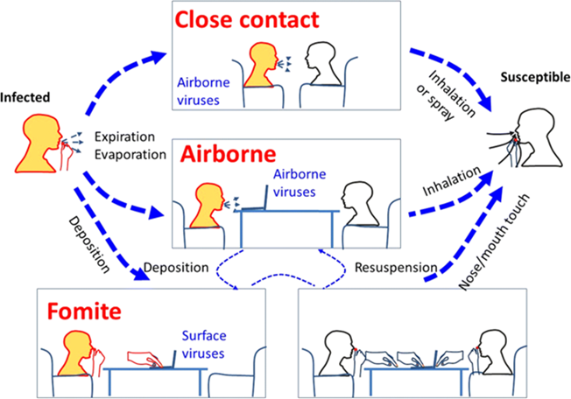
Prevention
Contact precautions; direct or indirectly. Most common
Droplet precautions; from one individual to another via short distances
Airborne precautions; without having direct contact with an infected persons
Interrupting transmission of COVID-19 requires both droplet and contact precautions
  Reference: https://www.e-lfh.org.uk/programmes/coronavirus/

Slide 6
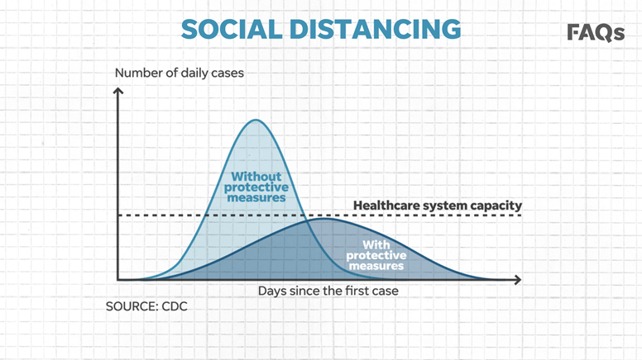
Prevention
Government advice to the public is:
Social distancing/ avoid close contact
Self-isolating if symptomatic for 7 days. 14 days for everyone in your household
Early recognition
Shielding; minimising interactions from the extremely vulnerable
Lockdown
Please follow your organisation’s policies

Slide 7

Prevention
Hand washing, hand washing hand washing
  https://twitter.com/ava/status/1241006006496145408
PPE
Uniform
Decontamination of reusable equipment
Decontamination of ‘frequently used surfaces’
Follow local guidance and policies available through your own organisation

Slide 8
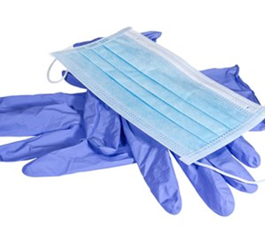

PPE
Personal Protective Equipment:
Gloves
Apron
Face masks
Eye masks
Please think about your patient / client and consider when you would use these?
Please follow your own organisation’s policies

Slide 9
Guidance from NHS England and Public Health England
Guidance is changing constantly. To ensure you keep up to date with guidance please check regularly:
https://www.hee.nhs.uk/coronavirus-covid-19
https://coronavirusresources.phe.gov.uk/

Slide 10

Management of patients with COVID-19
Managing patients with COVID-19
Follow local policies
Liaise with line manager & infection control
Can the appointment be virtual/telephone contact?
Community: If essential to attend as a home visit with correct PPE or reschedule.
Inpatient: Isolate patient with ensuite room if not possible – transfer patient to where this is possible
Prevention is key
Isolating and monitoring your symptoms
NHS 111 Service
Hospitalisation for worst cases
Require intubation and mechanical ventilation in ICU
No vaccine or specific treatment known to treat COVID-19.
Manage complications e.g. secondary infections.

Slide 11

Further Learning
This programme has been created by Health Education England e-Learning for Healthcare (HEE e-LfH) in response to the Coronavirus (COVID-19) global pandemic.
The programme includes key materials to help the health and care workforce respond to Coronavirus.
  https://www.e-lfh.org.uk/programmes/coronavirus/
Content now available in the COVID-19 programme includes:
  Essential Guidance from the NHS, UK Government, WHO and BMJ
  Public Health England – Personal Protective Equipment (PPE)
  Infection Prevention and Control
  Resources for Staﬀ Working in Critical Care Setting
  Resources for Staff Working in Community Setting
  End of Life Care COVID-19
  Wellbeing for Staff

Slide 12

Your role as NQP
Communication and staying connected is vital
Following local policies
Raising any concerns with line managers
Team work and collaboration has never been more important
Job specifications will alter & redeployment in some teams
Adaptive
Using technology
Finding your community of support

Slide 13
What changes might be on the way?

Slide 14


Stay up to date
AHPs: On behalf of the Chief Allied Health Professions Officer resources for AHPs that curate key published guidance and updates in relation to COVID-19:
https://www.ahpnw.nhs.uk/latest-news/422-covid-19-information-and-resources-for-ahps-latest-version-now-available
You can also keep up to date via the HEE webpages: https://www.hee.nhs.uk/coronavirus-covid-19

Slide 15
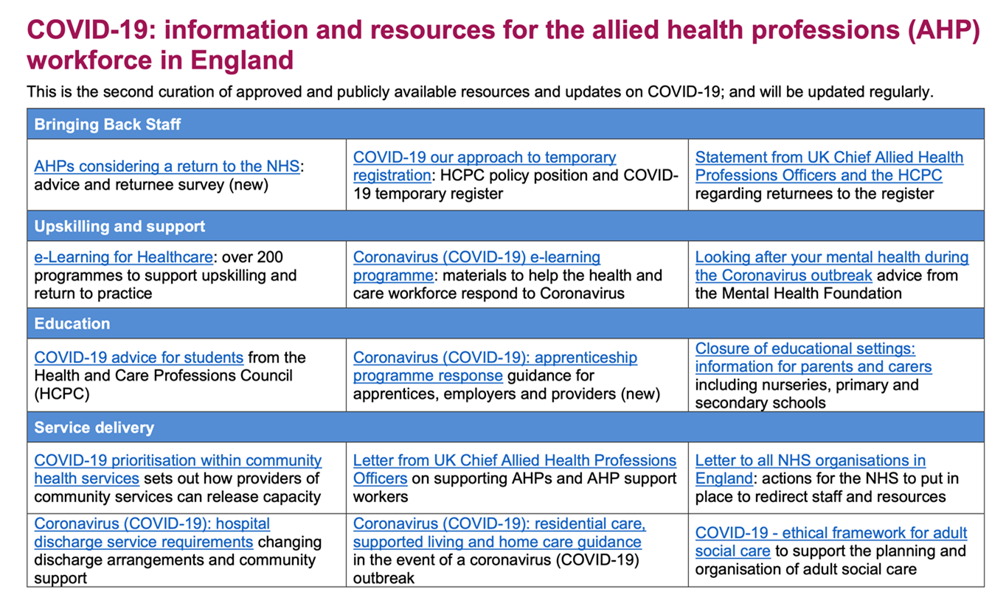
AHPs: Stay up to date

Slide 16
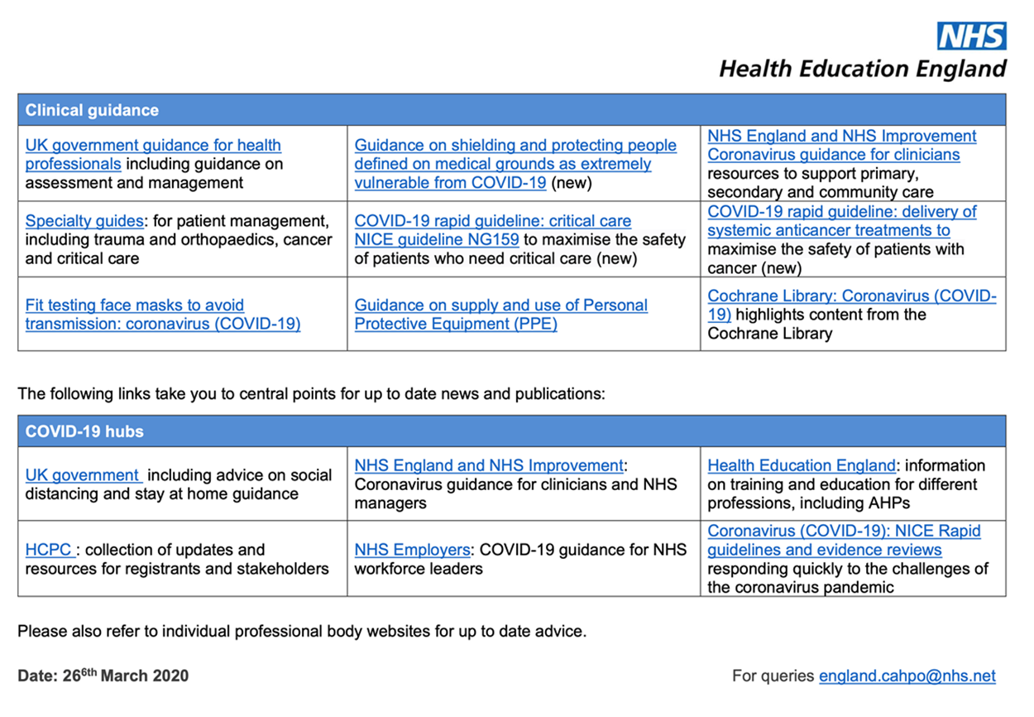
AHPs: Stay up to date

Slide 17


Nurses: Stay up to date
Nurses: All nurses should stay up-to-date with the latest guidance which is available from Health Education England (HEE), the Nursing & Midwifery Council (NMC) and the Royal College of Nursing (RCN).
https://www.nmc.org.uk/news/coronavirus/
https://www.rcn.org.uk/get-help/rcn-advice/covid-19

Slide 18
What does this mean for me?
You may be undertaking new and unfamiliar roles as part of the national effort
Each organisation will be coordinating this differently and communication will be provided
You will be supported.

Slide 19


Looking after your mental health
Access to good quality information e.g. WHO, NHS England, Government websites
Having a break from the media/news
Stay connected with friends/family via social media or certain apps e.g. Zoom
Muting or unfollowing any accounts that may make you feel anxious.
Trying to have a new routine
A form of exercise per day
It’s okay not to be okay – knowing who you can talk to for support
Eating good nutritious foods and keeping hydrated.

Slide 20
Free wellbeing apps
NHS staff have been given free access to a number of wellbeing apps from now until the end of December 2020 to support their mental health and wellbeing.
NHS England and NHS Improvement have worked with the following app providers to waive costs for the NHS workforce who are dealing with the unprecedented challenges of the COVID-19 pandemic.
Health Education England have provided resources to help support the wellbeing of all NHS staff available at: https://london.hee.nhs.uk/covid-19-wellbeing-hub
Unmind
Unmind is a mental health platform that empowers staff to proactively improve their mental wellbeing. Using scientifically-backed assessments, tools and training you can measure and manage your personal mental health needs, including digital programmes designed to help with stress, sleep, coping, connection, fulfilment and nutrition.
The team at Unmind are offering free access to NHS staff until the end of December 2020, which is active now.
How NHS staff can get access: Go to: nhs.unmind.com/signup

Slide 21
Free wellbeing apps
Sleepio clinically-evidenced sleep improvement programme that is fully automated and highly personalised, using cognitive behavioural techniques to help improve poor sleep.
Free access to Sleepio for all NHS staff is active now until 31 December.
Daylight is a smartphone-based app that provides help to people experiencing symptoms of worry and anxiety, using evidence-based cognitive behavioural techniques, voice and animation.
Free access to Daylight is active now until 31 December.
sleepio.com/access
trydaylight.com/access
Headspace
Headspace is a science-backed app in mindfulness and meditation, providing unique tools and resources to help reduce stress, build resilience, and aid better sleep.
Free access to all NHS staff with an NHS email address is available until 31 December 2020 and is active now.
How NHS staff can get access:
Go to: www.headspace.com/nhs

Slide 22

Free wellbeing apps
Find accurate sources of information
Ask questions if you’re unsure
Eating well and taking care of yourself
Avoid rumours and sources of negativity

Slide 23


Slide 24
Acknowledgments
Pan-London Mental Health Allied Health Professionals Preceptorship Programme by Oxleas NHS Foundation Trust
Jules Marchant, Therapy Practice Development Lead, Guy’s and St Thomas’ NHS Trust, and HEE RePAIR Fellow
Catherine DesForges, Head of Education and Development for AHPs, Royal Free London NHS Trust
Desiree Cox, Preceptorship Project Manager, CapitalNurse

Slide 25
THANK YOU

