Slide 1
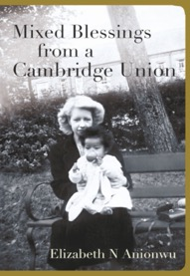
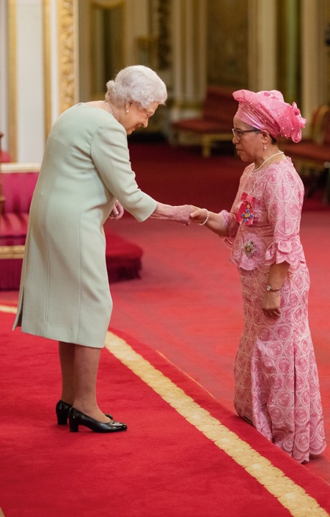
Born in shame but Became a Dame!
Professor Dame Elizabeth N Anionwu DBE CBE FRCN FQNI PhD
Emeritus Professor of Nursing: University of West London
Website: www.elizabethanionwu.co.uk Twitter: @EAnionwu
Facebook: https://www.facebook.com/SickleToSeacoleMemoirs

Slide 2
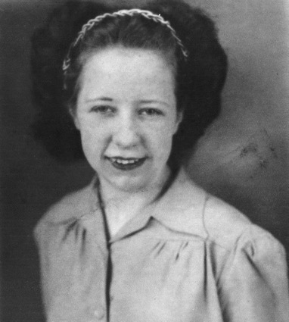
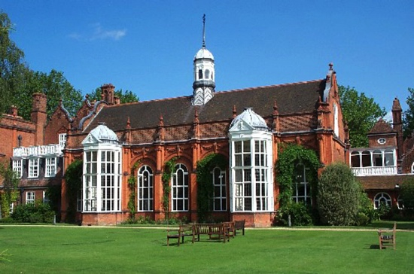
In 1947 my 20 year old mother (Mary/Maureen Furlong) was in her 2nd year at Cambridge University, having won a scholarship to study Classics at Newnham College
She won the Goodhart Memorial Prize for Classics in 1945, the Eleanor Purdie Prize for Greek in 1946 and gained a First in her Classics prelim exams
Newnham College later informed my grandfather that she had a very promising career ahead of her and was expected to obtain a First in Part 1 of her Tripos

Slide 3
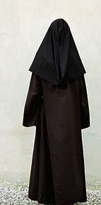
“To be sure, the baby looks a little dark.”
And then…..

Slide 4
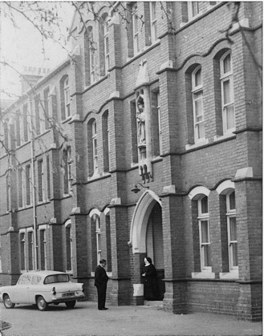
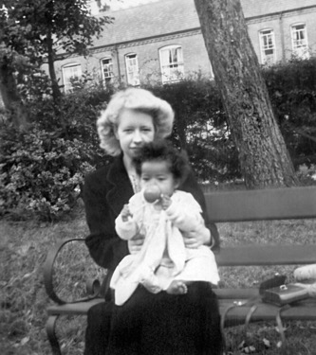
I was In the care of nuns in a convent in Birmingham until 9 years of age, but never ‘up for adoption’
St Teresa’s Nursery Coleshill until 3½ years
Nazareth House Rednal until
9 years
Aged ~ 9 months old and sitting on my mother’s knee
From 4 years old I wanted to be like the ‘white nun’ (who turned out to be a nurse!). This was due to how well she treated my severe & painful eczema. BUT nuns had a very cruel treatment for bedwetting.

Slide 5
Then at 9 years of age I left the convent in Birmingham to live with my mother and stepfather in their council house in Wolverhampton. It lasted for 20 months.
Rescued a few months before my 11th birthday by maternal grandparents following severe physical abuse from my stepfather. He had been teased by his mates in the pub about me being a ‘half-caste’.

Slide 6
1968: Qualifying as a Nurse,
Paddington General Hospital

Slide 7
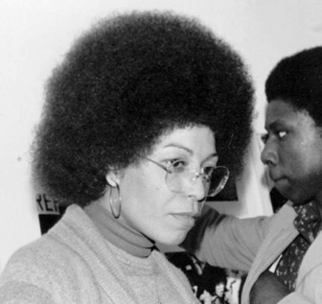
1969 -1970: worked in Paris for 9 months to improve French. Introduced to Frantz Fanon’s book ‘Black Skin, White Masks’
September 1970 in Brent, London. Studied and (after appeal) qualified as a health visitor. Became politically active. Volunteered at a Black Supplementary School in west London. 1st trip to USA in Sept 1971, met Bayard Rustin, Civil Rights activist
Met Angela Davis, 10th Dec 1974 at Keskidee Centre, London

Slide 8
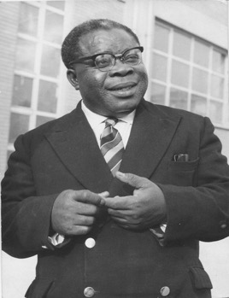
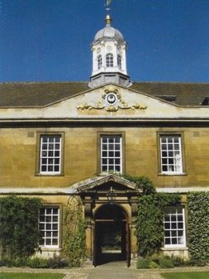
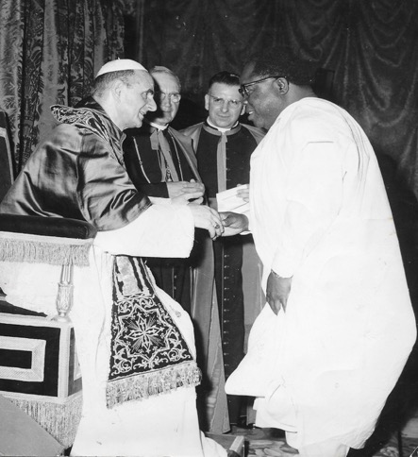
My father had studied law at Trinity Hall, Cambridge University.
He then went to Lincoln’s Inn, London where he was called to the Bar, returning to Nigeria in 1949.
Ran a legal office, became a civil servant, (Nigerianisation Officer/established Ministry of External Affairs). Then in 1963 he became Nigeria’s 1st Ambassador to Italy & the Vatican. Seen here greeting Pope Paul VI.

Slide 9
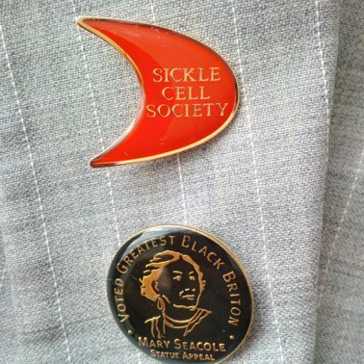
NURSING CAREER: From sickle to seacole
Using my deep-seated anger in a positive way
There are 19 chapters in the book
Chapter 16: Why sickle cell disease?
Chapter 18: Mary Seacole

Slide 10
Thames Valley University (TVU) now University of West London (UWL) 1997: Appointed as dean of the school of adult nursing 1998: awarded title of professor of nursing

Slide 11
Then Established & ran the Mary seacole centre for nursing practice: 1998 - 2007
I called the research centre (into multi-ethnic aspects of nursing) after Mary Seacole due to poor awareness of her amongst students and staff
Photo by Joanne O’Brien - 2000

Slide 12
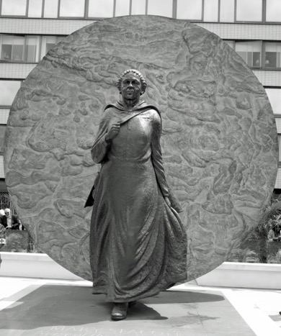
THE MARY SEACOLE MEMORIAL STATUE WAS UNVEILED AT
ST THOMAS’ HOSPITAL LONDON 0N 30TH JUNE 2016
BY
BARONESS FLOELLA BENJAMIN
Now ‘Mary Seacole Trust’: @seacolestatue
www.maryseacoletrust.org.uk
1st statue to a named
Black Woman in the UK

Slide 13
made a Dame!
Postscript
In 2017
New Year’s Honours
‘For services to nursing & the Mary Seacole Statue Appeal’

Slide 14
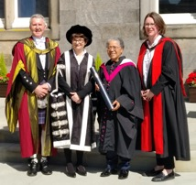
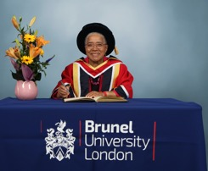
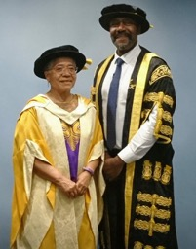
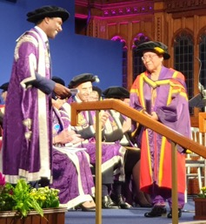
University of St Andrews 26/6/2019
Brunel University 9/7/2019
Birmingham City University 24/7/2019
University of Manchester 9/10/2019
Honorary Doctorate Degrees
28th October 2019: Pride of Britain ‘Lifetime Achievement’ Award presented by Janet Jackson

Slide 15
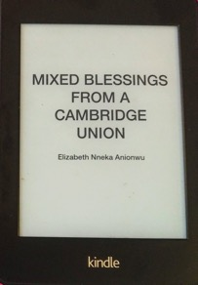
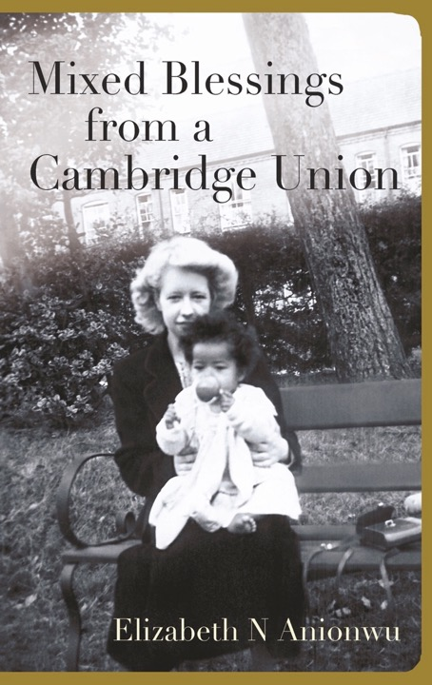
My memoirs are on Amazon as an
e-book (£6.99) & paperback (£14.99).
123/127 Amazon reviewers
have given it a 5-star rating!
MANY THANKS FOR LISTENING!
www.elizabethanionwu.co.uk
Twitter: @EAnionwu

