Slide 1
Welcome to the North West Streamlining webinar for Cumbria and Lancashire
31st July 2018
2.00 pm
Please Note
If you have not yet connected your audio as per the invite joining instructions, please dial in by using the “Quick Link” tab on the top left of your screen, select “dial in” & follow the instructions (including entering your Access code)
To limit visual distraction and background noise - Please turn off your video and mute yourself by clicking the camera and the mic icons respectively, which will appear next to your name/call in user
Participants can use the chat facility to type in questions, comments or feedback

Slide 2
AGENDA
Introduction
Sinead Fletcher, Streamlining Area Manager, C&L
Overview of Core Deliverables
Sinead Fletcher
Experience of Streamlining
Karen Mainwaring, East Lancashire Hospitals NHS Trust
Experience of Streamlining
Brenda Little, North Cumbria University Hospitals NHS Trust
Policy Workstream
Paula Roles, Healthier Lancashire & South Cumbria
Close
Sinead Fletcher

Slide 3
OVERVIEW: YEAR 2 CORE DELIVERABLES

Slide 4
OBJECTIVES
“Enabling Employee Mobility Across the North West”
Reduce time spent on statutory and mandatory training
Improve staff satisfaction with the recruitment and induction process
Release administration time & reduce costs
Reduce the time to hire

Slide 5
WORKSTREAMS
03
01
OCCUPATIONAL HEALTH
RECRUITMENT
04
POLICY
02
TRAINING

Slide 6
MILESTONES
Recruitment, Training & Occupational Health
Use of the NHS Employers factual reference, replacing subjective
Alignment to National CSTF refresher periods
Recording of CSTF competences within OLM (ESR)
Share training competences via the ESR automated IAT process
Cleanse data in current OH systems: Cohort/OPAS

Slide 7
ACHIEVEMENTS
Factual reference trial completed via the ESR IAT process
Factual References implemented in current systems in 3/7 (Trac/NHS Jobs)
Data cleanse complete
Recruitment
OH
Training
All organisations aligned to the national core skills (CSTF) refresher periods
6/7 sharing S&M training status
4/7 now using this information to reduce training on induction
- efficiency saving of £3,892 made in one trust within first 6 months

Slide 8
Karen Mainwaring
Education Development Manager,
East Lancashire Hospitals NHS Trust

Slide 9
Reducing Induction Time for New Starters

Slide 10
TRAINING WORKSTREAM
Key Information
We employ over 8000 staff
We have commissioned the use of a Moodle-based Learning Management System Learning Hub (totara)

Slide 11
TRAINING WORKSTREAM
Case for change
From Jan – Dec 14, East Lancashire Hospitals NHS Trust (ELHT) put 1297 new starters through a corporate induction of one to three days in duration, depending on whether or not they had clinical responsibilities. Despite attending this induction, staff still had to complete additional core mandatory training following attendance at induction.
The Trust decided to explore whether or not the corporate induction programme could be reduced, for the benefit of both new starters and the Trust

Slide 12
TRAINING WORKSTREAM
Step 1 – Revised Corporate Induction Programme (Apr-15)
Induction Policy revised - attendance required as first two working days of employment
Reduced Corporate Induction from three days to two days duration:
Day one – Values-based training
Day two - Core Mandatory & Essential Skills training

Slide 13
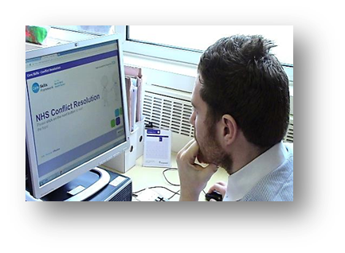
TRAINING WORKSTREAM
Step 2 – Launched Core Skills Training Framework (CSTF) aligned e-Learning packages (Apr-16)
Corporate Induction programme revised further:
Facilitated CSTF e-Learning sessions introduced to day two
Essential to role classroom sessions removed from day two (i.e. ANTT)

Slide 14
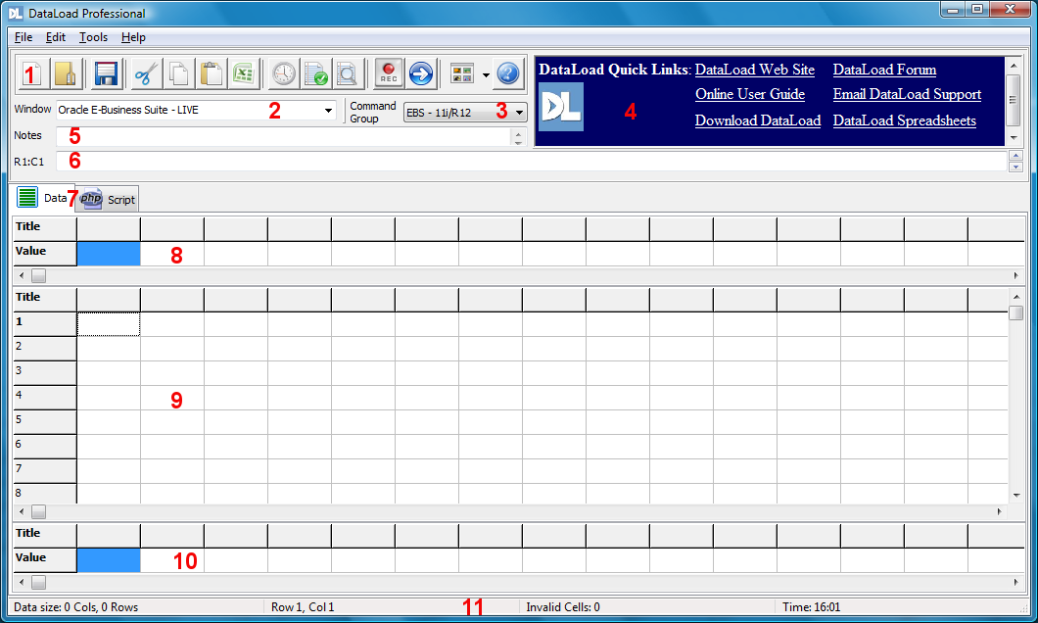
TRAINING WORKSTREAM
Step 3 – Purchased and installed DataLoad Professional Tool (Jul-Oct 17)

Slide 15
TRAINING WORKSTREAM
Step 4 – Learning Hub courses mapped to CSTF competencies on ESR (Jul-17)CSTF competencies on ESR

Slide 16
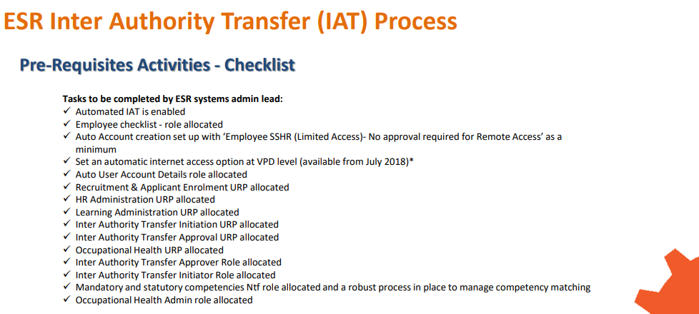
TRAINING WORKSTREAM
Step 5 – Set up of ESR Inter-Authority Transfer Process (Jul-17)
3 x Stat & Mand Role Holders set up in ELHT:
1 x Education Development Manager – Induction, Core and Essential Skills
2 x Induction, Core and Essential Skills Trainers
http://www.nhsemployers.org/-/media/Employers/Documents/Streamlining/ESR-IAT-process-map-FINAL.pdf?la=en&hash=FF5A6F29D9D8D8AACDF88A0FEA35982388951B27
Source:

Slide 17
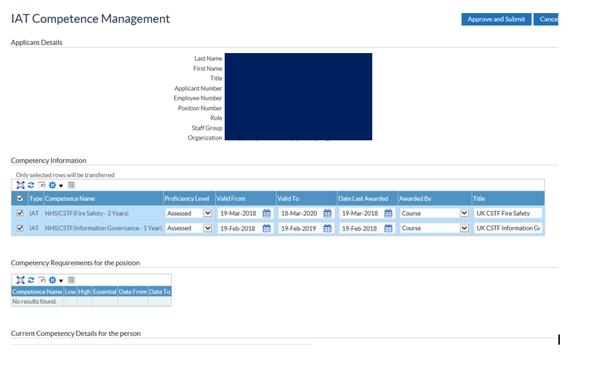
TRAINING WORKSTREAM
Step 6 – Stat and Mand IAT notifications received (Jul-17)

Slide 18
TRAINING WORKSTREAM
Step 6 – Stat and Mand IAT notifications received (Jul-17)
Role holder reviews competencies for applicant and approves, edits or rejects the competencies (we only accept CSTF competencies)
Record of accepted CSTF competencies retained until applicant attends corporate induction
Induction team receive notification of new starter attending induction
Induction team send IAT CSTF competencies to Learning Hub team for uploading into new starter’s Learning Hub account – the new starter’s ‘Required Learning’ profile reflects the competencies completed
New starter attends induction - personalised training matrix prepared for day two showing CSTF competencies already completed

Slide 19
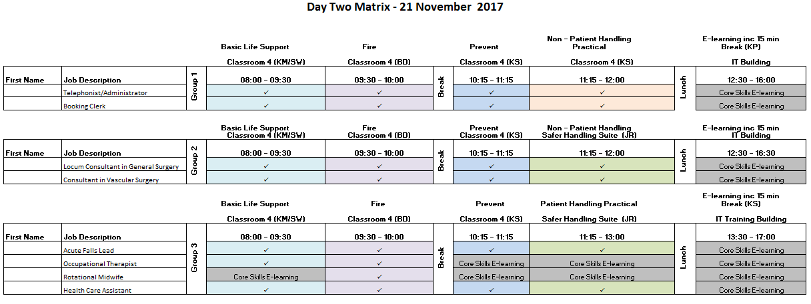
TRAINING WORKSTREAM
Step 6 – Stat and Mand IAT notifications received (Jul-17)

Slide 20
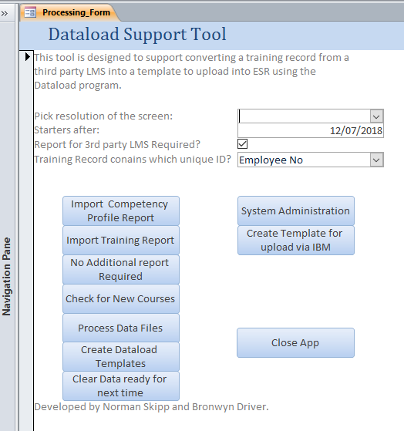
TRAINING WORKSTREAM
Step 7 – Weekly CSTF Data transfer from Learning Hub to ESR initiated (Jan-18)
NB: Historical CSTF data transferred from Learning Hub to ESR via ESR Central Team in Jan-18, prior to commencing weekly data transfer.

Slide 21
TRAINING WORKSTREAM
Key Outcomes
Increase in CSTF compliance - Trust compliance is now above the threshold in 10 out of the 11 subjects (as at the end of Jun 18)
CSTF competency data is received at pre-hire stage and enables better planning of Corporate Induction day two
Reduction in unnecessary repeat of training - better quality induction/welcome to the organisation for new starters
A significant reduction in the amount of time staff spend completing CSTF e-Learning/training during day two of induction – staff either complete essential skills e-Learning or report to their ward or department sooner!

Slide 22
TRAINING WORKSTREAM
Key Outcomes
Consistency of learning outcomes and refresher periods across the region enables prior learning to be accepted
Automatic sharing of ELHT CSTF competency data via ESR with other NHS organisations (weekly data transfer from LH to ESR)
To date, implementation of the Stat and Mand IAT process has released a saving of nearly 6k for the Trust

Slide 23
TRAINING WORKSTREAM
Advice for other Trusts
Consider carefully which PC DataLoad will be installed on – PC cannot be used for other activity during the DataLoad transfer
Ensure strong management buy-in
Engage with your employment services team or equivalent recruitment teams to ensure pre-hire IATs are run
Engage with your ESR lead to set up the Stat & Mand role holders to ensure notifications are received
Have more than one role holder to ensure cover

Slide 24
TRAINING WORKSTREAM
Thank you for listening!
Karen Mainwaring
Education Development Manager
Workforce Education & Development
Training & Development Centre
Burnley General Hospital
Casterton Avenue
Burnley
BB10 2PQ
01282 803310
www.elht.nhs.uk search ‘Education’

Slide 25
Brenda Little
Learning Systems Coordinator,
North Cumbria University Hospitals NHS Trust

Slide 26
Managing Competencies with DataLoad
North Cumbria University Hospitals Trust

Slide 27
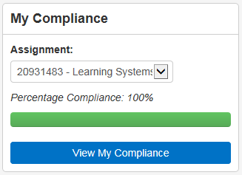
TRAINING WORKSTREAM
Recognised need to implement competencies within OLM:
Mandatory requirements visible
View compliance at a glance
Easy to find end enrol on required training
Managers can track individual and team compliance

Slide 28
TRAINING WORKSTREAM
Core Skills Framework
IATs
Biting the Bullet!

Slide 29
TRAINING WORKSTREAM
Requirements
Assign competencies based on position numbers
Backdate huge amount of training data
Find additional Admin resource

Slide 30
TRAINING WORKSTREAM
Implications
Time
Cost
Training

Slide 31
TRAINING WORKSTREAM

Slide 32
TRAINING WORKSTREAM
Phase 1: Spreadsheets populated and sent to Central Team:
Assign competencies to position numbers
Back date training
Phase 2: Use DataLoad to enable self population of records

Slide 33
TRAINING WORKSTREAM
Attach competencies to new position numbers
Remove competence requirements
Back dating training achievements
Roll out competencies for non Core Skills subjects
Populating the Educator Register

Slide 34
TRAINING WORKSTREAM
Management of Competencies:
Quicker
Easier
Cost effective
Reduce risk of manual input/manipulation

Slide 35
TRAINING WORKSTREAM

Slide 36
Paula Roles
Strategic Workforce/HR Lead
Healthier Lancashire & South Cumbria
Policy Workstream

Slide 37
POLICY MILESTONES
Improve policy format - generic statement & policy on a page
Develop and adopt a best practice approach to policy
Review and share best practice (in relation to the 'Big 5' policies)
Review notice periods with view to align where possible
Agree a standard time for policy review

Slide 38
ACHIEVEMENTS: POLICY
Disciplinary policy
Performance policy
Protection policy
Pay award change
Format for policy assessment
NCUH flowcharts shared
Notice periods reviewed
UHMB policy on a page- 3/7 using this format moving forward
Organisation change & TUPE

Slide 39
LESSONS
Opportunity to network, share & support one another proved hugely beneficial – barriers overcome by working collaboratively
Governance needs to be strengthened - to align with integration plans
Central priorities need to be aligned to local
Local ownership required
Agreement in trusts required at all levels- before sharing resources with other areas
Recognition of urban v rural pull factors
Strong HRD lead – noticeable impact on the enablement of change

Slide 40
MORE GOOD NEWS FROM OUR STAKEHOLDERS
“Networking opportunity is fantastic!”
“I value the support of the PMO so much I don’t want them to leave!”
“We’ve used the project plans to drive progress”
“Teleconferences are really useful for sharing information and progress”
“Opportunities to collaborate have helped us align our refresher periods”

Slide 41
T H A N K S F O R J O I N I N G U S
If you would like to know more about Streamlining in the North West please contact us at:
streamlining.nw@nhs.net
@StreamliningNW
Or visit our website:
http://www.workforcestreamliningnw.co.uk/

