Slide 1
Preceptorship for Students
Notes:
CD & JM

Slide 2
What is AHP Preceptorship?
We know that following registration the period of transition from student to band 5 clinician can be a challenging time for you.
Preceptorship is a period of structured transition, supported by a preceptor, to help you to:
Apply the knowledge and skills learned at University / Apprenticeship
Develop and enhance your competence and confidence as an autonomous professional in the workplace
Create a foundation of lifelong learning throughout your career.
Notes:
JM

Slide 3
What is CapitalAHP?
CapitalAHP is led by NHS England – Workforce, Training and Development Directorate. It reflects a programme of work being undertaken across the Capital.
Launched in 2019 – it is being delivered through action across London.
It belongs to all AHPs in the Capital.
On the next page, you will see all the ways we are growing and supporting the AHP workforce across London.
Notes:
JM

Slide 4
Why CapitalAHP? - supply
Collectively, allied health professionals (AHPs) are the third largest clinical workforce in the NHS:
There are 185,000 AHPs in 14 professions working across the spectrum of health and care, education (including early years), academia, research, criminal justice system, voluntary and private sectors
The NHS needs more AHPs to address current and future NHS needs with a specific focus on ‘growing for the future’.
To ensure AHP stay with us in London, we need to support them, invest in them and value their contributions. This includes you as a newly registered AHP.
Notes:
JM

Slide 5
London is the best global city to have an AHP career
To grow and retain the AHP workforce in London
Diversity & Inclusion
1. Best place to learn and develop
Pre-registration supply and quality clinical placements Widening participation Early career support Career long learning AHP leadership
2. Best place to work
Structured career pathways Belonging to the Capital AHP community London skills and expertise exchange Safe and inclusive workplace
3. Best opportunity to make a difference
Contributing to London as the healthiest global city and best global city to receive healthcare Addressing health inequalities using innovation, new models of care and supporting personalisation Greatest opportunity to support system transformation – including integration
NHS People Plan, NHS Long Term Plan, London Vision
Notes:
JM

Slide 6
What is the aim of CapitalAHP?
The aim of CapitalAHP is to grow and sustainably retain the AHP workforce in London. CapitalAHP priorities are:
Attracting the future AHP workforce, clarifying and supporting routes into the AHP professions
Bridging the gap between education and employment
Supporting the development of our current AHPs to have the right skills, in the right places and take on new roles.
AHP Preceptorship helps us to bridge the gap between education and employment to help you to transition into the workplace and develop your confidence in your new role.
Notes:
JM

Slide 7
CapitalAHP Preceptorship: Our Vision
Capital organisations will be supported to offer quality preceptorship programs to NReg AHPs
NReg AHPs will see Capital NHS organisations as employers of excellence who support and invest in newly qualified staff.
J
Notes:
JM

Slide 8
AHP Foundation Career Support
AHP Foundation Career Support helps you to develop in the early stages of your career across the 4 pillars of practice – from first 6 months into specialist roles
Notes:
JM

Slide 9
CapitalAHP Preceptorship Framework
CapitalAHP has developed a Preceptorship Framework for London-based AHPs, which provides a recommended set of standards based on best-practice, to which all Integrated Care Systems in London have agreed.
The framework is a resource for London health and care organisations to support the transition from pre-registered AHPs to practising as newly registered AHPs.
This recommended ‘best practice’ approach to preceptorship has been developed through extensive stakeholder engagement across London.
Access the framework here
Notes:
JM

Slide 10
Why Preceptorship?
HCPC and NHSE recommends a period of supported practice for you once you qualify
You may find that the transition from student to registered AHP can be challenging - preceptorship can support you during this transition
Preceptorship programmes mean that newly registered AHPs are more likely to stay in London and continue their career here
See on the next slide what AHP students in the Capital told us they needed
Notes:
JM

Slide 11
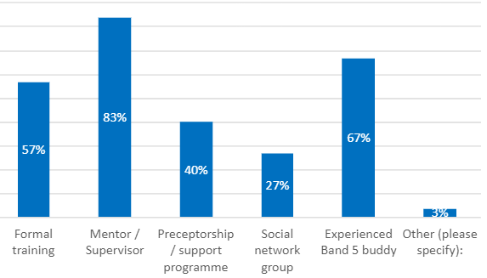
What CapitalAHP students said
You told us that 67% of you feel anxious about your transition into the workplace. 60% feel excited about joining the workforce.
You told us that you need mentorship and supervision, support from experienced B5 buddies and formal training. The good news is that Preceptorship, if done right, can deliver all these things!
Student survey
Aim: To hear the student voice and establish how they are feeling as they approach their transition to a newly registered practitioner
Notes:
JM

Slide 12
Benefits to you Preceptorship will help you to:
Develop confidence
1
Be supported across the 'flaky bridge' from student to practitioner
2
Be supported to understand how your organisation works and how to navigate it
3
Access increased peer support, interprofessional learning and networking
4
Have increased job satisfaction, which = increased patient satisfaction
5
Feel more valued, respected and invested in
6
Show your achievement by completing a period of learning supported and recognised across London
7
Notes:
JM

Slide 13
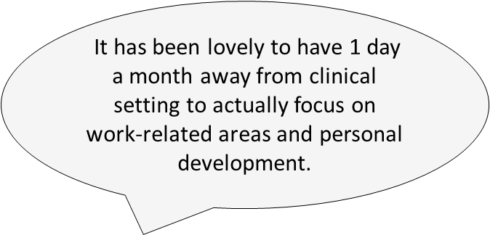
Preceptee feedback
S

Slide 14
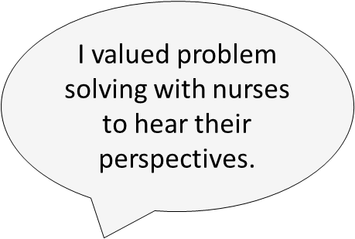
I feel more confident about raising concerns
S
Notes:
Anecdotal findings – preceptees that have completed programmes
Catherine has quotes – will send to sarah

Slide 15
Role of Preceptor
Monitors completion of induction and other training
Facilitates your introductions
Holds regular meetings with you
Ensures you have protected time to learn and develop
Assesses your learning needs and establishes your personal development plan with SMART objectives
Gives you timely and regular feedback
Encourages a supportive learning environment
Uses coaching skills to support your development to help you to find your own answers
Notes:
JM

Slide 16
Preparing for Preceptorship
Don’t be afraid to ask questions
Ask for help when you’re uncertain
Make connections
Take opportunities
Think about what you want from preceptorship
Consider support you need
Stay positive – your preceptor is there to help
Keep calm!
Notes:
JM

Slide 17
For more information, visit CapitalAHP Preceptorship | Health Education England (hee.nhs.uk) email capitalAHP@hee.nhs.uk or join the conversation on Twitter (@NHSHEE_LDN) Also, did you know there is an AHP student Self-Care resource to support you? Check it out here: AHP Student self-care resource | Health Education England (hee.nhs.uk)

