Slide 1
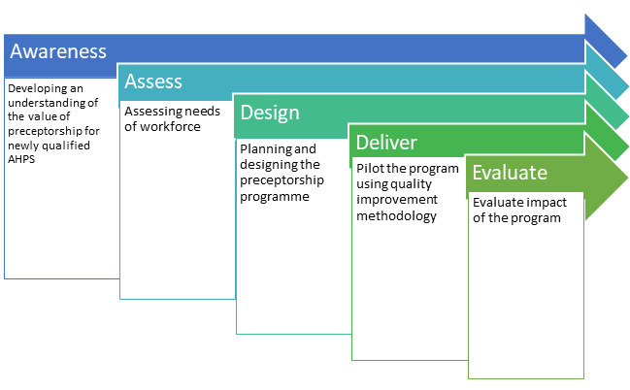
Readiness Framework - AADDE (recap)
C

