Slide 1
Celebrating Maternity Support Workers
Multi-disciplinary team working at its best
Christine Hughes

Slide 2
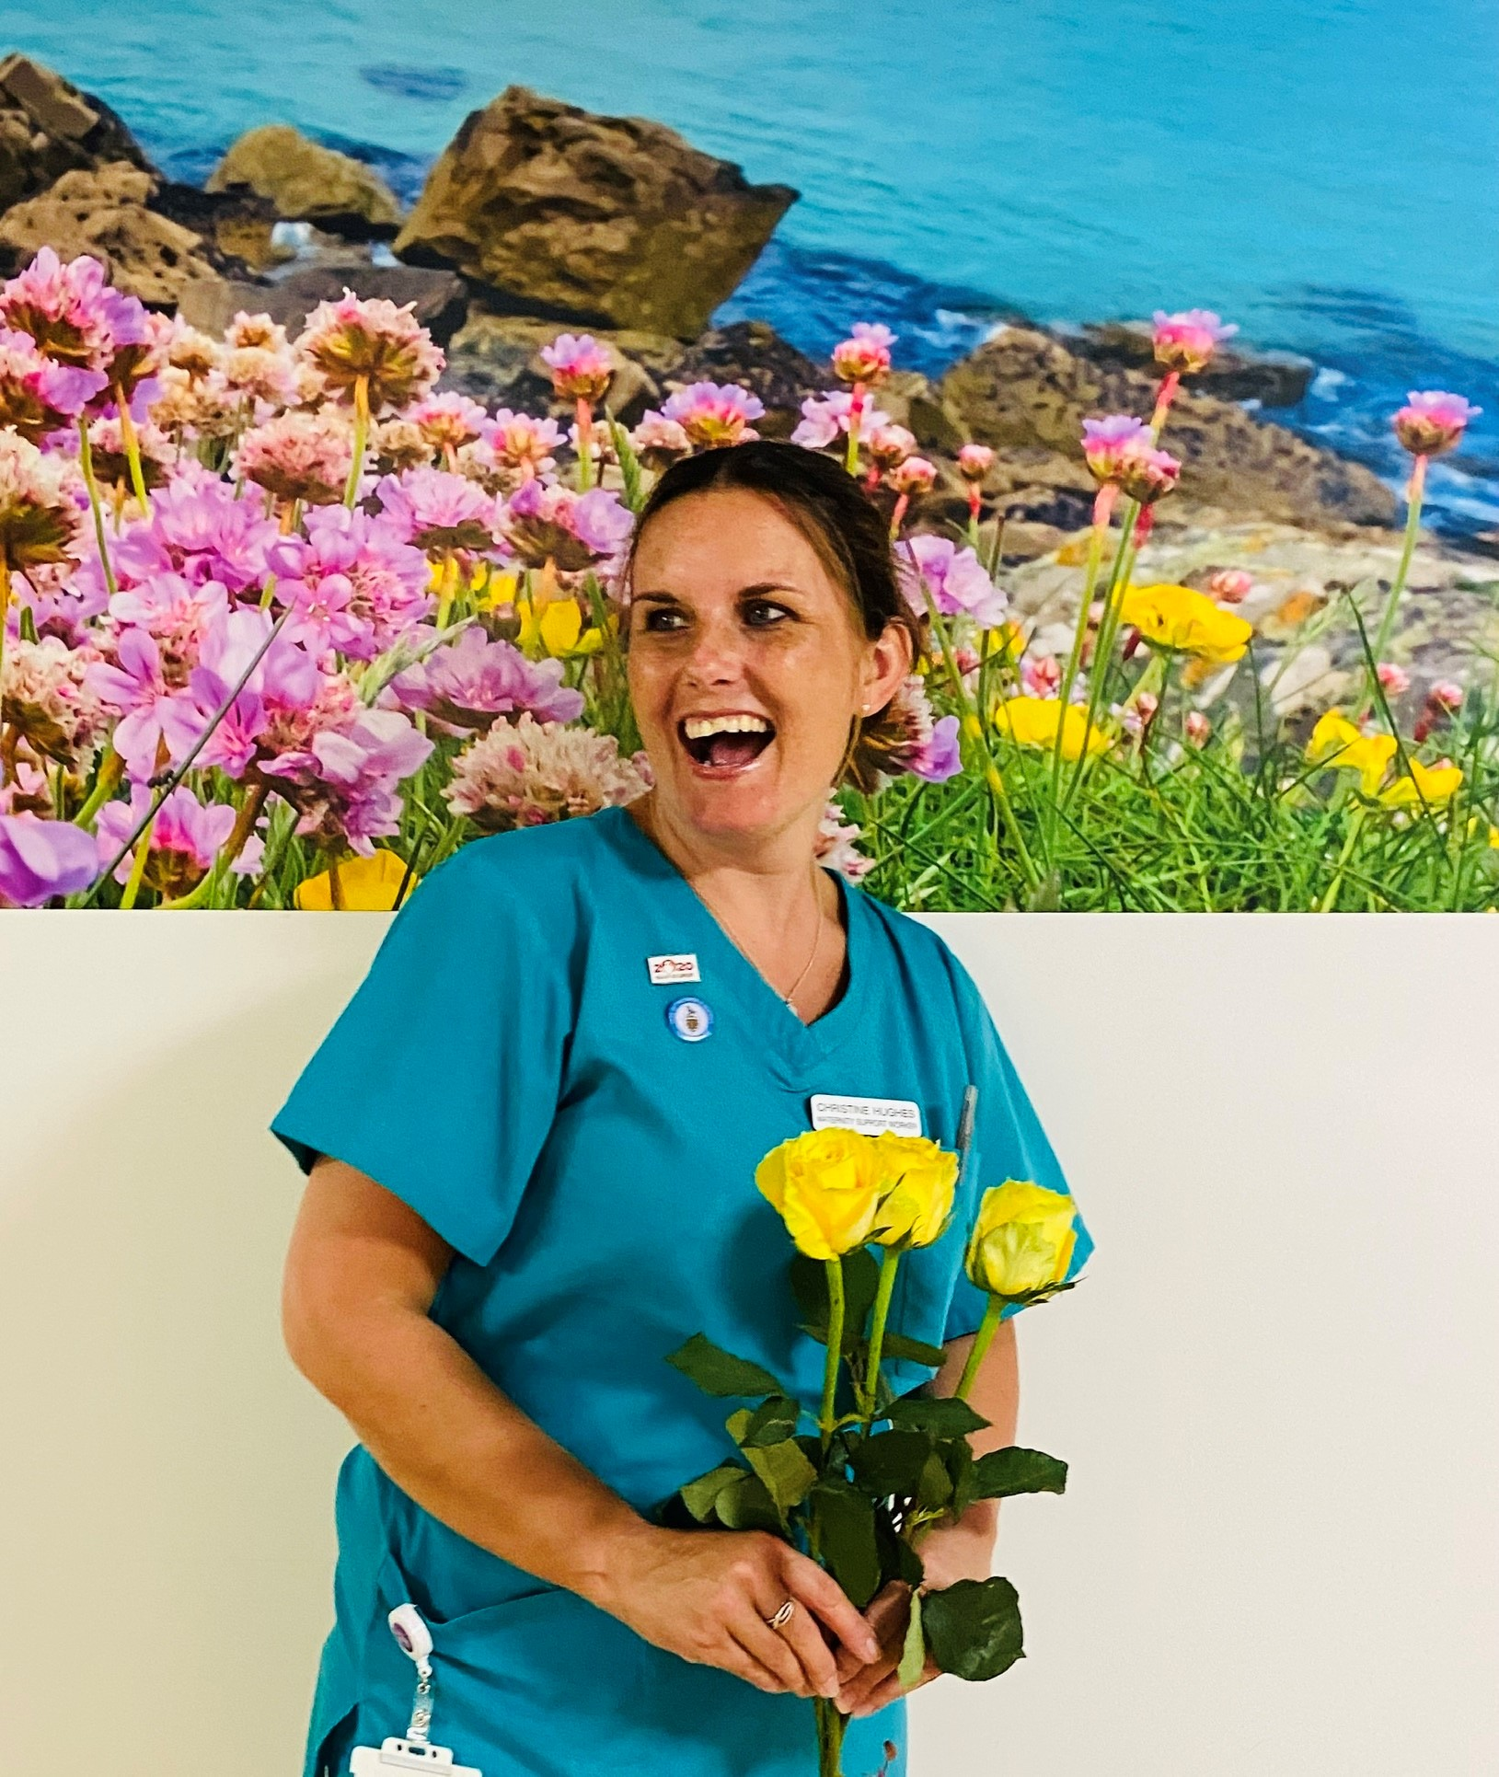
A Bit About Me
Maternity Support Worker (MSW) for 9 years in Cornwall
Royal College of Midwifery (RCM) MSW Advocate and Learning Representative for Cornwall Branch
Journey to date – Care Quality Commission (CQC)
New Head of Midwifery (HOM) who is invested in staff
Committed to Better Births philosophy
Deputy HOM and Consultant Midwife for vulnerability
Philosophy of my role has evolved over the years

Slide 3
MSW role during COVID
Thinking outside the box to continue to train new staff virtually and in COVID safe ways
Maintained usual level of recruitment
Utilising the existing skills of the MSW’s and ability to adapt
Existing Quality Improvement (QI) Project on the Intrapartum floor has gained momentum
Drivers – Patient experience and patient flow
Ability to adapt because of current and transferable skills

Slide 4
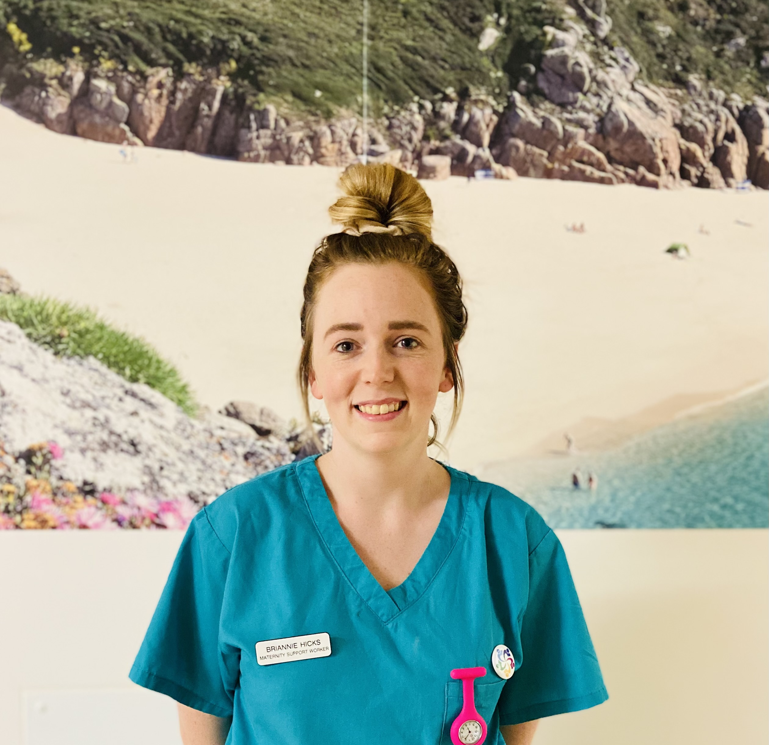
Quote from Bryannie Hicks, MSW
“Before I applied for the role of MSW I definitely underestimated what would be involved in the level of care we would be providing to women and their babies, but I wouldn’t change it for anything! The role is very diverse from emergency situations to emotional support and advice. Joining the team during COVID wasn’t difficult for me as I feel the team are close and realise we are all in this together and must ride the storm. I can’t wait to see where I progress to!”
Induction pack
Health Education England (HEE) Framework forming the basis of our competency pack – Band 3
Clear guidelines of skills to achieve

Slide 5
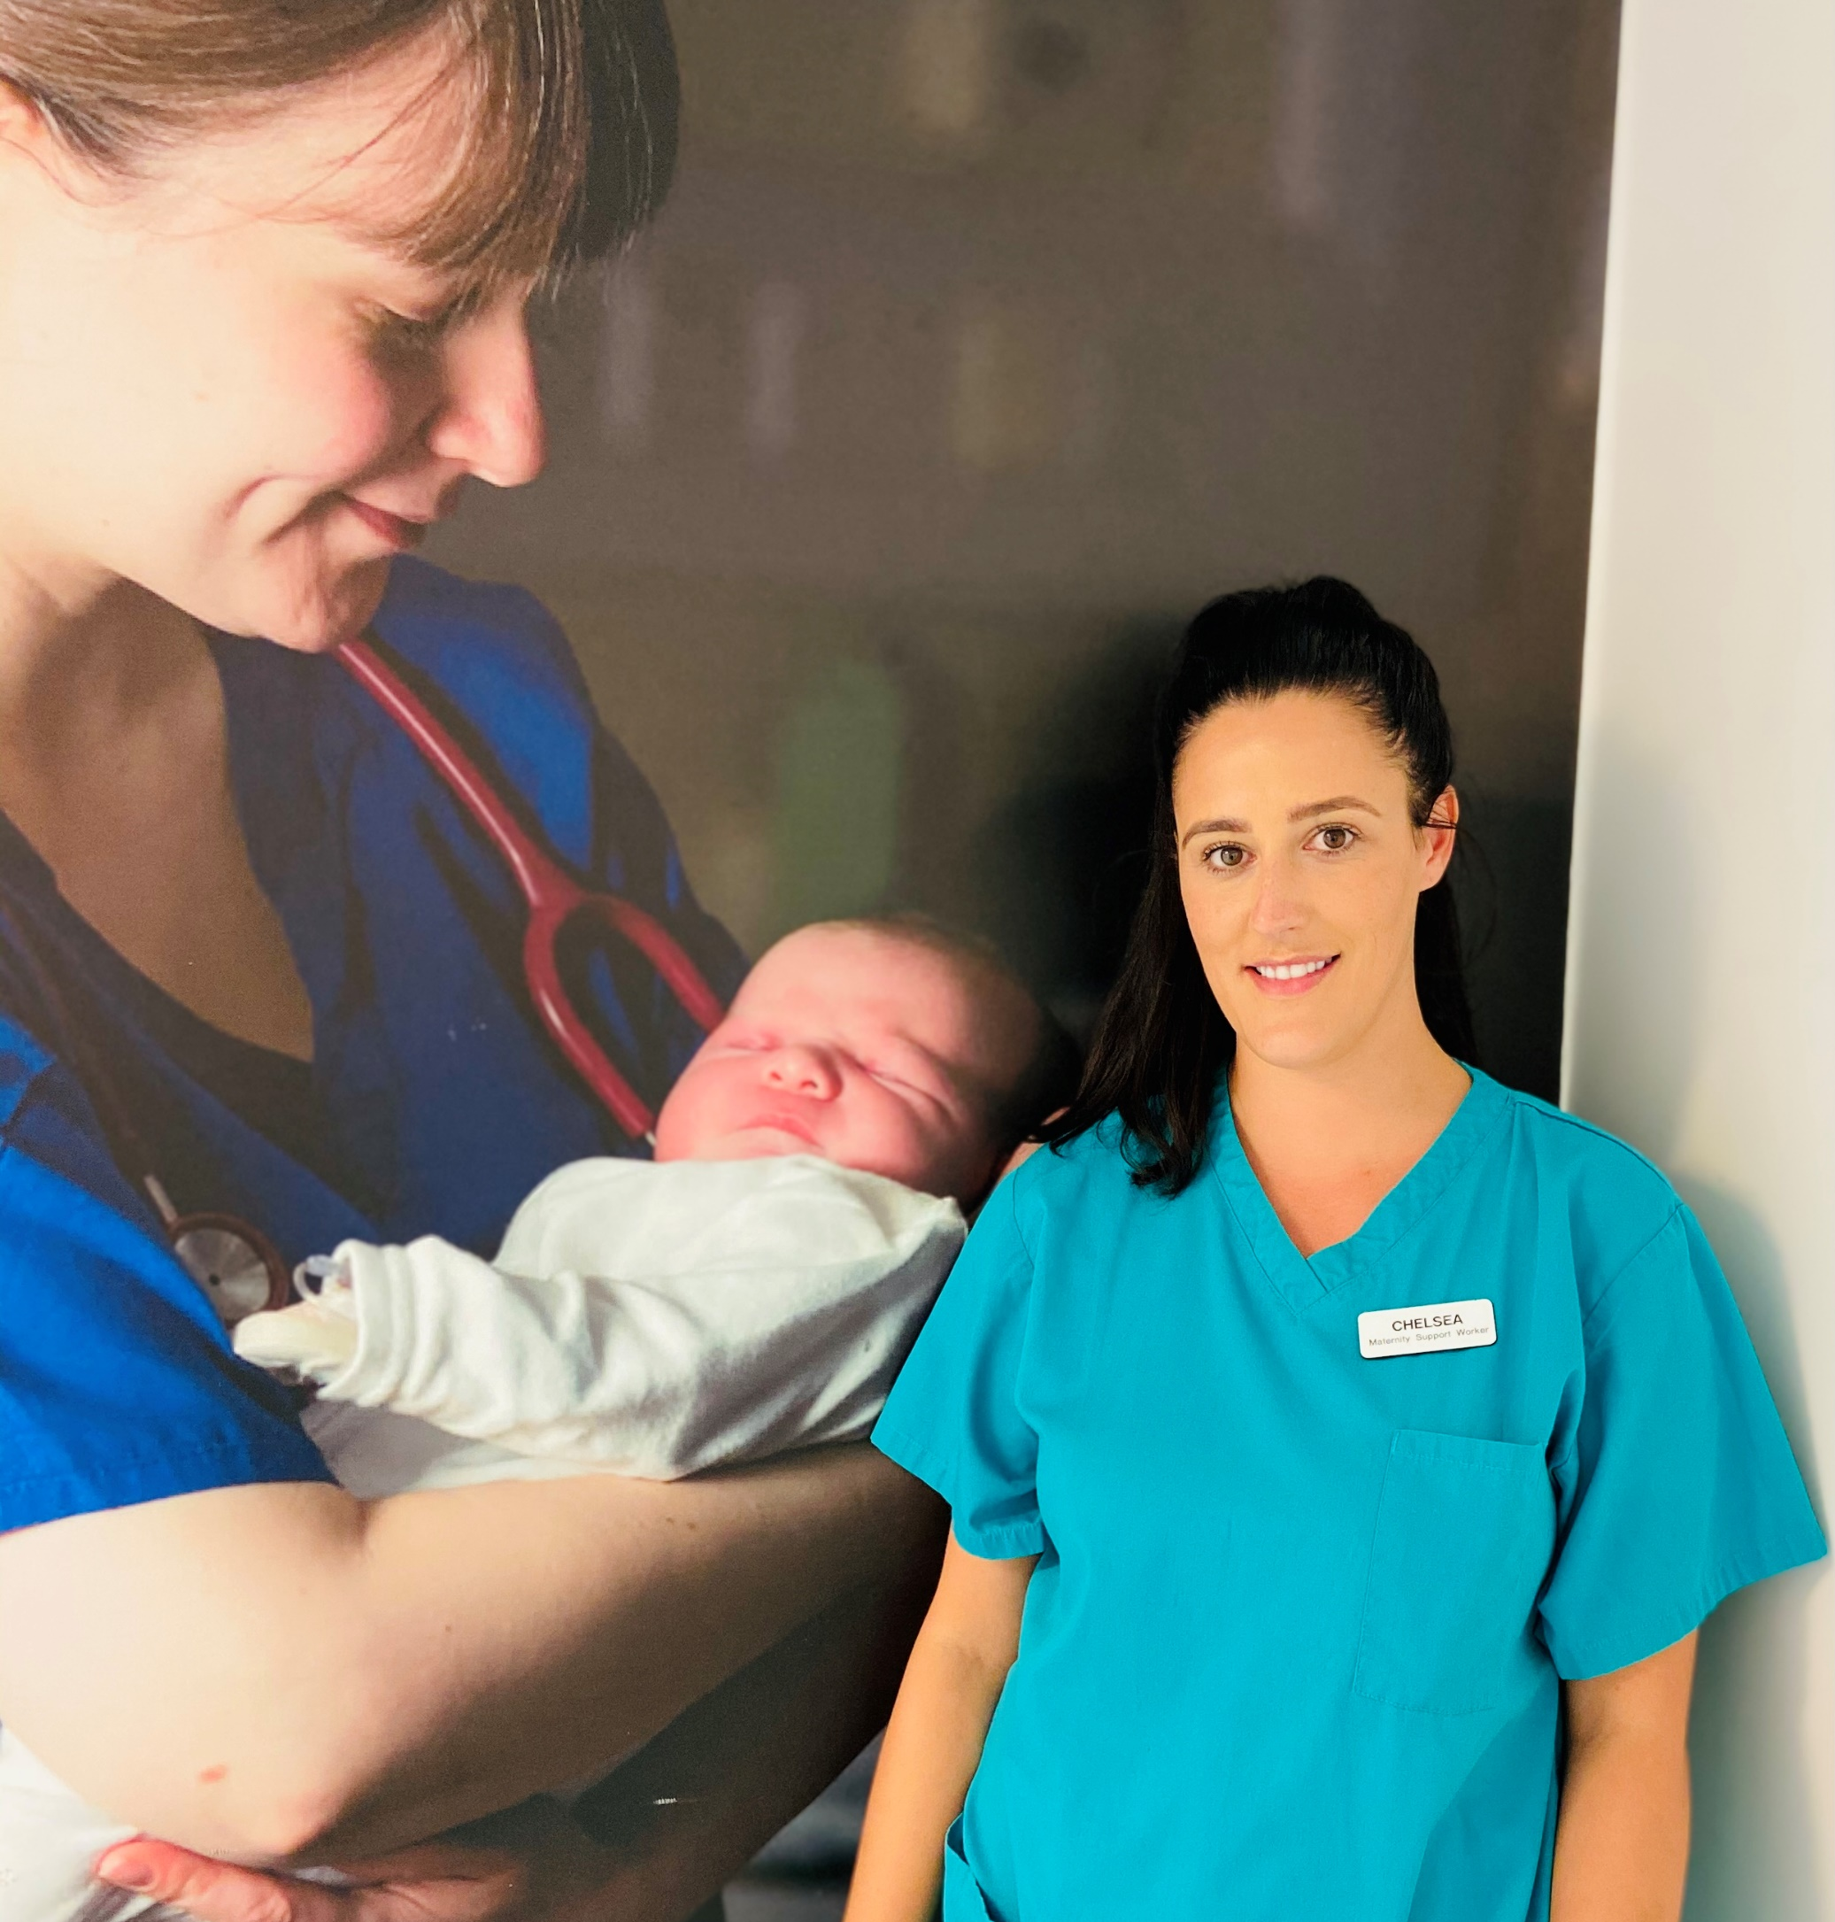
Quote from Chelsea Gornell, Transitional Care MSW
“Being an MSW on our transitional care ward has allowed me to be an even bigger part of the support network during the pandemic, by forming close relationships whilst building trust during such uncertain and challenging times. This is what makes my role so rewarding”.
Transitional Care – additional Neonatal skills training
No partners allowed to stay during COVID
Moving forward – improving patient experience

Slide 6
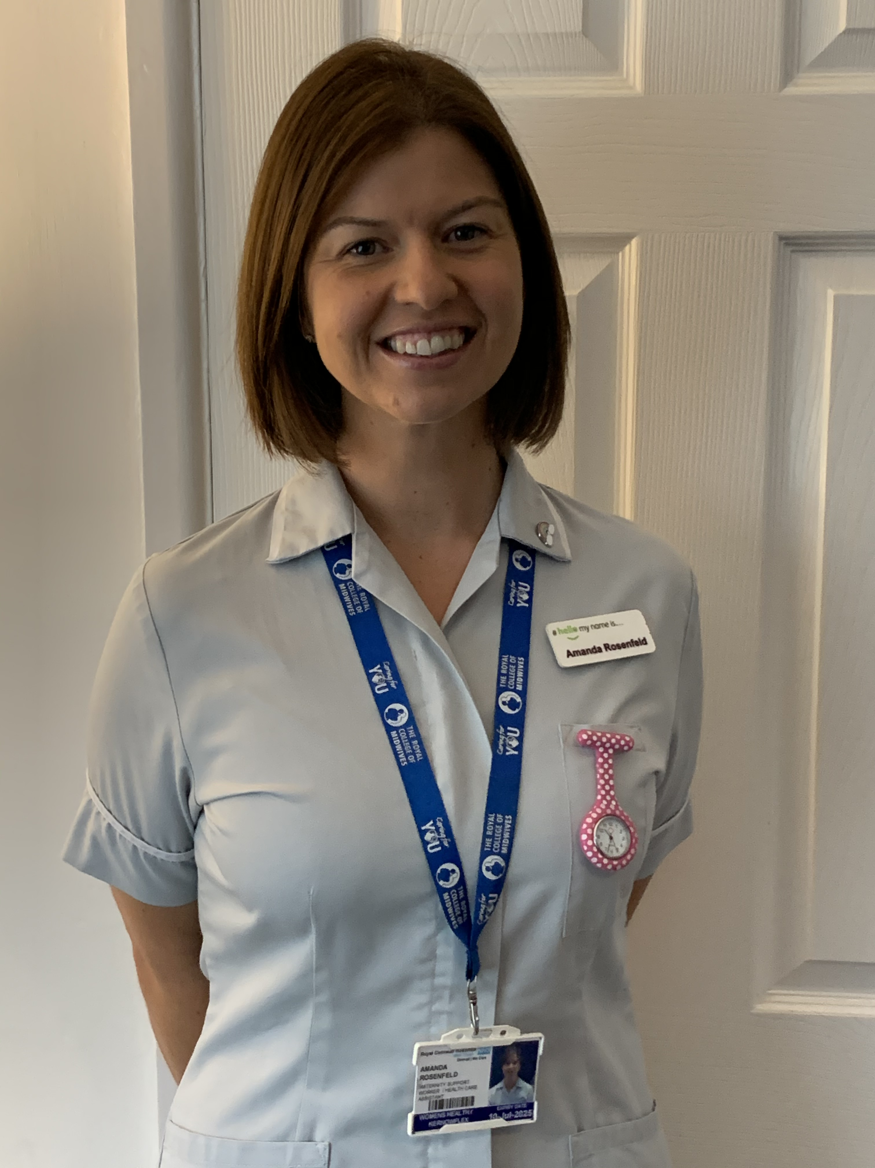
Quote from Amanda Rosenfield, Community MSW
“Working in community as a Maternity Support Worker is a role I feel privileged to have. Being able to support women from the first exciting ‘I’m pregnant!’, to the moment they are holding their baby in their arms beaming at you that they have done it!
During COVID I have particularly enjoyed the antenatal feeding phone calls, where it gives women the opportunity to talk through things that they may have previously been embarrassed to discuss in a face to face appointment”.

Slide 7
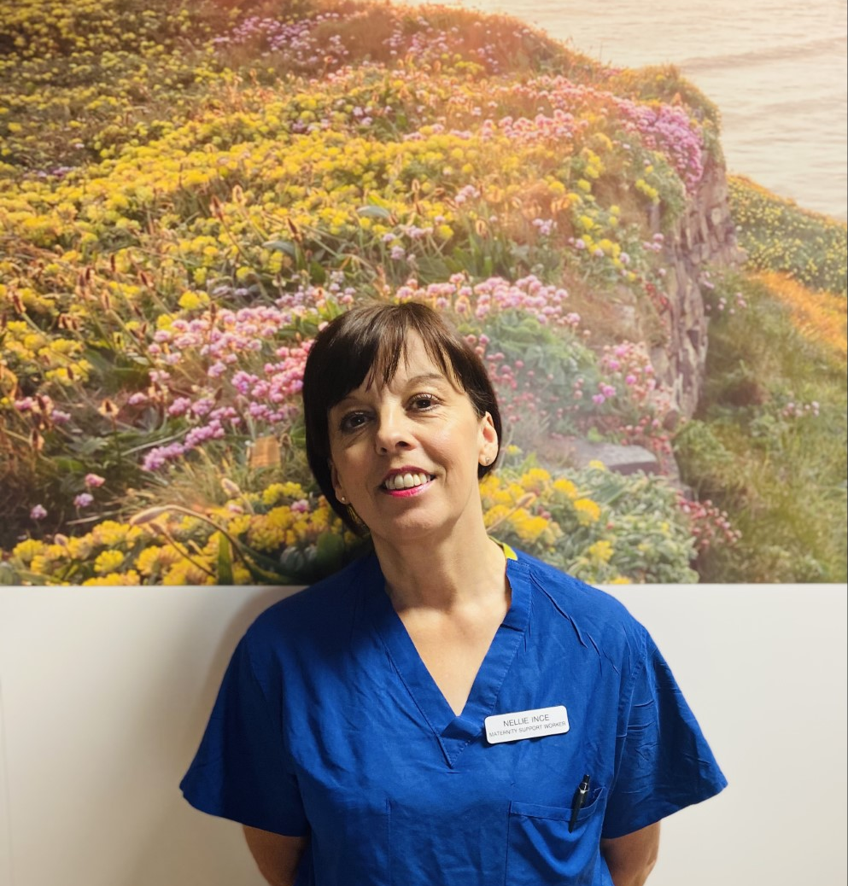
Quote from Nellie Ince, MSW
“As an MSW working on the intrapartum floor I really feel valued and part of the multi professional team and am a cog in the wheel. We all need to work together to ensure safe practice and a high standard of care. I have great job satisfaction from a simple ‘thank you’ from a new mum with her baby. Everyday is different and this adds to the enjoyment of the job”.
Fluidity between high and low risk areas
Specific theatre skills training
Future plans for doula training
Waterbirth
Maternal and neonatal care

Slide 8
Quote from Debbie Parsons, Obstetric Theatre Lead
“MSW’s are an integral part of the team and are an invaluable link between the maternity unit and theatre, being able to transfer their skills fluidly between the two”.

Slide 9
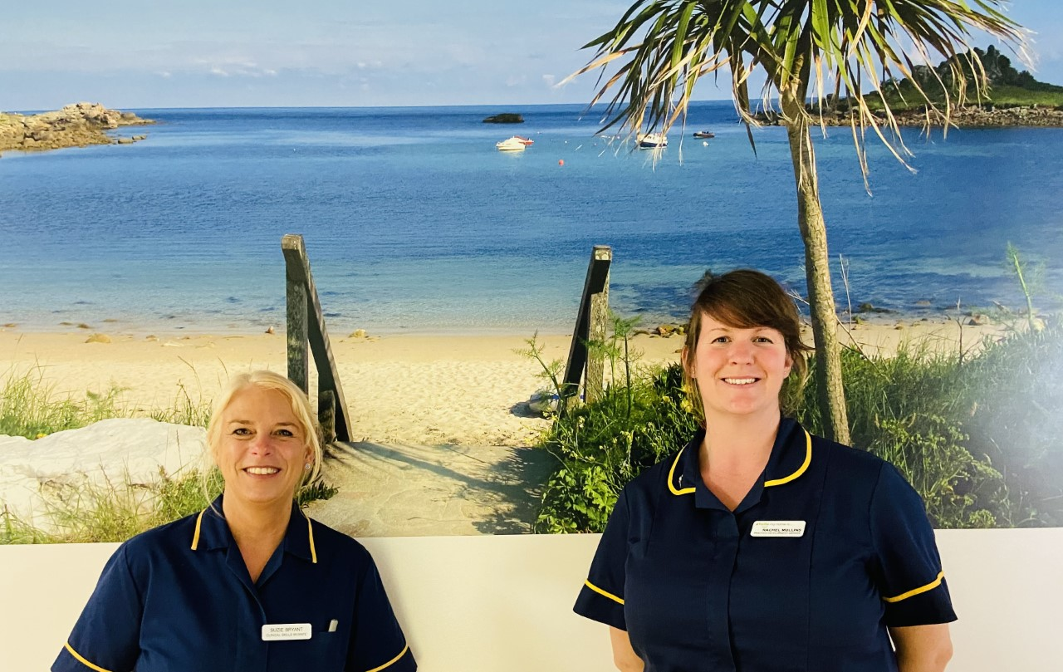
Quote from Suzie Bryant and Rachel Mullins
“Our Maternity Support Workers play a vital role in the Cornish maternity team! We recognise that the positive contribution made by MSWs in the maternity service is maximised when they are appropriately trained, pay banded and work as an integral part of the care team. The Clinical Skills Facilitators and I are committed to proactively supporting MSWs’ personal and professional growth”.
PROMPT
Multidisciplinary training: staff that train together work well together
Virtual training during COVID-19
Serious Incident Management System Clinical Skills Facilitators

Slide 10
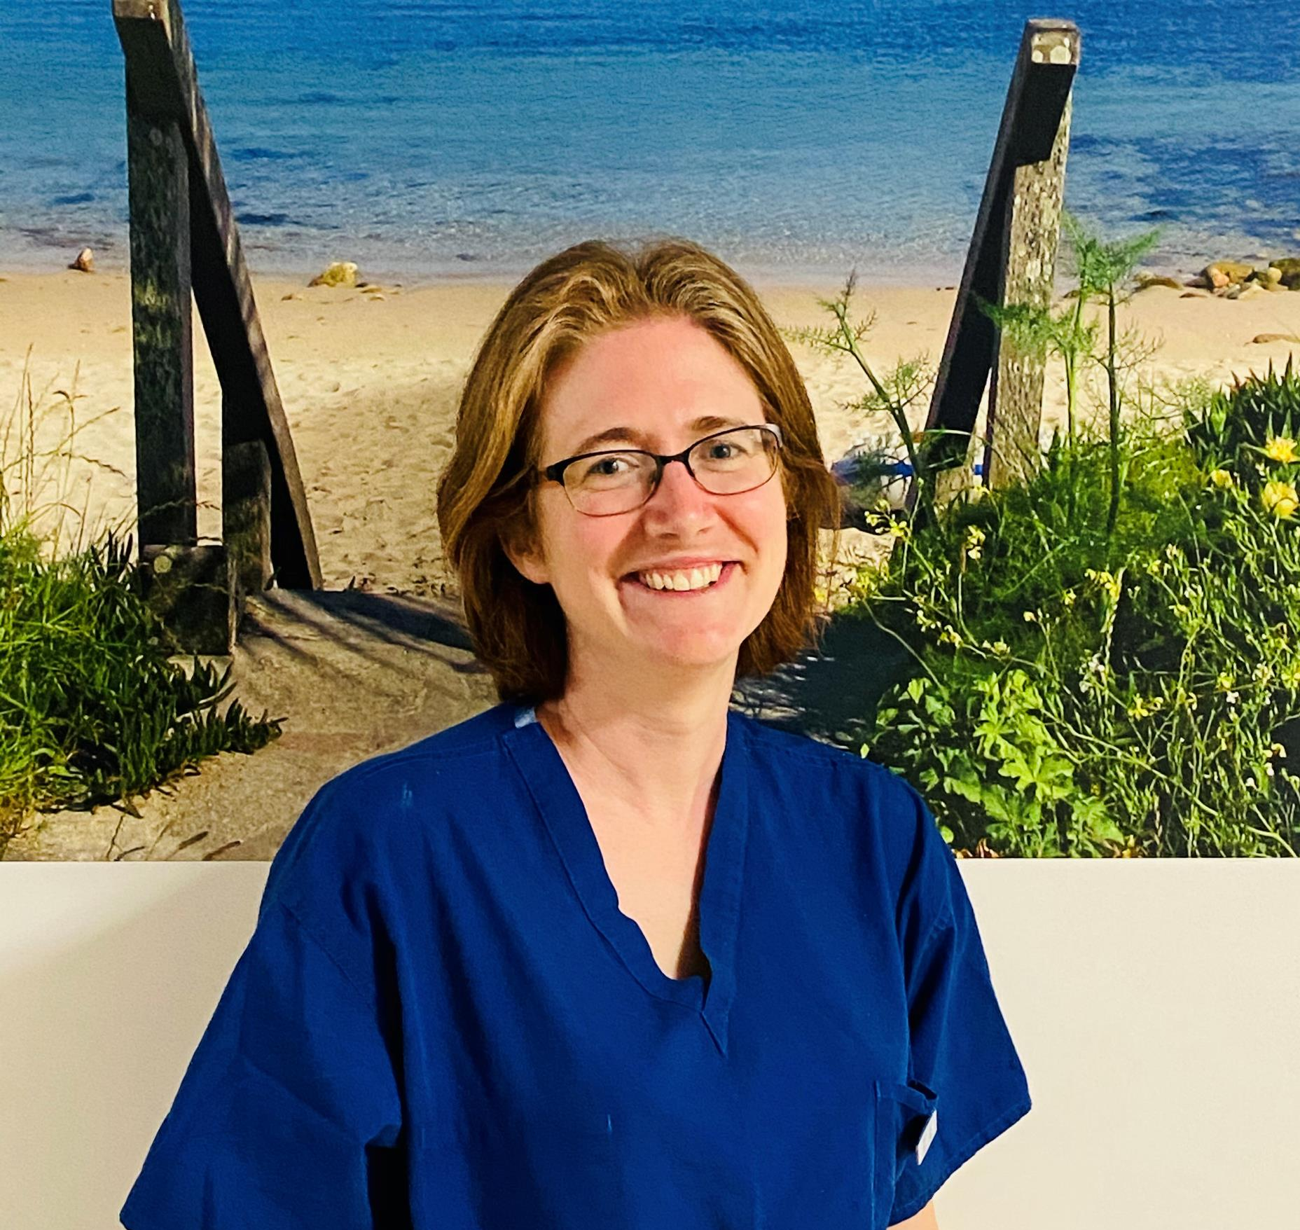
Quote from Sophie Haynes, Obstetric Consultant
“MSW’s are an integral part of the obstetric team and play a vital role in supporting patients, midwives and doctors. I am always grateful for their assistance and help in difficult situations and on busy shifts where they can hold a team together through the flexible nature of their work”.

Slide 11
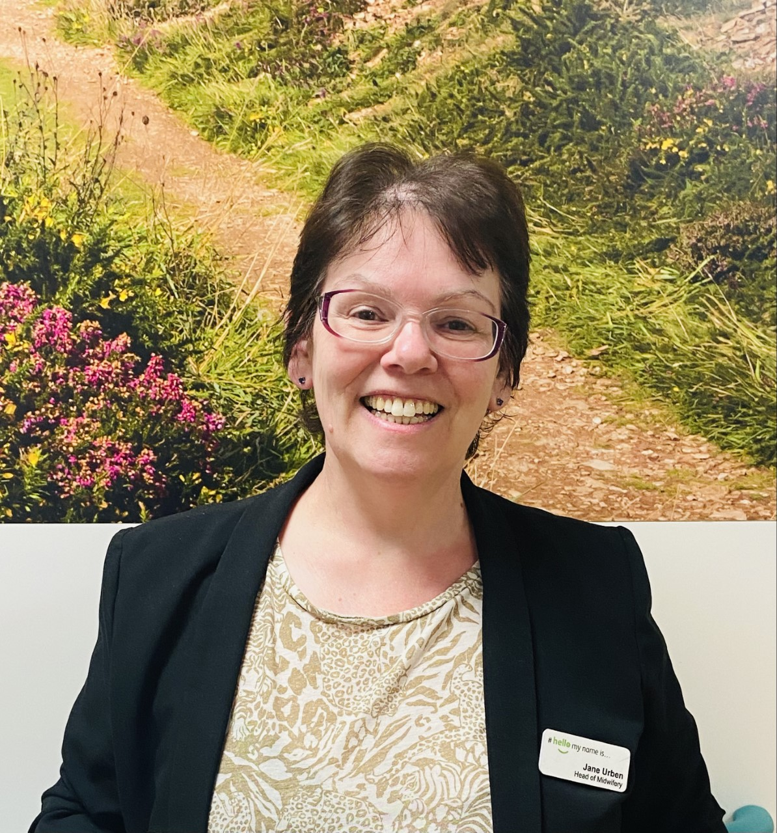
Quote from Jane Urben, Head of Midwifery
“Maternity Support Workers are very much an integral part the workforce pivotal to our future plans. MSWs are utilised in all areas of the service and for those that are wanting to do their midwifery training, supported to apply and their application is supported by the management team. MSWs must be recognised as critical to the future of maternity services, supported in their development and respected for the crucial role they do”.

Slide 12
What is the future for MSW’s in Cornwall?
HEE early adopter for MSW Transformation Programme
MSW role modelling
Experience to date – resilience and NHS working
Midwifery training – representative of what is being offered in Cornwall
Apprenticeship in the future
Grow your own

Slide 13
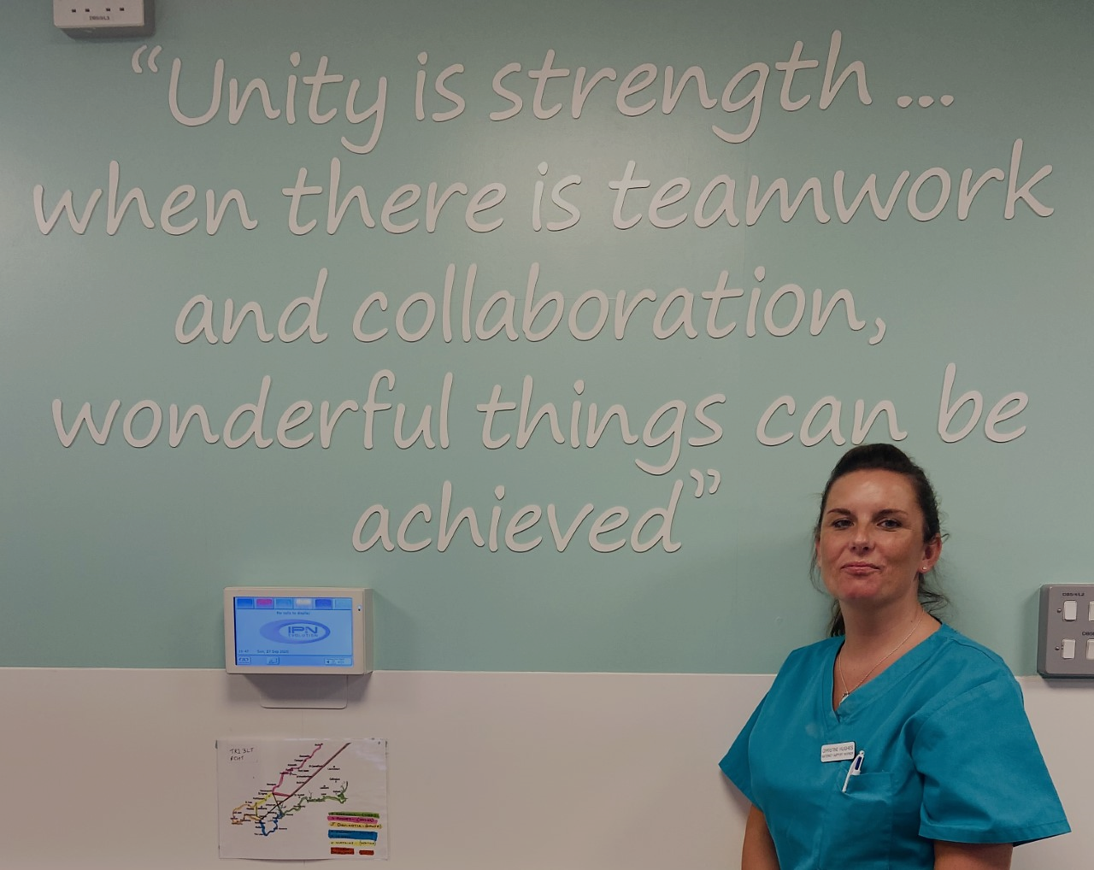
Teamwork Slogan

