Slide 1
Health Education England Children and Young People’s Mental Health Workforce Census
January 2023

Slide 2
Contents
Executive Summary | 3
Summary of growth | 5
Project process | 6
Project participation profile | 7
NHS workforce | 9
Independent Sector | 22
Local Authorities | 26
Voluntary Sector | 31
Youth Offending Teams | 36
Vacancies | 41
Staff demographics | 46
Skills & training | 56
Service models | 62
Conclusions and further information | 65
Appendices
Appendix 1 - Skills and training | 71
Appendix 2 - 2020/21 Key metrics | 82
Appendix 3 - Staff roles | 84

Slide 3
Executive Summary (1)
This report details the findings from the fourth national stocktake of the Children and Young People’s Mental Health (CYPMH) workforce across England. The report builds on the previous collections undertaken by NHSBN on behalf of Health Education England, which were undertaken in 2016, 2019 and 2021. As such there was a three-year gap between the 2016 and 2019 census, a two-year gap between the 2019 and 2021 census and only a one-year gap between the 2021 and the 2022 census this year. The 2016 and 2019 censuses covered the 2015 and 2018 calendar years respectively, both with a census date of the 31st December. The 2021 census covered the financial year 2020/21, with a census date of the 31st March 2021. The census this year collates data from the 2021/22 financial year with a census date of 31st March 2022.
The project, as in previous years, recognised the multi-agency nature of CYPMHS across England and collected data across five sectors to provide a holistic view of the CYPMHS workforce. These sectors were:
  NHS providers
  Independent sector (also known as private providers)
  Local authorities
  Voluntary sector
  Youth offending teams (YOTs)
The growth seen within the NHS workforce can be linked with an increase in funding for CYPMH within the Five Year Forward View and the NHS Long Term Plan strategies. HEE continues to commit significant investment to support expansion through supply routes and training; this includes supporting retention and expansion through the creation of new roles. For example, education mental health practitioners increased from 11 WTE in 2019 to 707 in the most recent census and is the job role with the largest increase between 2021 and 2022. However, demand for CYPMH services has also shown a continual increase over recent years; increases in referral rates, waiting times, and caseloads were also evident in 2022 (2021/2022 Children and Young People’s Benchmarking Project - NHS Benchmarking Network). Workforce growth and retention remains challenging against a backdrop of increasing demand for CYPMHS. Keeping pace with service demand will rely on multiple factors including continued investment to support expansion. Equally, a commitment from services to ensure employment opportunities are available for newly qualified staff will support workforce growth and retention.
The key findings from this years’ analysis are as follows:
A total of 26,148 staff are employed in CYPMH services across England delivering 21,643 whole time equivalent (WTE) staff in post across all sectors. This equates to a 5% growth in WTE compared to 2021.
There were decreases in staff WTE in the independent (-718) and voluntary (-16) sectors and slight increases in local authority (+147) and YOTs (+327), but this largely mirrored changes in the number of submissions. However, if we look at the average WTE per submission in each of these sectors it has increased. While this is not a definitive statement of growth, as submissions are not from the same providers each year, it does suggest that the overall growth of 5% may be understated.

Slide 4
Executive Summary (2)
The majority of staff are employed in the NHS (77%). For this sector, the workforce (combined inpatient and community) grew by 8% between 2021 and 2022.
Most NHS CYPMH staff are employed in community services; 83% in 2022 compared to 82% reported in 2021.
The NHS vacancy rate for NHS staff was 17%, an increase from 9% reported in 2021. This was consistent with increases in vacancy rates reported in adult inpatient and adult community mental health services. The percentage of staff still in post at the start of the year that were still in post at the end had fallen from 80% to 77%.
Nurses were the largest proportion of the NHS workforce (26%) and WTE increased 8% between 2021 and 2022. Note that 5% (90 WTE) of the 1,865 WTE support workers included in the census were nursing associates, with a further 1% (18 WTE) nursing associate trainees.
The NHS psychology workforce (WTE) grew notably between 2021 and 2022, up from 2,123 to 2,589 (+466). The psychology workforce accounted for 16% of the total workforce in 2022 compared to 14% in 2021.
Analysis of the workforce demographics showed that CYPMH staff are predominantly female (NHS 85%). The age of the workforce is well distributed although there has been a slight decline in NHS staff aged over 55 in 2021 and 2022. There continued to be notable diversity in the workforce.
Two thirds of the workforce are employed full time in the NHS and local authorities, with three quarters full time in the independent sector but less than half in the voluntary sector. The proportion of NHS staff in post for less than a year increased from 30% in 2021 to 35% in 2022. This is in part due to new roles and the expansion of the workforce.
In England, 9% of the working age population are Asian/Asian British people. Across all four sectors surveyed in 2022, there was an under-representation of Asian/Asian British staff in CYPMHS, with Asian/Asian British staff accounting for 5% of the workforce in the local authority and voluntary sectors, and 6% in the NHS and independent sector.
There was greater representation of Black/Black British staff in the CYPMH workforce compared to the general population (ranging from 6% in voluntary sector to 18% in the independent sector, compared to 4% in the England resident population (16-64).

Slide 5
Summary of growth in CYPMHS workforce
Across the five sectors, organisations reported 21,643 WTE staff working in CYPMH services across England in 2021/22. This is a 5% increase in the workforce compared to 2021, where providers reported 20,626 WTE CYPMHS staff.
The NHS CYPMHS workforce accounts for 77% of the workforce across the five sectors. Providers reported an 8% increase in WTE from 15,486 WTE in 2021 to 16,763 WTE in 2022.
The independent sector accounted for 7% of the workforce, 3% work in local authorities and 7% in voluntary organisations.
The reduction in WTE working in the independent sector is likely due to the reduction in organisations submitting data in 2022 compared to 2021.
The core CYPMH row is a sum of the previous four rows. Please note, as in previous years YOT staff are not dedicated CYPMH workers but staff members have CYPMH responsibilities as part of their wider role.
Sector | 2016 WTE (31/122015) | 2019 WTE (31/12/2018) | 2021 WTE (31/03/2021) | 2022 WTE (31/03/2022) | change 2021 to 2022 | Number of providers (2021) | Number of providers (2022)
NHS | 8,976 | 11,036 | 15,486 | 16,763* | +1,277 | 65 | 65*
Independent | 1,688 | 1,643 | 2,293 | 1,575 | -718 | 11 | 5
Local Authority | 865 | 1,065 | 600 | 747 | +147 | 46 | 53
Voluntary | 158 | 321 | 1,457 | 1,441 | -16 | 74 | 55
Core CYPMH | 11,687 | 14,065 | 19,836 | 20,526 | +690 | - | -
YOT | 996 | 792 | 790 | 1,117 | +327 | 89 | 106
Total | 12,683 | 14,857 | 20,626 | 21,643 | +1,017
*Partial or full CYPMHS workforce data has been taken from NHSBN’s Core CYPMHS benchmarking collection for 10 organisations who did not submit to the project or only partially submitted. This is aligned with the methodology applied in previous years.

Slide 6
Project process
The data specifications for the fourth national CYPMHS workforce census were scoped in consultation with colleagues from Health Education England, NHS England and Local Government Association in April 2022. The data collection consisted of metrics largely in line with previous censuses to allow changes over the past five years to be tracked and reported.
The data collection period launched on 11th July 2022 to CYPMH services across the NHS, independent sector, local authorities, voluntary sector and youth offending teams. Organisations were given until October 2022 to submit their responses.
The project team validated the census data throughout the data collection period, with further validation occurring in November 2022, after data collection closed. This ensured the project’s findings were complete and accurate and that all data within this report had been agreed with providers.
In addition to the data presented in the body of the report three appendices are included to provide additional information. Additional information is provided on skills and training, key metrics from the 2020/21 census, and a breakdown of staff roles.
The initial draft findings from the census were presented to colleagues from Health Education England, NHS England and Local Government Association, with the feedback helping construct the final national report.
The NHS Benchmarking Network and Health Education England would like to thank everyone for their continued support and contribution to the project.

Slide 7
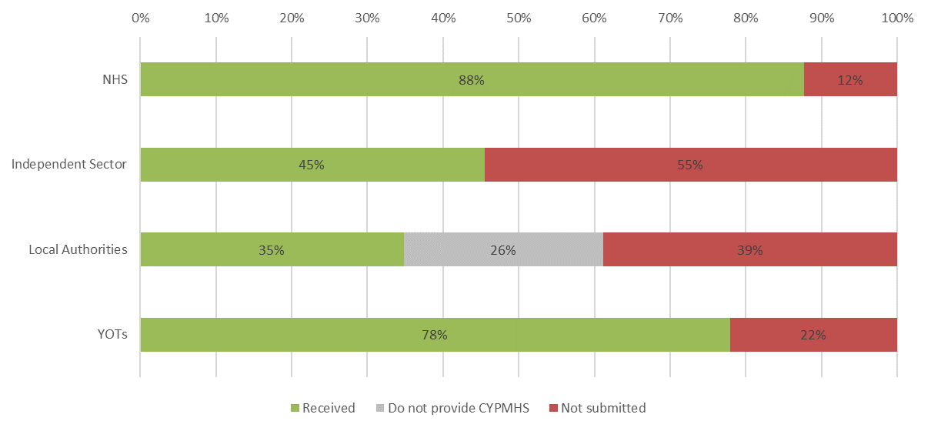
Project participation profile
The chart below shows the participation profile across the CYPMHS sectors the census covered. The percentages have been calculated by dividing the number of submissions received by the number of known providers in the respective sectors (NHS, independent sectors, local authorities and youth offending teams). The voluntary sector does not have a participation rate due to the complexity of the provider landscape making it impossible to estimate the relative completeness.
Participation for the NHS sector this year was in line with the previous year with 55 of the 65 expected organisations making full submissions. Note, workforce totals and discipline mix profiles are plugged with data from the 2021/2022 Children and Young People’s Benchmarking Project (NHS Benchmarking Network) to provide year on year comparisons. However, other metrics are based on submissions received directly for this workforce census project in 2022.
Submissions for the independent sector were lower this year with five of an expected 11 organisations submitting data compared to 100% in 2021. Local authority submissions were higher this year with 53 submission compared to 46 in 2021. Similarly, the number of submissions for YOTs increased to 106 from 89 in the previous year.

Slide 8
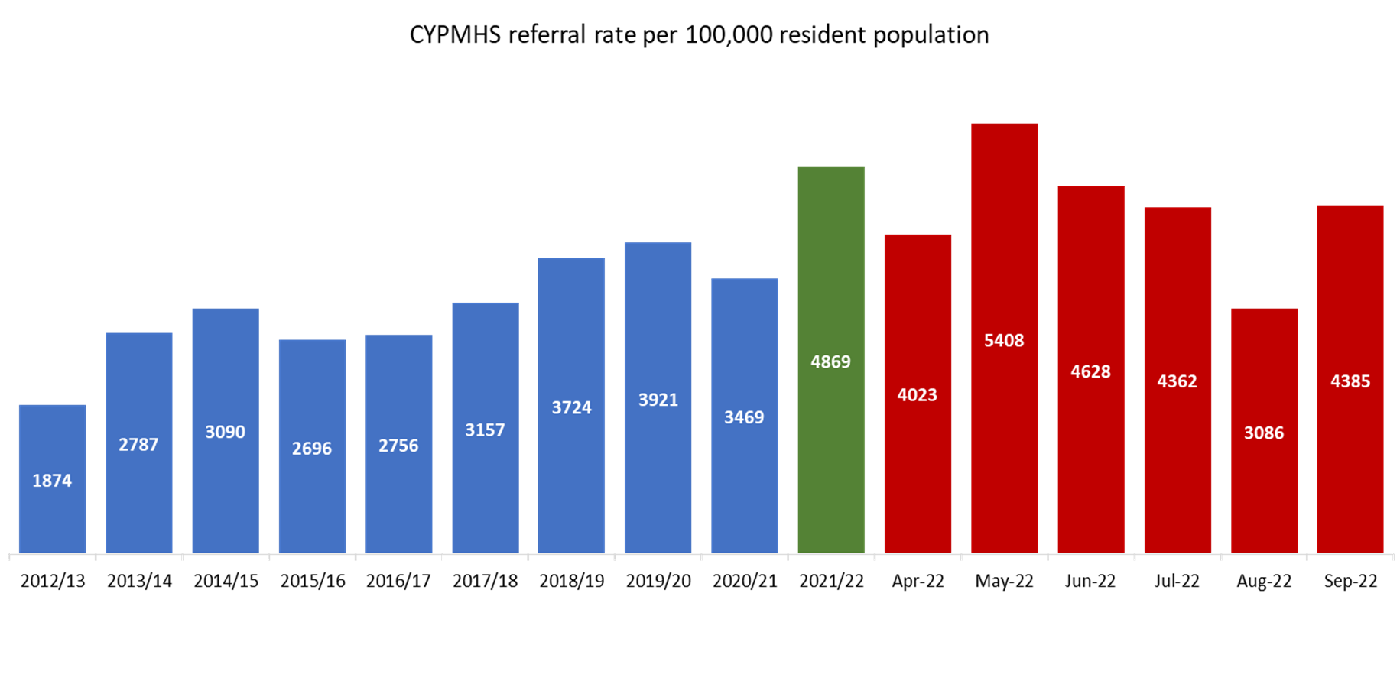
Context for CYPMHS (NHS)
The chart below depicts timeseries analysis of referrals into NHS CYPMH services over the period 2012/13 to 2021/22, along with the six months April to September 2022. On the left-hand side (shown in blue) are the historic annual national positions reported to NHSBN from providers across the UK, in green is the 2021/22 year which is the period that aligns with this census, while the right-hand side (in red) shows the monthly fluctuations in the national referral rate over the last six months.
Referrals into CYPMHS were 40% higher in 2021/22 compared to the previous year reflecting the clear recovery of demand following the removal of lock downs associated with the Covid-19 pandemic (this reflects the UK position).

Slide 9
CYPMHS Workforce Profile
NHS

Slide 10
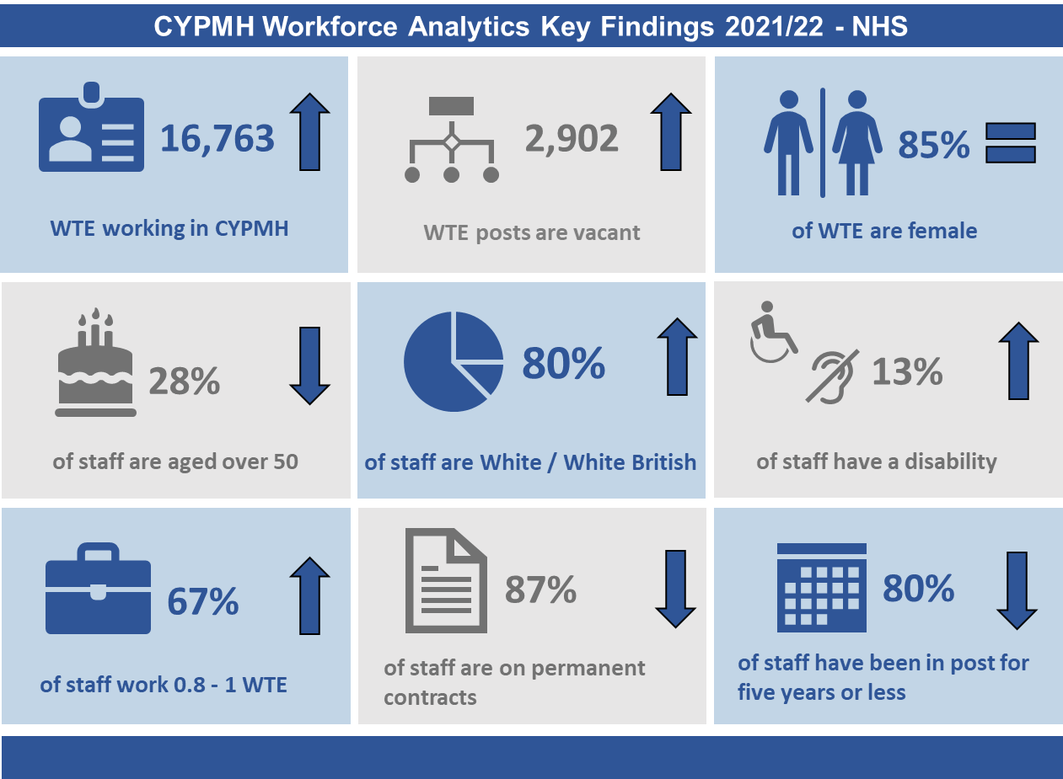
Key findings for NHS – 2021/22
Please note that the arrows demonstrate whether the metric increased, decreased, or stayed the same from the position in 2020/21 (values shown in Appendix 2).

Slide 11
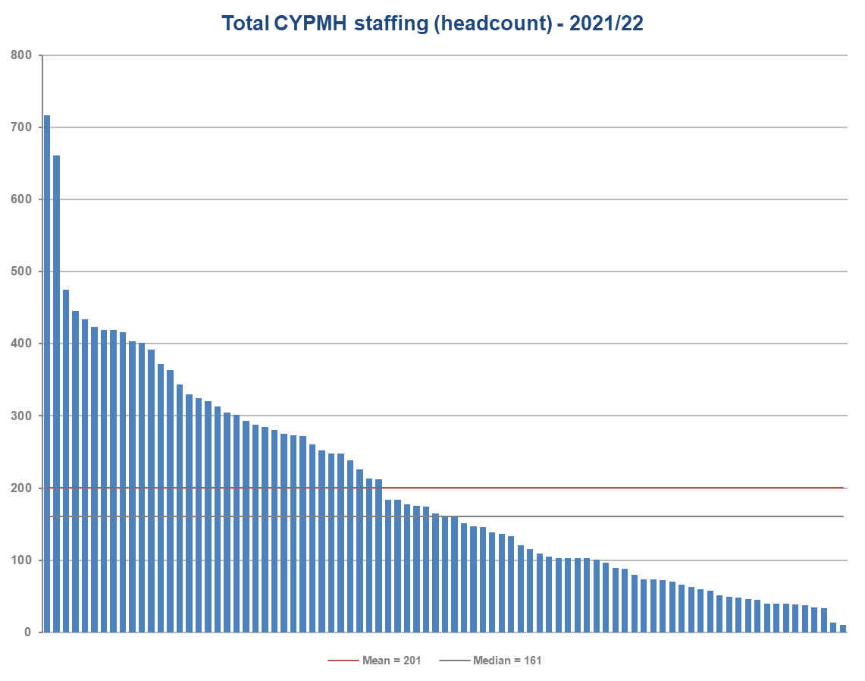
Workforce (headcount) by site - NHS
Total CYPMHS
In 2022, NHS Trusts reported a mean of 201 staff working in CYPMH services (headcount). This is similar to the figure reported in the 2021 census (195).
There is wide variation in the headcount of staff across sites in England ranging from 10 to 717. This variation is to be expected as some providers submitted at site/borough level, while others submitted for the whole organisation. Further to this, CYPMH services tend to have differences in service models across England, which affect staffing levels.

Slide 12
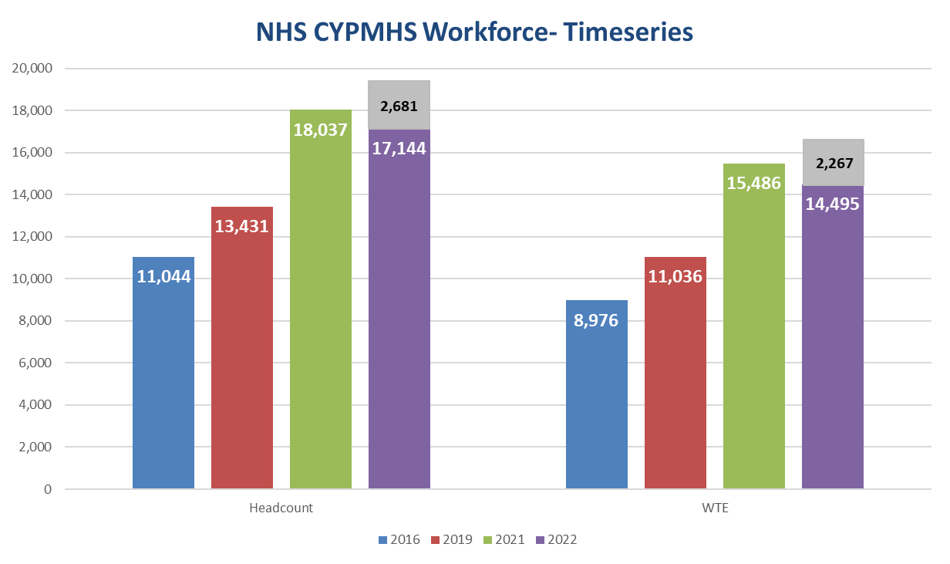
NHS CYPMHS Workforce – Timeseries
Total CYPMHS
The chart shows the headcount (left four bars) and WTE (right four bars) for the four years 2016, 2019, 2021 and 2022.
Providers reported a 10% increase in headcount and an 8% increase in WTE staff in this year’s census (31st March 2022) compared to the 2021 census (31st March 2021). This represented a slower rate of growth than reported between 2016 and 2019 (headcount 21%, WTE 23%) and between 2019 and 2021 (headcount 34%, WTE 40%).
The gap between previous censuses was three and two years compared to one year between the 2021 and 2022 censuses. However, even accounting for this, there is a reduction in the rate of growth of the workforce. This is despite significant investment and efforts to support expansion through supply routes and training.
*Grey section represents 10 NHS organisations who have not or only partially submitted
Please note that the sum of the purple and grey sections of the WTE chart is one less than the total WTE figure reported.
This is due to rounding.
Analysis of the change in funded establishment (total WTE staff in post plus WTE vacancies) showed that overall it had increased by 16%. This suggests recruitment and/or leavers are driving increases in vacancy rates impacting on the rate of workforce growth.

Slide 13
Analysis of workforce growth (NHS)
The table below provides a summary of the workforce WTE by job role for the 2019, 2021 and the 2022 census. The column to the right shows the percentage change between 2021 and 2022.
Whilst there is an overall increase of 8% this masks changes at job role level.
The number of education mental health practitioners (EMHPs) increased by 90% to 707 WTE, now 4% of the workforce compared to 2% in 2021.
Conversely the growth of children’s wellbeing practitioners (CWPs), another relatively new role, has plateaued in 2022 following a growth between 2019 and 2021. Note that some CWPs may work in other sectors outside the NHS.
Psychology, psychotherapy and social work WTE also increased in 2022 compared to 2021.
Therapists, occupational therapists, student and other roles have lower WTE compared to 2021.
A change in the roles mapped to ‘medical’ between 2021 and 2022 mean year on year they are not directly comparable. Please see appendix for further detail.
*
**
*The roles mapped to medical changed between 2021 and 2022 so these are not directly comparable
** The difference in Psychology WTE between 2021 and 2022 is 131 due to rounding
Please note that the total reported in this table (16,699) is lower than the overall total (17,006) due to some staff not having job roles assigned.

Slide 14
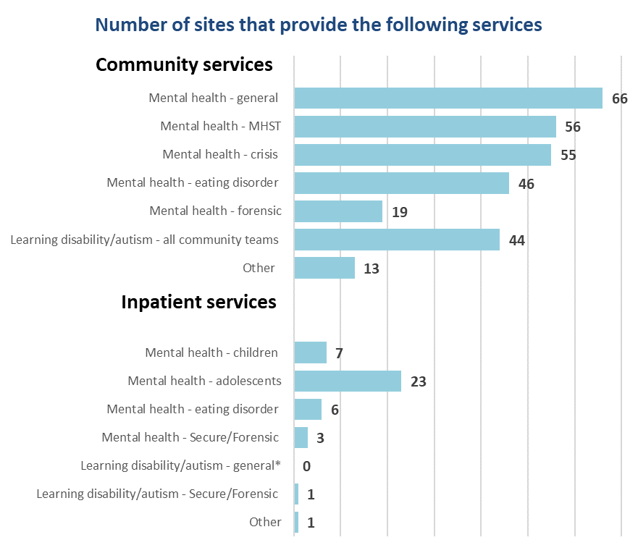
Service summary – NHS
Participants were asked to report the range of community and inpatient CYPMH services their sites provided in 2022. Seventy three of the potential eighty four participants responded.
The number of sites providing general CYPMH services has remained similar to 2021 (63), with 66 sites reporting they provided a general CYPMH team in 2022. However, the provision of mental health support teams (MHST) has increased from 47 sites in 2021 to 56 sites in 2022.
In the inpatient setting, similar to 2021, the most commonly provided service was general CYPMH adolescent beds, followed by general CYPMH children’s beds. It should be noted that both had decreased compared to 2021 from 31 and 9 respectively.
This appears to be in line with the long term plan ambition for children and young people’s mental health services, to boost community services and reduce reliance on in-patient care. However, note that a slightly different cohort responded in 2021 to 2022. The percentage of the NHS CYPMH workforce employed in community settings has increased slightly from 82% in 2021 to 83% in the most recent census.
*Organisations that reported general learning disability/autism services in the 2021 census, did not complete this question in the 2022 census

Slide 15
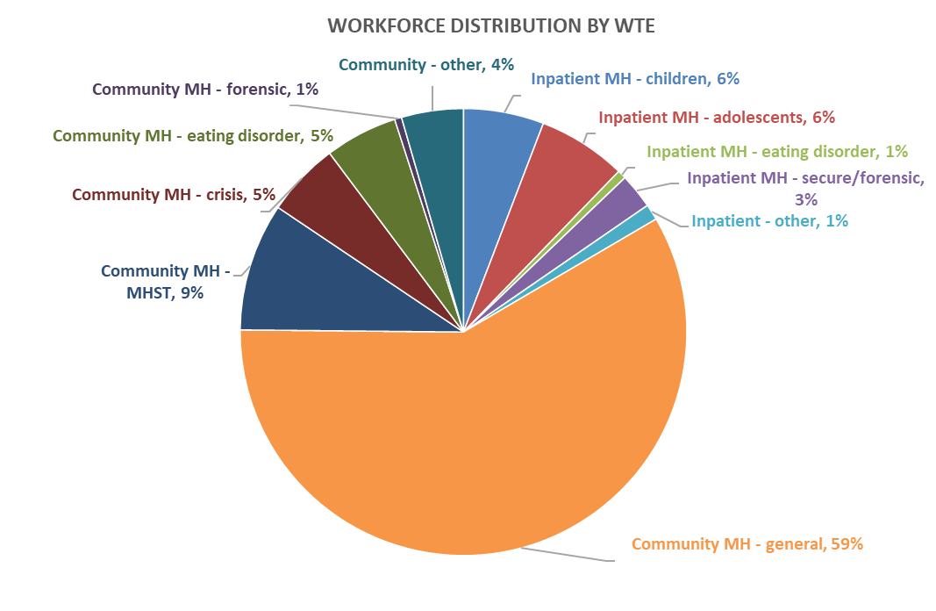
Workforce distribution - NHS
The chart to the right shows the distribution of NHS CYPMH staff across the different community and inpatient CYPMH services in England.
Nearly five in every six CYPMH staff employed by NHS providers is employed in community CYPMH services (83%), with 17% employed in inpatient services.
The largest team in terms of staffing is the general community CYPMH team, accounting for 59% of the NHS CYPMHS workforce. This is in line with the figure reported in 2021, also 59%.
In the inpatient setting, children and adolescent teams account for 12% of the total NHS CYPMH workforce, similar to the 14% reported in 2021.
The table to the right shows the WTE and headcount for each service area. The final column shows the ratio of WTE to headcount, with eating disorder services reporting the lowest ratio, suggesting a higher rate of part time working.
*Numbers reported in the table may be different to numbers reported elsewhere in the report as they only include staff where team type and contracted hours were recorded

Slide 16
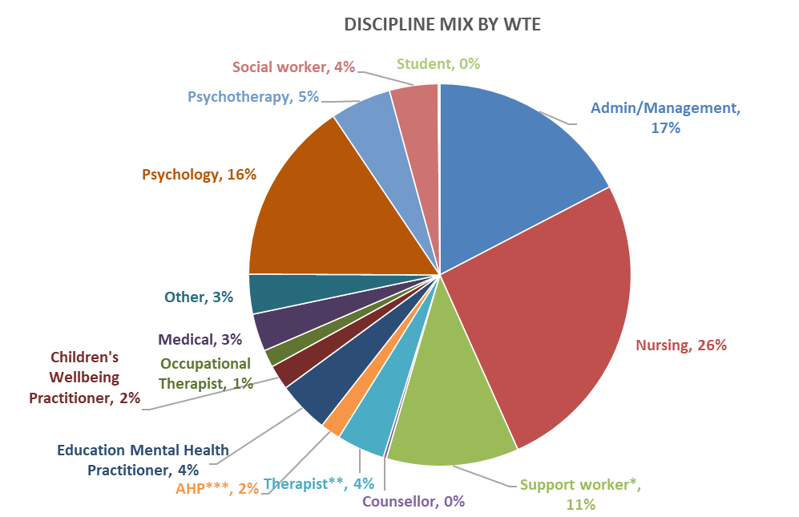







Total CYPMHS Discipline mix (NHS)
The chart below shows the discipline mix within NHS CYPMH services (community and inpatient services). Registered nurses account for just over a quarter of the CYPMH workforce (26%), followed by administrative/management staff (17%). There has been a slight increase in the proportion of psychologists, from 14% in 2021, to 16% in 2022. Of support workers, 5% were nursing associates and 1% were nursing associate trainees. The following pages explore the discipline mix for community and inpatient CYPMH services separately.
Percentage change from 2020/21
Admin = 0%
Nursing = 0%
Support worker* = -1%
Psychology = +2%
Medical = -1%
Psychotherapy = 0%
Therapist** = -2%
Other = -1%
*The data collection grouped nursing associates with support workers
**Systemic family therapists, play and other therapists are categorised as therapists for the purposes of this data collection
***Dieticians, physiotherapists, speech and language therapists, art, drama and music therapists are categorised as AHPs

Slide 17
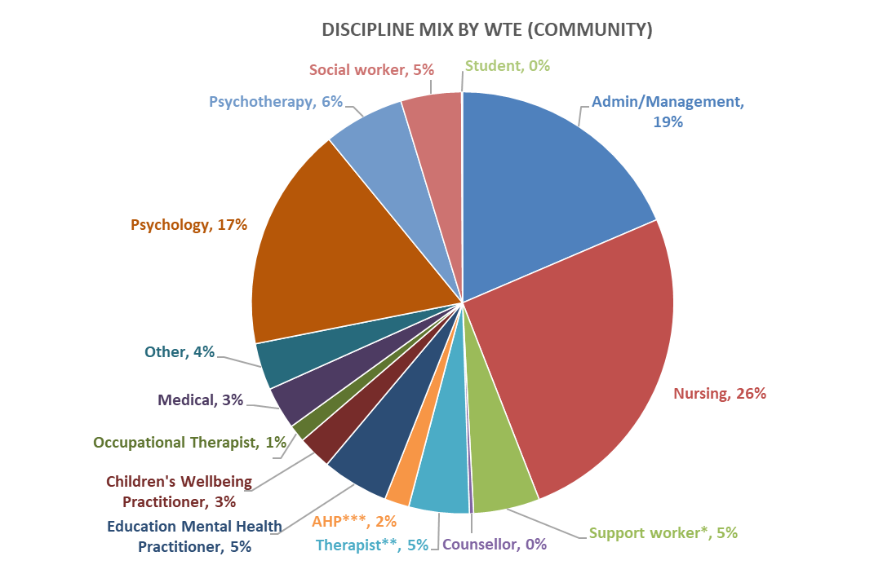
Community CYPMHS Discipline mix (NHS)
The chart below shows the community NHS CYPMHS discipline mix across England. Registered nurses account for 26% of the community CYPMH team; psychologists accounted for 17% of the discipline mix. As noted previously, there has been an increase in education mental health practitioners (EMHP), accounting for 5% of the workforce compared to 3% in 2021.
Psychotherapists are the fourth largest discipline in community CYPMHS, with a 6% share of the discipline mix, similar to 2021.
Percentage change from 2020/21
Admin = +1%
Nursing = +1%
Support worker* = -1%
Psychology = +2%
Medical = -1%
Psychotherapy = 0%
Therapist** = -2%
Other = 0%
*The data collection grouped nursing associates with support workers
**Systemic family therapists, play and other therapists are categorised as therapists for the purposes of this data collection
***Dieticians, physiotherapists, speech and language therapists, art, drama and music therapists are categorised as AHPs

Slide 18
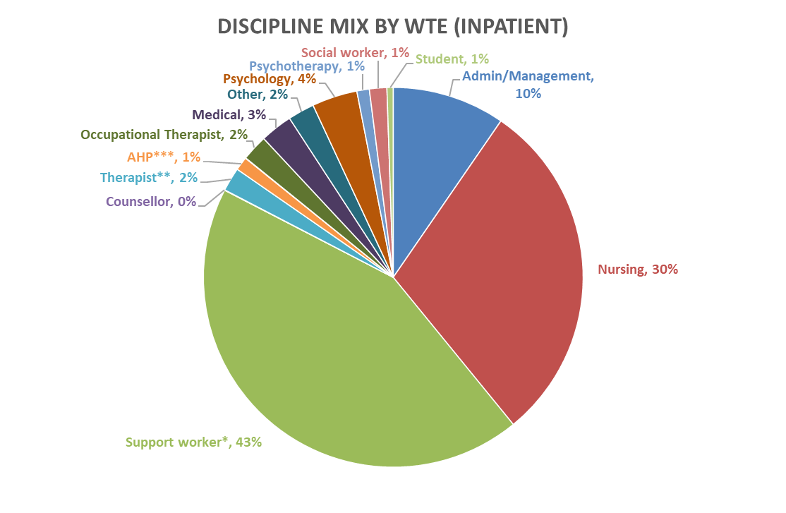
Inpatient CYPMHS Discipline mix (NHS)
The discipline mix within inpatient CYPMH services largely contrasts the community services, with a notable presence of support workers (43%, compared to 5% in community CYPMHS), similar to 2021. Registered nurses account for just under a third of the workforce, with 30% of the discipline mix. Psychologists are the fourth largest discipline in inpatient services, similar to community, but they only account for 4% of the inpatient workforce, compared to 17% in the community.
Percentage change from 2020/21
Admin = -1%
Nursing = -2%%
Support worker = +2%
Psychology = -1%
Medical = 0%
Psychotherapy = 0%
Therapist = +1%
Other = 0%
*The data collection grouped nursing associates with support workers
**Systemic family therapists, play and other therapists are categorised as therapists for the purposes of this data collection
***Dieticians, physiotherapists, speech and language therapists, art, drama and music therapists are categorised as AHPs

Slide 19
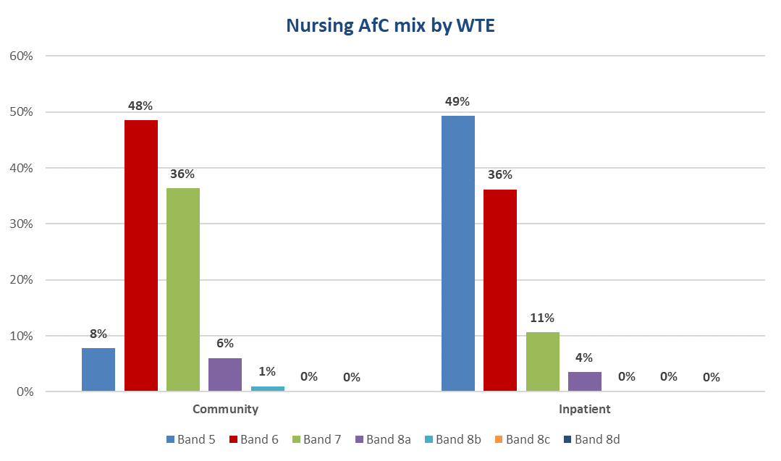
Nursing skill mix (NHS)
Total CYPMHS
The left side of the chart shows the skill mix of registered nurses within community CYPMHS and the right side shows the profile for inpatient CYPMHS.
In 2022, just under half the registered nurses in the community setting were Agenda for Change (AfC) band 6 (48%),with 44% of registered nurses band 7 or higher.
In the inpatient setting the nursing skill mix is more junior, with 49% of the nursing workforce band 5, and only 14% of registered nurses band 7 or higher.

Slide 20
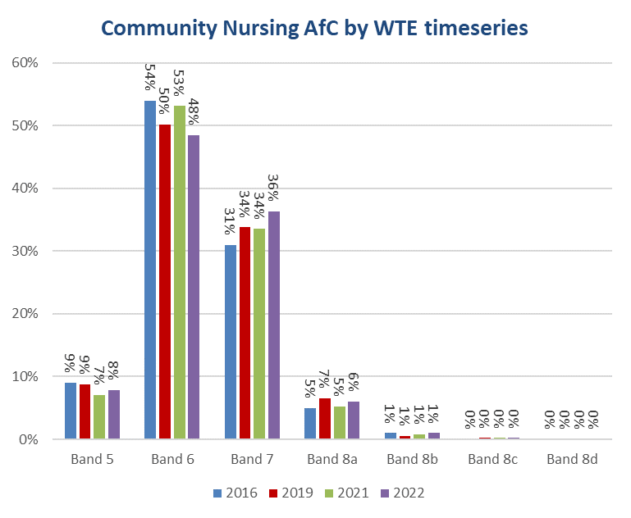
Nursing skill mix (NHS) – timeseries analysis
Community
The chart to the right shows the community registered nursing skill mix in more detail, analysing the fluctuation in the skill mix over the last four censuses.
The proportion of band 5 nurses has increased slightly from 7% in 2021, to 8% in 2022. Band 6 nurses now account for 48%, a decline from 53% in 2021.
However, the overall nursing workforce has seen a marginal increase in seniority, with an increase in band 7 nurses (36%, compared to 34% in 2021), and a 1% increase in band 8a nurses to 6%.

Slide 21
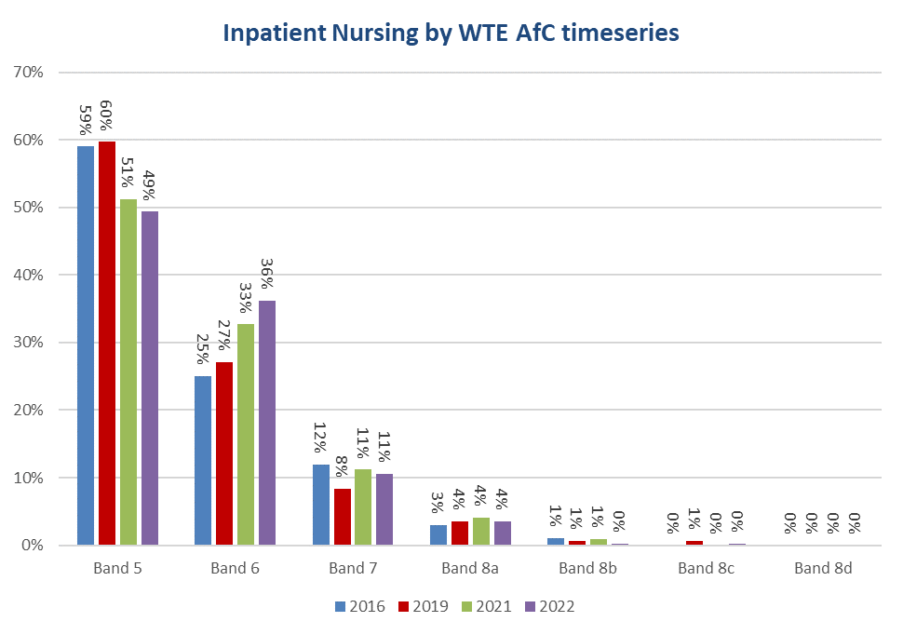
Nursing skill mix (NHS) – timeseries analysis pt. 2
Inpatient
The discipline mix in the inpatient setting has continued to increase in seniority. There was a marginal decrease in band 5 nurses from 51% in 2021 to 49% in 2022. There was also a previous decrease of 9% between 2019 to 2021.
The upward trajectory in the proportion of band 6 nurses has continued, with an increase from 33% in 2021 to 36% in 2022, a third consecutive increase.
The percentage of the inpatient nursing workforce band 7 and above has remained fairly consistent across the four censuses.

Slide 22
CYP MHS Workforce Profile
Independent Sector

Slide 23
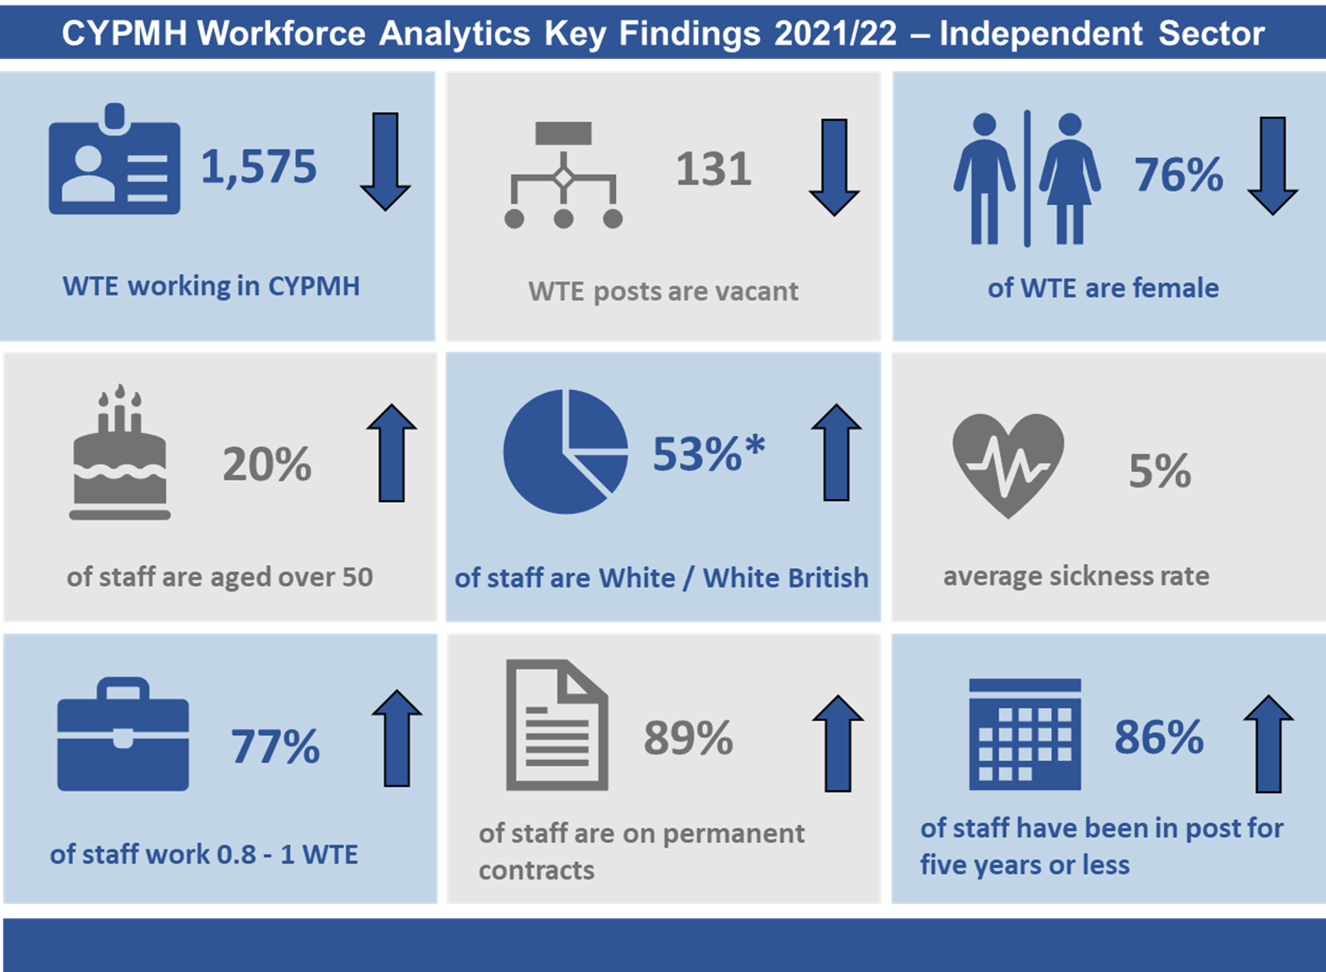
Key findings for Independent Sector – 2021/22
Please note that the arrows demonstrate whether the metric increased, decreased, or stayed the same from the position in 2020/21 (values shown in Appendix 2). Average sickness was not shown as a key metric in 2020/21.

Slide 24
Independent sector data submissions
The following section explores the submissions from independent sector (also known as private providers) providers of CYPMH services commissioned by NHS England Specialised Commissioning. In total, five providers submitted data for the 2022 census. Most of the organisations provided inpatient services only although provision of services outside of the inpatient setting were also reported, e.g. intensive home treatment.
Independent sector providers were given the option to submit their data at either an organisational level or site level. This allowed organisations which may have a mix of services or CYP sub-specialties in different regions to understand their services better. Due to this, a total of ten submissions were received from the five organisations. The mix of submissions at organisation and site level, does not affect the national position as all data is aggregated.
It is difficult to make caparisons with previous years due the relatively low number of submissions received in 2022 compared to 2021.

Slide 25
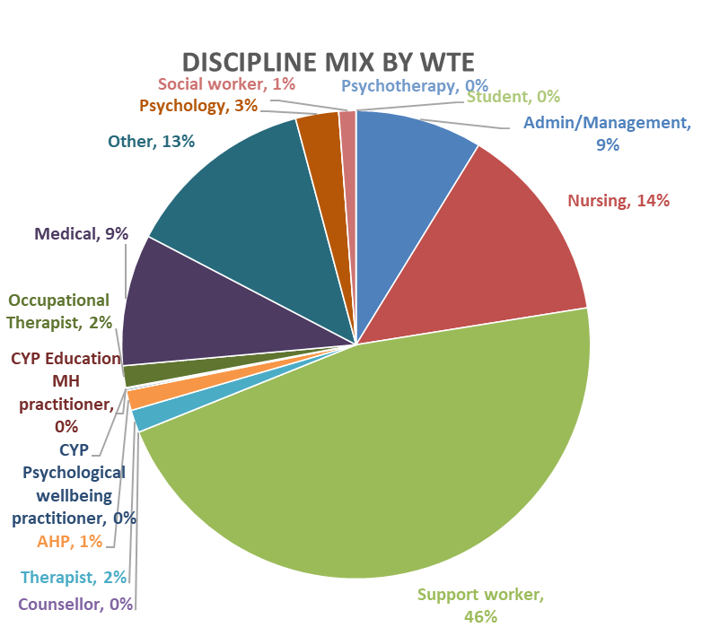
Independent sector – discipline mix
The chart to the right shows the discipline mix of CYPMH staff employed by the independent sector in 2021/22.
Just under half the staff employed in the independent sector were reported to be support workers (46%). This has decreased from 58% in 2020/21.
Nurses as a proportion of the workforce have increased slightly to 14%, from 12% in 2020/21.
The proportion of medical staff has increased from 2% in 2020/21 to 9% in 2021/22.

Slide 26
CYP MHS Workforce Profile
Local Authorities

Slide 27
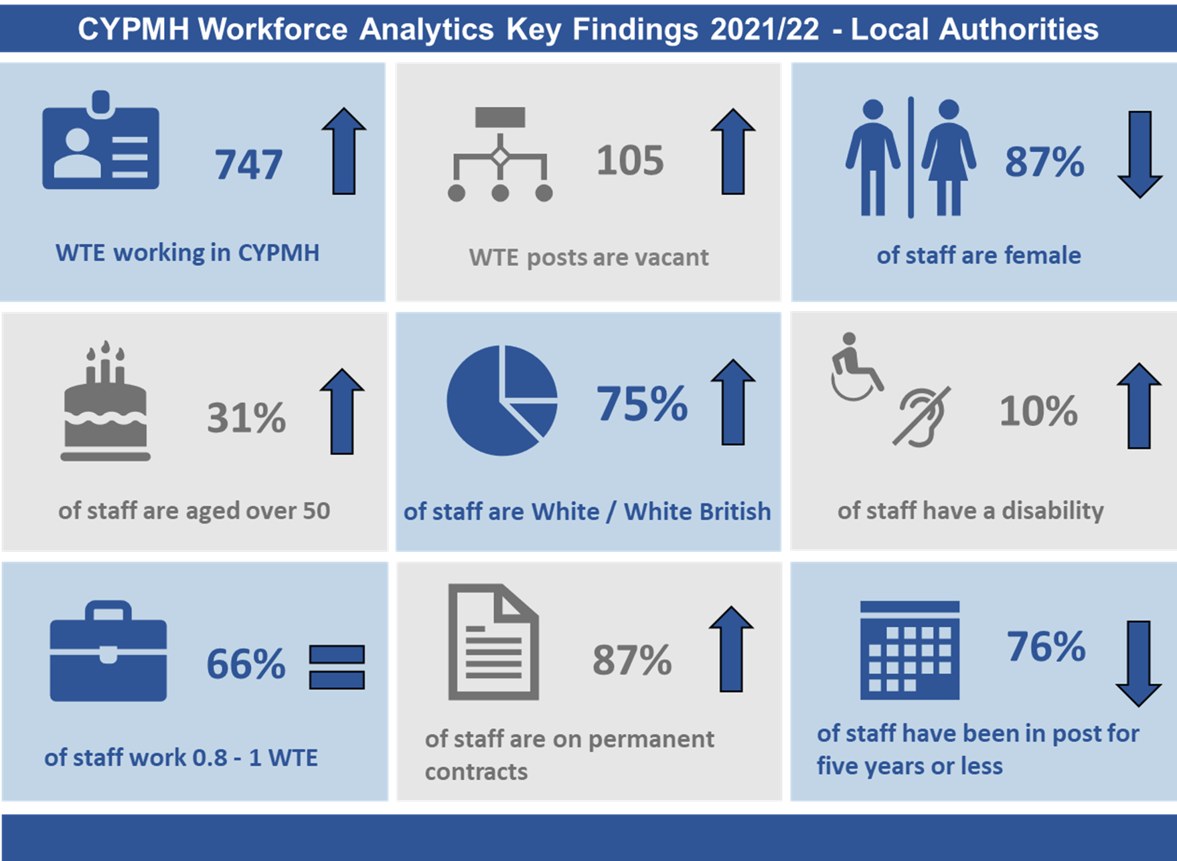
Key findings for Local Authorities– 2021/22
Please note that the arrows demonstrate whether the metric increased, decreased, or stayed the same from the position in 2020/21 (values shown in Appendix 2).

Slide 28
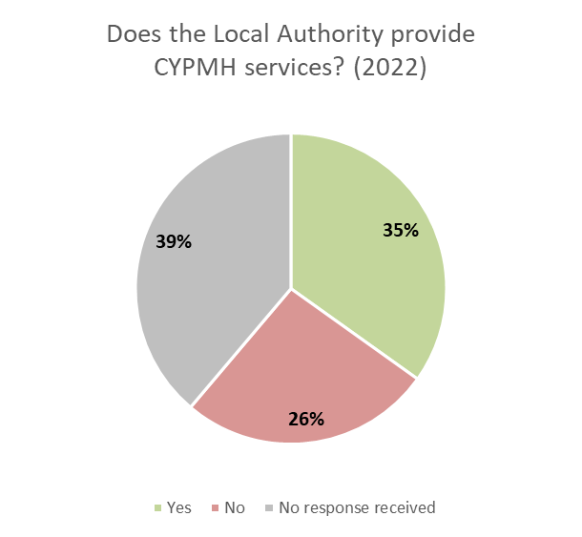
Local authority data submissions
The Local authority data collection specification was distributed to the 152 local authorities in England. Of these, 53 (35%) responded that they provide CYPMH services and submitted to the data collection. Forty (26%) responded that they do not provide CYPMH services. The remaining 59 (39%) did not respond to the survey.
The presence of local authorities as providers of CYPMH services is less evident, with staff from this sector making up just 3% of the total CYPMHS Workforce.

Slide 29
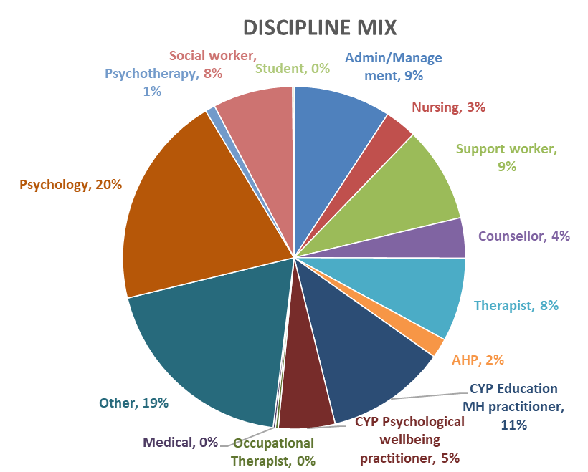

Local authority – discipline mix
Within CYPMHS services in local authorities the most common job role was psychologist (20%), with more than half of these (56%) being educational psychologists. The next largest staffing group was CYP education mental health practitioners, which have increased from 8% of the workforce in 2021 to 11% of the workforce in 2022. Nationally 19% of the CYPMH workforce in local authorities was categorised as ‘Other’, suggesting the traditional CYPMH job roles seen within NHS healthcare settings are less applicable to this setting.
Percentage difference from 2021
Admin = 0%
Nursing = +1%
Support worker = 0%
Psychology = -2%
Medical = 0%
Psychotherapy = 0%
Therapist = -4%
Other = +2%

Slide 30
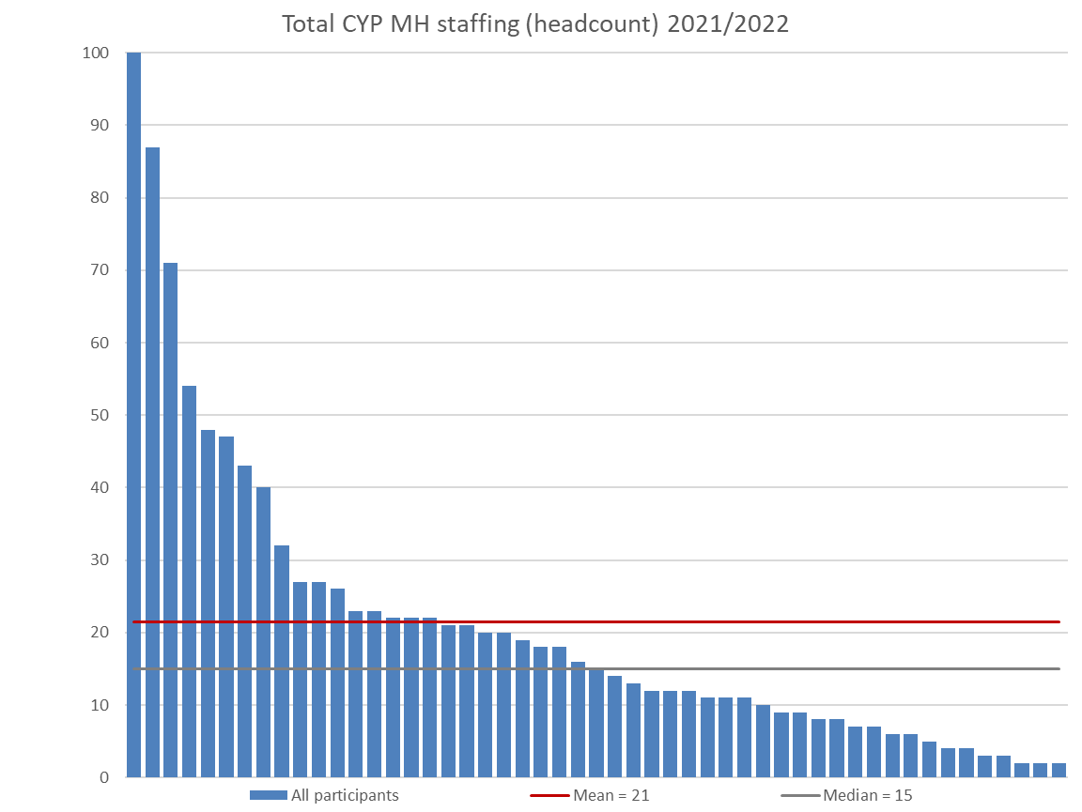
Local authority staff in post
This chart shows the headcount of the CYPMHS workforce within participating local authorities.
There is a high degree of variation across the sector, likely due to differences in service models and commissioning arrangements.
There was a mean of 21 staff (headcount) per local authority, a slight increase from 2021 when it was 18.
The total headcount of staff reportedly working in CYPMHS services within local authorities was 899 (747 WTE). This is an increase from the 746 (600 WTE) reported in 2021 but is still well below the 1,259 (1,065 WTE) reported in 2019.
However, if we look at the average WTE per submission it has increased from 13 to 14 and while this is not a definitive statement about growth as submissions are not the same providers each year, it does suggest that WTE within this sector has been relatively stable.
It is worth noting that the vacancy rate increased from 6.25% to 12%.
The percentage of staff on permanent contracts increased to 87% from 77% whilst the percentage of staff in post for 5 year or less fell to 76% from 82%.
This fluctuation in metrics will be impacted by the variation in participating organisations from year to year, along with changing service delivery models.

Slide 31
CYPMHS Workforce Profile
Voluntary Sector

Slide 32
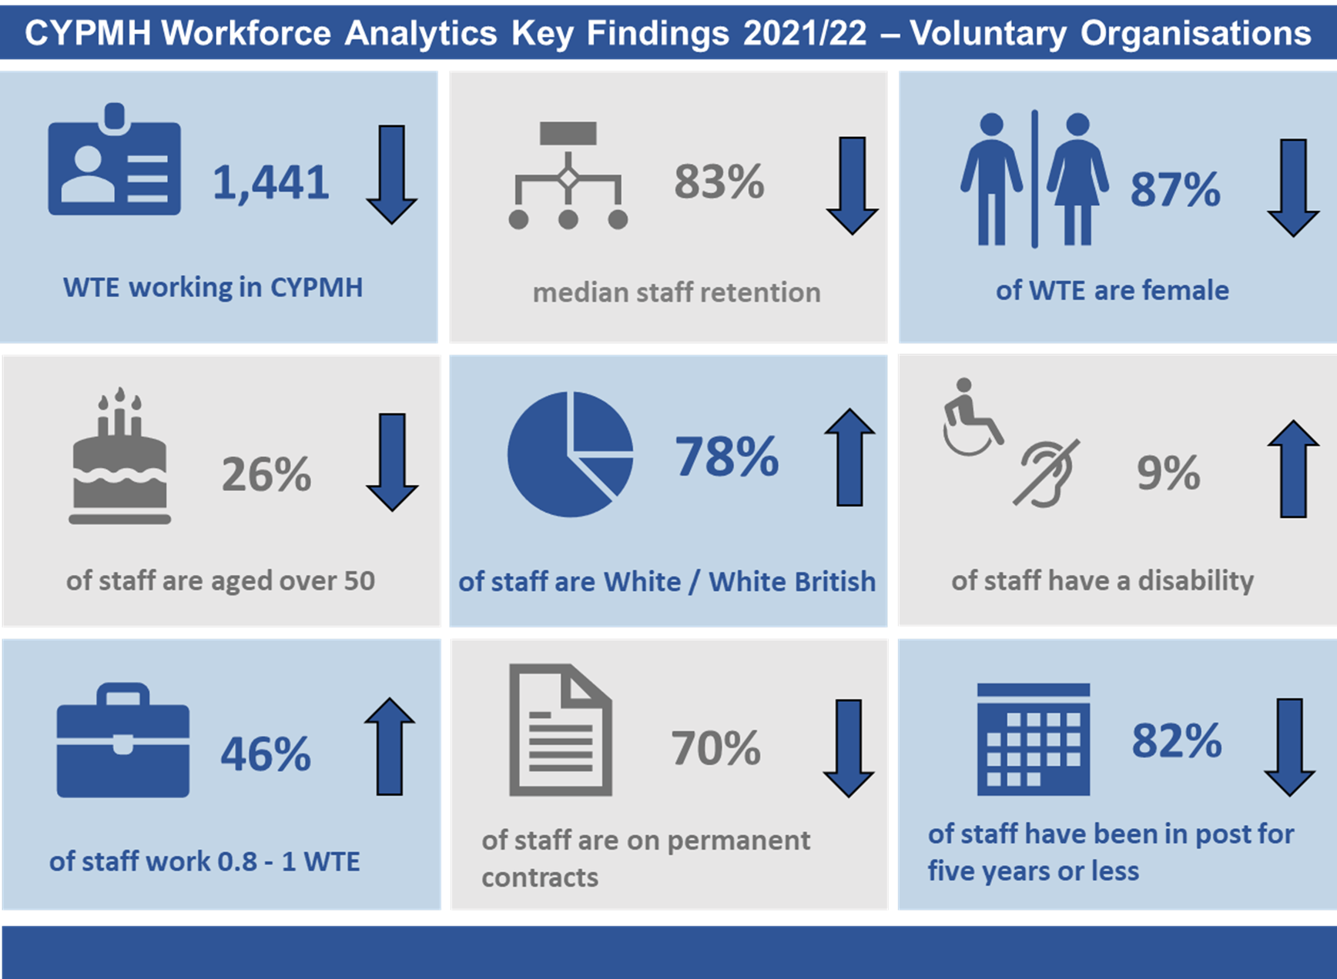
Key findings for Voluntary Organisations – 2021/22
Please note that the arrows demonstrate whether the metric increased, decreased, or stayed the same from the metric’s position in 2020/21 (values shown in Appendix 2).

Slide 33
Voluntary sector data submissions
Typically the voluntary sector is more diverse and variable in the provision of CYPMH services than statutory providers. The position of the voluntary sector reflects the diversity of commissioning arrangements in the sector, with organisations commissioned by a variety of statutory organisations including NHS organisations and local authorities. The size and shape of CYPMH provision by voluntary organisations also differs due to commissioning scope and can vary from wide access to general services to more niche and targeted activities for small groups.
Voluntary organisations play a key role in supporting CYP with mental health needs, often also supporting their families and carers. Voluntary providers often offer a wider range of services focused around less acute needs than NHS providers.
In 2022, 55 voluntary organisations submitted data to the project. This is a reduction from the 74 organisations who took part in 2021, but is still greater than the 35 organisations that submitted data to the project in 2019. A variety of organisation types took part ranging from UK wide charities to small local charities. There was also variation in the age range that the participating organisations provided services for. Some organisations provided services specifically for children and young people while others catered for adults and young people transitioning between CYPMH and adult care. Furthermore, participants also included charities funded largely through the NHS and others who were entirely funded through other sources.
Anonymised demographic data about the staff in post was also provided by a number of organisations, including both clinical and nonclinical staff. This data provided an insight into the time in post, contract type, and gender split of an organisation’s employees.

Slide 34
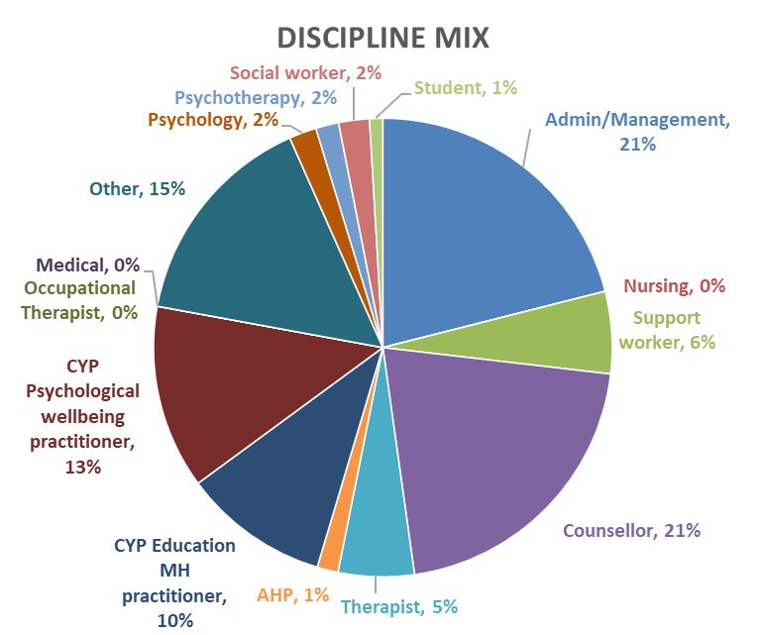
Voluntary sector – discipline mix
In CYPMH services provided by voluntary organisations, the most common job roles were counsellors (21%), and admin/management (21%), with CYP psychological wellbeing practitioners (13%) and CYP education mental health practitioners (10%) as the next largest proportions of the workforce. Nationally 15% of the CYPMH workforce in voluntary organisations was categorised as ‘Other’, suggesting the traditional CYPMH roles seen within NHS healthcare settings are less applicable in this setting.
Percentage difference from 2021
Admin = +4%
Nursing = -1%
Support worker = +2%
Psychology = 0%
Medical = 0%
Psychotherapy = -2%
Therapist = 0%
Other = -1%

Slide 35
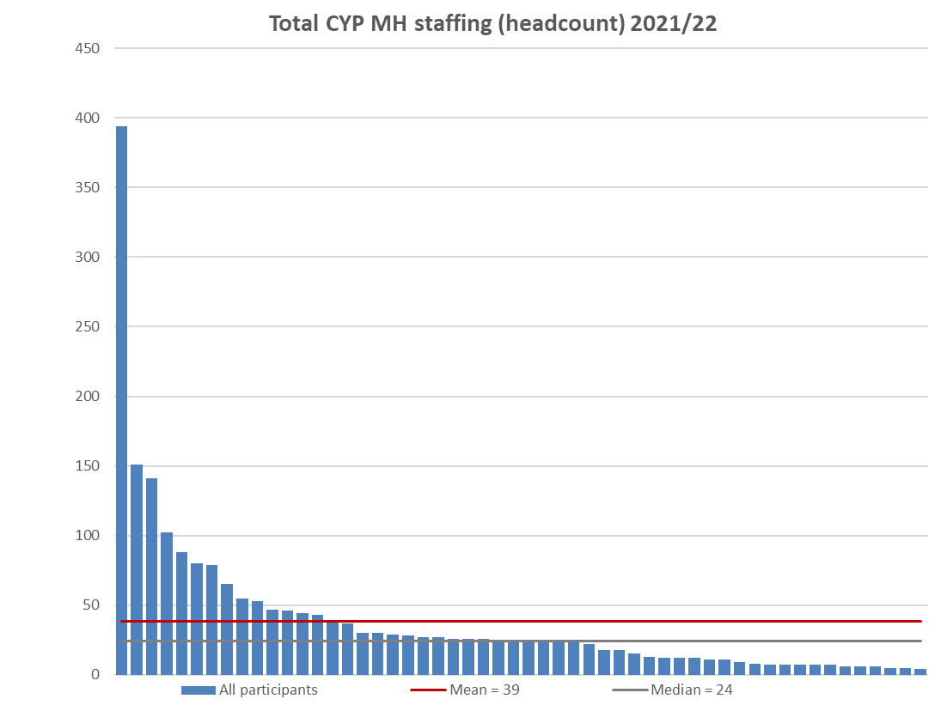
Voluntary sector – staff in post
This chart shows the size of the voluntary sector workforce through the reported headcount of each participating organisation. Organisations in this sector are typically smaller than statutory providers.
There is a wide range of headcount reported, from 4 members of staff to 394 working in voluntary sector CYPMH organisations. This variation may be due to the diversity of voluntary sector provision, as well as an expansion in the services delivered by charities and third sector organisations.
The national median of 24 has continued to grow, from 18 in 2021 and seven in 2019.
Also, the average WTE per submission has increased from 19.7 to 26.2. While this is not a definitive statement about growth as submissions are not the same providers each year, it does mirror the median profile above, suggesting year on year growth.

Slide 36
CYPMHS Workforce Profile
Youth Offending Teams

Slide 37
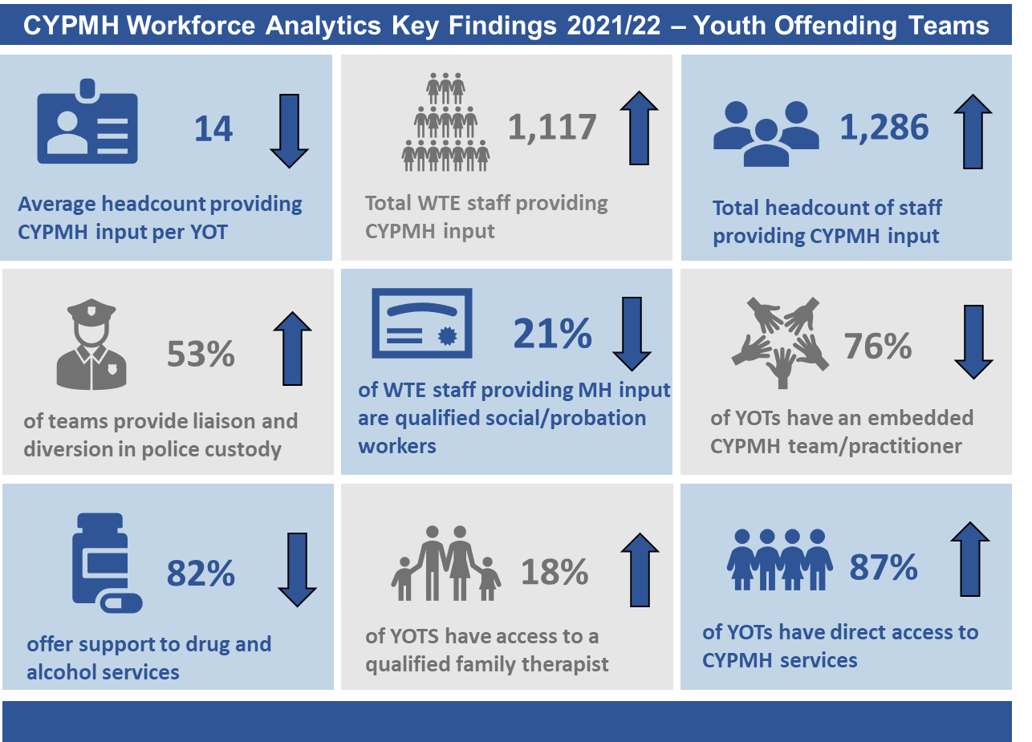
Key findings for Youth Offending Teams– 2021/22
Please note that the arrows demonstrate whether the metric increased, decreased, or stayed the same from the metric’s position in 2020/21 (values shown in Appendix 2).

Slide 38
Youth offending teams data submissions
This year 106 Youth Offending Teams (YOTS) provided data for the stocktake of CYPMH workforce. This is a 19% increase from 2021 when 89 Youth Offending Teams provided data for the collection.
When viewing this data it should be noted that YOTs typically employ very small numbers of designated CYPMH workers. The service model of YOTs tend to be organised in such a way that supporting children and young people with mental health issues is part of the holistic role of the YOT, and a role that many members of the team contribute towards. This may include social workers, probation officers, other practitioners, and a range of managerial and support staff. Due to this, the census question asked of YOTs is slightly different to that of the other sectors included in this report. Instead of asking how many staff are employed specifically as CYPMH workers, they were asked to include all their staff that provide CYPMH input, recognising that many of these staff will have wider roles.

Slide 39
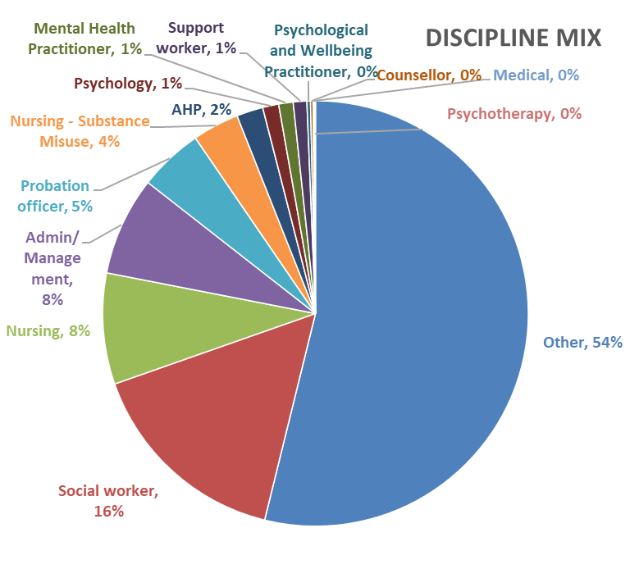
Total CYPMHS Discipline mix (Youth offending teams)
Participating youth offending teams were asked to provide the WTE of staff who contribute to CYPMHS by job role. ‘Other’ makes up the largest segment at 54% of the workforce. Of the roles that map to 'other' 57% were 'other practitioners', and 31% were staff with a ‘youth justice effective practice certificate’ (or working towards). It was reported that 16% of the workforce are qualified social workers, an increase from 13% in 2019. Furthermore, 5% of the workforce were qualified probation officers, a marginal increase from 4% in 2021. ‘Nursing – Substance misuse’ has been separated from other nursing roles as they make up the largest proportion of nurses in this sector.
Percentage change from 2021
Probation officers = +1%
Social workers = +3%

Slide 40
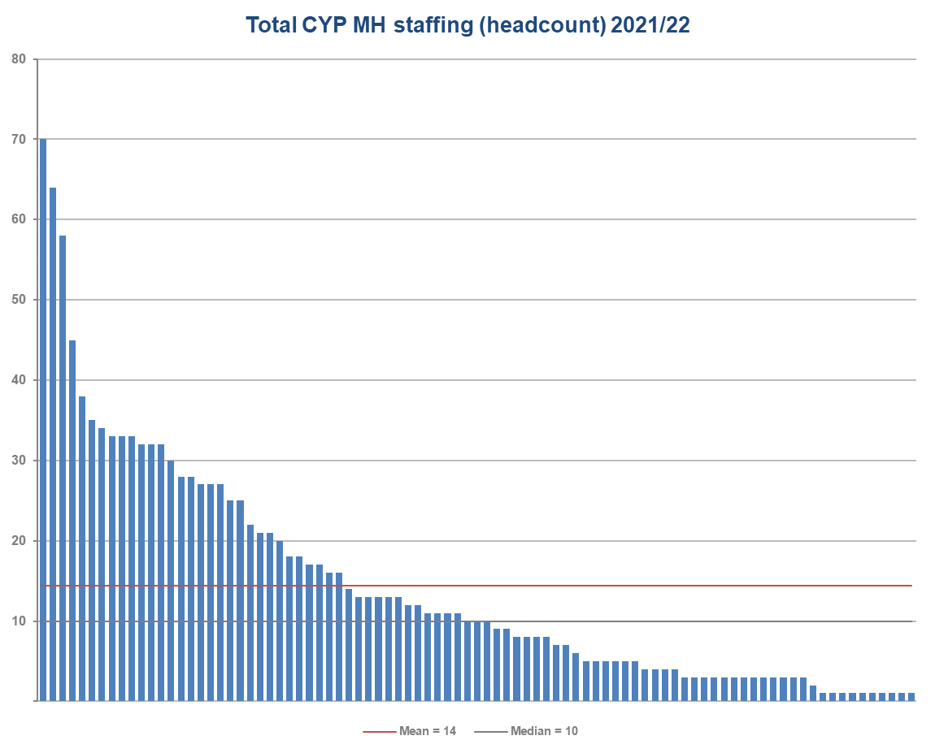
Youth offending teams – staff in post
A total of 106 Youth Offending Teams participated in the data collection and provided the headcount of their workforce who provided children and young peoples mental health input.
The average number of staff who provide children and young people’s mental health input per YOT has remained in line with the last iteration of the project in 2021. Whilst the mean for 2021 was 15 staff per YOT the average number of staff that provided CYPMH input per YOT in 2019 was marginally higher (18).
The range in staffing numbers was between 1 and 70.

Slide 41
Vacancies
NHS CYPMH Staff

Slide 42
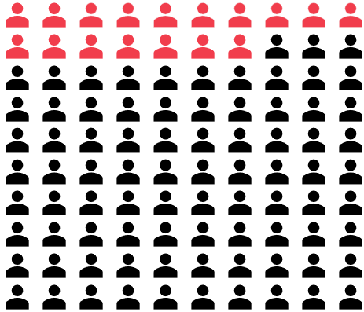
Vacancies – NHS
The continued increase in demand for CYPMH services continues the need to grow the CYPMH workforce.
The 2,902 vacancies reported across NHS CYPMH services in 2022 was almost double the number reported in 2021 (1,642). This resulted in a vacancy rate of 17% compared to 9% in 2021.
The increase in vacancies may be due to a number of factors, including a lag in the recruitment process, an increase in the number of staff leaving services and staff supply issues.
In attempting to understand the drivers for this increase it is worth noting that the WTE funded establishment (staff in post + vacancies) increased by 16% over the same period. This compared to a 8% increase in staff in post.
Staff retention in 2022 (staff in post at the beginning of the financial year that were still in post at the end) was 77% compared to 83% in 2019 and 80% in 2021.
Note: We have refined our methodology relating to the calculation of vacancies, which is now based only on direct data submissions to this project.
Looking at retention and the potential retirement of the workforce due to changes in the NHS pension scheme, the percentage of staff aged 50+ fell by 1% from 29% to 28% between 2021 and 2022. Similarly, if the percentage over 55 or over 60 is compared they also show a 1% point reduction to 16% and 7% respectively. The percentage of nursing staff aged over 50 increased from 26% in 2021 to 28% in 2022.
The following pages analyse vacancies by job role including changes compared to the previous year.
This census did not ask about the reason for leaving or the why posts were vacant. Similarly, retention rates were captured at organisational level and not broken down any further.

Slide 43
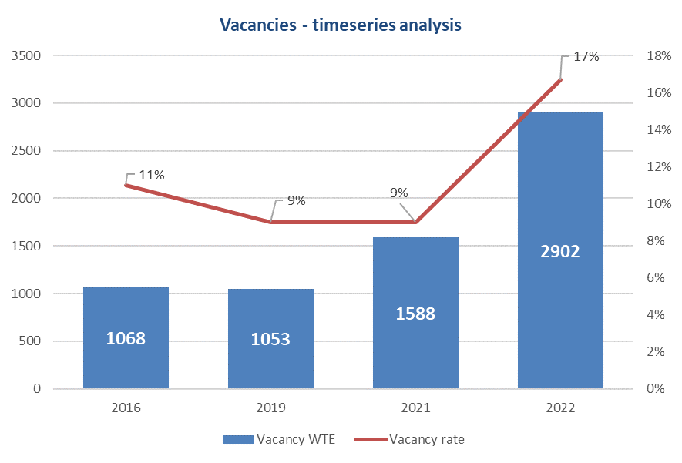
Vacancies (NHS) – timeseries analysis
The chart to the right plots the absolute number of vacancies (WTE) for the 2016, 2019, 2021 and 2022 censuses and the vacancy rates in each year. Volumes were stable between 2016 and 2019. Whilst they increased between 2019 and 2021 vacancies as a proportion of the workforce remained consistent at 9%.
Between 2021 and 2022 the number of vacancies increased by 1,314, resulting in a vacancy rate of 17%, a notable increase on the previous two years.
This compares to adult mental health services vacancy rates in 2022 of 18% for inpatient services and 14% for community services. As in CYP services, the vacancy rates in these sectors had increased compared to 2021 from 12% and 7% respectively.
Other sectors reported lower rates than mental health services. Emergency inpatient care had 12% vacancies and community district nursing 10%.
This year 7 organisations (12 sites) submitted over-establishment which is excluded from the vacancy calculation. These organisations submitted 131 WTE over-establishment.
More detailed analyses of vacancies by job role are included in the following pages.

Slide 44
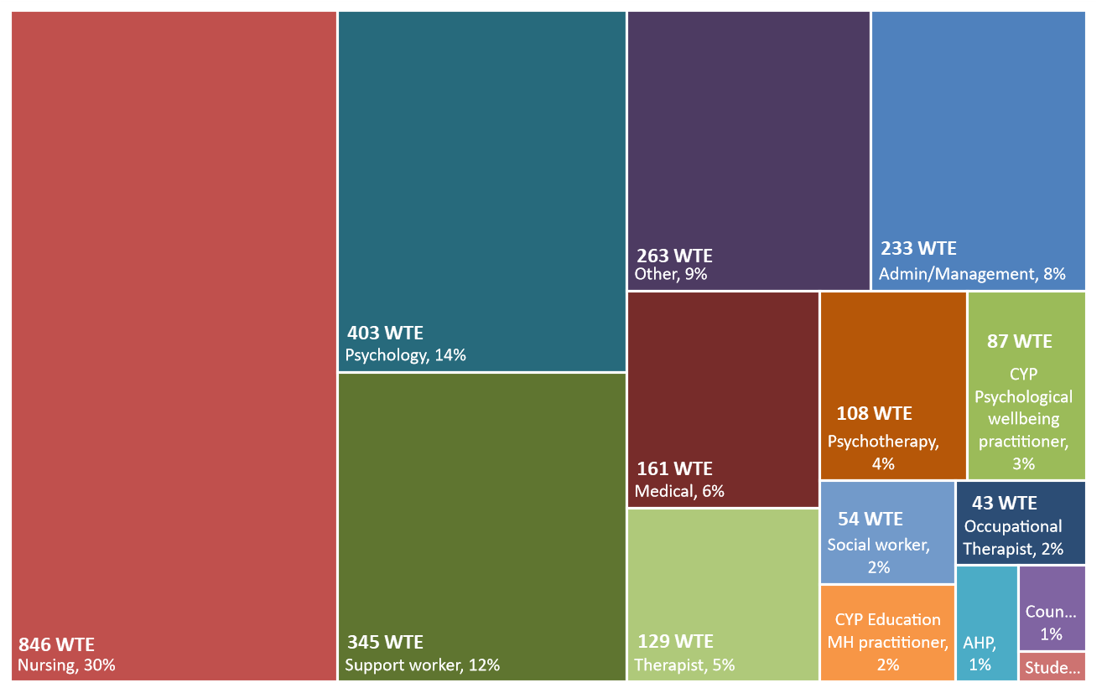
Vacancy profile - NHS
The graphic below shows the distribution of vacancies across job roles where vacancies are reported. The number is the number of WTE vacancies, and the percentage is the proportion of vacancies that the job role represents. The percentage is not the vacancy rate.
The number of vacancies should be considered alongside the workforce WTE for each group which was reported earlier.
Vacancy rates are reported for groups with the highest vacancies on the next page.

Slide 45
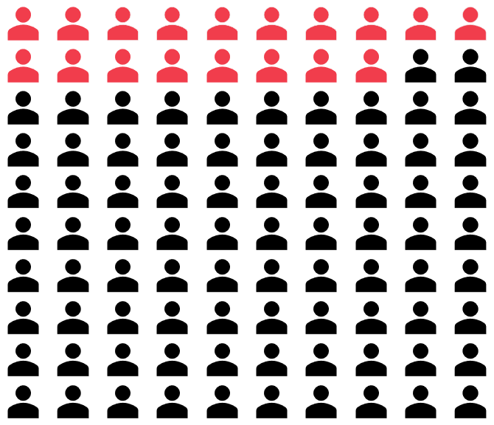
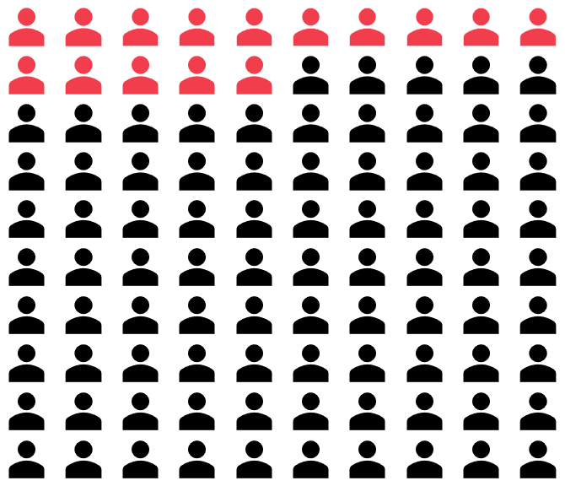
Vacancy rates by role
The vacancy rates reported for the three job roles with the highest vacancies are detailed below along with the WTE vacancies and comparison with 2021.
Nursing
The nursing vacancy rate in 2022 was 18% (846 WTE) which had increased from 14% in 2021 (545 WTE).
Support workers
The support workers vacancy rate in 2022 was 17% (345 WTE) which had increased from 6 % in 2021 (156 WTE).
Psychology
The psychology vacancy rate in 2022 was 15% (403 WTE) which had increased from 10% in 2021 (193 WTE).

Slide 46
Staffing Demographics

Slide 47
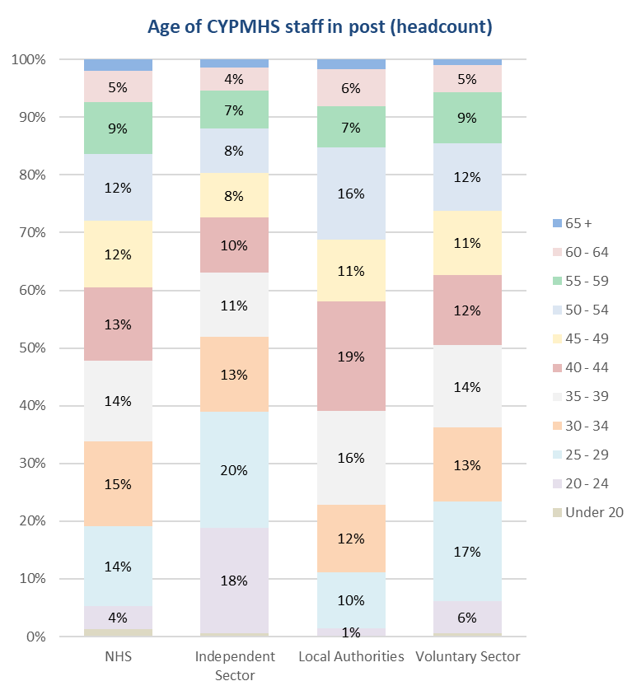
Age of staff
The stacked bar chart to the right shows the age of CYPMHS staff across England in the different sectors. Each colour represents a five year age band, between 20 and 65 years old.
The providers within the NHS (far left bar) reported an evenly distributed workforce across the five year age brackets. This is also evident in local authorities and the voluntary sector.
However, in the independent sector, the workforce shows a higher proportion of young staff members, with 38% of the workforce being under the age of 30.
The table below is the profile over time for NHS staff showing a slight rise in lower age bands and decline in the percentage of staff aged 55 and over in 2021 and 2022.

Slide 48
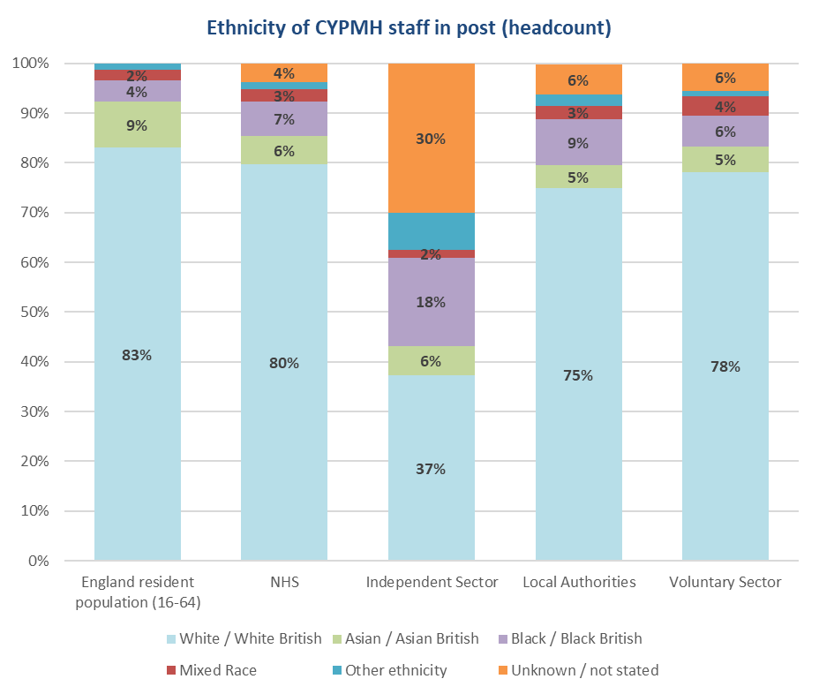
Ethnicity of staff
The chart to the right shows the comparison between the CYPMHS workforce across the four sectors with the ONS resident working age population for England (16 – 64 year olds).
In England, 9% of the working age population are Asian/Asian British people. Across all four sectors surveyed in 2022 there was an under-representation of Asian/Asian British staff in CYPMHS. Asian/Asian British staff accounted for 5% of the workforce in the local authority and voluntary sectors and 6% in the NHS and independent sector.
There was a higher representation of Black/Black British staff in the CYPMH workforce compared to the general population (ranging from 6% in voluntary sector to 18% in the independent sector, compared to 4% in the England resident population (16-64).
The independent sector ethnicity breakdown is skewed, with a large proportion of the workforce’s ethnicity either unknown or not recorded by their systems.

Slide 49
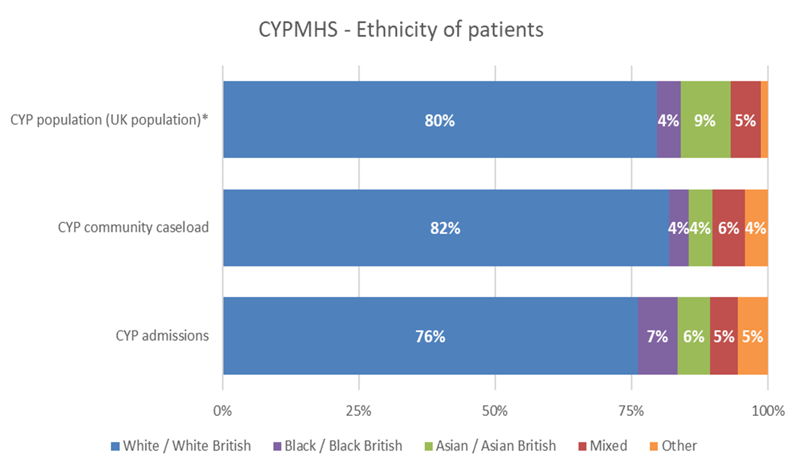
Ethnicity of CYPMHS service users (NHS)
The NHS Benchmarking Network run an annual benchmarking project that collects comprehensive data on CYPMH services across the UK (2021/2022 Children and Young People’s Benchmarking Project, NHS Benchmarking Network). This data supports a range of subsequent analysis that provides insight to local commissioners, providers and also national policy organisations.
The chart to the right shows the ethnicity of children and young people treated within community and inpatient services across the UK. It also shows the ethnicity profile of the associate CYP population.
Compared to the population there is an under representation of Asian /Asian British children and young people within both community and inpatient services. For Black/Black British CYP there was an over representation in inpatient services.
*The data used is the latest available from each of the nations. For England and Wales this is from the Office of National Statistics (2019), Scotland is from the Population Estimates from the National Registry Office (2014) and the Northern Ireland data is from the 2011 Northern Ireland census.
Comparing this to the profile of the NHS workforce on the previous page, the proportion of White/White British workers (England) is the same as in the CYP population (UK) at 80%.
Black/Black British and Asian/Asian British staff (England) percentages are in line with the profile for CYP admissions (UK) and higher than children and young people in community services (UK). There is a lower percentage of mixed race staff (England) at 3%, compared to the rates reported for inpatient (5%) and community service users (6%) .

Slide 50
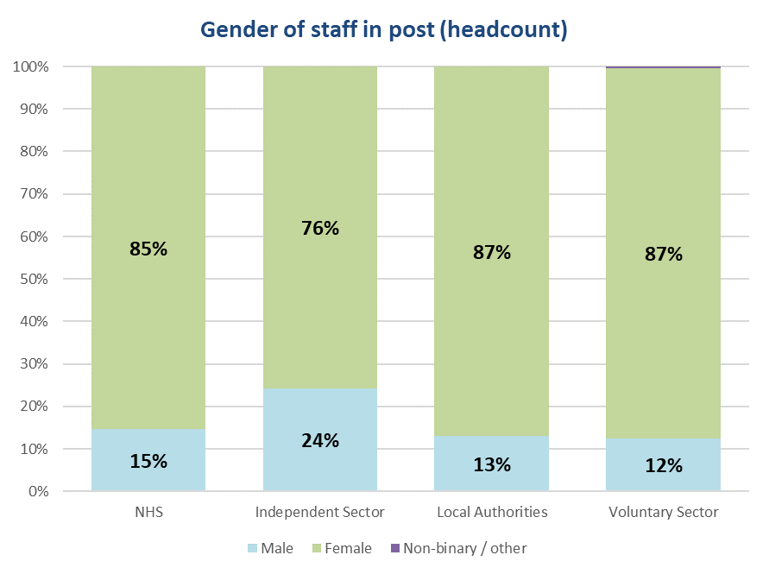
Gender of staff
Organisations reported the gender of staff working in their CYPMH services in 2021/22.
Similar to previous years, across all four sectors, the CYPMHS workforce was predominantly female. In the NHS the ratio of male to female is 1:6, while in the independent sector it is 1:3.
In the local authority sector, the proportion of males has increased from 11% in 2021 to 13%. The proportion of males working in the voluntary sector is the same as in 2021.

Slide 51
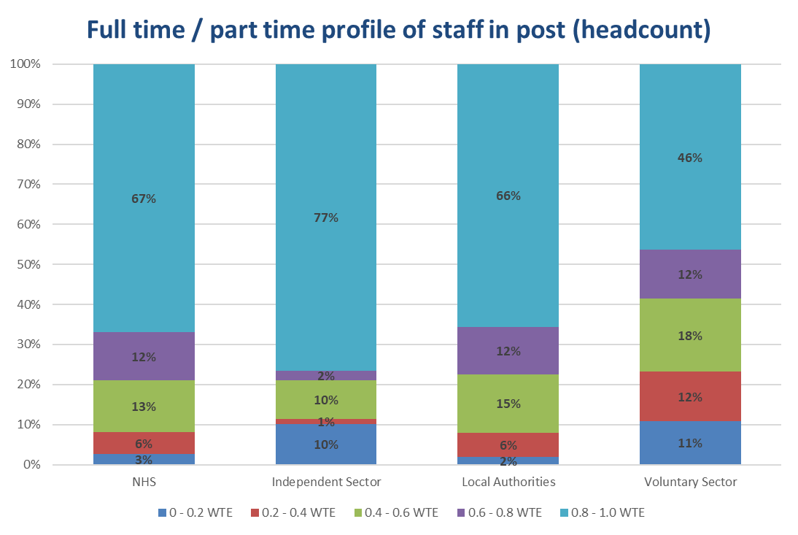
Contracted hours of staff
The chart to the right shows the full time/part time profile of CYPMHS staff across England.
In the NHS, independent sector and local authority, the majority of CYPMHS staff work full time (0.8 – 1.0 WTE).
In the NHS and local authority, full time workers account for two thirds of staff, while in the independent sector, they account for just over three quarters of staff in post. The percentage of full time staff has increased in the independent sector from 65% in 2021, but this is based on fewer submissions.
In the voluntary sector, 46% of staff recorded they worked full time, an increase from 44% in 2021.

Slide 52
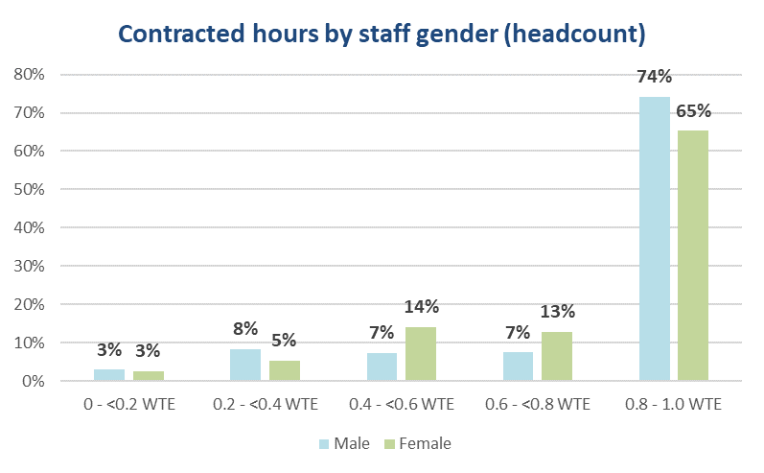
Additional gender profiling - NHS
Looking at staff contracted hours by gender, the chart on the right shows a higher proportion of male staff work full time (74%) compared to female staff (65%).
For staff that work between two and four days a week (0.4 – 0.8 WTE) there are proportionally twice as many women (27%) compared to men (14%).
When comparing staff that work up to one day per week there is negligible difference between the proportion of male and females (both at 3%). Among staff that work between one to two days per week there are marginally more men than women - 8% compared to 5% respectively.

Slide 53
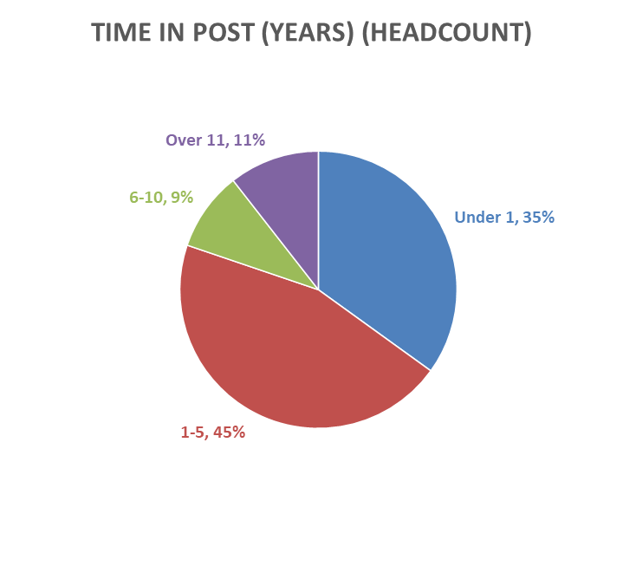
Time in current post - NHS
NHS providers were asked to report the number of years CYPMH staff had been in their current role as of 31st March 2022.
The vast majority of staff were reported to have been in their current role for five years or less (80%), with 35% of staff being in their current role for less than one year. Whilst the percentage of staff that had been in post for 5 years or less was consistent with the previous year at 81% the proportion in post for less than a year had increased from 30% to 35%.
There are several factors that may affect this data including staff being promoted to a new post, expansion of the workforce, and general staff turnover.

Slide 54
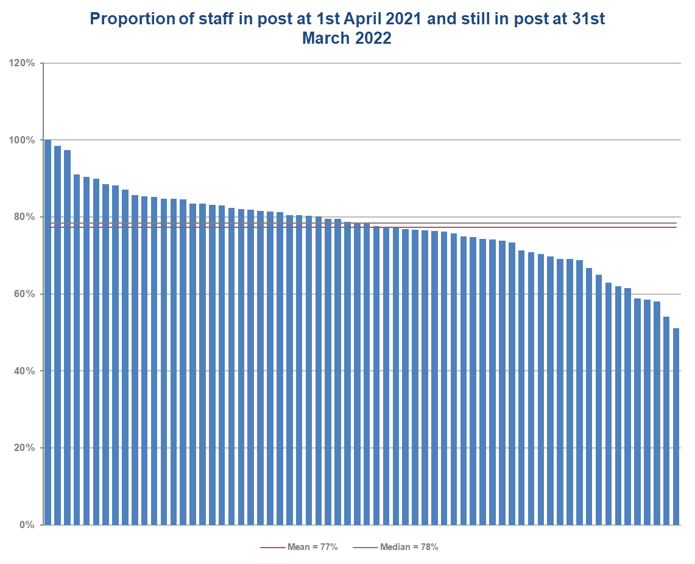
Staff retention - NHS
The chart to the right shows the percentage of staff who were in post on 1st April 2021 and were still in post on 31st March 2022.
Providers reported in 2022 that 77% of staff were still in post at 31st March 2022. This is a second successive fall from 83% in 2019 and 80% in 2021.
The chart shows that there was a wide range in staff retention across the NHS from 51% to 100%.
The number of respondents to this question decreased slightly in 2022 (66 compared to 70 in 2021).

Slide 55
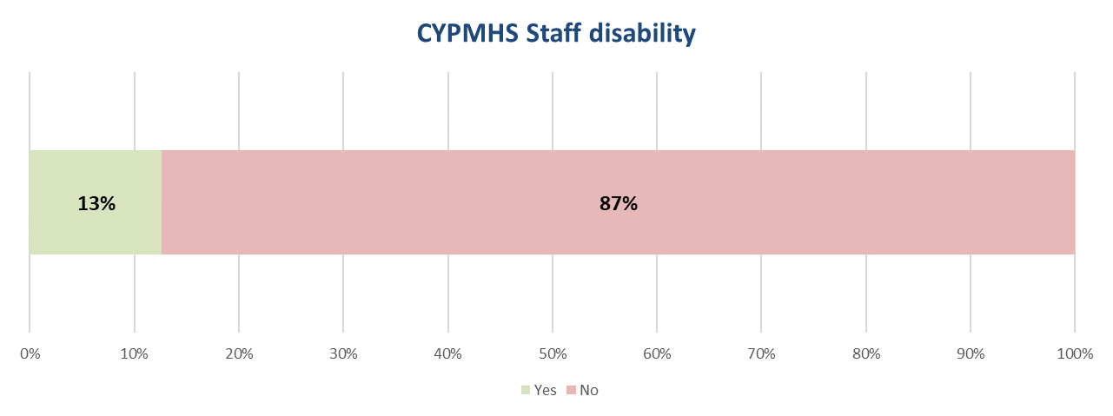
Staff disability - NHS
Where staff reported their disability status, NHS providers submitted the number of staff who have a disability and the number of staff who don’t have a disability. Over the past three censuses, the staff disability rate has gradually increased from 5% in 2016, to 11% in 2021. In 2022, providers reported there had been a further increase in the percentage of CYPMHS staff with a disability (13%).

Slide 56
Skills and Training
The following section explores the main skills and competencies of the CYPMH workforce. A full breakdown of the skills & training of the NHS CYPMH workforce can be found in the appendix. Providers segregated the skills and training profile into separate team types. This section explores staff within NHS providers and is at an aggregated level to comply with GDPR requirements. Further detailed analysis of each sectors skills and training can be found in the relevant bespoke reports provided to each participant organisation.

Slide 57
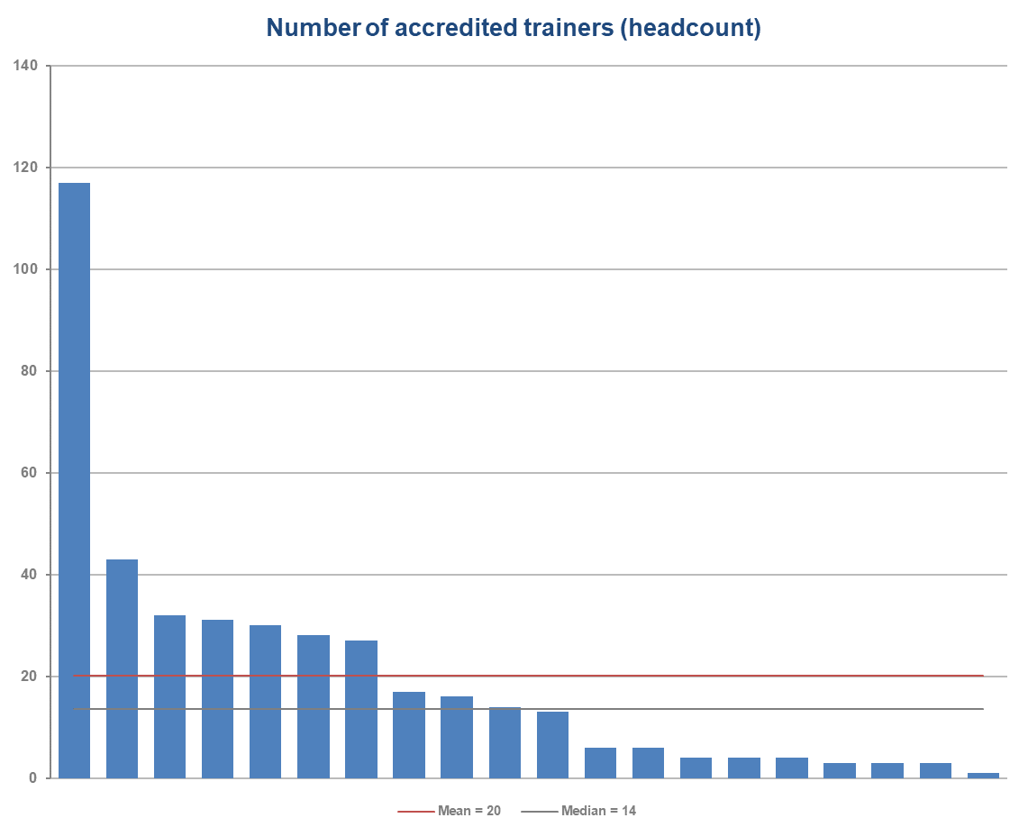
Accredited Trainers (headcount) - NHS
In order to understand the operational ability to train new staff organisations were asked for the first time about the number of accredited trainers they employed in 2021/22.
Twenty NHS organisations provided a response and reported a median of 14 accredited trainers (headcount) per organisation in 2021/22.
There was wide variation across providers from 1 to 117.

Slide 58
General Community Teams (NHS)
The red and green tables on this and the following three pages show high (green) and low (red) provision of services delivered by trained staff as reported by providers.
In terms of the high provision, a number of the services reported slightly higher or lower rates than the previous year Although the ordering of services has changed eight of the top ten services remained in the same position. Formal instruction and supervision were listed in the top ten this year but not in the previous year. Motivational interviewing and parenting for children with conduct and behavioural problems has dropped out of the top ten.

Slide 59
Mental Health Support Teams (NHS)
In terms of the high provision a number of the services reported slightly higher or lower rates than the previous year and whilst the order has changed, nine of the top ten remained unchanged.

Slide 60
Eating Disorder Community Teams (NHS)
In terms of the high provision, six of the top ten services remained unchanged in 2022 compared to 2021. The following services were no longer reported in the top ten:
Dialectical Behaviour Therapy (DBT);
Cognitive Behavioural Therapy (CBT) for young people with depression and anxiety
CBT Informed Practice/Low Intensity
Multi-Systemic Therapy (any modality)

Slide 61
Inpatient Adolescent Teams (NHS)
In terms of the high provision, five of the services listed in the top ten in 2022 were also reported in 2021 with the rates and order of the remaining five also changing compared to the previous year. Those no longer present in the top ten were:
Suicide prevention
Self-harm
Formal instruction in bio-psycho-social mental health assessment including risk assessment
Motivational Interviewing
CBT Informed Practice/Low Intensity

Slide 62
Service Models

Slide 63
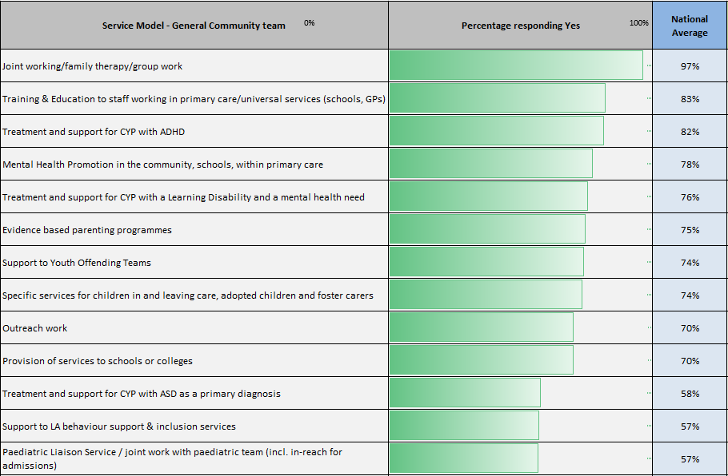
Service Models – NHS General community team
The following two pages explore the different services provided within NHS general community CYPMH teams across England. The question received responses from 68 organisations, with nearly all CYPMH services reporting that they provided joint working, family therapy or group work as part of their CYPMH offer.

Slide 64
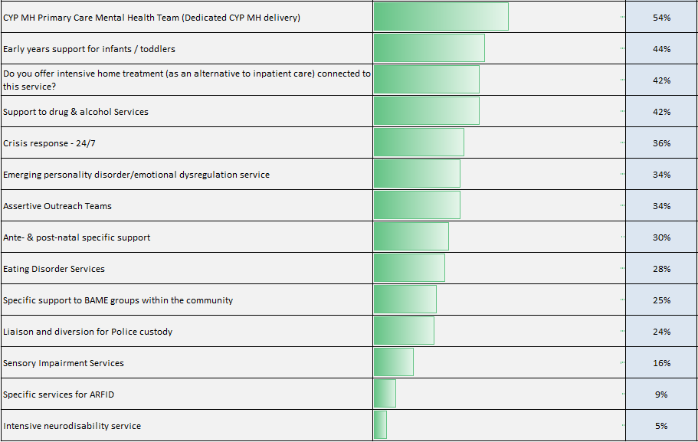
Service Models – NHS General community team

Slide 65
Conclusions and Further Information

Slide 66
Conclusions (1)
This report examines the results from the fourth national workforce stocktake of Children and Young People’s Mental Health services (CYPMHS) across England. The census focuses on the 2021/22 financial year, with a national census date of 31st March 2022 taken to assess and analyse the size and shape of the CYPMH workforce. Throughout the report comparisons have been made between the 2022 census and the previous three censuses that were undertaken in 2016, 2019 and 2021.
This year’s census received submissions from across the multi agency CYPMH sector, with data submitted from NHS providers, independent sector, local authority, voluntary sector and youth offending teams.
Overall, across all sectors, the workforce grew by 5% between 2021 and 2022.
The following paragraphs highlight the key findings:
NHS
The growth in workforce was 8% between 2021 and 2022 compared to 40% between 2019 and 2021. Accounting for the fact that the gap in censuses differed (two years between 2019 and 2021 compared to one between 2021 and 2022), whilst growth has slowed, it is less than the direct comparison might suggest.
Vacancy rates had almost doubled at 17% compared to 9% previously. Retention rate had dropped by 3% year on year to 77% following a similar drop between 2019 and 2021.
Funded establishment increased by 16%. This suggests recruitment and retention issues are driving an increased vacancy rate which is impacting on the rate of workforce growth.
The percentage of staff aged over 50 remained largely unchanged at 28% and whilst the percentage of staff in post for five years or less remained consistent at 80% the percentage staff in post less than one year had risen from 30% to 35%.
There appear to be a shift towards community services. This is in line with the long term plan ambition for children and young people’s mental health services to increase community services and reduce reliance on in-patient care. The percentage of staff employed in community settings has increased slightly from 82% to 83% and there appeared to be a growth in community services and a fall in inpatient services.

Slide 67
Conclusions (2)
The discipline mix has remained consistent, although there are some minor percentage changes year on year. Nursing staff continue to make up approximately a quarter of the workforce. However, support staff were the main staff group in inpatient services at 43%, an increase of 2% compared to 2021. Nursing associates were 5% of the overall support staff workforce group.
The majority of staff are female with two thirds of the workforce working full time.
The age profile shows that there was a fall in the percentage of staff aged 45 and over across the four censuses from 50% of the workforce on 2016 to 39% in 2022. This was mirrored by an increase of 9% of staff under 35.
In England, the ethnicity of 9% of the working age population was Asian/Asian British people. Across all four sectors surveyed in 2022 there was an under-representation of Asian/Asian British staff in CYPMHS with Asian/Asian British staff representing 6% of the NHS workforce.
Comparing the ethnicity profile of the NHS workforce (England) to the CYPMH population (UK), there are a similar proportion of White/White British workers (80%) as the CYP population (83%). Black/Black British and Asian/Asian British staff percentages are in line with the profile for CYP admissions and higher than children and young people in community services. There is a lower percentage of mixed race staff (England) at 3%, compared to the 6% reported for both inpatient and community service users (UK).
Independent sector
There were fewer submissions this year compared to 2021 making year on year comparisons difficult.
This sector reported 1575 WTE staff in post and a vacancy rate of 8%.
24% of the workforce were male compared to 15% in the NHS.
The sector reported a high percentage of support workers at 46% but this was lower than the 58% reported in 2021.

Slide 68
Conclusions (3)
Local authorities
The vacancy rate increased from 6% to 12%
76% of staff had been in post for less than five years compared to 80% in the NHS. The sector had a higher percentage of staff over 50 at 31% compared to 28% in the NHS.
This sector had a different discipline mix to the NHS with psychologists the most common job role (20%).
Voluntary sector
The most common patient facing job roles were counsellors (21%), CYP psychological wellbeing practitioners (13%) and CYP education MH practitioners (10%).
The majority of the workforce were female (87%).
82% of the workforce in post for less than five years and 70% of staff were on permanent contracts compared to 87% in the NHS. 46% percent of staff were full time compared to 67% in the NHS.
Youth Offending Teams
This was the second smallest sector in terms of workforce after local authorities with 1117 WTE staff providing CYPMH input.
76% of YOTs had an embedded CYPMH team/practitioner with 87% having direct access to CYPMH services.

Slide 69
Further information
This report provides a summary of the national results from the fourth census of Children and Young People’s Mental Health Services across England. The report has been written in consultation with colleagues from Health Education England and will be shared with partner organisations when the report has been signed off for publication by HEE.
Further to this report, a series of additional bespoke reports will be published and distributed to each sector. All organisations who contributed and submitted data to the census will receive a copy of their organisation’s bespoke report outlining how their service compares to the wider national picture.
Requests for any clarification or issues raised in this report, please contact the NHS Benchmarking Network support team via a.worden@nhs.net or b.sheard@nhs.net

Slide 70
Appendices

Slide 71
Appendix 1: Skills and Training

Slide 72
General community teams (46 respondents)

Slide 73
General community teams (46 respondents)

Slide 74
Mental health support teams (34 respondents)

Slide 75
Mental health support teams (34 respondents)

Slide 76
Crisis teams (23 respondents)

Slide 77
Crisis teams (23 respondents)

Slide 78
Eating disorder community teams (31 respondents)

Slide 79
Eating disorder community teams (31 respondents)

Slide 80
Inpatient Adolescent teams (10 respondents)

Slide 81
Inpatient Adolescent teams (10 respondents)

Slide 82
Appendix 2: 2020/21 Key metrics

Slide 83
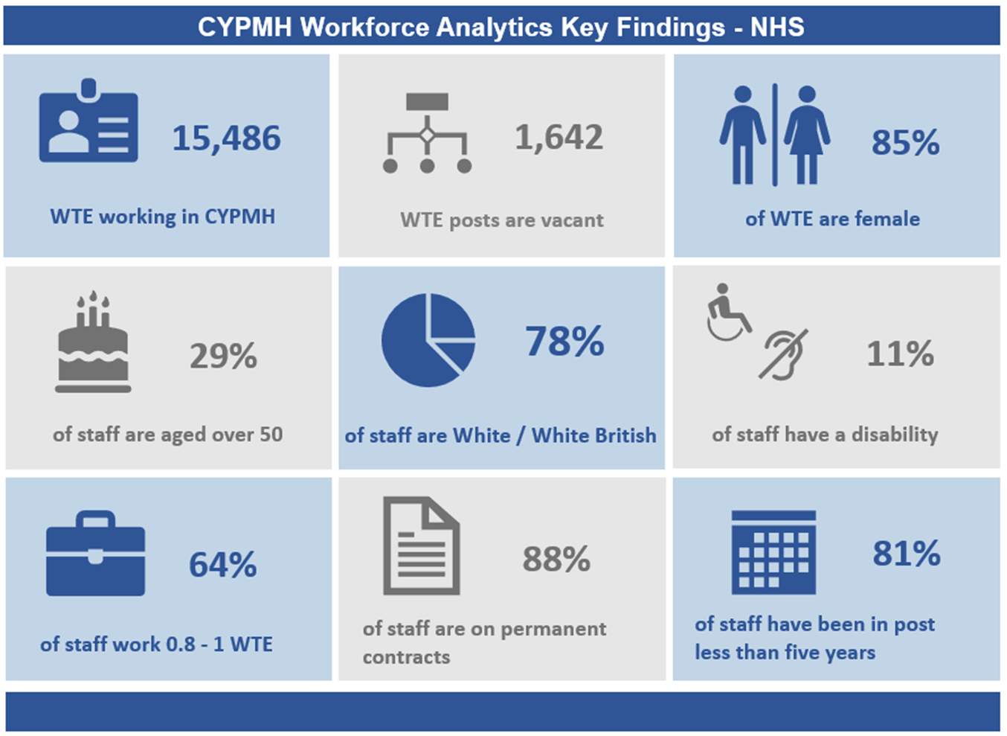
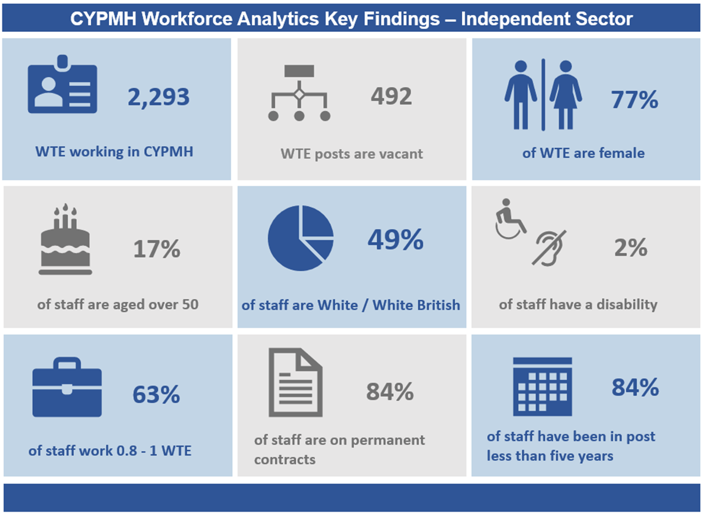
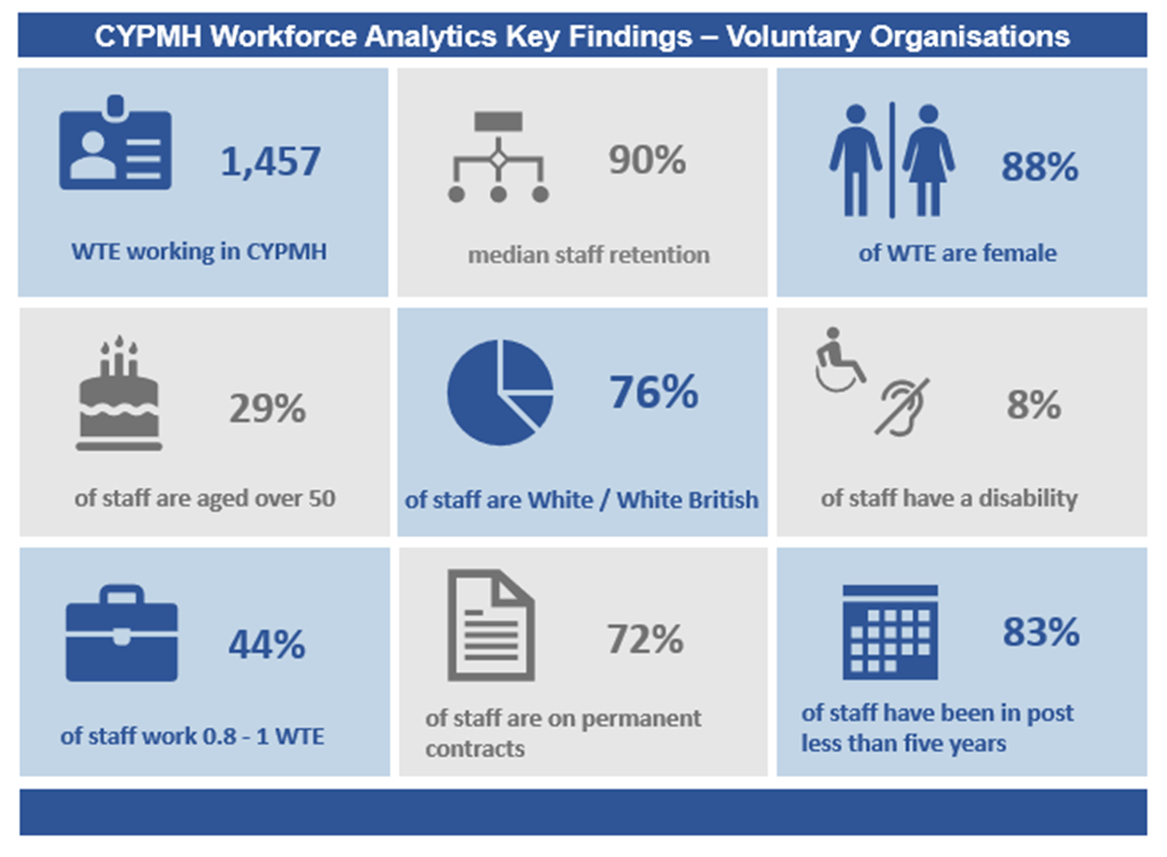

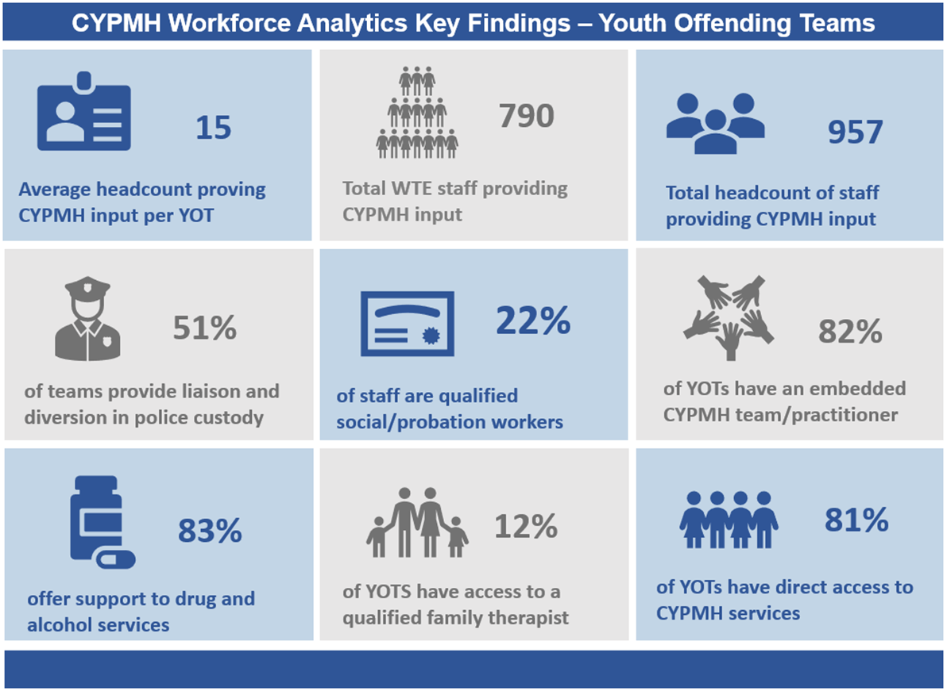
2020/21 (last year) infographics

Slide 84
Appendix 3: Staff roles

Slide 85
Workforce groups: NHS, Local Authorities, Independent Sector, Voluntary Organisations

Slide 86
Workforce groups: NHS Medical roles 2021 and 2022

Slide 87
Workforce groups: YOTs

