Slide 1
Choices College
Market Engagement May 2025
Notes:
Standard title slide

Slide 2
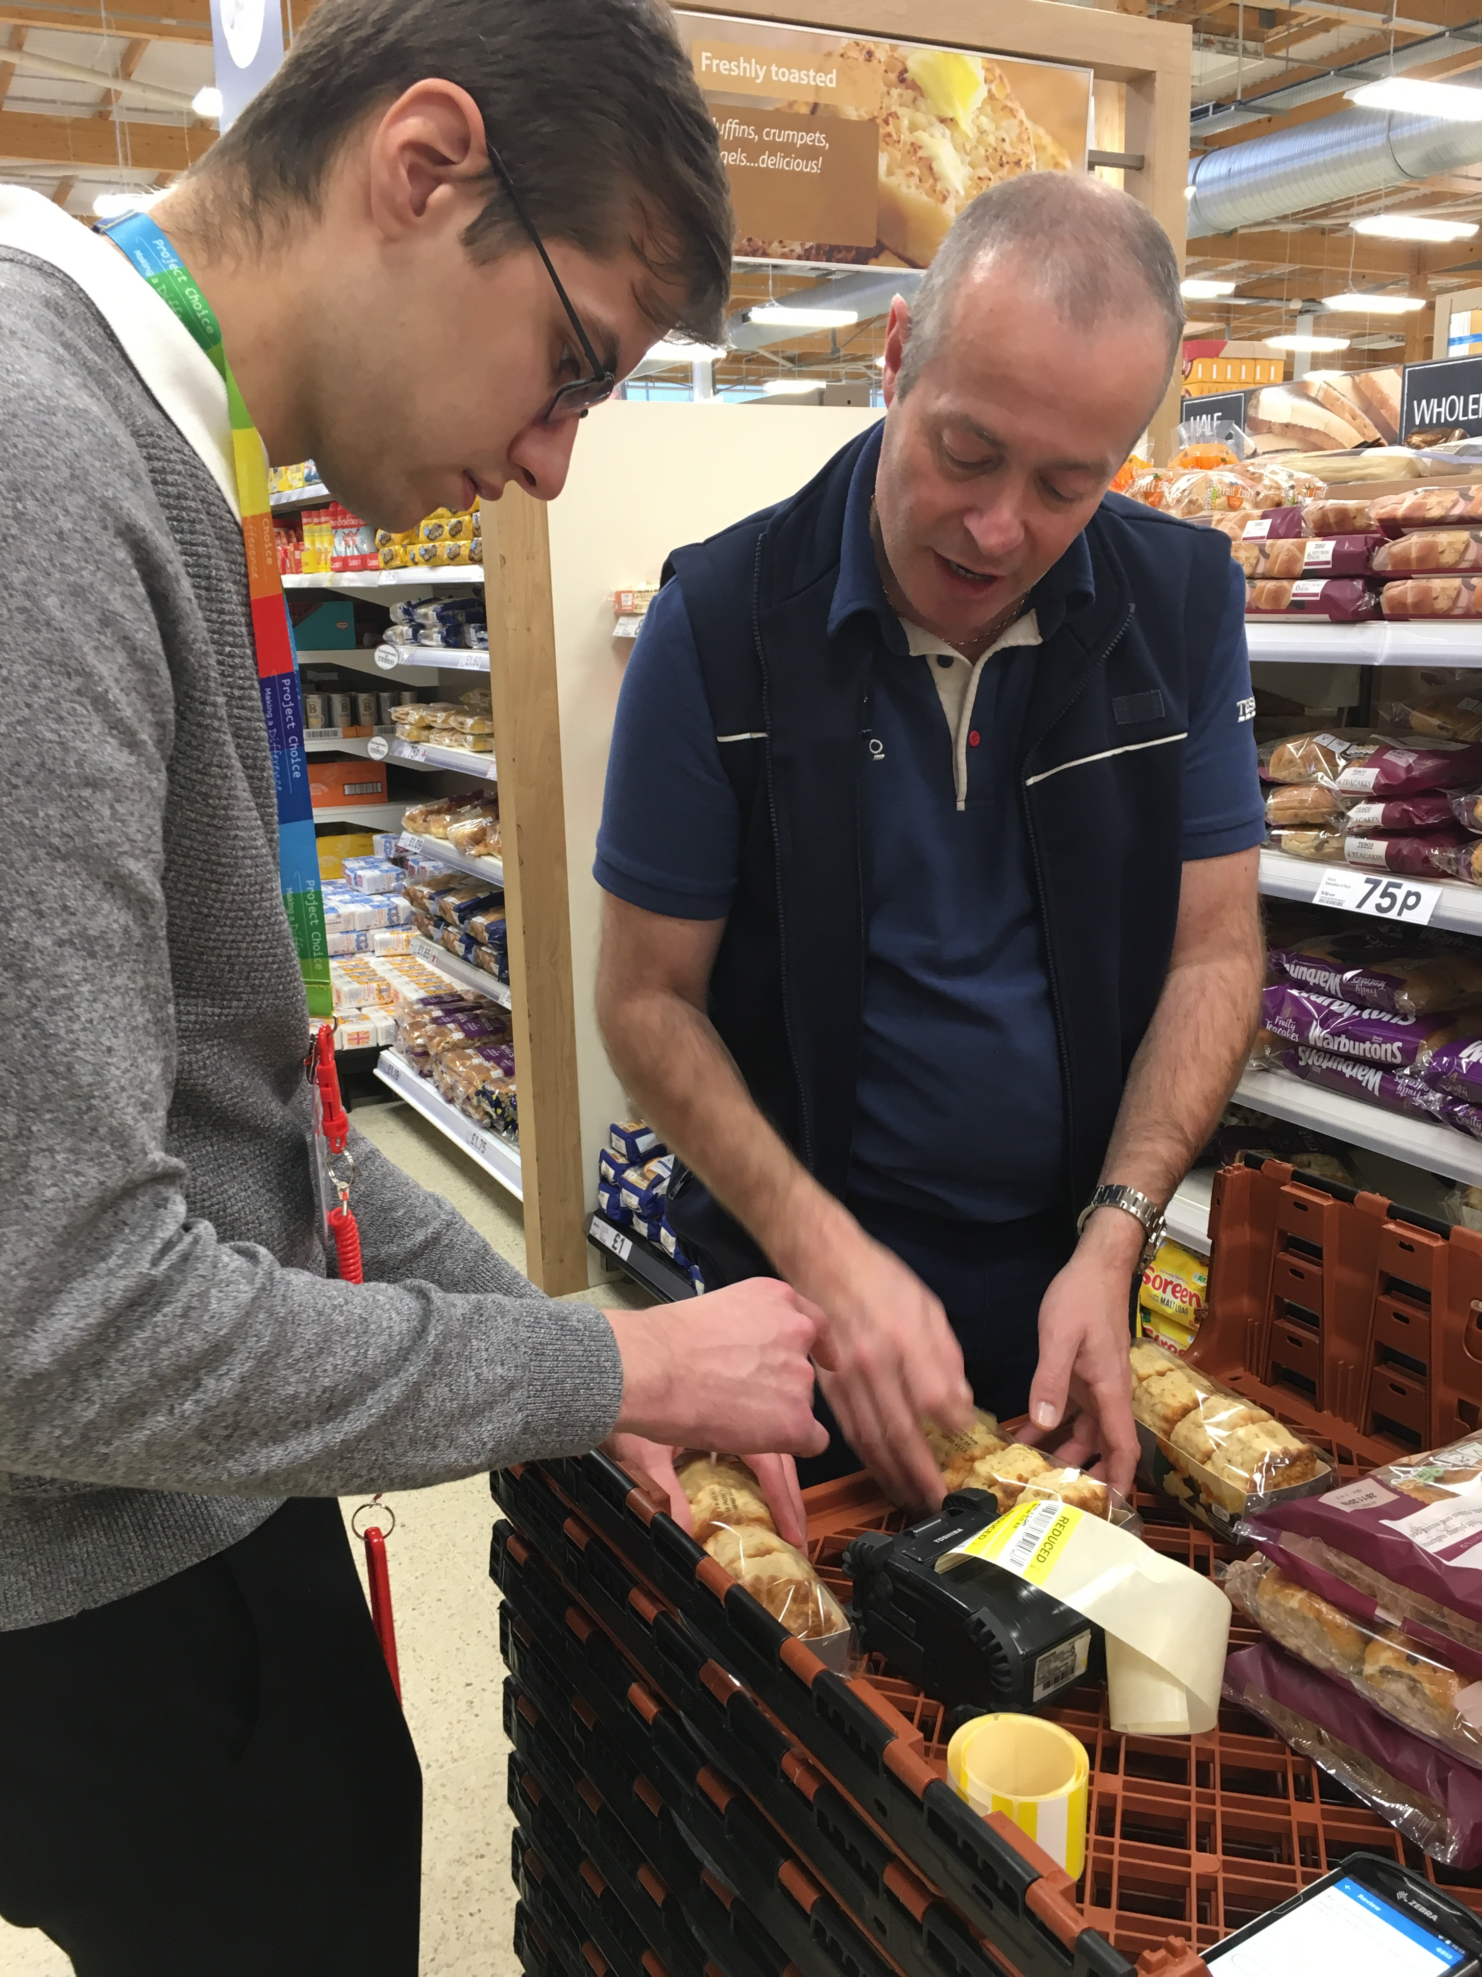
About Choices College (formerly Project Choice)
Choices College is a national specialist college which delivers high-quality provision for young people with learning difficulties, disabilities and/or autism.
Graded “Good” by Ofsted it provides bespoke educational support, alongside a supported internship study programme, for young people aged 16-24 who have a current Education, Health and Care Plan (EHCP).
The college has strong partnerships with NHS healthcare settings, local organisations, and private businesses to create supported work environments and provide real work experience for its interns.
During the study programme, interns spend one academic year attending up to three 12-week placements to increase their vocational knowledge, skills and experience. This is supported by weekly classroom sessions for maths, English and employability qualifications, alongside Preparing for Adulthood (PfA) curricula.
Notes:
Plain slide with subhead and bullets

Slide 3
Our vision
The college believes that every young person embarking on a supported internship has the potential to succeed, and it provides skilled, informed support to maximise potential.
We partner with NHS organisations and private businesses, train mentors and provide positive, skill-enhancing work environments to give a secure, uplifting work experience for each intern.
Our staff are dedicated to the overall welfare of the interns and ensuring they develop academic, work and life skills across the duration of the course. We work closely with family and other professionals to benefit the interns.
Choices College not only contributes to the intern and their journey to employment but also enables local and NHS partners to enhance inclusion, diversity and accessibility in their workforce.

Slide 4
Our approach
Choices College has been supporting interns for over 18 years and these are our values.
Person-centred
Excellence
Considering the individual needs of all Choices College stakeholders to enable interns to get the best start to their working lives.
Being the best in our field and transforming societal expectations of people with additional needs.
Outcome focused
Quality driven
Creating positive outcomes for the interns and business partners.
Ensuring that we maintain a high standard of support and education.

Slide 5
Funding, staff, partners and learners
The college is contracted directly by the Department for Education (DfE) to provide a full-time equivalent study programme, delivered over 38 weeks across each academic year, September to July.
This funding is supplemented via the commissioning local authorities and as necessary, the Department for Work and Pensions (DWP), based on support needs identified in each intern’s EHCP.
The college currently has 81 staff across England. Each cohort of interns has a dedicated, locally based college team, which remains with them from pre-entry to transition at the end of the academic year.
It partners with 22 NHS healthcare settings and 122 local organisations and businesses to create person-centred work environments.
The college supports around 200 learners annually over 25 sites across England, working with 57 commissioning local authorities.
Notes:
Plain slide with subhead and bullets

Slide 6
Ofsted
Choices College retained its “Good” Ofsted rating in January 2025. The report highlighted the following:
Interns value the interesting activities that tutors organise for them at college.
Interns thoroughly enjoy attending work placements which are well matched to their long-term career aspirations and personal interests.
Leaders form highly-effective partnerships with NHS healthcare employers and private businesses to secure these valuable work placements.
Interns improve their confidence, develop resilience in the workplace and make a valuable contribution to the work placements they complete.
Highly-qualified tutors use effective teaching methods to teach English and mathematics.
Staff accurately identify what interns can and cannot do when they start at college. They use the information from Education, Health and Care Plans to set clear and appropriate targets for interns to help them develop the skills and knowledge they need to gain employment.

Slide 7
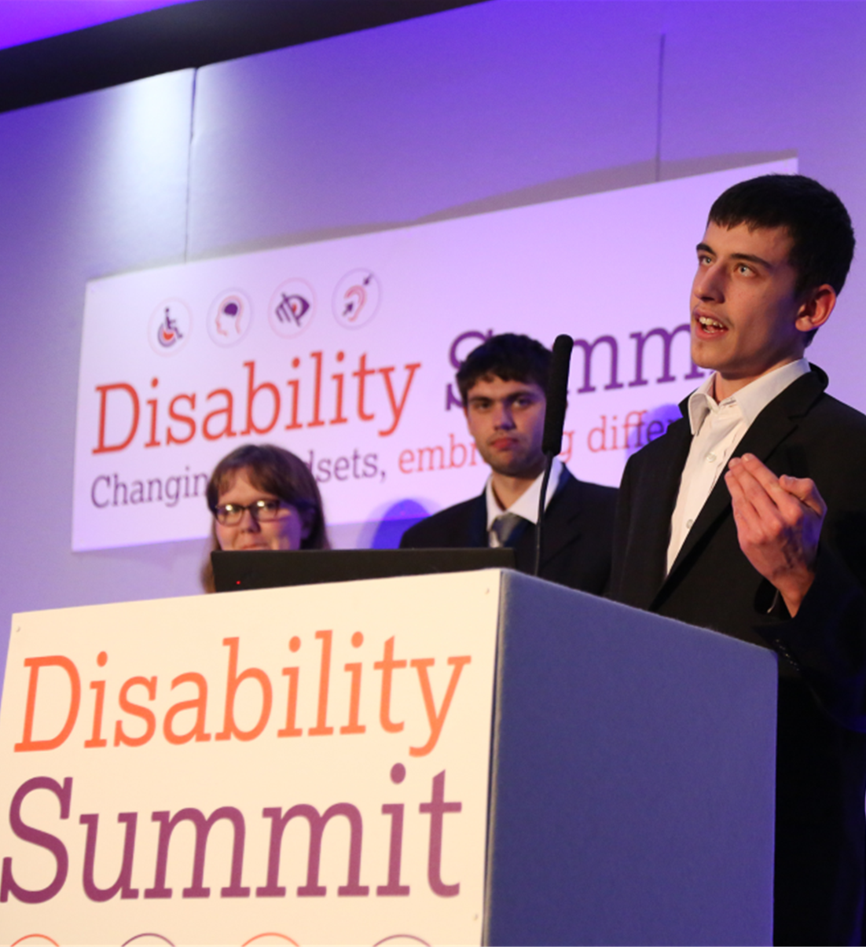
What else…
Ofsted January 2025: NHS England (Choices College) continues to be a “Good” provider, which it first achieved in 2019.
Demonstrates compliance with the Department for Education’s Supported Internship Quality Assurance Framework (SIQAF) to meet local authority contractual expectations.
As a Specialist Post-16 Institution (SPI), the college is also registered on the Secretary of State for Education’s approved list of independent special institutions (Section 41 of the Children and Families Act 2014).
The college supports widening access and participation for individuals from diverse backgrounds and those who may be disadvantaged to gain employment.
The college creates more opportunities for individuals with limited qualifications or experience to enter the NHS workforce.
Notes:
Plain slide with subhead and bullets

Slide 8
Supported Internship Quality Assurance Framework
The college has an excellent reputation and track record, which has been evidenced by the SIQAF reviews.
Exceptional tracking and recording system which demonstrates interns’ clear journeys throughout their programme.
Robust partnership working with local schools, commencing with Year 9 pupils, to facilitate transitions; working with learners to ensure they are aware of, and understand, their choices; empowering them to plan and be in control of their own pathways.
Excellent bespoke taught ‘preparing for adulthood’ sessions, work experience placements and access to a virtual work learning platform which has been developed by the team.
The college is committed to ensuring support is in place for 5 years after the end of the programme, recently naming it “Follow On”.
Throughout the review, the peer reviewers received very positive feedback on the service from everyone they spoke to. They also noted that the staff team were very committed to delivering a high-quality service that supports the interns to gain paid employment.

Slide 9
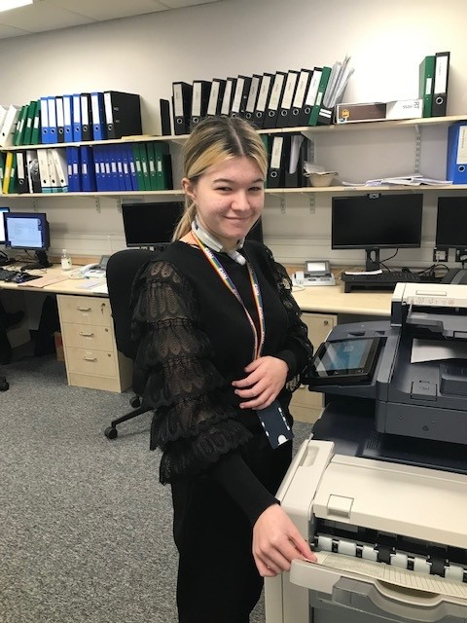
Ellie’s story
Ellie’s diagnosis is Congenital Myasthenic Syndrome, a rare disorder that causes extreme muscle weakness. She uses an electric wheelchair when she becomes tired and has a permanent tracheostomy for ventilation if she becomes unwell.
Ellie joined Choices College with no previous work experience due to her condition. Mentors and staff supporting Ellie were given specialist training prior to her starting her Study Programme, to ensure there was an awareness of her needs and appropriate care if she ever became ill in the workplace.
Ellie then commenced admin placements with the Research and Education teams at Newcastle Hospitals. She flourished in these roles, learning all about NHS administrative systems and processes; she made fantastic progress.
Ellie was supported to apply for a Business Administration apprenticeship in the NHS at the end of her internship and was able to talk with confidence at her interview about all the experience, skills and independence she has gained through Choices College.

Slide 10
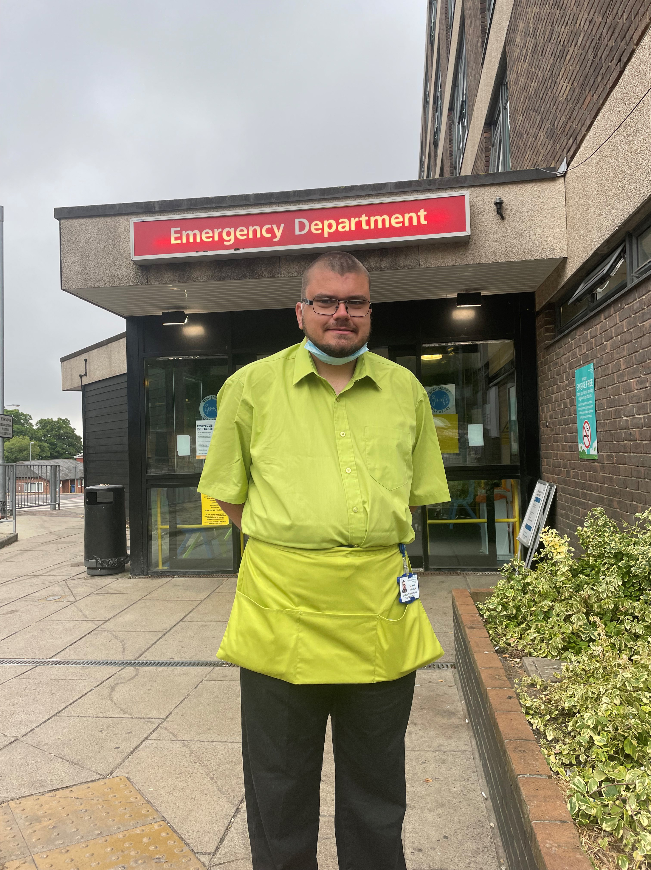
Nathan’s story
Nathan has a diagnosis of Cerebral Palsy and Global Development Delay.
He commenced the Study Programme, and his first placement was in a hospital post room. This allowed Nathan to be slowly introduced to a hospital environment to allow time to increase his confidence and move somewhere busier at his own pace.
When Nathan felt ready, he asked to move to a ward environment. There, he assisted patients coming into the department, supported the transfer of patients and chatted with people waiting in the discharge room.
Nathan’s work on the department was so valuable that when a position for Ward Assistant in the Emergency Department became available, staff encouraged him to apply. Nathan was given reasonable interview adjustments and scored highly at interview, securing a part-time position on the ward.

Slide 11
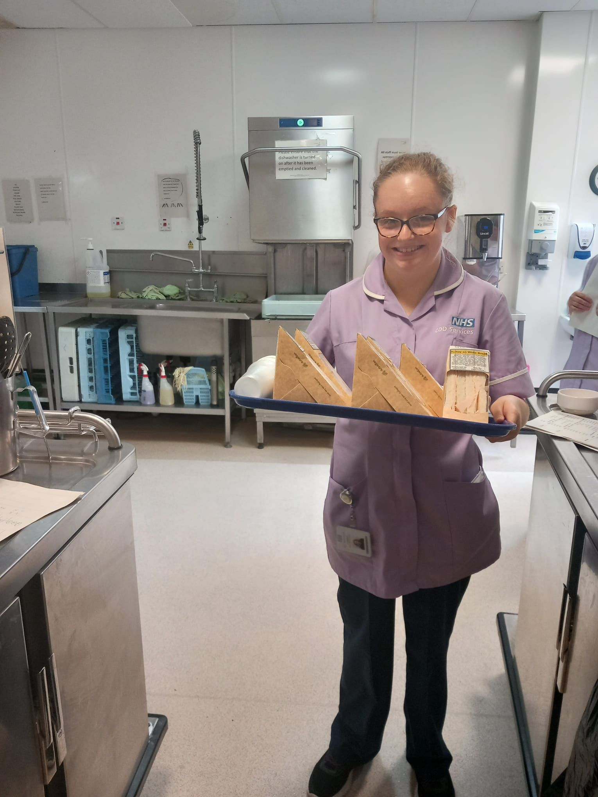
Molly’s story
Molly had placements in a nursery setting, then Darlington Memorial Hospital.
This enabled Molly to overcome her anxiety and thrive in the busy environment. Molly secured employment as a Ward Hostess at the end of her supported internship.​
The catering manager stated​:
“Darlington Memorial Hospital is thrilled to be a part of Molly's journey. Our collaboration with Choices College enables young individuals like Molly to develop essential skills and gain hands-on experience, paving the way for successful employment."

Slide 12
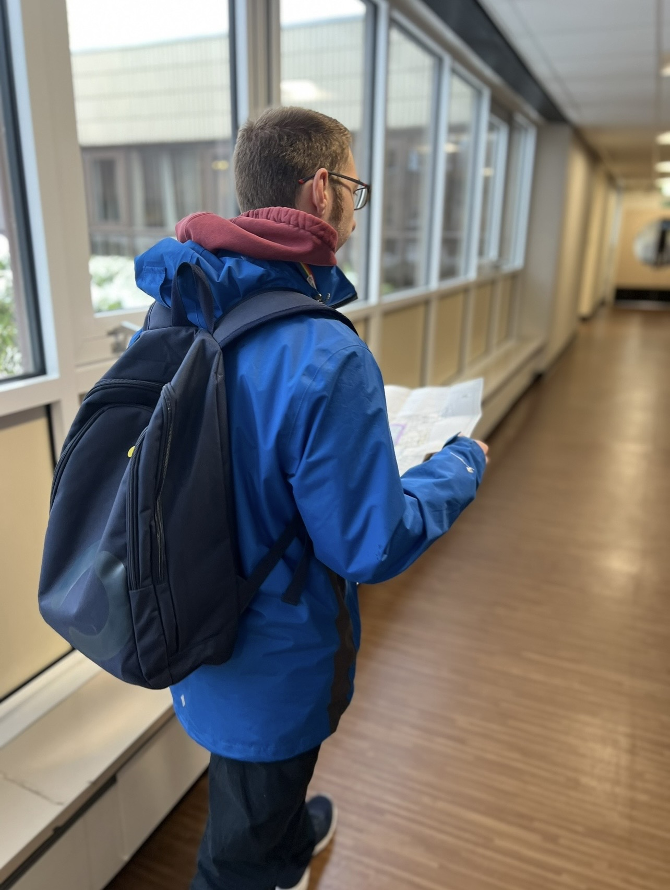
Will’s story
Will joined Choices College in 2023.​ He has a diagnosis of ASD which impacts on his daily life, including difficulty in reading facial expressions, pragmatic language difficulties and managing social situations. ​
Prior to starting an internship Will was enrolled onto a university course, however during the Covid-19 pandemic his classes were transferred online and Will felt unsupported and isolated. This anxiety and feeling of ‘failure’ led to Will not leaving his house, his mental health was poor, and he had limited social opportunities.
The college staff supported Will to travel to college and build on his social interactions. ​For his first placement Will was placed in Tees, Esk and Wear Valley NHS Foundation Trust’s Finance Department. Will’s mentor helped him to learn new skills and processes to primarily manage the central finance email inbox, print invoices and input information onto the procurement system. ​

Slide 13
Visit: Choices College on the NHS England Workforce, Training and Education website
Find out more
Email: england.choices.college.future@nhs.net
Notes:
”Quote” slide with placeholder for image on right hand half

