Slide 1
Compassionate Education
March 2022

Slide 2
Compassionate Education
Traditional focus on education and developing proficiency in academic, clinical, skills and knowledge
Help educators to develop compassionate approach to training and the workplace
Need for focus on self-care to promote positive mental health and wellbeing
Increase awareness and embed compassion in workplace

Slide 3
What is Compassion?
Compassion is understanding how another person is feeling, the emotions they are experiencing
Based on empathy, respect and dignity
Showing compassion helps people feel cared for and valued
Compassion can be learned
Notes:
Empathy is putting yourself in another person’s shoes and understanding how they are feeling

Slide 4
Developing a compassionate approach
Ask lots of open questions – Kipling’s Men
Listen actively – ears, eyes, heart
Show understanding through non-verbal cues
Reflect back to others
Notes:
Kipling’s Men – who, what, where, when, why, how

Slide 5
Take Five
Beginning or end of training sessions
Take five minutes to introduce compassion
Can be
Asking learners how they are feeling
Asking learners to make pledges
5-minute activity as a group
Introduce a 5-minute self-care activity
Encouraging learners to reflect on how they are feeling

Slide 6
Techniques
Everyone is different
Different techniques help different people
Activities in two groups:
Grounding techniques
Refocusing techniques

Slide 7
Grounding Techniques

Slide 8
“Look deep into nature and you will understand everything better”
Albert Einstein

Slide 9
FOFBOC
Feet on Floor, Body On Chair
Sit on a chair with feet resting on the floor
Feel your body on the chair
Now feel your feet on the floor
Think about your legs and how they feel moving onto lower body
Focus on your belly, then your breathing
Sit and relax for just a couple of minutes tuned into an awareness of your body
Notes:
Developed as a mindfulness technique for teenagers, this 3-minute technique takes you from fight or flight to rest and digest which can help as a calming technique after a difficult interaction

Slide 10
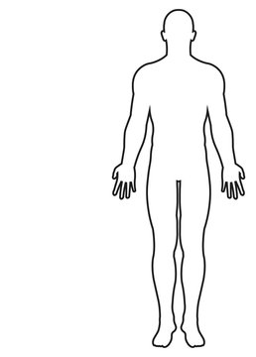
Body Awareness
You can do this sitting or standing
Focus on how your body feels from head to toe, noticing each part in turn
Pay attention to hair, neck, shoulders and belly
Feel your heartbeat and breathing
Consider how you feel – temperature, pressure, emotions
Notes:
You can do this sitting or standing. Focus on how your body feels from head to toe, noticing each part.
Can you feel your hair around your face, forehead, or shoulders? Glasses on your ears or your nose? Any earrings in your ears or necklace around your neck? The weight of your shirt on your shoulders? What position are your arms in? Do they feel relaxed or tense? Can you feel your heartbeat? Is it rapid or steady? Does your stomach feel full, or are you hungry? Are your legs crossed, or are your feet resting on the floor? Is your back straight?
Curl your fingers and wiggle your toes. Are you barefoot or in shoes? Are your feet warm or cold? How does the floor feel against your feet?

Slide 11
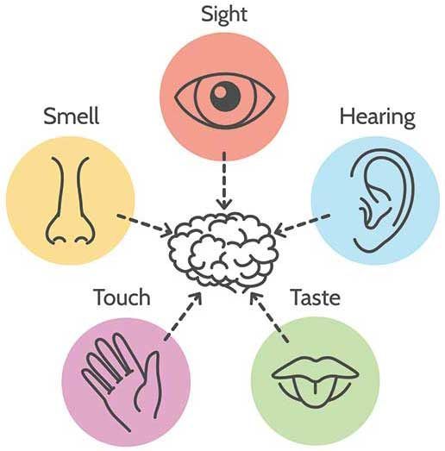
5-4-3-2-1…
Use your senses and see what you can sense in the world around you. Work backwards from 5 to notice:
5 things you can see
4 things you can hear
3 things you can touch
2 things you can smell
1 thing you can taste
Notes:
Example: I can see some crumbs left on the table, a cobweb in the corner of the room, a ray of light coming through the window, a leftover wrapper by the bin, a sign showing me how to wash my hands. I can hear lots of noisy voices, the clicking of a pen, the ‘clip-clop’ of someone’s high heels, a bee buzzing around. I can touch the cold surface of the chair, the soft wool of my jumper, the smoothness of my skin as my fingers rub against one another. I can smell soap suds and strong perfume. I can taste the toothpaste on my tongue from when I last brushed my teeth.

Slide 12
Guided Meditation
Short podcasts or video clips
Help to disassociate from stressors
Three to five minutes
https://www.youtube.com/watch?v=TsSbCntmMHo

Slide 13
3-4-5 Breathing
Breathe in for three seconds
Hold your breath for four seconds
Breathe out for five seconds
Repeat for a few minutes
Notes:
When your out-breath is longer than your in-breath, you reduce the activation of your stress state and encourage your body to move into a thrive state. You can do a few rounds of this breath or extend it to take five minutes. Listen to your body and see what works for you.
https://drchatterjee.com/the-3-4-5-breath/

Slide 14
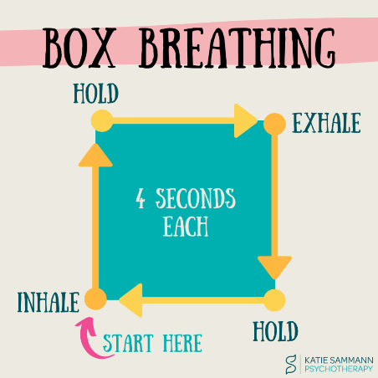
Box Breathing
Breathe in counting to four slowly. Feel the air enter your lungs
Hold your breath for four seconds
Slowly exhale for four seconds
Repeat steps above until you feel re-centered.
Notes:
Breathe in counting to four slowly. Feel the air enter your lungs
Hold your breath for four seconds. Try to avoid inhaling or exhaling for four seconds
Slowly exhale through your mouth for four seconds
Repeat steps above until you feel re-centered.
https://www.webmd.com/balance/what-is-box-breathing

Slide 15
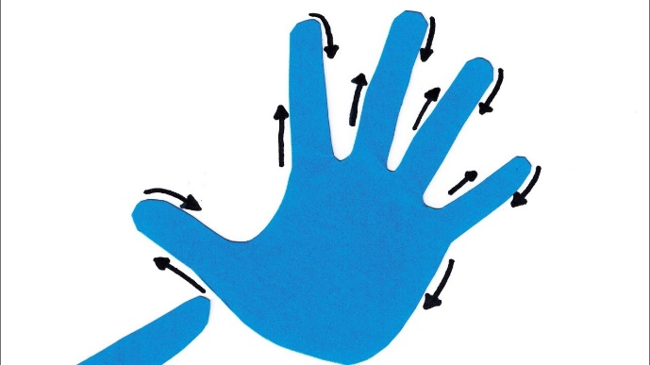
Hand tracing
Take one hand and hold it in your other hand
With your forefinger, place the fingertip on your palm
Trace up your thumb and up the next finger.
Trace all the way around your hand,
Repeat using the other hand
Notes:
Take one hand and hold it in your other hand
With your forefinger, place the fingertip on your palm, just below your thumb and trace up the ridge of your thumb, over the edge and up the next finger.
Trace all the way around your hand, feeling the edge, noticing every crevasse and joint as you go all the way around your hand with your fingertip until you have reached the other side of your palm, just below your littlest finger
Repeat using the other hand

Slide 16
4-7-8 Breathing
Inhale for four seconds through your nose
Hold the breath for seven seconds
Exhale for eight seconds through your mouth
Repeat this exercise as many times as you can. 30 seconds of deep breathing will help you feel more relaxed and in control.

Slide 17
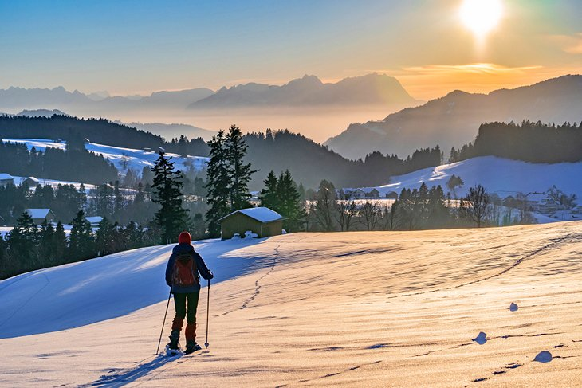
Visualisation
Think about one of your favourite places… imagine you are there now:
What can you see?
What can you feel?
What can you smell?
What can you hear?
What can you taste?
What are you doing?
Who is there with you?
What is the weather like?
How are you feeling?
Notes:
Example: my favourite place is in the mountains. Surrounded by no one else, with nothing but snow and sky for miles and miles around. Total silence: peace, calm, tranquillity. I can smell the freshness of the Swiss air, hear the swish of the wind as it wraps itself between my layers of clothing – an attempt at keeping warm in the icy coldness. I can taste snowflakes, cool and newly fallen upon my lips…

Slide 18
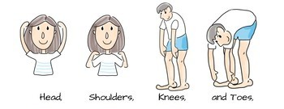
Head, Shoulders, Knees and Toes
Try a few simple stretches:
Head – roll your head round, tilt it back and forth, turn it from side to side
Shoulders – gently rise your shoulders, up and down. Try rotating them
Knees – move your knees side to side, swing them apart
Toes – gently place your feet flat on the ground and slowly rise to your tiptoe, and then back down again.
Notes:
Take yourself somewhere quiet for a few minutes and, either sitting or standing, try a few simple stretches:
Head – roll your head round, tilt it back and forth, turn it from side to side
Shoulders – gently rise your shoulders, up and down. Try rotating them, one at a time and then both together, clockwise and then anti-clockwise
Knees – move your knees side to side, swing them apart and then back together again, cross one knee over in front of the other and then reverse it
Toes – gently place your feet flat on the ground and slowly rise to your tiptoe, and then back down again. Repeat going up and down from flat-foot to tiptoe, gradually

Slide 19
Refocusing Techniques

Slide 20
Mindful Moments
Begin your session with a slide showing a photo of nature
Ask delegates to focus on the picture, what they see and how they feel for two minutes

Slide 21
Pledges
Ask learners to make a pledge for self-care
These should be written and may be shared
Focus on doing something for themselves
Providing pretty paper for them may help

Slide 22
Sample pledges
More family time
Start taking my full break
Give myself one hour every Friday to reflect
Look after myself
Dedicate 10 minutes after work for mindfulness
Actively leaving work at work
Gain confidence, relax more

Slide 23
Category thinking
Take a category – for example: musical instruments, or ice cream flavours
Give yourself a minute or two to list as many things from that category as possible.
Notes:
Example: category – ice creams: chocolate, vanilla, cookie, mint, mint chocolate chip, raspberry, strawberry, blueberry, bubblegum, rum and raisin, lemon, brownie, strawberries and cream, cookie dough…

Slide 24
Recital
Think of a poem, song, or book passage you know by heart
Recite it quietly to yourself
If you say the words aloud, focus on the shape of each word on your lips and in your mouth
If you say the words in your head, visualize each word as you’d see it on a page.
Notes:
Example: “One fine day, in the middle of the night; two dead men got up to fight; back to back, they faced each other; drew their swords and shot each other.”

Slide 25
Count tables (not sheep)
Try counting, either single digits: 1 elephant, 2 elephants, 3 elephants …
Or count through your times tables:
2, 4, 6, 8…
6, 12, 18, 24…
Or count backwards from 100

Slide 26
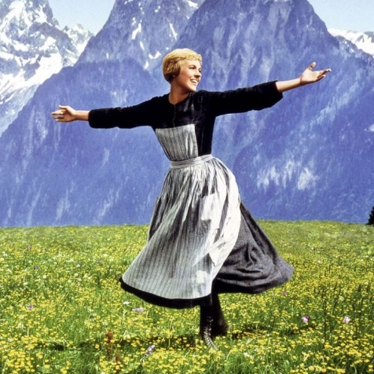
“These are a few of my favourite things!”
Create a list of three things you love – these could be people, places, objects, foods, animals… Visualise each of them, one at a time.
What does it look like?
Sound like?
Feel like?
Taste like?
Smell like?
What does it remind you of?
Are there any associated memories?
Notes:
Example: my favourite food is chocolate gateau. It looks tall and grand with many layers of chocolate sponge, sticking to one another with thick gooey chocolate, all melting together in a rich, sickly sweet merge of chocolate and sugar. It feels sticky to touch but smells delightful: deliciously enticing and warm, freshly baked. I tastes like heaven in a mouthful, all the sweetness oozing onto my touch as the chocolate melts and the cake flakes into pieces, dissolving between indulgent bites…

Slide 27
Be grateful
Think of all the things that have gone well for you, all the people who love you, things that make you smile or occasions that made you laugh.
Think of three things that you are lucky to have.
Cherish these three things
Consider keeping a gratitude journal
Notes:
Think of all the things that have gone well for you, all the people who love you, all the things that make you smile, the occasions that have made you laugh.
Think of three things that you are lucky to have and that you often take for granted.
Cherish these three things and be grateful for them, actively appreciate having them in your life
Consider keeping a gratitude journal and take five minutes at the end of each day to complete
Example: I am grateful for being able to wake up next to someone who loves me. I am grateful for having fresh, cold, clean water to drink. I am grateful for being able to run and cycle and dance.

Slide 28
I remember, I remember…
‘I remember, I remember,
The house where I was born,
The little window where the sun
Came peeping in at morn…’
Choose a happy memory.
Close your eyes and remember:
What are you doing?
Where are you?
Who’s with you?
What can you feel?
Notes:
Example: I remember making fresh bread at home with my mum. The kitchen is warm as the sun beats through its afternoon heat, making the entire kitchen feel like a sauna. We are measuring out the ingredients – one cup, two teaspoons, some yeast…I can smell the ingredients as they go into the mixture, one by one.

Slide 29
'My hope is that, one day, formal education will pay attention to what I call education of the heart’
– Dalai Lama

Slide 30
Authors
Developed by
Desiree Cox, CapitalNurse
Tracey Coyne, LNWH
James Clay, CNWL
Riina Hilton, NELFT
References and additional resources available in accompanying document

