Slide 1
Dementia Education And Learning Through Simulation 2 (DEALTS 2) programme Workshop Slides Developed in partnership by Health Education England and the Ageing & Dementia Research Centre, Bournemouth University

Slide 2
Welcome
Introductions
Housekeeping
Definition of Tier 2 Training
Overview of workshop session
Notes:
Welcome to the session

Slide 3
Housekeeping
Fire
Refreshments
Toilets
Ground Rules
Confidentiality
Self disclosure
Opportunity for questions/debrief
Notes:
Make sure every one knows what is where and what to do if there is a fire alarm (check if a test is expected in advance)
Ground rules = Listen to people. Allow people to speak. Respect their views. Keep them confidential
Explain that self disclosure is a powerful tool for learning but also requires the knowledge that what is disclosed remains confidential. Ask if people are happy to adhere to these ground rule.
Explain that some of the content may be emotionally challenging or may trigger emotional responses. This is OK, and offer to talk to people at the end of the session if required.

Slide 4
Definition of Tier 2 training
Knowledge, skills and attitudes for roles that have regular contact with people living with dementia.
It is relevant to all health and care staff in settings where they are likely to have regular contact with people affected by dementia.
It is also appropriate for social care workforce group 2 including all social care staff directly providing care and support including care assistants working in residential or home care and also personal assistants.
Tier 2 underpins the more specialist skills and knowledge required at Tier 3.
(Skills for Health and Health Education England, 2015)
Notes:
This training session is for all hospital staff who have regular contact with people with dementia and need Tier 2, including clinical and non-clinical and qualified and unqualified.
DEALTS 2 is a simulation training programme that uses discussion and interactive activities, rather than other more involved approaches to simulation. Depending on previous experiences or perceptions of what simulation involves, some staff may feel uneasy about attending simulation training. To make it clear to staff what DEALTS 2 is and will involve, we suggest that you advertise the session and provide those attending with the following information beforehand:
The Dementia Education And Learning Through Simulation 2 (DEALTS 2) programme is Tier 2 dementia training for health and social care staff in hospital settings. The session is appropriate for all hospital staff who have regular contact with people with dementia and need Tier 2 training, including clinical and non-clinical and qualified and unqualified. The content is designed to provide opportunities for staff to understand the lived experience by putting staff into the shoes of a person with dementia. Simulation is used in the broadest sense and includes the use of video case studies, role play and other group discussion and interactive activities. To promote inter-professional learning and improve practice, staff from both clinical and non-clinical areas are encouraged to attend sessions together.

Slide 5
Dementia Core Knowledge and Skills Framework
Subject |  | Tier 1 | Tier 2 | Tier 3
1. | Dementia Awareness
2. | Dementia identification, assessment and diagnosis
3. | Dementia risk reduction and prevention
4. | Person-centred care
5. | Communication, interaction and behaviour in dementia care
6. | Health and well being in dementia care
7. | Pharmacological interventions in dementia care
8. | Living well with dementia and promoting independence
9. | Families and carer as partners in dementia care
10. | Equality, diversity and inclusion in dementia care
11. | Law, ethics and safeguarding in dementia care
12. | End of life in dementia care
13. | Research and service improvement in dementia care
14. | Leadership in transforming dementia care
Source: Skills for Health and Health Education England, 2015
Notes:
Todays session covers 3 subject areas of Tier 2. It does not cover the whole of Tier 2.

Slide 6
Overview of workshop
Time | Activity
 | Arrival/ Registration
10 mins | Welcome/ Introductions Structure of the session
50 mins | Dementia risk reduction and prevention - Tier 2 Subject 3
10 mins | Break
70 mins | Person centred care - Tier 2 subject 4
10 mins | Break
80 mins | Communication, interaction and behaviour in dementia care - Tier 2 subject 5
10 mins | Questions, comments or concerns? Evaluation
 | Close
Notes:
This workshop schedule sets out the recommended time the Trainer should spend on each activity.
Based on the above timings it will take 4 hours to deliver the workshop, the trainer should also allow time before (to set up the room, powerpoint and any simulation activities) and after the session (to allow any participants that wish to ask additional questions/seek support or signposting individually).
A short break between each topic is also recommended.

Slide 7
Dementia Risk Reduction and Prevention Tier 2, Subject 3
Notes:
The first unit focuses on dementia risk reduction and prevention

Slide 8
Session aims
Recap on dementia awareness prior learning (Tier 1)
To understand:
the lifestyle factors that may increase the risk of developing certain types of dementia and how lifestyle changes may delay the onset and severity of certain types of dementia;
motivational factors that may impact on the ability to make changes;
the challenges to healthy living that may be experienced by different socioeconomic and/or ethnic groups;
how to signpost to sources of health promotion information and support and effectively communicate messages about healthy living according to the abilities and needs of individuals.
Notes:
It is important to state these at the beginning of the session.

Slide 9
Group activity: Joined up sentences
Dementia is an ‘umbrella term’ referring to many different types of dementia
Quiz
Each separate section of the umbrella illustrates the lesser common types of dementia, such as Vascular, Lewy Body and Frontotemporal.
The handle illustrates the most common type of dementia, Alzheimer's Disease
Sentences from sources: Alzheimer's Society, 2014; Public Health England, 2016
Notes:
Split the group into pairs, or threes. – try to move people if they already know the person next to them by giving them a number and asking them to join that group.
Give them the worksheet and ask them to join together the sentences. Give them 5 mins and then ask them to feedback to the whole group. Start a discussion about the first sentence and see if the groups would like to contribute. Give as much detail as the group need. Some groups may be more knowledgeable than others so try to avoid repeating information they already know.

Slide 10
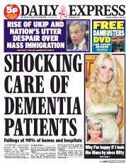
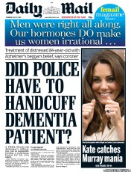
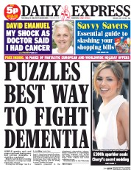
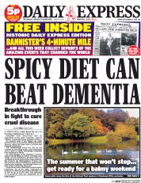
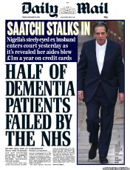
Dementia a public health priority and public concern
850,000 people with dementia in the UK and 44 million worldwide
The number of people with dementia in the UK is forecast to increase to over 1 million by 2025 and over 2 million by 2051.
Dementia costs the UK economy £26 billion per year: more than cancer and heart disease combined.
(Alzheimer's Disease International and World Health Organisation, 2012).
Notes:
The number of people living with dementia is increasing globally.
The cost of caring for people with dementia is also increasing and a cause for concern.
Headlines from newspaper present mixed information about dementia, giving people mixed information about what they can do to reduce their own risk. Public are concerned about being diagnosed with dementia. What evidence lies behind these – can check out the evidence behind these headlines at NHS Choices – Behind the evidence
Where are you likely to meet people with dementia – across the whole hospital from A&E to wards, Discharge, to restaurant area if popping in for a check up.
As professionals you may get approached by people concerned about their memory and asked what advise you would give them – do you know where to signpost people – in this session we will discuss.

Slide 11
Importance for health and social care workforce
Where possible health and social care providers should:
use routine appointments and contacts to identify people at risk of dementia;
promote healthy behaviours during times in people’s lives when substantial change occurs, such as retirement, or when children leave home;
give people advice on how to reduce the risk factors for dementia whenever the opportunity arises.
Public Health England, 2016

Slide 12
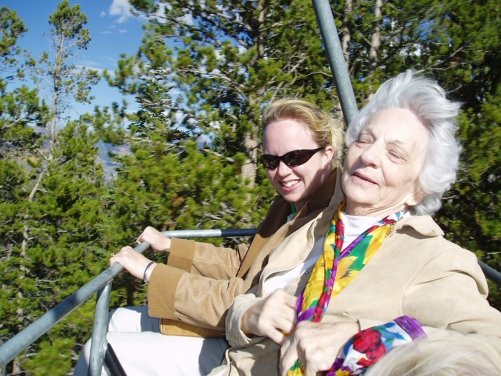
Pause and think
Who might be at risk of dementia?
What lifestyle factors might increase risk of developing certain types of dementia?
Notes:
Ask the participants:
“Who might be at risk of dementia?”
Teaching point:
Facilitate discussion around risk factors: note that these are the predisposing factors that increase the risk of developing dementia. They do not ‘cause’ dementia but make you more susceptible.
A person’s age
Age is the biggest risk factor for dementia
The ageing population is fuelling the growth in cases of dementia (65+ 11.4 million people in the UK, this figure is predicted to rise by over 40% in the next 17 years to over 16 million). By 2040 nearly 1 in 4 people (24.2%) in the UK will aged 65 or over.
This increased risk may be due to factors associated with ageing, such as:
higher blood pressure in midlife
an increased incidence of some diseases
changes to nerve cells, DNA and cell structure
the weakening of the body’s natural repair systems
changes in the immune system
Dementia is not always associated with ageing.
Early-onset dementia, also known as younger people with dementia, affects people in their 30s, 40s, 50s and early-60s.
In the UK, at least 40,000 people under 65 have dementia.
1 in 688 people under 65 have dementia. 1 in 14 people over 65 have dementia and this rises to 1 in 6 for people over 80.
Gender- women more likely to get Alzheimer’s Disease and men are more likely to get Vascular Dementia
People who smoke
Eating a diet high in cholesterol
Being overweight or obese
Not doing enough exercise
Having a sedentary life style
Drinking too much alcohol
Having a family history of dementia
Genetics only cause dementia in a small proportion of cases. In most people, lifestyle factors play a role in determining how likely they are to develop the condition. Family History - a clear inherited pattern exists in approximately 10% of cases Familial Alzheimer's disease (FAD) or Early onset Familial Alzheimer's disease (EOFAD) is an uncommon form of Alzheimer's disease that usually strikes earlier in life, defined as before the age of 65 (usually between 50 and 65 years of age, but can be as early as 15) and is inherited in an autosomal dominant fashion, identified by genetics and other characteristics such as the age of onset. It accounts for approximately half the cases of early-onset Alzheimer's disease. Familial AD requires the patient to have at least one first degree relative with a history of AD. Non-familial cases of AD are referred to as "sporadic" AD, where genetic risk factors are minor or unclear. 5-10% early onset and les than half of those are thought to be genetic.
It is important to note that these mutations are extremely rare and account for fewer than one in 1,000 cases of Alzheimer's disease
Having high blood pressure
Chronic Hypertension - Treatment reduces the risk
Head Injuries - Three times more likely to develop AD
People with Down Syndrome
Down’s Syndrome - Nearly 100% of people who live into their 40’s
Pre existing medical conditions
There are a number of pre-existing medical conditions that can also increase the risk of dementia including: Parkinson’s disease; stroke; type 2 diabetes; high blood pressure

Slide 13
Identifying those at risk
Do not conduct general population screening.
In middle-aged and older people, review and treat vascular and other risk factors for dementia (such as smoking, excessive alcohol use, obesity, diabetes, hypertension and raised cholesterol levels).
Offer referral to genetic counselling to those thought to have a genetic cause of dementia and to their unaffected relatives.
(National Institute for Health and Care Excellence, 2013)
Image credit: Nick Youngson CC BY-SA 3.0 Alpha Stock Images

Slide 14
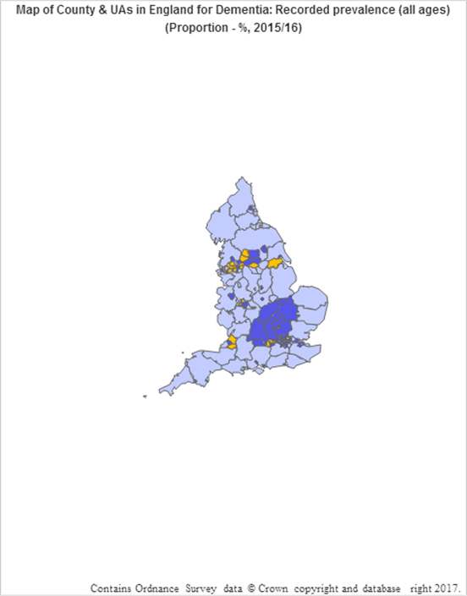
Identifying those at risk
Public Health England have developed a tool to check prevalence of dementia (and other statistics on risk factors that can lead to dementia) across UK.
Growing body of research looking into psychosocial risk factors:
Andel et al 2012, work related stress may increase vascular dementia
Norton et al 2014, Lifestyle behaviour reduces risk of dementia
Pre-existing health inequalities (Marmot, 2010).
Compared with benchmark:
Source: Public Health England, 2016

Slide 15
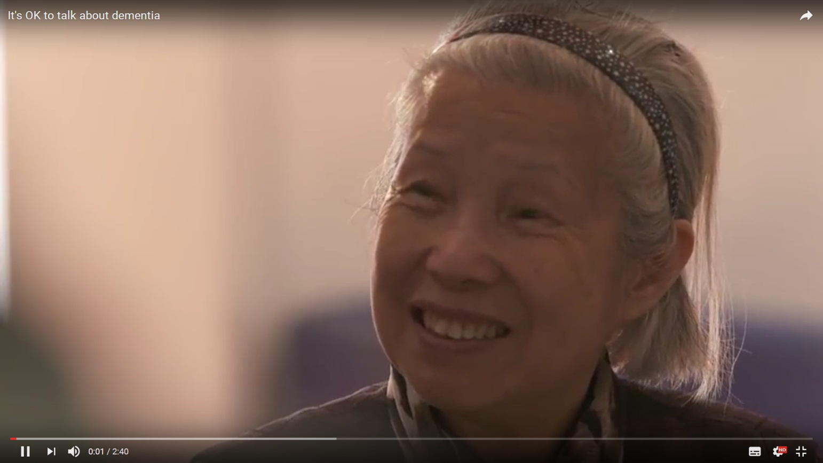
Video: ‘It’s ok to talk about dementia’
https://www.youtube.com/watch?v=veWILEVO434
Source: Dementia Action Alliance England
Notes:
Introduce the video: "It's OK to talk about Dementia" is an initiative that aims to address the stigma around dementia in black, Asian and ethnic minority (BAEM) communities in the UK. The project is working with 5 dementia champions from BAEM communities who have been raising awareness of dementia, explaining the signs and symptoms and signposting where to go for information, advice and support.
Play the video.
Debrief after watching the video:
How does this resonate with your own community? What are your experiences of working with BAEM groups in your role at the hospital?? What resources do you have available to you to support BAEM groups with regards to dementia?
Some interesting facts that you can read to the group:
There is greater prevalence of dementia among black and South Asian ethnic groups.
In 2011, there were 25,000 people with dementia from black, South Asian and minority ethnic groups in England and Wales, according to the Alzheimer’s Society.
This number is expected to double to 50,000 by 2026 and rise to over 172,000 by 2051.
This amounts to a sevenfold increase over 40 years, compared to just over a twofold increase in the numbers of people with dementia across the whole UK population.
These groups are more prone to risk factors such as cardiovascular disease, hypertension and diabetes, which increase the risk of dementia and contribute to increased prevalence. Public Health England, 2016

Slide 16
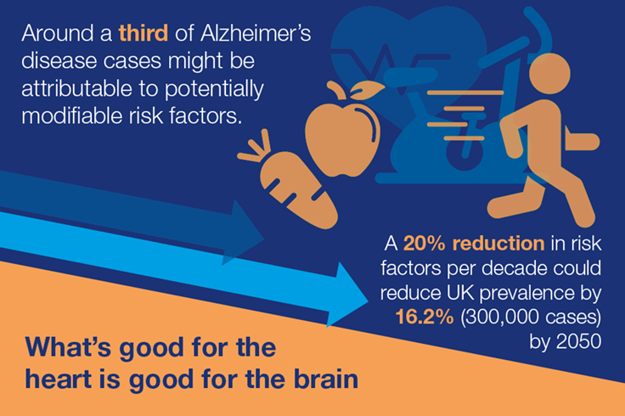
Good for the heart; good for the brain
NICE guidelines recommend reducing the risk of or delaying the onset of disability, dementia and frailty by helping people to:
stop smoking
be more active
reduce their alcohol consumption
improve their diet
lose weight if necessary and maintain a healthy weight
Alzheimer's Society have created a leaflet to inform people about how to reduce their risk of dementia
Sources: Alzheimer's Society, 2017; National Institute for Health and Care Excellence (NICE), 2015; Public Health England, 2016.
Notes:
Ageing is the biggest risk factor for dementia and can't be changed. There are however lots of things you can do to reduce your risk. It’s up to you.
It's never too young to develop good habits, but mid-life (age about 40-64) is a good time to start making healthy choices if you’re not already doing so. Many people use changes in their lives – children moving out, a health scare, divorce or starting the menopause – as a prompt to start living more healthily. You’ll find it easier to adopt a healthier lifestyle if you can build it into your normal daily routine. Get your friends and family to support you – or better yet, join you.
Based on the latest research, here are our top tips to reduce your risk of dementia. Your risk will be lowest if you can adopt several of these and not just one or two
Click on the link for the leaflets and discuss the lifestyle factors that can reduce risk of developing dementia….
1. Keep physically active – for at least 30 minutes, five times a week. You’ll need to be active enough to raise your heart rate and get a bit out of breath. You could walk, cycle, swim or join an exercise or dance group. Regular physical exercise in middle-aged or older adults reduces the risk of developing dementia. It’s also good for your heart and mental wellbeing. Exercise like this brings health benefits even if you’re not losing weight.
Read more about physical activity as a risk factor associated with dementiaI
n Norton’s study, physical activity was estimated to have the greatest influence of the risk factors studied in the UK. 21.8% of the Alzheimer’s cases were estimated to be attributable to physical inactivity. These could potentially be prevented if people were more active.
(Norton et al, 2014
2. Don’t smoke – if you already do smoke, try to stop. By smoking you are at a greater risk of developing dementia and harming your lungs, heart and circulation. If you want to stop smoking, talk to your GP. They can provide help and advice about quitting, and can refer you to an NHS Stop Smoking Service.
3. Eat a healthy balanced diet - A healthy diet has a high proportion of oily fish, fruit, vegetables, unrefined cereals and olive oil, and low levels of red meat and sugar. Such a diet will help reduce your risk of dementia and heart disease, stroke and type 2 diabetes. Try to cut down on saturated fat (eg cakes, biscuits, most cheeses) and limit sugary treats. Keep an eye on your salt intake too, because salt raises your blood pressure and risk of stroke. Read food labels to see what’s in them and seek out healthier options.
Read more about diet as a risk factor associated with dementia
4. Keep your alcohol within recommended limits – and remember that these limits changed in 2016. They are now a maximum of 14 units each week for men and women, spread over 3 or more days. This is the same as four or five large glasses of wine, or seven pints of beer or lager with a lower alcohol content. Regularly exceeding these weekly limits increases your dementia risk. If you find yourself struggling to cut down what you drink, talk to your GP about what support is available. – Korsecough dementia
Read more about alcohol and dementia
5. Take control of your health – If you’re invited for a regular mid-life health check at the doctor’s, be sure to go. It’s like an ‘MOT’ for your body and will include a check of your blood pressure, weight and maybe cholesterol level. These are linked to dementia and conditions that are strong risk factors for dementia (heart disease, stroke and diabetes). If you’re already living with one of these long-term conditions, follow professional advice about medicines and lifestyle. If you feel that you might be getting depressed, seek treatment early.
Read more about high blood pressure as a risk factor associated with dementia
Read more about cholesterol and dementia risk
6. Keep to a healthy weight – this will reduce your risk of type 2 diabetes, stroke and heart disease – and hence probably of dementia. A good place to start is to follow the advice on exercise and diet. Keep a diary of your food intake and exercise for each day, and remember that alcohol contains hidden calories. The NHS Live Well website has lots of practical tips. Or you could join a local weight loss group. If you’ve tried to make changes without success, your GP can also offer advice.
7. Give your brain a daily workout – This could be reading, doing puzzles, word searches or crosswords, playing cards or learning something new - maybe another language. If you can keep your mind active you are likely to reduce your risk of dementia. There is a bit less evidence, but keeping socially engaged and having a good social network may also reduce your dementia risk. Visit people or have them visit you, join a club or volunteer.

Slide 17
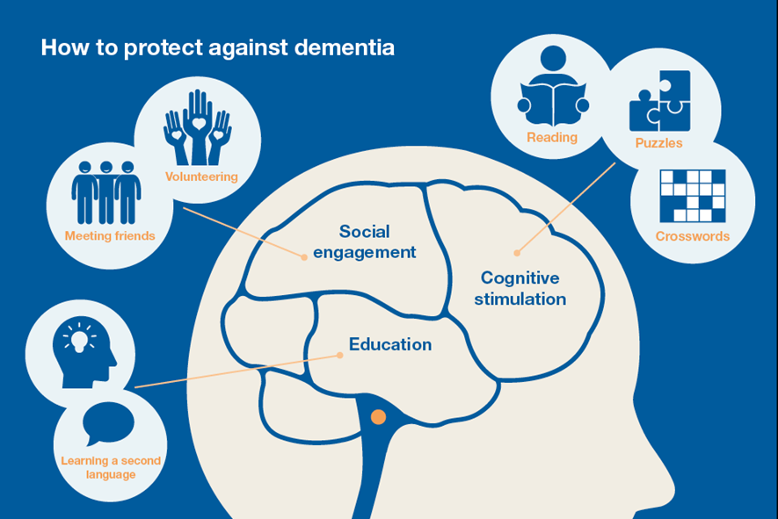
Protective factors
Source: Public Health England, 2016
Keeping your brain active and challenged throughout life may help reduce your dementia risk.
Higher levels of education, more mentally demanding occupations, and cognitive stimulation, such as doing puzzles or learning a second language lower the risk of developing dementia (Valenzuela and Sachdev, 2006)
Being socially active can help to reduce dementia risk by:
improving your mood
relieving stress
reducing the risk of depression
reducing loneliness
Notes:
Protective factors
Keeping your brain active and challenged throughout life may help reduce your dementia risk.
Research shows that a lower risk of developing dementia is associated with:
higher levels of education
more mentally demanding occupations
cognitive stimulation, such as doing puzzles or learning a second language
In a review of brain reserve and cognitive decline Valenzuela and Sachdev (2006) found a 46% lower risk of dementia in those with high levels of mental activity than those with low mental activity (based on data from 22 studies with over 29,000 participants)
A review of brain reserve and cognitive decline, combining the data from 22 studies and over 29,000 participants, found a 46% lower risk of dementia in those with high levels of mental activity than those with low mental activity.
Being socially active can help to reduce dementia risk by:
improving your mood
relieving stress
reducing the risk of depression
reducing loneliness

Slide 18
Factors that impact ability to make changes to health
Confidence (i.e. belief in one’s ability to perform the behaviour)
Motivation (i.e. one’s desire or will to engage in the behaviour) - our reasons for action (what is your motive?) and our enthusiasm for doing it (how motivated are you?)
Kings Fund, 2008
Notes:
Remember that we are all different and will be affected by a range of factors that impact our ability to make changes to our health.
This includes:
Confidence (i.e. belief in one’s ability to perform the behaviour)
Motivation (i.e. one’s desire or will to engage in the behaviour) - our reasons for action (what is your motive?) and our enthusiasm for doing it (how motivated are you?)

Slide 19
Social determinants of health
Relationship between the individual, their environment and their health.
Determines ability to make changes, risk of becoming unwell, ability to prevent ill health and access to treatments
Dahlgren and Whitehead, 1991
Notes:
See also Social determinants of health model – Dahlgren and Whitehead 1991.
Health inequalities in society - where your level of health is connected to your socioeconomic level - has led to a growing awareness that many health issues can be determined by social factors. Economic, environmental and social inequalities can determine people's risk of getting ill, their ability to prevent sickness, or their access to effective treatments.
These social health factors have been explored by researchers using several models, but the most widely used is the Dahlgren-Whitehead 'rainbow model'. The model, developed by Göran Dahlgren and Margaret Whitehead in 1991, maps the relationship between the individual, their environment and health. Individuals are placed at the centre, and surrounding them are the various layers of influences on health – such as individual lifestyle factors, community influences, living and working conditions, and more general social conditions.
This framework has helped researchers to construct a range of hypotheses about the determinants of health, to explore the relative influence of these determinants on different health outcomes and the interactions between the various determinants.
The Dahlgren-Whitehead rainbow model remains one of the most effective illustrations of health determinants, and has had widespread impact in research on health inequality and influences.
Age, sex and hereditary factors: in Dahlgren and Whitehead's model personal characteristics (such as age, sex, ethnicity and constitutional factors (e.g. genetic, biological) occupy the core.
These factors are highly significant for health, yet they are largely seen as beyond the reach and influence of public health improvement strategies, policies and practices. However, other factors, that can in turn be influenced, extend out in layers from the model's core.
Individual lifestyle factors: sometimes described as lifestyle 'choices', this layer refers to behaviours such as smoking, alcohol and other drug misuse, poor diet or lack of physical activity.
Social and community networks: networks refers to family (parents, children, partners), friends and the wider social circles around us. Social and community networks are a protective factor in terms of health. And although it may risk stating the obvious, it is the quality rather than quantity of relationships that matters.
Living and working conditions: includes access to and opportunities in relation to, for example; education, training and employment, health, welfare services, housing, public transport and amenities. It includes facilities like running water and sanitation, and having access to essential goods like food, clothing and fuel.
General socio-economic, cultural and environmental conditions: represents social, cultural, economic and environmental factors that impact on health and wellbeing and include, for example, wages, disposable income, availability of work, taxation, and prices; fuel, transport, food, clothing
These general conditions can directly affect government spending capacity, and in turn have a direct influence on health and social policy priorities.

Slide 20
Group activity
Consider how you can make positive changes to your own practice in terms of dementia risk reduction and prevention?
‘I want to help to shape practice for the future’
Work in pairs think about what you can do on a day to day to basis to positively influence practice?
Think about differing needs/abilities of people with dementia and carers from a range of different backgrounds. How can you ensure that you meet the range of different needs and abilities?
Notes:
Work in pairs: think about what you can do on a day to day to basis to positively influence practice?
Think about differing abilities/needs of people with dementia and carers from a range of different back grounds. How can you ensure that you meet the range of different needs and abilities?
Feedback from the pairs to the group.
Debrief – ideas could include a notice board with information, patient information leaflets (different languages), etc.
Is an acute setting the best place to diagnose? Who can you signpost to instead?

Slide 21
Sources of health promotion support and information
NHS Health Check for adults in England aged 40 to 74, is an ideal opportunity for GPs and other healthcare professionals to offer advice to promote a healthier lifestyle. Plus regular measurements of cholesterol levels, blood glucose, and blood pressure.
One you Campaign Public Health England – visit the Campaign Resource Centre for posters, leaflets and digital resources for use on social media.
One you ‘How are you’ online quiz Public Health England aimed at people aged 40-60 to motivate people to take steps to improve their health and reduce the risk of dementia.
Health Matters Online platform for challenging debate and comment on topical issues of policy and practice in the fields of healthcare, social care and public health, health and wellbeing.
NHS live well Website with tips for healthy living, including links to apps to manage own health
Staying healthy – Alzheimer's Society Website that explains adjustments that can be made to lifestyle or environment to boost the health of a person with dementia.
Notes:
Here are some sources of health promotion support and information that you can signpost people to. There are also some links to dementia specific guidance and policies.
Tip: create a hand out with local sources of support and information to give to staff that attend your training.

Slide 22
Sources of health promotion support and information
NICE Guidance Mid-life Guidance covers mid-life approaches to delay or prevent the onset of dementia, disability and frailty in later life. Aims to increase the amount of time that people can be independent, healthy and active in later life.
HEE Dementia Guide for Carers and Care Providers offers practical information for anyone caring for a person with dementia and has been developed by HEE Thames Valley team in collaboration with healthcare professionals, educators and carers
NICE Guidance Dementia Guidelines covers preventing, diagnosing, assessing and managing dementia in health and social care.
Prime Minister’s Challenge on Dementia 2020 Policy document outlining progress to date on improving dementia care, support and research.
Dementia Nursing Vision and Strategy Policy document that sets out the role and responsibilities for nurses providing care and support for people with dementia.
Notes:
Here are some sources of health promotion support and information that you can signpost people to. There are also some links to dementia specific guidance and policies.
Tip: create a hand out with local sources of support and information to give to staff that attend your training.

Slide 23
Key points to remember
The care and management of people with dementia is one of the biggest challenges facing the global population (Alzheimer's Disease International and World Health Organisation, 2012).
Health and social care workforce have a responsibility to signpost people with dementia and carers to health promotion support and information.
Support and information should be available to suit different needs and abilities.
What’s good for the heart is good for the brain (Public Health England, 2016)

Slide 24
Time for a break
Notes:
15 minute comfort break

Slide 25
Person-Centred Care Tier 2, Subject 4
Notes:
Welcome back. We are now going to think about person-centred care in dementia care.

Slide 26
Session aims
To understand:
principles of person-centred care and the humanising values framework;
the importance of viewing a situation through the perspectives of people with dementia and their carers/family members, and relationships and interactions to the well-being of people with dementia;
the role of family carers, advance planning, life story work and clear documentation in the care of people with dementia;
the significance of knowing the person and their background, that needs may change as dementia progresses and how to adapt the physical environment to meet changing needs.
Notes:
It is important to state these at the beginning of the session.

Slide 27
Principles of person-centred care – VIPS model
Valuing people with dementia as
Individuals; looking at the world from the
Perspective of a person with dementia and a positive
Social environment in which the person living with dementia can experience relative well-being.
(Brooker, 2005; 2017)
Notes:
There are a number of person-centred care models that guide dementia care, VIPS is one example.
Consider the person not the disease! Dementia affects all areas of a persons life - physical, emotional, intellectual, social, spiritual etc.
See how everything can have an impact on the person with dementia – including staff attitude, lack of access to outdoor space,
Emphasise the imperative in dementia care to consider the needs of carers, whether family and friends or paid care‑workers, and to consider ways of supporting and enhancing their input to the person with dementia. This is increasingly described as 'relationship‑centred care'.
NICE. (2016) ‘Dementia: supporting people with dementia and their carers in health and social care’,
https://www.nice.org.uk/guidance/cg42/chapter/personcentred-care. Accessed 25.04.17

Slide 28
Group activity
Divide into pairs
Using an item you have with you (photo on your phone/piece of jewellery) tell the other person about the significance of this item to you
The other person should just listen
After 3 minutes change and let the other person tell you the significance of something
Notes:
Divide the group into pairs
Using an item you have with you (photo on your phone/piece of jewellery) tell the other person about the significance of this item to you
The other person should just listen
After 3 minutes change and let the other person tell you the significance of something
Debrief (6 mins):
How much did you learn in 3 minutes about the other person?
What difference would this make, taking 3 minutes of your time to ‘just listen’ to your patient?
What do stories tell us?
What are the benefits of stories?
What's it like sharing your story?
What is it like to hear a person’s story?
Emphasise the uniqueness of our own stories, that of others, that we share our humanity

Slide 29
Value of narratives
People with dementia place great emphasis on interpersonal aspects of care rather than technical interventions.
Historically, older people had lower expectations of health care which made it more difficult for them to participate fully in decisions about their care (Wetzels et al, 2007).
Active involvement of older people in service developments, evaluation and decision-making is fairly recent.
(Hsu and Mccormack 2011; Karlsson et al 2014)

Slide 30
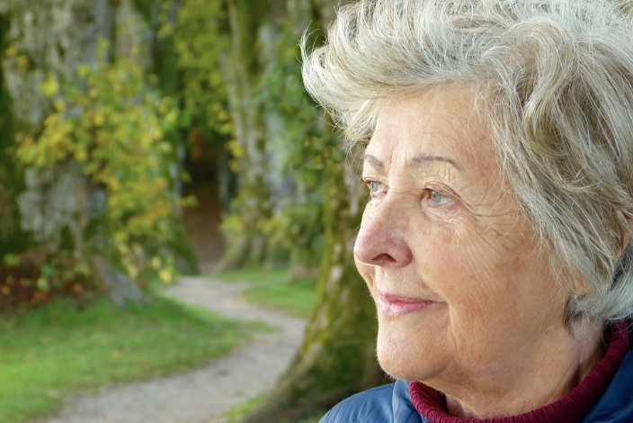
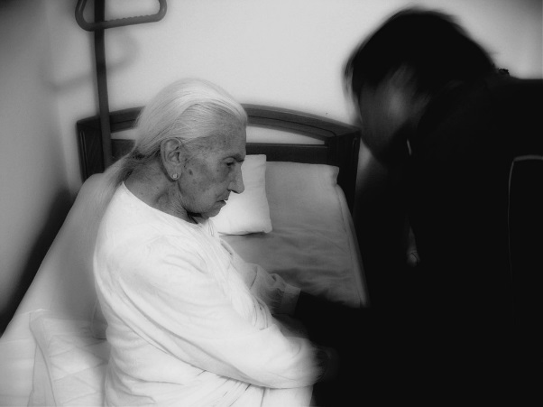
Value of narratives
People with dementia should be viewed as the experts.
People with dementia can narrate their story.
Admission to hospital/poor health may changes their identity and their story.
Staff narrative versus patient narrative (Price 2013).
(Hsu and Mccormack 2011; Karlsson et al 2014)

Slide 31
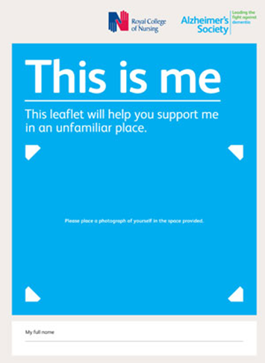
Collecting stories
How?
This is Me (or alternative document
Carers/family/friends
Documentation
On-going process with contributions from all those involved in that persons care
Source: Alzheimer’s Society, 2016

Slide 32
Humanising Values Framework
Source: Todres et al, 2009
Notes:
Humanising Values Framework.
Developed by Bournemouth University.
Continuum of care.
You can deliver care along this continuum at different times and different points.
It overlaps with person-centred care but it offers a set of values to support change in practive.

Slide 33
Forms of humanisation/ dehumanisation
Objectification
Insiderness
Focus on the person’s abilities
Getting to know the person
Focus on the person’s problems
Seeing the person as an object

Slide 34
Forms of humanisation/ dehumanisation
Agency
Passivity
Work with the person to achieve goal/outcome
Person is passive
Staff do to patient

Slide 35
Forms of humanisation/ dehumanisation
Uniqueness
Homogenised
We are all unique
Label the person
‘Dementia patient’
‘Wanderer’
‘Feeder’
‘Human dignity, human rights and equality: every human being has dignity, everyone should be treated as an individual’
(Universal Declaration of Human Rights, 1948)

Slide 36
Forms of humanisation/ dehumanisation
Togetherness
Isolation
To be human is to be part of a community
Relationship between the person & the care giver
Can be detrimental to a person’s health
No offer to build a relationship

Slide 37
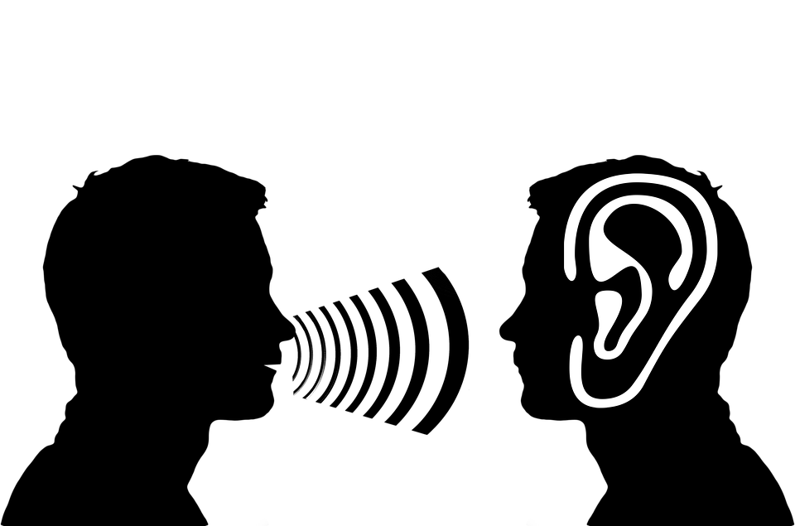
Forms of humanisation/ dehumanisation
Sense making
Loss of meaning
Helping a person to understand
Look at how someone lives rather than just what they should do
Don’t help a person to understand
No explanation

Slide 38
Forms of humanisation/ dehumanisation
Personal journey
Loss of personal journey
The person’s life journey – their hopes/ dreams/ goals
No individual help offered, no positive response
Person is anxious

Slide 39
Forms of humanisation/ dehumanisation
Sense of place
Dislocation
Not welcome
Not home
Objects/ tasks a person gets comfort from

Slide 40
Forms of humanisation/ dehumanisation
Embodiment
Patronising/judge
Focus on physiology & tests
Not treating the person with respect & dignity
How the person experiences the world
Perceptions of ourselves
Consider; psychological, social and social-cultural aspects of the person

Slide 41
Experiences of hospital care
People with dementia over 65 use up to ¼ of UK hospital beds.
People with dementia are staying for longer than others who are in for the same procedure.
This is putting a resource strain on an already struggling health system.
(Alzheimer’s Society, 2016; 2009).

Slide 42
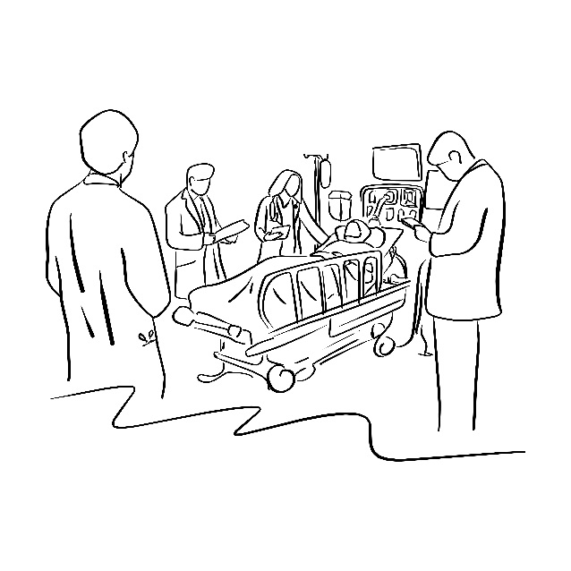
Experiences of hospital care
Areas that require improvement have been identified including:
inconsistent assessment leading to poor care
information sharing
planning and delivery of personalised care
assessment for delirium
communication of relevant information at discharge
recording of information pertinent to people’s care
dementia training
(The Care Quality Commission, 2014; Royal College of Psychiatrists, 2013).

Slide 43
Link between health status and mistreatment
O’Keeffe et al (2007)
Notes:
We often hear negative stories about care and the treatment of older people in care homes in the media – the recent example in Bristol.
A UK study by O’Keefe et al exploring abuse and neglect of older people.
The survey sample was weighted so that it was representative of general UK population aged 66 and over in private households
found that the frequency of mistreatment increased with declining health status.

Slide 44
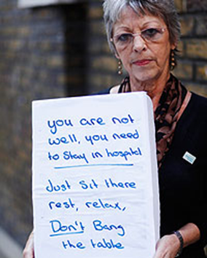
Experiences of hospital care
‘My mum quickly became confused and frightened in hospital. One day the staff left a sign next to her bed telling her: ‘you are not well, you need to stay in hospital. Just sit there, rest, relax and don't bang the table’. My mum did not understand: she did not have her reading glasses with her and could not remember anything for more than two seconds….
….This was very upsetting for me - I nursed my husband through severe dementia until his death six months earlier. He too received poor care in hospital. He went in walking, and within ten days he was unable to walk and barely able to talk. I knew my mum deserved better.’
Ann Reid, 63, from Eastbourne, whose mother has dementia, cited in Alzheimer's Society (2012).
Source: Alzheimer's Society, 2012
Notes:
Here is an example from a carers perspective of how the needs of the PWD had not been considered by the nursing staff

Slide 45
Person Centred Care Simulation
Notes:
Follow the guidance in the resource pack.

Slide 46
Best practice: people with dementia in acute settings
Maintaining identity: ‘see who I am’
People with dementia want staff to know what is important to them, and relatives want staff to value what they know about the patient.
Creating community: ‘connect with me’
A connected and two-way relationship with staff gives people with dementia and relatives the reassurance that staff will care for them and meet their needs.
Sharing decision making: ‘involve me’
People with dementia and relatives want to understand what is happening and to be given on-going involvement in decision making.
(Bridges et al, 2009)
Notes:
Maintaining identity: ‘see who I am’ –
Challenges: Connections with who they are are broken; Difficulties in communicating, understanding and remembering intensifies loss of identity
Opportunities: What is important for them; Accommodate normal routine where possible
Creating community: ‘connect with me’
Challenges: A connected and two-way relationship with staff gives people with dementia and relatives the reassurance that staff will care for them and meet their needs; “The Difficult patient!!!” how labelling can influence care interactions; communication/interpretation difficulties
Opportunities: Meeting with families; time when communicating; This is Me; a connection helps identify needs to increase security
Sharing decision making: ‘involve me’
Challenges: people with dementia and relatives want to understand what is happening and to be given on-going involvement in decision making.
Opportunities: In every encounter actions are negotiated to decrease anxiety promote self-hood; health can increase confusion and increase anxiety, influencing decision making; time with communicating

Slide 47
Importance of person-centred care
Professional carers may not have the opportunity to interact with the person before the onset of dementia…. thus the person with dementia may be seen as dependent rather than an active subject.
Knowing about the personal background, interests and preferences increases the likelihood of needs being met.
Dementia care ‘maintenance of personhood in the face of failing mental power’ (Kitwood, 1997).

Slide 48
Key points to remember
Ensure people with dementia and their carers are:
asked how they would like to be addressed and that staff respect this
given all the information on the service, in the appropriate format and, wherever possible, in advance.
Care planning should include opportunities for people with dementia and their carers to talk with staff regularly.
Involve people with dementia and their carers in the production of information resources.
Facilitate ways of obtaining the views of people with dementia and their carers.
……see the person not the disease!

Slide 49
Time for a break
Notes:
15 minute comfort break

Slide 50
Communication, Interaction and Behaviour in Dementia Care Tier 2, Subject 5
Notes:
Welcome back. Now we are going to think about communication, interaction and behaviour in dementia care.

Slide 51
Aims of the session
To understand:
the impact of dementia on communication skills and the need for effective communication and active listening skills;
distressing behaviour as a means of communicating an unmet need;
how different approaches may enable or support more effective communication (focusing on humanisation, person-centred, life story information, the ABC analysis of behaviour model);
the importance of effective communication with family and carers and the expertise that they may be able to offer to support effective communication with the person with dementia; and
how to adapt the environment to minimise sensory difficulties experienced by an individual with dementia.
Notes:
It is important to state these at the beginning of the session.

Slide 52
Communication simulation
Notes:
Follow the guidance in the resource pack

Slide 53
Significance
In a recent study, on average each person living with dementia spent less than 2% of their day engaging in social communication with a care worker.
Communication can be complex because of cognitive impairments.
(Blair 2007 cited Machiels et al 2017; Ward et al 2005 cited Downs and Collins 2015)
Source: BSG Ageing Photography Competition 2016

Slide 54
Significance
Evidence suggests that healthcare staff can lack the skills and knowledge to communicate properly.
Communication is often a low priority because of workload and task orientated care.
Communication difficulties can cause staff burnout.
(Downs and Collins 2015; Stans et al 2013 cited Machiels et al 2017)

Slide 55
Humanised Communication
Using humanisation (Todres et al, 2009) as a theoretical lens can improve efficacy of communication.
Head – understanding of brain damage on communication skills
Heart – understanding of
living with dementia
Hands – recognition of humanity
by communicating with compassion

Slide 56
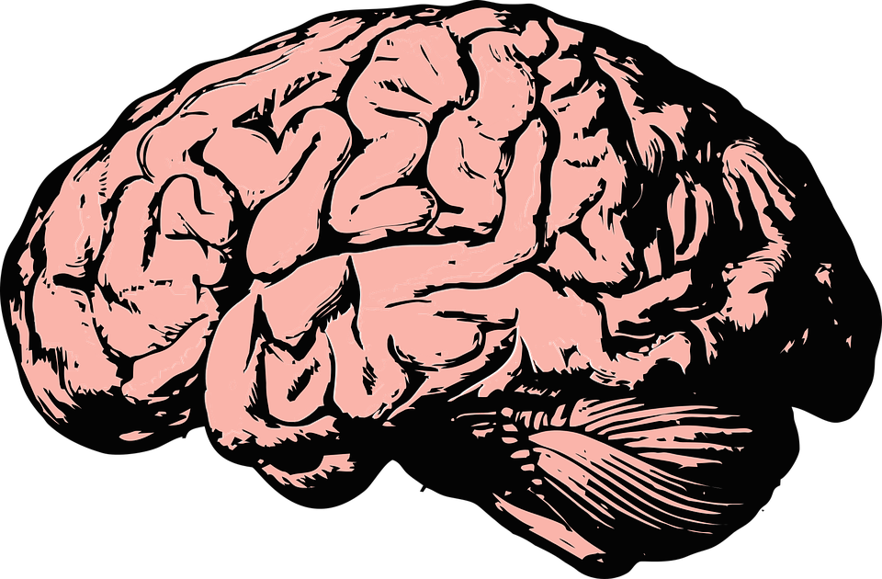
Humanisation - Head
https://kids.alzheimersresearchuk.org/teens/explore-the-brain/
Notes:
Click on the link and explore the different parts of the brain and how damage in those parts impacts on the person and the different dementia symptoms likely to be experienced

Slide 57
Humanisation - Head
Progressive Aphasia
Difficulties in word finding.
Person may ‘talk around’ the subject
Reduced fluency
Difficulties in comprehension of complex sentences
Reduction of language use
Difficulties in producing words/phrases
Becoming ‘stuck’ on words

Slide 58
Video: Communication difficulties
2008
https://www.youtube.com/watch?v=SqayhP3ebDw
2013
https://www.youtube.com/watch?v=rNt5O5X5QhQ
1948 -2015
Notes:
You will play 2 videos of Terry Pratchett who had PCA, a rare form of dementia.
Play the first video from 2008, explain that Terry was well educated and wrote a number of best selling books.
Then play the second video from 2013) and draw out the differences in terms of language used (more simple language used in the second video), pausing to consider words etc.

Slide 59
Humanisation - Head
Sensory changes associated with ageing e.g. deterioration in hearing and vision.
Disorientation, for example, regarding day and night, increase fear and agitation.
Can lead to withdrawal, social isolation, miscommunication, decreased self-esteem, sense of vulnerability, insecurity, loss of confidence, feelings of exhaustion, depression.
(Heine and Browning, 2004)

Slide 60
Humanisation – Heart
Psychological factors
Loss of confidence.
Anxiety and depression.
Responding to the frustration others express when communicating increases anxiety (Malignant social psychology, Kitwood 1997)
Fear, not knowing where they are, especially if admitted to hospital.
Lack of appreciation of the lived experience of dementia.

Slide 61
Humanisation – Hand Communication Skills
Ensure the person knows you are speaking to them, use clear non-verbal communication:
facial expression
Eye contact/gaze
gesture
body movement
posture
touch
spatial behaviour
clothing appearance.
(Argyle 1994 cited Nazarko 2014)

Slide 62
Humanisation – Hand Communication Skills
Avoid looking rushed, make that 5 minute conversation your sole focus at that time.
Make sure glasses, hearing aids are clean, in place and turned on.
Good lighting to avoid shadows can decrease anxiety.
Cover over mirrors if the person finds their own image alarming/ confusing.
Involve the person with dementia and their families to identify communication difficulties and strategies to over come them.

Slide 63
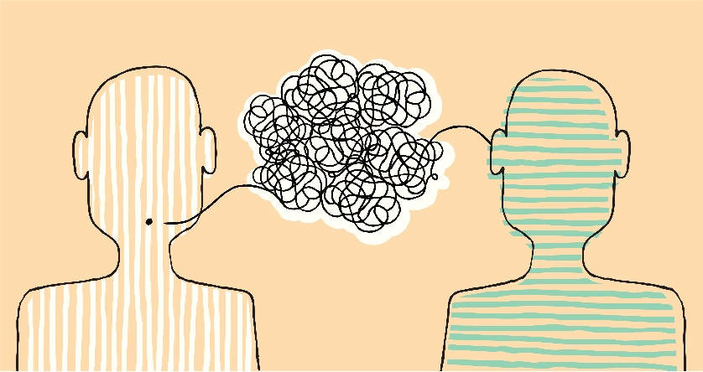
Humanisation – Hand Communication Skills
See the person NOT the diagnosis and value the humanity of the person (Brooker 2004).
Active listening - Live in the present with that person, accept their reality.
Use gestures, pictures and objects as well as words.
Offer visual choices if the person is having difficulty in making verbal choices, e.g. offer two plates of food instead of filling out a written menu.
Prompt the person about the topic of conversation if they go off track, for example ‘You were just telling me about your daughter, Susan’.

Slide 64
Humanisation – Hand Communication Skills
Avoid objectifying e.g. ‘Has everyone in bay 1 been done’!
Avoid challenge and arguments
Use distraction when necessary
VERA model (Blackhall et al 2011)
Validation
Emotion
Reassure
Activity

Slide 65
What remains…?
Now, this moment
Memories of self and relationships with others
Your references and emotional responses to stimuli
The defences you retreat into when you are stressed or anxious
For some, understanding of changes to self:
‘You and I, John, we speak the same language. Only you speak it straight and I speak it upside down’. (Person with dementia)
‘I used to know some of the language, but I could never quite get a hold of it. Somehow or other I can’t gather myself to be the same as I was’. (Person with dementia)
(Killick and Allan, 2001: 80)
Notes:
John Killick is a poet who has worked extensively with people with dementia to explore their experiences of living with the condition. Here are some quotes from people with dementia discussing how they feel about communication. http://www.poetrypf.co.uk/johnkillickpage.html

Slide 66
Behaviour is a form of Communication
Look for clues to understand reasons for behaviour:
More confused – infection, medication?
Sleepy – medication, pain, other physical cause, relaxed, contented? National Institute for Health and Care Excellence (NICE) Delirium 2014; Duxbury et al 2013
Aggressive – feeling threatened, pain, fear?
“Wandering” – bored, lonely, need
the toilet, previously active?
Distressed – unfamiliar setting, confused, fear, lonely, remembering trauma?
Unmet need Dewing 2010
Notes:
‘Challenging’ behaviour (!!!!), Who is challenging who?
‘Challenging’ behaviour can be defined as any behaviour that is unpredictable, frequent and of long duration, and is distressing to the individual or a nuisance to others (Ouldred and Byryant 2008)
BUT
Agitation and distress can often be a sign that people have an unmet need that is causing them discomfort or distress (Dewing 2010: and Livingston et al 2014)
Sundowning:
Sleep-wake cycle may be affected
Increasing agitation at night
Could be linked to light changes, fewer clues to time of day, exhaustion, age related, carer exhaustion
Current state
Emotional state, behaviour could be triggered by an emotion such as boredom (people with dementia have a short attention span but still require stimulating activities), anger, anxiety
These could include medical and physiological factors, such as pain, hunger, need for the toilet, and need for exercise. (Oppokofer & Geschwinder 2014.. Yamakawa et al 2014)
Delirium or other co-morbities

Slide 67
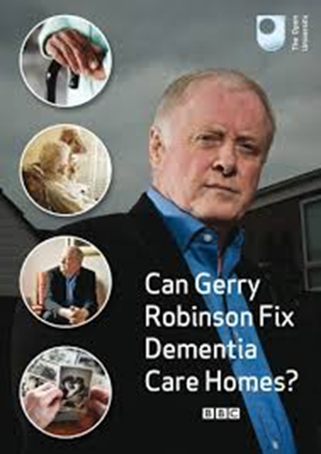
Simulated Activity
Note examples of humanised communication
Note examples of dehumanised communication
Notes:
Play the video clip of Ken and Evelyne and ask participants to note examples of humanised and dehumanised communication.
Ask participants to feedback to group on what they felt were humanised and dehumanised examples of communication.
Follow the guidance in the resource pack.

Slide 68
Group Discussion
Small actions can make a big difference! Share examples of humanised care from your practice.
Notes:
Read this short story:
One day an old man was walking down the beach just before dawn. In the distance he saw a young man picking up stranded starfish and throwing them back into the sea. As the old man approached the young man, he asked, "Why do you spend so much energy doing what seems to be a waste of time?" The young man explained that the stranded starfish would die if left in the morning sun. The old man exclaimed, "But there must be thousands of starfish. How can your efforts make any difference?" The young man looked down at the starfish in his hand and as he threw it to safety in the sea, he said," It makes a difference to this one!"
At times in our lives, we are all the old man, the young man, or the starfish. Sometimes, as the old man, we don't see the purpose to actions. Sometimes, as the young man, we persevere and make a difference. And sometimes, we are the starfish who just need a little help.
Explain that small actions can make a big difference!
Ask the group to consider and then share their own examples of humanised care from their own practice.

Slide 69
Key points to remember
All behaviour is a form of communication – look for clues to identify reasons for behaviour, or an unmet need.
To improve value of communication remember:
Head – understanding of brain damage on communication skills
Heart – understanding of living with dementia
Hands – recognition of humanity by communicating with compassion
Small actions can make a big difference.

Slide 70
Final thoughts….
Notes:
Ask the participants if they have any further thoughts or questions.

Slide 71
Evaluation
We would like to hear your feedback on how you found the workshop today.
Please complete an evaluation form before you leave.
Many thanks
Notes:
Evaluation of Unit:
Encourage participants to complete their Tier 2 Dementia Awareness Training Unit Evaluation Form
Collect the evaluation forms and prepare to send them to your Local Education & Training Lead
Thank all the participants for attending the training.

Slide 72
Acknowledgements
Health Education England
Jan Zietara
Reena Valand
DEALTS Project team:
Sue Clarke and all those involved in developing DEALTS
Health Education England Thames Valley
Jacqueline Fairbairn Platt
Leeds Beckett University
Prof. Claire Surr
Dementia Academic Action Group
University of Northampton
University of Bedfordshire
University of West London
Oxford Brookes University and all those involved in developing Tier 1 materials
DEALTS 2 Project team:
Bournemouth University
Prof. Jane Murphy
Dr Michele Board
Dr Michelle Heward
Ashley Spriggs
Mary-Ann Robertson
Michelle O’Brien
DEALTS 2 pilot
Stacey Ackerman
Jane Youell
Sandra Williamson
Lucy Garrod
Karen Rudman
Katherina Posadzki
Chloe Taylor-Jones
Juliet Thorogood
Rebecca Haynes
Jo Birrell
Notes:
Inform the participants that this training has been created in a project funded by Health Education England. The materials have been developed by Bournemouth University drawing from work previously undertaken by the people named on this slide. Thank you also to those that attended the pilot session for sharing your valuable experiences and feedback on the draft materials.

Slide 73
Credits
Many thanks for the images used throughout, where appropriate attribution for individual images is detailed on each slide.
Sincere thanks also go to the Origami Resource Center for permission to use the origami swan materials http://www.origami-resource-center.com/

Slide 74
References – Dementia Risk Reduction and Prevention
Alzheimer's Disease International and World Health Organisation. (2012) ‘Dementia: A Public Health Priority’, http://apps.who.int/iris/bitstream/10665/75263/1/9789241564458_eng.pdf?ua=1. Accessed 1st May 2017.
Alzheimer's Society. (2014) ‘Dementia UK: Update - Second edition’, https://www.alzheimers.org.uk/download/downloads/id/2323/dementia_uk_update.pdf. Accessed 1st May 2017.
Alzheimer's Society. (2017) ‘How to reduce your risk of dementia’, https://www.alzheimers.org.uk/info/20010/risk_factors_and_prevention/737/how_to_reduce_your_risk_of_dementia. Accessed 1 May 2017.
Andel, R., Crowe M, Hahn E, Mortimer J, Pedersen N, Fratiglioni, L., Johansson B, Gatz, M. (2012) ‘Work-related stress may increase the risk of vascular dementia’, Journal of American Geriatric Society, 60(1): 60-7. doi: 10.1111/j.1532-5415.2011.03777.x.
Dahlgren, G., and Whitehead, M. (1991) Policies and Strategies to Promote Social Equity in Health. Stockholm, Sweden: Institute for Futures Studies.
Kings Fund. (2008) ‘Motivation and Confidence: what does it take to change behaviour?’ https://www.kingsfund.org.uk/sites/files/kf/field/field_document/motivation-confidence-health-behavious-kicking-bad-habits-supporting-papers-anna-dixon.pdf. Accessed 1 May 2017.
Marmot, M. (2010). ‘Fair Society, Healthy Lives: The Marmot Review’, www.ucl.ac.uk/marmotreview. Accessed 20 April 2017.
National Institute for Health and Care Excellence. (2013) ‘Dementia: independence and wellbeing’, https://www.nice.org.uk/guidance/qs30. Accessed 20 April 2017.
National Institute for Health and Care Excellence. (2015) ‘Dementia, disability and frailty in later life – mid-life approaches to delay or prevent onset’, https://www.nice.org.uk/guidance/ng16. Accessed 20 April 2017.
Norton, S., Matthews, F., Barnes, D., Yaffe, K., and Brayne, C. (2014) ‘Potential for primary prevention of Alzheimer's disease: an analysis of population-based data’, The Lancet Neurology, 13 (8): 788 – 794. DOI: http://dx.doi.org/10.1016/S1474-4422(14)70136-X
Public Health England. (2016) ‘Health matters: midlife approaches to reduce dementia risk’, https://www.gov.uk/government/publications/health-matters-midlife-approaches-to-reduce-dementia-risk/health-matters-midlife-approaches-to-reduce-dementia-risk. Accessed 20 April 2017.
Skills for Health and Health Education England, 2015) ‘Dementia Core Skills Education and Training Framework’, http://www.skillsforhealth.org.uk/images/projects/dementia/Dementia%20Core%20Skills%20Education%20and%20Training%20Framework.pdf?s=cw1. Accessed 20 April 2017.
Valenzuela, M., and Sachdev, P. (2006) ‘Brain reserve and cognitive decline: a non-parametric systematic review’, Psychological Medicine, 36(8):1065-73. DOI: 10.1017/S0033291706007744

Slide 75
References Person-centred care
Alzheimer’s Society. (2009) Counting the cost: caring for people with dementia on hospital wards. London, Alzheimer’s Society.
Alzheimer's Society (2012) Hospitals commit to improve dementia care, available at http://www.alzheimers.org.uk/site/scripts/news_article.php?newsID=1402. Accessed 07/01/2014.
Bridges, J., Flatley, M., Meyer, J., and Nicholson, C., (2009) ‘Best practice for older people in acute care Settings (BPOP): guidance for nurses ,’ http://journals.rcni.com/userimages/ContentEditor/1373367366877/Caring-for-older-people.pdf. Accessed 1 May 2017.
Brooker, D. (2005) Person-centred dementia care: Making services better. London, Jessica Kingsley Publications.
Care Quality Commission. (2014) Cracks in the pathway. Care Quality Commission.
Hsu, M., and McCormack, B. (2011) ‘Using narrative inquiry with older people to inform practice and service developments’. Journal of Clinical Nursing, 21, 841–849.
Karlsson, E., Axelsson, S., Zingmark, K. (2014) ‘Stories about life narrated by people with Alzheimer’s disease’, Journal of Advanced Nursing 70(12): 2791–2799.
Kitwood, T. (1997) Dementia Reconsidered: The person comes first. Buckingham: Open University Press.
National Institute for Health and Care Excellence. (2016) ‘Dementia: supporting people with dementia and their carers in health and social care’, https://www.nice.org.uk/guidance/cg42/chapter/personcentred-care. Accessed 1 May 2017.
O’Keeffe, M., Hills, A., Doyle, M., McCreadie, C., Scholes, S., Constantine, R., Tinker, A., Manthorpe, J., Biggs, S., and Erens, B., 2007. UK Study of Abuse and Neglect of Older People Prevalence Survey Report. London: Comic Relief/Department of Health.
Royal College of Psychiatrists (2013). National Audit of Dementia care in general hospitals 2012-13: Second round audit report and update. Editors: Young J, Hood C, Gandesha A and Souza R. London: HQIP.
Todres, L., Galvin, K. & Holloway, I. (2009). ‘he Humanisation of Healthcare: A value framework for Qualitative Research’,. International Journal of Qualitative Studies on Health and Well-being ,4(2): 68-77.
Universal Declaration of Human Rights. (1948) ‘Universal Declaration of Human Rights’ http://www.un.org/en/universal-declaration-human-rights/. Accessed 6 May 2017.

Slide 76
References – Communication, Interaction and Behaviour in Dementia Care
Blackhall, A., Hawkes, D., Hingley, D., and Wood, S. (2011) ‘VERA framework: communicating with people who have dementia’, Nursing Standard, 26(10): 35-9.
Dewing, J. (2010) ‘Moments of movement: active learning and practice development’, Nurse Education in Practice, 10(1): 22-26.
Downs, M., and Collins, L. (2015)., 'Person-centred communication in dementia care', Nursing Standard, 30(11): 37-41.
Duxbury, L., Higgins, C., and Smart, R. (2011) ‘Elder care and the impact of caregiver strain on the health of employed caregivers’. Works, 40(1): 29–40.
Heine C., and Browning, C. (2004) ‘The communication and psychosocial perceptions of older adults with sensory loss: A qualitative study’, Ageing & Society, 24: 113–130.
Killick , J., and Allan, K., (2001) Communication and the care of people with dementia. Buckingham: Open University Press.
Kitwood, T. (1997) Dementia Reconsidered: The person comes first. Buckingham: Open University Press.
Machiels, M., Metzelthin, S., Hamers, J., and Zwakhalen, S. (2017) 'Review: Interventions to improve communication between people with dementia and nursing staff during daily nursing care: A systematic review', International Journal Of Nursing Studies, 66: 37-46.
National Institute for Health and Care Excellence. (2014) ‘Delirium in adults’, https://www.nice.org.uk/guidance/qs63. Accessed 6 May 2017.
Nazarko, L. (2014) ‘People living with dementia: components of communication’, British Journal of Health Care Assistants, 8: 11. DOI: http://dx.doi.org/10.12968/bjha.2014.8.11.554
Todres, L., Galvin, K. & Holloway, I. (2009) ‘The Humanisation of Healthcare: A value framework for Qualitative Research’, International Journal of Qualitative Studies on Health and Well-being, 4(2): 68-77.

Slide 77
Useful resources
Alzheimer’s Society. (2016) ‘Fix Dementia Care: Hospitals’, https://www.alzheimers.org.uk/site/scripts/download_info.php?fileID=2907. Accessed 30/09/16.
ASPiH and HEE (2016) ‘Standards Framework and Guidance on Simulation-Based Education in Healthcare’ https://worldspanmedia.s3.amazonaws.com/media/aspihdjango/uploads/documents/standards-consultation/standards-framework.pdf. Accessed 09/02/2017.
Galvin K., and Todres, L. (2012) Caring and Well-being: A Lifeworld Approach. London: Routledge.
HEE Fred’s Story films and related resources https://hee.nhs.uk/our-work/person-centred-care/dementia/freds-story
HEE Tier 2 resources: https://www.hee.nhs.uk/hee-your-area/thames-valley/our-work/dementia/dementia-tier-2-resources
Notes:
Additional sources of information for those that are interested.

Slide 78
Contacts
Bournemouth University
Ageing and Dementia Research Centre
adrc@bournemouth.ac.uk
@BournemouthARDC
Health Education England
https://hee.nhs.uk/
@NHS_HealthEdEng

