Slide 1
Dementia Education And Learning Through Simulation 2 (DEALTS 2) programme
Train the Trainer Session Slides
Developed in partnership by Health Education England and the Ageing & Dementia Research Centre, Bournemouth University

Slide 2
Welcome
Introductions
Housekeeping
Overview and purpose of Train the Trainer day
Notes:
Welcome to the session.

Slide 3
Housekeeping
Fire
Refreshments
Toilets
Ground Rules
Confidentiality
Self disclosure
Opportunity for questions/debrief
Notes:
Make sure every one knows what is where and what to do if there is a fire alarm (check if a test is expected in advance)
Ground rules = Listen to people. Allow people to speak. Respect their views. Keep them confidential
Explain that self disclosure is a powerful tool for learning but also requires the knowledge that what is disclosed remains confidential. Ask if people are happy to adhere to these ground rule.
Explain that some of the content may be emotionally challenging or may trigger emotional responses. This is OK, and offer to talk to people at the end of the session if required.

Slide 4
Overview of Train the Trainer day
Timings
09.00 | Arrival/ Registration
09.30 | Welcome/ Introductions Structure of the day; Introduction to simulated learning; Learning styles
10.00 | Run through: Dementia risk reduction and prevention - Tier 2 Subject 3
11.00 | Coffee
11.15 | Debrief
11.45 | Run through: Person centred care - Tier 2 subject 4
12.45 | Debrief
13.15 | Lunch
13.45 | Run through: Communication, interaction and behaviour in dementia care - Tier 2 subject 5
14.45 | Debrief
15.15 | Coffee
15.30 | Peer support groups; Action Plan
16.20 | Evaluation and follow up
16.30 | Close
Notes:
Explain to the trainers the structure of the day

Slide 5
Purpose of Train the Trainer day
To explain the relevance of simulated learning in health care settings
To suggest how Tier 2 training can be delivered using a variety of simulation activities
To participate in three examples of Tier 2 training and explore how it made you feel
To highlight opportunities that support the delivery of Tier 2 training – peer support and action planning
Discuss how materials can be adapted to suit local needs.
Notes:
Explain what the purpose is of the train the trainer day

Slide 6
Background: DEALTS -> DEALTS 2
DEALTS* simulation based dementia education package for health care professionals in acute settings developed in 2013/14.
Since then educational frameworks outlining key competencies for health care professionals working with people with dementia have been developed for example Dementia Core Skills Education and Training Framework – Tier 1, 2, 3 (Skills for Health, Health Education England and Skills for Life, 2015).
Health Education England commissioned Bournemouth University to update DEALTS and align competencies to Tier 2 in 2016/17.
For clarity, the updated version is referred to as DEALTS 2.
*Dementia Education and Learning Through Simulation
.
Source: Skills for Health, Health Education England and Skills for Care, 2015)
Notes:
Explain the background to DEALTS and the reasons for DEALTS 2.

Slide 7
Definition of Tier 2 training
Knowledge, skills and attitudes for roles that have regular contact with people living with dementia.
It is relevant to all health and care staff in settings where they are likely to have regular contact with people affected by dementia.
It is also appropriate for social care workforce group 2 including all social care staff directly providing care and support including care assistants working in residential or home care and also personal assistants.
Tier 2 underpins the more specialist skills and knowledge required at Tier 3.
Source: Skills for Health, Health Education England and Skills for Care, 2015)
Notes:
Define Tier 2 and where it fits in the overall dementia core skills framework.

Slide 8
What is simulation?
Simulation can be delivered through a wide spectrum of activities including, although not limited to: virtual reality and augmented reality; video; case studies or vignettes; role playing; actors; simulated patients; part-task trainers; hybrid models; full body manikins and complex simulated environments (ASPiH and HEE, 2016; Lateef, 2010).
The underlying principle of DEALTS was to ‘understand the lived experience by putting staff into the shoes of a person with dementia, facilitating a positive impact on practice’ (Sue Clarke), and simulation is key to achieving this.
Notes:
Give an over view of simualtion.

Slide 9
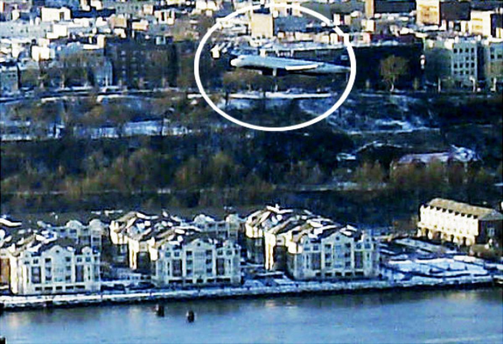
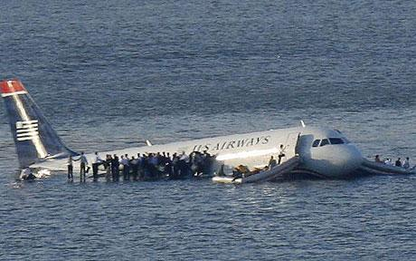
Why simulate?
Notes:
As each picture appears on a click ask candidates what the connection is (US Airways Flight 1549), ask the candidates if they think the pilot had real life experience of landing his aircraft on a river- this can lead to a discussion about the value of simulation.

Slide 10
Why simulate in health care settings?
Provides a safe space for staff to discover how they react under pressure and practice core knowledge, skills and attitudes
Protecting patients from unnecessary risks
Rare or difficult cases can be presented
Complexity and time course of scenario controllable - ability to stop and go back
Different outcomes possible, depending on treatment and reactions
Has the ‘potential to create lasting and sustainable behaviour and culture change that will make health care more effective and safer’
Human factors training:
communication
leadership
team work
problem solving
(Lateef, 2010)
Notes:
Explain why simulation is used in health and social care settings to deliver training.

Slide 11
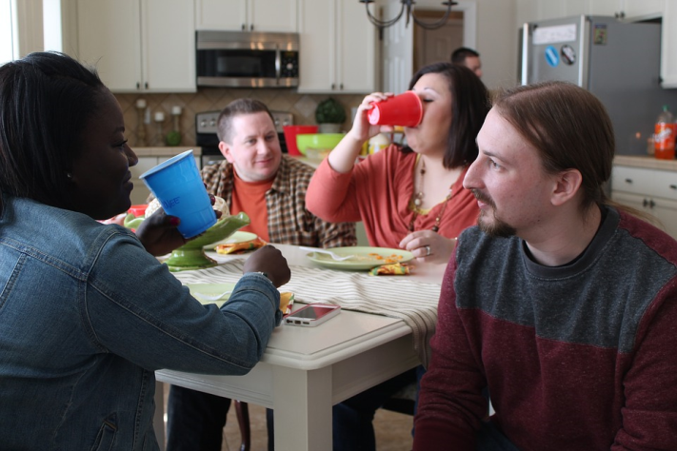
Ways to help us understand dementia
Accounts written by people with dementia themselves
Listening to what people with dementia say
Attending carefully and imaginatively to what people express by concrete, metaphorical or allusive means
Learn from their behaviour, or their actions and attempt at actions
Speaking with people who have undergone an illness with dementia like features such as depression
Simulating the experience ourselves through role play
Kitwood, 1997
Notes:
Ways to help us understand about dementia.

Slide 12
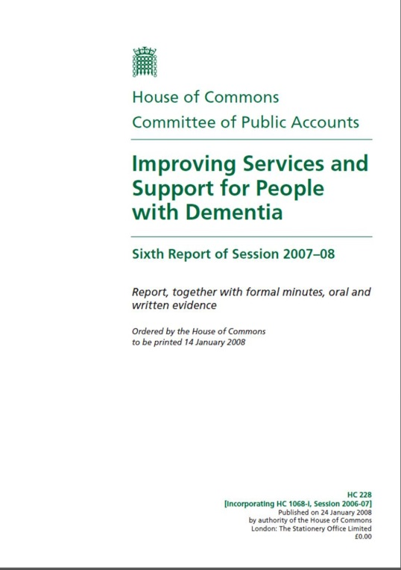
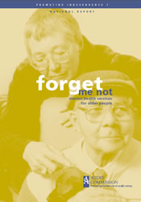
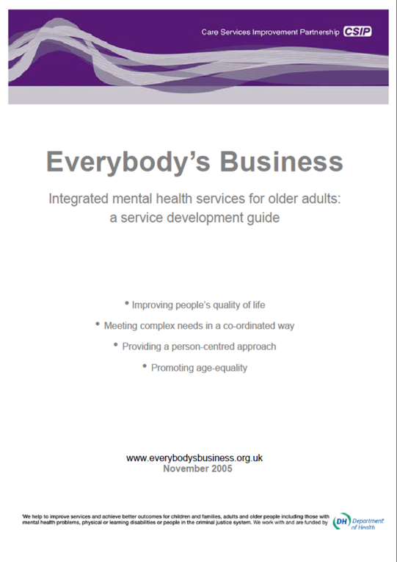
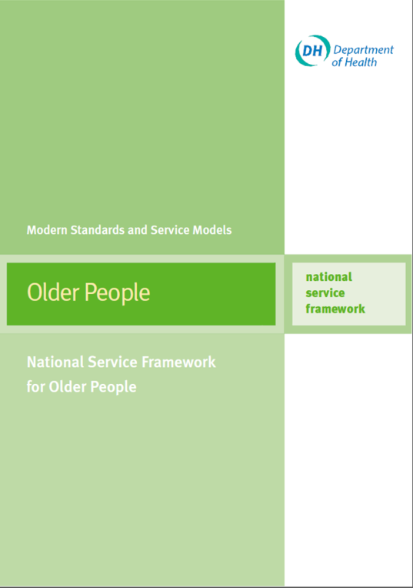
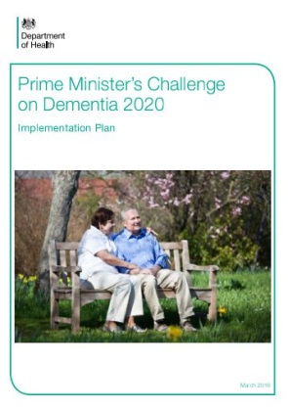
Why is dementia important?
Notes:
Highlight the policy context and level of national support for the dementia agenda

Slide 13
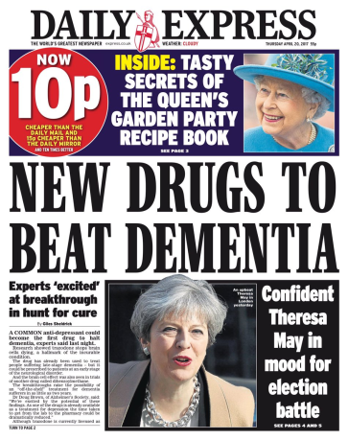
Experiences of hospital care
People with dementia over 65 use up to ¼ of UK hospital beds, and are staying for longer than other people who go in for the same procedure. This is increasing their likelihood of developing further infections and risk of harm as well as putting a resource strain on an already struggling health system (Alzheimer’s Society, 2009).
Instances of poor care and inconsistent assessment, information sharing, planning and delivery of personalised care in hospitals have also been identified (The Care Quality Commission, 2014).
Areas that require improvement have been identified including: assessment for delirium, communication of relevant information at discharge, recording of information pertinent to people’s care and dementia awareness training at staff inductions (Royal College of Psychiatrists, 2013).
Notes:
Explain the real need for dementia training for hospital staff.
The number of people living with dementia ending up in hospital is increasing and instances of poor care have ben identified and is a cause for concern.
Headlines from newspaper present mixed information about dementia, giving people mixed information about what they can do to reduce their own risk. Public are concerned about being diagnosed with dementia. What evidence lies behind these – can check out the evidence behind these headlines at NHS Choices – Behind the evidence

Slide 14
Value of lived experience
‘I have dementia, I also have a life’
‘I am a person living with dementia, with the emphasis on LIVING, and my mission is to empower others with dementia to live with it too, not only to go home and wait to die…’
Kate Swaffer, 2017
Source: https://kateswaffer.com/2017/06/01/how-would-you-feel-being-diagnosed-with-dementia/
Notes:
No matter the academic context – the real context is the person living with dementia and their friends and family.
Discuss one of the many people living with dementia who have become advocates – e.g. Kate Swaffer or George Rook

Slide 15
Experiential learning
‘… this learning process must be reimbued with the texture and feeling of human experiences shared and interpreted through dialogue with one another’. (Kolb, 2015: 2)
Experiential learning is the process of learning through experience, and is more specifically defined as ‘learning through reflection on doing’. (Patrick, 2011)
Notes:
Explain the relevance of experiential learning

Slide 16
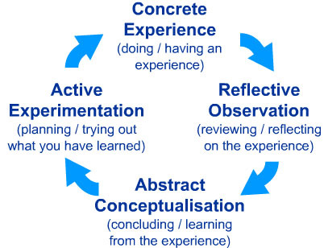
Learning styles model and experiential learning theory
Kolb, 1984
Notes:
kolb learning styles definitions and descriptions
Knowing a person's (and your own) learning style enables learning to be orientated according to the preferred method. That said, everyone responds to and needs the stimulus of all types of learning styles to one extent or another - it's a matter of using emphasis that fits best with the given situation and a person's learning style preferences.
Here are brief descriptions of the four Kolb learning styles:
Diverging (feeling and watching - CE/RO) - These people are able to look at things from different perspectives. They are sensitive. They prefer to watch rather than do, tending to gather information and use imagination to solve problems. They are best at viewing concrete situations several different viewpoints. Kolb called this style 'Diverging' because these people perform better in situations that require ideas-generation, for example, brainstorming. People with a Diverging learning style have broad cultural interests and like to gather information. They are interested in people, tend to be imaginative and emotional, and tend to be strong in the arts. People with the Diverging style prefer to work in groups, to listen with an open mind and to receive personal feedback.
Assimilating (watching and thinking - AC/RO) - The Assimilating learning preference is for a concise, logical approach. Ideas and concepts are more important than people. These people require good clear explanation rather than practical opportunity. They excel at understanding wide-ranging information and organising it a clear logical format. People with an Assimilating learning style are less focused on people and more interested in ideas and abstract concepts. People with this style are more attracted to logically sound theories than approaches based on practical value. These learning style people is important for effectiveness in information and science careers. In formal learning situations, people with this style prefer readings, lectures, exploring analytical models, and having time to think things through.
Converging (doing and thinking - AC/AE) - People with a Converging learning style can solve problems and will use their learning to find solutions to practical issues. They prefer technical tasks, and are less concerned with people and interpersonal aspects. People with a Converging learning style are best at finding practical uses for ideas and theories. They can solve problems and make decisions by finding solutions to questions and problems. People with a Converging learning style are more attracted to technical tasks and problems than social or interpersonal issues. A Converging learning style enables specialist and technology abilities. People with a Converging style like to experiment with new ideas, to simulate, and to work with practical applications.
Accommodating (doing and feeling - CE/AE) - The Accommodating learning style is 'hands-on', and relies on intuition rather than logic. These people use other people's analysis, and prefer to take a practical, experiential approach. They are attracted to new challenges and experiences, and to carrying out plans. They commonly act on 'gut' instinct rather than logical analysis. People with an Accommodating learning style will tend to rely on others for information than carry out their own analysis. This learning style is prevalent and useful in roles requiring action and initiative. People with an Accommodating learning style prefer to work in teams to complete tasks. They set targets and actively work in the field trying different ways to achieve an objective.

Slide 17
To get the most out of today….
Try to act naturally
Try to suspend any disbelief that you may have
Try not to over-act
Try to do it for real
Have fun!
By using feedback, reflection and aspects of core and instinctive knowledge, we will develop and reinforce your learning – this will last a lot longer
Following today you will receive the resources that you will need to deliver your own DEALTS 2 sessions by email.
You can also contact us by email if you have any questions.
Notes:
Explain how participants can get the most out of the session today.

Slide 18
Workshop
Notes:
Run through workshop slides – inform the participants that you will now use the powerpoint slides that you are providing them with.

Slide 19
Peer support
How confident do you feel about rolling out DEALTS 2 in your own Trust?
How about linking up as a group of trainers and supporting each other to successfully roll out DEALTS 2 across your region?
Committing to attending one another's first training session and providing constructive feedback will help you to enhance your skills and build your confidence in delivering DEALTS 2.
Please provide your name and email address on the list being passed round to be part of the peer-support group.
Notes:
Offer participants the opportunity to join up and provide each other with peer-support to roll out DEALTS 2 at a local level.

Slide 20
Be prepared for the unexpected
Expect the unexpected - you may be faced with situations that you do not expect when delivering dementia education.
Dementia may touch personal lives as well as our professional roles.
Participants may be upset or distressed – allow them to leave the room or express their emotions if they wish.
Participants may feel that this education is irrelevant for them ‘what am I going to learn I have been doing this job for 10 years, I don’t want to be here’ – respect their experience and tell them that you would value their feedback after the session – given that they have so much experience. After the session ask them if they found it meaningful/fun/different to what they expected.
Notes:
Explain to participants that dementia can be a highly emotive topic to deliver training about, as people may have professional and personal experience of the condition.
Some participant may choose to engage in self-disclosure about their experience of dementia. They need to be reminded that they should only disclose information that they are comfortable with and they are happy for that information to be shared with other people once the training has finished.
Be aware that not everyone will be interested in dementia. When people feel valued and welcome, they are more inclined to relax and to have an open mind towards the facilitator and the content of the session.
It is important to recognise that some people may be experiencing dementia on a personal level. This may determine individual levels of participation and interest at the outset. It is common for participants to become quite emotional and some may cry due to the emotional nature of the session. It is important to show care, consideration and personal interest by supplying small packets of pocket size tissues and have them available for any participants who may need them.
Other participants may become angry or disgruntled because of issues that they may have with the care that may have been delivered to their loved ones. Such participants may attend the sessions with a view to ventilate their own feelings of anger and frustration about their own situations. Should this happen, it is appropriately to acknowledge their feeling and then to tactfully but firmly redirect the participant to sources of support, which are available in abundance within this training pack. Feel free to offer them time to debrief after the session.
You may get some participants in the group who may begin the training by saying that they do not know anyone with dementia. However, as the session progresses, they discover that they do have some experience but they had not realised that it was dementia. Be mindful that the training session may act as a catalyst in bringing such experiences and emotions to the fore. Again, state that you will be available to provide a debrief to participants who may want to talk to you about issues that were raised during the training once it has finished.

Slide 21
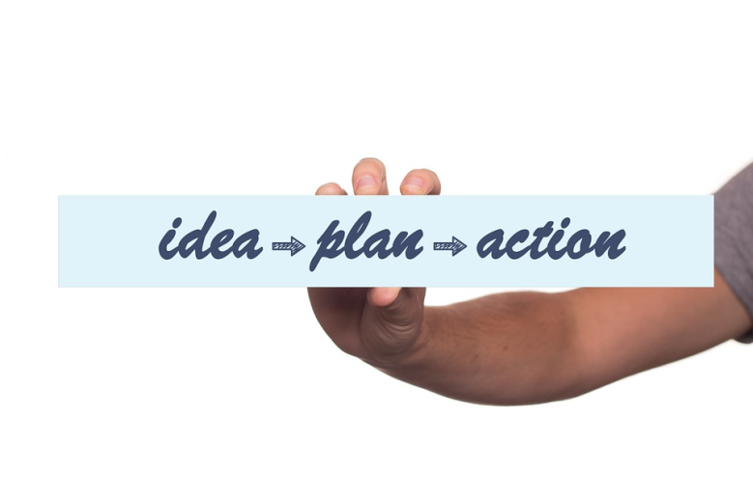
Action plan
How do I plan to roll out DEALTS 2 within my own Trust?
What might be the barriers/facilitators to rolling out DEALTS within my own Trust?
What resources can I use/will I need?
How will I engage all staff and who might I need to speak to before I am able to do so?
When do I plan to run my first session and can I link up with other trainers to get some feedback to support my own development?
Action plan
Objectives (list of goals) | Tasks (what you need to achieve the goals) | Success criteria (how you will identify your success) | Timeframe (by when you need to complete the tasks) | Resources (what or who can help you complete tasks)
Notes:
Ask participants to think about how they might roll out DEALTS 2 in their own Trust and make a plan.

Slide 22
Evaluation and follow up
We would like to hear your feedback on how you have found the day today. Please complete an evaluation form before you leave.
We would also like to hear how you are getting on rolling out DEALTS 2 in your own Trust in the future. Please leave your details on the evaluation form if you are happy for us to contact you for feedback in the future.
Many thanks
Notes:
Evaluation of Unit:
Encourage participants to complete their Evaluation Form
Collect the evaluation forms
Thank all the participants for attending the training.

Slide 23
Acknowledgements
Health Education England
Jan Zietara
Reena Valand
DEALTS Project team:
Sue Clarke and all those involved in developing DEALTS
Health Education England Thames Valley
Jacqueline Fairbairn Platt
Leeds Beckett University
Prof. Claire Surr
Dementia Academic Action Group
University of Northampton
University of Bedfordshire
University of West London
Oxford Brookes University and all those involved in developing Tier 1 materials
DEALTS 2 Project team:
Bournemouth University
Prof. Jane Murphy
Dr Michele Board
Dr Michelle Heward
Ashley Spriggs
Mary-Ann Robertson
Michelle O’Brien
DEALTS 2 pilot
Stacey Ackerman
Jane Youell
Sandra Williamson
Lucy Garrod
Karen Rudman
Katherina Posadzki
Chloe Taylor-Jones
Juliet Thorogood
Rebecca Haynes
Jo Birrell
Notes:
Inform the participants that this training has been created in a project funded by Health Education England. The materials have been developed by Bournemouth University drawing from work previously undertaken by the people named on this slide. Thank you also to those that attended the pilot session for sharing your valuable experiences and feedback on the draft materials.

Slide 24
Credits
Many thanks for the images used throughout, where appropriate attribution for individual images is detailed on each slide.
Sincere thanks also go to the Origami Resource Center for permission to use the origami swan materials http://www.origami-resource-center.com/

Slide 25
References
Alzheimer’s Society. (2016) ‘Fix Dementia Care: Hospitals’, https://www.alzheimers.org.uk/site/scripts/download_info.php?fileID=2907. Accessed 30/09/16.
ASPiH and HEE (2016) ‘Standards Framework and Guidance on Simulation-Based Education in Healthcare’ https://worldspanmedia.s3.amazonaws.com/media/aspihdjango/uploads/documents/standards-consultation/standards-framework.pdf. Accessed 09/02/2017.
Care Quality Commission. (2014) Cracks in the pathway. Care Quality Commission.
Kitwood, T. (1997) The experience of dementia, Aging & Mental Health, 1:1, 13-22, DOI: 10.1080/13607869757344
Kolb, D. (2015) Experiential Learning: Experience as the Source of Learning and Development. New Jersey: Pearson FT Press.
Lateef, F. (2010) ‘Simulation-based learning: Just like the real thing’, Journal of Emergency Trauma Shock, 3(4): 348–352. doi: 10.4103/0974-2700.70743.
Patrick, F. (2011). Handbook of Research on Improving Learning and Motivation. ISBN 1609604962.
Royal College of Psychiatrists (2013). National Audit of Dementia care in general hospitals 2012-13: Second round audit report and update. Editors: Young J, Hood C, Gandesha A and Souza R. London: HQIP.
Skills for Health and Health Education England (2015) ‘Dementia Core Skills Education and Training Framework’, http://www.skillsforhealth.org.uk/images/projects/dementia/Dementia%20Core%20Skills%20Education%20and%20Training%20Framework.pdf. Accessed 01/02/2017.
Notes:
Reference list for those that might like to do some additional reading in this area.

Slide 26
Contacts
Bournemouth University
Ageing and Dementia Research Centre
adrc@bournemouth.ac.uk
@BournemouthARDC
Health Education England
https://hee.nhs.uk/
@NHS_HealthEdEng
Notes:
Contact details if you have any further questions or would like to get in touch with ADRC

