Slide 1
Demystifying Qualifications
National AHP support workforce masterclass
21st January 2022

Slide 2
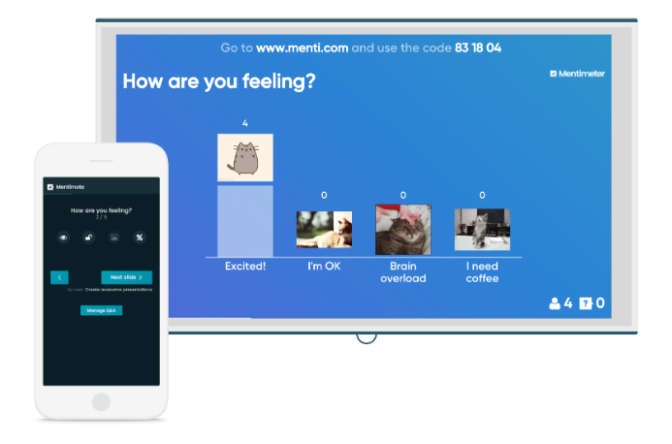
Menti.com
Code: 6919 309
#AHPsupportworkers

Slide 3
Welcome
Slides and recording will be shared via AHP Workforce Supply Implementation Strategy project SharePoint site
Cameras and audio disabled - Please use the chat box for questions and comments
Hashtag: #AHPsupportworkers
Menti.com
#AHPsupportworkers

Slide 4
Agenda | Agenda
9:30 | Introduction and overview Gaby Ford, AHP Clinical Fellow, National AHP Support Workforce Programme, Health Education England
9:35 | Educational qualifications & the Regulated Qualifications Framework (RQF) Richard Griffin, Professor of Healthcare Management, King’s Business School, King’s College London
9:45 | Value & importance of functional skills / skills for life Kirsty Marsh-Hyde, National programme manager – apprenticeships, Talent for Care Team, Health Education England
9:55 | Clarifying apprenticeships Gemma Hall, Talent for Care Relationship Manager (Apprenticeships) – North West, Talent for Care, Health Education England
10:10 | Levels of qualifications & job evaluation Gaby Ford, AHP Clinical Fellow, National AHP Support Workforce Programme, Health Education England
10:15 | Next steps & Close Gaby Ford, AHP Clinical Fellow, National AHP Support Workforce Programme, Health Education England
#AHPsupportworkers

Slide 5
Overview of the masterclass
Education, qualifications, and development available for the support workforce, and the range of HEE supportive resources available
The differences between educational levels, qualifications, and apprenticeships
The value and importance of functional skills / skills for life and the support offer from HEE
The importance of creating supportive learning cultures and processes to enable development
#AHPsupportworkers

Slide 6
Our aim is to have consistent, occupation-specific and sustainable education and career development pathways for AHP support workers, and fair opportunities to access these, implemented by provider services across England by April 2024
#AHPsupportworkers

Slide 7
2 Key resources to help
https://www.hee.nhs.uk/our-work/allied-health-professions/enable-workforce/developing-role-ahp-support-workers

Slide 8
Understanding the Regulated Qualifications Framework (RQF) & Qualifications for support workers
Richard Griffin, Professor of Healthcare Management, Kings Business School, Kings College London
#AHPsupportworkers

Slide 9
The RQF
Levels
Credits
Award
Certificate
Diploma
UCAS tariffs

Slide 10
Level | Examples of qualifications
Entry-level | Skills for Life, Entry-level diploma, Entry level English for foreign language speakers
1 | GCSE 3,2,1 or D,E,F,G, Level 1 Diploma
2 | GCSE 9,8,7,6,5,4 or A*,A,B,C, Level 2 Certificate, Level 2 NVQ, Level 2 National Diploma
3 | A Level, Level 3 Diploma, Technical Levels
4 | Certificate of Higher Education, Higher National Certificate, Level 4 Award
5 | Foundation Degree, Higher National Diploma
6 | Degree with honours
#AHPsupportworkers

Slide 11
Apprenticeships
Intermediate (e.g, Healthcare Support Worker apprenticeship standard)
Advanced (Senior Healthcare Support Worker apprenticeship standard)
Higher (Mammography Associate, Assistant Practitioner)
Agenda for Change
AHP Support Worker Competency, Education and Career Development Framework
#AHPsupportworkers

Slide 12
2 Key resources to help
https://www.hee.nhs.uk/our-work/allied-health-professions/enable-workforce/developing-role-ahp-support-workers

Slide 13
Functional skills / Skills for life
Kirsty Marsh-Hyde, National programme manager – apprenticeships, Talent for Care Team, Health Education England
#AHPsupportworkers

Slide 14
Skills for Life
21st January 2022

Slide 15
What are Skills for Life?
#AHPsupportworkers

Slide 16
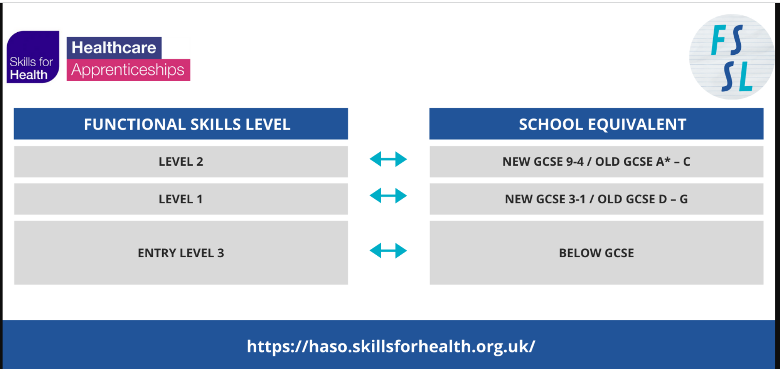
What are Functional Skills Qualifications?
Completion of level 2 is a requirement of most apprenticeships
Level 2 is equivalent to GCSE
Academic levels not to be confused with NHS banding
#AHPsupportworkers

Slide 17
Why support Skills for Life?
Hidden but real challenge – direct impact on workforce numbers
At least 20,000 colleagues in the NHS workforce do not feel confident in their skills
Preventing progression to roles including and above Level 3
As much a challenge of individual psychology as skill set
#AHPsupportworkers

Slide 18
Current support offer
basic key skills builder (bksb)
Fully funded access to exams
National Numeracy champions
Employer network and mailing list
https://haso.skillsforhealth.org.uk/skills-for-life/
#AHPsupportworkers

Slide 19
Employer emails hee@bksb.co.uk
Support pathway
All free to employers
Also accessible by video here
Follow Individual Learning Plan
Take diagnostic assessment
Access additional learning resources on HASO
Feel more confident and take next career step
From summer:
Access online exams
Where needed – Engage with ESOL support
Employer can also use ENIC tool to check equivalency status
of qualifications gained overseas

Slide 20
Clarifying apprenticeships and AHP support workers
Gemma Hall, Talent for Care Relationship Manager (Apprenticeships) – North West, Talent for Care, Health Education England
#AHPsupportworkers

Slide 21
Demystifying Qualifications - Apprenticeships
Gemma Hall - Talent for Care Relationship Manager (Apprenticeships) | North West, Health Education England

Slide 22
What is an Apprenticeship?
An apprenticeship is a job with training.
Apprentices will gain the technical knowledge, practical experience and wider skills and behaviours they need for their immediate job and future career.
The apprentice gains this through formal off-the-job training and the opportunity to practise these new skills in a real work environment.
#AHPsupportworkers

Slide 23
Apprenticeship Basics
Apprenticeship Levy was introduced in 2017 to fund the provision of apprenticeship training
All large employers in scope and pay apprenticeship levy
Levy funds 100% of education costs for the apprentice (but not salary)
Unlike a typical training course or degree, apprenticeships combine on-the-job training at an employer’s site with off-the-job training provided by a training organisation or university
Leads to a national qualification – apprentices are employed in a real job whilst training
In the NHS we use apprenticeships to develop the skills and knowledge of both new and existing employees
#AHPsupportworkers

Slide 24
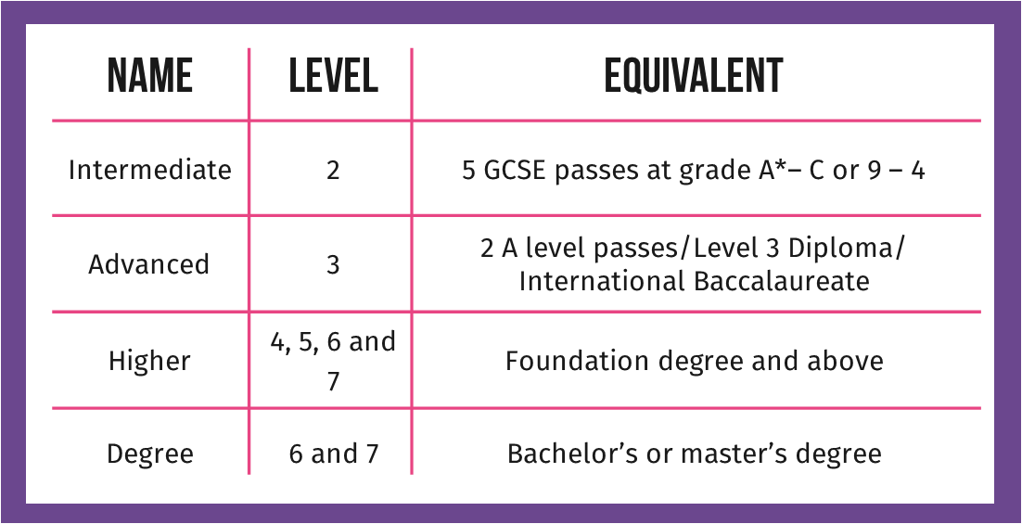
Levels of Apprenticeships
#AHPsupportworkers

Slide 25
Format of Apprenticeships
Level 2 to Level 7
Relate to an occupation – occupational competence
Knowledge Skills and Behaviours (KSBs) and End Point Assessment (EPA)
20% off the job learning
Mandated qualifications – included in some but not all
Models of delivery of apprenticeships – can vary by provider
Placements – some but not all
#AHPsupportworkers

Slide 26
Apprenticeship Standards and Resources
All Apprenticeship Standards – Institute for Apprenticeships and Technical Education
HEALTHCARE SUPPORT WORKER – Level 2
OCCUPATIONAL THERAPIST (INTEGRATED DEGREE) – LEVEL 6
Healthcare Apprenticeship Standards Online – HASO
HASO – Apprenticeship Pathways
#AHPsupportworkers

Slide 27
Apprenticeship Procurement
Gemma Hall - Talent for Care Relationship Manager (Apprenticeships) | North West, Health Education England
Simon Dennis, Apprenticeship Procurement Lead, Salisbury

Slide 28
Why?
AHP Support Workforce Competency Framework and Profession Specific Frameworks / Standards
Generic Assistant Practitioner Apprenticeship Programmes
Issues around entry and progression
Generic L5, can cause difficulty / prevent APEL/RPL into Level 6 Degree Apprenticeships resulting in limited options for accelerated progression due to generic focus
Extended learning duration through an apprenticeship pathway due to lack of specialist focus
Lack of consistency nationally regarding L3 apprenticeship achievement and entry to Level 6 Degree Apprenticeships – Link to HEE APEL project
Effective mapping of competency and profession specific standards / frameworks to the SHSW L3 & Assistant Practitioner L5 apprenticeship – national standardised / consistent approach
Development of Profession specific L5 Assistant Practitioner apprenticeships as deemed appropriate / necessary
#AHPsupportworkers

Slide 29
Apprenticeship Pathways
Level 3
Level 5
Pre reg Level 6 / 7*
Post – Reg Level 6
Post Reg Level 7
Occupational Therapist
Therapeutic Radiographer
Physiotherapist
Diagnostic Radiographer
Senior Healthcare Support Worker
Assistant Practitioner
ODP
Enhanced Clinical Practitioner
Advanced Clinical Practitioner
Prosthetist and Orthotist
SLT
Dietician *
Podiatrist
#AHPsupportworkers

Slide 30
Purpose
Apprenticeship Education Provision - Facilitating a robust quality exercise in AHP support workforce apprenticeship education provision in order to secure the development of a strong and well-adapted provider market which meets quality ambitions for apprenticeships applicable to the development of the AHP support workforce which will:
Maximise opportunities to work with wider stakeholders to jointly procure apprenticeship education provision
Develop an inclusive and participative approach to the implementation of apprenticeship education at a local system level through supported partnership working across the region in designing and delivering apprenticeship programmes applicable to the development of the AHP support workforce, particularly progression, development of specialisms, on the job learning, and the identification of regional challenges and solutions
Ensure the development of local educational infrastructures to accommodate apprenticeships and their delivery models
Maximising opportunities and ensuring efficiency in placement rotations within the system
#AHPsupportworkers

Slide 31
Workforce - Supporting the workforce pipeline which will:
Ensure stability and sustainability of the AHP support workforce supply
Identify priority workforce AHP specialisms in order to guide procurement activity
Increase equity of access and apprenticeship experience for AHP support workforce apprentices
Demand - A facilitated strengthening of engagement with local systems around maximising the opportunities presented by the apprenticeship levy which will:
Support the creation of development pathways for the AHP support workforce, from AHP support staff to registered practitioners, which satisfies local workforce demand projections
Promote how apprenticeships can support an effective 'grow your own' approach to AHP workforce supply and development
Support the development of local and National AHP apprenticeship strategies
Support the accelerated uptake of apprenticeships applicable to the development of the AHP support workforce
#AHPsupportworkers

Slide 32
Procurement
A robust competitive procurement activity will:
Support employers in designing the programmes to meet their need and providing the best outcomes for learners and the future workforce
Ensure NHS procurement compliance
Significantly reduce procurement administration burden on individual organisations; only one set of mini competition documents needs to be produced
Reduce bid fatigue by providers; one tender response per provider means less “mini competition fatigue”, resulting in more and potentially higher quality bids; the greater combined volume of apprentices required may be more attractive to training providers and HEIs
Provide the opportunity to co-produce / bespoke programmes with providers, including subcontracting delivery
Allow the evaluation of the bids to be split between employers which can be more efficient
Be open to all public sector bodies
Ensure the best value for money and best quality of provision whilst maintaining employer control and freedom of choice
#AHPsupportworkers

Slide 33
A simple, supported process
Collate numbers for potential starts across STP/Regions/Nationally – This includes NHS Trusts/Health & Social Care/Primary Care
Tender document written including all requirements
Evaluate the bids as part of a consortium approach, with panel of professionals from sector
Presentations from bidders
Award contracts, issues call off order forms and employer guides
Employers commence work with training providers
#AHPsupportworkers

Slide 34
Healthcare Apprenticeships Standards Online
https://haso.skillsforhealth.org.uk
#AHPsupportworkers

Slide 35
Thank You!
Getting in touch
Gemma.Hall@hee.nhs.uk
Talent for Care
talentforcare@hee.nhs.uk
Healthcare Apprenticeships Standards Online
https://haso.skillsforhealth.org.uk
#AHPsupportworkers

Slide 36
Levels of qualifications & Job evaluation
Gaby Ford, AHP clinical fellow, National AHP Support Workforce Programme, Health Education England
#AHPsupportworkers

Slide 37
AHP support worker competency framework
Enables all AHP support workers to have the opportunity to access and undertake training
Enables greater investment in training opportunities
Consistent with existing national job profiles
#AHPsupportworkers

Slide 38
AHP support worker competency framework
Is not an additional requirement
Educational levels are not the same as AfC banding
Does not determine banding
https://www.nhsemployers.org/publications/nhs-job-evaluation-handbook
https://www.nhsemployers.org/articles/national-job-profiles

Slide 39
Next steps
Gaby Ford, AHP Clinical Fellow, National AHP Support Workforce Programme, Health Education England
#AHPsupportworkers

Slide 40
Next steps: for us
National AHP Workforce Supply Project support sessions
Continue to work in collaboration with employers to ensure occupation specific education
Continue to work in collaboration with professional bodies
Development of further guidance and support offers
Future webinars
https://www.hee.nhs.uk/our-work/allied-health-professions/enable-workforce/developing-role-ahp-support-workers
#AHPsupportworkers

Slide 41
Next steps: for employers
Steps | Suggested activities | Dates
Start out | Convene a steering/working group Engage support workers Review key HEE documents and professional body resources | Oct 2021
Define and scope | Use HEE’s readiness toolkit as your starting point Review baseline workforce data and intelligence, including current workforce numbers, vacancy rates, workforce diversity, and staff satisfaction Identify examples of good practice that could be shared | Nov/Dec 2021
Measure and understand | Map your workforce against the education recommendations in the Framework Develop a training needs analysis for your AHP support workforce | Jan 2022
Design and plan | Agree a clear and shared understanding of the future, and prioritise actions suggested in the toolkit to get there | Feb/March 2022
#AHPsupportworkers

Slide 42
Next steps: for everyone
Share what you have heard today with your teams and colleagues
Make your local education department / education lead your friend
Collectively contribute to creating supportive learning cultures and processes to enable development
Join future webinars - https://www.hee.nhs.uk/our-work/allied-health-professions/enable-workforce/developing-role-ahp-support-workers
Champion the importance of the AHP support workforce and meaningful career conversations
#AHPsupportworkers

Slide 43
Additional Information
National Programme Lead: Naomi McVey
Academic advisor: Richard Griffin, Professor of Healthcare Management, Kings Business School
National AHP Workforce Lead: Suraiya Hassan
National AHP Clincial Fellow: Gaby Ford
Project manager: Loretta Achiekwelu
Apprenticeship lead: Gemma Hall
Email: ahp.supportworkforce@hee.nhs.uk
#AHPSupportWorkers
Web: https://www.hee.nhs.uk/our-work/allied-health-professions/enable-workforce/developing-role-ahp-support-workers
#AHPsupportworkers

Slide 44
Menti.com
Code: 6919 309
#AHPsupportworkers

Slide 45
Thank you!
Menti.com
Code: 6919 309
#AHPsupportworkers

