Slide 1
Drug and Alcohol Treatment and Recovery Services
National Workforce Census
February 2023

Slide 2

Content
Acknowledgements |  |  |  | 3
Executive summary |  |  |  | 5
Introduction |  |  |  | 9
Scope |  |  |  | 10
Participation |  |  |  | 11
Workforce overview |  |  |  | 15
Treatment providers |  |  |  | 22
LA Commissioners |  |  |  | 43
Lived experience recovery organisations (LEROs) |  |  |  | 51
Appendices |  |  |  | 57
Contact details |  |  |  | 68

Slide 3
Acknowledgements
The NHS Benchmarking Network would like to extend our thanks to the programme leads of the Health Education England National Mental Health Programme, who have offered invaluable insight throughout the duration of the project. Our thanks too to the HEE project oversight group members.
Additionally, we are grateful to the Office for Health Improvement and Disparities representatives who also formed an integral part of the oversight group, providing guidance and feedback. We are also grateful for their help and support in identifying participants and facilitating our wide-reaching engagement with participants via their regional offices. We would also like to thank the National Workforce Skills Development Unit for their feedback.
Finally, we would like to thank the large number of providers and commissioners who participated in this, the first national census of the workforce in drug and alcohol services.

Slide 4








Drug and alcohol workforce summary 2022
The D&A workforce consisted of 11,453 WTE treatment provider and LERO staff and 398 WTE commissioning staff
535 submissions received
from treatment providers, LEROs and commissioners
Drug and alcohol workers were the largest workforce group across treatment providers
48% (5,443 WTE)
74% of staff working in drug and alcohol services work in the voluntary sector
684 WTE peer support workers recorded across the drug and alcohol workforce
Within the drug and alcohol treatment provider workforce 60% of staff are female
84% of treatment provider staff were on permanent contracts
12% of the D&A treatment provider workforce were unpaid volunteers

Slide 5
Executive Summary (1)
Introduction
Dame Carol Black's (DCB) Independent Review of Drugs set out recommendations to tackle the scale of drug-related harm in the UK. This included the need to improve the capacity and capability of the drug and alcohol treatment and recovery workforce. In response to the DCB review, the government published a new 10-year drug strategy From Harm to Hope: A 10-year drugs plan to cut crime and save lives in April 2022. It committed to a range of actions to support workforce transformation.
To deliver the ambitions of the drug strategy, Health Education England (HEE) were commissioned to develop a workforce strategy, which will outline the vision for the drug and alcohol treatment and recovery workforce. To support the development of the workforce strategy the NHS Benchmarking Network (NHSBN) were commissioned to undertake the first ever comprehensive workforce census across treatment providers, local authority (LA) commissioners and lived experience recovery organisations (LEROs). A lived experience recovery organisation (LERO) is an organisation led by people with lived experience of recovery. LEROs deliver a range of harm reduction interventions, peer support, recovery support and help people to access and engage in treatment and other support services.
This is the most comprehensive workforce data collection for drug and alcohol services to date. The data presented in this report will be invaluable in supporting the development of the strategy and future workforce training and needs.
The report provides an overview of the workforce across LA-commissioned drug and alcohol services, as well as the workforce working for treatment providers, lived experience recovery organisations (LEROs) and LA commissioning organisations. For the purposes of this report, the ‘drug and alcohol workforce’ refers to LA-commissioned treatment and recovery services, LEROs and LA commissioning teams. The data is summarised primarily by job role group; more detailed information for individual roles is provided in Appendix 1.
Participation
There were 535 data submissions of which 347 were from treatment providers, 23 from LEROs and 165 from commissioners. Most treatment provider submissions were received from voluntary organisations (78%; N=270) followed by the NHS (18%; N=63), and the independent/private sector (4%; N=14). We received a range of submissions from LA commissioners including those reporting activity for commissioning staff only (72%; N=119), those including activity for treatment staff employed by the LA (19%; N=31) and those that sent submissions including commissioning and treatment staff (9%; N=15).
We received submissions for all seven health regions from all sectors. The majority of independent/private sector submissions (9) were from the North West; there were no submissions received from independent/private sector organisations in the East of England, London and the Midlands. Most submissions for LEROs were from London (4) and the Midlands (8), although there was at least one submission for each region.
By service type, most submissions were for community treatment and recovery support services (69%) followed by young people’s alcohol and drug services (20%), residential rehabilitation (8%) and inpatient detoxification (4%). Please note these percentages are calculated using the total submissions that were received (N=535).

Slide 6
Executive Summary (2)
Key findings
Across all sectors 11,851 whole time equivalent (WTE) staff were reported, 11,269 WTE (95%) for the treatment provider workforce, 398 WTE (3%) commissioning staff and 184 WTE (2%) lived experience and recovery organisation (LERO) staff. The voluntary sector accounted for almost three quarters of the drug and alcohol workforce (74%) followed by the NHS (15%), LA-delivered treatment staff (4%), independent /private sector (3%), LA commissioning staff (3%) and LEROs (2%). Regionally, whole time equivalent per 1000 treatment number ranged from 34 WTE to 42 WTE. Many factors may influence this metric but it should be reviewed with local stakeholders to understand the variation.
The profile of the workforce by job role shows just less than half of the treatment provider workforce is made up of alcohol and drug workers, followed by service management and administration (23%), peer support and service user development staff (including support workers) (10%), and nurses (9%). Across all sectors 684 WTE peer support workers were reported.
Vacancy, sickness absence and turnover rates for all staff were 11%, 4% and 19% respectively. For alcohol and drug workers, the largest staff group, rates were 15%, 5% and 14% for vacancy, sickness absence and turnover, respectively. Please refer to the specific report sections for caveats associated with these metrics.
More detailed findings for each of the specific sectors are detailed below.
Focus on Treatment Providers
The treatment provider data presented below includes data from the voluntary sector, the NHS, the independent/private sector and also activity relating to treatment provision delivered by local authorities (LA-delivered treatment).
The voluntary sector makes up 78% of the treatment provider workforce (8,768 WTE), with the NHS the second largest sector at 16% (1786 WTE). The independent/private sector and LA-delivered treatment sector account for a smaller proportion of the workforce at 3% (299 WTE) and 4% (417 WTE), respectively. Alcohol and drug workers make up the largest proportion of the workforce at 48%.
Vacancy rates ranged from 11% (voluntary sector) to 25% (LA-delivered treatment sector) for all staff. For the largest staff group, alcohol and drug workers, vacancy rates ranged from 13% (voluntary and independent/private sectors) to 21% (NHS).
The rate of sickness for all staff ranged from 3% in the independent/private sector to 6% in the NHS which was in line with the 5.2% reported by NHS Digital for all NHS staff.
For alcohol and drug workers (the largest staff group) the turnover rates ranged from 13% (460 leavers) in the voluntary sector to 23% (52 leavers) in the NHS. For all staff the voluntary sector reported the highest turnover rate at 27%. NHS Digital reported a leaver rate of 11.9% for all NHS staff.
Due to the high percentage of voluntary organisations there is a high number of volunteer/unpaid staff in the sector.

Slide 7
Executive Summary (3)
Twelve percent of the treatment provider workforce are unpaid/volunteers. These unpaid/volunteers can be qualified or unqualified staff who are providing their services on a volunteer basis. Bands 5 (£22k-31k) and 6 (£32-39k) each make up a quarter of the workforce overall, but for the voluntary and independent/private sectors approximately 80% of the workforce are band 5 or below (<£32k) compared to approximately 65% for the NHS and 57% for LA-delivered treatment. The majority of the alcohol and drug workers staff group (93%) are band 5 or lower (<£32k), compared to 76% within this salary range across all staff groups. Agenda for Change bands were used alongside a breakdown of the salary ranges for each band. Non-NHS organisations were asked to report their staff within the appropriate salary range. This was done to allow comparisons across sectors.
Individuals who have been in post for less than one year make up the largest percentage of staff overall at 37%, with the voluntary sector reporting the highest rate at 40%. LA-delivered treatment staff have the lowest percentage of staff that have been in post for less than a year at 17%. Overall, 84% of staff are on permanent contracts and 69% of staff work full time. LA-delivered treatment includes staff who work in frontline roles in drug and alcohol treatment and recovery services. It does not include LA commissioning staff. Some LAs have taken some service provision in-house, while others have LA staff such as social workers specifically employed to work in drug and alcohol treatment and recovery services.
The percentage of the workforce from a Black/Black British ethnic minority background was higher (5%-9%) compared to the general population in England (working age) (4%). In contrast the percentage of the workforce who were Asian/Asian British was smaller (4%-8%) than the English working age population (9%). The workforce in all sectors was generally older than the English working age population with higher percentage of staff in the 40-49 and 50-59 age bands. Ten percent of staff across all sectors reported a disability although this was lower for the NHS (7%) and LA (5%) sectors.
There were 472 non-medical prescribers (NMPs) reported of which 389 (82%) were actively prescribing in their current role. Nurses were the main NMPs reported making up 86% of all active NMPs.
One hundred and sixty-seven social workers were identified based on their qualification alone. This is more than the 114 social workers identified within the main workforce census based on job role. This is due to some social workers in the workforce census being employed and reported with a different job title, for example, as an alcohol and drug worker.
Sixty-three organisations reported a percentage of their nursing staff as dedicated alcohol nurses although 162 respondents said that they had no nurses dedicated to this role. For non-nursing staff, there were 82 organisations who reported some dedicated alcohol staff but a further 136 who reported no dedicated staff.
Focus on Commissioners
Of the 165 submissions recorded from local authorities 119 contained workforce data for commissioning staff only, 15 contained information relating to treatment provider staff as well as the commissioning workforce and the remaining 31 submissions contained only treatment provider staff. The treatment provider staff on these returns is a mix of LA-delivered treatment and LA-employed treatment staff. Please note that the demographic data is for all local authority staff and cannot be disaggregate by commissioning and treatment provider staff.

Slide 8
Executive Summary (4)
Local authorities reported 398 WTE commissioning staff across a total of nine roles, the largest of which was ‘commissioners (adult)’, at 33% of the workforce. This followed by ‘other commissioning staff’ (14%), ‘coordinators (adults)’ and ‘commissioners / coordinators (young people)’(10%), ‘project managers’ and ‘strategy managers’ (8%), ‘administrators’ and ‘data analysts’ (6%), and ‘contracts officers’ (5%). The salary reported for each role varied considerably, highlighting a diversity across apparently similar staff roles.
Overall, 78% of commissioning staff were full time with 83% on permanent contracts and 26% in post for less than a year.
For commissioning roles specifically, the vacancy rate was 14%, turnover 11% and sickness absence 2%. The ethnicity profile for all local authority staff is generally in line with the English working age population. There was a higher percentage of staff aged 40-59 (55%) in this sector compared to the working age population (39%): there was a smaller percentage aged 60+ (6%) compared to the working age population (15%).
Focus on Lived Experience Recovery Organisations (LEROs)
Lived experience recovery organisations (LEROs) returned 23 submissions for a limited number of local authority areas (N=18). Analysis reported within this section should therefore be interpreted with caution. LEROs reported 184 WTE across six workforce groups with peer support and service user development roles the largest at 84 WTE (46%).
Unpaid/volunteer staff accounted for 17% of the LERO workforce and 78% were band 4 (<£26k) or below. LEROs reported 34% of staff in post for less than a year with 42% on permanent contracts. The remaining staff were on temporary (17%) and fixed term (41%) contracts. 59% of LERO staff were full time which compared to 69% for treatment providers.
The vacancy, sickness and turnover rate metrics were based on relatively low numbers of submissions making it difficult to provide a national position.
There is greater representation of Black / Black British individuals in the drug and alcohol LERO workforce compared to the English working age population: there was a smaller percentage of individuals from an Asian / Asian British. The workforce is generally older than the working age population with 76% of staff aged 40 or over; this compares with 55% of the working age population. Within LEROs 45% of the workforce were female. This differs to treatment providers where between 58% and 69% of the workforce were female.

Slide 9
Introduction
Dame Carol Black's (DCB) Independent Review of Drugs set out recommendations to tackle the scale of drug-related harm in the UK. This included the need to improve the capacity and capability of the drug and alcohol treatment and recovery workforce.
In response to the DCB review, the government published a new 10-year drug strategy From Harm to Hope: A 10-year drugs plan to cut crime and save lives in April 2022. It committed to a range of actions to support workforce transformation including:
work to implement a comprehensive strategy to develop and expand the workforce.
work to define and improve the training and skills of all sections of the drug treatment workforce, including registered health professionals, drug and alcohol workers and peer supporters.
The Office for Health Improvement and Disparities (OHID) is leading the drug and alcohol treatment and recovery workforce transformation programme in order to deliver the ambitions of the drug strategy, Health Education England (HEE) were commissioned by OHID to develop a range of products including the workforce strategy.
To inform the development of the workforce strategy HEE commissioned the NHS Benchmarking Network (NHSBN) to undertake a census and analysis of the drug and alcohol treatment and recovery workforce in post on 30th June 2022 (some metric data related to the year to 30th June 2022). The scope included local authority (LA)-commissioned NHS, voluntary and independent treatment and recovery service providers including inpatient detoxification and residential rehabilitation; lived experience recovery organisations (LEROs); and LA drug and alcohol treatment and recovery commissioning teams. The stocktake encompassed adult and children and young people's service provision.
The report includes participation rates by region and sector type as well as a summary of services provision.
The report is structured with an initial overview of the workforce across all sectors, highlighting where staff are employed by sector and region. It also includes an overview of workforce numbers by job role group¹. The overview is followed by three sections focussing on treatment providers (NHS, voluntary, independent/private and LA-delivered treatment²), LEROs and commissioners. Each section summarises workforce by job role group, salary profile, time in post, contract detail as well as metrics for vacancies, sickness, turnover and the use of bank and agency staff. Workforce demographics for ethnicity, age, sex and disability are also analysed as well as the percentage of staff considering themselves part of the LGBTQ+ community. A section on specialist nurse roles, non-medical prescribers, social workers and trusted assessors is also included for treatment providers. There is a summary of findings at the end of each section.
Whole time equivalent staff per 1000 treatment number (episodes) are reported. Treatment episodes are categorised into a treatment ‘journey’ which is a treatment period of concurrent or consecutive episodes. For this report, the latest journey per individual which occurred (i.e., overlapped) between 1st July 2021 and 30th June 2022 has been selected.
Throughout the report totals are based on actual rather than rounded values and may vary slightly to the sum of the rows.
¹Job role groups include a summary of individual job roles within a specific professional area, such as, alcohol and drug workers summarising the 12 more specific roles within this group. Details of the individual job roles within each group along with key analysis are included in Appendix 1
²LA-delivered treatment is where commissioners reported services that they directly managed or sub-contracted but did not identify a treatment provider separately

Slide 10
Project scope
The aim of this work is to provide a detailed profile of the alcohol and drug workforce within the following scope:
Local authority (LA) drug and alcohol commissioning teams
LA-commissioned adult and young people’s treatment providers in the NHS, local authority (services delivered directly by the LA), voluntary and independent sectors, including:
  Community drug and alcohol treatment and recovery
  Residential rehabilitation
  Inpatient detoxification service providers
  This includes services funded by LAs through the local drug and alcohol treatment budget including those funded by the public health grant, Supplemental Substance Misuse Treatment and Recovery grant (SSMTR), Rough Sleeping Drug and Alcohol Treatment (RSDATG), Individual Placement and Support (IPS), ADDER/Accelerator and any other drug and alcohol treatment and recovery related direct grant from OHID to LAs.
  Note: sub-contracted providers including those not delivering treatment/recovery services, such as harm reduction and family services, were brought into scope of the exercise. Records on those sub-contracted providers are not held so participation rates for those providers cannot be included.
Lived experience recovery organisations (LEROs).
The following were out of scope:
NHS-commissioned substance misuse teams in secure settings; NHS-commissioned alcohol care teams (ACTs); Pharmacists in retail community pharmacies and hospital pharmacies (only pharmacists directly employed by treatment services are within scope); and GPs treating dependence, in people dependent on drugs and alcohol, outside of a shared care arrangement with a specialist drug and alcohol treatment service, or not as part of a primary care-led specialist treatment service.
Data was collected at provider level with separate submissions for each local authority services are provided to. This allows the data to be aggregated to a regional level and compared to other data held at a regional level, such as treatment numbers.
The census collection tool including completion guidance, definitions and frequently asked questions can be found here.

Slide 11
Participation

Slide 12
Participation (1)
Overall, 535 submissions. The table below shows the number of submissions received by treatment providers, commissioners and lived experience recovery organisations (LEROs) by region. For local authorities, submissions were received in three ways: the majority (119) were submissions including information about local authority commissioning staff only; secondly, some local authorities (31) made separate submissions for workforce delivering treatment services; and third, we received local authority submissions that included treatment provider staff and commissioning staff (15).
Participation rates by sector were 81% for treatment providers, 89% for local authorities and 60% for LEROs. The percentage of LEROs who participated was based on a partial list and although this grew over the course of the project, remained incomplete. Therefore, information within this report relating to LEROs should be viewed as indicative rather than definitive. Similarly, the list of treatment providers changed. Initially the list included lead providers submitting to the National Drug Treatment Monitoring System (NDTMS) but changed to include submissions from sub-contracted services. As the project progressed, sub-contractors were identified and it was important to include these services for a comprehensive dataset of treatment services.
The table below reports the number of submissions by sector and region. The ‘National’ column includes providers that reported services available nationally rather than in one specific region.
Not all participants completed all sections of the workforce survey. Where partial data has likely impacted on the analysis the number of responses is included for context.

Slide 13
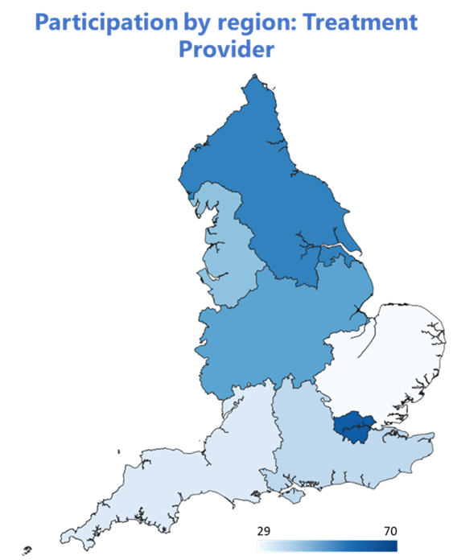
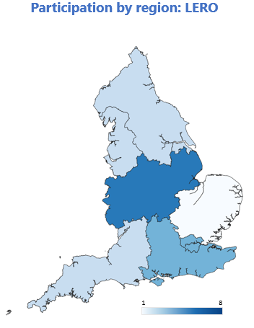
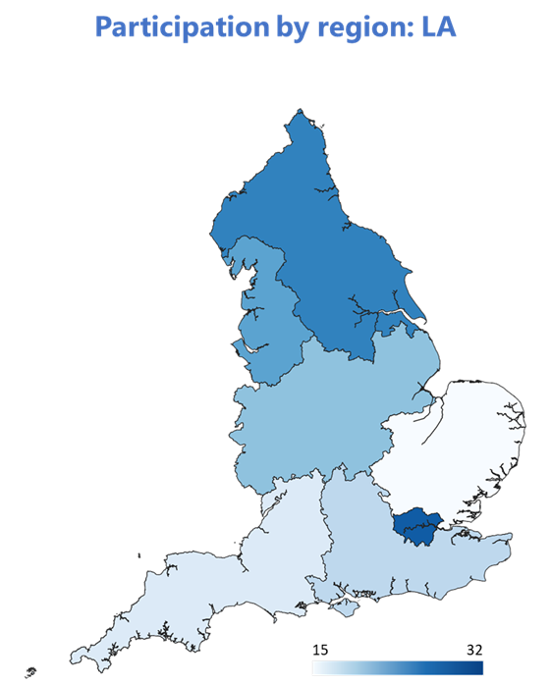
Participation (2)
The three maps below show the number of submissions by treatment provider, LERO and local authority. The maps should be viewed in conjunction with the table on the previous page, to see the number of submissions in each region for each organisation type.

Slide 14
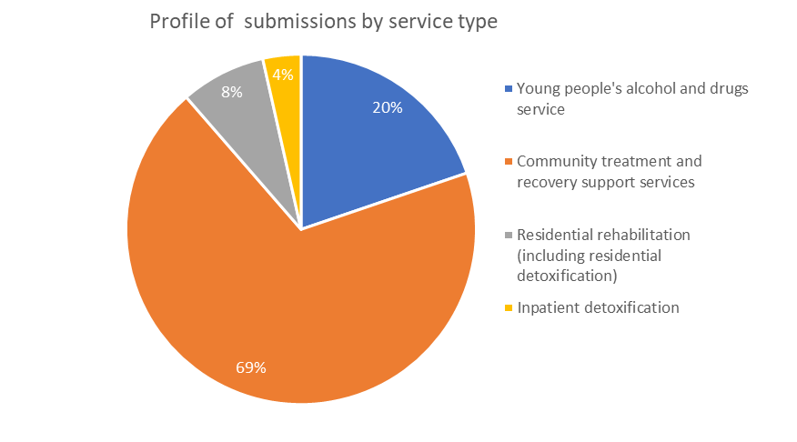
Participation (3)
The chart and table below show the profile of service types provided by LA-commissioned drug and alcohol treatment services across England. This profile includes voluntary sector, NHS and independent treatment providers, LEROs and LA-delivered treatment services. Note that 80% of this cohort responded to the question about service provision type.
The chart shows that most submissions (69%) were from providers delivering community treatment and recovery support services with young people’s alcohol and drug services reporting the next highest number of submission (20%). There were fewer submissions from residential rehabilitation (8%) and inpatient detoxification services (4%) which is not unexpected given the more specialist nature of these services.
The table shows the number of submissions by service type and sector. For the voluntary sector, NHS, LEROs and LA-delivered treatment providers mostly delivered community treatment and recovery support services and young people’s alcohol and drug services. However, the services provided by independent/private sector organisations that submitted to the project were more focussed on residential rehabilitation and inpatient detoxification.

Slide 15
Workforce overview
Includes all treatment providers, lived experience recovery organisations (LEROs) and commissioners across all sectors

Slide 16
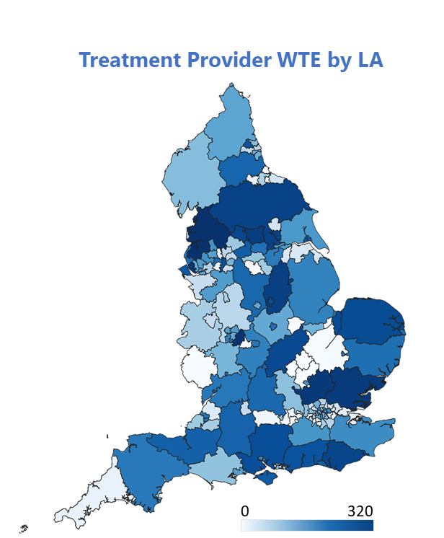
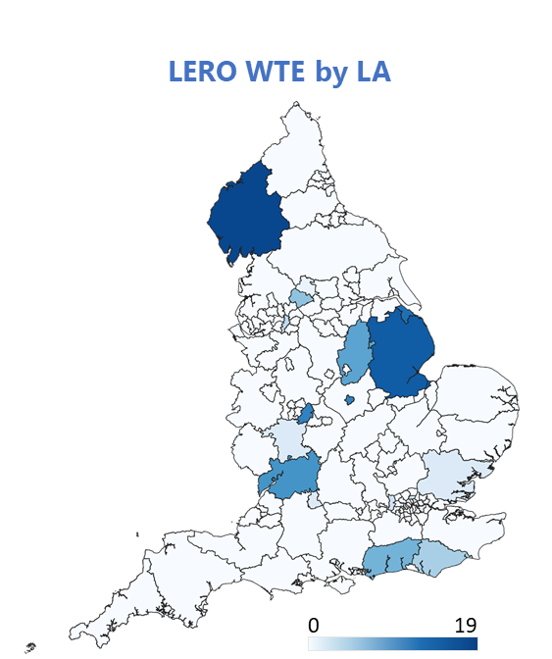
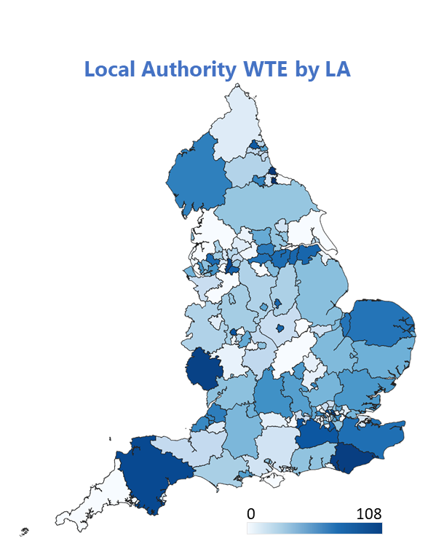
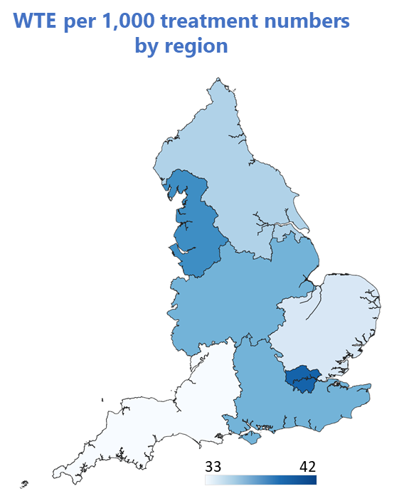
Geographical profile of workforce
The maps below provide a geographical view of the workforce across England. The first map on the left shows the WTE per 1000 treatment numbers by regions¹. The three remaining maps show the workforce by local authority of service delivery: for treatment providers; lived experience organisations; and local authority drug and alcohol commissioning teams. Please note the different scales on each map.
The maps highlight the gaps in workforce across England, particularly in relations to LEROs. This will for the most part reflect the organisations who did and did not participate in the census, but it should prompt discussions between local commissioners and providers to understand where there may be service gaps.
¹ Treatment numbers for the 12 months 1st July 2021 to the 30th June 2022 provided by OHID. Note providers with national coverage are excluded from this map.

Slide 17
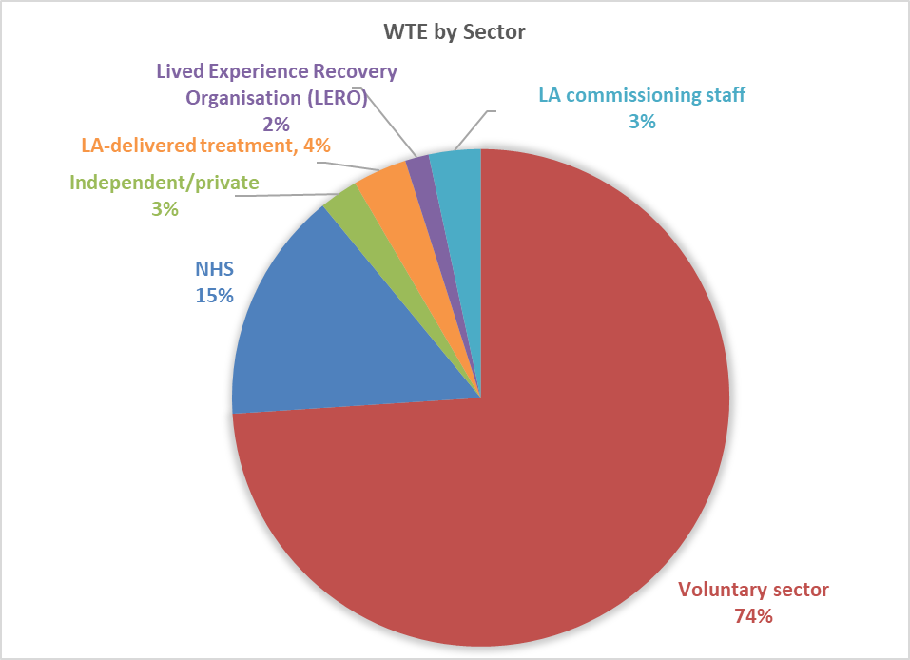
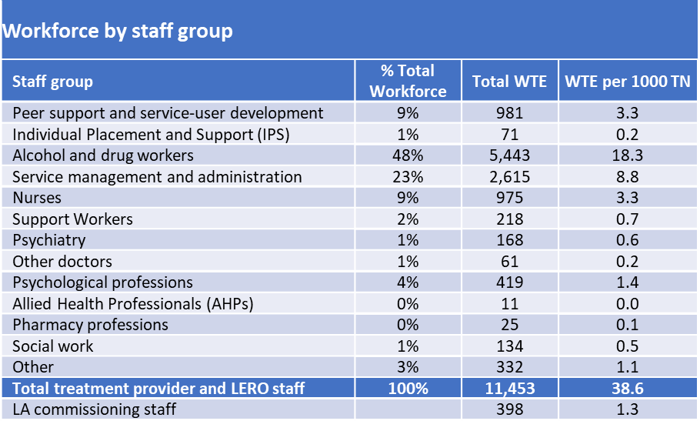
Total workforce composition
The chart and table below are based on whole time equivalent (WTE) workforce numbers for the total workforce.
The voluntary sector accounts for almost three quarters (74%) of the drug and alcohol workforce followed by the NHS (15%), LA-delivered treatment staff (4%), independent/private sector (3%), LA commissioning staff (3%) and LEROs (2%). The profile of the workforce by role shows just less than 50% of the treatment provider and LERO workforce is made up of alcohol and drug workers, followed by service management & administration (23%), nurses (10%) and peer support & service user development staff (9%).
For the alcohol and drug workers staff group, breakdown by individual roles showed 40% were recorded as ‘other’ roles, with criminal justice D&A workers and young peoples’ D&A treatment workers the only two roles above 10% of the D&A workers staff group at 17% and 11% respectively.
Within the peer support and service-user development workforce group, 70% of the 981 WTE were peer support workers.
50% of the staff reported as service management & administration were service managers / team leaders. Service managers may include registered professions.
Further breakdown of commissioning roles is included overleaf, with further analysis of the individual roles included in each of the staff groupings included in Appendix 1.

Slide 18
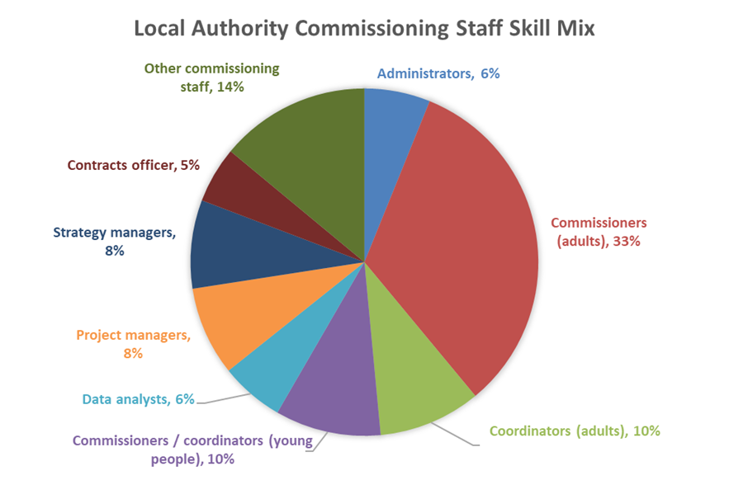
Commissioning workforce composition
The chart and table below are based on whole time equivalent (WTE) workforce numbers.
Commissioners and coordinators for adult services made up 43% of the commissioning workforce with 10% dedicated to services for young people. Data analysts, project and strategy managers made up a further 22% of the workforce with contracts officers accounting for 5% of the workforce.

Slide 19
Workforce total by staff group and region
The table below shows the WTE workforce numbers by region and job role for treatment providers and the total workforce WTE for LERO and local authority commissioning staff. The bottom three rows in the table show the total treatment provider WTE; the WTE (for all treatment providers) expressed in relation to 1000 treatment number; and the number of submissions for treatment providers. The latter is broken down in more detail in the earlier section on participation but is included here for context.
The ‘National’ column includes providers that reported services available nationally rather than in one specific region.
¹ Treatment numbers for the 12 months 1st July 2021 to the 30th 2022 provided by OHID
² Treatment providers include LA-delivered treatment
³ Treatment numbers were not specific to service and as most national services related to residential rehabilitation and inpatient detox, providing a WTE / 1000 treatments is inappropriate

Slide 20
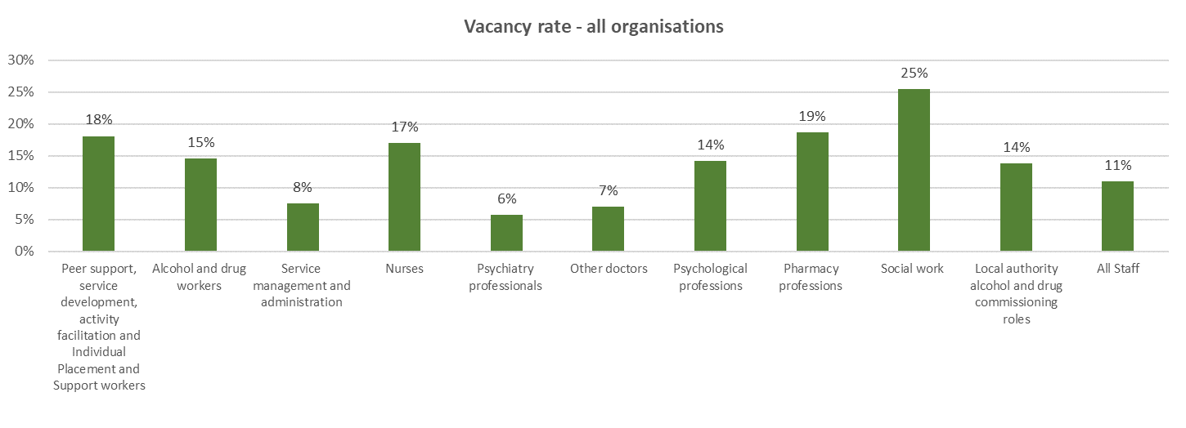
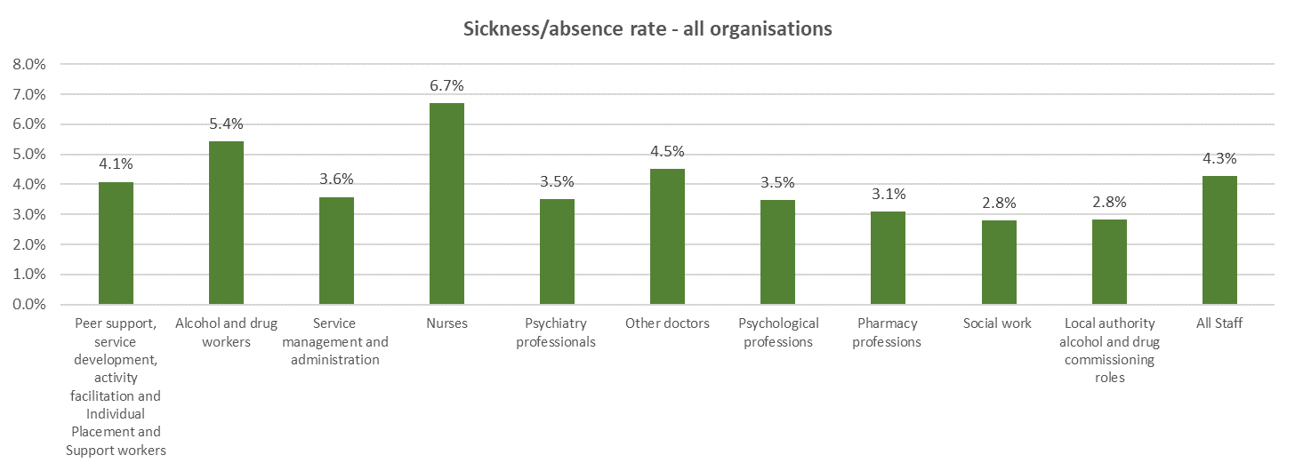
Summary of workforce metrics
The charts below include data from all participants including treatment providers, LEROs and local authorities.
*Nurses include ‘support workers and other unregistered clinical staff’. The data was collected at this level and cannot be disaggregated further.
The workforce census asked for HR metrics for 10 staff groups as well as for all staff combined. Not all participants were able to supply all data requested. Some were able to complete the rates for all the individual staff groups and also provide data for ‘all staff’. However, many providers were only able to provide information for some of the staff groups and/or the all staff position.
Therefore the sum of the position for each of the staff groups will not exactly match the position reported for all staff. The all staff vacancy rate is based on 176 submissions whereas the specific roles for alcohol and drug workers is based on 145. Service managers is based on 120 submissions and LA commissioning staff 46. This compares to just 8 submissions specifically for pharmacy staff and 14 for social workers.
Details of submissions by role (and all staff) and metrics are included in the table on the following page. This should be viewed in conjunction with the rates reported.
Calculating the overall rate from the individual staff group responses results in a 14% vacancy rate, above the rate based on the data submitted for all staff of 11%. As noted above the same cohort of providers will not have provided data for both calculations.
The same submission caveats apply to sickness rates.
Nurses reported the highest sickness rate at 6.7% followed by alcohol and drug workers at 5.4%. Both of these were above the rate reported for all staff of 4.3%. Calculating the ‘all staff’ rate from the individual staff groups responses results in a 4.7% sickness rate, in line with the rate based on the data submitted for all staff.
*
*

Slide 21
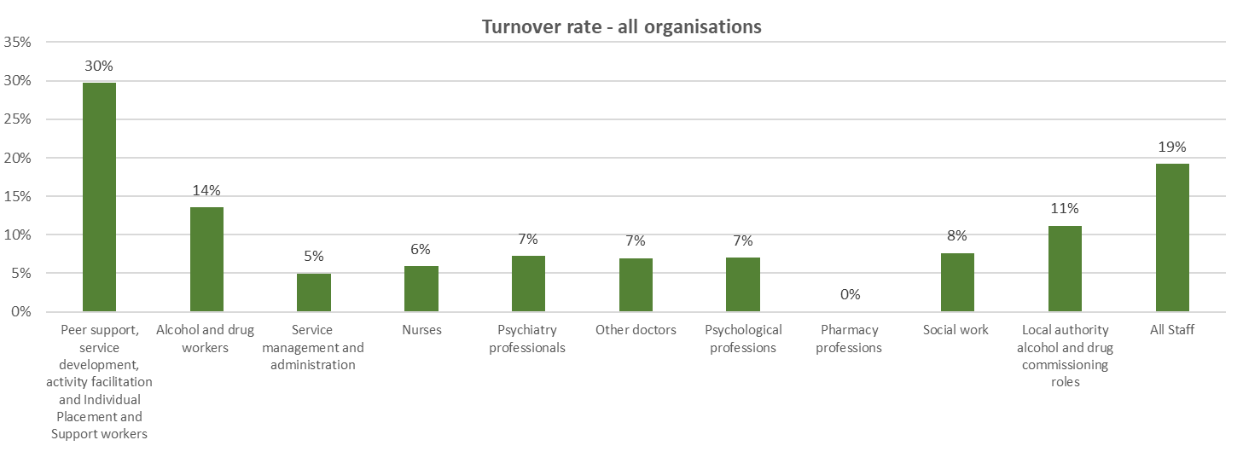
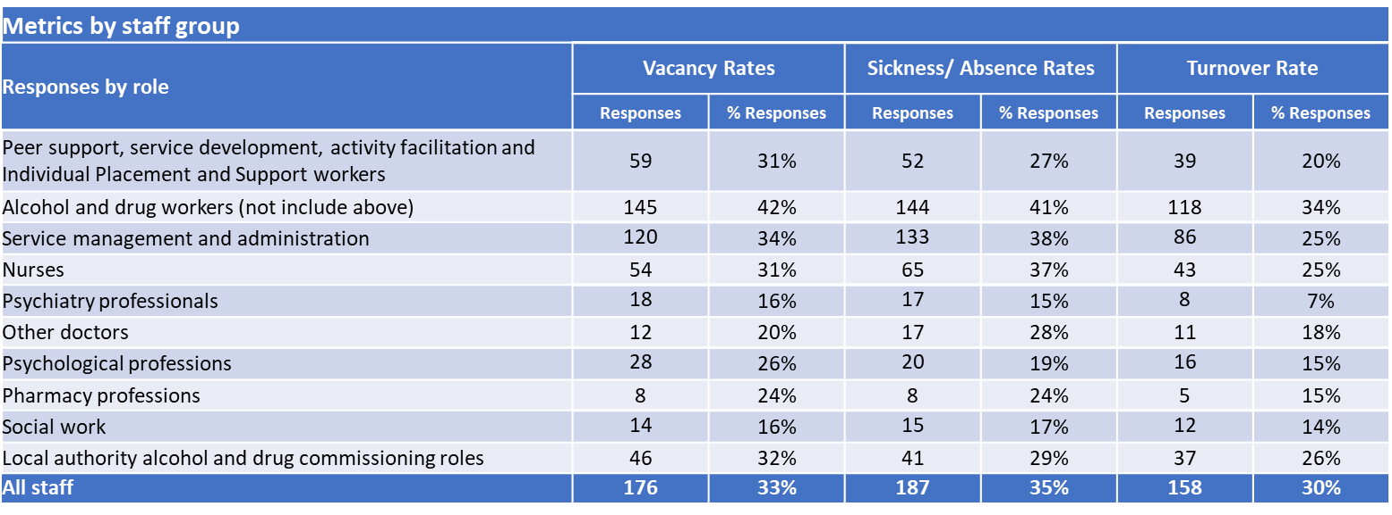
Summary of workforce metrics
*Nurses include ‘support workers and other unregistered clinical staff’. The data was collected at this level and cannot be disaggregated further.
Turnover rates were higher for peer support workers compared to the other job roles for all organisations.
As for staff vacancy and sickness rates, not all organisations completed all data for all roles. Therefore, the sum of the individual rows will not match the ‘all staff’ information.
Calculating the overall rate from the individual staff group responses results in a 10% turnover rate, much lower than the rate based on the data submitted for all staff of 19%. We received a number of submissions where we only received the rate and not the numerator and denominator. The median rate when we include submissions that submitted only the rate and those where the rate was calculated from the supplied numerator and denominator was 20%.
The table to the left shows the number and percentage of responses for each metric (vacancy, sickness/absence, turnover) by job role. The percentage is of organisations that reported WTE for the job role group.
*

Slide 22
Treatment Providers
Focus on NHS, voluntary and independent/private sectors
LA-delivered treatment is also included but LEROs and commissioning staff are excluded from this section

Slide 23
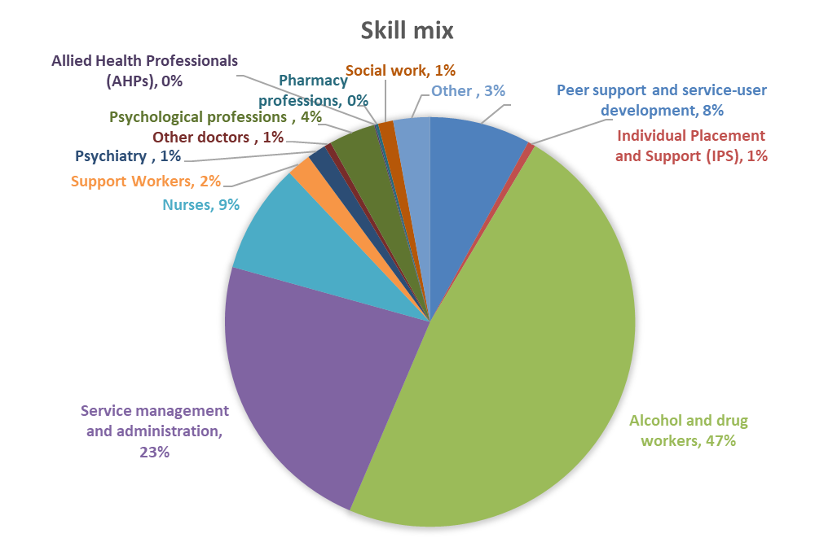
Workforce profile
This analysis is based on whole time equivalent (WTE) data. The voluntary sector makes up 78% of all treatment sector staff WTE, with the NHS the second largest sector at 16%.
The chart to the left shows the combined skill mix profile for voluntary, NHS, independent/private and LA-delivered treatment providers whilst the table below breaks this down by sector.
As noted previously, alcohol and drug workers and service management make up almost three quarters of the workforce. There is variability by sector with both the voluntary and LA-delivered treatment reporting a higher percentage of alcohol and drug workers at 52% and 56% compared to the NHS and independent/private sectors at 29% and 37% respectively.
The NHS has a higher percentage of nurses at 20% compared to 11% in the independent/private sector and 6% each in the voluntary sector and LA-delivered treatment. The higher percentage of nurses in the NHS and independent/private sectors may reflect the higher percentage of inpatient detoxification services in these sectors. The higher percentage of nurses in the NHS may also reflect their role as non-medical prescribers in this sector.

Slide 24
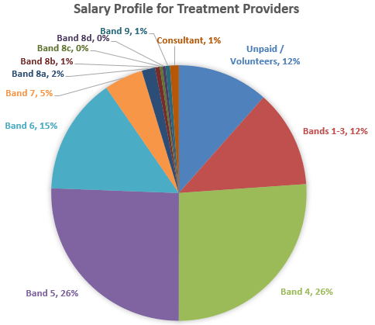
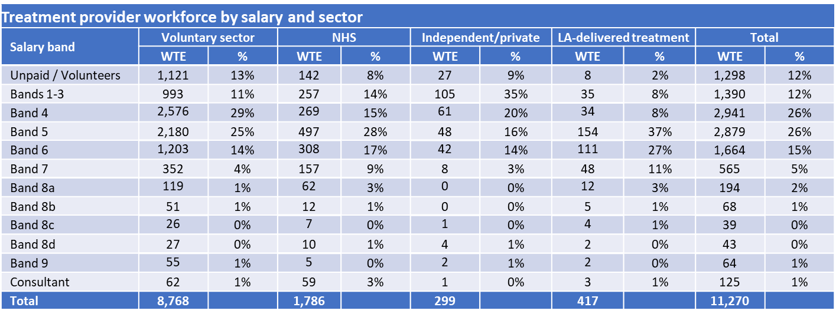
Salary profile – All staff roles and by sector
This analysis is based on WTE. The chart below shows that 12% of the treatment provider workforce are unpaid/volunteers and the table shows that this is relatively consistent across sectors except for LA-delivered treatment, where only 2% fell into this category. A further 12% of the workforce are bands 1-3 (<£22k). The voluntary sector has the highest percentage of unpaid staff at 13% whilst the independent/private sector has the highest percentage of band 1-3 at 35% (other sectors 10%-14%). The voluntary sector also has the highest percentage of band 4 staff 29%.
LA-delivered treatment providers have fewer staff employed in bands 1-4 (£22-25k) with 37% of their workforce employed at band 5 (£26-31k).
Bands 5 (£22k-31k) and 6 (£32-39k) each make up a quarter of the workforce overall, but for the voluntary and independent/private sectors approximately 80% of the workforce are Band 5 or below (<£32k) compared to approximately 65% for the NHS and 57% for LA-delivered treatment.

Slide 25
Salary profile – by staff role
Following on from the previous slide, the majority (93%) of staff within the ‘alcohol and drug workers’ staff group are band 5 or lower (<£32k), compared to 76% within this salary range across all staff groups. Alcohol and drug workers are the largest workforce group delivering treatment services at 48%. Twenty two percent of nurses (including registered nurses, nursing associates, and student nurses) are band 5 or below. Registered nurses are the largest role within this group at 921 WTE (94%). The group also included 25 WTE nursing associates and 29 WTE student nurses.
Psychiatry staff were the highest paid group and consisted of 168 WTE including 89 WTE consultant psychiatrists, 51 WTE specialist doctors/associate specialists in psychiatry/staff grades and 28 WTE training grades. The largest staff groups within psychological professions were psychology/therapy support workers (115 WTE), registered counsellors (105 WTE) and trainee counsellors (110). Registered psychologists accounted for 39 WTE. The wide range of roles is reflected in the range of salaries reported within this staff group.
The 35% of psychological professions that are unpaid may be accounted for by volunteer counsellors. 110 trainee counsellors were reported. Drug and alcohol services often take on counselling volunteers who have completed a British Association of Counselling and Psychotherapy (BACP) accredited course and are completing their practice hours under the supervision of a BACP registered practitioner. The 37% of unpaid social work roles may be accounted for by social work students. Some drug and alcohol service providers work with higher education institutions to offer social work student placements in drug and alcohol services.

Slide 26
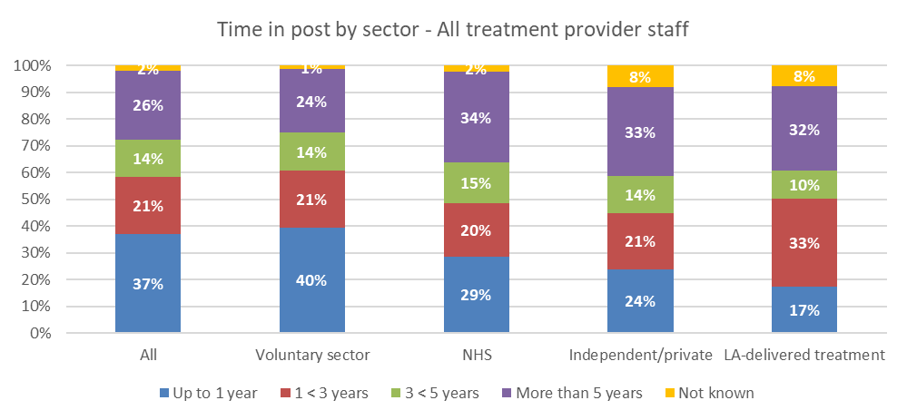
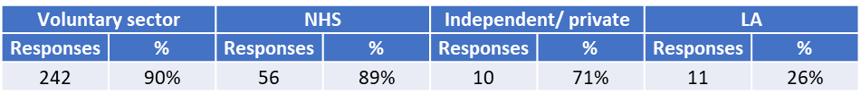
Time in post by sector – treatment provider staff
This analysis is based on headcount. The chart below shows that individuals who have been in post for less than one year make up the highest proportion of staff overall, with the voluntary sector reporting the highest rate at 40%. LA-delivered treatment staff have the lowest percentage of staff that have been in post for less than a year at 17%.
The table to the right shows the profile of time in post by staff group. Service managers & administrators, nurses, psychiatry staff and other doctors report the highest percentage of staff in post for more than 5 years, all above 30%.
The table below the chart shows the number of responses received in relation to time in post.

Slide 27
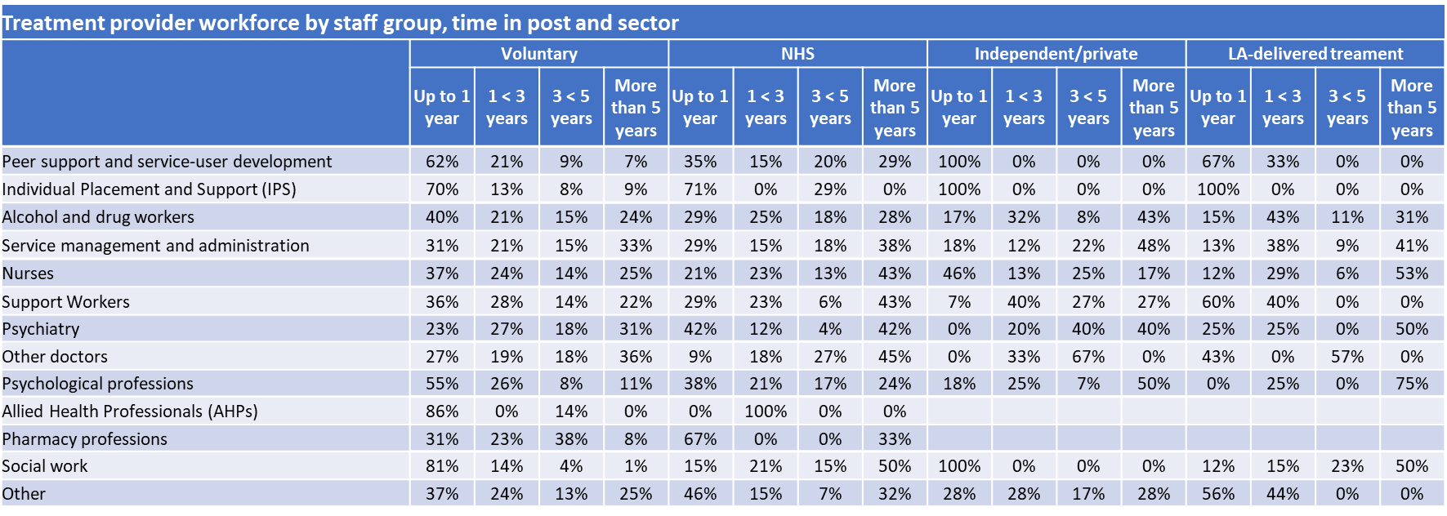
Time in post by staff group and sector
The table below shows the time in post by staff group and sector. It highlights that, whilst based on a small number of staff (79), peer support workers have been in post longer in the NHS than in other sectors.
Although the percentage of service management and administration staff, nurses, psychiatry and other doctors in post for more than five years remained high in all sectors it did vary with the highest percentage of nurses in post for more than five years in the NHS and LA-delivered treatment sectors at 43% and 53% respectively. Service management and admin staff in post for more than five years were highest in the independent/private sector at 48% and psychiatry staff in post for more than five years were higher in the NHS at 42% compared to 31% in the voluntary sector, the two sectors where most psychiatry staff were reported.

Slide 28
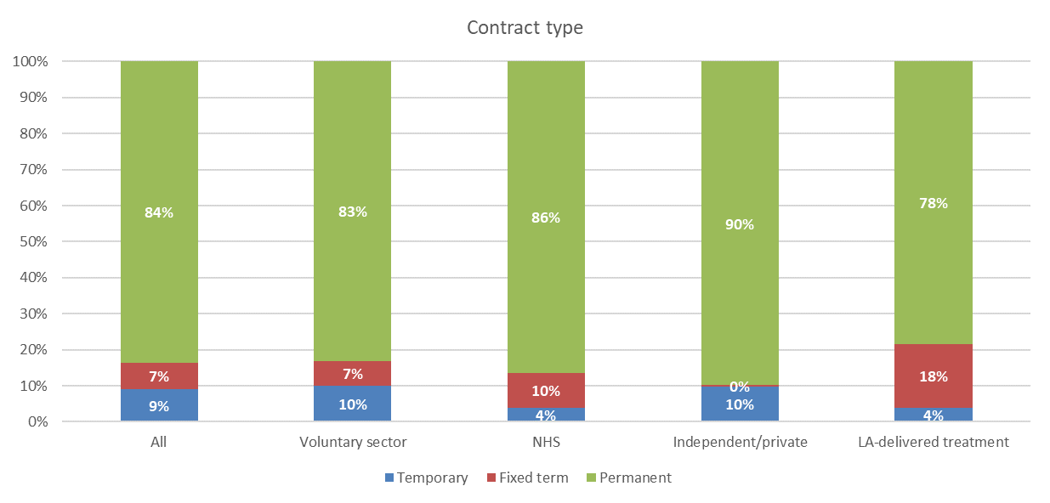

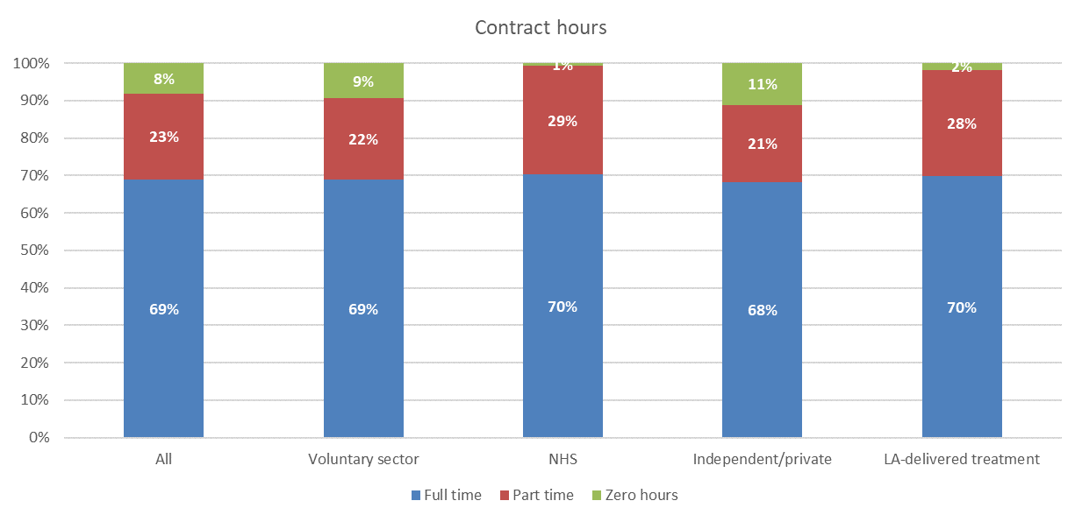
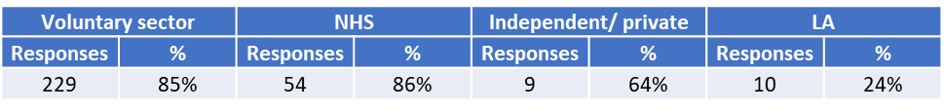
Contract type and hours
Most staff have permanent contracts with the NHS and independent/private sectors reporting the highest rates at 86% and 90% respectively.
The voluntary and independent/private sectors both reported 10% of staff on temporary contracts.
The NHS, voluntary and LA-delivered treatment sectors all reported staff on fixed term contracts at 7%, 10% and 18% respectively.
The table below notes the number & percentage of responses by sector.
Overall 69% of staff work full time, which was consistent across sectors.
The voluntary and independent/private sector recorded 9% and 11% of staff on zero hour contracts respectively. For the NHS and LA-delivered treatment sectors this was much lower at 1% and 2% respectively.

Slide 29
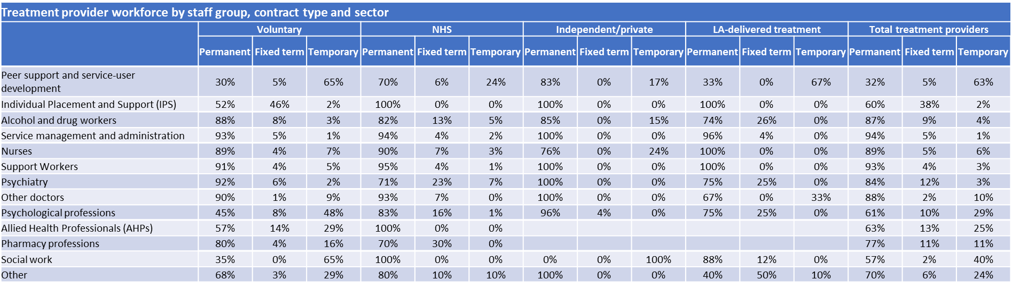
Contract type by staff group and sector
The table below shows the breakdown of contract type by job role and treatment provider sector. The previous slide showed that the majority of staff are employed on permanent contracts ranging from 78% in LA-delivered treatment to 90% in the independent/private sector.
The analysis by job role shows that peer support and service user development staff within the voluntary sector have a different profile with 63% of the workforce on temporary contracts.
At 48%, psychological professions in the voluntary sector have a higher percentage of staff on temporary contracts compared to the other three sectors. It should be noted that the number of staff in the independent/private and LA-delivered treatment sectors was low at 20 and 4 respectively.

Slide 30
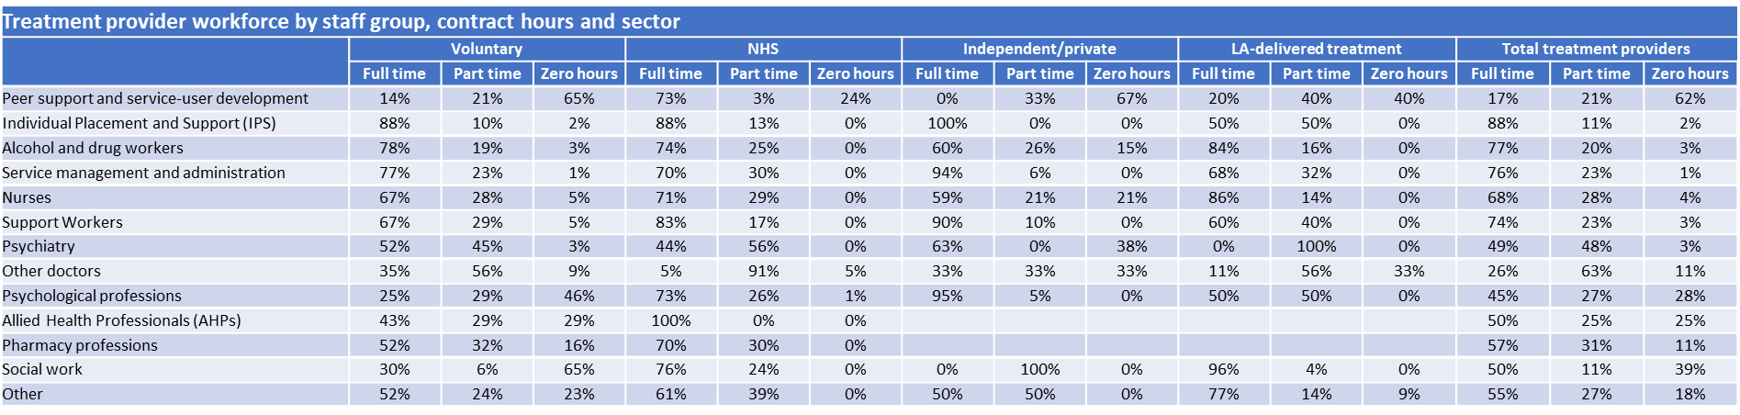
Contract hours by staff group and sector
Approximately 70% of staff are employed on full time contracts across all treatment provider sectors. The table below shows the profile of contract hours by job role and sector.
As was the case for contract type, peer support and service user development staff withing the voluntary sector have a different profile with 62% of the workforce on zero hour contracts. There were also high rates of zero hour contracts for this staff group across the other three sectors but the number of staff in these sectors was low compared to the voluntary sector.
Also, as was the case for contract type, psychological professions in the voluntary sector stood out with 46% of staff on zero hour contracts. The psychiatry and other doctors staff groups had the highest rates of part time working at 48% and 63% respectively for all treatment providers combined.

Slide 31
Project findings
Metrics –vacancy, sickness and turnover
Organisations did not complete all data for all roles. Some provided a total for all staff but no or limited breakdown by staff group, whilst others provided information for some staff groups but not all and no total for all staff. Therefore, the sum of the individual row responses will not match the ‘all staff’ information.
Please note that the data relating to all staff was submitted by providers and is not a calculated field based on the individual staff groups.
The all staff group includes all local authority staff including both LA-delivered treatment provision and commissioning specific roles as we are not able to disaggregate the data further.
Nurses include ‘support workers and other unregistered clinical staff’. The data was collected at this level for theses metrics and cannot be disaggregated further.

Slide 32
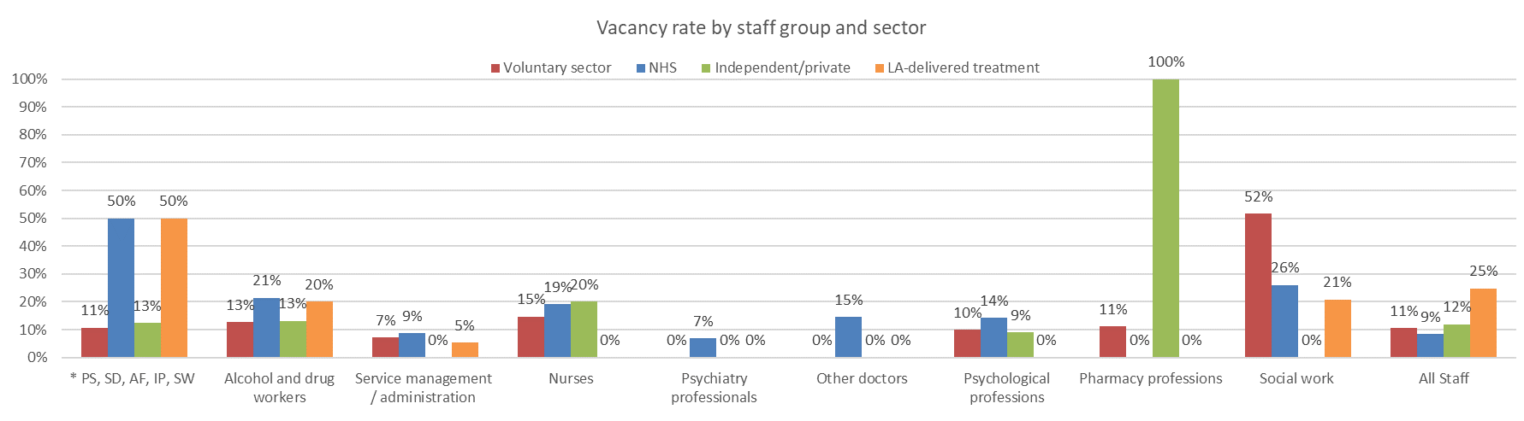
Vacancy rates by staff group and sector
Vacancy rates by role reported in the chart should be read in conjunction with the table below which includes the number of vacancies. Alcohol and drug treatment provider vacancies are expressed as a % of funded establishment (the total WTE staff funded for that organisation – staff in post and vacancies).
For alcohol and drug workers (the largest staff group) the vacancy rates ranged from 13% (220 vacancies) in the voluntary sector to 21% (81) in the NHS. Nursing vacancy rates were also high in the voluntary sector (15%, 28 vacancies) and the NHS (19%, 31 vacancies). Other vacancy rates were based on relatively low numbers.
NHS Digital reported for June 2022 an NHS vacancy rate of 9.7% for all staff across acute, ambulance, community, mental health and specialist providers. For registered nurses the rate was 11.9% and for medical staff 7.4%. From the NHSBN annual adult mental health survey, vacancy rates for 2021/22 for staff in adult acute inpatient services were 18% and for generic community mental health teams 13.6%.
**
*Peer support, service development, activity facilitation, Individual Placement, Support workers
**Nurses include ‘support workers and other unregistered clinical staff’. The data was collected at this level and cannot be disaggregated further.

Slide 33
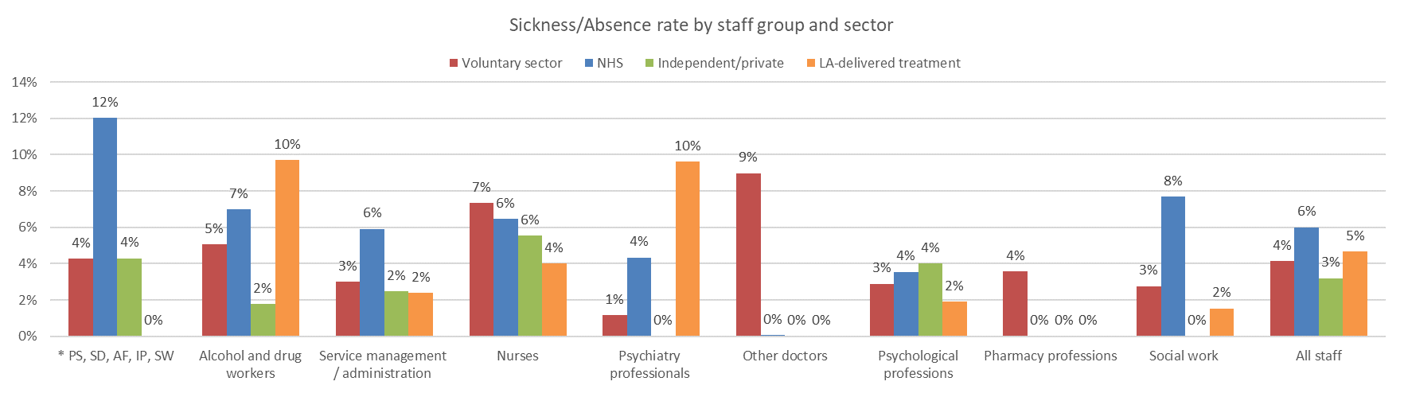
Sickness rates by staff group and sector
For the main staff group of alcohol and drug workers the sickness rates vary by sector ranging from 2% for the independent/private sector to 10% for LA delivered treatment. For the voluntary sector with the highest proportion of staff in this group the rate was 5%.
The rate of sickness for all staff ranged from 3% in the independent/private sector to 6% in the NHS. This was broadly in line with the rate reported by NHS Digital of 5.2% in June 2022 for all NHS staff. The rates reported in the NHSBN annual adult mental health survey were slightly higher with sickness rates for 2021/22 for staff in adult acute inpatient services at 8% and for generic community mental health teams 7.1%.
**
Sick days
Voluntary sector | 1410 | 19654 | 4900 | 3676 | 21 | 159 | 189 | 101 | 72 | 85736
NHS | 175 | 4878 | 3056 | 4675 | 252 | 1 | 1124 | 0 | 192 | 10409
Independent /private | 67 | 182 | 163 | 394 | 0 | 0 | 77 | 0 | 0 | 763
LA-delivered treatment | 0 | 1874 | 181 | 0 | 5 | 0 | 1 | 0 | 146 | 954
*Peer support, service development, activity facilitation, Individual Placement, Support workers
**Nurses include ‘support workers and other unregistered clinical staff’. The data was collected at this level and cannot be disaggregated further.

Slide 34
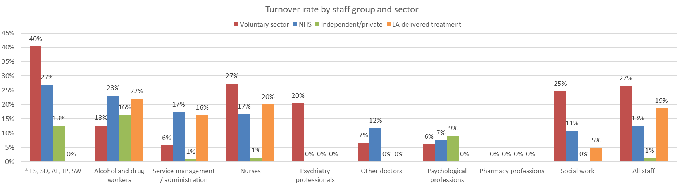
Turnover rates by staff group and sector
Turnover rates by role reported in the chart should be read in conjunction with the table below which includes the number of leavers.
For alcohol and drug workers (the largest staff group) the turnover rates ranged from 13% (460 leavers) in the voluntary sector to 23% (52 leavers) in the NHS. For all staff the voluntary sector reported the highest turnover rate at 27%. NHS Digital reported a leaver rate of 11.9% for all NHS staff between April 2021 and March 2022.
From the NHSBN annual adult mental health survey, turnover rates for 2021/22 for staff in adult acute inpatient services were 14% and for generic community mental health teams 13.2%.
**
Leavers
Voluntary sector | 25 | 460 | 88 | 32 | 1 | 1 | 1 | 0 | 2 | 1297
NHS | 2 | 52 | 22 | 28 | 0 | 0 | 6 | 0 | 1 | 62
Independent /private | 2 | 12 | 6 | 12 | 0 | 0 | 1 | 0 | 0 | 22
LA-delivered treatment | 0 | 24 | 4 | 1 | 0 | 0 | 0 | 0 | 3 | 46
*Peer support, service development, activity facilitation, Individual Placement, Support workers
**Nurses include ‘support workers and other unregistered clinical staff’. The data was collected at this level and cannot be disaggregated further.

Slide 35
Project findings
Workforce demographics
This section includes LA treatment provider and commissioning staff together as demographic data was not collected separately for these two groups – denoted with *

Slide 36
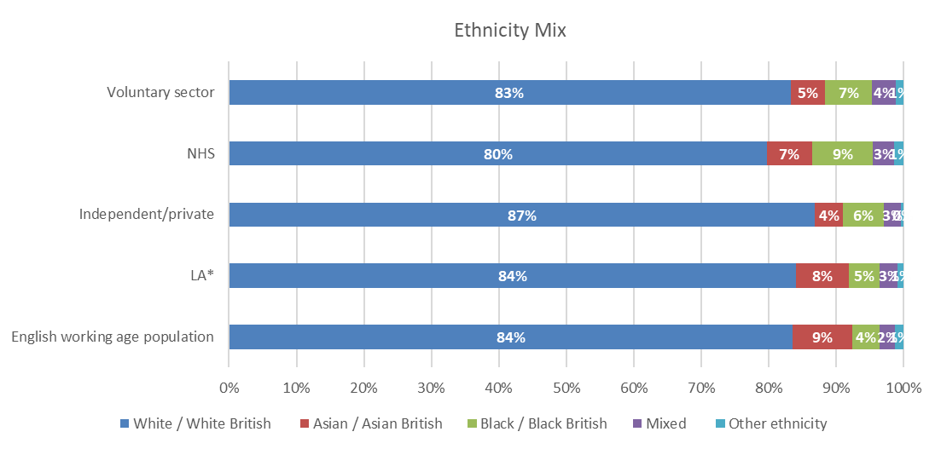
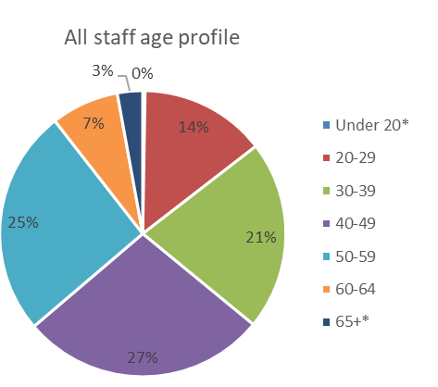
Ethnicity and age profile
All sectors have a higher proportion of Black / Black British ethnicity staff than the English working age population (4%), with the NHS reporting the highest rate at 9%.
There is a lower representation of Asian / Asian British workers across all sectors compared to the 9% reported in the English working age population.
Each sector included unknown ethnicity which has been excluded from the chart. If the proportion of staff of 'unknown' ethnicity that were reported were included here, it would, for example, make up 14% of the voluntary sector, 8% Independent/private, 7% LA, 4% of the NHS and 0% LEROs ethnicity profile.
The workforce has fewer staff aged 20-29 years old compared to the working age population with most sectors reported a higher proportion of staff in the 40-49 and 50-59 age ranges.
* these two groups are 16-19 and 65-69 for the English working age population

Slide 37
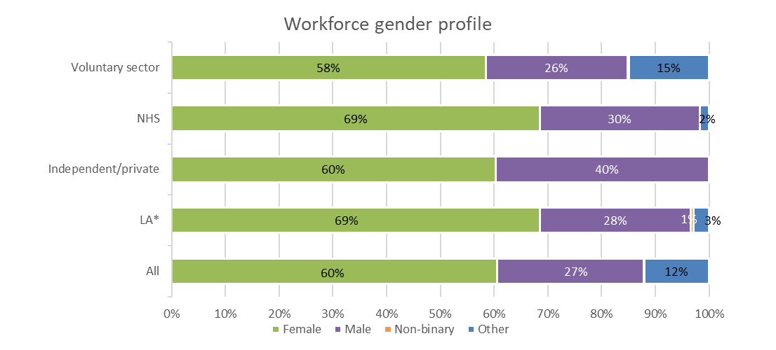
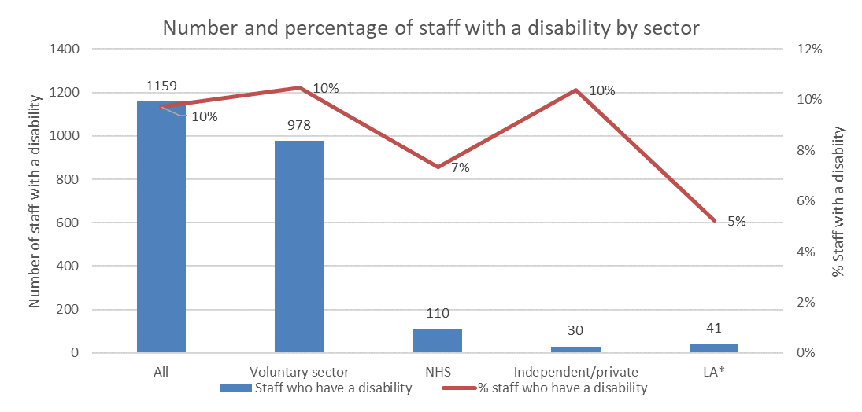
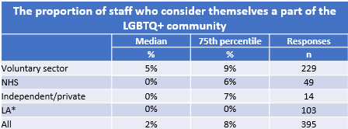
Disability, gender and sexual orientation profiles for all staff groups
The majority of staff are female across all sectors with the NHS and LA-delivered treatment reporting the highest proportion of female staff at 69% and the voluntary sector the lowest proportion at 58%. However, the high proportion of ‘other’ reported that were not further explained may be skewing the profile.
10% of staff reported a disability although this was lower for the NHS (7%) and LA (5%) sectors.
The median percentage of staff who consider themselves part of the LGBTQ+ community was 2%. This was based on 395 responses across all sectors with 195 respondents reporting zero percent staff identifying as part of the LGBTQ+ community.
The 75th percentile rate for organisations that responded to this metric is also included in the table below.
Note LA is for all LA staff including commissioning staff as it cannot be disaggregated.
* Include all LA staff both treatment provider and commissioning as it cannot be further disaggregated

Slide 38
Project findings
Specialist roles

Slide 39
Focus on non-medical prescribers & social workers
There were 472 non-medical prescribers (NMPs) reported of which 389 (82%) were actively prescribing in their current role. Please note, ‘Other’ was included as an option, however only nurses and pharmacists are expected to be NMPs. The ‘Other’ category may include registered nurses or pharmacists who have a different job title, for example, Alcohol and drug worker and have been incorrectly reported by role rather than qualification.
Nurses were the main NMPs reported, making up 87% of all active NMPs. Overall, 81% of nursing NMPs were active in their current role but the rate was lower in the NHS (69%) compared to the voluntary sector (86%).
167 social workers were reported within this section which was higher than the 114 reported in the main workforce census as social workers. These additional social workers will be employed in other roles, for example, as alcohol and drug workers. Social workers represented a higher percentage of the workforce in LA-delivered treatment (13.7%) compared to the NHS (2.4%) and voluntary sectors (0.7%).
Qualified: How many staff (headcount) are registered non-medical prescribers
Active: How many of these (headcount) prescribe medicines as part of the service they provide

Slide 40
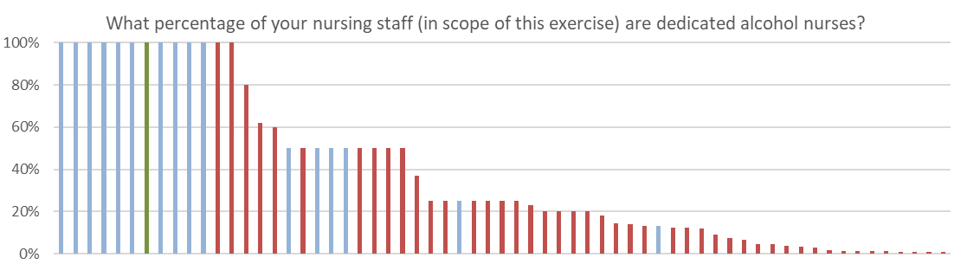
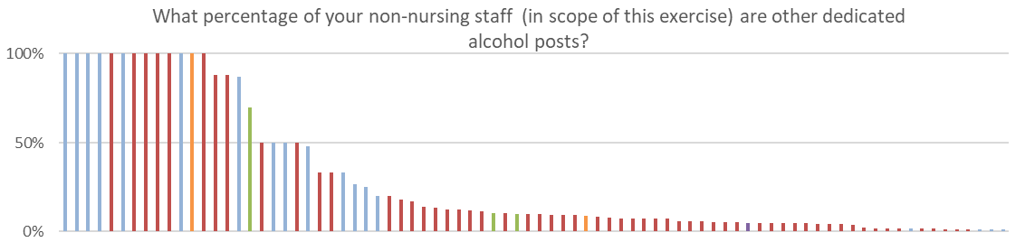
Focus on specialists in alcohol treatment and trusted assessors
The two charts to the left show the percentage of nurses (top chart n=63) and non-nursing staff (bottom chart n=82) that were dedicated* to providing support to people with alcohol misuse for each provider that reported more than zero percent.
A further 162 providers reported that zero percent of their nursing staff were dedicated to the support of people with alcohol misuse.
Similarly a further 136 reported that zero percent of their non-nursing staff were dedicated to the support of people with alcohol misuse.
70 (0.9%) staff are trained trusted assessors based on the 200 responses received. Note the vast majority of those who responded reported zero trusted assessors with only 17 respondents across all sectors reporting more than 1 trusted assessor.
* Nursing and non-nursing staff should be counted as dedicated to providing support to people with alcohol misuse if they spend more than 80% of their time in this role
** Trusted assessors work in an LA-commissioned alcohol and drug setting with the qualifications, skills, knowledge and experience needed to carry out health and social care assessments, and to formulate plans of care on behalf of adult social care providers (https://www.cqc.org.uk/sites/default/files/20180625_900805_Guidance_on_Trusted_Assessors_agreements_v2.pdf)

Slide 41
Treatment providers: summary of key findings (1)
The key findings of the drug and alcohol workforce census for treatment providers are detailed below. They include data for submissions from the voluntary sector, the NHS, the independent/private sector and activity relating to treatment provisions submitted by local authorities (LA-delivered treatment). We received 416 submissions for treatment provider organisations.
The voluntary sector makes up 78% of the treatment provider workforce with 8,768 WTE, with the NHS the second largest sector at 16% (1,786 WTE). The independent/private sector and LA-delivered treatment sector account for a smaller proportion of the workforce at 3% (299 WTE) and 4% (417 WTE) respectively.
Alcohol and drug workers make up the largest proportion of the workforce at 47%, with service managers/administrators the next largest group at 23% of the workforce and nurses 9%. Registered nurses are the largest role within the nurse group with 921 WTE (94%).
Vacancy rates ranged from 11% (voluntary sector) to 25% (LA-delivered treatment sector) for all staff and for the largest staff group, alcohol and drug workers, from 13% (voluntary and independent/private sectors) to 21% (NHS).
12% of the treatment provider workforce are unpaid/volunteers. Bands 5 (£22k-31k) and 6 (£32-39k) each make up a quarter of the workforce overall, but for the voluntary and independent/private sectors approximately 80% of the workforce are Band 5 or below (<£32k) compared to approximately 65% for the NHS and 57% for LA-delivered treatment.
The majority of the alcohol and drug workers staff group (93%) are band 5 or lower (<£32k), compared to 76% within this salary range across all staff groups.
Individuals who have been in post for less than one year make up the highest proportion of staff overall, with the voluntary sector reporting the highest rate at 40%. LA-delivered treatment staff have the lowest percentage of staff that have been in post for less than a year at 17%.
Overall, 84% of staff are on permanent contracts ranging from 78% in LA-delivered treatment services to 90% in the independent/private sector. 69% of staff work full time, which was consistent across sectors.
The ethnicity of the workforce across all sectors had a higher proportion of Black/Black British staff (5%-9%) than for the English working age population (4%) and a lower proportion of Asian/Asian British staff (4%-8%) than the English working age population (9%).

Slide 42
Treatment providers: summary of key findings (2)
The workforce was generally older than the English working age population with most sectors reporting a higher proportion of staff in the 40-49 and 50-59 age ranges.
10% of staff reported a disability although this was lower for the NHS (7%) and LA (5%) sectors.
There were 472 non-medical prescribers (NMPs) reported of which 389 (82%) were actively prescribing in their current role. Nurses were the main NMPs reported, making up 86% of all active NMPs.
167 social workers were reported within this section which was higher than the 114 reported in the main workforce census as social workers. These additional social workers will be employed in other roles, for example, as alcohol and drug workers.
63 organisations reported a percentage of their nursing staff as dedicated alcohol nurses although 162 reported that they had no nurses dedicated to this role. It was a similar profile for non-nursing staff dedicated alcohol posts with 82 organisations reporting some dedicated staff but a further 136 reporting zero dedicated staff.

Slide 43
LA Commissioners

Slide 44

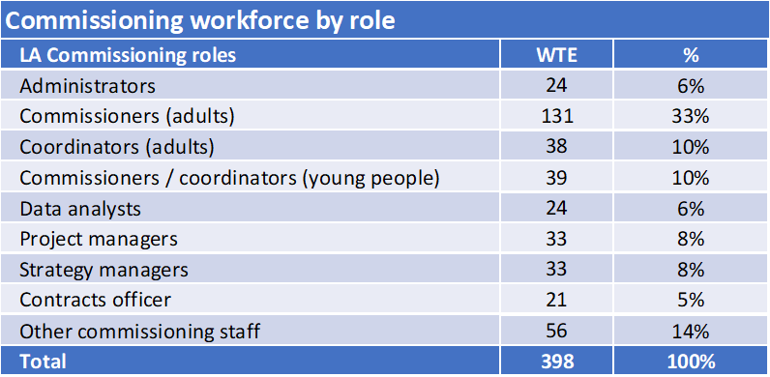
Commissioning workforce composition
The chart and table below are based on whole time equivalent (WTE) workforce numbers.
Commissioners and coordinators for adult services made up 43% of the commissioning workforce with 10% dedicated to services for young people. Data analysts, project and strategy managers made up a further 22% of the workforce with contracts officers accounting for 5% of the workforce.

Slide 45
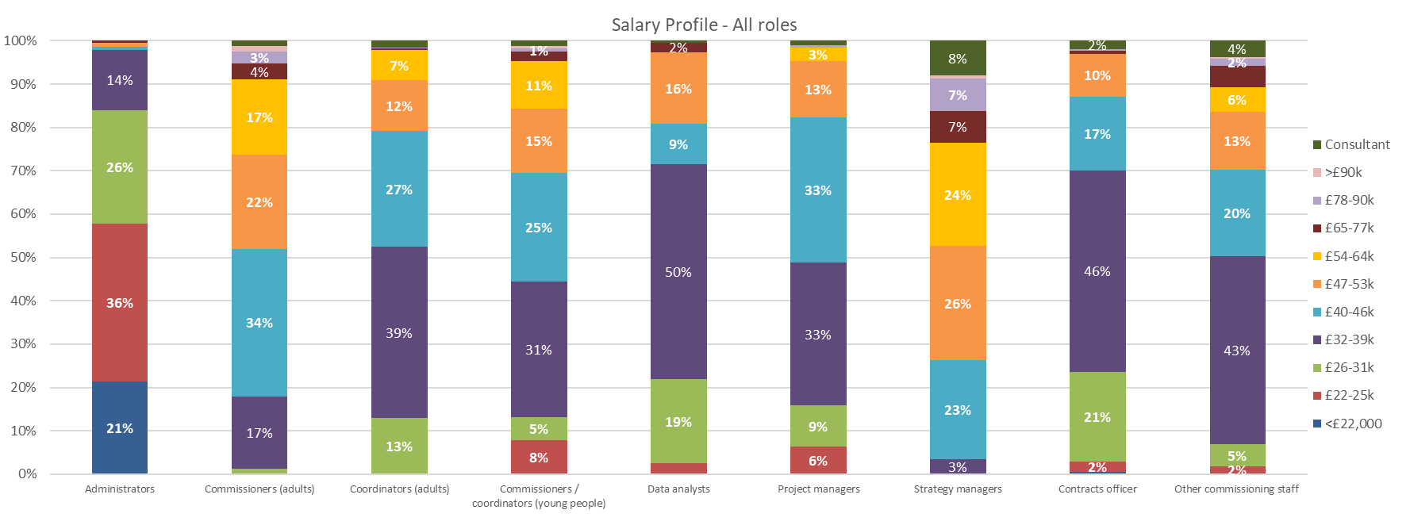
Salary profile for commissioning roles
The chart below shows the salary profile for commissioning roles and highlights the diversity of rates for apparently similar roles.

Slide 46
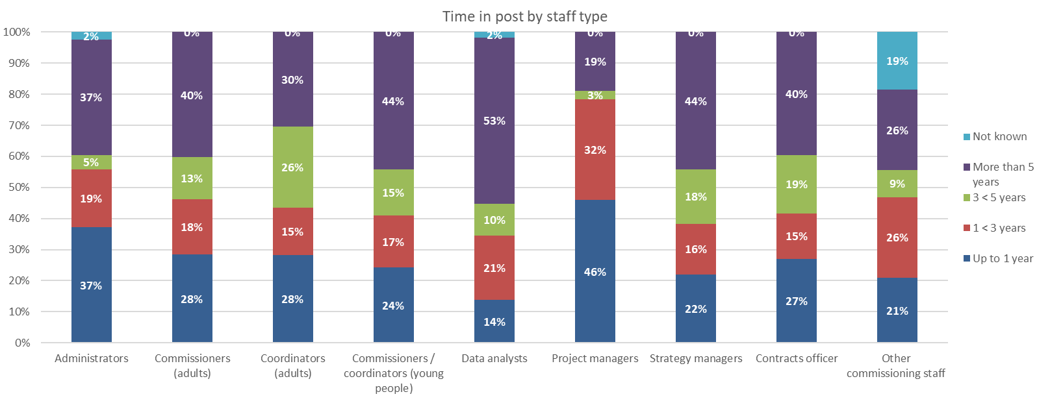
Time in post by staff group
This section is based on headcount. With staff working across multiple roles, participants were asked to apportion the WTE as appropriate. For headcount, participants were asked to enter the staff in each role their time was allocated, for time in post, contract type and contract hours. It was acknowledged that this would lead to duplication in the number of staff reported and therefore this section focusses on the workforce profile rather than the absolute number of staff (headcount) reported against each role.
The chart below plots the percentage of staff that have been in post in four bands, from less than one year to more than five years. Project managers have the highest proportion of staff in post less than a year at 46%. Data analysts (53%) and strategy managers (44%) have the highest proportion of staff in post more than 5 years.

Slide 47
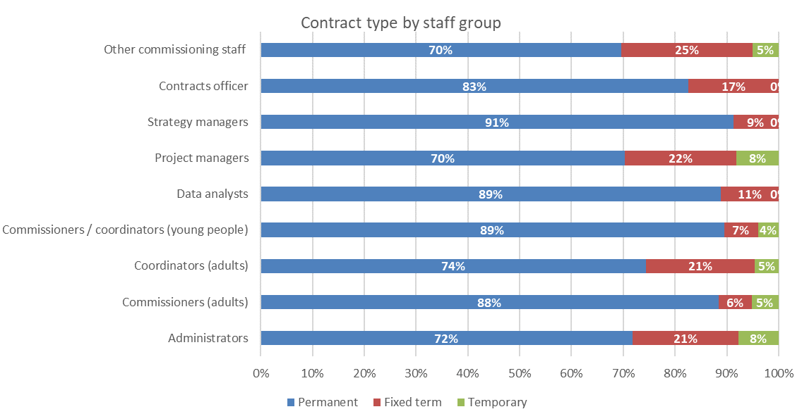
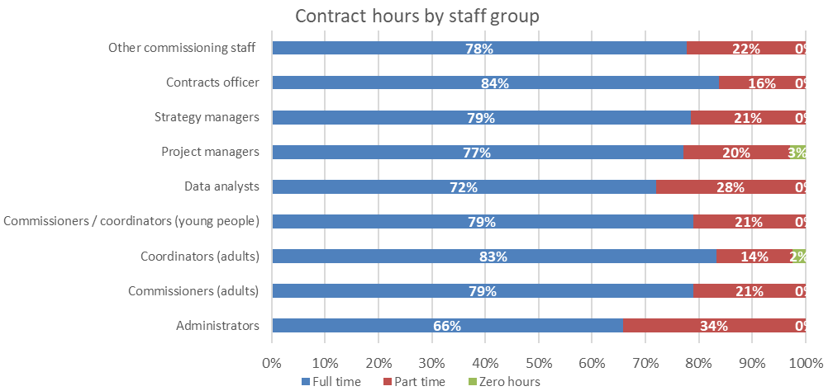
Contract type and contract hours by staff group
The charts to the left show the breakdown of contract type (top) and contract hours (bottom) by commissioning job roles.
Other commissioning staff and project managers report the lowest percentage of staff on permanent contracts which ties in with project managers reporting the highest proportion of staff in post for less than a year (previous page). This group also have staff (3%) on zero hour contracts.
Between 72% and 83% of staff across job roles work full time, the exception being administrators which is slightly lower at 66% part time.

Slide 48
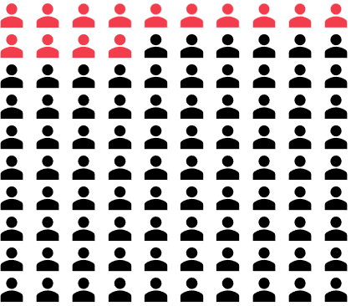
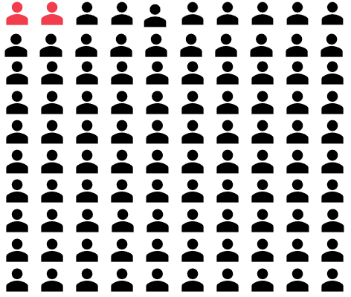
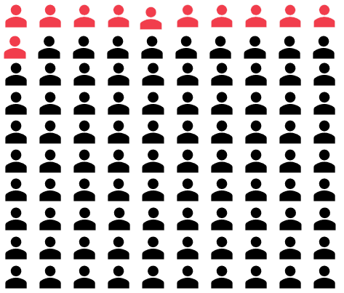
Workforce metrics for commissioning staff
For all commissioning staff roles, the vacancy, sickness and turnover rates were as follows.
The census did not capture this data at a more granular role level.
14% vacancy rate
2% sickness rate
11% turnover

Slide 49
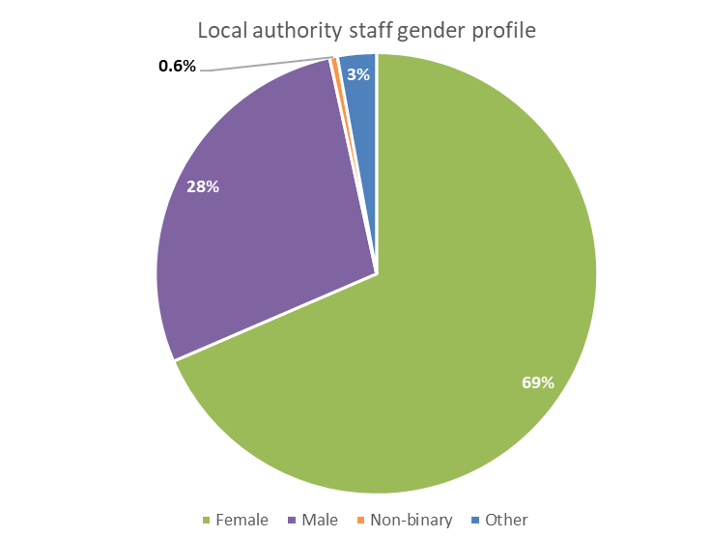
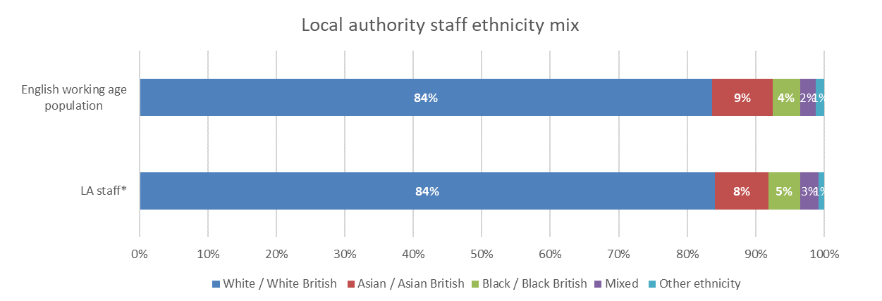
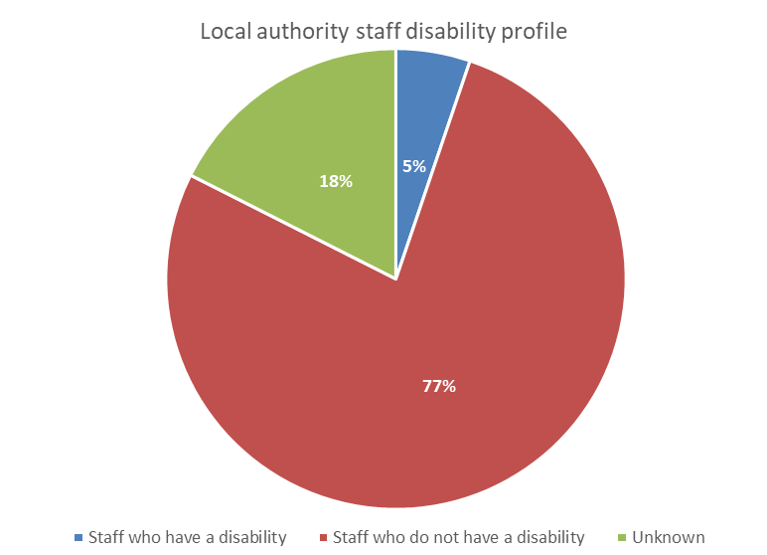
Demographic profile
The demographic profiles illustrated below are based on workforce data for all local authority staff, both commissioning and LA-delivered treatment. We are not able to disaggregate further.
The bar chart below shows that the ethnicity profile of staff working in local authority commissioning roles is in line with the English working age population. Note that unknown responses have been excluded from the chart.
The top pie chart to the right show that 69% of staff were female. This is in line with drug and alcohol treatment providers in the NHS but higher than the rates reported by drug and alcohol treatment providers in the voluntary (58%) and independent/private (60%) sectors.
The bottom pie chart shows that 5% of LA staff reported a disability, below the 10% reported for voluntary and independent/private providers and the 10% reported by NHS drug and alcohol treatment providers.
There were 103 LA submissions that responded to the question about the percentage of staff that identified as LGBTQ+. The median and 75th percentile rates were both 0% with 25 of the 103 respondents reporting a rate above 0%.

Slide 50
Commissioning: summary of key findings
Local authorities made 165 submissions. Of these, 119 contained workforce data for commissioning staff only, and a further 15 contained information relating to treatment provider staff as well as the commissioning workforce. The remaining 31 submissions contained only treatment provider staff. Please note, that the data on demographics is for all local authority staff as we are not able to disaggregate it to commissioning and treatment provider staff separately. They key findings for local authority staff are summarised below:
Local authorities reported 398 WTE commissioning staff across nine roles, the largest of which was ‘commissioners (adult)’, at 33% of the workforce. The remaining staff were relatively evenly reported across the eight other roles with between 5% and 10% of the workforce in each.
The salary reported for each roles varied considerably, highlighting a diversity across apparently similar roles. To some extent this will reflect the seniority of staff but may also reflect different banding of staff across authorities.
Overall, 78% of commissioning staff were full time with 83% on permanent contracts and 26% in post for less than a year. Project managers reported the lowest percentage of staff on permanent contracts, 3% of staff on zero hour contracts and the highest percentage of staff in post for less than a year.
For commissioning roles specifically, the vacancy rate was 14%, turnover 11% and sickness absence 2%. These were generally in line or below the rates reported for treatment provider staff.
The ethnicity profile for local authority staff is generally in line with the English working age population.
The age profile of staff in this sector had a higher proportion of staff aged 40-59 (55%) compared to the working age population (39%) but a lower proportion aged 60+ (6%) compared to the working age population (15%).

Slide 51
Lived experience recovery organisations (LEROs)

Slide 52
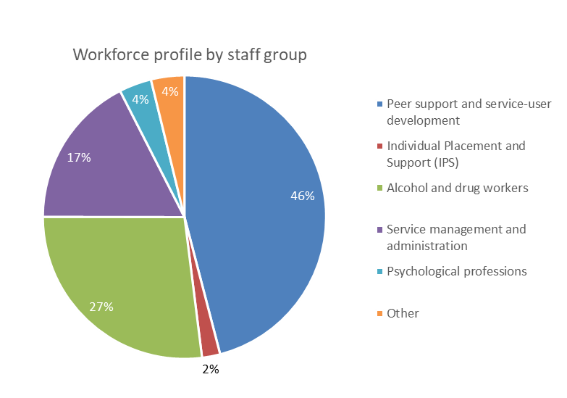
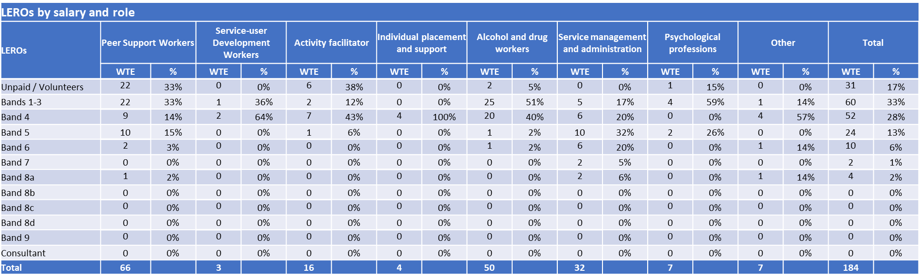
Workforce composition
The chart shows the workforce profile by staff group with the table below showing the salary profile. Note the table includes the individual roles reported within the peer support and service user group as well as some alcohol and drug workers and psychological professions employed by LEROs.
Lived experience recovery organisations (LEROs) reported 184 whole time equivalent (WTE) staff in total. Peer support and service user development roles make up the biggest proportion of the workforce at 46% (84.3 WTE) which compared this staff group representing 9% of the treatment providers workforce.
Service managers make up a lower proportion of the workforce in LEROs at 17% compared to 23% for treatment providers.
Within LEROs 17% of the workforce are unpaid/volunteers and 78% are band 4 or below (<£26k). This compares with 12% of treatment provider staff being unpaid/volunteers and 50% a band 4 and below.
When reviewing the LERO workforce the low number of staff reported for some staff groups should be considered.

Slide 53
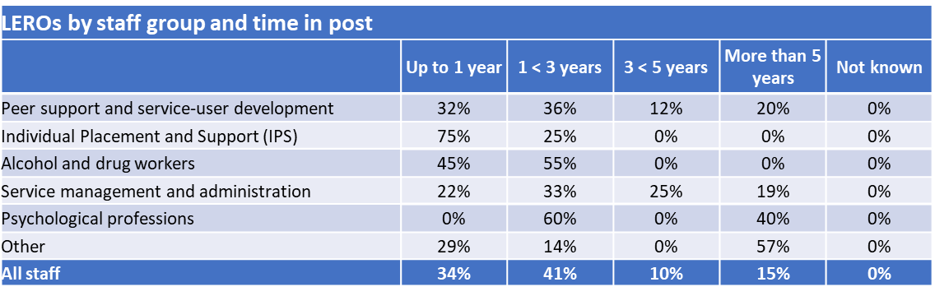


Time in post, contract type and contract hours by staff group
The table below shows that overall 34% of the LERO workforce have been in post for less than a year (based on 20 responses, 87% of LERO submissions) which was in line with the 37% reported for treatment providers. As for treatment providers, individual placement and support workers had a high percentage of staff in post for less than a year but note this was based on 4 WTE staff in these roles. Similarly, the profiles for psychological professions and other staff need to be viewed in the context of each reporting 7 WTE staff in post.
The table below left shows that overall 42% of the LERO workforce were on permanent contracts, 42% on fixed and 17% on temporary contracts. This differs to treatment providers where 84% of staff were on permanent contracts.
The table bottom left shows that 57% of LERO staff worked full time compared to 69% in treatment providers. A lower percentage of LERO staff are on zero hour contracts at 4% compared to 8% for treatment providers.

Slide 54



Workforce metrics
LEROs did not all complete all metric data for all roles. Some provided a total for all staff but no or limited breakdown by staff group, whilst others provided information for some staff groups but not all and no total for all staff. Therefore, the sum of the individual staff groups will not match the ‘all staff’ information.
The 42% vacancy rate reported for peer support and development staff is based on 19 WTE vacancies. This rate compared to a vacancy rate of 11% for this staff group in voluntary drug and alcohol treatment providers and 50% for NHS treatment providers.
The 20% turnover rate reported for peer support and development staff was based on 8 leavers. The voluntary sector reported a 40% turnover rate for this staff group and the NHS 20%.
*Peer support, service development, activity facilitation, Individual Placement, Support workers

Slide 55


Demographic profile
As for the treatment providers there is a higher representation of Black / Black British individuals in the drug and alcohol LERO workforce compared to the English working age population and lower representation of Asian / Asian British individuals in the workforce.
The workforce is generally older than the working age population with 76% of staff aged 40 or over. This compares with 55% of the working age population.
Within LEROs 55% of the workforce were male, 45% female,1% non-binary and 2% other. This differs to treatment providers where between 58% and 69% of the workforce were female.
Within LEROs, 9% of staff report as having a disability. This is between the 7% reported by voluntary treatment provider organisations and 10% reported by NHS drug and alcohol treatment providers.

Slide 56
LEROs: summary of key findings
Lived experience recovery organisations (LEROs) made 23 submissions for a limited number of local authority areas and therefore the analysis within this section should be viewed with some caution but provide a broad overview of the workforce in these organisations. The key findings of the drug and alcohol workforce census for (LEROs) are noted below:
LEROs reported 184 WTE across six workforce groups with peer support and service user development roles the largest at 84 WTE (46%).
Unpaid/volunteer staff accounted for 17% of the LERO workforce and 78% are band 4 (<£26k) or below. This compares with 12% of treatment provider staff being unpaid/volunteers and 50% a band 4 and below.
LEROs reported 34% of staff in post for less than a year with 42% on permanent contracts. The remaining staff were on temporary (17%) and fixed term (42%) contracts.
57% of LERO staff were full time which compared to 69% for treatment providers.
The vacancy, sickness and turnover rate metrics were based on relatively low numbers of submissions making it difficult to state a national position.
There is a higher representation of Black / Black British individuals in the drug and alcohol LERO workforce compared to the English working age population and lower representation of Asian / Asian British individuals in the workforce.
The workforce is generally older than the working age population with 76% of staff aged 40 or over. This compares with 55% of the working age population.
Within LEROs 45% of the workforce were female. This differs to treatment providers where between 58% and 69% of the workforce were female.

Slide 57
Appendices

Slide 58
Appendix 1
Staff group breakdown by role
All sectors

Slide 59

Drug and alcohol workers
* Participants were asked to submit the total number and WTE drug and alcohol workers and then provide a breakdown by the specific roles. Not all were able to provide a breakdown of all roles. Therefore, the two totals show the sum of the individual drug and alcohol worker roles where these were provided and the overall summary total that all providers submitted.

Slide 60


Service managers
Pharmacy roles

Slide 61

Nursing and aligned roles
* Advanced level practice nurse is a subset of registered nurses
Support Workers and Other Unregistered Clinical Staff
Social work roles

Slide 62

Peer support, service development, activity facilitation & placement and support staff group
Allied health professionals (AHPs)

Slide 63


Psychiatry roles
Other doctors

Slide 64

Psychological professions
Treatment providers: Other staff not captured in identified groups

Slide 65

Local authority: Commissioning roles

Slide 66
Appendix 2
HR Metric definitions

Slide 67
HR metric definitions
Vacancy Rate | As at 30.6.2022 | Numerator: Number of vacancies (WTE) by roles Denominator: Total funded establishment (WTE); multiplied by 100 to give the percentage rate
Sickness/ Absence Rate | 1.7.2021 - 30.6.2022 | Numerator: WTE sickness and absence days Denominator: Total available WTE working days, multiplied by 100 to give the percentage rate
Staff Turnover Rate | 1.7.2021 - 30.6.2022 | Numerator: Leaver WTE in the period, Denominator: Average WTE staff in post, multiplied by 100 to give the percentage rate
Funded Establishment |  | This is the sum of staff in post and vacancies

Slide 68

Contact details
Kirsten Windfuhr | Associate Director (Mental Health) k.windfuhr@nhs.net
Beverley Sheard| Senior Project Manager b.sheard@nhs.net
Jade Coles| Project Manager j.coles8@nhs.net

