Slide 1



Finding Patience
Dementia Training

Slide 2
Key Facts: dementia in the UK
Over 850,000 people living with dementia in UK
Over 1 million by 2025
Over 42,000 people living with dementia are under the age of 65
Over 25,000 people with dementia from BAME groups
Notes:
Section 1:
Introduction slide to present context of training. Prevalence of dementia in the UK, numbers of people living with dementia who are under 65, numbers living with dementia from Black and Minority Ethnic (BAME) groups

Slide 3
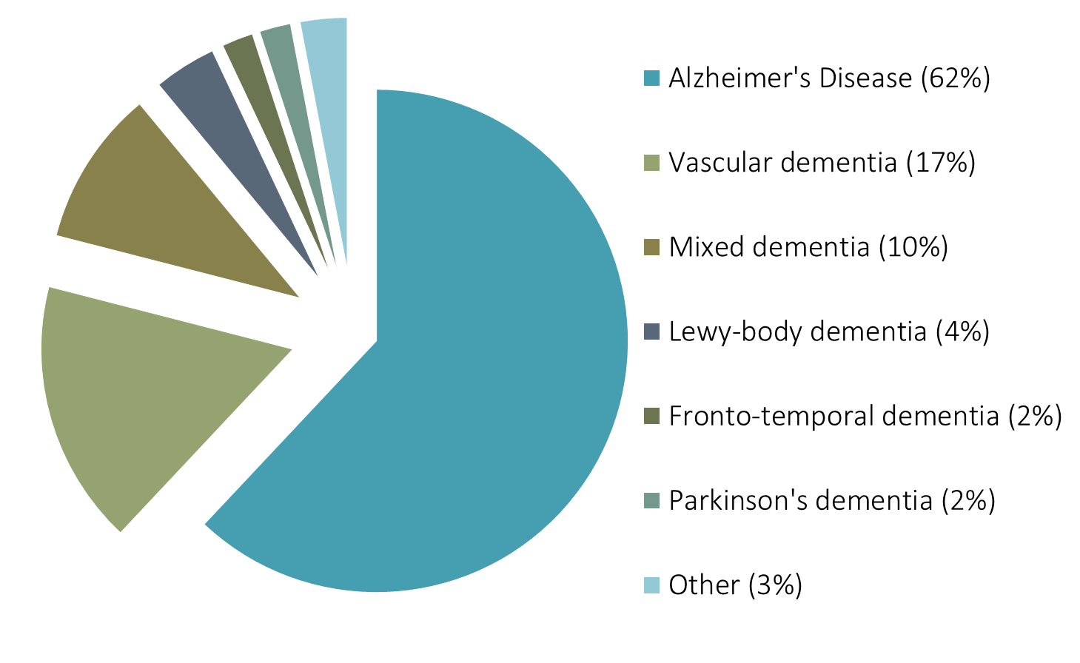
Types of dementia
Notes:
There are over 100 different types of dementia, but these are the most common types
At the point of diagnosis there can sometimes be difficulties distinguishing between types of dementia. It is important to identify the type of dementia to enable to access to the right treatment.
Delays in access to treatment can bring about negative health outcomes in the long term.
Although the chart gives a good overview of the types of dementia, changes in diagnostic practice and the way data is gathered means that some of these estimates are changing. For example:
More people are now receiving a diagnosis of mixed dementia.
Although some estimates of Lewy Body dementia are quite low- recent estimates from NICE suggest that prevalence of this type of dementia may in fact be as high as 15%
Go through each type and see if the learners are familiar with these types of dementia

Slide 4
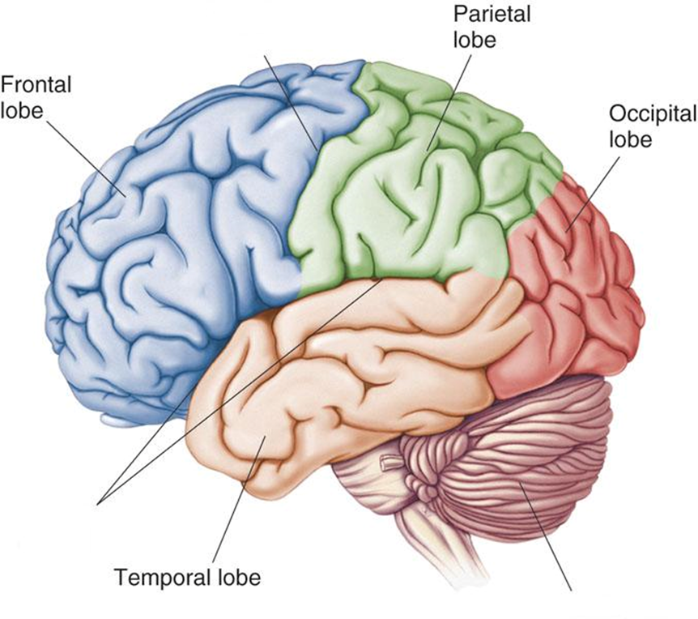
Lobes of the Brain
http://www.bioon.com/book/biology/whole/image/1/1-8.tif.jpg
Notes:
Present to the learners the key functions that are associated with each lobe of the brain
Parietal Lobe
The parietal lobe is a part of the brain that helps us know where our body relates to the rest of our body and to the rest of the world i.e. our “body sense”. This involves seeing and recognising things as they exist in three dimensions i.e. picking up objects. The left parietal lobe is integral for telling our left form our right and knowing where our limbs are. It is also responsible for ordering and sequencing things, like actions or numbers or letters. The right parietal lobe helps us to recognise objects as three dimensional and work out where they are in relation to each other.
When people have damage to the parietal lobes they might have difficulties with everyday tasks like getting dressed which involves the coordination of our limbs as we dress as well as carrying our these actions in a pre-determined sequence. This can be common in Alzheimer’s disease and can be perceived as clumsiness. Difficulty with coordination in this way is known as Apraxia.
Frontal Lobe
The frontal lobe is important for regulation of our thinking and behaviours. The frontal lobe is strongly associated with our “executive functions” which can be seen to manage our thinking and behaviour. Some of the core executive functions are planning, reasoning, inhibiting, regulating our emotions, switching between tasks, monitoring and updating our thinking.
Since the frontal lobe is associated with our ability to reason, manage our emotions, and inhibit behaviours that might be seen as socially inappropriate, damage to this region can result in perceived changes in personality. This can occur in some types of frontotemporal dementia.
Damage to the frontal lobe can occur when proteins build up and damage nerve cells in this region. Changes in might also occur when there are vascular changes in this region, or when there are changes in the function of neurotransmitters in the region which affects the ability of cells to “talk” to one another.
Occipital Lobe
The occipital lobes are located right at the back of the brain. The occipital lobes deal with all of the visual information that enters the brain. The eyes are responsible for perceiving the outside world, but once these visual perceptions enter the brain it is converted into electrical signals and processed by the visual cortex (occipital lobe). It is the role of the occipital lobes to make sense of the information. Damage to this part of the brain can lead to difficulties with recognising (i.e. making sense) of objects. It can also lead to people experiencing visual hallucinations (i.e. misperceptions).
This area of the brain can be particularly affected for people with a rare form of Alzheimer’s disease called Posterior Cortical Atrophy (PCA). People with PCA can have particular problems with processing visual information leading to difficulties with reading, judging distances, recognising objects, and visual hallucinations. Like in Alzheimer’s, the disease is caused by the build-up of proteins leading to plaques and tangles.
Temporal Lobe
The temporal lobes are important for our memory and language function. This means that the temporal lobes are important for many of our day to day functions such as
remembering and recognising, faces, words, objects
retrieving information about recently learned information or past events
remembering words, the names of objects or people
Inside the temporal lobes is a brain structure called the hippocampus. The hippocampus is known to be linked to a particular type of memory called episodic memory. Episodic memory refers to personal experiences and the specific objects, people and events that form part of these experiences. This includes recently learned information as well as remembering events from our past. Damage to this structure means that people have problems making new episodic memories as well as retrieving some information.
Damage to the hippocampal structure are one of the first changes seen in Alzheimer’s disease. This is why some of the first “symptoms” of Alzheimer’s disease is difficulties with recalling events that have happened recently.

Slide 5
Alzheimer’s Disease
Abnormal proteins cause “Plaques” and Tangles” in the brain
Temporal lobe first affected
Gradual decline over time
Symptoms typically related to
  Memory (remembering recent events)
  Navigation (getting lost in familiar places)
  Language (finding the right words or names)
Notes:
It is estimated about 70% of people living with dementia have Alzheimer’s disease. The symptoms are caused by abnormal proteins that build up in the brain to cause “plaques” and “tangles”. These cause the cells around them to die as well as affecting the chemicals “neurotransmitters” that send messages from one part of the brain to another.
The temporal lobe is the first area affected in the disease process. Changes to the structure of the temporal lobes shows up on neuroimaging tests for Alzheimer’s disease.
People who have Alzheimer’s disease typically first experience difficulties with their memory, particularly remembering new information. People tend to find that their difficulties become worse gradually over time (progressive decline). Language problems can also be common as the disease progresses; people may experience word-finding difficulty, with names and unusual words being preceded by long pauses, and being replaced with related words.
The majority of people are diagnosed with Alzheimer’s disease after the age of 65, and risk of developing Alzheimer’s disease increases with age. However, more than 5% of people with dementia in the UK are diagnosed before the age of 65, and many of these have Alzheimer’s disease (30-35% of people with young onset dementia). Frequently younger people can wait 2 years for a diagnosis, and in the process are often misdiagnosed leading to delays in accessing the right treatment

Slide 6
Vascular Dementia
Vascular damage in the brain (blood vessels)
Can affect any brain region
Sudden decline
Language frequently affected
Memory can be affected
Movement can be affected
Notes:
Vascular dementia is the second most common type of dementia. It is somewhat misleading to think of vascular dementia as a progressive brain disease because the term “vascular dementia” does not refer to a specific type of disease or process, rather a dementia caused by any form of cerebrovascular damage. Up to 15% of all dementias have their origin in vascular disease or damage, although it is common for vascular disease to co-exist with other types of damage, especially Alzheimer’s disease.
When considering whether or not vascular factors are important in a case of dementia it is important to look at the person’s general cardiovascular health. The more indications of poor cardiovascular health the greater the chance that vascular factors are involved. The following would support a diagnosis of vascular dementia:
· A history of stroke or transient ischaemic attack (TIA)
· A history of falls
· Presence of vascular risk factors (e.g. hypertension, diabetes, atherosclerosis, high blood pressure)
· Evidence for recent vascular damage in the brain on a structural brain scan
Symptoms of a dementia with a vascular origin are very difficult to distinguish from those of Alzheimer’s disease because the impact of both types of damage is to disrupt brain structures that support memory and other higher order cognitive functions.
The main difference is that symptoms will come on suddenly, rather than gradually, and may be related to a specific incident (such as a small stroke or fainting attack). Symptoms may remain stable, or may show worsening. However, if the symptoms do worsen they often show a “step-wise” pattern.
Language is again likely to be particularly affected- specifically difficulties with the mechanics of speech. The person may find it very difficult to articulate, making speech stuttering and slow. There may be problems with movement which may show up in problems with writing, drawing or dressing – which may be shaky and effortful.

Slide 7
Lewy Body Dementia
Lewy body deposits in the brain
Fluctuating concentration
Hallucinations
Some problems with memory
Can affect gait, movement and facial expression
Notes:
Lewy bodies are small spherical structures found in the nerve cells of the brain. It is thought that these structures contribute to the death of brain cells. It is estimated that between 7 – 30% of people diagnosed with dementia have Lewy bodies in their brains. Lewy body dementia is difficult to identify accurately, because of similarities with Alzheimer’s disease and Parkinson’s disease dementia.
People with Lewy body typically have difficulties related to:
· Visual hallucinations
· Fluctuating concentration, in which during the course of a day the person can have periods of clear thought followed by periods of deep confusion
Many people with lewy body dementia develop coping mechanisms to deal with the presence of hallucinations.
Lewy body deposits affect the functioning of occipital regions important for visual processing
People with Lewy Body dementia might have difficulties with memory, but these are considered to be less important than the other difficulties that they have. People also tend to experience more fluctuation; during one day there may be periods of lucidity followed by periods of confusion.
Because Lewy body disease is associated with Parkinson’s disease, the symptoms of this type of dementia may be accompanied by some of the symptoms we associate with Parkinson’s disease such as difficulties with facial emotional expression a low blink rate, tremor and shuffling gait.

Slide 8
Frontotemporal Dementia
Damage to frontal and/or temporal lobes
Can affect behaviour and/or language
Behaviour changes include
  Lack of inhibition and insight
  Personality changes
Language changes include
  Knowing meaning of words
  Production of speech
Notes:
The term Frontotemporal dementia in fact refers to a range of conditions, which includes behavioural variant Frontotemporal dementia (bv-FTD), semantic dementia (SD), progressive nonfluent aphasia (PNFA) and dementia associated with motor neurone disease. All of these types of dementia are caused by damage to the frontal and/or temporal lobes. Whilst Frontotemporal dementia is relatively rare, it does occur more frequently in people under the age of 65, and is as common as Alzheimer’s disease in this age group.
Patients presenting with FTD may present with lots of different problems including changes related to behaviour, memory, attention and movement.
In general, people with frontotemporal dementia can be separated into two groups based on the problems they experience: people with behavioural changes (behavioural variant) and language problems (language variant).
People with the behavioural variant generally are affected by:
Personality or behaviour change
Lack of insight
Loss of inhibition
People with the language variant can have problems with remembering the meaning of words (semantic dementia) or with the productions of speech (progressive nonfluent aphasia).
There is often overlap between the types of frontotemporal dementia.

Slide 9
Mixed Dementia
More than one type of dementia at the same time
Often Alzheimer's and Vascular
Symptoms are that of Alzheimer’s +
Notes:
Frequently changes in the brain (pathology) associated with Alzheimer's is present along with blood vessel changes common to vascular dementia
Symptoms can be variable due to the vascular component, but usually Alzheimer's plus some of the other changes that you may associate with vascular changes
Helpful to make suggestions to improve lifestyle factors that may exacerbate vascular changes

Slide 10
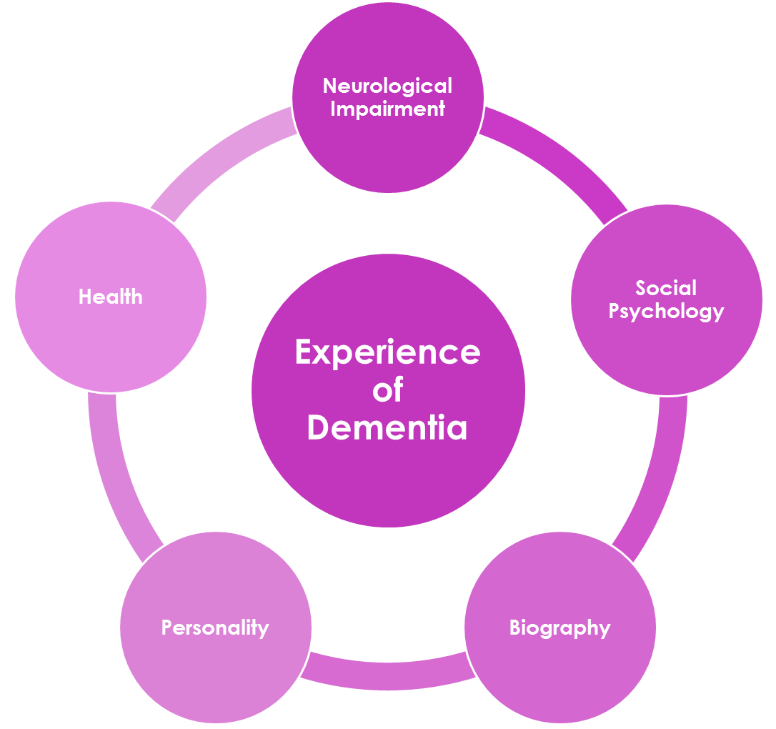
The Enriched Model of Dementia
Notes:
Section 2:
The enriched model helps us to understand the different factors that are important for understanding an individuals experience of living with dementia.
The enriched model was proposed by Tom Kitwood (1997) as an equation to help to understand the experience of a person with dementia from a person centred perspective.
In the model
P – Personality
B – Biography, or life history
H – Health (including other physical or mental health problems, sensory deficits etc)
NI–Neurological impairment or Impaired thinking abilities (the extent of difficulty with memory and other cognitive skills)
SP– Social psychology (the extent to which the social environment meets, or fails to meet, the person’s needs)
Using this model can help us to better understand a persons experience and behaviour. In the past there may have been a tendency to put the difficulties that people with dementia have down to the disease process of dementia. this model helps us to understand that whilst the disease process might influence a persons experience- it is not the only factor.
Let us take an example of al lady who attends hospital as an emergency and becomes very distressed.
It may be that being in a new environment and circumstances is difficult to process due to memory impairments and difficulty with orientation (NI). She is experiencing pain because of the condition that has bought her to hospital (H), but a contributing factor is that the person had a distressing experience giving birth in a hospital which brings back distressing memories (B). The emergency department is very busy and noisy which is distressing and confusing (SP). Because eth lady is quite emotional by nature this is more readily expressed (P).
How can understanding this information help us to support this lady?

Slide 11

Dementia and Stigma
What does the word ‘sufferer’ suggest?
What does it make you think about a person?
What images does it portray?
Notes:
Section 3:
Ask the students to think about the image and the word sufferer
Historically the term stigma has been used to refer to a mark or signify something bad or unusual about the person bearing the mark
Theories assert that stigma is constructed at a social level (whether experienced publically or privately).
The World Alzheimer Report: Overcoming the stigma of dementia, released on 21 September 2012, shares results from a worldwide survey conducted with people with dementia and carers on their personal experiences of stigma. The report indicates that the stigma associated with dementia often means people are excluded and marginalised in society.
A further issue is since stigma is socially constructed it is also culturally determined. People from different societies and eras construct differing stigmatising attributes. For example one research study found South Asians had a tendency to perceive dementia as contagious but curable condition as compared to the Caucasians (Purandare et al., 2007).
The Facing Dementia survey indicated that 19% of 600 lay people thought that dementia equated to being crazy and insane whilst only 4% of people thought this applied to Alzheimer’s disease (Rimmer et al., 2005).
It is important to note that stigmatising views of dementia affect the way that people going through the assessment and diagnostic perceive and react to diagnosis.

Slide 12
Words Matter
Words are very powerful – they can build you up or put you down. When you are speaking about dementia remember this.”
Agnes Houston, person with dementia
DEEP Guide to Language
‘Curl up and Die words’
Dementia sufferer
Demented
Senile or senile dementia
Burden e.g. people are a burden or cause burden
Victim
Plague
Epidemic
Living death e.g. dementia is a living death
http://dementiavoices.org.uk/wp-content/uploads/2015/03/DEEP-Guide-Language.pdf
Notes:
When it comes to addressing stigmatising views about dementia it is really important to consider the language that we use to talk about dementia
A group of people with dementia have described some words used about dementia as “curl up and die” words. These words affect the way we view and think about people with dementia
It is important to use words that people living with dementia feel represent them- that promote the PERSON with dementia rather than the person with DEMENTIA
Using the right language is one step towards addressing stigmatising views about dementia

Slide 13
Communication in Dementia (1)
Can be affected by cognitive impairment
  Memory
    difficulty following conversation, repeating questions, using a primary language, problem remembering words or names
  Language
    Less concise language, recognising words and understanding, problems with production
  Attention
    Following and maintaining conversation, difficulty with complex instructions
Notes:
Section 4:
Language difficulties are common for people with dementia, although the types of language problems that people might experience vary according dementia type, personal history and social environment.
Common language problems for people with dementia include:
• less concise language with fewer ideas
• repeating the same words and phrases (maybe asking the same or similar questions)
• word-finding difficulties and word substitutions
• difficulty recalling names of family and friends
• grammatical errors
• use of jargon and less of meaningful speech
• difficulty following and maintaining conversation;
• regression to primary language (in people who are bilingual patients)
• difficulty understanding what people are saying
• difficulty with complex instructions that have more than one step
• impaired writing abilities
• reading comprehension difficulties
Language problems are common for people with Alzheimer’s disease ; the content of speech can become increasingly impoverished and the person can experience word-finding difficulty. Names and unusual words may be preceded by long pauses or replaced with other related words. There is a sense that the person is losing knowledge of what words mean.
People with vascular dementia may have more difficulties with the mechanics of speech. For example, a person may find it very difficult to articulate, making speech stuttering and slow. If time is taken, the person knows what they are attempting to communicate, and their knowledge of language (e.g. understanding) may be better than people who have other types of dementia.
The language variant of frontotemporal dementia (also referred to as primary progressive aphasia), is characterised by difficulties with language. The language variant can be further classified as to whether people have Semantic Dementia- characterised by loss of factual (semantic) memory in both the verbal and non-verbal domains (e.g. loss of meaning of words) or progressive non-fluent aphasia (e.g. difficulties with the production of speech.).

Slide 14
Communication in Dementia (2)
Can be affected by social environment and the conversational partner
Background noise and physical Space
  Make sure the environment is comfortable and distractions are minimised
Communicator
  Use non verbal communication, don’t use jargon, don’t use complex sentences, consider attention
Notes:
Social Environment
Considering the social environment is extremely important when thinking about communication. The communicator plays and important role in preserving and supporting a persons retained language abilities. For example, asking multiple questions or talking very quickly is extremely unhelpful for people with language difficulties.
As well as the conversational partner, the physical social environment plays an important role in supporting language and communication. For example, some researchers and practitioners have shown that using “walking interviews” or “walking and talking” is a technique can improve the ability of people to communicate fluently.

Slide 15
Communication in Dementia (3)
Can be affected by health and mood
  Sleep and well being
    concentration and attention
  Physical Health
    May reduce access
    Pain
    Sensory impairment
  Mood
    Low mood = low motivation
Notes:
It is important to consider health and mood related factors that may affect willingness to engage or attention in conversation. Sometimes these factors can be addressed or accommodations made to compensate- such as talking to people in the morning when they may be more alert than the afternoon, and making sure that if people have sight or hearing correction aids these are available and working.

Slide 16
Biopsychosocial Approach
Notes:
Section 5:
Until the 1990s, living with dementia was mainly thought about from a biomedical perspective. That is, the experience and behaviour of people living with dementia can be determined by the changes in the brain caused by the disease course of dementia.
this approach was problematic in that it assumes the actions of people with dementia can be ‘explained’ in terms of underlying neurological disease. It also meant that people were readily reduced to a set of signs and symptoms (dysphasia; disorientation to time and place; confabulation etc).
A bio-psycho-social model of dementia presents an alternative to the biomedical model. This approach considers the whole person rather than just the brain disease.
This approach asserts that bio, psycho and social factors are all important elements of a persons experience. This factors are not distinct but relate to one another.
When we think about a persons experience we should consider all of these factors- not just the impact changes in the brain.
Examples of these factors
BIO- Neurological impairments (brain changes) but also sensory impairments, general health (infections), exercise, sleep, diet
PSYCHO- mood, anxiety, depression, spirituality, identity
SOCIAL- living environment, family, stigma, education, class, culture

Slide 17
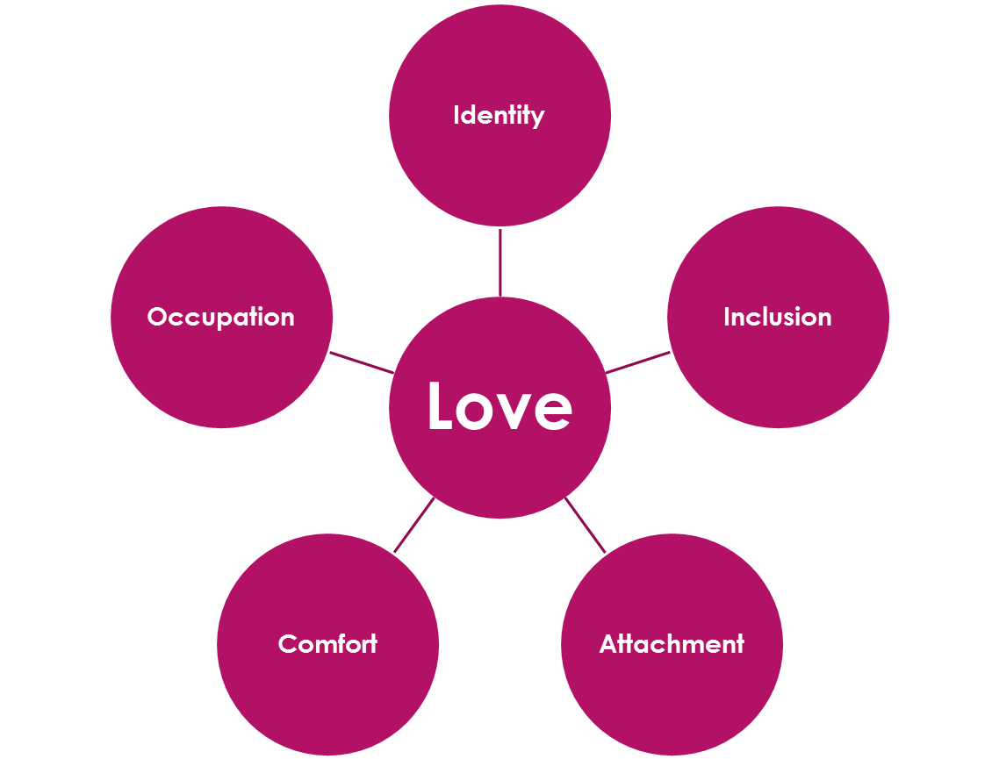
Psychological Needs
Notes:
Section 6:
Central to adopting a person centred approach to understanding and supporting a person living with dementia (or any person) is recognising their psychological needs.
Kitwood (1997) identified the importance of maintaining and meeting the psychological needs of people with dementia. He recognised that meting these needs is key to providing high quality care and support.
Kitwood identifies six psychological needs; Love, identity, attachment, inclusion, occupation and comfort.
Attachment – the need for secure bonds with others
Comfort – closeness and tenderness; relief from pain
Identity – to be recognised by others as a unique individual
Occupation – being involved in day-to-day activities
Inclusion – need to have our social standing recognised
All of these needs centre, in Kitwood’s view, on the universal need for love.

Slide 18
References
Alzheimer’s Society (2014). Dementia UK Update. alzheimers.org.uk/dementiauk
Kitwood T (1997) Dementia reconsidered: The person comes first. Buckingham: Open University Press.
Kitwood T and Bredin K (1992) Person to person: A guide to the care for those with failing mental powers. Loughton: Gale Publications.

