Slide 1
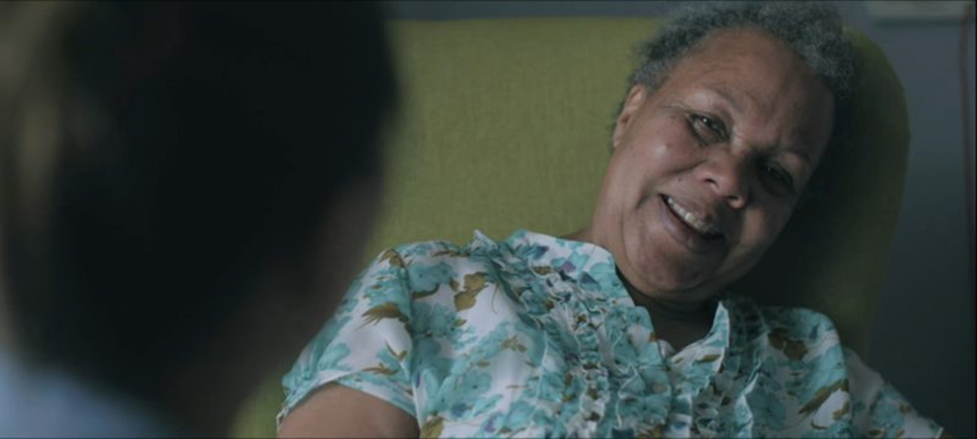


Finding Patience
The Later Years
Dementia Training

Slide 2
VIPS model of Person Centred Care
VIPS stands for:
V = Values people – Values and promotes the rights of the person
I = Individual’s needs – Provides individualised care according to needs
P = Perspective of service user – Understands care from the perspective of the person with dementia
S = Supportive social psychology – Social environment enables the person to remain in relationship
Notes:
Section 1:
The guiding principles behind VIPS are:
Do my actions show that I respect, value and honour this person?
Am I treating this person as a unique individual?
Am I making a serious attempt to see my actions from the perspective of the person I am trying to help? How might my actions be interpreted by them?
Do my actions help this person to feel socially confident and that they are not alone?

Slide 3
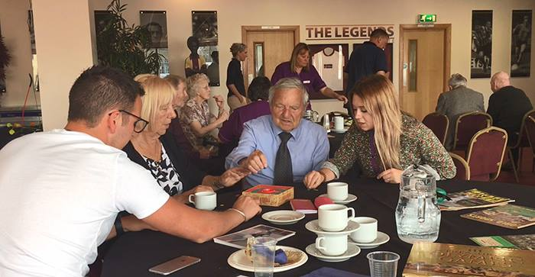
Cultures of Care
Kitwood (1997)
Malignant social psychology
  Usually unintentional ways we can undermine people with dementia
  Create or ignore unmet needs
Positive person work
  Skills and approaches we use that support and value a person
  Attempt to address unmet needs
Notes:
Person centred dementia care has been important for best practice policy and guidance over the last 20 years.
Prior to the introduction of person centred approaches to care, designed to support personhood and well being (as described in the VIPS model), delivering care had a tendency to be task orientated rather than person orientated.
In other words there has been a move from care focusing on the DEMENTIA- manging the symptoms of the illness from a medicalised perspective, toward focusing on ensuring the well being of the person, who happens to be living with dementia
From a person centred perspective, the goal of effective care should be to deliver individualised care that supports the persons well being.
Interactions in the care environment that support the well being of people with dementia, can be referred to aspostive person work, since they enhance the well being of people with dementia.
Sometimes, carers may interact with people in a way that undermine the personhood and well-being of people with dementia. These types of behaviours have also been called Malignant Social Psychology- they exist in care settings often not because of malicious intent, but because of a lack of training, or because care remains task driven rather than person driven.

Slide 4
Positive Person Work
Empowerment
Facilitation
Enabling
Collaboration
Recognition
Including
Belonging
Fun
(University of Bradford 2005)
Warmth
Holding
Relaxed pace
Respect
Acceptance
Celebration
Acknowledgement
Genuineness
Validation
Notes:
Recognition A person who is recognised by name and acknowledged as a person with unique thoughts, feelings and preferences, for example greeting a person by their preferred name.
Collaboration Partnership between the healthcare professional and the person to carry out an activity or task, for example having a bath or getting dressed in ways that are comfortable for the person.
Celebration Not just during celebratory occasions, such as birthdays or anniversaries, but the person should see their achievements celebrated.
Validation Connected to the work of Feil (1993), this is about accepting the reality of another even if it is as a result of hallucinations or misperceptions.
Holding Providing a safe psychological space or environment to enable people to truly express themselves. For example, if a person with dementia is experiencing distress do not isolate them, stay beside them and validate their experiences without trying to stop or ignore them.
Facilitation Enabling the person to do what otherwise they would be unable to do.

Slide 5
Personal Detractions
Intimidation
Withholding
Outpacing
Infantilization
Labelling
Disparagement
Accusation
Treachery
Invalidation
Disempowerment
Imposition
Disruption
Objectification
Stigmatization
Ignoring
Banishment
Mockery
(University of Bradford 2005)
Notes:
Treachery The use of deception to distract or manipulate behaviour.
Disempowerment Not allowing or enabling a person to use the abilities they still have.
Infantilisation Treating the person like a child.
Intimidation Causing the person to feel fearful as a result of threat or physical power.
Labelling Referring to people inappropriately, for example ‘elderly mentally infirm’.
Stigmatisation Treating the person as if they were an outcast.
Outpacing Providing information or choices too quickly thus potentially making information difficult to understand.
Invalidation Not acknowledging the reality of the person.
Banishment Excluding the person either physically or emotionally.
Objectification Treating the person as an object, for example during washing or dressing.
Ignoring Conversing with others in the presence of the person as if they are not present.
Imposition Forcing the person to do something.
Withholding Failure to provide attention or meet an obvious need.
Accusation Blaming a person for their misunderstanding or inability.
Disruption Suddenly disturbing a person and interrupting their activity or thoughts.
Mockery Making fun or joking at the expense of the person.
Disparagement Telling the person that they are worthless.

Slide 6
Biopsychosocial Model
Notes:
Part 2:
For learners who have completed the Finding Patience Training the facilitator should recap the model.
For others this model should be presented in detail.
Until the 1990s, living with dementia was mainly thought about from a biomedical perspective. That is, the experience and behaviour of people living with dementia can be determined by the changes in the brain caused by the disease course of dementia.
this approach was problematic in that it assumes the actions of people with dementia can be ‘explained’ in terms of underlying neurological disease. It also meant that people were readily reduced to a set of signs and symptoms (dysphasia; disorientation to time and place; confabulation etc).
A bio-psycho-social model of dementia presents an alternative to the biomedical model. This approach considers the whole person rather than just the brain disease.
This approach asserts that bio, psycho and social factors are all important elements of a persons experience. This factors are not distinct but relate to one another.
When we think about a persons experience we should consider all of these factors- not just the impact changes in the brain.
Examples of these factors
BIO- Neurological impairments (brain changes) but also sensory impairments, general health (infections), exercise, sleep, diet
PSYCHO- mood, anxiety, depression, spirituality, identity
SOCIAL- living environment, family, stigma, education, class, culture

Slide 7
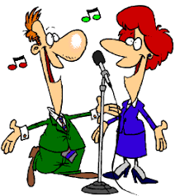

Creative Communication
Notes:
PLEASE NOTE WE ARE SOURCING SOME MORE EFFECTIVE COPYRIGHT FREE IMAGES FOR THESE SLIDES
Part 3:
Creative approaches to communication can help people to communicate their preferences regarding care.
It can be helpful to know a bit about a persons life story (personal history) and preferences to start with so that you can adopt the right approach, this will in turn help you to learn more about the person and build rapport.
Talking to family members or other carers can be a useful starting point- though isn’t always necessary.
Some approaches to creative communication are outlined below
Art based approaches
Photography
Dance
Music
Green exercise
Gardening
Story-telling
Reminiscence work
Trips and outings
Assistive technologies
Communication tools
For example,
Communication tools that use pictures can be a very useful way of facilitating communication for people who have difficulty finding the right words
OR
Art can be useful to help someone to express themselves in a failure free manner

Slide 8

Non Verbal Communication
70%
Notes:
The majority (up to 70%) of communication is non verbal.
Non verbal communication is especially important when communicating with people with dementia who may have difficulty with language and expression.
Taking a biopsychosocial perspective we know that behaviour is meaningful and provides us with clues to what a person is thinking and feeling. Therefore behaviour is a non-verbal indicator important for communication and care planning.

Slide 9

Life Story Work
Notes:
Creative approaches to communication will help you to find out information about a persons personal history-which is important for developing a personalised care plan.
Simply put, the better we understand someone else’s life story, the more effectively we can understand their care and support needs.
The more that is understood about an individual the more care planning can take place and be shared across everyone who will be supporting the person with dementia. This is particularly important for planning for the later stages when communication about care and support needs will become much more difficult.
Life story work can incorporate some of the creative approaches that mentioned earlier, and may have an element of reminiscence.
It can also be multisensory, often incorporating objects and smells as well as photographs

Slide 10
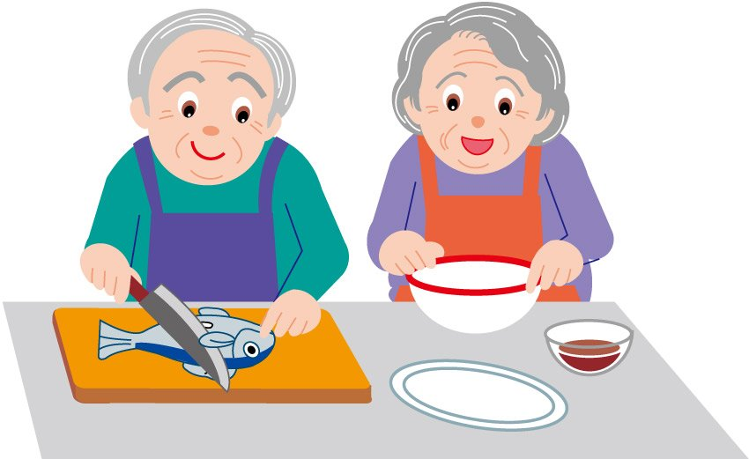
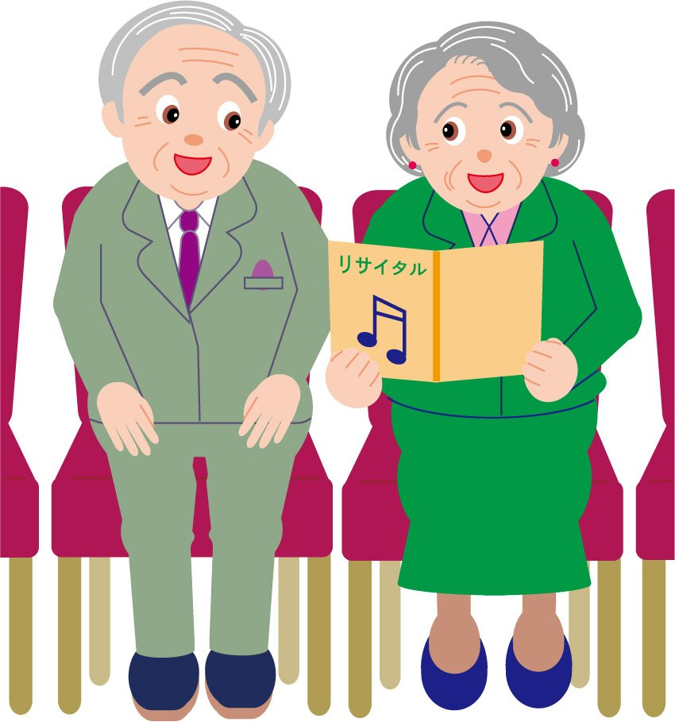
Creative Care Planning
Notes:
When choosing an approach to creative care planning it is important to consider ABILTY and PREFRENCES
For example, for someone who enjoys being outdoors it may be appropriate to conduct a walking interview where you can discuss what kind of activities they like doing, which may include outdoor activities.
However, this approach would not be good for someone less mobile.
It is important to never exclude people from being involved in care planning just because they cannot tell you about their preferences in conversation. For people who are less able to talk, it may be appropriate to observe them doing a variety of activities, or receiving different types of support, to find out about things that they enjoy or their preferences.
It is also important to consider engaging all of the SENSES to stimulate communication and involvement. For example, if considering what types of food someone enjoys why not involve them in cooking or tasting different foods to find out about their preferences.

