Slide 1
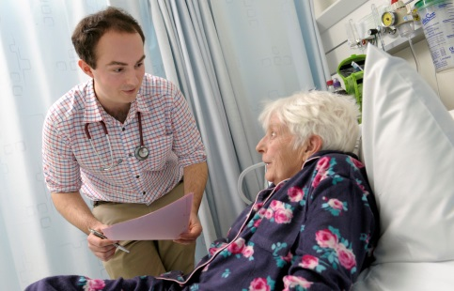
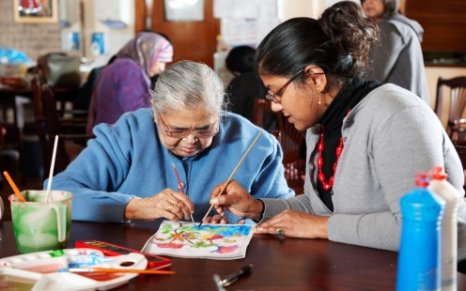
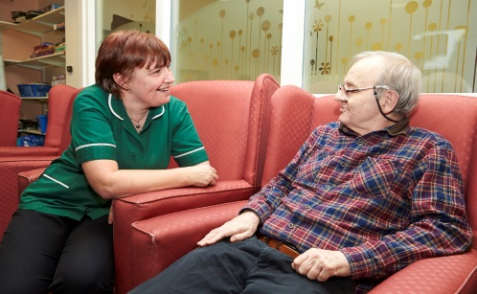
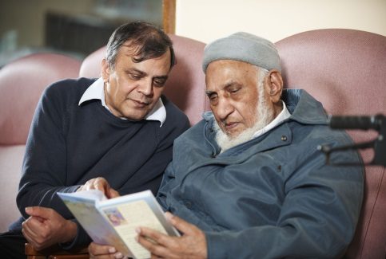
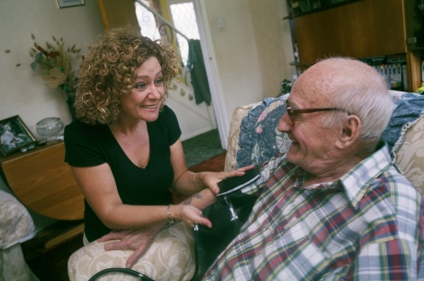
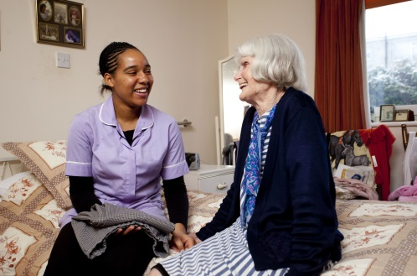

Tier 1 Dementia Awareness Training
Full Training Package
Notes:
First Published in 2016
Health Education England (HEE)
This work is owned by Health Education England (HEE).
This training package is subject to HEE copyright and any reproduction of all or part of this package is expressly prohibited, unless HEE has granted its consent.
The Dementia Academic Action Group (DAAG) was commissioned by Health Education England Thames Valley and is a collaboration between University of Bedfordshire, Oxford Brookes University, University of Northampton and University of West London. For further information about the DAAG Tier 1 Dementia Awareness training, please contact Health Education England Thames Valley.
Web add: https://www.hee.nhs.uk/hee-your-area/thames-valley
Email: enquiries@thamesvalley.hee.nhs.uk
Tel: 01865 785500
The content of this package has been developed with a view to raising awareness of what dementia is and how it affects people with dementia along with their family, relatives, carers, friends and significant others. It has been delivered as face to face training to over 1,500 clinical and non-clinical staff working in a variety of health and social care settings.

Slide 2

Welcome
Introduction
Tier 1 Training
Raising your awareness
Starting point for your exploration, personal & professional development
@NHS_HealthEdEng #DAAG
Notes:
Welcome to the session
Explain this is tier 1 only
Not an ‘all there is to know about dementia’ session, as this would take months, but for some a starting point and a refresher for others.

Slide 3
Definition of Tier 1 Training
Tier 1 training is aimed at raising awareness, in terms of knowledge, skills and attitudes of all those working in health and care settings.
It is relevant to the entire health and social care workforce including ancillary staff. This could form part of induction training and also provide a foundation for more advanced practice.
It is also appropriate for social care workforce group 1 including all social care staff who do not provide direct care and support such as catering, maintenance or administration staff. (Skills for Health, 2015)
@NHS_HealthEdEng #DAAG
Notes:
Notes:
An alternative definition:
“Tier 1 (foundation level) training will familiarise staff managing patients affected by dementia with recognising & understanding dementia, interacting with those with dementia, & to be able to signpost patients & carers to appropriate support.” (HEE, 2015)
This is the definition provided by the e-Learning for Healthcare education providers formerly for Department of Health and, latterly, Health Education England.

Slide 4

House Keeping
Fire
Refreshments
Toilets
Ground Rules
Confidentiality
Self disclosure
Opportunity for debrief at the end.
@NHS_HealthEdEng #DAAG
Notes:
Make sure every one knows what is where and what to do if there is a fire alarm (check if a test is expected in advance)
Ground rules = Listen to people. Allow people to speak. Respect their views. Keep them confidential
Explain that self disclosure is a powerful tool for learning but also requires the knowledge that what is disclosed remains confidential. Ask if people are happy to adhere to these ground rule.
Explain that some of the content may be emotionally challenging or may trigger emotional responses. This is OK, and offer to talk to people at the end of the session if required.

Slide 5
Aims of the Session
What is dementia?
Different forms of dementia
Early signs & symptoms & diagnosis
Supporting people with dementia & carers
Impact of dementia
Hints and tips
Sources of support
@NHS_HealthEdEng #DAAG
Notes:
Objectives of the Unit:
It is important to state these at the start of the unit.

Slide 6
Individual Activity - “Forget Me Not”
Please complete this sentence:
When I can’t tell you what I want, this is what’s important to me…
@NHS_HealthEdEng #DAAG
Notes:
Individual Activity - “Forget Me Not”
This is the start of the session.
For this exercise, ask the participants to consider themselves in any situation where they are no longer able to express their needs verbally.
Give out the Worksheet for Unit 1
Read out the statement on the power point slide
Ask them to write down the most important things they would want their carers to be aware of in terms of their own needs and preferences.
Tell the audience that you will review their comments at the end of the session.
Teaching points:
This invariably gives a wide range of answers, exemplifying the need to identify each person’s individual strengths, desires and needs. Within this there is the opportunity to stress the need to consider individual variables such as cultural background.

Slide 7

Group Activity
Your perceptions of dementia
Work in pairs and think about these questions:
  What are your perceptions about dementia?
  Who do you know that has dementia?
  How does it affect them?
Please think about your professional and/or personal experience of dementia.
Write down some of your answers.
@NHS_HealthEdEng #DAAG
Notes:
Group Activity - “Your perceptions of dementia”
Ask the participants were to work in pairs or trios
Ask them to think about the questions posed on the slide
What are your perceptions about dementia?
Who do you know that has dementia?
How does it affect them
Teaching points:
Encourage participants to share their perceptions, professional or personal experiences of dementia. The outcome of this conversation will give you the trainer a feel of the pre-existing knowledge and experience in the room, which you can refer to and utilise later in the session and also in future units.
The DAAG Project team experienced that participants will express predominantly negative views or experiences. This is a good starting point for presenting the concept of ‘living well with dementia’ as the currently advocated perspective on dementia. This is reflected in the title of the National Dementia Strategy (DoH 2009), which is covered a little later in the session.

Slide 8

Pause & think: What is dementia?
Is it any of these?
Psychiatric disorder?
Neurological condition?
Chronic long term condition?
Normal part of ageing?
@NHS_HealthEdEng #DAAG
Notes:
Pause & think: What is dementia?
Teaching points:
There has been, and to some extent there still is debate on how to view dementia as a condition.
Some view it as a psycho-geriatric disorder, where service input should come from Mental Health services.
Others suggest that it clearly caused by neurological deterioration, and that it therefore is a neurological condition
Others still suggest it is a long term and chronic condition which causes health and social care needs requiring a multi agency support
One thing must be clear – it is NOT a normal part of ageing
Next we will look at the definition

Slide 9
What is dementia?
Not a disease in itself, but a term used to describe a group of symptoms that occur when brain cells stop working properly.
Over time, there are changes in the way people think which affects their memory, their ability to reason, to communicate, their personality and their behaviour. At times, they may walk or be restless.
They may no longer be able to perform activities of daily living* (ADL) such as eating, drinking, washing or dressing themselves.
(*Roper, Logan & Tierney, 2014)
@NHS_HealthEdEng #DAAG
Notes:
Definition of dementia.
Teaching point:
This is a simple definition that clearly explains what dementia is.

Slide 10

Why all the fuss now?
The National Dementia Strategy Aims
To improve dementia services in three key areas:
improved awareness
earlier diagnosis & intervention
higher quality of care
The strategy aims to change the way that people with dementia are viewed & cared for in England.
(DoH, 2009)
@NHS_HealthEdEng #DAAG
Notes:
Notes:
This slide explains the National Dementia Strategy and what it aims to achieve.
Emphasise that there is a strong policy context around the dementia awareness raising agenda.
Suggest people can go on line to read details for themselves

Slide 11
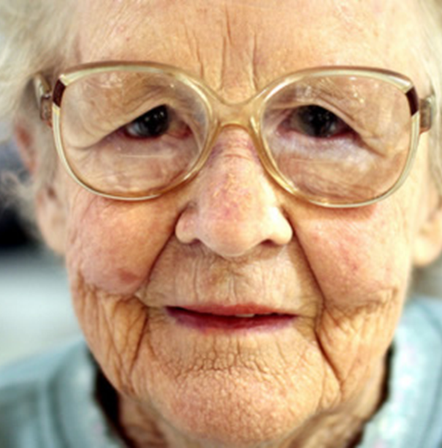
Prime Minister’s Challenge on Dementia
The global number of people with dementia is expected to rise to 135 million by 2050
In the UK, there are around 850,000 people who have been diagnosed with dementia
There is a global ambition to develop a dementia cure or treatment by 2025
@NHS_HealthEdEng #DAAG
Notes:
Notes:
This slide explains the prevalence of dementia and why we need to know about it.
Teaching points:
There is a political agenda
There is no cure
Prime Minister’s Challenge on Dementia 2020 ~ encourage all participants to access this information, in order for them to familiarise themselves with it.

Slide 12
Video Presentation
Living with dementia
4 people with lived experiences of dementia
This is the ‘lived experience’ of real people and there is no acting
Look out for the differences in their experience of dementia
Living with Dementia SCIE TV Video
10 minutes
@NHS_HealthEdEng #DAAG
Notes:
Video presentation (10 minutes)
Participants to watch the Social Care Institute of Excellence Video (SCIE) TV video:
“Living with dementia”
2 minute feedback
(12 minutes in total)
Facilitator explains: “This is a video that lasts for 10 minutes and it is from SCIE TV (Social Care Institute for Excellence) Television.
It presents the experience of dementia directly from the people who are experiencing it.
Four people with dementia share their insights and experiences of living with advancing dementia.
The points to raise before the start of the video are:
This is the ‘lived experience’ of real people and there is no acting
Look out for the differences in their experience of dementia
After 10 minutes, involve audience in a discussion about what they just viewed.
You can ask for their questions, comments or observations.
You can help them to arrive at the following differences:
Barry:
Has lived with dementia for 15 year (so dementia is not a death sentence!)
Main problem is with his memory
Barry is still very articulate, but explains he cannot make himself a cup of tea
Judith:
Multiple issues: motor problems, sensory perception problems, expressive aphasia (can’t find words)
Young onset dementia
Still has a strong personal identity
Bob:
Psychiatric symptoms – Hallucinations such as seeing things that other people cannot see, thinking that his house was on fire
Dangerous behaviour – climbing on the roof at 2 am. He was aware that he had done this, but did not know why!
Important role of the partner
Olive:
Talks about feeling of guilt
Gives contrast of sadness but also happiness
Note to facilitator:
People may express negative emotions about dementia. For example feelings of hopelessness, no cure, you are only going to get worse.
Please make sure that you end the discussion by saying: “We will now explore the early signs and symptoms of dementia.”

Slide 13
Early Symptoms of Dementia
Memory Problems - short term memory
Getting lost in familiar places, issues with names
Orientation in time and place
Communication – word finding difficulties, reading and writing
Cognitive difficulties- concentration & thinking things through
Worry about memory problems
Other people comment on your memory
@NHS_HealthEdEng #DAAG
Notes:
In order to have a diagnosis of dementia, there needs to be a composite of symptoms
Solely having some issues with memory, such as regularly forgetting where you left your keys does not mean you have dementia
Recent reports suggest that since dementia awareness has taken of, up to 75% of people attending memory clinics consist of the ‘Worried Well’ . These have age related normal memory loss.

Slide 14

Risk factors associated with dementia
A person’s age
Gender- women more likely to get Alzheimer’s Disease and men are more likely to get Vascular Dementia
People who smoke
Eating a diet high in cholesterol
Being overweight or obese
Not doing enough exercise
Having a sedentary life style
Drinking too much alcohol
Having a family history of dementia
Having high blood pressure
People with Down Syndrome
@NHS_HealthEdEng #DAAG
Notes:
Risk factors
The risk factors will appear one at a time at the click of the mouse.
Ask the participants:
“What they think of the risk factors that appear on this slide?”
Teaching point:
These are the predisposing factors that increase the risk of developing dementia. They do not ‘cause’ dementia but make you more susceptible.

Slide 15
Types of Dementia
Alzheimer's Disease 62%
Vascular Dementia 17%
Mixed 10%
Lewy Body Dementia 4%
Frontal Lobe Dementias 2%
Rarer forms of Dementia 5%
Alcohol Related Dementia, e.g. Korsakoff’s Syndrome
Creutzfeldt-Jakob Disease (CJD)
HIV & Aids Related Dementia
(Alzheimer's Disease Society 2014)
@NHS_HealthEdEng #DAAG
Notes:
Types of dementia.
There are 5 main types of dementia and several much rarer subtypes. Alzheimer's Disease is by far the most common
There are growing concerns about heavy alcohol use and it’s effect on the brain, although Korsakoff’s Syndrome results from heavy and chronic alcohol misuse.
Teaching points:
For more statistics, please see Alzheimer's Society Infographic – https://www.alzheimers.org.uk/infographic

Slide 16
Young Dementia
Dementia is considered ‘young onset’ when it affects people under 65 years of age. Also referred to as ‘early onset’ or ‘working age’ dementia. Onset can be as early as mid/late 30’s.
Young dementia has arguably even more impact:
It may be unexpected
Impact on family life
Partners & children may become carers
Loss of income (possibly double)
  Living with Young Onset Dementia - Dementia UK
@NHS_HealthEdEng #DAAG
Notes:
Young Dementia Teaching Point:
If time permits, you may wish to share this experience from Oxfordshire:
There was an item on the local news in Oxford in 2015. It showed the real impact of early onset dementia. It showed a man in Witney and his family.
He was 37 years old
Discharged from his job in the army
His wife had to give up her job to look after him
He had 2 young daughters he would never see grown up
They lost the house as they could not afford the mortgage
His father had died aged 35 from Young Onset Dementia
Young Dementia UK is based in Witney. The provide real support in the context of the specific issues that face the people with YOD, their families and carers
Home page: https://www.youngdementiauk.org/
Additional video resource:
If participants are interested in the lived experiences of people with Young Onset Dementia, they can be signposted to the SCIE TV Video entitled, “Living with young onset dementia”. This can be accessed via: http://www.scie.org.uk/socialcaretv/video-player.asp?guid=61aa9350-6c43-4098-bb5d-1c0ee733f3c7
This video can also be accessed as an MP4 file on the USB Stick that accompanies this Power Point Presentation.

Slide 17
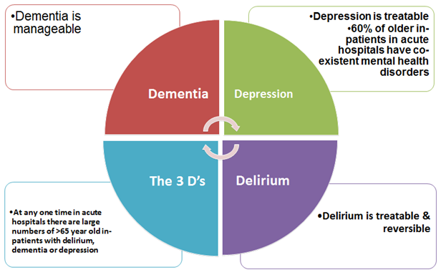
The 3 ‘D’s’
Is it Dementia, Delirium or Depression?
@NHS_HealthEdEng #DAAG
Notes:
The 3 Ds of Dementia
In older people a number of common conditions can make the diagnosis a little more difficult.
In hospital more than half of patients will have both mental and physical illnesses. These are referred to as the 3 ‘D’s’
Delirium results from some underlying cause such as infection and is reflected in mental confusion, visual or auditory hallucinations, and alterations in communication, mood and/or attitude.
Depression is signifies by chronic low mood , negative thoughts, lack of appetite and loss interest in activities
Both of these can be treated with medication.
Depression can only be managed. i.e. the process can only be slowed down, because we do not yet have a ‘cure’ for dementia.

Slide 18
Video Presentation
The experience of dementia
Barbara's Story
@NHS_HealthEdEng #DAAG
Notes:
This video presentation shows the experience of a person who dementia and it charts their journey through a variety of health and social care situations.
The facilitator needs to encourage each member in the audience to see if their role/department/profession is represented in the video and for them to consider how the dementia affects the person, family as well as the professionals represented in the video.
Highlight sensory hypersensitivity (in A&E), ‘Big Head’ communication (always talk at eye level), distraction rather than confrontation, not too many questions, dealing with husband being dead = discuss truth telling versus therapeutic lies. ( there is no prefect solution, must be appropriate to the person & agreed with MDT).
Highlight red tray for food = improved nutrition

Slide 19
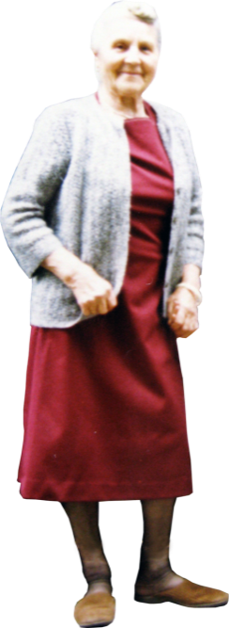
Personhood
To improve the care & experience of an individual with dementia, care should be geared to promoting personhood.
Dementia affects a person’s cognitive functioning (memory, orientation, problem solving, comprehension & planning), but personhood is more than just those abilities.
People with dementia are still Fred, Mary or Rachel, each with unique identities, needs & preferences.
@NHS_HealthEdEng #DAAG
Notes:
Present Slide 19 – Personhood
Emphasise that after diagnosis, people with dementia go on a journey.
As their condition progresses they may need to access services, and find solutions to emerging issues, but each person’s journey will be unique
You will come across many different people who may share a diagnosis of dementia, but that is it.
Note:
Link back to the SCIE TV Video called “Living with Dementia” that was featured in Unit 2
Remember the experiences that Barry, Judith, Bob and Olive shared with us
They all had a strong sense of identity ~ “I am still me…despite the dementia”.

Slide 20

Person-centred approaches
“I believe in God and my faith is important to me”
“Please respect my end of life wishes”
“I can only eat halaal meat, so please make sure that I am able to have it”
“I am proud that I served Queen and country”
“I was born in Italy. I dram and feel in Italian and I have lost the ability to speak English. Please keep communicating with me”
@NHS_HealthEdEng #DAAG
Notes:
People will have their own;
Likes and dislikes
Habits
Skills
Wishes
Cultural or religious beliefs
Therefore our interaction needs to respect this, and to be individual and specific to their needs.

Slide 21
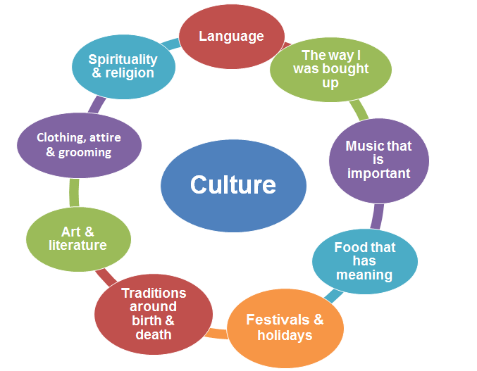
Person-centred approaches
What do we mean by ’culture’ & what are the issues
@NHS_HealthEdEng #DAAG
Notes:
Person centred approaches” - What do we mean when we use the word culture
Person centredness is a concept that is widely accepted in health and social care, which emphasises that each patient should be seen as a unique individual.
We live in an increasingly multicultural society. Culturally sensitive care looks to address the specific cultural needs of individuals. E.g. related to food (Hala/Kosher) festivals (Christmas/Ramadan/Purim/Divali) or religious practices (prayers/end of life rituals and burials). Keep in mind that British culture is also important, but dominates.
Consider terminology and stigma – the equivalent word for ‘dementia’ in some Asian languages is ‘Madness’, in japan it is ‘Idiocy/Metal Retardation’ and in Poland it is ‘Deeply Mentally Disturbed’. In each case the stigma of dementia is made worse by the associated phrases and their interpretations.
In Japan there have been cases of the families of an older person with dementia who was killed by a train being sent a huge bill by the railway company for the economic losses caused by their death. The families are expected to stop them from wandering!!

Slide 22
How does dementia impact on the person?
Why do people with dementia sometimes get frustrated or agitated?
Emotional aspects of dementia:
Acceptance of diagnosis
Dealing with loss of memory (and sensory loss)
Increased dependency and becoming a ‘burden’
Loss of employment/social role/driving license
Confusion, anxiety and depression
Communication issues
Some or all of the above may cause challenging behaviour
Many of these may also apply to carers
@NHS_HealthEdEng #DAAG
Notes:
Notes:
If time permits, as the participants to think about some examples of how dementia has impacted on a person and other people around them.
Encourage the participants to think about what they learned in Unit 1 activity: “Your perceptions of people with dementia” and the Video that was shown in Unit 2, “Living with dementia”.
The issue of driving is controversial. Not easy to know when someone is no longer safe. Should be reported to DVLA on diagnosis and referred for a Dementia driving test at local test station Briefly click om the link to show where info can be found.

Slide 23
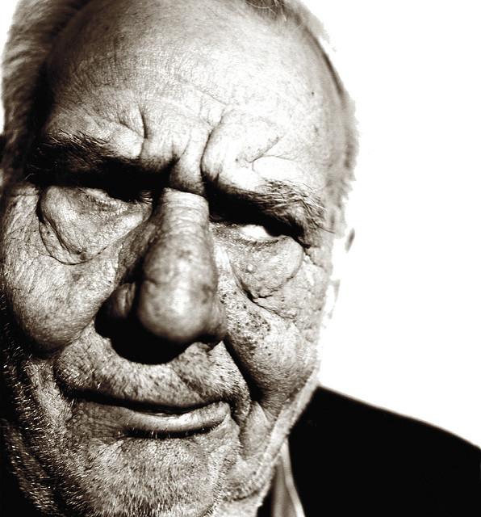
Why might a person with dementia show signs of distress?
It is not always the dementia that causes the distress.
It is important to consider other potential causes
They may be communicating an unmet physical, psychological , social or spiritual need.
@NHS_HealthEdEng #DAAG
Notes:
Notes:
Important not to always assume distress is cause by dementia
Facilitator to include reasons why people with dementia might show signs of distress
If time permits, engage in a developmental conversation about any experiences that the participants may have encountered.

Slide 24
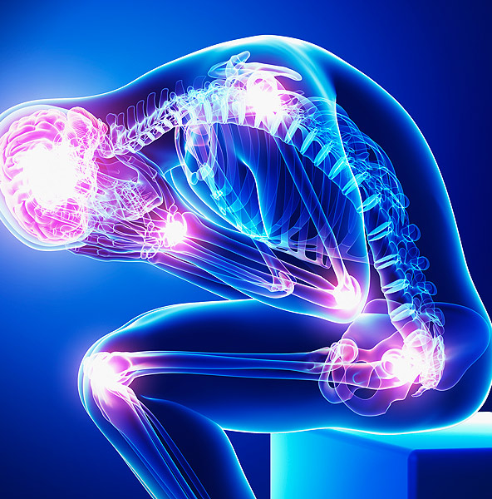
Why might a person with dementia show signs of distress?
Physically, they may be in pain or feeling tired feeling hungry &/or thirsty.
Needing to go to the toilet.
The distress may be also be triggered by environmental factors such as noise, heat, cold, darkness or bright lights.
@NHS_HealthEdEng #DAAG
Notes:
Notes:
Stress that many view the cause of behaviours that challenge to be ‘unmet needs’!
Examples = If a person refuses to get up from a chair, maybe they have hurt their leg or back. Or the reason why the refuse to go into a room is that it is too noisy for them

Slide 25
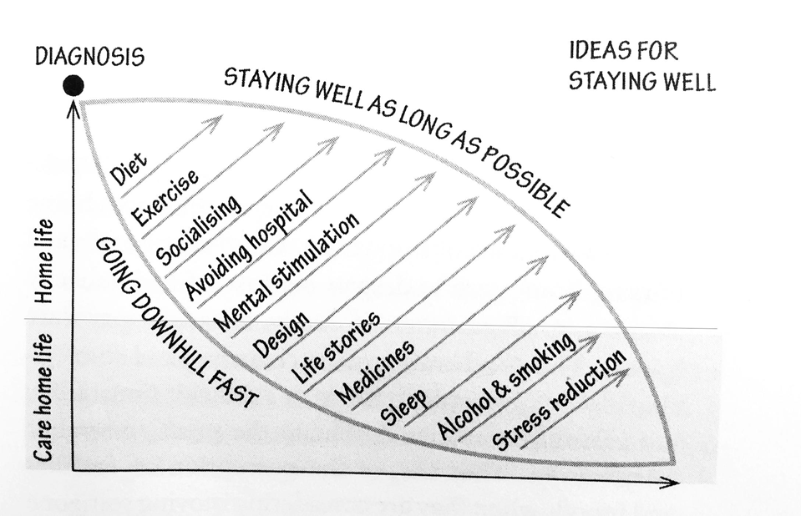
Pause & think: Ideas for staying well
Image used with permission form (Andrews 2015) & Profile Books
@NHS_HealthEdEng #DAAG
Notes:
Notes:
This model was developed by Professor June Andrews, Director of the Dementia Services Development Centre (DSDC) in the School of Applied Social Science at the University of Stirling. It shows that although each dementia journey is unique, there are two possible pathways
One is to stay as well as possible for as long as possible, and delay the possible point of needing admission to a care home
The other is to go downhill faster than you need to for avoidable reasons
Note how most of these also apply to cardiac health & overall well being = multiple benefits!
Professor Andrew’ s book Dementia: The One-Stop Guide: Practical advice for families, professionals, and people living with dementia and Alzheimer's Disease, is a very easy to read, comprehensive and helpful guide.

Slide 26
Ideas for staying well with dementia
Communication:
People with dementia may take time to process verbal conversations
As language becomes an issue, nonverbal communication becomes more important
Speak slowly & clearly & use shorter sentences
Don’t ask too many questions
Don’t challenge or raise your voice
Use ‘This is me’/’Knowing Me’/Life story or Memory books
Environment:
Clear signage
Bright, well lit environment
Quiet/reduced stimuli
Coloured crockery/toilet seats/doors Stirling University
@NHS_HealthEdEng #DAAG
Notes:
Good communication skills are important when dealing with a person with dementia
It is important to be clear and not confuse people. Use single short questions.
Ask if they have a ever used a Communication Passport/ This is me/ Knowing Me form.
Show them the Knowing me form, which will be provided in the workshop pack.

Slide 27
Final Points
Dementia can cause serious challenges, but emphasis must be ‘living well’ with dementia and person centred approaches.
There are many sources of help available
Consider becoming a “Dementia Friend” (Alzheimer Society)
@NHS_HealthEdEng #DAAG

Slide 28
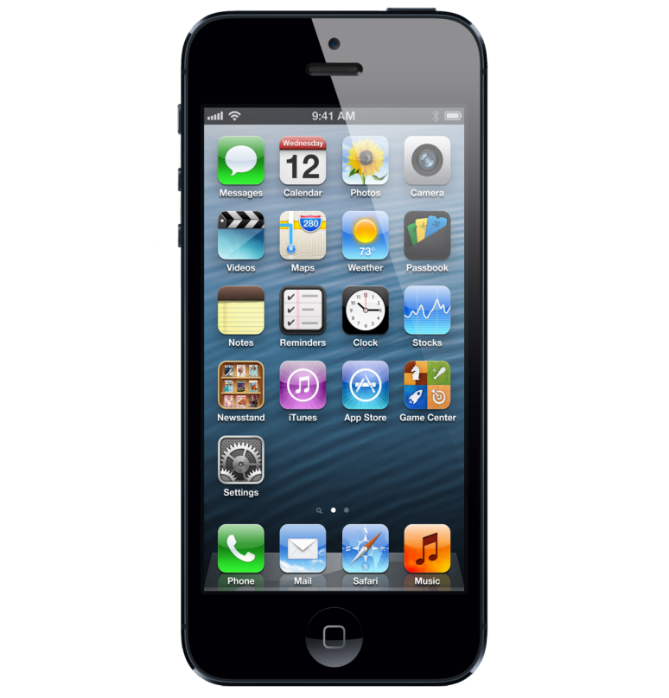
Useful Dementia Apps
Free in the Apple App Store:
Sea Hero Quest – Glitchers Ltd (2016)
Dementia Guide for Carers and Care Providers – Text Matter Ltd (2016)
MindMate – Empowering People with Dementia – MindMate (2016)
Understanding Dementia for Care & Support Workers v.2 – by Scottish Social Services Council (2016)
Dementia: Understanding Stress & Distress v.2 – by Scottish Social Services Council (2016)
Dementia: Personal Outcomes v.2 –by Scottish Social Services Council (2016)
Dementia Support – by Swedish Care International (2013)
Pathways Through Dementia – by Patriona Briggs (2013)
@NHS_HealthEdEng #DAAG

Slide 29

Useful Dementia Apps
Free in the Android Play Store:
Confusion: Delirium & Dementia: A Bedside Guide – by Confusion App (2014)
Vascular Dementia Information – by Pachara Kongsookdee (2014)
Dementia Support – by Swedish Care International (2013)
Pathways Through Dementia – by Patriona Briggs (2013)
Fronto-temporal Dementia – by Emanuel Bolachi (2014)
Lewy Body Dementia – by T. Boonmarkmee (2014)
@NHS_HealthEdEng #DAAG

Slide 30
Some sources of help
Alzheimer Society: http://www.alzheimers.org.uk/
Berkshire Health Care (2014) Your Dementia handbook: http://www.berkshirehealthcare.nhs.uk/page_sa.asp?fldKey=344
Carers of people with dementia: http://www.healthtalk.org/peoples-experiences/nerves-brain/carers-people-dementia/topics
Dementia Action Alliance: www.dementiaaction.org.uk
Dementia Friends: http://alzheimers.dementiafriends.org.uk/
Dementia UK: http://www.dementiauk.org/
Dementia Services Development Centre: http://dementia.stir.ac.uk/
@NHS_HealthEdEng #DAAG
Notes:
Notes:
Show this slide and encourage participants to access the freely available resources.

Slide 31
Some sources of help
Improving Dementia Education and Awareness (IDEA): http://idea.nottingham.ac.uk/
Young Dementia UK: http://www.youngdementiauk.org/
Social Care Institute for Excellence (SCIE): http://www.scie.org.uk/socialcaretv/topic.asp?t=dementia
Skills for Care (2014) Better domiciliary care for people with dementia Best practice case studies from domiciliary care employers developing their workforces to support people with dementia. Leeds: Skills for Care: http://www.skillsforcare.org.uk/Document-library/Skills/Dementia/Better-domicilary-care-for-people-with-dementia.pdf
@NHS_HealthEdEng #DAAG
Notes:
Notes:
Show this slide and encourage participants to access the freely available resources.

Slide 32

Evaluation - Now what?
After completing this Dementia Awareness Training Unit, one thing I will do from now on is……..
One thing I will stop doing from now on is……..
@NHS_HealthEdEng #DAAG
Notes:
Evaluation of Unit:
Encourage participants to complete their Tier 1 Dementia Awareness Training Unit Evaluation Form
Collect the evaluation forms and prepare to send them to your Local Education & Training Lead
Thank all the participants for attending the training.

Slide 33
Acknowledgements
Commissioners and Programme Leads
Health Education England Thames Valley
Jacqueline Fairbairn Platt, Associate Dean Quality Improvement
Zoe Scullard, Health Dean
Project Team
University of Northampton
Institute of Health and Wellbeing
Professor Jacqueline Parkes (Chair)
Alison Ward (Phase 1 Lead)
Dr Matthew Callender
Professor Judith Sixsmith
Dr Jane Youell
Project Team continued:
University of Bedfordshire
Melsina Makaza (Phase 2 Lead)
Professor Mike Fisher
Samson Ojo
Oxford Brooks University
Peter Zaagman (Phase 2 Lead)
Casey Law
Catherine Wheatley
Kim Fredman-Stein
University of West London
Professor Heather Loveday (Phase 3 Lead)
Debi Joyce
Samantha Chan
@NHS_HealthEdEng #DAAG

