Slide 1
Health Education England Adult IAPT Workforce Census 2021
National Report
February 2022

Slide 2
Contents
Acknowledgements 3
Introduction to IAPT 4
Introduction to IAPT – workforce roles 5
Project background 6
The IAPT workforce in summary – 2021 7
National IAPT workforce overview 8
Project findings
  Core IAPT service provision and activity 11
  Workforce profile 17
  High Intensity staffing 26
  Low Intensity staffing 30
  IAPT LTC 33
  Workforce demographics 37
  Sickness, vacancies and temporary staffing 40
Conclusions 45
Appendices 47
Contact details 53

Slide 3
Acknowledgements
The NHS Benchmarking Network would like to express our gratitude for the ongoing support for this project shown by Julian Emms, Chair of the NHSBN Mental Health Reference Group.
We would like to extend our thanks to the Programme Leads of the Health Educational England National Mental Health Programme, who have offered invaluable insight throughout the duration of the project. Our thanks too to the HEE project oversight group members, who helped shape this year’s collection and provided interpretation on findings.
Additionally, we are grateful to the NHS England and NHS Improvement representatives who also formed an integral part of the oversight group, providing guidance and feedback to help form the national and local project outputs.
Finally, we would like to thank the large number of providers who participated in the project this year, with 201 submissions received from 100% of CCG areas in England, thus allowing a national position to be developed.

Slide 4
Introduction to IAPT
The Improving Access to Psychological Therapies (IAPT) programme began in 2008 and has transformed the treatment of adult anxiety disorders and depression in England. IAPT is widely-recognised as the most ambitious programme of talking therapies in the world and in 2020-21 more than one million people accessed IAPT services for help to overcome their depression and anxiety, and better manage their mental health.
IAPT services provide evidence-based treatments for people with depression and anxiety disorders, and comorbid long-term physical health conditions (LTCs) or medically unexplained symptoms (MUS) (when integrated with physical healthcare pathways). IAPT services are characterised by three key principles:
Evidence-based psychological therapies at the appropriate dose: where NICE recommended therapies are matched to the mental health problem, and the intensity and duration of delivery is designed to optimise outcomes.
Appropriately trained and supervised workforce: where high-quality care is provided by clinicians who are trained to an agreed level of competence and accredited in the specific therapies they deliver, and who receive weekly outcomes focused supervision by senior clinical practitioners with the relevant competences who can support them to continually improve.
Routine outcome monitoring on a session-by-session basis, so that the person having therapy and the clinician offering it have up-to-date information on the person’s progress. This helps guide the course of each person’s treatment and provides a resource for service improvement, transparency, and public accountability.
Services are delivered using a stepped-care model, which works according to the principle that people should be offered the least intrusive intervention appropriate for their needs first. Many people with mild to moderate depression or anxiety disorders are likely to benefit from a course of low-intensity treatment delivered by a psychological wellbeing practitioner (PWP). Individuals who do not fully recover at this level should be stepped up to a course of high-intensity treatment. Further details about IAPT services can be found in the IAPT Manual.

Slide 5
Introduction to IAPT - workforce roles
The IAPT workforce consists of low-intensity practitioners and high-intensity therapists who together deliver the full range of NICE-recommended interventions for people with mild, moderate and severe depression and anxiety disorders, operating within a stepped-care model. National guidance suggests that approximately 40% of the workforce in a core IAPT service should be PWPs and 60% high-intensity therapists. For the new IAPT-LTC services it is recommended that there is a slightly stronger focus on high-intensity interventions with the workforce being 30% PWPs, 60% high-intensity therapists and 10% senior therapists (such as clinical health psychologists) who have expertise in LTCs/MUS and can manage more complex problems as well as providing supervision to others. All current IAPT curricula and training materials can be found on the IAPT section of the HEE website.
Low-intensity workforce
Psychological Wellbeing Practitioners (PWPs) deliver low-intensity interventions for people with mild to moderate depression and anxiety disorders. All PWPs should have completed an IAPT training course or be in the process of doing so, with linked professional registration with the relevant professional body following training. The core IAPT low-intensity courses for PWPs are accredited by the British Psychological Society. PWPs who work in IAPT-LTC services are also expected to have completed the relevant IAPT continuing professional development (CPD) course for working with LTCs.
High-intensity workforce
High-intensity therapists deliver a range of NICE-recommended evidence-based therapies. Therapists need to have been trained in the particular therapy or therapies that they deliver in IAPT, with linked professional accreditation with the relevant professional body. NICE recommends cognitive behavioural therapy (CBT) for anxiety disorders and five different high-intensity therapies for depression (CBT, interpersonal psychotherapy, brief psychodynamic therapy, counselling for depression and couple therapy). Mindfulness based cognitive therapy is recommended For people with a history of recurrent depression but who are currently well, to prevent relapse. NICE recommends both CBT and eye movement desensitisation and reprocessing for post-traumatic stress disorder.

Slide 6
Project background
NHS Benchmarking was commissioned by Health Education England (HEE) to deliver the Improving Access to Psychological Therapies (IAPT) workforce census 2021. The census is a detailed workforce stocktake involving IAPT providers from all CCG areas in England, inclusive of both NHS and non-NHS organisations.
Now in its third year, this IAPT workforce census provides a snapshot of the size and shape of staffing across IAPT providers in England as at March 31 2021. Throughout this report, comparisons will be drawn between the three census dates – 2019, 2020 and 2021.
The NHS Benchmarking Network (NHSBN) is the in-house benchmarking service of the NHS, hosting a wide ranging work programme covering commissioning, community healthcare, acute and mental health sectors. NHSBN is a membership organisation that includes all statutory mental health providers in England as well as national bodies such as Department of Health and Social Care, NHS England and NHS Improvement, and Health Education England.
The aim of this work is to provide a detailed profile of the IAPT workforce and service delivery including:
  Service provision and activity
  Therapy modality capacity
  Adoption of digital technologies
  Workforce size and composition
  Workforce demographics
  Vacancies and temporary staffing
The specification is similar to previous years to ensure comparability of metrics across the three census dates. In addition, however, the census this year included a focus on: the impact of the COVID-19 pandemic on the workforce and delivery of services; use of digital modalities, and more detailed information relating to High Intensity Therapists.

Slide 7








The IAPT workforce in summary – 2021
33% increase in staff WTE working within IAPT services between 30th June 2019 - 31st March 2021
201 data submissions received, spanning 100% of CCG areas in England
On 31st March 2021, the Adult IAPT workforce consisted of 10,721 WTE patient facing and 3,059 WTE additional roles
Between 2020 and 2021, Psychological Wellbeing Practitioner (PWP) staff numbers rose by 23%, and High Intensity Therapists (HITs) by 17%
2,650 WTE trainees in post, representing a 31% increase from the 2020 census position
Within IAPT workforce, 82% of staff are female, 18% male
81% of IAPT staff are from a white ethnic background compared to 84% of wider UK population. 19% from BAME backgrounds
5% mean average sickness rate reported in IAPT services on census date vs 7% seen in adult acute MH inpatient services during 2020/21

Slide 8
National IAPT workforce overview 2019-2021
The table to the left provides a detailed analysis of the national IAPT workforce in post on the 31st March 2021, in comparison to the data provided in the 2019 and 2020 censuses. All figures are detailed as Whole Time Equivalent (WTE).
As the table shows, there have been notable increases seen across the majority of staffing groups between 2020 and 2021 and cumulatively (2019-2021).
In summary, total workforce numbers have grown by 33% between 2019 and 2021, comprised of a 31% increase in patient-facing staff, and a 43% uplift of non-patient facing staff.
It is worth noting that 19 additional organisations submitted data for the 2021 collection (excluding services who have replaced previous providers), which reflects to some extent the growth in number of providers within the market (10 new providers). IAPT is a fast growing programme with ambitious targets for future growth in patient coverage, to allow improved access to support for common mental health conditions.

Slide 9
National IAPT workforce overview 2019-2021 – breakdown by role (1)
When workforce numbers are broken down by job role, there was a 46% increase in low intensity staff WTE numbers between 2019 and 2021 (+27% excluding trainees). Growth is evident in both Psychological Wellbeing Practitioner and Senior Psychological Wellbeing Practitioners roles, which have seen increases of 25% and 37% respectively since 2019.
High Intensity staffing numbers have also increased between the three census dates, with 2021 data illustrating a 33% rise from 2019 (+23% excluding trainees). High Intensity Therapists numbers have increased by 27%, and High Intensity Counsellor numbers have grown by 26%.
Trainee staff numbers have undergone significant increases during the three years of data collection, which is a positive finding of the report, particularly in light of the increased demand levels anticipated in the NHS Long Term Plan. Additionally, this growth coincides with the enhanced support offered to Integrated Care Systems by HEE towards funding students’ IAPT training.
Applied psychologist staffing numbers have decreased by 48% between 2019 and 2021. This may be due to roles being reclassified within the data specification, rather than a reduction in staffing numbers. It could also reflect a change in demand from providers requiring staff with specific therapy accreditations.

Slide 10
National IAPT workforce overview 2019-2021 – breakdown by role (2)
Staff WTE numbers have grown from 10,325 to 13,779 between 30th June 2019 and 31st March 2021, with increases across both patient facing and non-patient facing roles. This represents a total increase of 33% between the 2019 and 2021 census date (+24% excluding trainees).
When reviewing the changes seen over the last twelve months, providers reported an 18% uplift in workforce numbers between the 2020 and 2021 census dates (+16% excluding trainees).
In other patient facing roles, there has been a notable shift in employment support staff being brought in-house by IAPT providers in both 2021 and 2020 when compared to 2019. In 2019, 48% of the employment support workforce was externally contracted, compared to 20% in 2021.

Slide 11
Project findings
IAPT service provision and activity

Slide 12
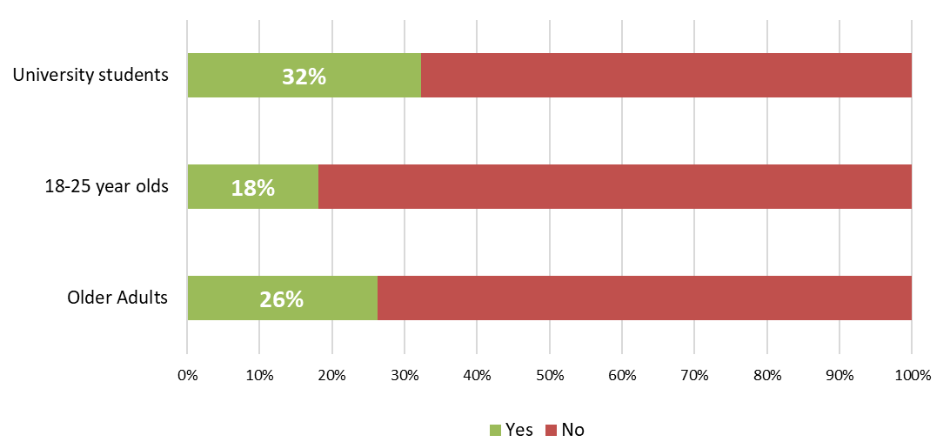
Service provision - Access
Whilst the majority of IAPT services offer broad access to all patients aged above 18, a growing number of services have developed pathways for specific patient age cohorts. The charts below show the proportion of providers who reported targeted services for young adults and older people. University services are common in areas with large student populations, and may be co-located within, or have strong ties with, student medical centres.
The proportion of IAPT providers who reported specific pathways for patients aged 18-25 has increased from 2020, rising from 15% to 18%. This is a notable increase from the 2019 census when only 9% of respondents reported specific pathways for this age cohort.
Additionally, 32% of IAPT providers reported specific pathways for University students (up from 27% last year), while 26% have services targeted specifically at older adults (23% in 2020).

Slide 13
Age restrictions
The placement of the upper and lower age bandings reported on 31st March 2021 remained largely unchanged from 2019 and 2020, with the majority of providers reporting a lower age limit between 16 and 18 years of age. The green bars represent non-NHS organisations, with NHS providers detailed in blue.
Only a small number of respondents reported the use of patient upper age limits, with those enforcing upper age restrictions typically reporting boundaries of either 80 or 100 years of age.

Slide 14
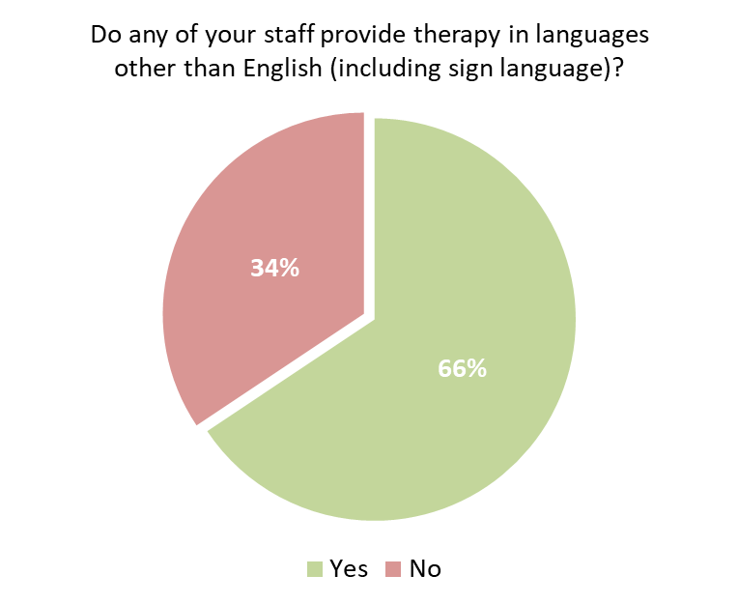
Therapy in languages other than English
66% of IAPT providers (128 of 195 respondents to this metric) reported staff in post who were able to provide therapy in languages other than English, including British Sign Language.
Many providers have a selection of languages available to patients. Commonly available languages include:
  Polish – 43 providers
  Urdu – 37 providers
  Punjabi – 28 providers
  Spanish – 22 providers
  French – 16 providers
  BSL – 10 providers
It is worth noting the fluidity of this metric, linking directly to the staff profile in post, which may result in frequent changes depending on staff turnover.

Slide 15
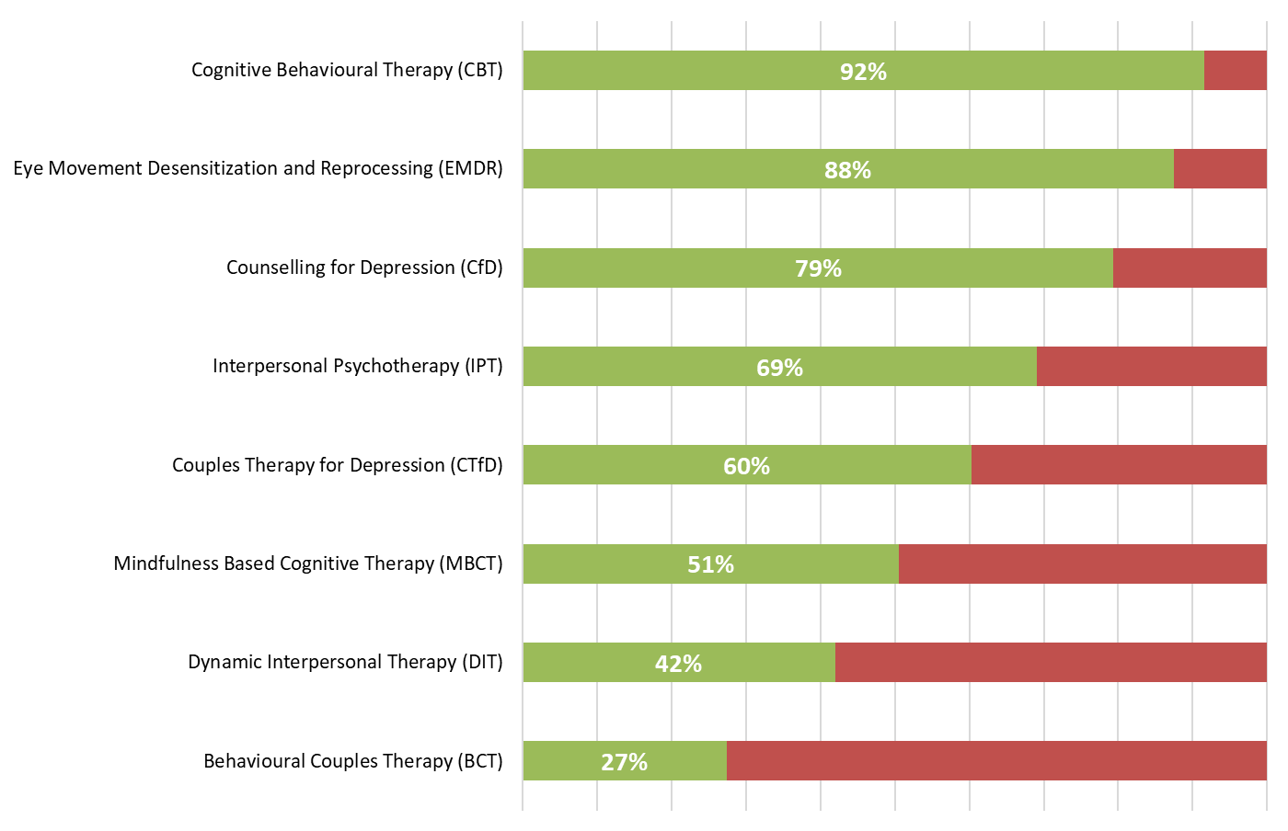
Therapeutic offer
The chart on the left summarises the therapeutic offer of participating IAPT providers, based on their position as of 31st March 2021.
As in previous censuses, the therapy offered most commonly by providers was Cognitive Behavioural Therapy (92% of providers), followed by Eye Movement Desensitisation and Reprocessing (88% of providers), and Counselling for Depression (79% of providers).
Dynamic Interpersonal Therapy is now offered by 42% of providers, compared to 36% reported in 2020 (+17%).

Slide 16
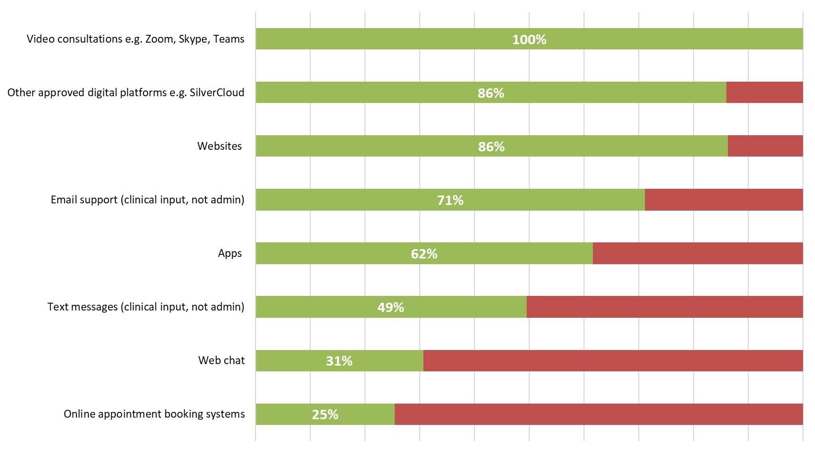
Digital offer
The Covid-19 pandemic changed the nature of healthcare delivery, demanding a rapid shift to virtual care encompassing a range of digital platforms. Almost all IAPT providers adopted a majority virtual model of care from April 2020. The chart to the left shows the levels of adoption of various digital tools reported by providers this year.
There has been a notable increase in participants utilising video consultations, with 100% of respondents to this metric reporting the use of virtual consultations as part of their digital service offer, compared to 95% in 2020, towards the start of the pandemic.
Additionally, 86% of participants utilise websites and other approved digital platforms, for example, SilverCloud.
This year’s data specification included two new metrics within the digital offer section; web chat, and online appointment booking systems, which were utilised by 31% and 25% of respondents respectively. Online appointment booking systems refer to a web-based system for booking appointments, differentiated from the video consultations previously detailed.

Slide 17
Project findings
Workforce profile

Slide 18
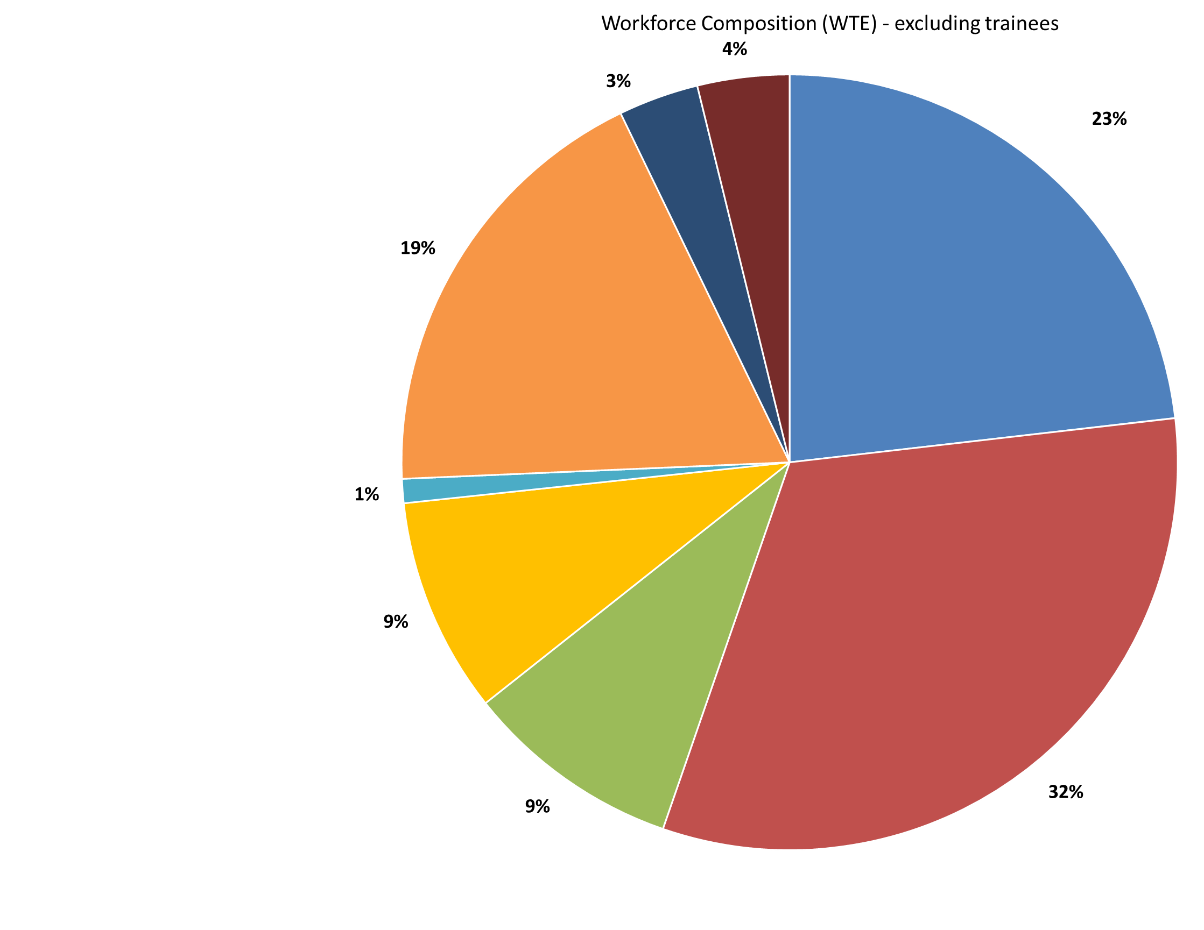
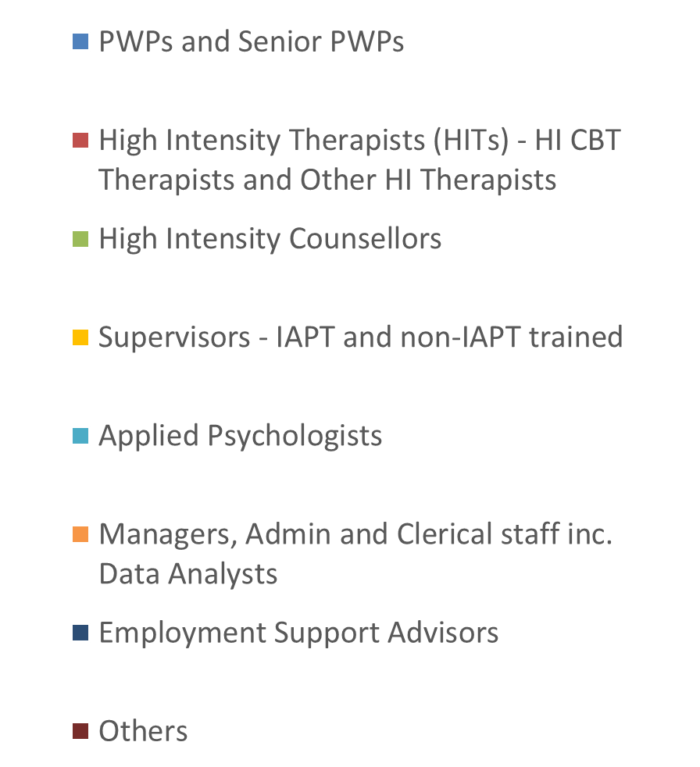
Workforce composition (WTE)
Analysis of the IAPT workforce WTE by role confirms that the majority of staff are employed within specific therapy roles.
Across all IAPT providers, 55% of staff sit within the core disciplines of PWPs or HITs.
Furthermore, approximately 19% of staff are in non-therapy positions including administration, management and clerical roles.
Employment advisers (including those who are externally contracted) represented 3% of total staffing WTE numbers as on the census date.
“Others” include:
Other uncategorised staff – 2%
Non-IAPT Qualified PWP Workers – 2%

Slide 19
Workforce composition (WTE) by role
Whilst the IAPT workforce has grown in size between 30th June 2019 and 31st March 2021, the workforce composition by staff role remains largely unchanged year on year.
As detailed in the chart and table below, over half of the IAPT workforce were employed in the core roles of PWPs and HITs (inclusive of CBT Therapists and Other High Intensity Therapists) across the 3 annual census dates.
In contrast, staff within the “Others” category have seen a reduction in staffing numbers from 2019 to 2021. This category includes PWP Workers (not IAPT qualified), and other non categorised staff.

Slide 20
Workforce size by provider
Total staffing numbers (excluding trainees) per provider are shown in the chart to the left. Services vary in size and coverage by provider organisation, with a median average position reported of 49 staff WTE, an increase from 46 staff WTE in 2020, and 42 staff WTE in 2019.
For providers placing within the upper quartile of the chart, workforce numbers exceed 100 staff WTE, with the largest organisations reporting team sizes in excess of 200 staff WTE.
This position is not benchmarked, and is included to highlight variation in team size from provider to provider.
The green bars represent non-NHS organisations, with NHS providers detailed in blue. NHS providers are typically larger than non-NHS providers, with many smaller providers evident from a diverse range of organisational backgrounds including; independent sector, community interest companies, charities, and the wider voluntary sector.

Slide 21
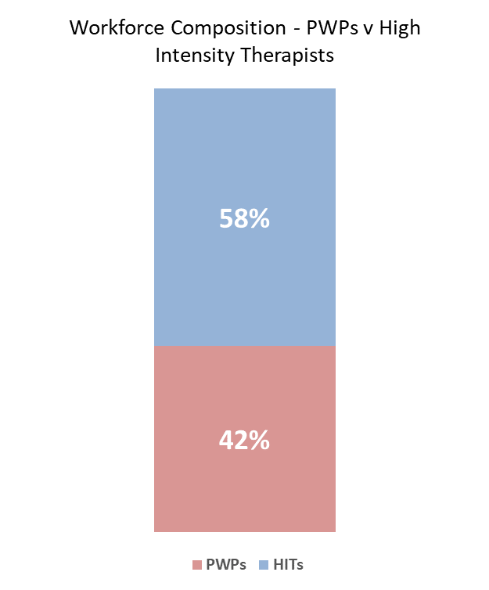
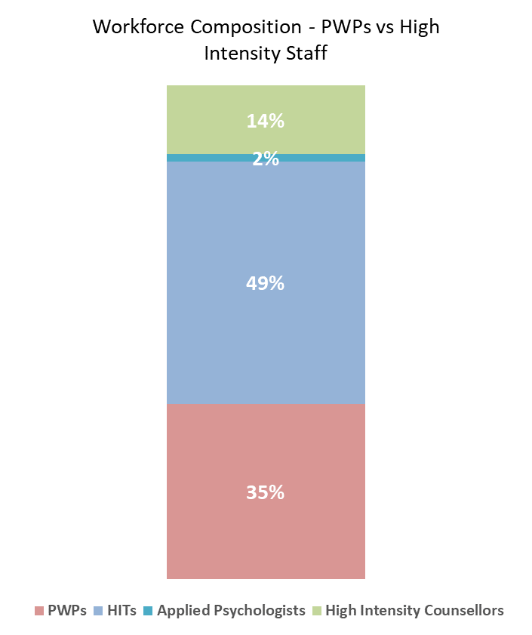
Workforce composition – HITs vs PWPs
The ratio of HITs (CBT Therapists and Other High Intensity Therapists) to PWPs (PWPs and Senior PWPs) has seen little change across the three years of the project to date, both in its totality and when apportioned between Core IAPT and IAPT-LTC. The High Intensity Therapist v Psychological Wellbeing Practitioner balance is largely consistent between services, with HITs accounting for 58% of these staffing numbers within Core IAPT services compared to 59% within IAPT-LTC services.
The chart to the right includes the provision in this comparison of the other High Intensity roles, in addition to the High Intensity Therapists detailed within the first chart. When these roles are included, PWPs (including Senior PWP roles) compile over a third of the staff WTE workforce numbers, with just under half (49%) of this workforce group comprised of High Intensity CBT Therapists and Other High Intensity Therapists. High Intensity Counsellors form 14% of these staff numbers, with the remaining 2% comprised of Applied Psychologists.

Slide 22
Workforce size by provider - HITs
High Intensity Therapists (HITs) – comprising of CBT Therapists and Other High Intensity Therapists - are the single largest staffing group employed by IAPT service providers. On the 31st March 2021, there were 3,574 staff WTE in HIT posts, illustrating a 17% increase from the 2020 figure (3,066 staff WTE), and a cumulative 27% increase from the 2019 census (2,804 staff WTE).
Of the participating organisations who employed HITs on the 2021 census date, this staffing cohort makes up 35% of workforce numbers, on average, per organisation - up from 32% last year.

Slide 23
Workforce size by provider - PWPs
On 31st March 2021, 2,580 staff WTE were reported as working in services within either PWP or Senior PWP roles. This represents a 23% increase from the 2,097 PWP / Senior PWP staff numbers recorded on the 2020 census date, and a 27% cumulative increase from 2019.
Where employed, PWPs / Senior PWPs represent a mean of 26% of providers’ IAPT workforce numbers, up from 23% in 2020.
There is notable variation in the proportion of PWP presence within IAPT services, as the profile and size of IAPT teams is a product of services’ specifications of commissioning bodies, with differing local priorities. It should be recognised that while every local system of stepped care should include PWPs, single providers may only provide part of the pathway.

Slide 24
HITs progressing from PWPs
The IAPT career development process includes a route for Psychological Wellbeing Practitioners who wish to train to become High Intensity Therapists.
In total, 311 PWPs WTE progressed into HIT training with the same employer over the last 12 months, up from 285 in 2020 (+9%). On average, 3 PWPs WTE per organisation moved into HIT training with the same employer in the year spanning 1st April 2020 to 31st March 2021.
Just over half of participants (51%) reported employee progression into HIT training within their service, similar to the 2020 position reported (54%).
The majority of providers who place within the upper quartile are NHS organisations, however, it is worth noting that the chart is not benchmarked and therefore is not indicative of progression rates in relation to overall staff numbers.
Additionally, these figures only represent activity related to progression within the same organisation, and therefore exclude PWPs that have moved organisations to retrain.

Slide 25
Trainees
Active training programmes recruit new staff into IAPT services, enabling their development into specialist therapy roles.
In 2021, there were 2,650 WTE trainees in post on the census date, compared to 2,025 in 2020 (+31%).
The breakdown by role was as follows:
  Trainee Psychological Wellbeing Practitioners - 1,520 staff WTE
  Trainee High Intensity CBT Therapists– 1,060 staff WTE
  Other trainees – 71 staff WTE
Examples given of ‘other trainees’ include Trainee Assistant Practitioners and Counselling Trainees.
There is notable variation evident between providers, with one service reporting trainee numbers in excess of 100 staff WTE.

Slide 26
Project findings
High intensity staffing

Slide 27
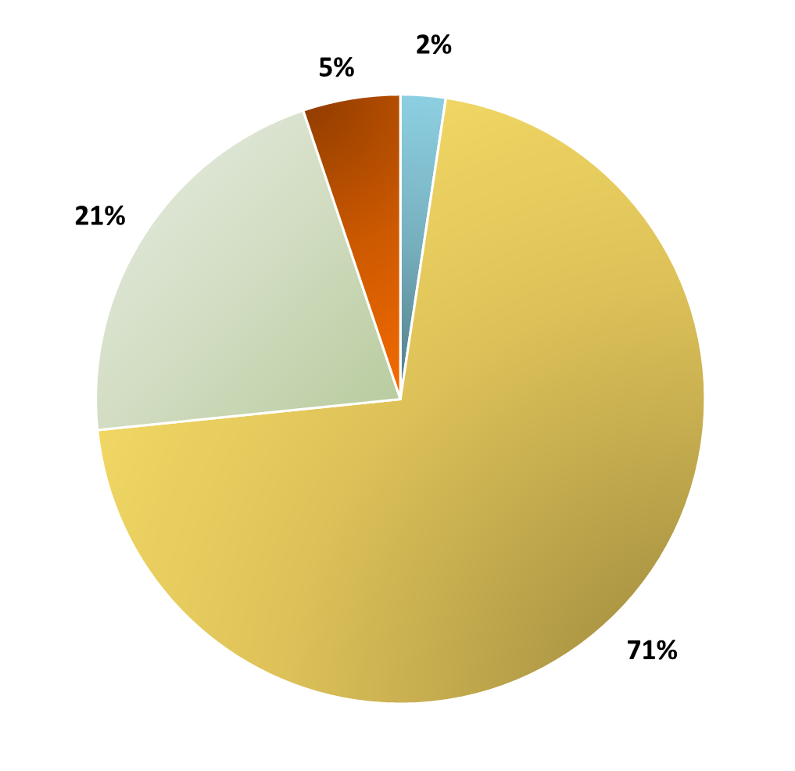

High Intensity workforce composition (WTE)
Over two thirds of the IAPT High Intensity workforce (excluding trainees) is made up of High Intensity CBT Therapists (71%), the largest cohort in this staffing group.
High Intensity Counsellors make up the majority of the remaining High Intensity workforce (21%), with smaller numbers of Other High Intensity Therapists (5%) and Applied Psychologists (2%) comprising the remainder of the workforce composition.

Slide 28
High Intensity workforce – IAPT accreditation
The chart to the left displays the number of non-IAPT accredited staff WTE reported by participants within their High Intensity workforce (excluding trainees).
It is important to note that these numbers in their totality (541 staff WTE vs 4,151 IAPT-accredited HI staff WTE) represent a small proportion of the High Intensity staffing cohort (12%), with over half of respondents reporting a fully IAPT-accredited High Intensity workforce as on the census date.

Slide 29
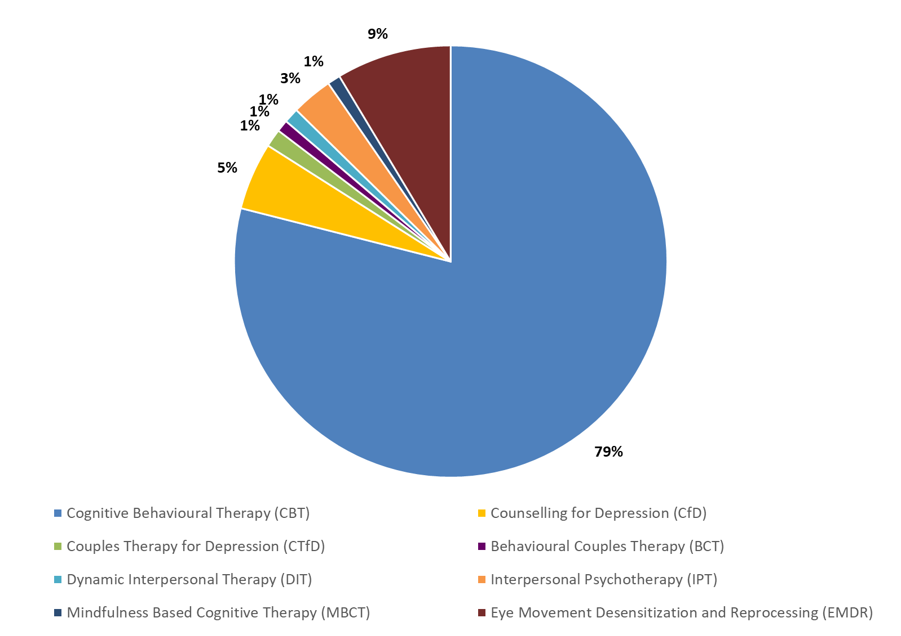
Delivery of therapies
Included for the first time this year, the chart opposite displays the therapeutic output apportionment of High Intensity Therapists (IAPT accredited) across different therapy methods.
Over three quarters of time (79%) is attributed to Cognitive Behavioural Therapy (CBT). Eye Movement Desensitisation and Reprocessing (EMDR) is the therapy method with the second highest allocation of HIT time, totalling 9% of IAPT-accredited HIT’s total reported WTE.
These figures reflect IAPT accredited High Intensity Therapists’ time only, excluding trainees and professionals without IAPT accreditation.

Slide 30
Project findings
Low intensity staffing

Slide 31
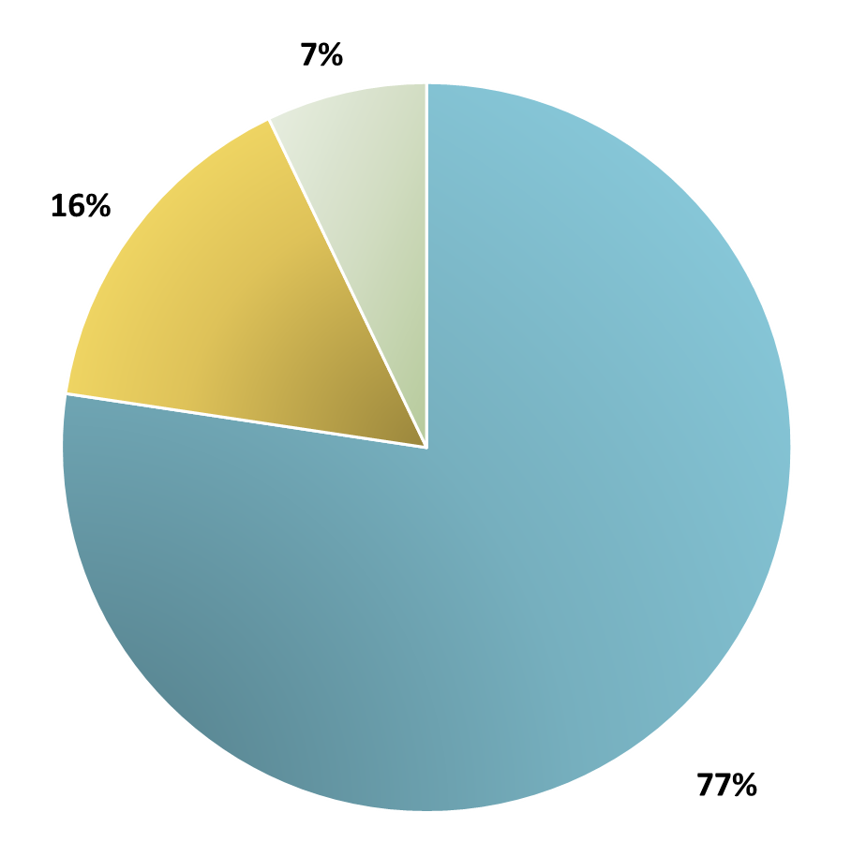
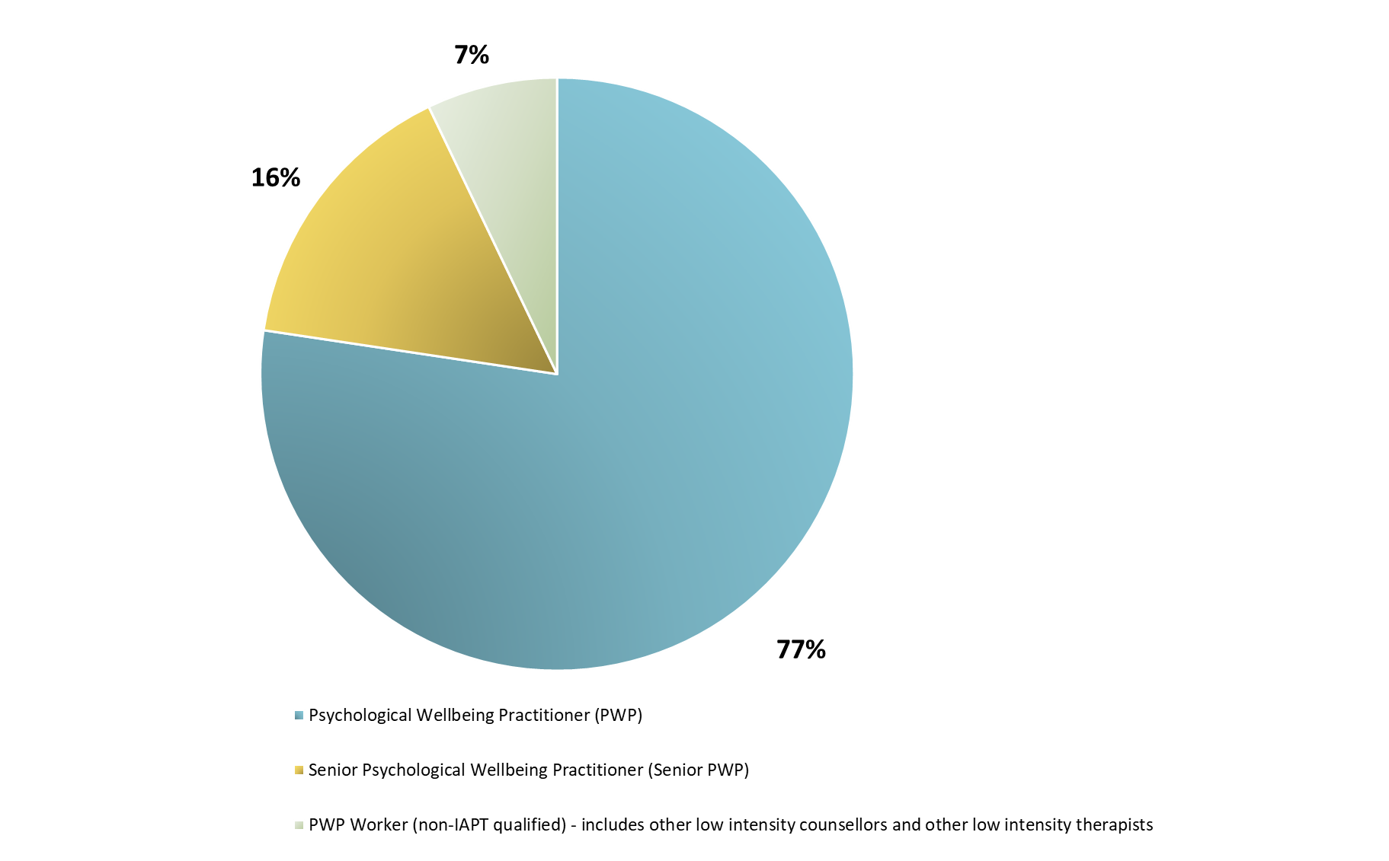
Low Intensity workforce composition (WTE)
On the census date of 31st March 2021, approximately three quarters of the Low Intensity IAPT workforce cohort (excluding trainees) was made up of Psychological Wellbeing Practitioners (77%), with the remaining 23% consisting of Senior PWPs (16%) and non-IAPT qualified PWP workers (7%).
Non-IAPT qualified PWP workers (including other low intensity counsellors and therapists) represented 11% of Low Intensity staff on the census date in 2020, evidencing an improvement since 2019 on the proportion of IAPT qualified staff delivering Low Intensity services.

Slide 32
Low Intensity workforce – IAPT qualified
As in the High Intensity workforce, non-IAPT qualified staff make up a relatively small proportion of total Low Intensity workforce numbers, accounting for 198 staff WTE (7%) overall.
The remaining 93% of the Low Intensity staff numbers reported on 31st March 2021 comprised IAPT qualified PWP or Senior PWP roles.

Slide 33
Project findings
IAPT LTC

Slide 34
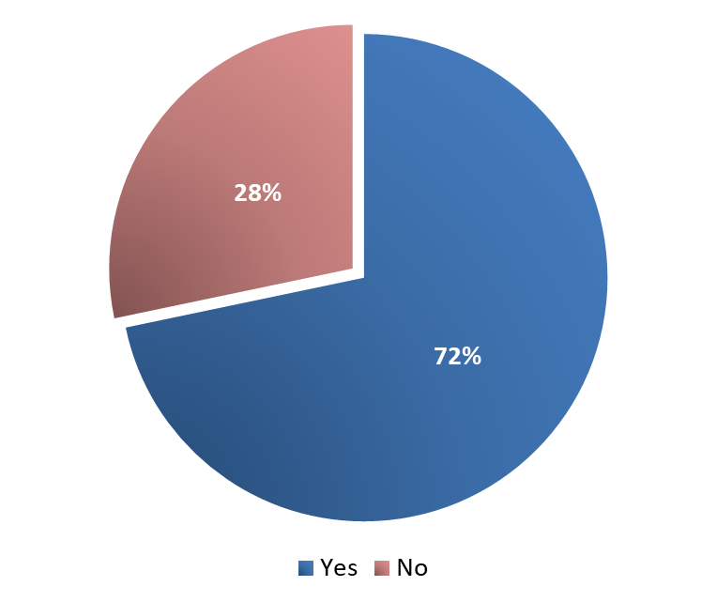
Service provisions – IAPT-LTC
IAPT-LTC services aim to allow improved access to IAPT treatments for patients with long term physical health conditions, through the co-location of mental and physical health services.
Within the 2021 census, 142 participants (of 198) confirmed that they offered an IAPT-LTC service, comprising 72% of providers overall.
This represents a decrease from last year’s collection, where 77% of participants provided IAPT-LTC within their service model (144 of 187 submissions).

Slide 35
HITs in IAPT–LTC services
High Intensity Therapists (HITs) represented the most commonly employed role within IAPT-LTC services, with 264 staff WTE in post on the census date of 31st March 2021, with this cohort comprising predominantly of CBT Therapists (97%), with a small number of Other High Intensity Therapists also reported (3%).
This is an 11% increase from last year’s figure of 237 staff WTE.
Of organisations that employ HITs within IAPT-LTC services, an average of 4 HITs WTE are employed per provider.
It is worth noting that a number of providers were unable to apportion their staff’s time between Core IAPT and IAPT-LTC services, and so the IAPT-LTC workforce numbers are likely to under-represent the staff provision working within these teams.

Slide 36
PWPs in IAPT–LTC services
Within the IAPT-LTC workforce, 184 staff WTE are Psychological Wellbeing Practitioners (PWPs) or Senior PWPs.
This illustrates an increase of 32% from 2020, when 139 PWPs / Senior PWPs were reported in post on the census date of 31st March 2020.
Of participating organisations who employ PWPs / Senior PWPs in their IAPT-LTC services, this equates to a mean average of 3 staff WTE in post, per service.

Slide 37
Project findings
Workforce demographics

Slide 38
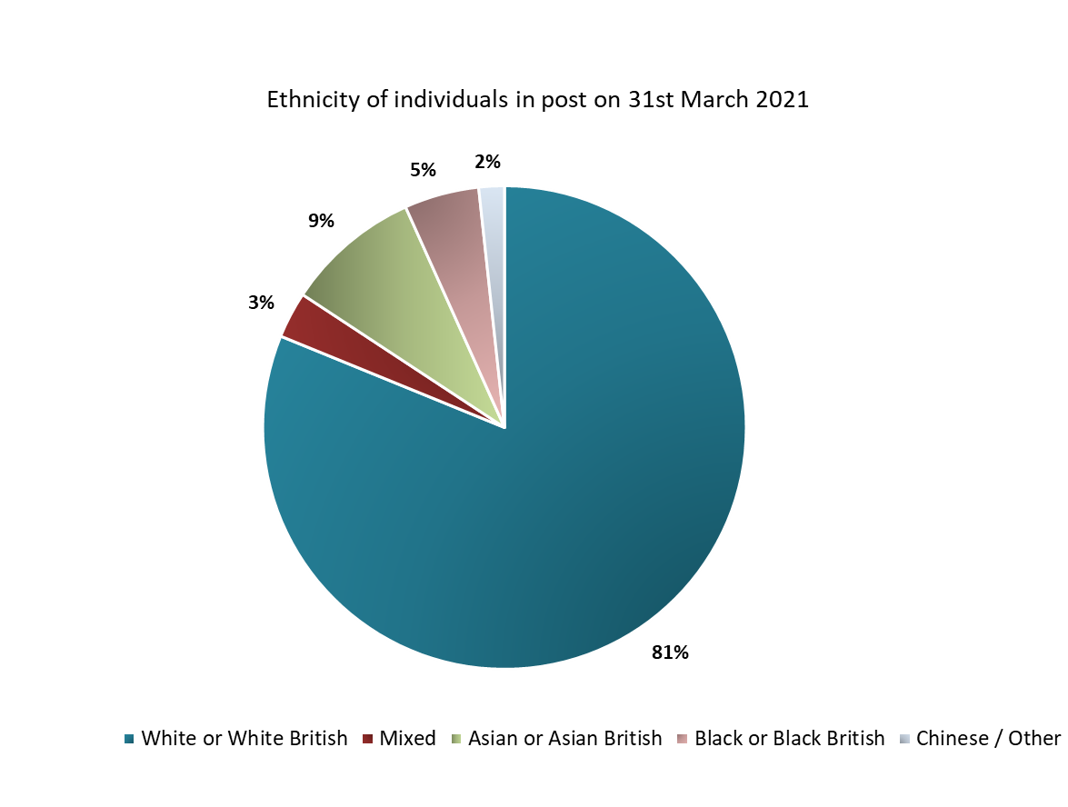
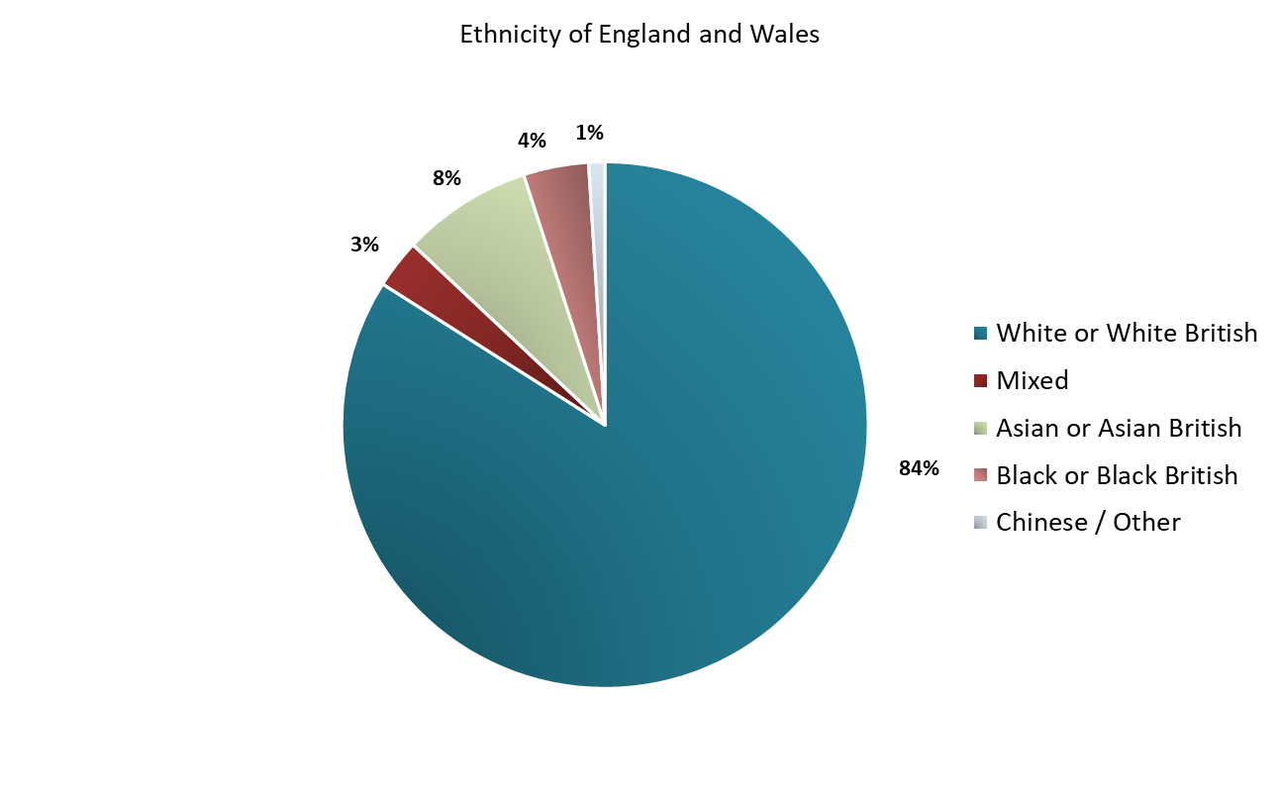

Ethnicity
Analysis of the ethnicity profile of the IAPT workforce confirms a profile that is broadly consistent with wider England population demographics, with 81% of staff in post on 31st March 2021 of White/White British ethnicity, compared to 84% of the wider England and Wales population composition (18+).
Whilst the IAPT workforce has undergone notable growth since the 2019 and 2020 census, demographic profiling for staff in the 2021 census date of 31st of March remains largely unchanged. Please note that whilst the table includes respondents who recorded staff members’ ethnicity as ‘Not stated’, whereas the pie charts do not, in order to allow for comparisons against general population data.
Ethnicity | 2019 | 2020 | 2021
White or White British | 77% | 77% | 76%
Mixed | 3% | 3% | 3%
Asian or Asian British | 8% | 8% | 8%
Black or Black British | 4% | 5% | 5%
Chinese / Other | 1% | 2% | 2%
Not stated | 7% | 6% | 6%
n = 13,663

Slide 39
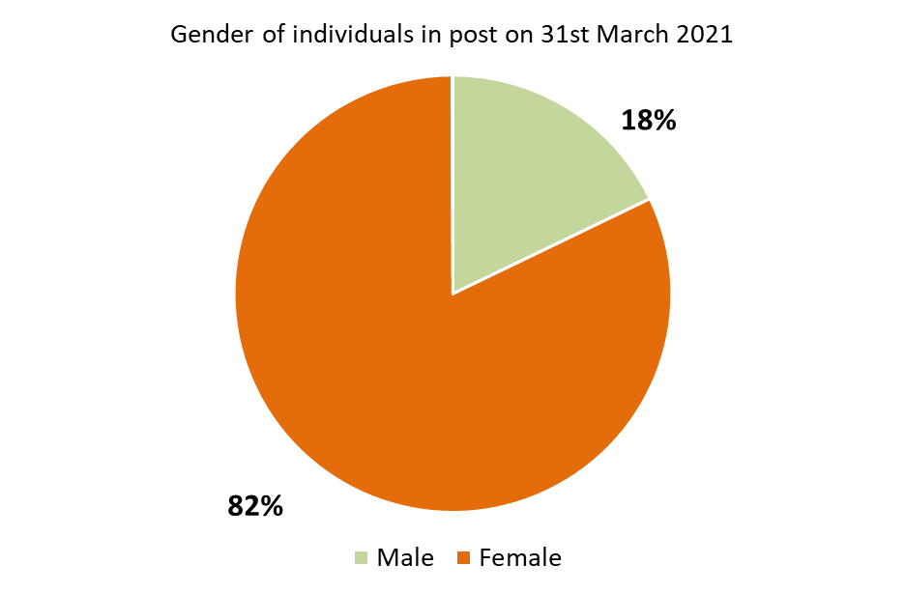
Gender
As with the ethnicity demographics, the gender of individuals working within IAPT services also remains consistent between census dates, with results displaying a predominantly female workforce.
At the time of the 2021 census, there were 11,368 female staff in post (82%) and 2,475 male staff in post (18%). Additionally, there was an increase in the number of staff identifying as non-binary this year - 8 individuals in 2021 vs 1 in 2020.
The gender profile of IAPT services is broadly consistent with wider NHSBN data on psychological therapies.
n = 13,746

Slide 40
Project findings
Sickness, vacancies and temporary staffing

Slide 41
Sickness
432 staff WTE were absent from work due to sickness on 31st March 2021. These came from the following staff groups:
  PWPs: 133 staff WTE
  HITs: 149 staff WTE
  Other Staff: 150 staff WTE
The mean average sickness absence rate reported by providers was 5% on the census date of 31st March 2021, despite the challenging context of COVID-19.
The median was 3% which is a positive finding, particularly in light of recently reported sickness absence rates within wider adult acute mental health inpatient services, which averaged (mean and median) 7% during 2020/21.

Slide 42
Bank and Agency Staffing
Bank and agency staff usage can adversely impact service quality, and patients’ continuity of care. IAPT services, reported infrequent use of bank and agency staff on the 2021 census date, when compared to wider mental health services nationwide. A total of 267 agency/bank staff WTE were reported within services at the time of the 2021 census, similar to the 289 staff WTE reported last year.
The bank and agency staff comprised the following roles:
  HITs – 101 staff WTE
  PWPs – 99 staff WTE
  Other – 67 staff WTE
The three highest placing providers were non-NHS organisations, illustrating a greater reliance on bank and agency staff proportionally on the 2021 census date.

Slide 43
Vacancies
IAPT providers reported 1,297 vacancies (WTE) on 31st March 2021, of whom:
  499 staff vacancies WTE were PWPs: 16% of all PWP/Senior PWP posts
  562 staff vacancies WTE were HITs: 14% of all HIT posts
  236 staff vacancies WTE were within other roles: 5% of all other posts
The mean average vacancy rate was reported as 12% (11% in 2020), this being broadly similar to wider NHS, and adult acute mental inpatient mental health service, vacancy rates.
The most notable increase was seen in HIT vacancy numbers, which comprised 10% of HIT posts in 2020 compared to 14% in 2021.

Slide 44
Total staff who left service in previous 12 months
In total, 1,549 staff WTE left their role in the 12 months to 31st March 2021, with the breakdown by role as follows:
  PWPs: 563 staff WTE
  HITs: 465 staff WTE
  Other: 521 staff WTE
This marks a 7% reduction in leavers from 2020, when 1,661 staff WTE leavers were reported.
Providers reported an average of 9 staff WTE leaving their service between April 2020 and March 2021, with NHS and non-NHS providers evenly distributed within the adjacent chart.
Turnover includes staff moving to other IAPT teams – either within the NHS or to a non-NHS service, leaving for an alternative role in a different healthcare service, or retirement.

Slide 45
Conclusion

Slide 46
Conclusions
This project has undertaken a comprehensive assessment of the Improving Access to Psychological Therapies workforce in England for the third year in succession. The census includes data submissions from 201 IAPT providers across all CCGs in England, and reflects the national position.
Key findings include:
A total of 13,779 staff (WTE) working in IAPT services were recorded across England on the 31st March 2021.
The majority of the workforce consisted of patient facing roles, of which there were 10,721 staff WTE recorded; this represents 78% of the total staff time in the service.
There has been notable growth in patient-facing staff numbers since the 2019 census, equating to a 31% increase between 30th June 2019 and 31st March 2021.
Trainee numbers continue to grow, most notably within the High Intensity CBT Therapist trainee cohort, which has increased by 108% since 2019. This growth in trainee numbers reflects the increased support from Health Education England for Integrated Care Systems (ICSs) to train increasing numbers of staff.
The IAPT workforce is predominantly female; ethnic diversity of the IAPT workforce is consistent with the wider England population.
A small number of new metrics were included within this year’s census. This provided more nuanced data relating to the type of therapy offered to patients, including digitally delivered therapy.
The annual IAPT workforce census is a definitive source of workforce data providing insight for both national organisations and individual providers. Now in its third year, the data collected is both a snapshot of the current position and trends in workforce and service delivery over time.
We would like to reiterate our thanks to all providers that took part in the 2021 census, and Health Education England and NHSE/I for their support and guidance.

Slide 47
Appendices

Slide 48
2021 staffing

Slide 49
IAPT workforce overview 2019-2021 - NHS providers - breakdown by role (1)

Slide 50
IAPT workforce overview 2019-2021 - NHS providers - breakdown by role (2)

Slide 51
IAPT workforce overview 2019-2021 - Non-NHS providers - breakdown by role (1)

Slide 52
IAPT workforce overview 2019-2021 - Non-NHS providers - breakdown by role (2)

Slide 53

Contact details
Steve Watkins| Director s.watkins@nhs.net
Ellie Gosling | Project Manager e.gosling2@nhs.net
Kirsten Windfuhr | Associate Director (Mental Health) k.windfuhr@nhs.net
Jack Boyd | Project Coordinator j.boyd3@nhs.net
Mike Harradine | Senior Project Manager m.harradine2@nhs.net

