Slide 1
Health Education England
NHS Talking Therapies for Anxiety and Depression Workforce Census
National Report
January 2023

Slide 2
Contents
Acknowledgements 3
Introduction to NHS Talking Therapies for Anxiety and Depression (previously known as IAPT) 4
Project background 6
The NHS Talking Therapies workforce in summary as of 31st March 2022 7
National NHS Talking Therapies workforce overview 8
Project findings
  NHS Talking Therapies service provision and activity 14
  Workforce profile 21
  High intensity staffing 31
  Low intensity staffing 35
  Workforce demographics 38
  Workforce summary metrics 41
  Staff discrimination 47
Conclusions 50
Appendices 52
Contact details 60

Slide 3
Acknowledgements
The NHS Benchmarking Network would like to extend our thanks to the Programme Leads of the Health Educational England National Mental Health Programme, who continue to offer invaluable insight, defining the collection and providing interpretation on findings.
We would also like to thank Julian Emms, Chair of the NHSBN Mental Health Reference Group, for his ongoing support for this project and the wider Health Education England workstream.
Additionally, we are grateful for the contribution made by the project oversight group, inclusive of representatives from NHS England, who were instrumental in shaping the 2022 national and regional findings.
Finally, we would like to thank the services who participated in the project this year, with 200 submissions received from 100% of CCG areas in England (as of 31st March 2022, prior to dissolution), thus allowing a national position to be established.

Slide 4
Introduction to NHS Talking Therapies for Anxiety and Depression (previously known as IAPT)
The NHS Talking Therapies for Anxiety and Depression (previously known as Improving Access to Psychological Therapies - IAPT) programme began in 2008 and has transformed the treatment of adult anxiety disorders and depression in England. NHS Talking Therapies is widely-recognised as the most ambitious programme of talking therapies in the world and in 2020-21 more than one million people accessed NHS Talking Therapies services for help to overcome their depression and anxiety, and better manage their mental health.
NHS Talking Therapies services provide evidence-based treatments for people with depression and anxiety disorders, and comorbid long-term physical health conditions (LTCs) or medically unexplained symptoms (MUS). NHS Talking Therapies services are characterised by three key principles:
Evidence-based psychological therapies at the appropriate dose: where NICE recommended therapies are matched to the mental health problem, and the intensity and duration of delivery is designed to optimise outcomes.
Appropriately trained and supervised workforce: where high-quality care is provided by clinicians who are trained to an agreed level of competence and accredited in the specific therapies they deliver, and who receive weekly outcomes focused supervision by senior clinical practitioners with the relevant competences who can support them to continually improve.
Routine outcome monitoring on a session-by-session basis, so that the person having therapy and the clinician offering it have up-to-date information on the person’s progress. This helps guide the course of each person’s treatment and provides a resource for service improvement, transparency, and public accountability.
Services are delivered using a stepped-care model, which works according to the principle that people should be offered the least intrusive intervention appropriate for their needs first. Many people with mild to moderate depression or anxiety disorders are likely to benefit from a course of low intensity treatment delivered by a psychological wellbeing practitioner (PWP). Individuals who do not fully recover at this level should be stepped up to a course of high intensity treatment. Further details about NHS Talking Therapies services can be found in the NHS Talking Therapies Manual.

Slide 5
Introduction to NHS Talking Therapies - workforce roles
The NHS Talking Therapies workforce consists of low intensity practitioners and high intensity therapists who together deliver the full range of NICE-recommended interventions for people with mild, moderate and severe depression and anxiety disorders, operating within a stepped-care model. Guidance suggests working towards a model where 35% of the workforce in a core NHS Talking Therapies service should be PWPs and 65% high intensity therapists. For NHS Talking Therapies-LTC services, it is recommended that there is a slightly stronger focus on high intensity interventions with the workforce being 30% PWPs, 60% high intensity therapists and 10% senior therapists (such as clinical health psychologists) who have expertise in Long Term Conditions/Persistent Physical Symptoms and can manage more complex problems as well as providing supervision to others. All current NHS Talking Therapies curricula and training materials can be found on the NHS Talking Therapies section of the HEE website.
Low intensity workforce
Psychological wellbeing practitioners (PWPs) deliver low intensity interventions for people with mild to moderate depression and anxiety disorders. All PWPs should have completed an NHS Talking Therapies training course or be in the process of doing so, with linked professional registration with the relevant professional body following training. The core NHS Talking Therapies low intensity courses for PWPs are accredited by the British Psychological Society. PWPs are required to be registered with either the British Psychological Society or the British Association for Behavioural and Cognitive Psychotherapies (BABCP). PWPs who work with LTC services are also expected to have completed the relevant NHS Talking Therapies continuing professional development (CPD) course for working with LTCs.
High intensity workforce
High intensity therapists deliver a range of NICE-recommended evidence-based therapies. Therapists need to have been trained in the particular therapy or therapies that they deliver in NHS Talking Therapies, with linked professional accreditation with the relevant professional body. NICE recommends cognitive behavioural therapy (CBT) for anxiety disorders and six different high intensity therapies for depression (CBT, interpersonal psychotherapy, brief psychodynamic therapy, counselling for depression, couple therapy, and mindfulness based cognitive therapy). NICE recommends both trauma focused CBT and eye movement desensitisation and reprocessing for post-traumatic stress disorder.

Slide 6
Project background
The NHS Benchmarking Network was re-commissioned by Health Education England (HEE) to deliver the NHS Talking Therapies for Anxiety and Depression workforce census for 2022. The census is a detailed workforce stocktake involving NHS Talking Therapies services from all CCG areas in England (as of 31st March 2022, prior to dissolution), inclusive of both NHS and non-NHS organisations.
The NHS Benchmarking Network (NHSBN) is the in-house benchmarking service of the NHS, hosting wide ranging work programmes covering commissioning, community healthcare, acute and mental health sectors. NHSBN is a membership organisation that includes all statutory mental health providers in England as well as national bodies such as the Department of Health and Social Care, NHS England, and Health Education England.
The Adult NHS Talking Therapies workforce census is now in its fourth annual project cycle and continues to provide a snapshot of the size and shape of NHS Talking Therapies service staffing in England as of 31st March. Throughout this report comparisons will be drawn between the four census dates – 2019 (30th June census date), 2020, 2021 and 2022. To note, there have been several changes to terminology/job role categorisations within the latest census, with the introduction of additional roles such as lead PWPs, along with the removal of applied psychologists, with services instead asked to include these staff within their specific modalities.
The aim of this work is to provide a detailed profile of the NHS Talking Therapies workforce and service delivery including:
  Service provision and activity
  Therapy modality capacity
  Adoption of digital technologies
  Workforce size and composition
  Workforce demographics
  Vacancies and temporary staffing
200 data submissions were received from services spanning all CCG areas in England (configuration as of 31st March 2022, prior to dissolution). 65% of submissions were returned by NHS services (130 returns) with the remaining 70 returns received from non-NHS services.
Two services who participated in the project in 2021 were unable to provide data for their equivalent positions as of 31st March 2022. Their 2021 workforce positions have been included within the latest findings in order to allow for accurate year-on-year comparisons, with the presumption of zero growth evidenced over the past twelve months.

Slide 7








The NHS Talking Therapies workforce in summary as of 31st March 2022
38% increase in staff (WTE) working within NHS Talking Therapies services between 30th June 2019 and 31st March 2022 – 4% growth evidenced from 2021 to 2022
200 data submissions received, spanning 100% of CCG areas in England (as of 31st March 2022)
2,979 trainees (WTE) in post; a 12% increase from the 2021 census position
Qualified high intensity therapists* comprised 4,317 staff (WTE) – 38% of the 2022 NHS Talking Therapies workforce nationally (excluding trainees)
Between 2021 and 2022, qualified psychological wellbeing practitioner** staff numbers (WTE) rose by 6%
Ratio of 39% qualified PWPs reported to 61% qualified HITs
80% of NHS Talking Therapies staff are from a White ethnic background compared to 83% of wider UK population. 20% from Black, Asian, Mixed, Chinese and other ethnic minority backgrounds
13% leaver rate reported in 12 months to 31st March 2022 (10% in 12 months to 31st March 2021). 39% of leavers were confirmed as no longer working in NHS-commissioned NHS Talking Therapies services
*Qualified high intensity therapists: qualified HITs – CBTs and other NHS Talking Therapies modalities (including NHS Talking Therapies qualified counsellors)
**Qualified psychological wellbeing practitioners: qualified PWPs, senior PWPs and lead PWPs

Slide 8
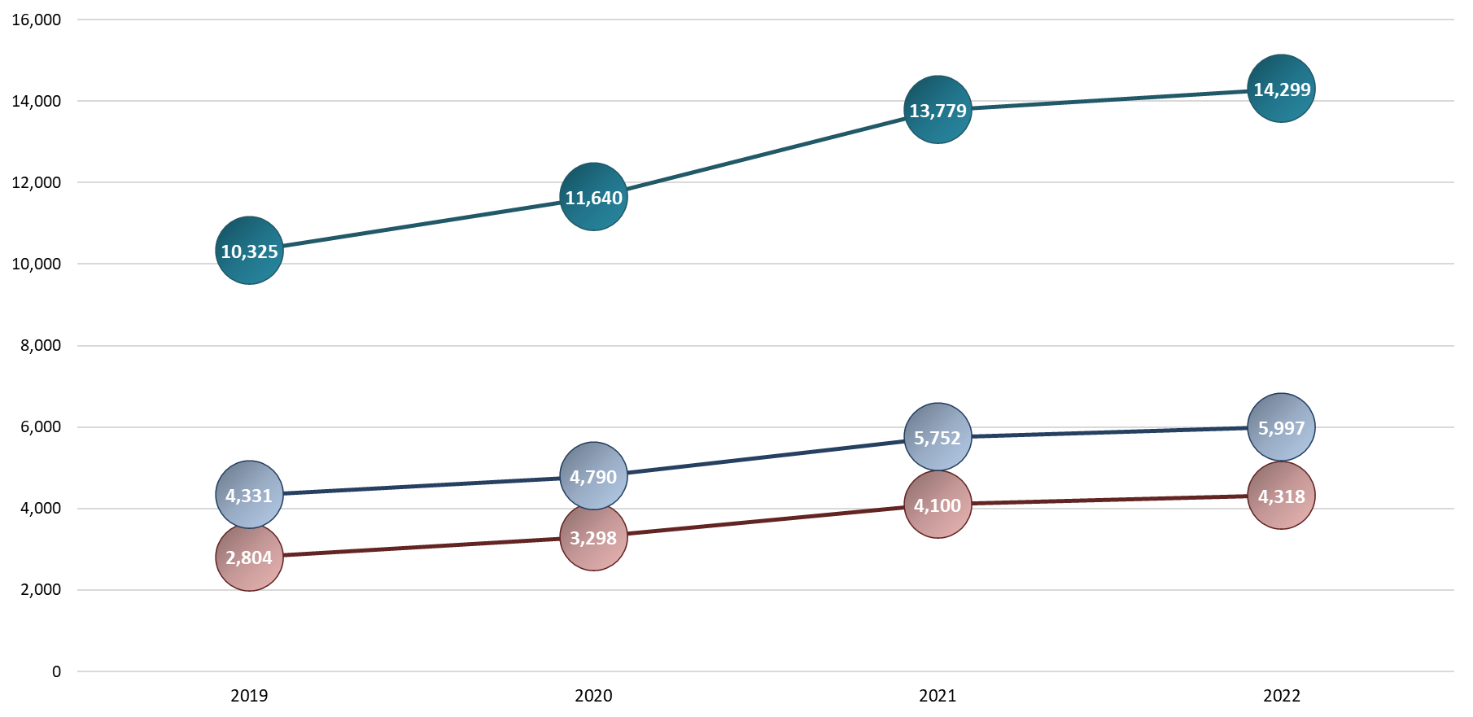
National NHS Talking Therapies workforce overview - timeseries
Total workforce (WTE) – clinical and non-clinical roles
The adjacent chart illustrates the growth in the adult NHS Talking Therapies Workforce nationally from the commencement of the workforce benchmarking series in 2019, through to the latest position as of 31st March 2022.
On the census date of 31st March 2022, there were 14,299 staff (WTE) in post (across clinical and non-clinical workforce roles) reported by 200 services. Though this represents a 4% increase from the 2021 position, it does not align with the heightened levels of growth evidenced in previous years.
5,997 staff (WTE) were reported within high intensity roles, also marking a 4% uplift from 2021 figures.
The low intensity workforce comprised 4,318 staff (WTE) in 2022, representing an increase of 5% from 2021.
+4%
+18%
+13%
High intensity
staff (WTE)
+20%
+4%
+11%
+5%
Low intensity
staff (WTE)
+24%
+18%

Slide 9
National NHS Talking Therapies workforce overview 2019-2022
The above table illustrates the change in the national NHS Talking Therapies workforce from 30th June 2019 to 31st March 2022, categorised by overarching staff groups, with more granular breakdowns by individual job role demonstrated on subsequent pages. All figures relate to Whole Time Equivalent (WTE) data, unless stated.
Between 2019 and 2022, total staff numbers (WTE) working within NHS Talking Therapies services across England have risen by 38%; comprised of a 39% increase in patient-facing staff, and a 37% uplift in non-patient facing roles. Though there have been notable increases in staff numbers across both the high and low intensity workforce, low intensity posts have undergone the largest increase of these staff groups, demonstrating 54% growth from 2019 to 2022.

Slide 10
National NHS Talking Therapies workforce overview 2019-2022 – breakdown by role (1)
*
*: 2020 – 2022 cumulative change
*
Workforce numbers are broken down above and over the next three pages by job role, with new categorisations shown in green text.
Lead psychological wellbeing practitioner was an additional categorisation included for the first time in 2022, with 74 staff (WTE) reported in this role. Though this has lead to a small decrease in the number of senior psychological wellbeing practitioners reported, when the two categorisations are collated, this resulted in a 17% annual increase in senior/lead PWP numbers (based on assumption that lead PWPs would have sat within senior PWP categorisation between 2019 and 2021). Overall, qualified PWP staff numbers underwent a 6% increase annually, with a 35% cumulative increase evident between the 2019 and 2022 census dates.

Slide 11
National NHS Talking Therapies workforce overview 2019-2022 – breakdown by role (2)
To allow for greater granularity, CBT therapists have been split out from other high intensity therapists within this workforce timeseries breakdown (based on assumption that anyone in high intensity therapists (HITs) categorisation in year 1 would go into one of either CBT therapists or other high intensity therapists categorisations from year 2 onwards). This does, however, remove the capability to compare cumulative 2019 to 2022 positions, and so it is worth noting that the cumulative change positions for these roles instead relate to 2020 (not 2019) to 2022 comparisons.
As highlighted within the project background information, several changes to terminology/job role categorisations were made for the 2022 data specification template, particularly in relation to high intensity roles such as other high intensity therapists, which have been categorised as follows over the project timeseries to date:
  2019: included within totality of high intensity therapists
  2020 and 2021: segregated as other high intensity therapists – both NHS Talking Therapies and non-NHS Talking Therapies accredited
  2022: segregated as other high intensity therapists (not recognised by NHS Talking Therapies)
Additionally, the previously utilised applied psychologist categorisation was removed from the 2022 data specification, with services instead asked to include these staff within their specific modalities.
When non-trainee HIT therapist numbers are reviewed in their totality, a 21% increase in staff numbers is evident from the 2019 to 2022 census dates.
Overall, low and high intensity staff numbers increased by circa 45% between 2019 and 2022; rising from 7,135 staff (WTE) to 10,315 staff (WTE) on 31st March 2022.

Slide 12
National NHS Talking Therapies workforce overview 2019-2022 – breakdown by role (3)
The senior employment support advisor role represents a further addition to the 2022 data specification, which has likely impacted employment support advisor numbers with some staff previously categorised here now likely placed within this new role. Overall, employment support staff numbers have undergone a 5% reduction between 2021 and 2022, with 353 staff (WTE) in post on the latest census date.
Further, additional low intensity roles were reclassified for 2022, with 13% growth evidenced by this staff cohort in the 12-month period. Staff numbers (WTE) within the overarching additional roles categorisation have remained largely in line with 2021 figures, though it is worth noting that this finding is heavily impacted by the removal of the previously utilised other trainee category. Other trainees accounted for 71 staff (WTE) during 2021, though this category was removed within the 2022 specification with services asked to categorise trainees into either low/high intensity roles.

Slide 13
National NHS Talking Therapies workforce overview 2019-2022 – breakdown by role (4)
95% of staff (WTE) time allocated to supervisory roles/duties was comprised of supervisors who had undertaken NHS Talking Therapies supervisory training. There has been a steady decline in the number of supervisors who have not undertaken the NHS Talking Therapies supervision module/training since the project inception in 2019, with numbers reducing cumulatively in that time by 63% - from 137 to 51 staff (WTE).
Other job roles accounted for a small proportion of NHS Talking Therapies workforce numbers, totalling 159 staff (WTE) on 31st March 2022. Responses by services detailed various roles categorised within this cohort, ranging from marketing/communications positions to referral co-ordinators.
As previously described, when viewing NHS Talking Therapies workforce numbers in their totality, staff levels have increased by 4% between the 2021 and 2022 census dates. Since the workforce benchmarking series commenced in June 2019, NHS Talking Therapies services have seen a 38% cumulative increase nationally.

Slide 14
Project findings
NHS Talking Therapies service provision and activity

Slide 15
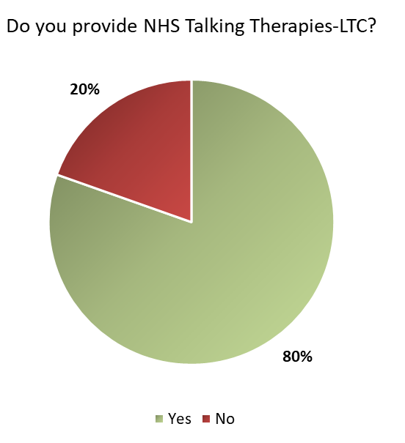
NHS Talking Therapies-LTC
80% of respondents to this metric confirmed an NHS Talking Therapies-LTC offer, comprising 156 of 194 responses. NHS Talking Therapies-LTC services aim to allow improved access to NHS Talking Therapies treatments for patients with long term physical health conditions.
Coverage has increased between the 2021 and 2022 census dates, with 72% of services confirming an NHS Talking Therapies-LTC offer in 2021, compared to 80% in 2022.

Slide 16
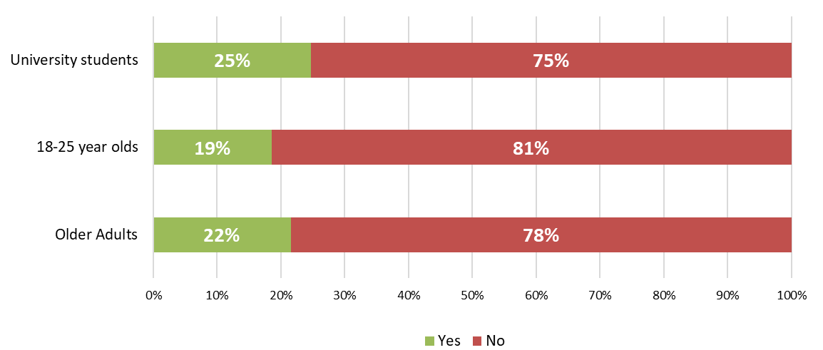
Service provision – access
In addition to capturing data regarding the composition of the adult NHS Talking Therapies workforce nationally, the census also included metrics relating to the wider service offer, for example, the provision of tailored pathways for patients within specific cohorts such as university students, 18-25 year olds, and older adults aged 65+.
As of 31st March 2022, 19% of NHS Talking Therapies services reported specific pathways for 18-25 year olds, marking a continued year-on-year increase from the 15% proportion of services who confirmed these pathways were in place in 2020.
Specific pathways for university students were reported by 25% of services, with university services nationally often having links, or sharing a location, with student medical centres. For the older adult cohort (patients aged 65+), 22% of services reported a specific pathway in place.
It is worth noting that these metrics relate solely to the provision of specific pathways, rather than indicating the absence of services delivering care to patients within these age groupings, with designated lower/upper age criteria for services detailed on the following page.

Slide 17
Age restrictions
As in previous iterations of the census, the majority of NHS Talking Therapies services reported a lower age criteria of between 16 and 18 years of age. The breakdown of respondents by lower age limit is as follows:
16 years of age: 98 services
17 years of age: 34 services
18 years of age: 66 services
Most services reported an absence of upper age limitations. Those who did report an upper age boundary for services typically stipulated a maximum age criteria of 90 to 100 years of age.

Slide 18
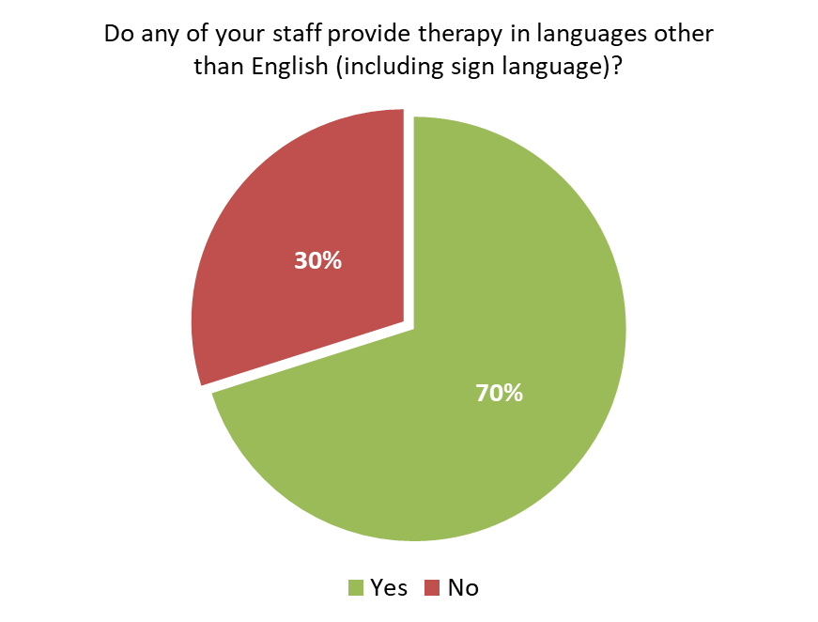
Therapy in languages other than English
70% of services confirmed that staff provided therapy to patients in languages other than English, marking an increase from the 66% reported in 2021.
Many services specified several languages (including sign language), with those with the highest provision detailed below:
Urdu – 44 services
Polish – 42 services
Punjabi – 35 services
French – 26 services
Spanish - 22 services
British Sign Language – 12 services
Farsi – 11 services
It is worth noting that this metric has a degree of fluidity, as it is influenced by the staff in post on the snapshot date each year.

Slide 19
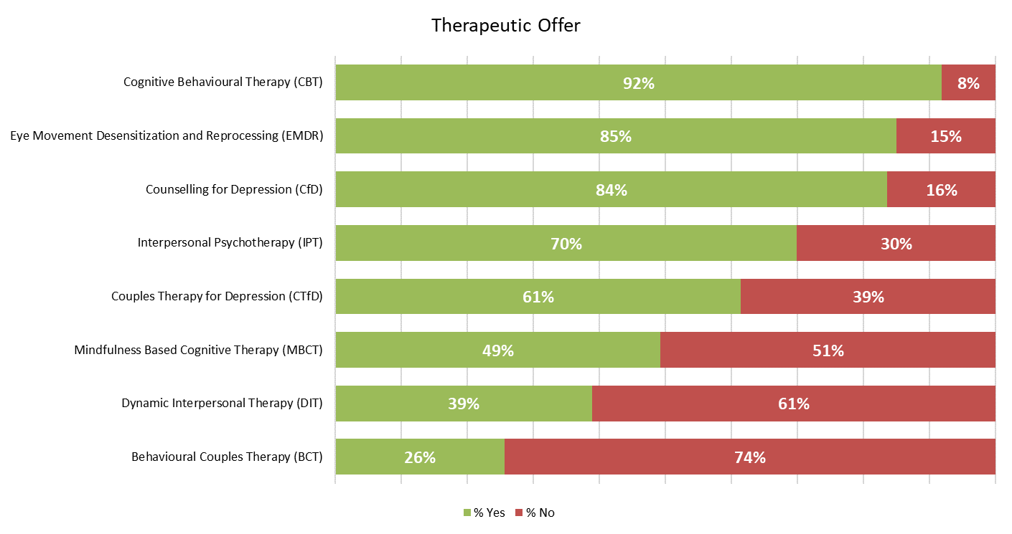
Therapeutic offer
This chart details the therapeutic offer delivered by NHS Talking Therapies qualified and/or accredited staff, excluding trainees, as of 31st March 2022.
As in previous years, cognitive behavioural therapy was the most commonly offered therapy nationally, provided by 92% of respondents to this metric.
Additionally, eye movement desensitization and reprocessing (EMDR) and counselling for depression (CfD) were offered by the majority of services – 85% and 84%, respectively.
It is worth noting that the proportion of NHS Talking Therapies services offering counselling for depression (CfD) has continued to rise, from 79% in 2020 to 84% in 2022.

Slide 20
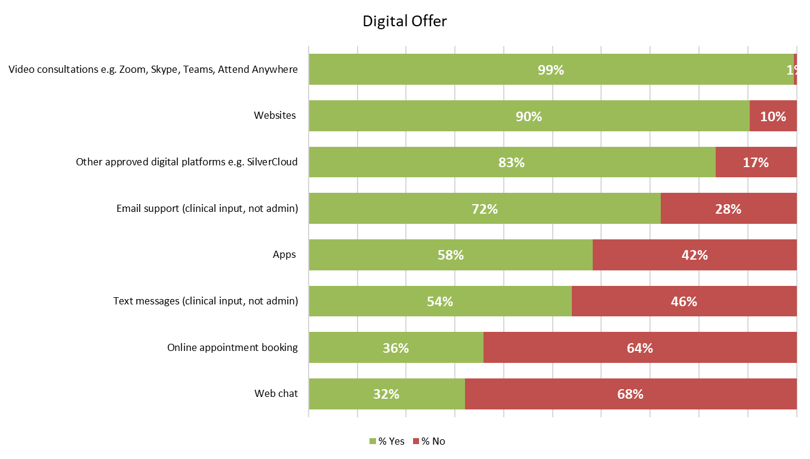
Digital offer
As reported within wider mental health services nationally, the Covid-19 pandemic necessitated a swift, widespread adoption of digital tools by NHS Talking Therapies services, in response to the restrictions in patient access to face-to-face care.
The adjacent chart displays the variety in digital offers reported by NHS Talking Therapies services during 2022, following the lifting of national restrictions which were still in place to various extents over the two previous census dates (2020 and 2021).
With increasing numbers of patients now returning to in-person care settings, apps and other approved digital appointment platforms, such as Silvercloud, have seen a decrease in utilisation between 2021 and 2022 (apps = 62% in 2021 vs 58% in 2022, other approved digital platforms = 86% in 2021 vs 83% in 2022).
In contrast, online appointment booking systems have seen an increase in service adoption, with 36% of respondents utilising this technology to support individuals in 2022, compared to 25% during 2021.
An increase in the use of text messaging (clinical input) was also evidenced in the 2022 dataset, with utilisation nationally increasing from 49% in 2021 to 54% in 2022.

Slide 21
Project findings
Workforce profile

Slide 22
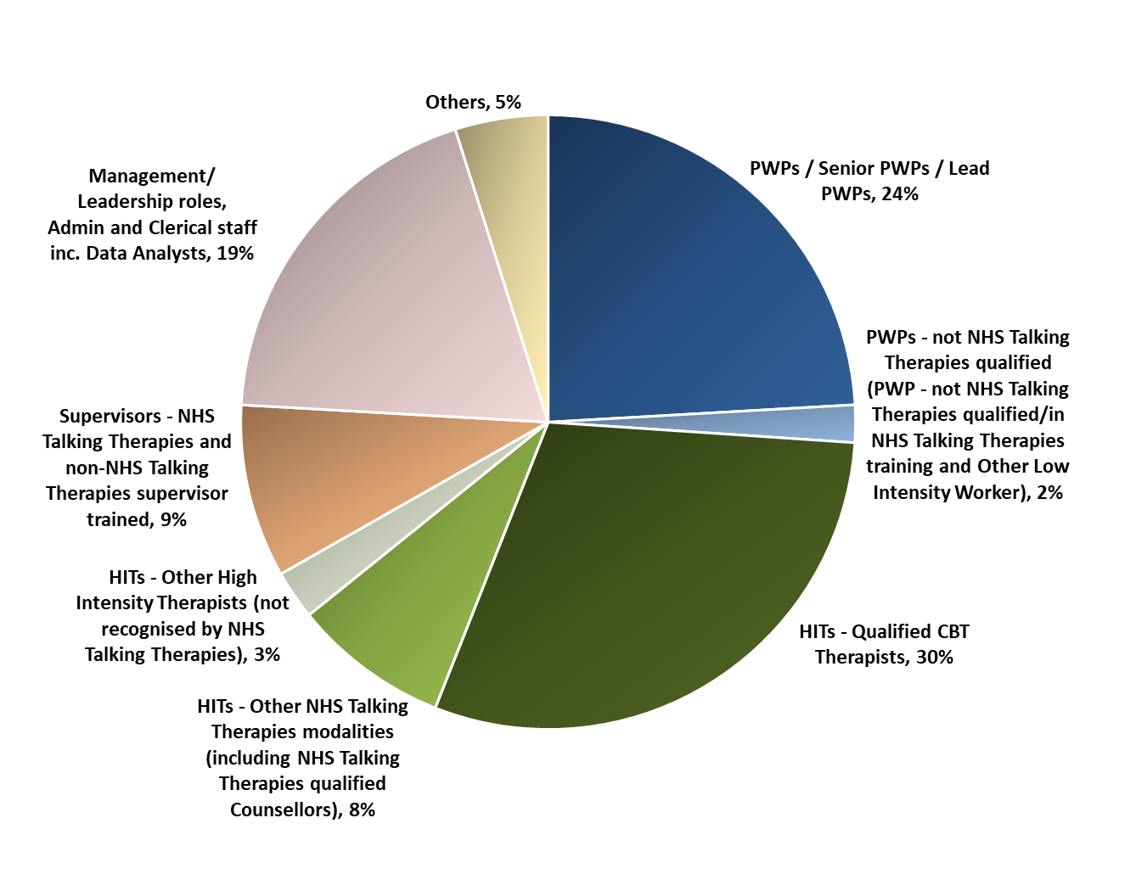
Workforce composition (WTE)
Though NHS Talking Therapies workforce numbers have undergone notable growth between 2019 and 2022, the workforce composition has remained relatively static.
As in previous years, analysis into the composition of the NHS Talking Therapies workforce confirmed the majority of staff (WTE) work within therapeutic roles.
67% of the workforce (excluding trainees) were made up of clinical staff, including non-NHS Talking Therapies qualified PWPs and other HITs not recognised by NHS Talking Therapies. This non-NHS Talking Therapies qualified/not NHS Talking Therapies recognised subgroup covers 5% of staff numbers overall, with qualified clinical staff (recognised by NHS Talking Therapies) comprising 62% of the reported workforce.
In line with last year’s figures, 19% of staff were employed within managerial/leadership, administrative or clerical roles.
“Others” include:
Employment support advisor and senior employment support advisor: 3%
Other: 1% - e.g. marketing/communications positions, referral coordinators etc.
Peer support worker: 0.4%

Slide 23
Workforce size by service
This chart illustrates the total NHS Talking Therapies staffing numbers (WTE), excluding trainees, reported per service.
2022 census data demonstrated a median average position of 53 staff (WTE) per service. This represents a continuation of the growth evidenced since 2019, with the median position rising from 42 staff (WTE) in 2019 to 53 staff (WTE) within the most recent dataset.
Services reported notable variation in their workforce size, with services placing in the upper quartile reporting team sizes in excess of 100 staff (WTE).
To note, this position is not benchmarked, and is included to demonstrate the wide range of staffing numbers per service reported on the census date.

Slide 24
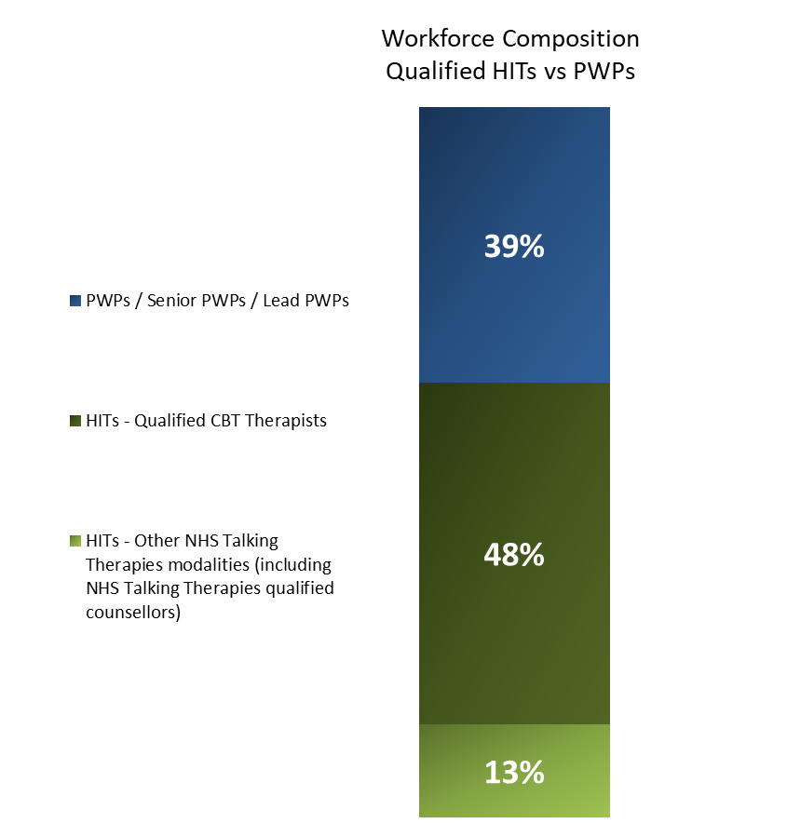
Workforce composition – qualified HITs vs PWPs
The adjacent chart demonstrates the split between:
Qualified HITs
  HITs - CBT therapists
  HITs - other NHS Talking Therapies modalities (including NHS Talking Therapies qualified counsellors)
Qualified PWPs
  PWPs
  Senior PWPs
  Lead PWPs
PWPs represented 39% of the total qualified HIT/PWP staffing numbers, with HITs accounting for 61%. The majority of HITs comprised qualified CBT therapists, with 13% HIT – other NHS Talking Therapies modality roles (including NHS Talking Therapies qualified counsellors).

Slide 25
Workforce size by service – qualified HITs
Data has also been reviewed in relation to the roles of HITs – qualified CBT therapists, alongside HITs – other NHS Talking Therapies modalities (including NHS Talking Therapies qualified counsellors), measured as a proportion of total staffing numbers (excluding trainees) on 31st March 2022.
On the census date, staff (WTE) within these roles totalled 4,317 WTE, representing, on average, 40% of total staff numbers across NHS Talking Therapies services where qualified CBT therapists/counsellors were employed.

Slide 26
Workforce size by service – qualified PWPs
Qualified psychological wellbeing practitioners (PWPs) are comprised of PWPs, senior PWPs and lead PWPs, with the latter categorisation newly added to the data specification for 2022. This chart shows the proportion of staff numbers comprised of PWPs at service level (excluding trainees).
The data shows a high level of variation in PWP representation across NHS Talking Therapies services. This is a product of different commissioning specifications for NHS Talking Therapies, with differing local priorities. Every local system of care should include PWPs, but individual services may only provide part of the NHS Talking Therapies pathway.
As of the 31st March 2022, for services where PWPs were employed, this staff cohort comprised an average (mean) of 27% of overall workforce numbers, similar to the 26% reported in 2021.
In regards to PWP staff numbers (WTE) in their totality, 2,728 PWPs (WTE) were reported in post on the 2022 census date – a 6% increase from the 2,580 (WTE) total seen in 2021.

Slide 27
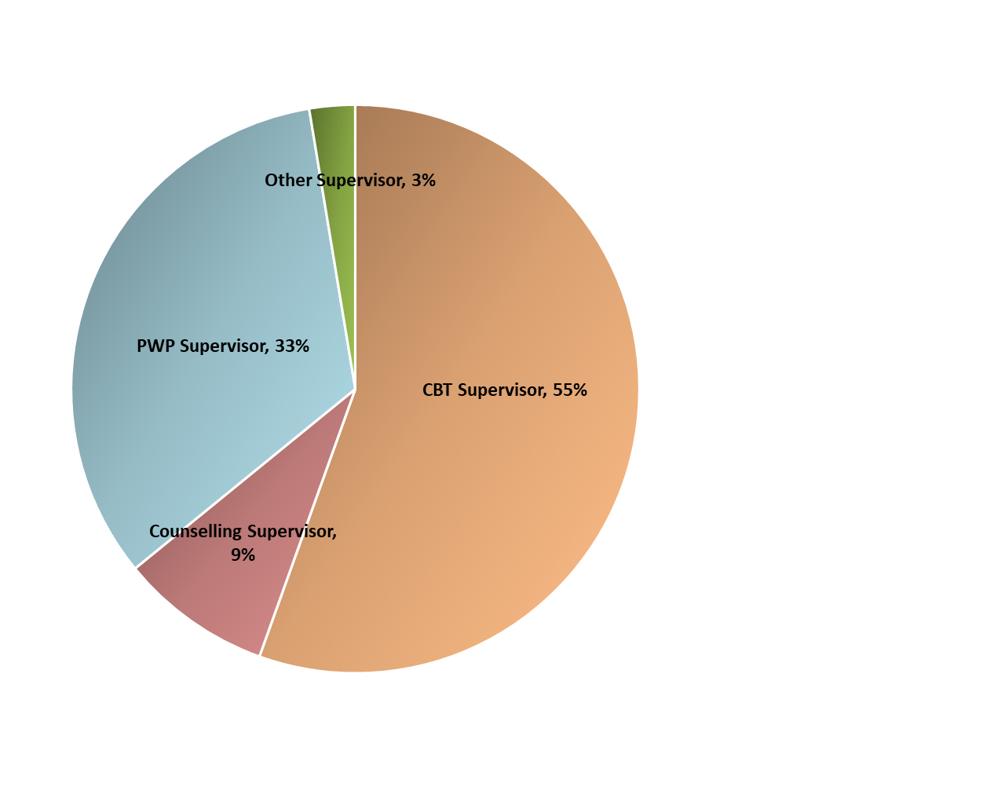
Supervisory roles – NHS Talking Therapies trained
Of the 981 supervisory roles/time (WTE) reported by NHS Talking Therapies-trained supervisors on 31st March 2022, 55% of this cohort was reported by CBT supervisors, representing over half of the total provision.
PWP supervisors comprised the next largest cohort, with a third of NHS Talking Therapies-trained supervisors within these roles.
Counselling supervisors (9%) and other supervisors (3%) made up the final 12% of NHS Talking Therapies-supervisor trained roles/times on the 2022 snapshot date.
Additionally, a further 51 supervisory roles/time (WTE) were reported on the census date for supervisors who had not undertaken the NHS Talking Therapies supervision module/training.

Slide 28
HITs progressing from PWPs
The NHS Talking Therapies career development process includes a route for psychological wellbeing practitioners who wish to train to become high intensity therapists. Though this metric has been included within previous census iterations, it was amended for 2022 to encompass staff progression across different services, where previously the sole focus related to staff progressing internally.
383 PWPs (WTE) progressed into HIT training over the last 12 months, including both those who remained with the same NHS Talking Therapies service and those who progressed into HIT training with another service.
111 (56%) participants reported progression of PWPs into HIT training within the last twelve months. These respondents reported an average of 3 PWPs (WTE) progressing via this route.

Slide 29
Trainees
NHS Talking Therapies provides clear pathways for progression for its staff, with active training programmes recruiting new staff into NHS Talking Therapies services, and enabling their development into specialist therapy roles.
On 31st March 2022, a total of 2,979 trainees (WTE) were reported within adult NHS Talking Therapies services, which represents a 12% increase from the 2,650 trainee (WTE) figure reported in 2021.
The breakdown by role was as follows:
  Trainee psychological wellbeing practitioners – 1,590 staff (WTE)
  Trainee high intensity CBT therapists – 1,257 staff (WTE)
  Trainee counsellors (NHS Talking Therapies Modality/HIT Upskilling) – 132 staff (WTE)
The chart on the left is not benchmarked, and is included to demonstrate the variation between services where trainees are employed. Results ranged from 1 to 98 trainees (WTE) employed on 31st March 2022, per service.
Trainee numbers per service remained relatively consistent to those reported in 2021, with a mean of 16 trainees (WTE) in post on the 2022 census date compared to 15 trainees (WTE) the previous year.

Slide 30
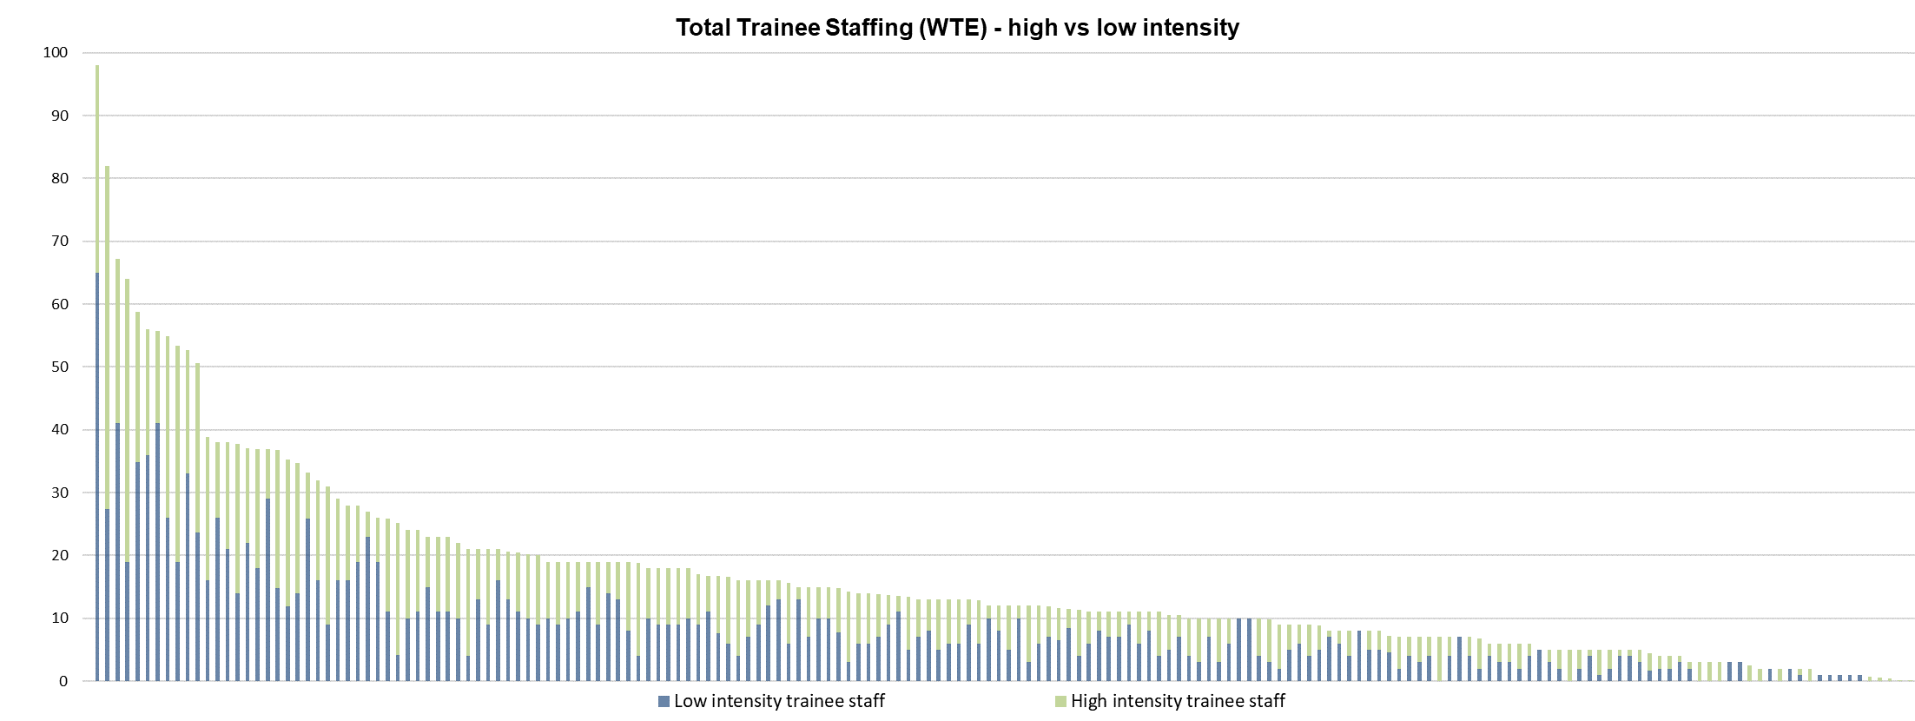
Low to high intensity trainees by service
This chart demonstrates the split of low to high intensity trainees, per service.
At a national level, services reported a largely even split between low vs high intensity trainee numbers, with 53% low intensity trainees to 47% high intensity trainees as on the 2022 census date.

Slide 31
Project findings
High intensity staffing

Slide 32
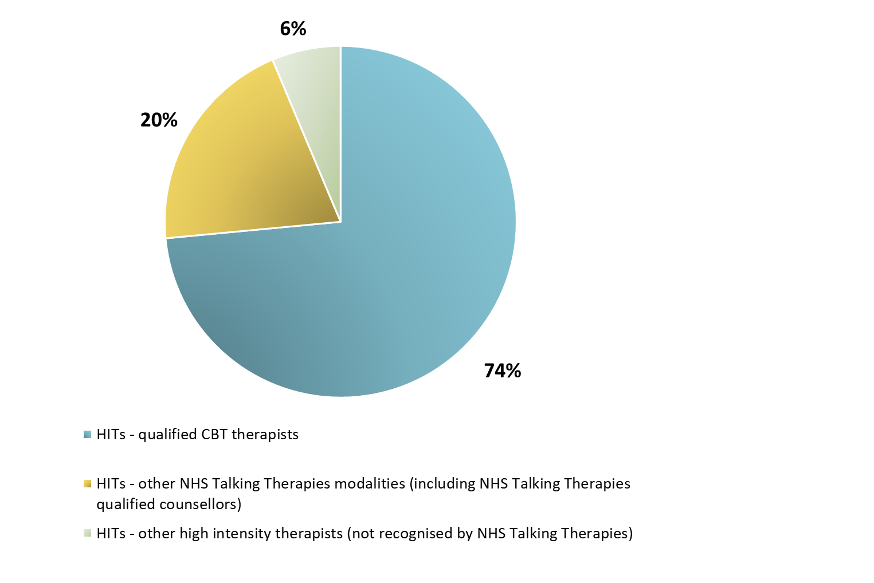
High intensity workforce composition (WTE)
The high intensity workforce is comprised of 3 main role types:
  HITs – qualified CBT therapists
  HITs – other NHS Talking Therapies modalities (including NHS Talking Therapies qualified counsellors)
  HITs – other high intensity therapists (not recognised by NHS Talking Therapies)
This chart examines the proportion of the high intensity workforce (excluding trainees) made up of each of these roles.
As in previous years, qualified CBT therapists made up the vast majority of the high intensity workforce, at 74%.
The remaining workforce in this sector is made up of HITs - other NHS Talking Therapies modalities (including NHS Talking Therapies qualified counsellors - 20%) and other high intensity therapists (not recognised by NHS Talking Therapies) which totalled 292 staff (WTE) – 6%. Accompanying narrative provided by NHS Talking Therapies services detailed a number of roles which sat within this latter job cohort, including clinical and counselling psychologists.

Slide 33
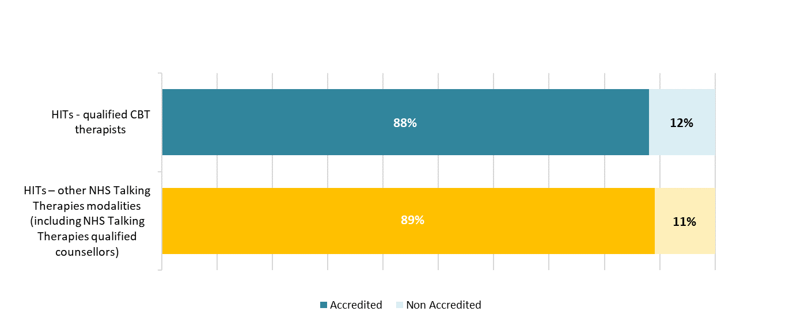
High intensity workforce – NHS Talking Therapies accredited
The below chart illustrates the proportion of staff (WTE) who have achieved accreditation as specified within the NHS Talking Therapies Manual, via the relevant NHS Talking Therapies-recognised professional body, e.g. the British Association for Behavioural and Cognitive Psychotherapies.
As on the 31st March 2022, services reported that 88% of HITs – qualified CBT therapists were NHS Talking Therapies accredited. A similar proportion of HITs – other NHS Talking Therapies modalities (including NHS Talking Therapies qualified counsellors) were accredited (89%) as on the 2022 census date.

Slide 34
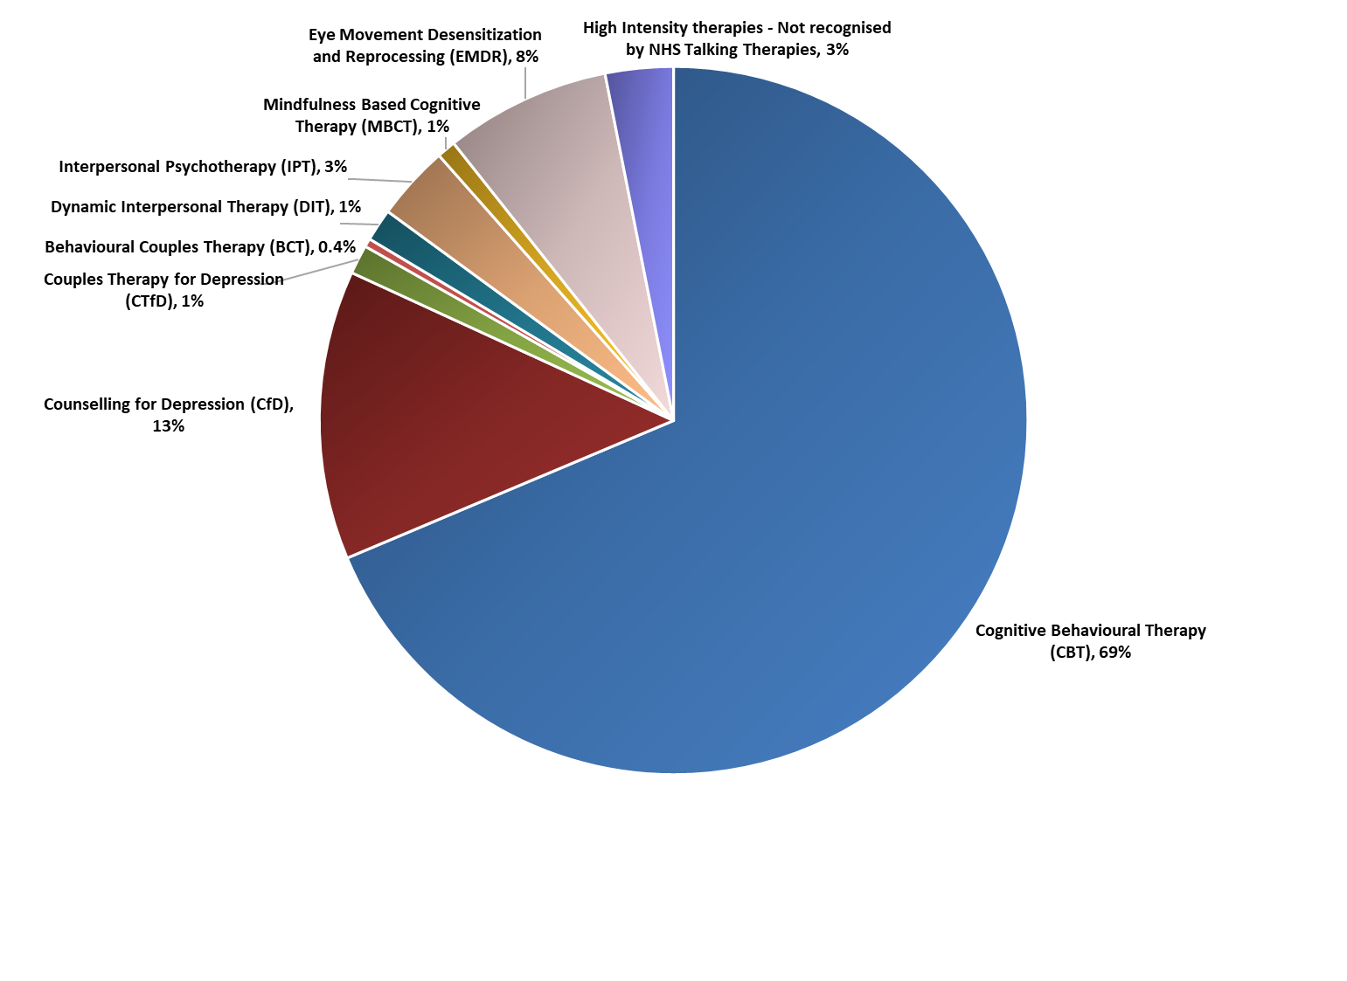
Delivery of therapies
The adjacent chart illustrates how high intensity workforce time is allocated nationally across different therapy modalities.
Service responses detailed over two-thirds of staff time being spent delivering cognitive behavioural therapy (69%). The next largest apportionment was 13% for staff delivering counselling for depression, with a further 8% of time spent working with service users delivering eye movement desensitisation and reprocessing therapy.
Interpersonal psychotherapy and other high intensity therapies (not recognised by NHS Talking Therapies) each had 3% of high intensity staff time (WTE) allocated nationally.

Slide 35
Project findings
Low intensity staffing

Slide 36
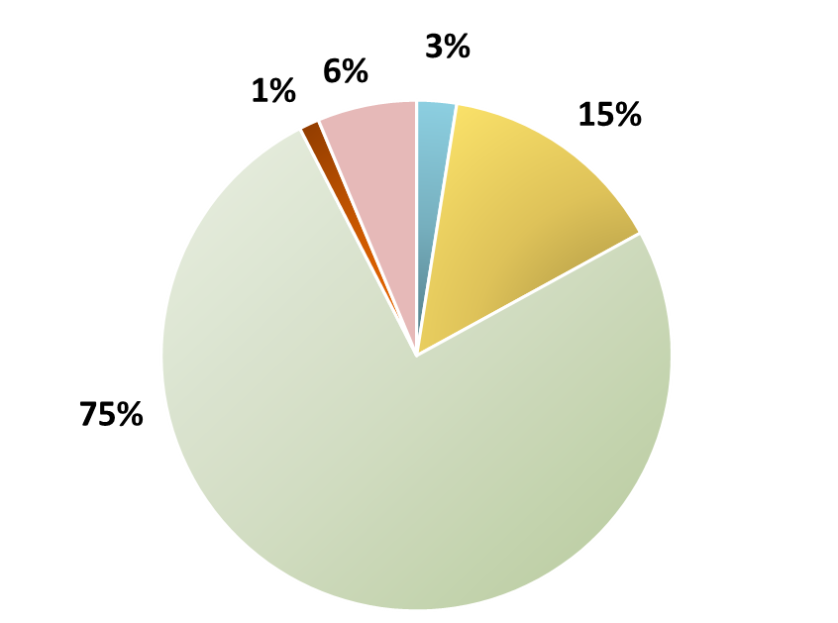
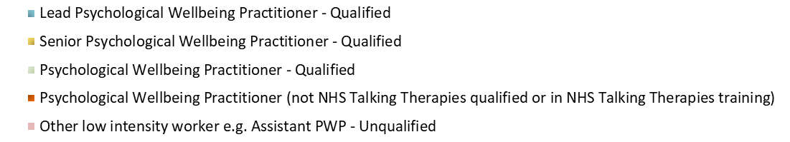
Low intensity workforce composition (WTE)
92% of the low intensity NHS Talking Therapies workforce (excluding trainees) was made up of psychological wellbeing practitioners – comprising qualified lead PWPs, senior PWPs, and PWPs.
The remaining 7% of the low intensity workforce (excluding trainees) is comprised of non-NHS Talking Therapies qualified PWPs.
This composition mirrors that of the 2021 census, where a 93% to 7% split was seen between NHS Talking Therapies qualified and non-NHS Talking Therapies qualified roles.

Slide 37
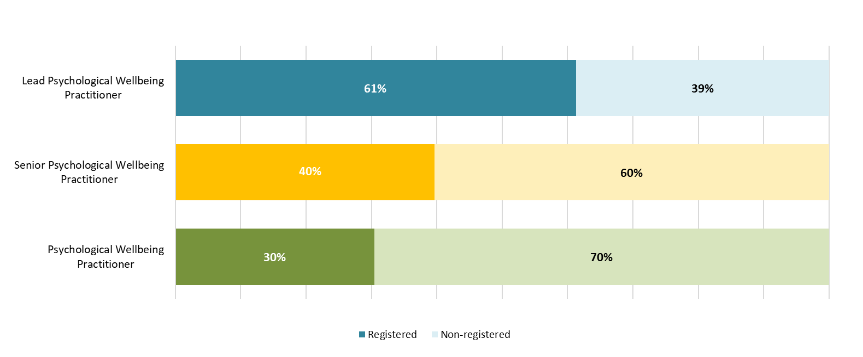
Low intensity workforce – NHS Talking Therapies registered
Additional analysis has been undertaken for 2022 relating to the proportion of qualified PWPs (WTE) who are registered with an NHS Talking Therapies recognised professional body, categorised by role type.
By way of further definition, registration refers to the PWP having undertaken a core NHS Talking Therapies low intensity course, with linked professional registration obtained following this training. This is particularly relevant in the context of the latest NHS England guidance, which stipulates that all PWPs should have either completed this course or currently be in the process of completing the training and be registered with the BABCP or BPS on successful completion.
The chart demonstrates that approximately 6 out of 10 lead PWPs were confirmed as NHS Talking Therapies registered, compared to circa 4 out of 10 senior PWPs, and 3 out of 10 PWPs.
Registers for PWPs opened on 10th June 2021 and became required for PWP practice in NHS Talking Therapies from 10th June 2022. The date for this snapshot of registration was 31st March 2022, during the transition period.

Slide 38
Project findings
Workforce demographics

Slide 39
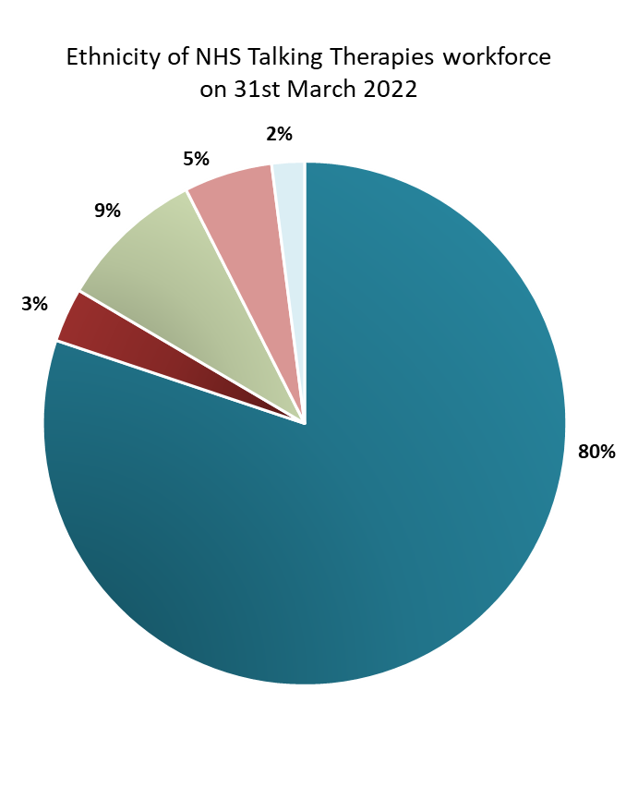
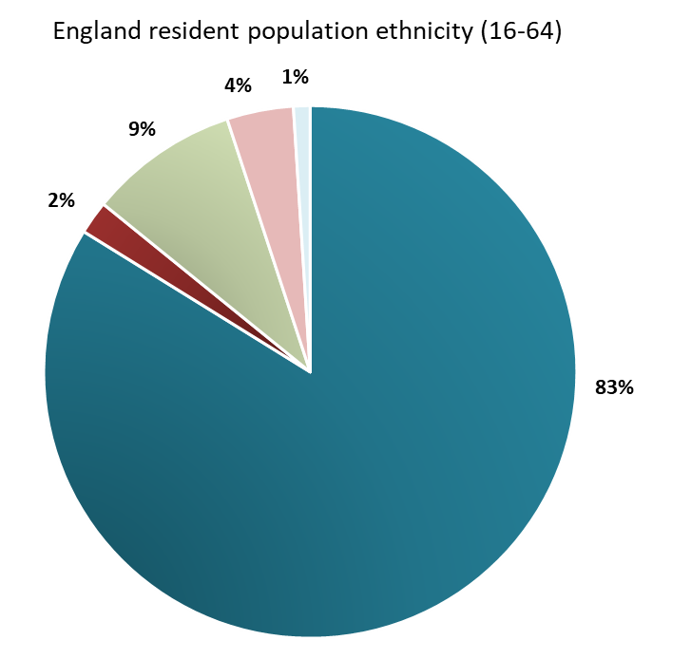
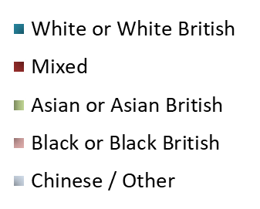
Ethnicity
Ethnicity demographic data was provided for 15,255 staff (headcount), with gender demographics data (provided for 15,368 staff) analysed on the following page.
The ethnicity profile of the NHS Talking Therapies workforce was broadly consistent with wider England population demographics, with 80% of staff in post (headcount) on 31st March 2022 of White/White British ethnicity, compared to 83% in the wider population composition of England (resident population aged 16-64). This composition remains largely unchanged from previous years, and aligns with positions reported across wider NHS Trusts and CCGs (21% of NHS staff from a black and minority ethnic background on 31st March 2020 - Workforce Race Quality Standard 2020 Report).
Please note that whilst the table includes respondents who recorded staff members’ ethnicity as ‘not stated’, the pie charts do not, to allow for comparisons against general population data.
n = 15,255 (headcount)

Slide 40
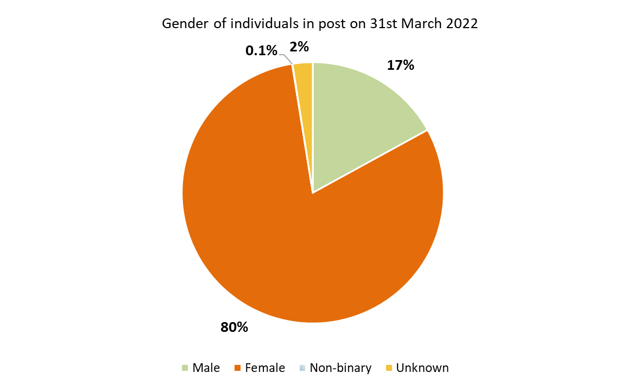
Gender
As with ethnicity demographic data, the gender of individuals working within NHS Talking Therapies services (headcount) on 31st March 2022 is broadly consistent with previously reported data.
Services continued to report a high majority of the workforce as female, though this proportion has reduced slightly from 82% in 2021 to 80% in 2022. This change, however, could be attributed to the increase in the NHS Talking Therapies workforce reported under “unknown” gender categorisation, rising from 0.2% in 2021, to 2.5% in 2022.
Nationally, 8 staff identified as non-binary, in line with 2021 reporting.
n = 15,368 (headcount)

Slide 41
Project findings
Workforce summary metrics

Slide 42
Sickness
801 staff (WTE) were absent from work due to sickness on 31st March 2022. These came from the following staff groups:
  High intensity roles (qualified HITs – CBTs and other NHS Talking Therapies modalities including NHS Talking Therapies qualified counsellors, plus non-NHS Talking Therapies qualified HITs, trainees): 369 staff (WTE)
  Low intensity roles (PWPs – qualified and unqualified, trainees): 265 staff (WTE)
  All other roles: 167 staff (WTE)
The mean sickness absence rate reported by services was 7%. It is worth noting that this is lower than the comparable sickness absence rate reported by adult acute mental health inpatient services during 2021/22, who confirmed a mean position of 8% nationally.

Slide 43
Bank and Agency Staffing
Though bank and agency staff can be vital in cases of widespread staff sickness, a high dependency on these staff can adversely impact service quality and patients’ continuity of care.
On 31st March 2022, a total of 304 bank and agency staff (WTE) were reported as having been utilised by NHS Talking Therapies services.
Bank and agency staff usage was as follows:
  High intensity roles – 132 staff (WTE)
  Low intensity roles – 111 staff (WTE)
  All other roles – 61 staff (WTE)

Slide 44
Vacancies
On 31st March 2022, 1,538 vacancies (WTE) were reported by NHS Talking Therapies services. The vacancies came from the following staff groups:
  High intensity roles: 668 staff (WTE) – 10% (when measured as vacancies / staff in post WTE plus vacancies)
  Low intensity roles: 661 staff (WTE) – 13% (when measured as vacancies / staff in post WTE plus vacancies)
  All other roles: 210 staff (WTE) – 5% (when measured as vacancies / staff in post WTE plus vacancies)
The mean vacancy rate (when measured as vacancies / staff in post WTE plus vacancies) was 12% in 2022. This is notably below the vacancy rate reported within adult acute mental health services, who confirmed an 18% mean vacancy rate nationally in 2021/22.

Slide 45
Staff leavers in previous 12 months
2,114 staff (WTE) left their role in the 12 months to 31st March 2022. This represents 13% of total workforce numbers (when measured as leavers / staff in post WTE on 31st March 2022 plus staff leavers during the preceding 12 months). This represents an increase from the 10% leaver rate reported by NHS Talking Therapies services during the 12 months to 31st March 2021.
The breakdown by staff group is as follows:
  High intensity roles : 803 staff (WTE) – 12% (when measured as leavers / staff in post WTE plus leavers)
  Low intensity roles: 840 staff (WTE) – 16% (when measured as leavers / staff in post WTE plus leavers)
  All other roles: 471 staff (WTE) – 11% (when measured as leavers / staff in post WTE plus leavers)
The mean position reported by services was 13 staff leavers (WTE) per service, up from 9 staff (WTE) per service reported in 2021.
The above figures are inclusive of staff moving on to other NHS Talking Therapies teams, leaving for another role in a different healthcare service, or retiring.

Slide 46
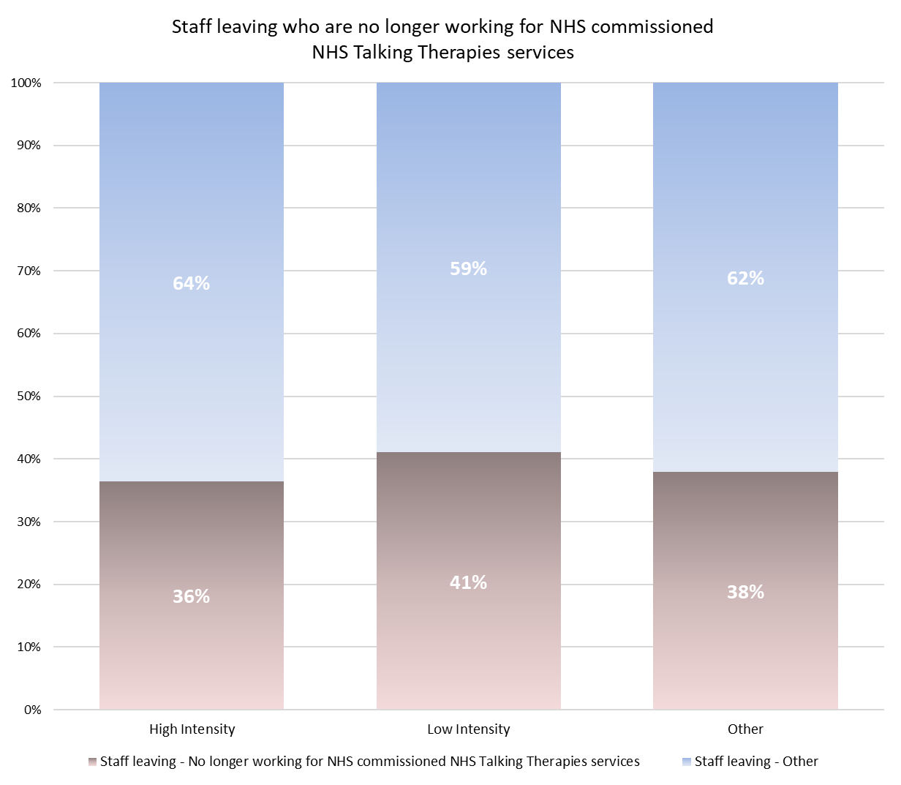
Staff leavers no longer working for NHS services
An additional metric was added to the 2022 data specification to understand staff’s future destination following their departure from NHS Talking Therapies services.
Of the 2,114 total staff (WTE) leaving services in the 12 months to 31st March 2022, 816 staff (WTE) were confirmed as no longer working in NHS-commissioned NHS Talking Therapies services, representing 39% of leavers.
Results ranged between staff groups, with 41% of low intensity staff leavers no longer working for NHS-commissioned NHS Talking Therapies services compared to 36% of high intensity staff leavers.
When clinical (high and low intensity) leaver figures were reviewed in their totality, staff within these roles who were reported as no longer working for NHS-commissioned NHS Talking Therapies services comprised 6% of clinical workforce numbers (when measured as leavers who are no longer working for NHS-commissioned NHS Talking Therapies services / staff in post WTE plus leavers who are no longer working for NHS-commissioned NHS Talking Therapies services).

Slide 47
Project findings
Staff discrimination

Slide 48
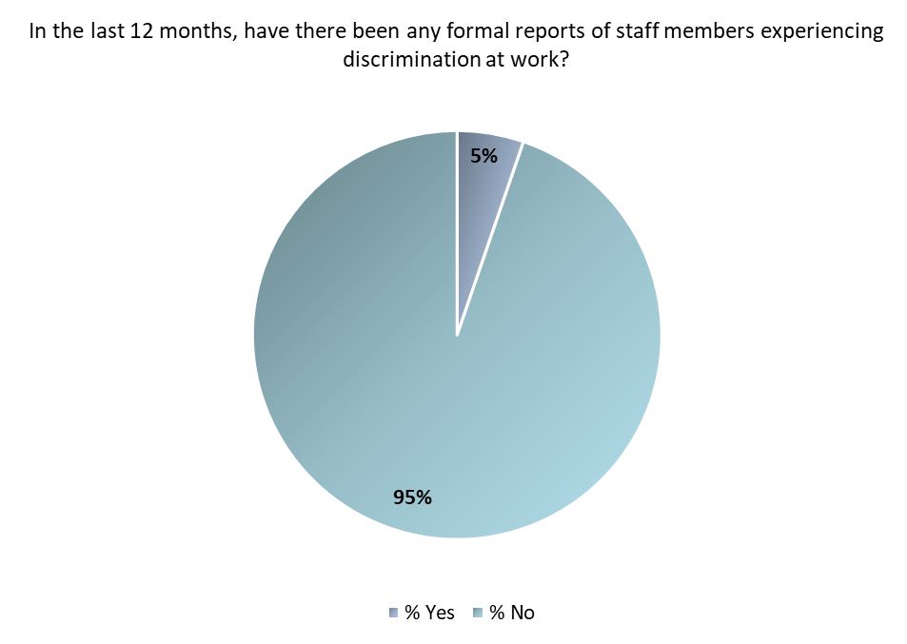
Discrimination in the workplace
Several additional metrics were added to the 2022 data specification to ascertain the prevalence of discrimination within NHS Talking Therapies services nationally.
171 of 200 services responded to this metric, with nine respondents (5%) reporting formal reports of staff members experiencing discrimination while working. This included discrimination by patients/service users and colleagues.
Four services disclosed a total of five reports of staff members experiencing discrimination at work from patients/service users.
Seven services disclosed a total of nine reports of staff members experiencing discrimination at work from colleagues. When reviewed in wider context, this represents a low rate of reporting of discrimination (colleague-to-colleague) for NHS Talking Therapies services, with the Workforce Race Equality Standard 2020 report detailing a 10%* proportion of staff experiencing discrimination at work from a manager/team leader or other colleagues across NHS services in England.
*10% comprised of discrimination data relating to staff from white, black and other ethnic minority backgrounds

Slide 49
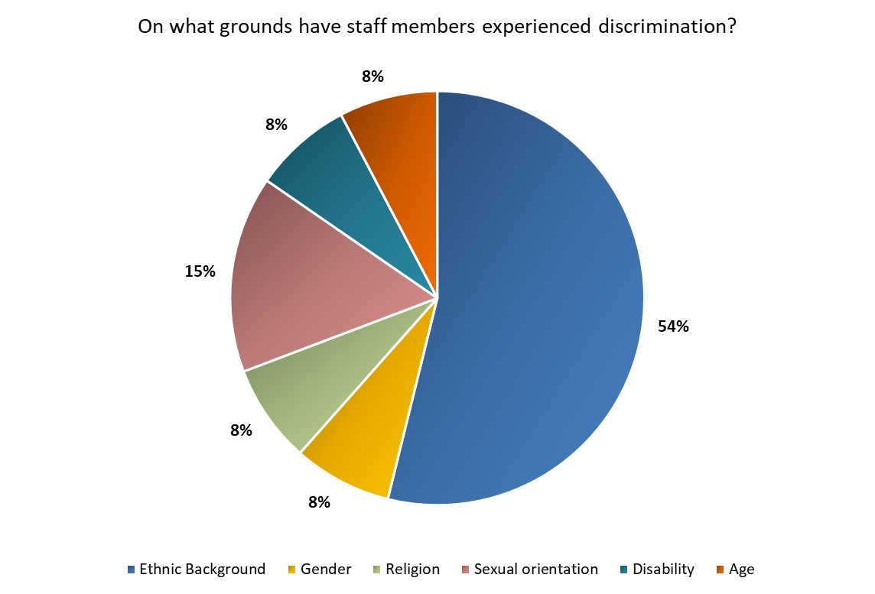
Grounds for discrimination
In conjunction with the metric on the previous page, grounds for discrimination experienced by NHS Talking Therapies staff members were also examined.
It is important to note that only 13 responses were received confirming discrimination as per the specified categorisations.
Ethnic background was reported as the most common ground for staff members experiencing discrimination, comprising 54% (7 responses) of the total formal reporting figures.
Two services confirmed formal reports of discrimination at work on the grounds of sexual orientation (15%).
Additional incidences were reported on the basis of gender, religion, disability and age.

Slide 50
Conclusions

Slide 51
Conclusions
The fourth annual adult NHS Talking Therapies Workforce Census comprised 200 data submissions from NHS Talking Therapies services spanning all CCGs in England as on 31st March 2022, prior to dissolution. Key findings of the stocktake include:
From the first iteration of the workforce benchmarking series in 2019, staff numbers (WTE) nationally have risen by 38%; from 10,325 on 30th June 2019 to 14,299 on 31st March 2022, less than three years later. However, the rate of growth has slowed between 2021 and 2022 to 4%.
Trainee numbers rose by 12% annually, with 2,979 trainees in post on 31st March 2022. These figures comprised 47% high intensity trainees (CBT therapists and counsellors) to 53% low intensity trainees (PWPs).
Qualified high intensity therapists (CBT and other NHS Talking Therapies modalities e.g. counsellors – excluding other HITs not recognised by NHS Talking Therapies) comprised 38% of total workforce numbers (excluding trainees) within the latest dataset (4,317 staff WTE).
The lead psychological wellbeing practitioner role was a new addition to the 2022 specification, with qualified PWPs (lead/senior/PWPs) totalling 2,728 (WTE) on the census date. This marks a 6% increase from the 2021 position, with staff in these roles representing 24% of total workforce numbers (excluding trainees) nationally in 2022.
When the above HIT and PWP qualified staff cohorts are jointly analysed, PWPs/senior PWPs/lead PWPs represent 39% of national workforce totals (WTE). The remaining 61% comes from the high intensity contribution – with 48% of qualified CBT therapists and 13% from HITs – other NHS Talking Therapies modalities (including NHS Talking Therapies qualified counsellors).
Ethnicity demographics of the adult NHS Talking Therapies workforce remain broadly similar to wider, national population statistics, though 20% of the adult NHS Talking Therapies workforce were from Black, Asian, Mixed, Chinese and other ethnic minority backgrounds, compared to 17% of England population numbers (ages 16-64).
13% leaver rate reported in 12 months to 31st March 2022, compared to the 10% rate reported during the previous year.
39% of total leavers in the 12 months to 31st March 2022 confirmed that they no longer worked in NHS-commissioned NHS Talking Therapies services.
The non-NHS-commissioned departure rate for clinical roles (low and high intensity) totalled 6% when calculated as a proportion of clinical staff in post plus leavers no longer working for NHS-commissioned NHS Talking Therapies services.
We would like to reiterate our thanks to all NHS Talking Therapies services who participated in the 2022 census, and Health Education England and NHS England for their ongoing guidance and support.

Slide 52
Appendices

Slide 53
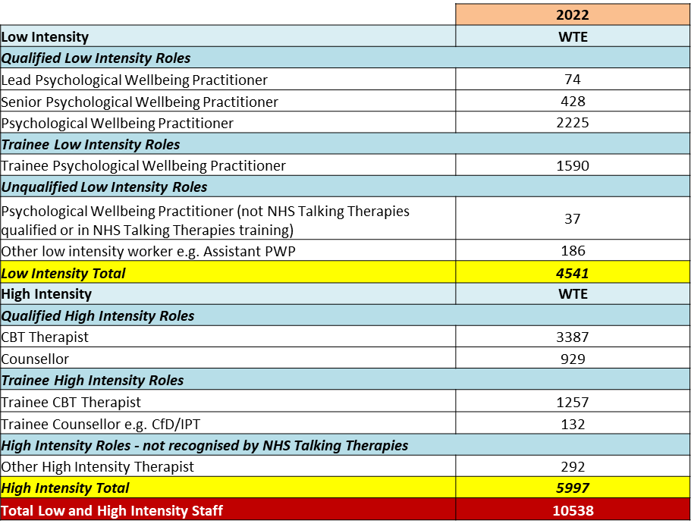
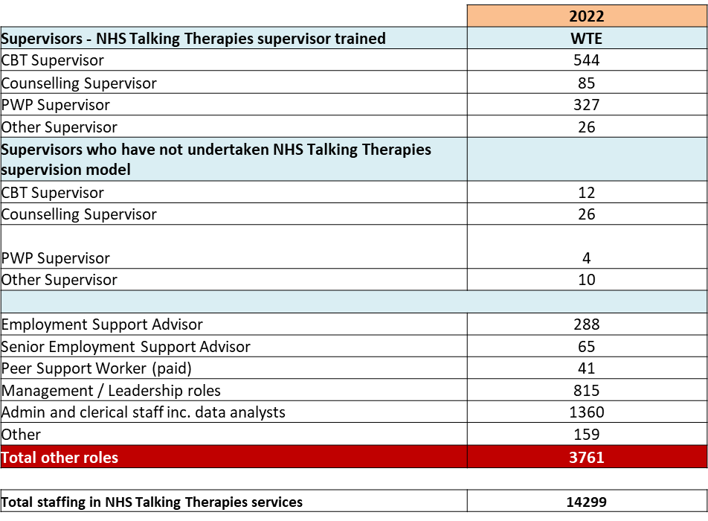
2022 staffing

Slide 54
NHS Talking Therapies workforce overview 2019-2022 –
NHS services - breakdown by role (1)
*
*: 2020 – 2022 cumulative change
*

Slide 55
NHS Talking Therapies workforce overview 2019-2022 –
NHS services - breakdown by role (2)

Slide 56
NHS Talking Therapies workforce overview 2019-2022 –
NHS services - breakdown by role (3)

Slide 57
NHS Talking Therapies workforce overview 2019-2022 –
Non-NHS services - breakdown by role (1)
*
*: 2020 – 2022 cumulative change
*

Slide 58
NHS Talking Therapies workforce overview 2019-2022 –
Non-NHS services - breakdown by role (2)

Slide 59
NHS Talking Therapies workforce overview 2019-2022 –
Non-NHS services - breakdown by role (3)

Slide 60

Contact details
Kirsten Windfuhr | Associate Director (Mental Health) k.windfuhr@nhs.net
Bev Sheard | Head of Workforce Programme b.sheard@nhs.net
Ellie Gosling | Project Manager e.gosling2@nhs.net
Kallie Phillips | Assistant Project Manager k.phillips20@nhs.net
Jack Boyd | Project Coordinator j.boyd3@nhs.net

