Slide 1
Health Education England
Adult IAPT Workforce Census 2020
Project findings v1.3
November 2020

Slide 2
Contents
Executive Summary 3
Introduction and background 4
National IAPT workforce overview 5
Project findings
  Core IAPT service provision and activity 7
  Workforce profile 15
  High Intensity staffing 25
  Low Intensity staffing 30
  IAPT LTC 32
  Workforce demographics 37
  Sickness, vacancies and temporary staffing 40
Conclusions 45
Appendix 47
Contact details 49

Slide 3








2020 Adult IAPT Workforce Census
This report provides a census position of staff in post at 31st March 2020
The Adult IAPT workforce consisted of 9,102 WTE patient facing & 2,538 WTE additional staff
The national average composition of HITs to PWPs is 60% to 40%
1.17 million people entered IAPT treatment in 2019/20
2,025 WTE trainees in post, representing a 50% increase from the 2019 census position
77% of respondents provide an IAPT-LTC service as part of their wider offer
81% of IAPT staff are female, 77% are from a white ethnic background
In 2019/20, 67% of people completing IAPT treatment showed reliable improvement

Slide 4
Introduction and background
The Improving Access to Psychological Therapies (IAPT) programme began in 2008 and has transformed the treatment of adult anxiety disorders and depression in England. Plans set out in the NHS Long Term Plan build on the ambitions of the Five Year Forward View for Mental Health, and will see the number of people with anxiety disorders or depression who can access talking therapies through IAPT increase by an additional 380,000 per year to reach 1.9 million by 2023/24.
The Improving Access to Psychological Therapies (IAPT) workforce census provides a snapshot of the size and shape of the IAPT workforce in England. This work continues to provide a comprehensive national stocktake of the Adult IAPT workforce, with the second iteration of the project measuring staff in post on 31st March 2020 from both NHS and non-NHS providers.
The project was commissioned by Health Education England (HEE) and the NHS Benchmarking Network were asked to complete a detailed workforce stocktake that involved all IAPT providers in England. The work was conducted over the period of May to September 2020 and reported to a project oversight group which included representation from Health Education England, NHS England and NHS Improvement, and provider IAPT specialists. Findings from the work have been discussed with the oversight group and senior workforce leads within HEE and NHS England and NHS Improvement’s mental health team.
The aim of this work was to provide a detailed profile of the IAPT workforce and associated service delivery context including the following areas:
  Service provision and activity
  Workforce size
  Workforce demographics
  Vacancies and temporary staffing
  Training
There was an additional focus this year on the adoption of digital technologies, with new metrics added to the previous data specification distributed to providers. The remainder of the specification was kept as similar as possible to the 2019 version, in order to ensure accurate analysis of the change in the Adult IAPT workforce shape/size between the two census dates.
The NHS Benchmarking Network would like to express our thanks for the contribution made to the project by members of the project’s oversight group, Health Education England, NHS England and NHS Improvement, and the large number of IAPT providers who took part.
About IAPT
IAPT stands for Improving Access to Psychological Therapies
The IAPT programme began in 2008
1.17 million people entered IAPT treatment in 2019/20
67% of people completing IAPT treatment showed reliable improvement in 2019/20

Slide 5
National IAPT workforce overview – 2019 v 2020 pt. 1
The table to the left provides a detailed analysis of the national IAPT workforce in post on 31st March 2020, in comparison to the data provided as part of the 2019 census.
Within core Psychological Wellbeing Practitioner (PWP) and Senior PWP low-intensity roles, there has been a small increase in workforce numbers within the 9 month time period between census dates.
The most notable increase in staffing is seen in high and low intensity trainee numbers, which have increased by 40% and 55% respectively. There has also been an increase in High Intensity Therapist (HIT) roles of 262 WTE (+9%).
Whilst Applied Psychologist numbers have seen a reduction, this may to be due to the re-classification of roles within the data specification rather than a reduction in staffing numbers. The overall High Intensity workforce was shown an 11% uplift.
Overall, there has been a 13% increase in low and high intensity IAPT staffing between the 2019 and 2020 census dates.
 | 2019 | 2020
Low Intensity | WTE | WTE | Change
Psychological Wellbeing Practitioner (PWP) | 1713 | 1747 | 2%
Senior Psychological Wellbeing Practitioner (PWP) | 314 | 350 | 11%
Low intensity trainees | 777 | 1201 | 55%
Low Intensity Total | 2804 | 3298 | 18%
High Intensity
High Intensity Therapists (HITs) | 2804 | 3066 | 9%
High Intensity Counsellors | 801 | 855 | 7%
Applied Psychologist - Clinical | 216 | 155 | -28%
High intensity trainees | 509 | 714 | 40%
High Intensity Total | 4331 | 4790 | 11%
Total Low and High Intensity Staff | 7135 | 8088 | 13%

Slide 6
National IAPT workforce overview – 2019 v 2020 pt.2
 | 2019 | 2020
Employment Support | WTE | WTE | Change
Employment Support Worker or Advisor | 188 | 264 | 41%
Externally contracted Employment Advisor/Coordinator | 172 | 99 | -43%
Employment Support Total | 360 | 363 | 1%
Other Low Intensity staff
PWP Workers (Not-IAPT qualified) | 155 | 280 | 81%
Other Low Intensity counsellors | 73 | - | -
Other Low Intensity therapists | 78 | - | -
Other Low Intensity subtotal | 306 | 280 | -8%
Other trainees | 68 | 110 | 62%
"Other" category | 322 | 261 | -19%
Other Total | 695 | 651 | -6%
Total patient-facing staff | 8191 | 9102 | 11%
In other patient-facing roles, there has been an evident shift in employment support staff being employed internally in March 2020, compared to June 2019 data which illustrated a greater reliance on external staff filling these roles.
As with high and low intensity trainee numbers, the number of other trainees in post has also seen an increase between census dates, although these trainees represent only a small number of employees nationally with the majority of trainee staff employed within either high or low intensity staffing groups.
Additionally, there has been a 19% increase in non-patient facing staff in post, which is to be expected in order to provide support for the increased number of patient-facing staff employed by IAPT providers.
Overall, total staffing has increased by 1,315 WTE (13%) which is a positive finding taking into account the short 9 month time period between census reporting dates.
 | 2019 | 2020 | Change
Non-patient facing staff
Supervisors - IAPT accredited | 540 | 782 | 45%
Supervisors - not IAPT accredited | 137 | 66 | -52%
Managers | 438 | 500 | 14%
Admin and clerical staff inc. data analysts | 1019 | 1189 | 17%
Total non-patient facing staff | 2135 | 2538 | 19%
Total staffing in IAPT services | 10325 | 11640 | 13%

Slide 7
Project findings
Core IAPT service provision and activity

Slide 8
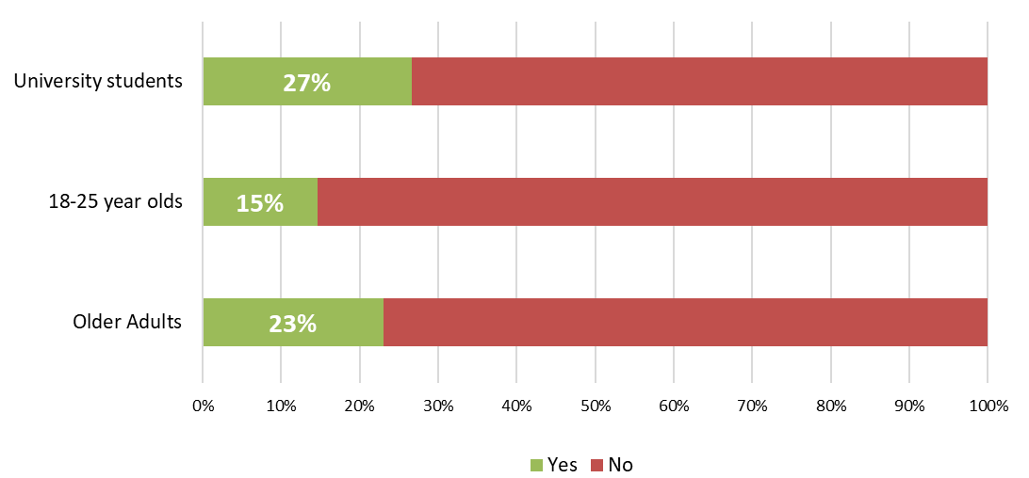
Service provisions - Access
Most services do not impose specific age limits. Indeed, a small number have developed pathways for specific patient cohorts. The charts below show the proportion of services with targeted services for young adults and older people. University services are common in areas with large student populations and may be co-located with student medical centres.
The proportion of IAPT providers who have specific pathways in place for patients aged 18-25 has increased from the 2019 project iteration, from 9% to 15%.
27% of IAPT providers have specific pathways for University students while 23% have services targeted specifically at Older Adults - unchanged from the 2019 reported position.

Slide 9
Age restrictions
Placement of lower/upper age bandings within core IAPT services remains largely unchanged from 2019, with the majority of organisations reporting a lower age limit of either 16 or 18 years.
In comparison, only a small number of providers advised that they had an upper age limit in place.

Slide 10
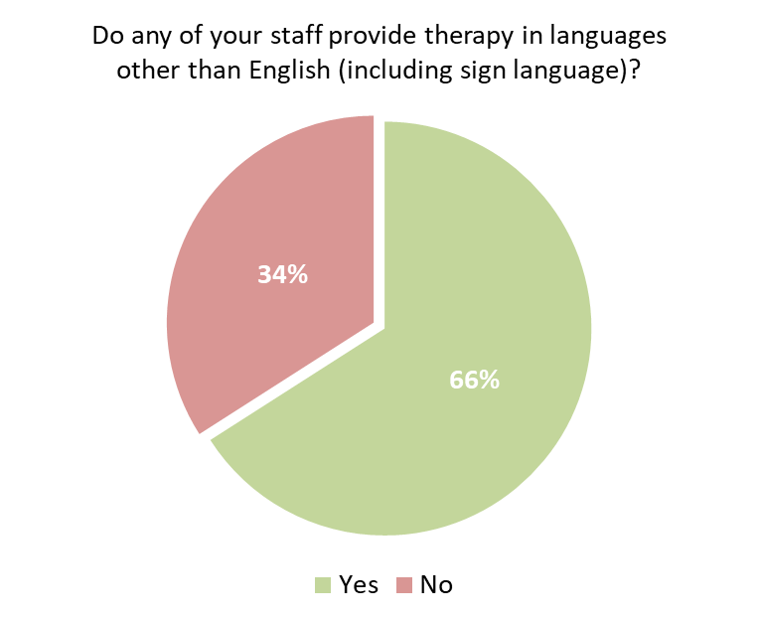
Therapy in languages other than English
66% of providers (122 of the 185 respondents to this metric) employ staff who can provide therapy in languages other than English, including sign language.
In many providers, a selection of languages are available. The most commonly available languages are:
Polish – 43 providers
Urdu – 37 providers
Punjabi –28 providers
Spanish –23 providers
This is a fluid metric that links directly to the profile of staff in post and may change frequently depending on staff turnover.

Slide 11
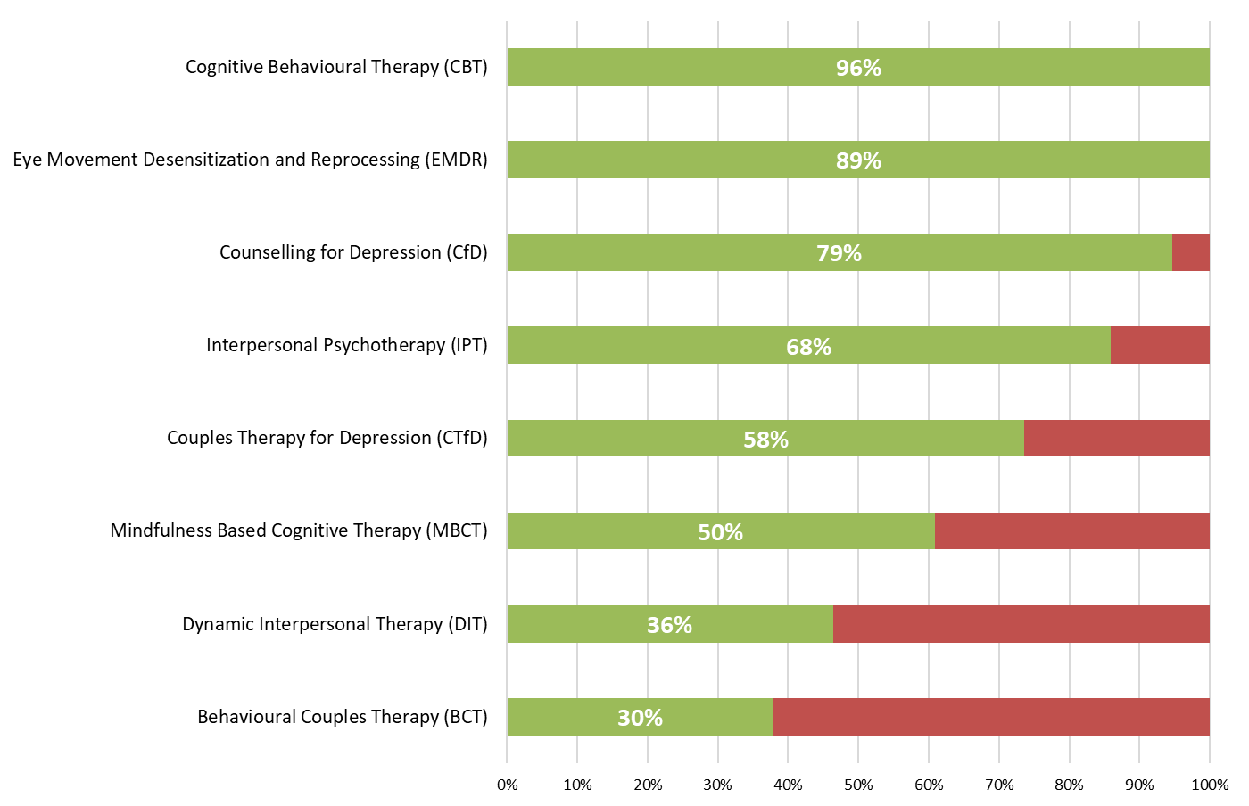
Therapeutic offer
The table below summarises the therapeutic offer of participating IAPT providers, based on staff in post on 31st March 2020.
As with the 2019 project iteration, the therapy with most provision was Cognitive Behavioural Therapy (CBT - 96% of providers), followed by Eye Movement Desensitization and Reprocessing (EMDR - 89% of providers) and Counselling for Depression (CfD - 79% of providers).
It should be recognised that whilst every local system of stepped care must include both high and low intensity service offerings, a single provider may only provide part of the pathway, hence the absence of CBT services within a small number of providers.

Slide 12
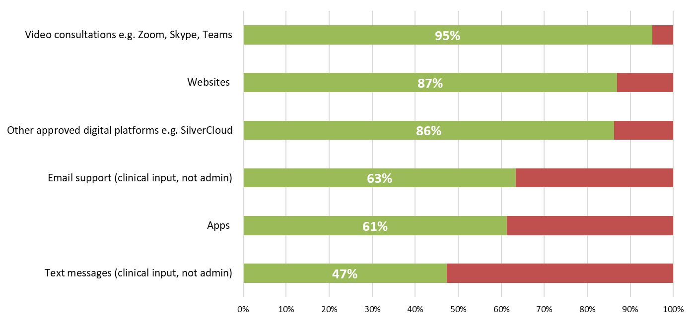
Digital offer
Additional metrics were added this year to quantify the digital offering currently in place within IAPT services.
Results showed that video consultation systems are now in use in almost all IAPT providers (95%), with over 80% of participants also promoting websites (87%) and other approved digital platforms (86%) as part of their overall digital service offering.

Slide 13
Project findings
Workforce profile

Slide 14
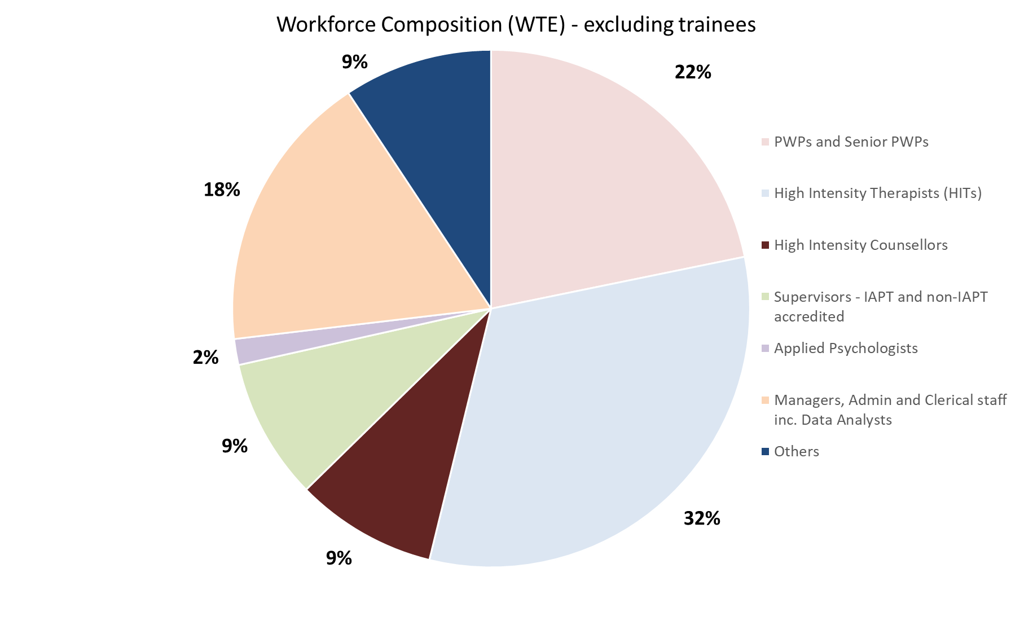
Workforce composition (WTE) pt. 1
“Others” include:
Employment Support Worker/Advisors: 3%
Externally contracted Employment Advisor/Coordinator: 1%
Other: 3%
PWP Workers: 3%
Analysis of the IAPT workforce by role confirms that most staff are employed in specific therapy roles.
Across all IAPT providers, 54% of staff are in the core disciplines of PWPs or HITs.
Around 18% of staff are in non-therapy roles including administration, management and clerical roles.

Slide 15
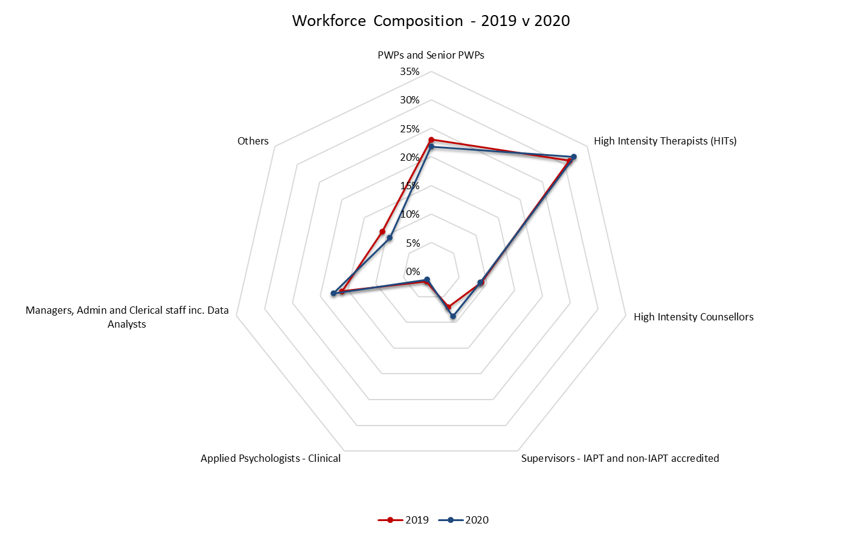
Workforce composition (WTE) pt. 2
Whilst the 2020 IAPT workforce has grown in size since 2019, the workforce composition remains largely unchanged.
As detailed within the chart and table below, over half of the IAPT workforce were in the core roles of PWPs and HITs on both the 2019 and 2020 census dates.
Workforce composition | 2019 | 2020
PWPs and Senior PWPs | 23% | 22%
High Intensity Therapists (HITs) | 31% | 32%
High Intensity Counsellors | 9% | 9%
Supervisors - IAPT and non-IAPT accredited | 7% | 9%
Applied Psychologists - Clinical | 2% | 2%
Managers, Admin and Clerical staff inc. Data Analysts | 16% | 18%
Others | 11% | 9%

Slide 16
Workforce size by provider
Total staffing numbers (excluding trainees) per team are shown in the chart opposite. Services vary in size and coverage by provider organisation, with a median average staffing position of 46 WTE per provider, an increase from 42 WTE in 2019.
In the bigger teams the workforce exceeds 100 WTE, with the largest provider reporting a team of over 200 WTE.
This is not a benchmarked position, but is included to highlight the variation in team size by provider.

Slide 17
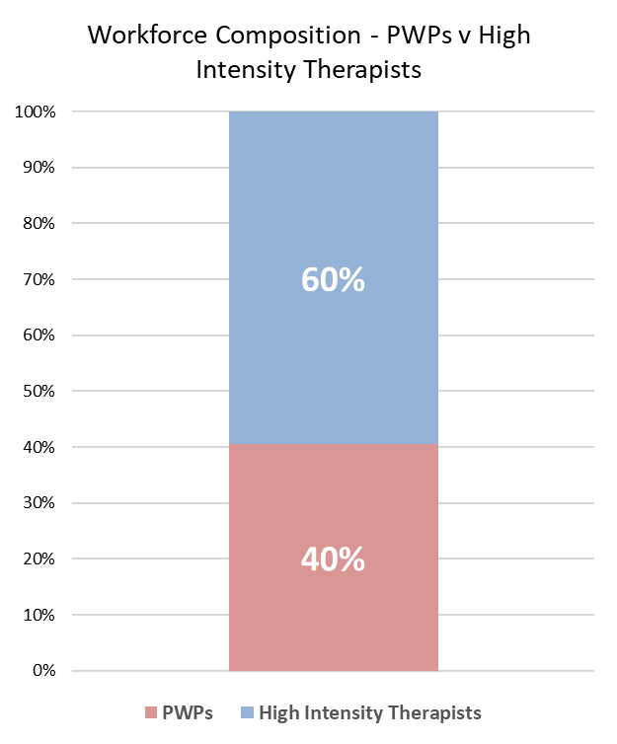
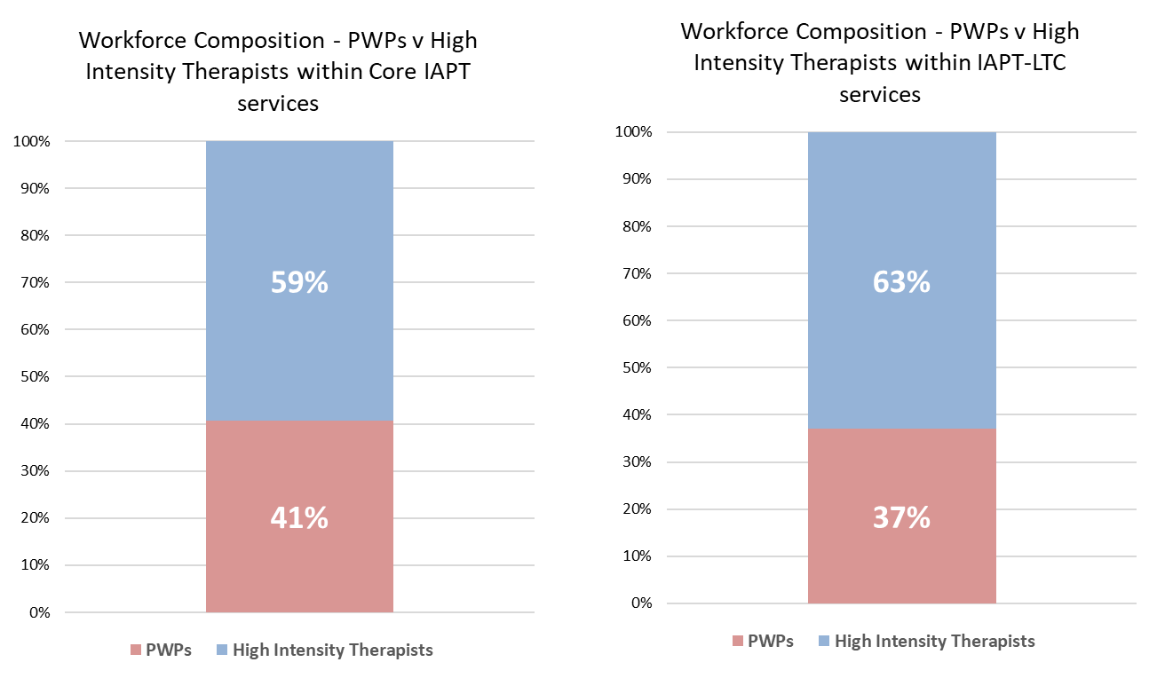
Workforce composition – HITs Vs PWPs
Since the 2019 project iteration, the ratio of HITs and PWPs has risen to 60% HITs to 40% PWPs (was 57% to 43%).
While both report higher levels of HITs than PWPs, there are differences between Core IAPT and IAPT LTC on this measure. Within Core IAPT services, the ratio is 59:41. In IAPT LTC, however, the lean towards HITs is even stronger, at 63:37 as shown in the charts below.

Slide 18
Workforce size by provider - HITs
High Intensity Therapists (HITs) are the single largest staff group employed within IAPT services. On 31st March 2020, there were 3,066 WTE staff in HIT posts – an increase from 2,804 (+9%) in 2019.
Within individual organisations where HITs are employed, these High Intensity Therapists make up an average of 32% of the overall workforce.
The range of HIT representation varies from 1% to 68% of staff in post at the time of the 2020 census.

Slide 19
Workforce size by provider - PWPs
Psychological Wellbeing Practitioners (PWPs) deliver a core role within low intensity IAPT services. In total on 31st March 2020, 2,097 WTE staff in post were PWPs or Senior PWPs. This represents a 13% increase from the 2,028 WTE PWP / Senior PWP staff recorded on the 2019 census date of 30th June.
The chart to the left shows that in organisations where PWPs/Senior PWPs are employed, these roles represent an average of 23% of the IAPT workforce.
There is notable variation in PWP presence within IAPT services, confirming the discretion exercised by providers in designing local teams. It should be recognised that while every local system of stepped care should include PWPs, single providers may only provide part of the pathway.

Slide 20
HITs progressing from PWPs
IAPT career paths include a recognised development route for Psychological Wellbeing Practitioners who wish to train to become High Intensity Therapists.
In total, 285 PWPs WTE progressed into HIT training within the last 12 months.
101 participants (54%) reported employee progression into HIT training within their services.
It is worth noting that these figures do not include other HITs who have progressed from PWP roles but have moved organisation in the process.

Slide 21
Trainees
The development of new staff into specialist therapy roles is enabled by the active training programmes which recruit trainees into IAPT.
Of these trainees, the breakdown by role was as follows:
Low intensity trainees – 1,201 WTE
High intensity trainees – 714 WTE
Other trainees – 110 WTE

Slide 22
Project findings
High Intensity staffing

Slide 23
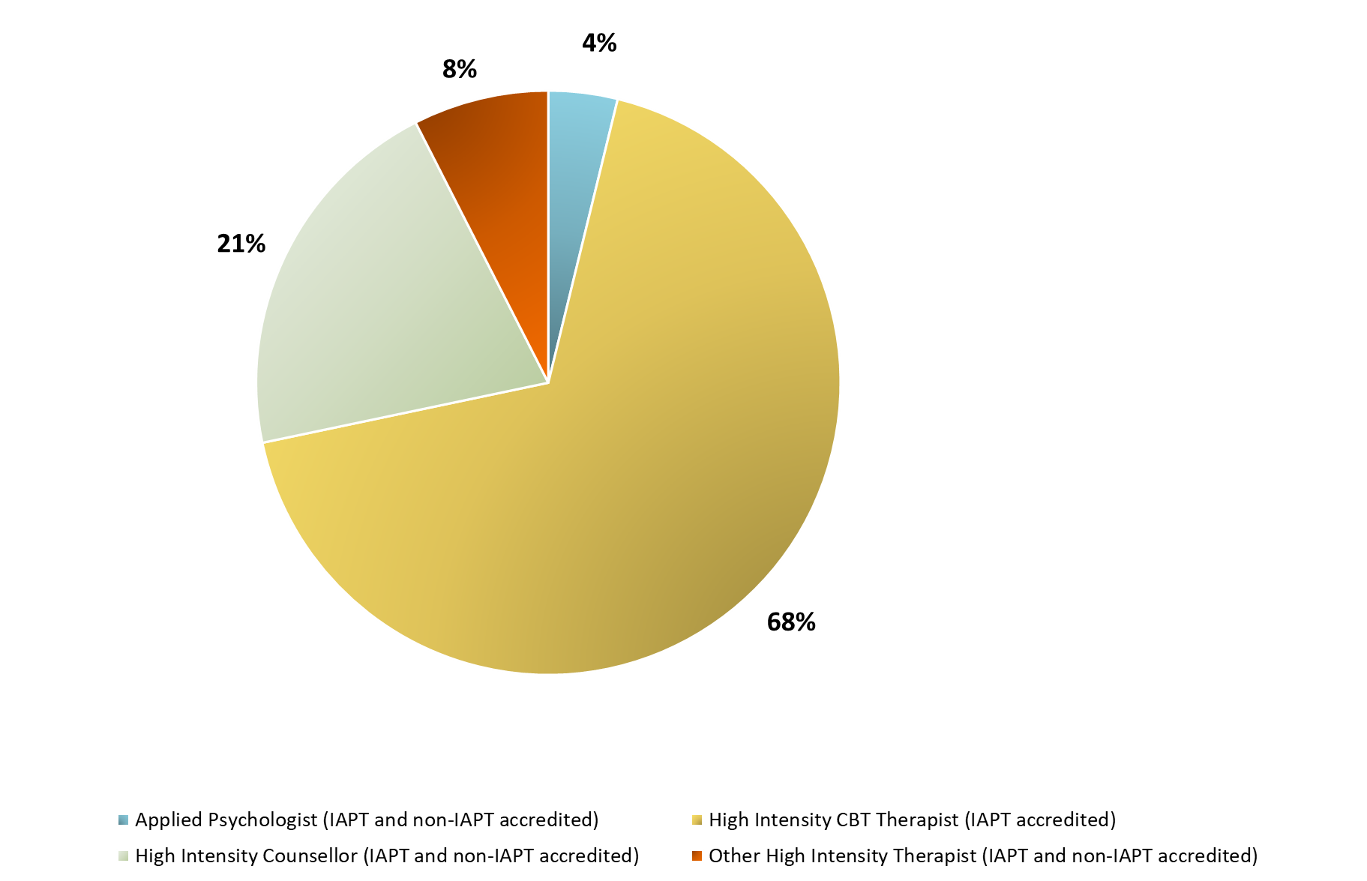
High Intensity Workforce composition (WTE)
Over two thirds of the IAPT High Intensity workforce (excluding trainees) is made up of High Intensity CBT Therapists (68%) – by far the largest cohort within this staffing group.
High Intensity counsellors make up the majority of the remaining workforce (21%), with smaller numbers of other high intensity therapists (8%) and Applied Psychologists (4%) completing the remainder of the IAPT High Intensity workforce composition.

Slide 24
High Intensity Workforce – IAPT accreditation
The chart to the left displays the proportion of participants’ High Intensity workforce (excluding trainees) that is made up of IAPT accredited staff.
On average, 88% of participating organisations’ High Intensity workforce consisted of IAPT-accredited staff.
Only a small number of participants (2 organisations) reported 0 IAPT accredited staff within their High Intensity workforce.

Slide 25
Project findings
Low Intensity staffing

Slide 26
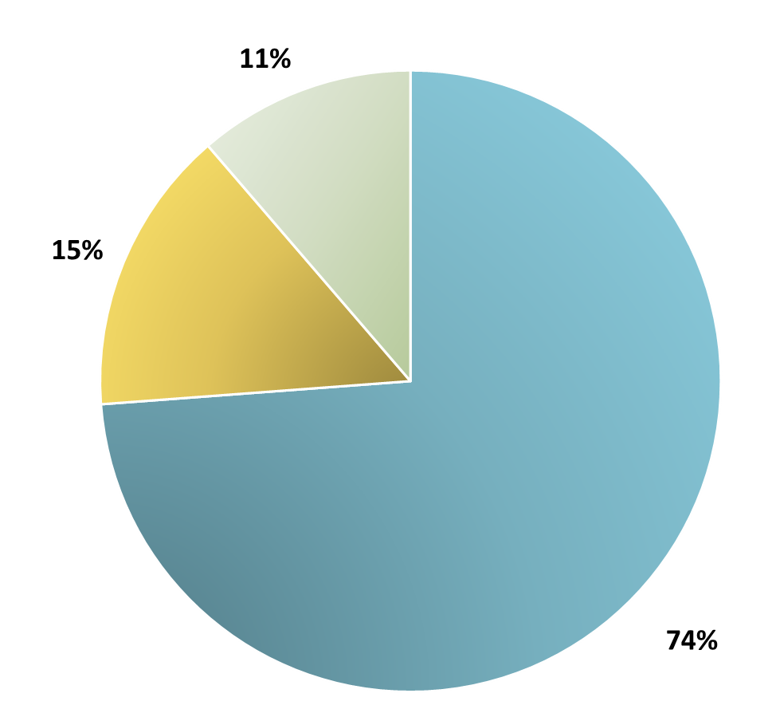
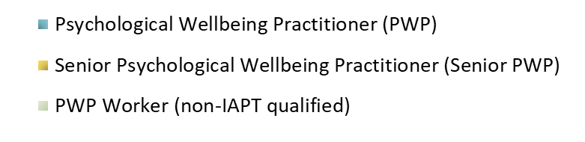
Low Intensity Workforce composition (WTE)
On the census date of 31st March 2020, approximately three quarters of the Low Intensity IAPT workforce cohort was made up of Psychological Wellbeing Practitioners (74%), with the remaining 26% consisting of Senior PWPs (15%) and non-IAPT qualified PWP workers (11%).

Slide 27
Low Intensity Workforce – IAPT accreditation
Nationally, an average of 90% of organisations’ Low Intensity workforce numbers were IAPT accredited, similar to the 88% reported within the High Intensity staffing cohort.
The majority of organisations reported a workforce consisting solely of IAPT accredited staff, as illustrated by the median position of 100%.
Just 1 organisation reported 0 IAPT accredited staff within their Low Intensity workforce.

Slide 28
Project findings
IAPT LTC

Slide 29
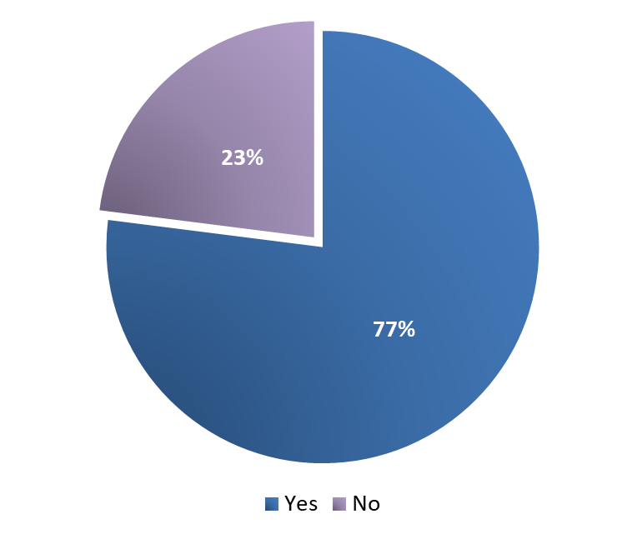
Service provisions – IAPT LTC
An additional focus of the 2020 project iteration was to better quantify the size and shape of the IAPT LTC workforce.
In terms of service offering, 144 of 187 participants confirmed that they offered an IAPT-LTC service, representing 77% of providers overall.
This illustrates an increase from last year’s collection, where 75% of participants provided IAPT-LTC within their service model.

Slide 30
HITs in IAPT – LTC services
High Intensity Therapists (HITs) represent the most commonly employed role within LTC services, with 237 WTE in post on the census date of 31st March 2020.
Of organisations who employ HITs within their IAPT-LTC workforce, an average of 3 WTE HITs are employed per service.

Slide 31
PWPs in IAPT – LTC services
Within the IAPT-LTC workforce, 139 WTE staff are Psychological Wellbeing Practitioners (PWPs) or Senior PWPs.
Of the participating organisations who employ PWPs in their IAPT-LTC services there is an average of 2 WTE PWPs in post.

Slide 32
IAPT – LTC top-up training
In over two thirds (69%) of teams, 100% of staff in post had attended the IAPT-LTC top up training.
These findings are consistent with the 2019 project data, and demonstrate broad compliance with the aims of ensuring staff have the skills and competencies required to deliver their role.

Slide 33
Project findings
Workforce demographics

Slide 34
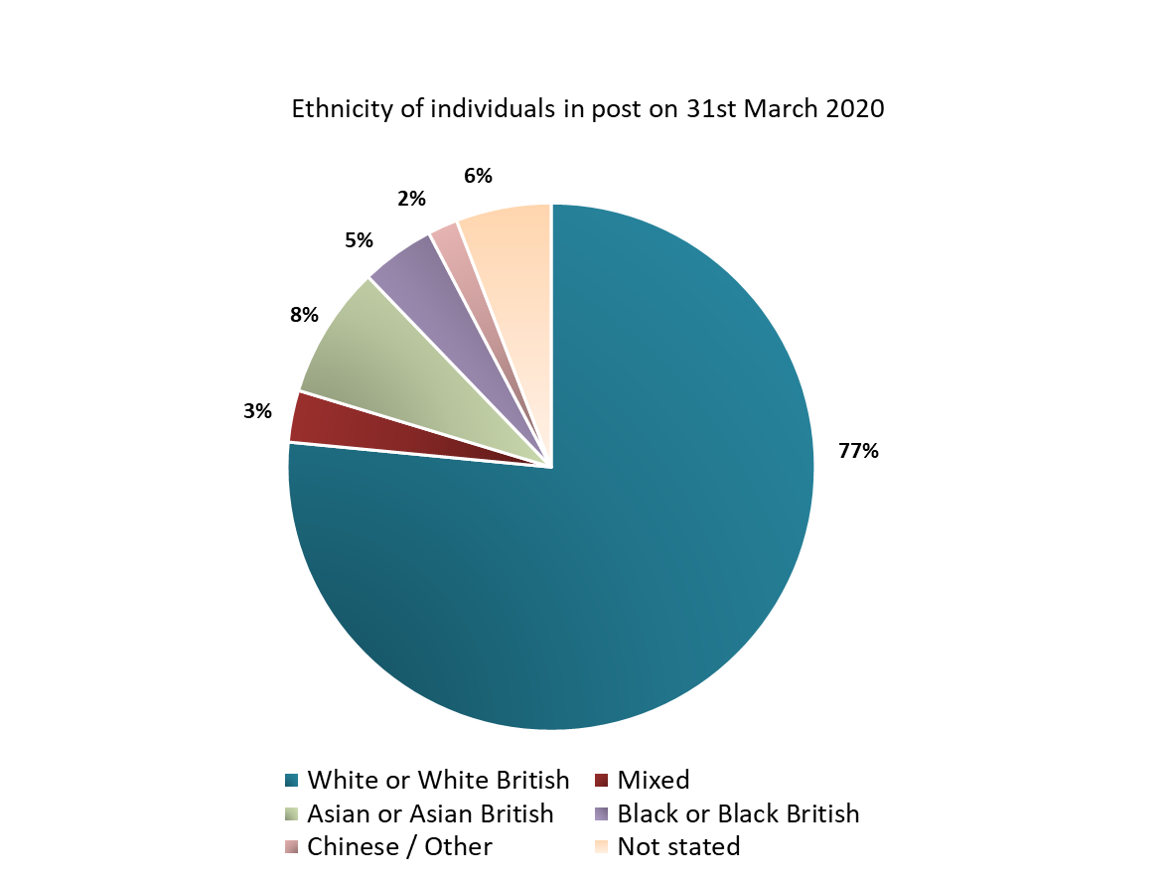
Ethnicity
Analysis of the ethnicity profile of the IAPT workforce confirms a profile that is broadly consistent with wider England population demographics.
Whilst the IAPT workforce has undergone notable growth since the 2019 census, demographic profiling for staff in place on the 2020 census date of 31st March remains largely unchanged.
n= 11,893

Slide 35
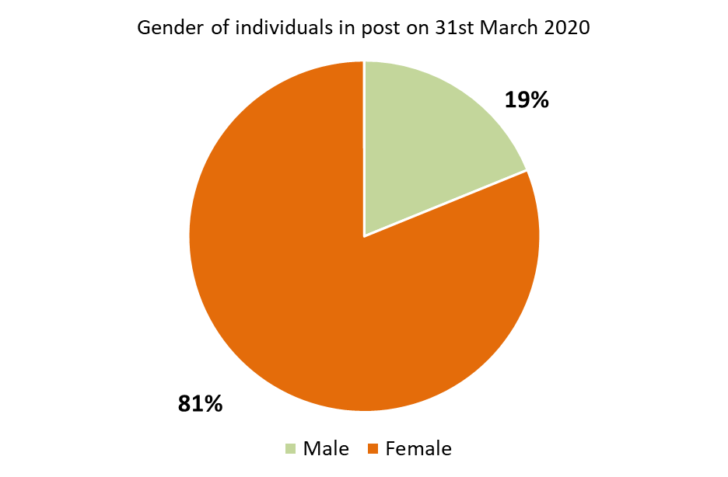
Gender
As with ethnicity, the gender of individuals working within IAPT services is also consistent between census dates, with results displaying a predominantly female workforce.
At the time of the 2020 census, there were 9,741 female staff in post (81% of the IAPT workforce) and 2,263 male staff in post (19% of the IAPT workforce).
Additionally 1 member of staff identified as non-binary and 34 staff members were recorded as unknown gender.
n = 12,039

Slide 36
Project findings
Sickness, vacancies and temporary staffing

Slide 37
Sickness
383 WTE staff were absent from work due to sickness on 31st March 2020. These came from the following staff groups:
PWPs: 95 WTE
HITs: 161 WTE
Other staff: 126 WTE
The mean average sickness rate of 5% nationally is slightly higher than the wider NHS-wide average sickness position of 3.5% of time lost due to illness.
It is worth noting that the results of this metric may have been influenced by the Covid-19 pandemic, with additional staff likely to be absent on the census date compared to normal levels.

Slide 38
Bank and Agency Staff
The use of temporary staff is an important issue which can reference service quality and continuity of care. Use of bank and agency staff within IAPT services is relatively infrequent, and illustrates the lowest rates recorded when compared to mental health services nationally, with a median average of 4% of staff allocated to this group at the time of the 2020 census.
Across all providers, 289 WTE bank and agency staff were in use on 31st March 2020, of whom:
PWPs: 111 WTE
HITs: 93 WTE
Other roles: 84 WTE
As with sickness rates detailed on the previous page, this metric could also have been influenced by the potential upswing in bank and agency staffing required to cover sickness of staff absent from work on the census date due to the Covid-19 pandemic.

Slide 39
Vacancies
IAPT providers reported 888 WTE vacancies at 31st March 2020, of whom:
411 WTE were PWPs: 17% of all PWP/Senior PWP posts
326 WTE were HITs: 10% of all HIT posts
151 WTE were other roles: 3% of all other posts
This illustrates a reduction from the total of 919 WTE vacancies reported in 2019, which is a positive finding particularly considering the workforce growth that has taken place between the two census dates.
Nationally, the average vacancy rate amongst participants was 11%, which is in line with the rates recorded within wider mental health services,

Slide 40
Total staff who left services in previous 12 months
In total, 1,661 WTE staff left their role in the 12 months to 31st March 2020.
The definition of turnover included all reasons for leaving including moving to another IAPT team, moving elsewhere in the NHS, leaving the NHS for another role, or retirement.

Slide 41
Conclusions

Slide 42
Conclusion
This project has successfully met the objective of undertaking a comprehensive assessment of the IAPT workforce in England. The project received data contributions from IAPT providers covering all CCGs in England except one, allowing a national position to be developed.
A total of 11,640 WTE staff were identified in IAPT services across England in March 2020. The majority of the IAPT workforce consisted of patient-facing staff, who amounted to 78% of the overall staffing numbers.
Analysis of workforce demographics confirms a service that has good levels of diversity consistent with the wider England population. The workforce is largely female in composition.
Recent developments in IAPT include the expansion of IAPT-LTC (Long Term Conditions), a primary care based pathway for people with physical health conditions and medically unexplained symptoms. In 2020, 77% of respondents offered an IAPT-LTC service compared to 75% in 2019.
The 2019 and 2020 censuses have provided a clear methodology for further collections which can be used to track workforce expansion in future years. The aspiration to conduct future IAPT workforce census exercises using the methodology will provide additional assurance on the changes that are taking place in the IAPT workforce over time.
We would like to thank all providers for taking part in the 2020 census.

Slide 43
Appendix

Slide 44
2020 staffing
 | 2020
Low Intensity | WTE
Psychological Wellbeing Practitioner (PWP) | 1747
Senior Psychological Wellbeing Practitioner (PWP) | 350
PWP Workers (non-IAPT qualified) | 280
Low intensity trainees | 1201
Low Intensity Total | 3577
High Intensity - IAPT accredited | WTE
High Intensity CBT Therapists | 2762
Other High Intensity Therapists | 213
High Intensity Counsellors | 572
Applied Psychologist | 126
High Intensity - non-IAPT accredited | WTE
Other High Intensity Therapists | 91
High Intensity Counsellors | 283
Applied Psychologist | 29
High intensity trainees | 714
High Intensity Total | 4790
Total Low and High Intensity Staff | 8368
Employment Support | WTE
Employment Support Worker or Advisor | 211
Senior Employment Support Worker or Advisor | 54
Externally contracted Employment Advisor/Coordinator | 99
Employment Support Total | 363
Other staff | WTE
"Other" category | 261
Other trainees | 110
Other Total | 371
Total other staff | 734
Total patient-facing staff | 9102
Supervisors - IAPT supervisor trained | WTE
Supervisor - HIT CBT | 409
Supervisor - PWP | 301
Supervisor - HIT Counsellor | 42
Supervisor - HIT Other | 31
Supervisors - non-IAPT supervisor trained | WTE
Supervisor - HIT CBT | 18
Supervisor - PWP | 11
Supervisor - HIT Counsellor | 35
Supervisor - HIT Other | 3
Other non-patient facing staff | WTE
Managers | 500
Admin and clerical staff inc. data analysts | 1189
Total non-patient facing staff | 2538
Total non patient-facing staff | 2538

Slide 45



Contact details
 | Stephen Watkins | Director | NHS Benchmarking Network s.watkins@nhs.net _ _
 | Zoë Morris| Programme Manager | NHS Benchmarking Network zoe.morris@nhs.net _ _
 | Ellie Fox | Assistant Project Manager | NHS Benchmarking Network e.fox4@nhs.net _ _

