Slide 1
Initial Education and Training of Pharmacists (IETP) Reform: Implementation for 2025/26
Update October 2024
NHS England Workforce, Training & Education Pharmacy Team

Slide 2
Content
Introduction – key facts relating to IETP reform
Supervision and Assessment in the Foundation Training Year
Practice Based Assessment Strategy for 2025/26
Training Plans: Template, guidance and process for 2025/26
National Recruitment Scheme (NRS) for 2025/26
Planning training posts for 2025/26
Training and support in the Foundation Training Year
Notes:
Plain slide with subhead and bullets

Slide 3
IETP reform: key facts

Slide 4
IETP reform – key facts (1)
New standards for Initial Education and Training of Pharmacists (IETP) published by the GPhC in 2021
New learning outcomes – enhanced clinical capabilities and independent prescribing at point of first registration
GPhC delegating responsibility for quality management of all training sites in England to NHSE Workforce Training and Education as the Statutory Education Body (SEB) for England.
All trainee pharmacists must be recruited through the National Recruitment Scheme (NRS) on the Oriel platform for 2025/26
NRS is key element of quality management of training sites
There will be no approval of training sites outside of this process (by NHSE or GPhC)
No eligibility or mechanism for payment outside of this process
Harmonisation of funding for training sites across all sectors for 2025/26: £26,500
Additionally, consistent training course offer for all trainees
Notes:
Plain slide with subhead and bullets

Slide 5
IETP reform – key facts (2)
The 2025/26 Foundation Training Year is the first year where:
NHSE WT&E will take on delegated responsibility from the GPhC for the quality assurance/management of all foundation trainee pharmacists in England
The full new learning outcomes (incorporating independent prescribing) will be used
All trainees graduating from university against the new learning outcomes will have to be assessed against all new learning outcomes including independent prescribing during the foundation year
There will be some graduates entering foundation training in 2025/26 who will not have graduated against the new learning outcomes and will not be able to be an independent prescriber at first registration:
Some MPharm graduates who have started against the old learning outcomes and have had their learning interrupted
Graduates from OSPAP (Overseas Pharmacists' Assessment Programme)
Notes:
Plain slide with subhead and bullets

Slide 6
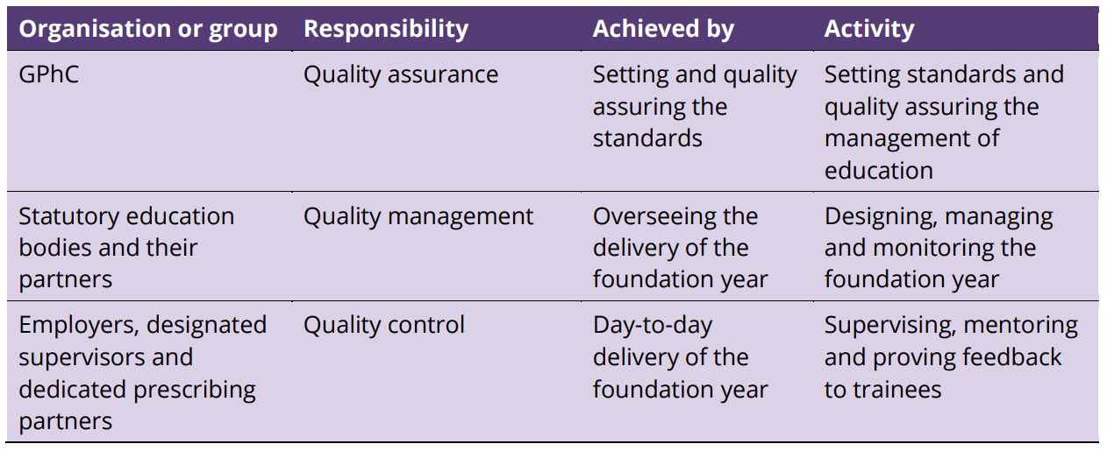
https://www.pharmacyregulation.org/sites/default/files/document/standards-for-the-initial-education-and-training-of-pharmacists-january-2021_final-v1.3.pdf

Slide 7
Supervision and Assessment in 2025/26

Slide 8
Supervision and Assessment (1)
https://www.hee.nhs.uk/our-work/pharmacy/transforming-pharmacy-education-training/initial-education-training-pharmacists-reform-programme/implementing-foundation-pharmacist
Notes:
Plain slide with subhead and bullets

Slide 9
Supervision and Assessment (2)
The requirements for training sites from 2025/26 are set out within:
National Recruitment Scheme Terms of Participation and associated documents:
NHS England Foundation Trainee Pharmacist Programme: Practice-based Assessment Strategy (from 2025/26)
NHS England FTPP Training Plan Template and Guidance
Prescribing supervision and assessment in the Foundation Trainee Pharmacist Programme from 2025/26
Foundation training site requirements for 2025/26
Designated Supervisor Requirements for the 2025/26 Foundation Training Programme
NHS England Quality Framework
Notes:
Plain slide with subhead and bullets

Slide 10
Supervision and Assessment (3)
These requirements include:
In accordance with GPhC requirements, Employers must ensure that the trainee will have access to:
a Prescribing Learning Environment
a Designated Supervisor
a Designated Prescribing Practitioner
Employers must use the NHS England Foundation Trainee Pharmacist Programme: Practice-based Assessment Strategy
Employers must use the NHS England Foundation Trainee Pharmacist E-portfolio
All supervisors must comply with the requirements of the NHS England Workforce, Training and Education standards for supervisors
All foundation training sites must engage with the process of completing a training plan, with the focus being how the Assessment Strategy and associated Activities/assessment will be conducted within the training period.
Notes:
Plain slide with subhead and bullets

Slide 11
NHS England FTPP Practice-based Assessment Strategy
(from 2025/26)

Slide 12
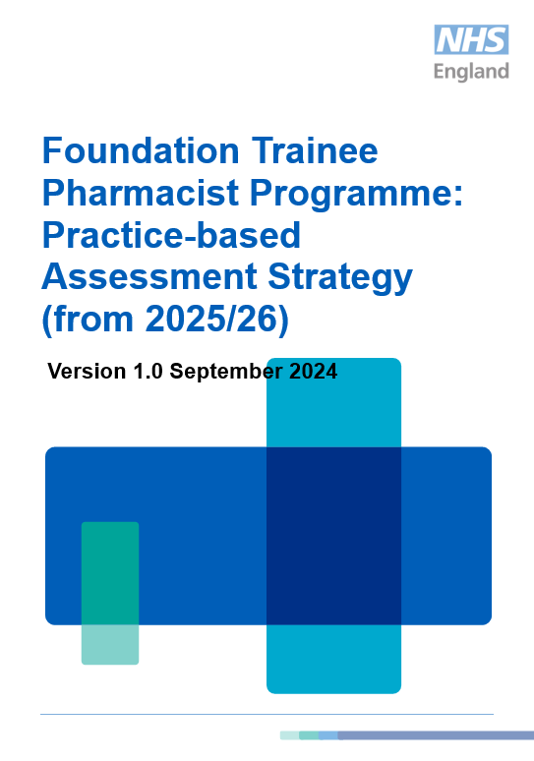
NHSE FTPP: Practice-based Assessment Strategy
All foundation training sites must use the NHSE FTPP Practice-based Assessment Strategy, and the mandated/embedded activities, assessment, progress review, sign-off etc.
All foundation training sites must use the e-portfolio for recording use of the assessment strategy, completion of the activities and sign-off.
All foundation training sites must engage with the process of completing a training plan, with the focus being how the Assessment Strategy and associated Activities/assessment will be conducted within the training period.
Notes:
Nick

Slide 13
Notes:
Nick

Slide 14
GPhC Standards for the Initial Education and Training of Pharmacists (IETP) - 2021
The new standards (2021) means that one set of learning outcomes is being used in the MPharm degree and the foundation training programme
55 Learning Outcomes
Incorporate independent prescribing
Uses ‘Miller’s Triangle’ to describe the level that each LO needs to be demonstrated in the MPharm and in the foundation training programme
Notes:
Nick

Slide 15
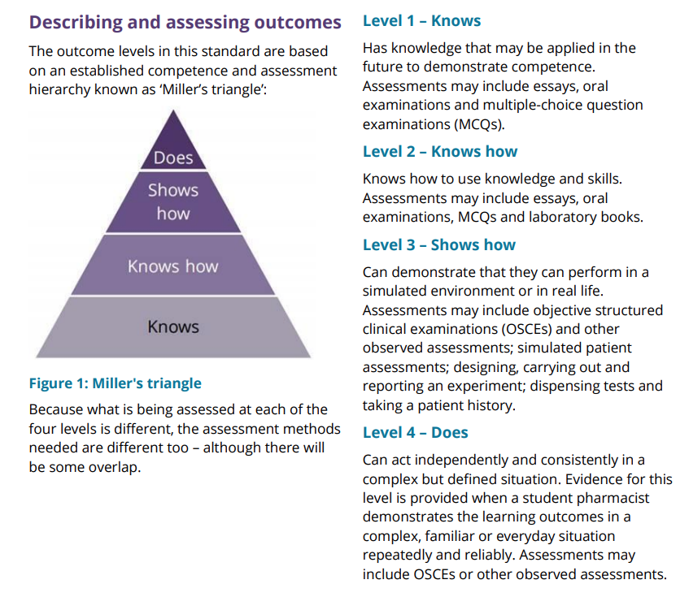
GPhC Standards for the Initial Education and Training of Pharmacists (IETP) - 2021
Domain 1: Person-centred care and collaboration (LOs 1-14
Domain 2: Professional Practice (LOs 15-44)
Domain 3: Leadership and Management (LOs 45-52)
Domain 4: Education and research (LOs 53-55)
Notes:
Nick

Slide 16
NHSE FTPP: Practice-based Assessment Strategy
Purposefully constructed suite of 28 Activities aligned to the professional activities of pharmacists
Designed to holistically provide multiple pieces of evidence against each of the 55 Learning Outcomes
“Repeatedly and reliable in everyday settings” for ‘Does’ level LOs
Activities are divided into:
Professional Development Activities
Observed Clinical Activities – Must be assessed using ‘Supervised Learning Event’ (SLEs) tools
Professional Development Activity Groups | Personal Development
 | Supplying Medicines
 | Education and Research
 | Mandatory and Specific Development
Observed Clinical Activity Groups | Clinical and Patient Facing
 | Prescribing
Notes:
Nick

Slide 17
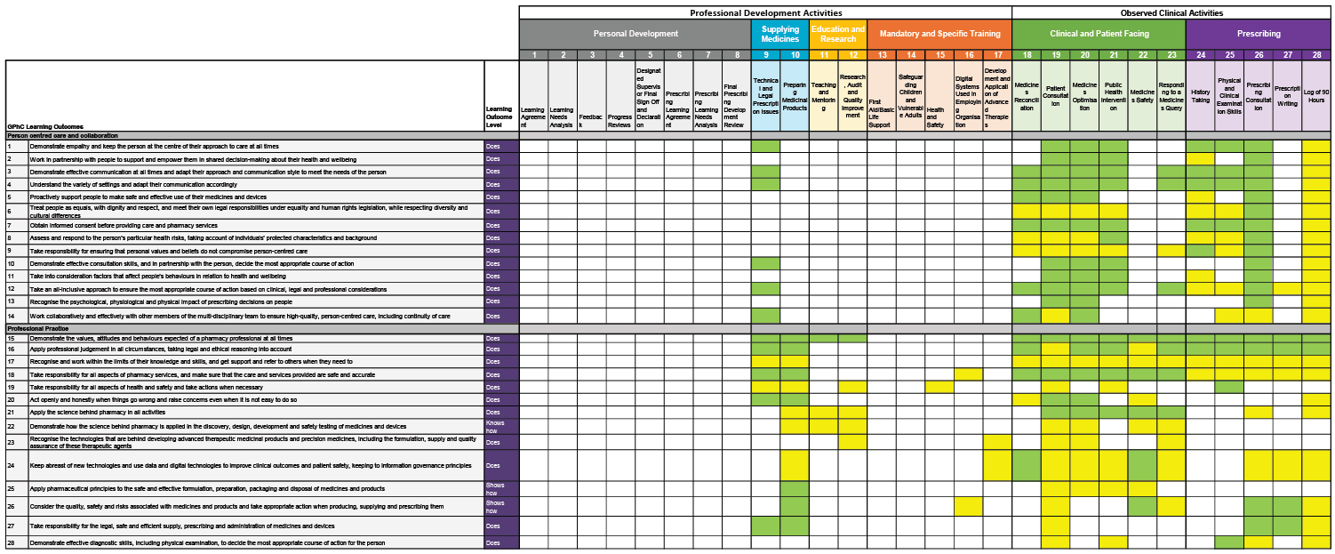
Notes:
Nick

Slide 18
NHSE FTPP: Practice-based Assessment Strategy
Each Activity must be demonstrated to a satisfactory standard, that aligns with safe and effective practice.
Each Activity within the Observed Clinical Activity group must be demonstrated a minimum of three times to a satisfactory level.
The measure of satisfactory performance is assessed using standardised descriptive scales as part of validated Supervised Learning Event (SLE) assessment tools.
Each Learning Outcome must be demonstrated aligned to the level of Miller’s Triangle as described by the GPhC.
Professional Development Activity Groups | Personal Development
 | Supplying Medicines
 | Education and Research
 | Mandatory and Specific Development
Observed Clinical Activity Groups | Clinical and Patient Facing
 | Prescribing
Notes:
Nick

Slide 19
Group |  | Activities | Approved evidence tool(s) | Requirements
Professional Development Activities
Personal Development | 1. Learning Agreement | 1. Learning Agreement | Learning agreement | During the first 2 weeks of training
 | 2. Learning Needs Analysis | 2. Learning Needs Analysis | LNA/PDP | During the first 2 weeks of training
 | 3. Feedback | 3. Feedback | MSF or PSQ | One MSF or PSQ must be completed during training
 | 4. Progress Reviews | 4. Progress Reviews | Progress review form | Week 13, 26 and 39 (or equivalent)
 | 5. Designated Supervisor Final Sign Off and Declaration | 5. Designated Supervisor Final Sign Off and Declaration | Final sign off form | From week 49 of training
 | 6. Prescribing Learning Agreement | 6. Prescribing Learning Agreement | Learning agreement | At the start of prescribing practice time
 | 7. Prescribing Learning Needs Analysis | 7. Prescribing Learning Needs Analysis | LNA/PDP | At the start of prescribing practice time
 | 8. Final Prescribing Development Review | 8. Final Prescribing Development Review | Prescribing development review form | At the end of prescribing practice time
Supplying Medicines | 9. Technical and Legal Prescription Issues | 9. Technical and Legal Prescription Issues | RA, CCL, CPD | Throughout training
 | 10. Preparing Medicinal Products | 10. Preparing Medicinal Products | RA, CCL, CPD | Throughout training
Education and Research | 11. Teaching and Mentoring | 11. Teaching and Mentoring | RA | Throughout training
 | 12. Research, Audit and Quality Improvement | 12. Research, Audit and Quality Improvement | RA | Throughout training
Mandatory and Specific Development | 13. First aid/basic life support | 13. First aid/basic life support | RA with certificate of completion uploaded | During the first 13 weeks of training
 | 14. Safeguarding children and vulnerable adults | 14. Safeguarding children and vulnerable adults | RA with certificate of completion uploaded | During the first 13 weeks of training
 | 15. Health and safety | 15. Health and safety | RA with certificate of completion uploaded | During the first 13 weeks of training
 | 16. Digital healthcare systems used in employing organisation | 16. Digital healthcare systems used in employing organisation | RA with certificate of completion uploaded | During the first 13 weeks of training
 | 17. Development and application of advanced therapies | 17. Development and application of advanced therapies | RA with certificate of completion uploaded | At an appropriate point during training
Notes:
Nick

Slide 20
Group | Activities | Approved evidence tool(s) | Requirements
Observed Clinical Activities
Clinical and Patient Facing | 18. Medicines Reconciliation | SLEs: Mini-CEX, DOPS Other: CPD, CCL, RA | SLEs: Minimum of 3
 | 19. Patient Consultation | SLEs: Mini-CEX, MRCF Other: CPD, CCL, RA | SLEs: Minimum of 3
 | 20. Medicines Optimisation | SLEs: Mini-CEX, CBD Other: CPD, CCL, RA | SLEs: Minimum of 3
 | 21. Public Health Intervention | SLEs: DOPS, CBD Other: CPD, CCL, RA | SLEs: Minimum of 3
 | 22. Medicines Safety | SLEs: DOPS, CBD Other: CPD, CCL, RA | SLEs: Minimum of 3
 | 23. Medicines Information | SLEs: DOPS, CBD Other: CPD, CCL, RA | SLEs: Minimum of 3
Prescribing | 24. History Taking | SLEs: Mini-CEX, DOPS Other: CPD, CCL, RA | SLEs: Minimum of 3
 | 25. Physical and Clinical Examination Skills | SLEs: DOPS Other: CPD, CCL, RA | SLEs: Minimum of 3
 | 26. Prescribing Consultation | SLEs: Mini-CEX, MRCF Other: CPD, CCL, RA | SLEs: Minimum of 3
 | 27. Prescription Writing | SLEs: DOPS, CBD Other: CPD, CCL, RA | SLEs: Minimum of 3
 | 28. Log of 90 Hours | The log must include SLEs from activities 24, 25, 26 and 27. Other: CPD, CCL, RA
Notes:
Nick

Slide 21
NHSE FTPP: Practice-based Assessment Strategy
Learning Agreement, LNA and PDP
Designated Supervisor: Final Sign Off and Declaration
13 Week Progress Review
26 Week Progress Review
39 Week Progress Review
Designated Supervisor
Activities
Activities
Activities
Activities
Prescribing Learning Agreement, LNA and PDP
Final Prescribing Development Review
Designated Prescribing Practitioner
Prescribing Activities
Notes:
Nick

Slide 22
Prescribing: Nominated Prescribing Area
Appropriate to the stage of training of a foundation trainee pharmacist
A clinical area relating to the provision of healthcare
An area that the DPP is sufficiently knowledgeable, skilled, and experienced to supervise within
An area within which the trainee is able to access patients with whom they can conduct consultations
Agreed by the DPP and Designated Supervisor
Recorded in the E-portfolio when the trainee starts
Notes:
Nick

Slide 23
Nominated Prescribing Area
The nominated prescribing area does not need to be one in which the trainee pharmacist is actively diagnosing a ‘new’ or undifferentiated condition – it could for example be:
the ongoing management of an existing condition (for example in a chronic condition clinic in general practice)
medicines optimisation within the provision of clinical services (for example in the admissions setting in secondary care as part of medicines reconciliation)
Both of the examples above will require diagnostic and /or clinical reasoning to be demonstrated and would give plenty of opportunity for the capabilities of a prescriber to be demonstrated.
In conjunction with stakeholders from all sectors, NHS England have developed some examples of what newly qualified prescribing might look like in 2026, in our Emerging routes to early career prescribing in pharmacy resource

Slide 24
Prescribing Assessment Activities
24. History Taking | Taking and documenting an appropriate medical, psychosocial and medication history including allergies and intolerances. This activity does not have to be completed in the nominated prescribing area as long as it does not progress to decision making and prescribing
25. Physical and Clinical Examination Skills | Performing and documenting appropriate physical and clinical examinations to decide the most appropriate course of action for the person. Follows local polices and has undertaken the appropriate training to undertake the role. This activity does not have to be completed in the nominated prescribing area as long as it does not progress to decision making and prescribing
26. Prescribing Consultation | Undertaking prescribing consultations that incorporate: Assessing the patient Identifying evidence-based treatment options available for clinical decision making Presenting options and reaching a shared decision Enacting a prescribing decision (which can include modification or deprescribing) Providing information and safety netting Recording, monitoring and reviewing This activity must be completed within the nominated prescribing area.
27. Prescription Writing | Safely prescribing (or deprescribing) medicines for patients whilst considering: Application of relevant legislation and ethical decision-making related to prescribing Use of relevant systems and frameworks for medicines use Clinical governance Using tools and techniques to avoid medication errors associated with prescribing This activity must be completed within the nominated prescribing area.
28. Log of 90 Hours | Accurately documenting learning hours attributable to development as a prescriber in practice. This log of hours should include all of the hours spent completing the other Prescribing Assessment Activities above, and any other learning activities that are planned/agreed between the DPP and trainee.
Notes:
Nick

Slide 25
Supervisor Roles and Responsibilities
The DS’s role is to:
Support the trainee to get the best from their training.
Supervise the trainee’s practice and provide feedback.
Provide support and guidance to other staff who are supervising the trainee pharmacist.
Provide regular feedback based on observation and review of submitted evidence.
Complete formal progress reviews at weeks 13, 26, 39.
Sign off of the foundation trainee pharmacist against the learning outcomes, including evidence from the Prescribing Activities supervised by the DPP.
Lead DS (where there is more than one): Final sign off and declaration at end of training to declare if the trainee pharmacist is competent, based on the evidence gathered throughout training, to join the register as a pharmacist.
The DPP’s role is to:
Determine whether the Prescribing Activities have been satisfactorily completed.
Determine that at least 90 hours of learning focussed on prescribing capabilities have been completed.
Regularly update the DS on the trainee’s progress
Escalate any concerns regarding the trainee’s progression in practice in relation to prescribing to the DS as soon as issues arise.
Confirm that all elements of prescribing assessment are completed, and the trainee pharmacist is therefore suitable for registration as a prescriber.
Notes:
Nick

Slide 26
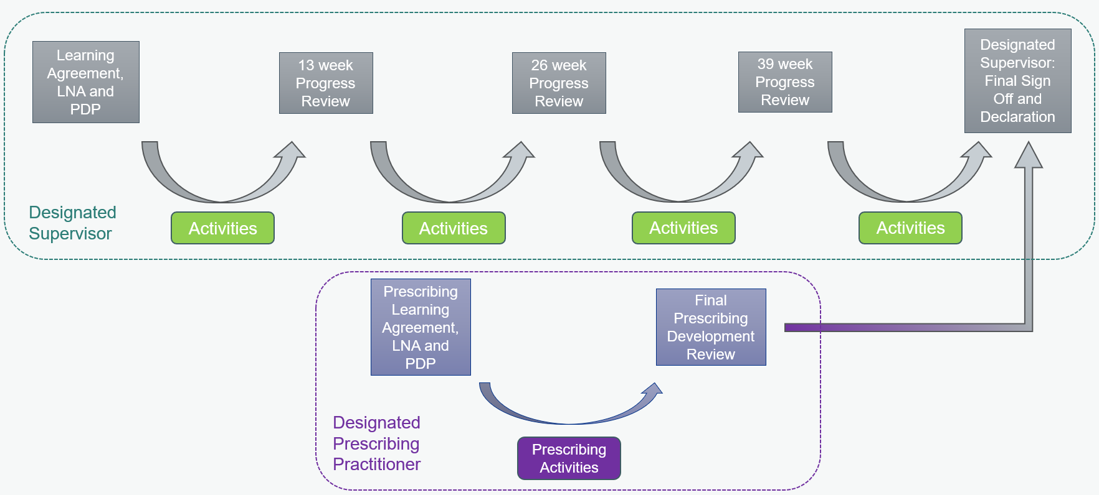
NHSE FTPP: Final Sign-off and Declaration
Confirmation that all Learning Outcomes signed off, including evidence from the prescribing Activities
Confirmation required duration of training has been completed
Confirm DPP has determined satisfactory outcomes for Prescribing Activities, and associated 90hours learning in practice completed
Record identification of second assessor (typically DPP)
Final declaration that the trainee has completed all of the above requirements and is therefore suitable to enter the register as a pharmacist with IP annotation
Notes:
Nick

Slide 27
NHS England FTPP Training Plan: Template, Guidance and Process

Slide 28
FTPP Training Plan
Prior to the 2025/26 training year, training plans have been developed by organisations hosting foundation trainee pharmacists and submitted to the General Pharmaceutical Council as part of the training site approval process.
From 2025/26, training plans will be submitted to NHS England, by the lead Designated Supervisor via the e-portfolio during July 2025.
From the 2025/26 FTPP, the training plan does not form the basis on which a training site is approved by NHS England. Site approval by NHS England is made on the basis of agreement to the National Recruitment Scheme (NRS) Terms of Participation and the associated declarations.
As part of the NRS Terms of Participation, all training sites agree to complete and submit a training plan in line with NHS England requirements
The purpose of the training plan is to provide assurance that the site/s can support the foundation trainee pharmacist through the use of the NHS England Assessment Strategy and e-portfolio, to enable them to demonstrate their development and sign-off against the GPhC Learning outcomes.
Notes:
Plain slide with subhead and bullets

Slide 29
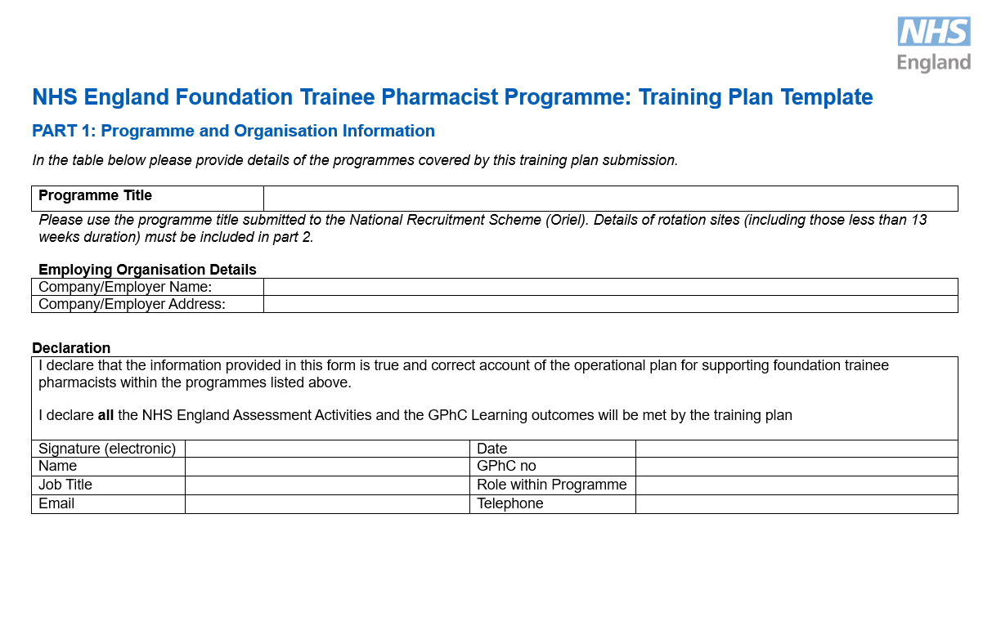
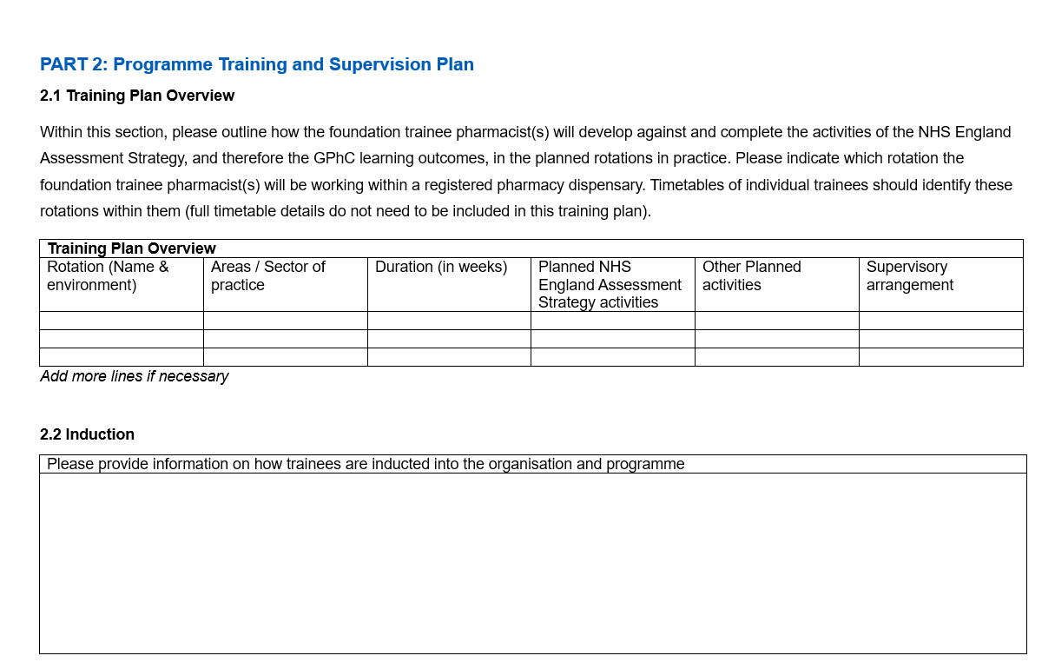
FTPP Training Plan: Template
Notes:
Plain slide with subhead and bullets

Slide 30
FTPP Training Plan:Guidance
PART 1: Programme and Organisation Information
PART 2: Programme Training and Supervision Plan
2.1 Training Plan Overview
Including internal and external rotations, how the activities of the assessment strategy will be completed and the planned supervision)
2.2 Induction
2.3 Independent prescribing development
2.4 Supervision
Focus on effective communication between supervisors and supervisor training and support.
PART 3: Local Quality Management Arrangements
How will effective continuous improvement process be achieved?
Notes:
Plain slide with subhead and bullets

Slide 31
National Recruitment Scheme (NRS) Process for 2025/26

Slide 32
National Recruitment Scheme (NRS) process for 2025/26 (1)
Date | Activity | Notes
January 2024-March 2024 | Training sites entered into Oriel/NRS | Must agree to terms of participation – agree that will provide access to DPP and prescribing learning environment Do NOT need to identify who the DPP is and where the prescribing environment is IF a multi-sector rotation is being including, must identify where this rotational site is
June 2024-October 2024 | Application and Preferencing | Applicants apply to the NRS and create their preferences; a list of sites in which they wish to train
September 2024-October 2024 | Assessments | Applicants undertake their recruitment assessment activity
December 2024 | Allocation | Employers informed of trainees allocated to their training programmes and begin contacting them
 |  | Informed if old or new LOs
June 2025 | Supervisor details | Required to upload details of supervisors (Lead DS, additional DSs, DPPs) – declarations; outputs as e-portfolio access
Jul/Aug 2025 | Trainee starts / Training Plan upload | Upload Training Plan to e-portfolio
Notes:
Plain slide with subhead and bullets

Slide 33
National Recruitment Scheme (NRS) process for 2025/26 (2)
Next steps and key points for 2025/26:
Removal of ‘unsuccessful’ threshold for NRS assessments
Focus on supporting students that performed less well in the NRS assessments, provision of feedback to university
Training site may be allocated graduate against new learning outcomes or graduate against previous learning outcomes / OSPAP
Will dictate need for prescribing environment/supervision
NHS England will continue to work with pharmacy ICS leads, other key stakeholders and submitted training sites to support development towards training site requirements
Notes:
Plain slide with subhead and bullets

Slide 34
Planning foundation training posts for 2025/26

Slide 35
Planning foundation training posts for 2025/26
Key focus:
Access to a Designated Prescribing Practitioner (DPP) and a prescribing learning environment
Consider what effective relationships/ communication arrangements between supervisors across multi-sector sites will look like
Support development of training plans, including consideration of prescribing learning and assessment
Notes:
Plain slide with subhead and bullets

Slide 36
Training for DPPs and DSs
DPPs and DSs must have appropriate experience and training to act effectively as educational supervisors
This is a generic, transferable set of skills and knowledge
There are a variety of training resources currently available to support people to gain these skills and knowledge
Education Supervisor Training - ProPharmace
NHSE WT&E will also provide clear training materials for DPPs and DSs on:
How to use the foundation training year Assessment Strategy
What the respective roles and responsibilities of the DPP and DS are
Notes:
Plain slide with subhead and bullets

Slide 37
Education Supervisor Training - ProPharmace

Slide 38
Training and Support in the Foundation Training Year

Slide 39
Training and Support in the Foundation Training Year (1)
NHS England will provide three main components of support and training:
NHS England regional teams will provide a coordinated programme of support for trainee pharmacists and supervisors that aims to directly support quality of training sites, and use of and engagement with the assessment strategy and e-portfolio. This will include an induction event at the start of the training period, and check-point online events at key points.
NHS England will provide access for all trainee pharmacists to a funded foundation trainee pharmacist training offer that is specifically designed to support trainee pharmacists to develop against the learning outcomes. The full specification for this training course is currently in development, with the input of a range of stakeholders.
The Trainee Pharmacist Learning e-resources is a curated range of digital learning material for all trainee pharmacists to help to support learning and development throughout the Foundation Training Year. Resources have been grouped according to the Assessment Strategy and assessment activities and are intended to help trainee pharmacists to learn and develop, and to demonstrate competence against the learning outcomes.
Notes:
Plain slide with subhead and bullets

Slide 40
Training and Support in the Foundation Training Year (2)
All foundation trainee pharmacists entering the programme in 2025 will have access to a core training offer provided by NHS England.
Stakeholder engagement across all sectors of practice has developed the specification for the training offer and its procurement:
Review of GPhC Learning Outcomes in the 2021 Standards for the Initial Education and Training of Pharmacists to identify the areas of learning that should be prioritised and focused on in the training offer, with reference to what would be most challenging to deliver within the workplace.
NHS England offer will focus on supporting trainees to develop the skills and knowledge to be able to demonstrate the learning outcomes in practice.
The training offer will include:
Induction to orientate trainees to the programme
First aid training
Facilitated local learning sets throughout foundation training, which will bring a group of learners together to focus on a range of themes linked to the priority learning outcomes.
Creation of communities of practice for trainees, to provide additional support to develop their clinical practice.
The training offer will not include:
Sector specific training relating to service provision. It is expected that any training provision related to the specific needs of individual organisations or employers will continue to be provided by those organisations
Specific registration assessment preparation including mock assessments.
Specific face to face teaching on clinical therapeutic areas.
Notes:
Plain slide with subhead and bullets

Slide 41
Next steps

Slide 42
Next Steps
NHSE WT&E
Continue to support training sites to develop plans
Development of additional support materials for supervisors
Confirmation of further details relating to training course provision
Employers/ foundation training sites
Continue to develop training posts submitted within the NRS
Rotations into other sectors
Develop DS and DPP capacity and capability
Training Plan development
Develop prescribing services and existing prescribers
Notes:
Plain slide with subhead and bullets

Slide 43
NHS England Regional Contacts For advice and information about planning foundation trainee pharmacist places
Region | Contact email
North West | england.WTEpharmacy.nw@nhs.net
North East Yorkshire and Humber | england.WTEpharmacy.ney@nhs.net
Midlands | england.foundationpharmacy.midlands@nhs.net england.WTEpharmacy.mids@nhs.net
East of England | england.WTEpharmacy.eoe@nhs.net
South West | england.WTEpharmacy.sw@nhs.net
South East | england.WTEpharmacy.se@nhs.net
London | england.WTEpharmacy.london@nhs.net

Slide 44
Find out more and get in touch
To receive news by email about the initial education and training of pharmacists, please complete this form: https://healtheducationyh.onlinesurveys.ac.uk/register-for-ietp-updates
Engage with the Assessment Strategy and E-portfolio: www.hee.nhs.uk/our-work/pharmacy/trainee-pharmacist-foundation-year-programme
Bookmark the NRS/Oriel site: www.lasepharmacy.hee.nhs.uk/national-recruitment/
Email address: england.traineepharmacist@nhs.net
Notes:
Plain slide with subhead and bullets

