Slide 1
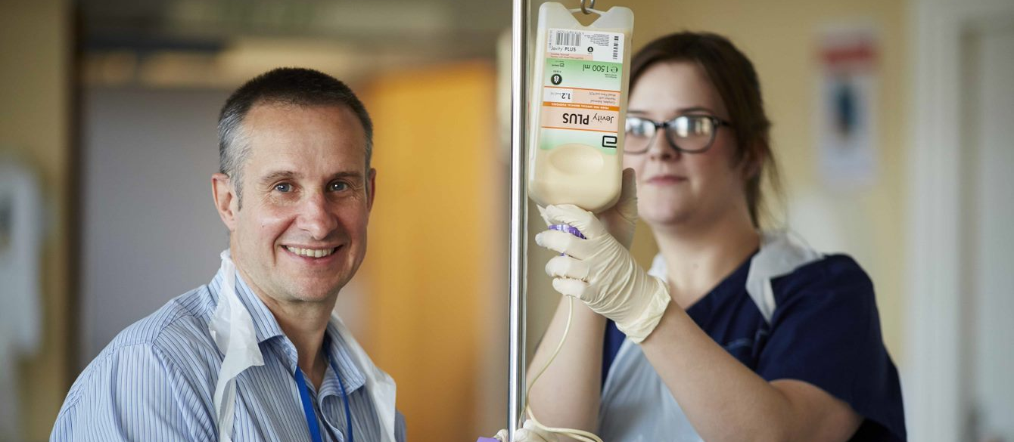
Inclusive recruitment for AHP support workers
Monday 15 May 2023; 14.00-15.30

Slide 2
Welcome
Please ensure that your microphones and cameras are switched off
Please use the chat box for questions and comments
Email: ahp.supportworkforce@hee.nhs.uk
Hashtag: #AHPsupportworkers
Menti.com

Slide 3
Scan the barcode to participate
or
Go to www.menti.com
Use the code:1653 7417

Slide 4
Aims of the webinar
To recognise the importance of widening participation and improving equality, diversity, inclusion and belonging for AHP support workforce
To understand the benefits of inclusive recruitment approaches for staff, services, patients and communities
To identify common barriers, enablers and best practice, including grow your own recruitment approaches and lessons learned from the national HCSW programme

Slide 5
Our aim is to have consistent, occupation-specific and sustainable education and career development pathways for AHP support workers, and fair opportunities to access these, implemented by provider services across England by April 2024
#AHPsupportworkers

Slide 6
Agenda | Agenda
14:00 | Introduction and overview Anne Tucker, AHP Workforce Lead, National AHP Support Workforce Programme, NHSE
14:05 | My AHP support worker journey Beatrice Ibe-Igwe, AHP Support Workers Project Lead/Therapy Technical Instructor, University College of London Hospital
14:15 | Context, purpose and best practice Suraiya Hassan, AHP Workforce Lead, National AHP Support Workforce Programme, NHSE
14:25 | Grow your own – inclusive recruitment in practice Richard Griffin, Professor of Healthcare Management, King’s College London
14:35 | Learnings from the Healthcare Support Worker (HCSW) Programme Nurjahan Ali Arobi, Nursing Workforce Improvement Lead, HCSW Programme, NHSE; Silke Moxon-Riedlin, Senior Programme Manager, HCSW Programme, NHSE
14:45 | Local Recruitment Partnerships Steve McCall, Work and Health Services Directorate, Department for Work and Pensions
14:55 | Recruit to retain: What “good” looks like Stefanie Johnson, Head of Recruitment, Lancashire Teaching Hospitals NHS Trust
15:05 | Q & A panel Ruth Mhlanga, Chair, Chief Allied Health Professions Officer BAME Strategic Advisory Group Rita Thakaria, Vice Chair, Chief Allied Health Professions Officer BAME Strategic Advisory Group Presenters
15:25 | Call to action and final comments Anne Tucker, AHP Workforce Lead, National AHP Support Workforce Programme, NHSE

Slide 7
My AHP Support Worker (AHPSW) Journey at University College London Hospitals (UCLH), NHS Foundation Trust
_{Beatrice Ibe-Igwe}
AHP Support Worker Project Lead
_{Therapy Technical Instructor}

Slide 8
AHP support worker recruitment at UCLH
UCLH is committed to the fundamentals of inclusivity in their recruitment processes, therefore, they ensure that their support workforce recruitment is diverse and inclusive.
They are currently implementing the NHS England AHP support worker competency, education and career development framework strategy of Grow Your Own (GYO) to build AHP support workforce capacity and capability across AHP services.
Notes:
AHPSW’s are recruited at entry or intermediate level stages, and everyone is given equal opportunity through training and development to acquire the knowledge and skills required to function effectively in their roles and to progress to the next level.
The trust is committed to use the NHS England AHP workforce strategy (Grow Your Own) to build the workforce capacity and capability of all our AHP support workforce across AHP services.

Slide 9
My AHPSW journey through recruitment & progression
2015
Band 3
Therapy/Rehab
Assistant: Elderly Medicine/Stroke Rehab Unit, Respiratory & Infectious Diseases
2017
Band 4
2023
Band 5
AHP Support Worker Project Lead
Completed the statutory Mandatory Training &
Level 2 Functional Skills in English/Math.
Care Certificate.
Attended internal/external, supervisions, IST.
Therapy Technical Instructor: Thoracic & Urology Surgery
Attended HEE, AHP Support Workers Public Health Development Training (Phase 1 & 2).
Level 3 CPD course in Occupational Therapy
HEE Level 3 Higher Development Diploma in Leadership & Management
HEE Level 3 Higher Development Diploma in Leadership & Management
Completed project management/presentation as part of my course, still learning on the job.
Notes:
My NHS journey started in 2014 after completing a BSc degree in Health & Social Care with The Open University in 2013. I worked as a Band 2 HCA in different acute settings and use to be very fascinated at the impact of physical therapy in improving patient’s care and QOL. I then joined UCLH in 2015 as a Therapy Assistant and was given all the support I needed in-work to develop the knowledge and skills I required to progress from the support worker level through to my present level. I took every that I was given to develop across the 4 pillars of practice.

Slide 10
My role & responsibilities across the four pillars of practice
Clinical Practice
Leadership
I work in collaboration with the MDT to plan and facilitate safe discharges to reduce hospital length of stay.
Facilitating learning
Evidence, Research & Development
I work alongside registered PT/OTs to provide care and support to patients, including those with complex needs.
I also undertake adhoc administrative duties
I delegate appropriate tasks to other support staff or less experienced employees and provide training to others.
I organise & deliver IST for AHPSWs/work colleagues and our nursing colleagues.
I demonstrate own duties to other support workers, students, or less experienced staff
I inducting PT/OT students on placement and facilitate the PT students’ peer sessions on health & wellbeing.
completed a comprehensive spreadsheet a questionnaire to identify individuals’ learning gaps and training needs
I am currently compiling data on AHPSW’s recruitment, vacancy, and leavers.
I am also an integral part of the interview panel interviewing for a support worker role.
Notes:
I acquired clinical knowledge, skills and competence required to provide safe & person-centred care/services to patients: This includes providing daily rehabilitations, progressing patients’ mobility and improving functional outcomes post-surgery.
I acquired the knowledge & skills required to lead and enable effective learning in my workplace.
Leadership: I understood the importance of being a role model while supervising and supporting others.
I acquired the knowledge and skills to use evidence to inform practice for instance, I am currently compiling AHPSWs data on recruitment, vacancy, and leavers, in order to explore reasons for attrition and how we can improve AHP support staff retention.

Slide 12
Context, purpose and best practice Suraiya Hassan, AHP Workforce Lead National Support Workforce programme, NHSE

Slide 13
Improving equality, diversity, inclusion and belonging for AHP support workers
Over 35,000 AHP support workers in England
Valued and essential members of the AHP community
Core to our strategy AHPs Deliver
Significant unwarranted variation in access to training, development and career progression
Identified need to improve diversity across protected characteristics and widen participation from harder to reach groups
An important entry route to NHS employment and AHP careers

Slide 14
Feedback from NHS trusts: AHP supply projects
Work needs to be done in relation to diversity (our Trust is predominantly white female AHP support workers)
We recognise as a Trust that our workforce needs to reflect the local community population to improve patient care and outcomes
Our main action plan is to look at ways of improving and increasing EDI. We hope to achieve this through IR and RTP programs and creative recruitment methods
There is a risk of not creating a supportive and environment that encourages progression and professional development
Diversity amongst the support workforce is low
Support worker focus groups have highlighted the huge diversity of the staff group given their different career and life backgrounds – this is helping to inform our recruitment strategies
Our Support Worker Lead chairs the ICS AHP EDI Recruitment group so we will implement advice from the ‘No More Tick Boxes’ document into our recruitment procedures and policies
The AHP workforce lead has worked closely with all stakeholders to develop a process by which the trust runs apprenticeships from equal and fair selection all the way to employment
Diversity is limited but more have disabilities than in the registered staff group

Slide 15
EDIB priorities for AHP support workers 2023/2024
Improving the diversity of the AHP support workforce (bands 2-4)
Health and wellbeing of ethnic minorities
Career development and progression
Raise profile of diverse AHPs

Slide 16
Grow your own: Inclusive recruitment in practice
Richard Griffin

Slide 17
What inclusive recruitment means in practice
Engagement with local skills and employment system to…target under-represented groups, under utilised supply pathways & groups that experience barriers to employment
Working as an anchor organisation
Internal promotion

Slide 18
Why undertake inclusive employment?
Workforce shortages & future workforce supply
A more stable, loyal & sustainable workforce
Culturally appropriate care
improved health outcomes.
Increased patient safety.
Reduced inefficiencies.
Reduced costs.
Reduce health inequalities.
Supports economic and social development locally

Slide 19
How to deliver inclusive recruitment
Work in partnership
Local and national support
Range of interventions: college engagement, work experience, supported employment, job brokerage
Include as part of a wider Grow Your Own workforce strategy

Slide 20
Inclusive recruitment is a High Impact Change
that will deliver strategic improvement

Slide 21
Inclusive Recruitment: Learnings from the Healthcare Support Worker (HCSW) Programme
Nurjahan Ali Arobi, Nursing Workforce Improvement Lead, HCSW Programme, NHS England;
Silke Moxon-Riedlin, Senior Programme Manager, HCSW Programme, NHS England.

Slide 22
HCSW programme 2022/23 purpose and objectives
Programme aim
To grow the HCSW workforce in line with demand (3,000 WTE net gain by March 2023), by ensuring inclusive and sustainable recruitment while reducing the attrition of existing HCSWs. This is with a view to:
Responding to increased demand for HCSWs, supporting the delivery of the ambitions laid out in the Elective Recovery Plan, the Long Term Plan and winter surge planning.
Reducing reliance on temporary staffing, therefore increasing quality of care and driving efficiencies.
Supporting a diverse and inclusive workforce by widening access to the HCSW role.
Strategic objectives (workstreams)
Attraction
Innovative recruitment
Learning and development
Recognition and value
Our offer (mechanisms for delivery)
Universal support: development of best practice standards through nationally led projects then support to embed this across the system via pilots, events, webinars, comms activity, resources, publications and forums/COPs.
Regional support and funding: embedding of best practice and sharing of solutions at regional level through direct regional engagement with trusts in addition to funding directly distributed to providers.
Direct support: intensive direct improvement support for c.14 most challenged providers, led nationally with regional support.
Alignment to and influencing of national policy and practice: working with programme partners to feed programme learnings into national workforce policy, while also ensuring each workstream is aligned accordingly.

Slide 23
Key Learnings
TMP job ads toolkit, national audits NtC, “Nearly NtC” and “Not NtC”, JDs & PSs matching job ads
New to Care (NtC)
Functional skills, pre-employment support, practical understanding of transferable skills
In-Person Recruitment Events resource, Indeed recruitment & market insights, plan and test whole journey
Centralised recruitment
Joint working with Indeed, team working, bespoke line management, trauma / disability informed recruitment
Attrition
Monitoring time to hire, TMP research – 5 elements for good candidate experience
Improved HR practices shared, improved ways to keep candidates “warm”
Skills for Health evaluation, HCSW Day, CNO & CMidO Awards
Pastoral support & Recognition
HCSW progression, roles extended, beyond induction
Co-created resources, data – not only how many but who, communication & reaching out, inclusive practices
Know your community
Widening Access & Supporting Diversity (WASD)
“Comms” & engagement team, local VCSE, Prince’s Trust, Project Choice, Project Search, the DWP
There has been a 15% increase in the number of male HCSW during the programme (comparing to Dec 2019).

Slide 24
Celebrating successes of the HCSW Programme
There has been a 31% increase in HCSWs from ethnic minority groups during the programme (compared to Dec 2019).
Within this financial year, the establishment increased by 3.6% vs workforce has increased by 4.9%
On average there were c.4,600 job offers each month. These translated into an average of 3,000 joiners.
Of the c.55,600 joiners in FY 22/23, 46% were new to care.
There has been a 15% increase in the number of male HCSWs during the programme (compared to Dec 2019).
Supported trusts to improve their Disability Confident accreditation. 13 achieved higher Disability Confident level.
A suite of resources developed to support organisations and partners with WASD. E.g., the VCSE packs utilised by the DWP.

Slide 25
Local Recruitment Partnerships Steve McCall DWP Department for Work and Pensions
November 2022 v3.0

Slide 26
In DWP we…..
Pay benefits and pensions
Support those on Universal Credit
Work with employers to understand and promote their vacancies
Address the challenges of recruiting into certain job roles
Work with training providers and employers to help provide skills, confidence and qualifications relevant to the job role
Work together with individuals on their journey and offer a pathway into employment
Notes:
Universal Credit is replacing the following benefits and tax credits:
Child Tax Credit
Housing Benefit
Income Support
income-based Jobseeker’s Allowance (JSA)
income-related Employment and Support Allowance (ESA)
Working Tax Credit
Once confirmed you are able to work or are in work but not earning enough, will receive support to help find work or increase earnings.
Jobcentres divided into districts, regions (or Groups) and National teams. Some big employers have a national account manager.
Locally Jobcentres work with claimants/customers to support them to move closer to work (eg functional skills, confidence skills etc) and ultimately into work

Slide 27
Find a job
Free at the point of service* on-line job-posting service
Accessed via GOV.UK, available 24/7 and available in English and Welsh
Service is open to everybody searching for a job

Slide 28
Our customers…..
In work but with support can earn more
In work facing redundancy
Ex-forces and families
Ex-offenders
Older jobseekers
Younger jobseekers
Schools
All communities and community groups
Resettlers
On a health journey
Notes:
In work but with support can earn more – in work support
In work facing redundancy – Rapid Response Service
Ex-forces and families
Ex-offenders
Older jobseekers
Younger jobseekers
Schools – schools advisers
All communities and community groups – incl BAME communities, Princes Trust,
Resettlers
On a health journey – including neurodiverse customers, those looking to get back to work after illness and those with addictions – Also DC
We work to

Slide 29
How we can support
Individual jobseeker journey
Place Based Planning
Talk to employer about skills & behaviours and any formal quals
SWAPs, Mentoring Circles, Work Experience, GJIs, Work Trials
Travel costs, childcare, clothing, licences, other barriers
Group sessions, journal messages and Jobs Fairs.
Perceptions of NHS and promoting positive messages
Help us to communicate and educate
Notes:
Perceptions and challenges and how we can overcome this….

Slide 30
Thank you!
Steve.mccall@dwp.gov.uk

Slide 31
Stefanie Johnson Head of Recruitment
Recruit to Retain
What good looks like!

Slide 32
Local context:
1.5 million residents
10,000 staff
One of the biggest Trusts in the North West
Royal Preston Hospital
Chorley District Hospital

Slide 33
Our locality:
Beautifully diverse
Brilliant partnerships and community outreach
Both hospitals are the hub of their communities
Wonderful people
Our challenges:
Some difficult to reach areas
Myths to bust about working in the NHS
Low levels of computer literacy
Quality of application forms poor
Competition high – labour market challenges

Slide 34
Standing out in a sea of similarity
Adverts – written in the first person: ‘I’ ‘We’ ‘You’ ‘Us’
Adverts that communicate effectively
Adverts that show openness and welcome everyone – no unintended bias
Adverts that allow candidates to choose if it’s the role for them
Adverts that inspire people to want to find out more
Think multi-generational approaches

Slide 35
Where we advertise typically….
TRAC

Slide 36
Working with local partners:
Three local Councils
Three local Job Centres
All Colleges/Sixth Forms
Third Sector organisations – to help us and help candidates
Local businesses

Slide 37
Physical presence in our Job Centres:
Attend regularly – people booked on and drop in
Candidates can discuss things openly with us
Helps dispel myths/builds trust
Offer support to candidates to apply
Inspire candidates

Slide 38
Getting out into local communities

Slide 39
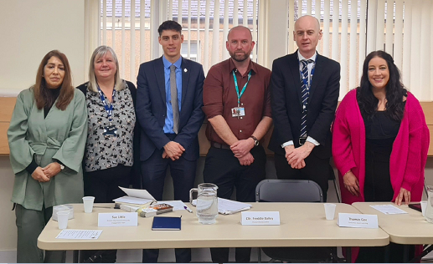
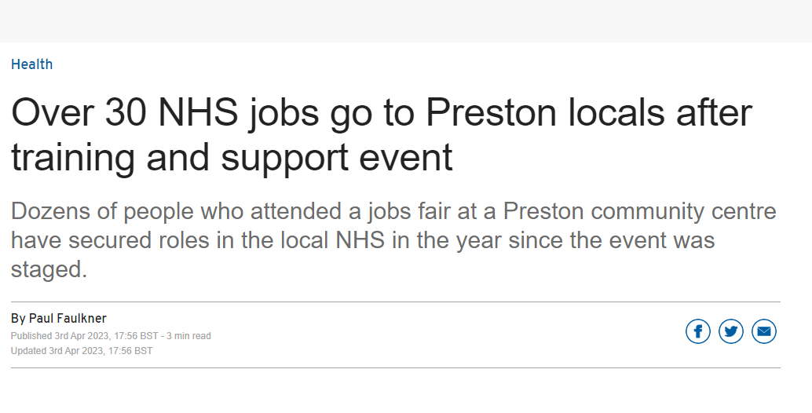
Getting out into local communities

Slide 40
Inspire local people: Showcasing our world

Slide 41
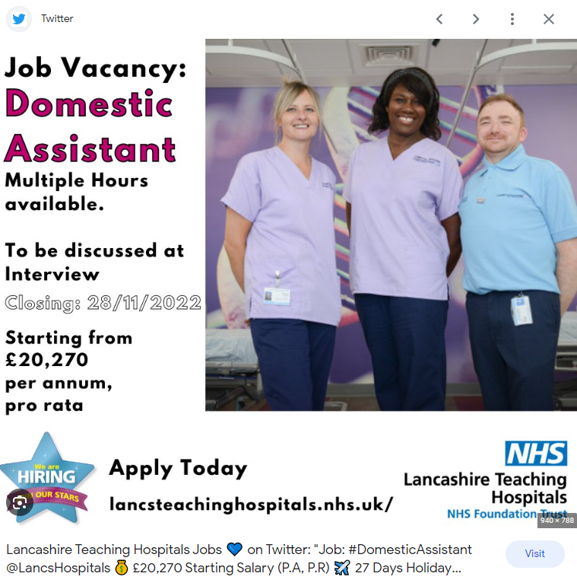
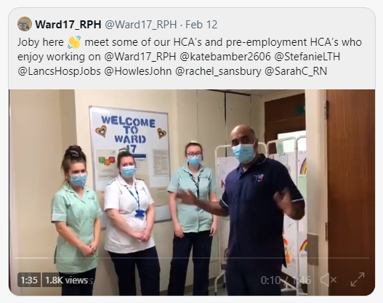
Social media campaigns across local groups – show inside our world:
Twitter
Facebook
Instagram
LinkedIn

Slide 42
Our Widening Participation team develop & deliver in-house programmes:
1 week Ready. Steady. Apply
2 week – Reboot
6 – 8 week Pre-employment course

Slide 43
Taking every opportunity we have to promote our roles – even our hospital vehicles get involved

Slide 44
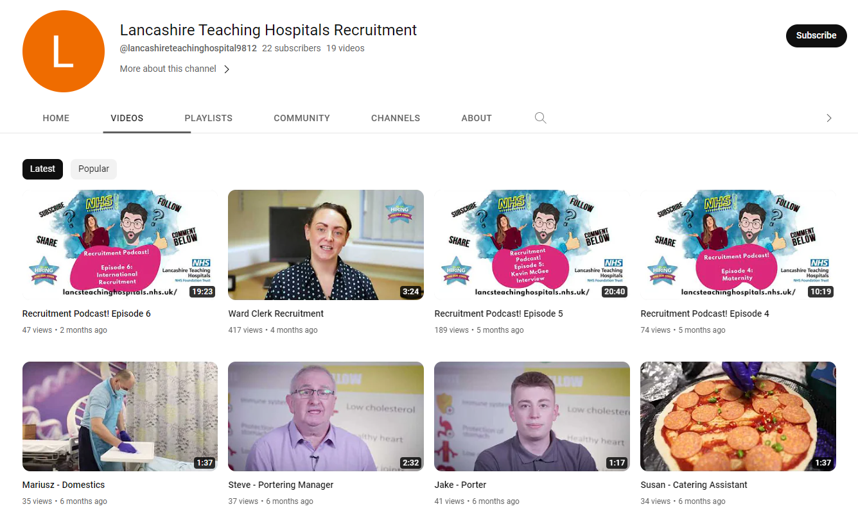
Design videos – realistic portrayal of our roles featuring real people

Slide 45
Develop recruitment campaigns:
Think where your candidate is now and how you need to reach them
Think about the diversity of candidates and approaches to reach them
So much more than just NHS Jobs/TRAC
Community engagement is key
Encourage managers to get their teams involves

Slide 46
Supporting candidates to apply:
Encourage people to seek support and identify where from ie Job Centre or partners organisation
Created an e-learning application form support guide
Give meaningful feedback on application form to break the cycle

Slide 47
The interview process
Share the questions in advance
Encourage diversity on interview panels – perhaps include someone doing the role
Build in more practical assessments
Think about time of day/day of week
Think about who does the interviews – need to be engaging, put people at ease, able to probe answers to gain more understanding

Slide 48
Recruiting to retain:
Adverts that are realistic – setting the scene
Describe the role - A day in the Life of…..
Videos of real staff doing a real job
Assessments in recruitment selection to assess skills more effectively

Slide 49
Impact made:
Reduced time to hire
Increased quality of applications
Increased community reach and candidates
Broke down barriers and dispelled myths
Inspired candidates by showcasing real roles
Foresee retention positively impacted
Relationships developed with partners that will continue to flourish

Slide 50
Q&A Discussion
Ruth Mhlanga, Chair, Chief Allied Health Professions Officer BAME Strategic Advisory Group
Rita Thakaria, Vice Chair, Chief Allied Health Professions Officer BAME Strategic Advisory Group

Slide 51
Next steps Menti.com Code: 5783 1250

Slide 52
Call to action
Share key messages and slides with your teams and colleagues
Use existing NHSE resources to support inclusive recruitment processes
Review local recruitment processes
Inclusively engage with AHP support workforce
Encourage partnership working

Slide 53
Resources and meet the team
National Programme Lead: Naomi McVey
Academic advisor: Richard Griffin, Professor of Healthcare Management, Kings Business School
National AHP Workforce Lead: Suraiya Hassan
National AHP Workforce Lead: Anne Tucker
National AHP Clinical Fellow: Gaby Ford
National Project Manager: Louise Devlin
Team administrator: Niat Hailemariam
Email: ahp.supportworkforce@hee.nhs.uk
AHP Support Workforce website for resources including case studies, webinar slides and recordings: https://www.hee.nhs.uk/our-work/allied-health-professions/enable-workforce/developing-role-ahp-support-workers
Apprenticeship resources:
An Introduction to AHP Apprenticeships
A guide to implementing AHP Apprenticeships
https://www.hee.nhs.uk/our-work/allied-health-professions/education-employment:

