Slide 1
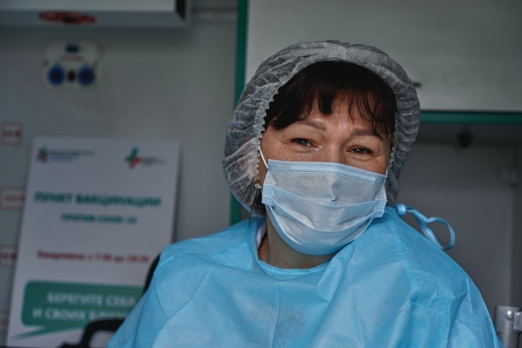
What is an internal transfer opportunity?
An internal transfer provides a member of staff with the opportunity to move within an organisation without completing a lengthy application process. It can be one of the outcomes of a career clinic.
What are the benefits?
Internal transfers offer benefits to the nurse and the organisation and these include:
A development opportunity for the nurse.
Improved staff engagement and morale
Movement within the organization which helps with sharing skills and knowledge
Improves staff retention.
Who are career clinics intended for?
All nursing staff including:
Bands 2-4 healthcare assistants and support workers
Band 4 registered nursing associates
Bands 5-8 registered nursing staff
An internal transfer offers the opportunity for movement within an organisation and within a specific pay band. It may also be offered for staff wishing to develop experience in a particular area at a lower pay band.
Are there any pre-requisites?
This may vary according to organisations, however internal transfers are available to staff who have a minimum of six months’ experience in current role, have completed a satisfactory probation period and preceptorship, and have no ongoing HR or performance issues.
Internal transfers

Slide 2
What is the process?
The process is managed locally:
Nurse expresses an interest in a transfer opportunity and discusses with current manager
Nurse identifies an opportunity where there is a vacancy and arranges a discussion with manager in the area
Following a discussion, the manager will make a decision and provide feedback to the nurse
Where the outcome is positive, HR are advised so that appropriate checks can be conducted
A start date and transfer arrangements are confirmed
Lara’s story …
I qualified three years ago as a paediatric
Nurse and joined a
large hospital as a
newly-registered nurse.
I was allocated to a
specialist ward and
although it was very
interesting and I learned a lot, it wasn’t where I wanted to be.
Through discussions with my practice educator, I found that we needed to be in post for a minimum of six months, however it was advisable to complete my preceptorship and make sure all competencies were signed off before considering an internal transfer. I took this time to really find out what would interest me.
After a year in post, I applied for an internal transfer to the paediatric intensive care unit where there was a vacancy. I had a discussion with the ward manager and was fortunate enough to be accepted. I have been working in PICU for eighteen months now and really enjoy my new role. The internal transfer scheme gave me an opportunity to find something I really wanted to do without having to leave the hospital.
Next steps
If you’re interested in an internal transfer, begin by talking to your current manager and thinking about what areas may be of interest to you. You may wish to have an independent career clinic discussion for further information on what is available within your organisation.
To find out more about career clinics and internal transfer opportunities, please visit:
https://www.hee.nhs.uk/our-work/capitalnurse

