Slide 1
Preparing for an interview Top tips, hints and ideas
(NAME OF TRUST)

Slide 2
AIM
To equip you with knowledge and skills to help you prepare for an interview

Slide 3
What is an interview for?

Slide 4
What are interviewers looking for?

Slide 5
https://www.youtube.com/watch?v=chkoryAGYLc

Slide 6
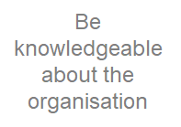
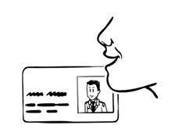
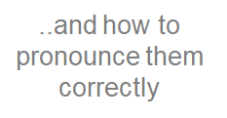

Slide 7
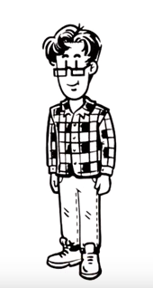
Role play questions with friends

Slide 8
Types of interview questions
Five of the most common…
Classic
Career goals
Character
Competency
Curveball or creativity

Slide 9
Classic Questions
What are they?
They come in all shapes and sizes and they’re generally asked to put the ball in your court. The interviewer is saying they want you to do the talking. One word answers won’t cut it here!
When are they asked?
Classic interview questions are likely to come up in almost every interview – making them the most common across all fields and interview types.
How to answer them:
Answering a classic interview question well comes down to your ability to talk about how your skills, experience, and personality match up with what the employer is looking for. Take this as the perfect opportunity to prove you’re a good fit.
The worst thing you can do:
Tell your entire life story, complete with why you stopped believing in Santa at age 6.
Examples:
Tell me about yourself
What are your weaknesses?
Why is there a gap in your work history?
Why did you apply for this position?

Slide 10
Career goal questions
What are they?
Career goal questions are asked to let employers know where you are in your professional life, and what your future plans are. Your answers will tell them whether you’re a good fit long-term, or if their role is simply a stepping stone to something else (and/or a second choice).
When are they asked?
Career goal questions are likely to be asked in a number of circumstances.
How to answer them:
Preparation is key. Do your organisation research – not only to understand what they’re looking for right now but also what they’ll need to have further down the line.
The worst thing you can do:
Tell them you want to be doing their job (or similar, cliché answer)
Examples:
Why do you want to work in this organisation?
Where do you want to be in five years’ time?
What’s your dream job?
What motivates you?

Slide 11
Character questions
What are they?
Character questions are a reliable indicator of what you’re capable of achieving. Your answers will reveal everything an employer needs to know about your morals, integrity, values, and generally speaking – who you really are.
When are they asked?
Character questions could feature at any kind of interview, but will often be asked when the role involves team work, difficult situations (e.g. with customers or clients), and making quick, fair judgments.
How to answer them:
Show you can do the job, and fit in. Focus on demonstrating your appreciation of values (both your own and the organisation’s), positive work ethic, ability to work well with others and handle tough situations.
The worst thing you can do:
Lie
Examples:
What are your core values?
Who do you admire, and why?
Tell me about a time you dealt with a difficult person
When were you last angry, and why?

Slide 12
Competency questions
What are they?
Competency questions focus on finding evidence of your ability to do the job, requiring you to provide real examples of ‘times you’ve demonstrated…’ or ‘how you’d react in….situation’. Their purpose? To weed out the candidates who are all talk, and shortlist the ones who can actually back up their claims.
When are they asked?
Competency questions are often asked when practical ability takes precedence over previous experience, achievements, or qualifications.
How to answer them:
Three words: Prepare. Your. Examples. Interviews can cause the best of us to draw a blank and relying on thinking fast is unlikely to yield the best results.
Before the interview, firstly highlight the key skills in the job description and secondly,
think of an example that proves you have each attribute.
Then, use the STAR technique to give context to your answer.

Slide 13
Competency question

Slide 14
Competency questions
The worst thing you can do:
Make it up as you go along
Examples:
Tell me about a time you’ve worked to/missed a deadline
Tell me about a big change you’ve had to deal with
Tell me about a time you supported a member of your team who was struggling
Give an example of a time you’ve had to improvise to achieve your goal

Slide 15
Curveball/Creative questions
What are they?
These questions are designed to put you under pressure, whether it’s to throw you a curveball and see how well you can dodge it, or test your ability to be creative on the spot and there’s no single right answer.
When are they asked?
It’s not uncommon for a curveball or creativity question to be thrown into just about any type of interview and at any point
How to answer them:
Remember: your answer isn’t as important as your reasoning. So instead of looking at the question literally, take a deep breath and think about why they’re asking it.
The worst thing you can do:
Cry
Examples:
If you were a medicine, what would you be?
Every CV has one lie in it. What’s yours?
Tell me about the last good idea you had

Slide 17
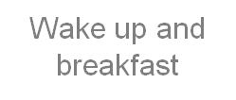
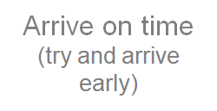

Slide 18
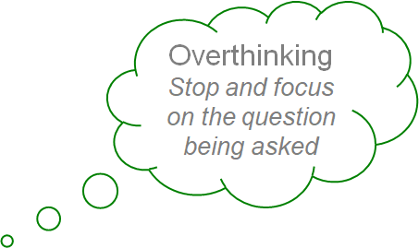
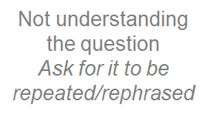
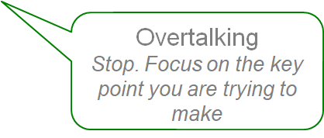
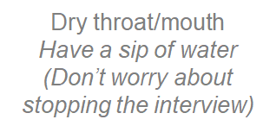

Slide 19
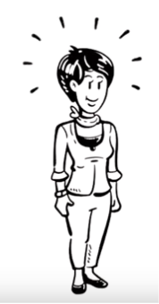
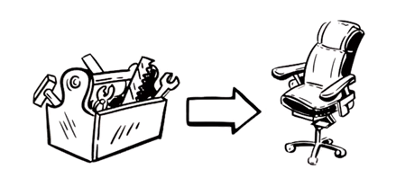
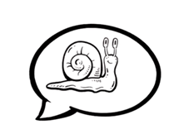
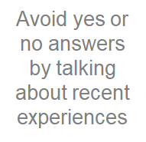
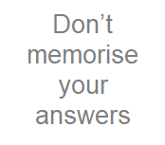

Slide 20
Small Talk.... What's the point?

Slide 21
At the end....

Slide 22
Futher information
https://www.youtube.com/watch?v=chkoryAGYLc
www.monster.co.uk
http://www.blueskyinterviews.co.uk/
http://www.reed.co.uk/career-advice/topics/interview-advice

