Slide 1
Preceptorship: Learning Network
Awareness
This resource is designed to support preceptorship leads within organisations

Slide 2
Session outcomes:
Through this completing session, you will gain awareness of preceptorship.
By the end of this session, you will:
understand the local, regional and national context of preceptorship
be able to define preceptorship
understand preceptorship from different stakeholder perspectives
be familiar with the implications of the CapitalAHP preceptorship framework
have a vision of preceptorship in practice
understand the organisational stages of readiness of preceptorship

Slide 3
Stages of Readiness

Slide 4
Readiness Framework - AADDE
There are 5 elements you'll need to consider in developing (or improving) your program.
We will cover these in the next few modules to support your program delivery.
Assessing the needs of the workplace.
Assess
Design
Planning and designing the preceptorship program.
Pilot the program using quality improvement methodology.
Developing understanding of the value of preceptorship for newly qualified AHPs.
Awareness
Deliver
Evaluate the impact of the program.
Evaluate

Slide 5
Activities...
State where your organisation currently sits within the stages of readiness
It may be helpful to:
List out what you have done within this stage of readiness
List what else you need to do within this stage of readiness

Slide 6
Preceptorship: The Landscape

Slide 7
CapitalAHP Priorities:
Attract the future Allied Health Professions (AHPs) workforce, clarify and support routes into the AHP professions
Bridge the gap between education and employment
Support the development of our current AHPs to have the right skills, in the right places

Slide 8
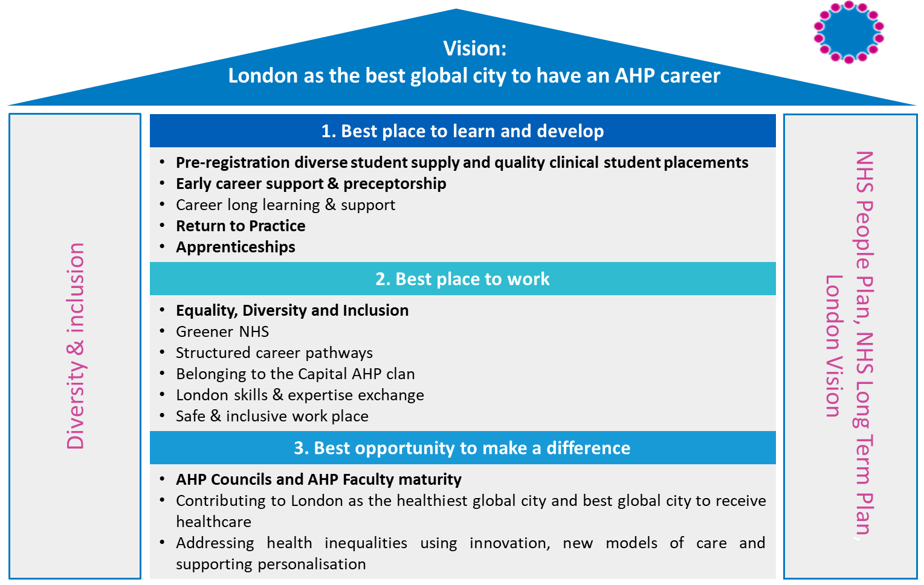
www.hee.nhs.uk/our-work/capitalahp
@LondonAHPs

Slide 9
Activities...
Describe what attracts AHPs to working in London.
What are the unique opportunities that London Health Organisations offer new AHPs?
What are the challenges, unique to capital working, that AHPs encounter?
How does your organisation attract and develop your current newly registered AHPs?

Slide 10
Preceptorship: A definition
Preceptorship is "A period of structured transition for the newly registered practitioner (preceptee) during which they will be supported by a preceptor, to develop their confidence as an autonomous professional, refine skills, values and behaviours and to continue on their journey of lifelong learning." (Department of Health, 2010).
Preceptorship is a period of structured transition, supported by a preceptor, to:
apply knowledge and skills
develop and enhance competence and confidence as an autonomous professional
create a foundation of lifelong learning

Slide 11
Preceptorship: Rationale
We recognise that the period following registration can be a challenging time for individuals. Preceptorship offers newly registered staff support to develop confidence within the workplace.
Organisations require support to develop quality programmes. The Health and Care Professions Council (HCPC) preceptorship principles, have been developed with NHS England to develop national overarching preceptorship principles.
Other staff may benefit from additional and structured support - the principles of preceptorship may be applied to healthcare professionals transitioning to a new setting, for example international recruits or those returning to practice.

Slide 12
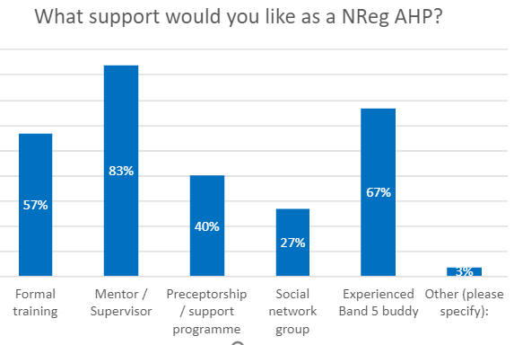
We consulted pre-reg AHP students across the region, this is what we found...
Students felt both anxious and excited about entering the workplace, highlighting a need for support
Student survey
Aim: To hear the student voice and establish how they are feeling as they approach their transition to a newly registered practitioner
Impact of Covid-19 survey: 27% AHPs considered leaving course. 38% within their final 6 months
67 per cent feeling anxious
60 per cent feeling excited

Slide 13
Activities...
Reflect on and describe how you found the transition from student to newly qualified AHP?
What do you know about your Band 5's experience of the transition into your workplace?
Describe what support is currently available in your organisation to develop newly registered staff?

Slide 14
The benefits of preceptorship to...
The Preceptee | The Preceptor | The Organisation
Develop confidence Supports Newly Qualified Paramedic (NQP) across ‘flaky bridge’ Builds effective working relationship Increased job satisfaction – improved patient satisfaction. Feels valued and respected by employer Feels invested in, enhancing career aspirations Feels proud and committed to Trusts corporate strategy and values Provides opportunity for peer support and networking Provides opportunity for inter-professional collaboration Develops pride / commitment to profession | Provides opportunity to enhance own lifelong learning and Continuing Professional Development (CPD) Develops coaching and facilitation skills Develop appraisal, supervision, mentorship and supportive skills Engenders a feeling of value to organisation Enhances motivation and confidence in skills and role Enhances future career aspiration Provides opportunity to deliver, monitor, evaluate and shape a different type of provision | Enhanced quality of patient care Enhanced recruitment and retention Reduced sickness and absence Enhanced staff satisfaction Opportunity to identify staff that require additional support Reduced risk of complaints Provides opportunity to explore new opportunities for Multidisciplinary Teams (MDT) working Provides evidence base for supporting staff against regulatory standards

Slide 15
Preceptorship context:
Organisations
Regional
National

Slide 16
Department of Health (2010): Preceptorship Framework for Newly Registered Nurses, Midwives and AHPs.
Health Education England (2018) RePAIR: Reducing Pre-registration Attrition and Improving Retention Report - Recommendation 12:
"HCPs should review their preceptorship programmes, ideally in partnership with HEIs, to improve s of their newly qualified (NQ) staff and ensure the preceptors are appropriately trained."
Impact of Covid-19 on student experience and the AHP workforce
Increased learners in learning environment due to placement expansion, apprenticeships and advanced practitioners.
National

Slide 17
Regional
CapitalNurse and CapitalMidwife Frameworks ensure that every NHS Trust in London has a nursing preceptorship programme. A quality mark supports organisations to achieve delivery of a quality programme.
Cost of living in London and impact on wellbeing. Staff require more support.
Wide variation in AHP preceptorship programme delivery in London.

Slide 18
Organisation Baseline Survey 2021:
Aim: To understand the current provision of preceptorship programmes for AHPs across the Capital
77%
Response Rate (30/36 trusts)
High variation in frequency of training days:
67%
Response Rate (30/36 trusts)
No preceptorship offered (10 Trusts)
9/10 trusts planning to offer in future
Individual
basis
33%
12 sessions
2 per / mth
100%
Interested in a Preceptorship Community of Practice – including, learning network
6 sessions
None
Uni-Professional – 16 per cent
Multi-Professional (AHP & Nursing) – 26 per cent
AHP – 21 per cent
65 per cent programme duration of 12 months
Majority of programmes not co-designed with HEI and not accredited – similar to RePAIR findings in 2019

Slide 19
National HEE AHP Preceptorship team

Slide 20
Capital organisations will be supported to offer quality preceptorship programs to newly registered AHPs
Newly registered AHPs will see Capital NHS organisations as employers of excellence who support and invest in newly registered staff
Preceptorship: Our vision

Slide 21
CapitalAHP Framework
The framework includes standards / domains of learning
The framework will be supported by:
CapitalAHP Preceptorship Toolkit – online resource
CapitalAHP Community of Practice

Slide 22
CapitalAHP standards to ensure organisations provide quality preceptorship programmes:
Standard​ | CapitalAHP Preceptorship Standards​
Standard 1 ​ | Organisations will offer preceptorship to all newly registered allied health professionals (AHPs) with a minimum length of program of 6 months. ​
Standard 2 ​ | Preceptorship activities will complement existing processes for new members of staff. ​
Standard 3 ​ | Organisations will have a preceptorship policy in place. ​
Standard 4 ​ | Organisations will have a designated lead for preceptorship. ​
Standard 5 ​ | Organisations will have a system to identify preceptees. ​
Standard 6 ​ | Organisations will offer a every newly qualified preceptee a preceptor. ​
Standard 7 ​ | Each preceptee and preceptor will have protected time for preceptorship. ​
Standard 8 ​ | Organisations will track and monitor preceptees through the preceptorship program. ​
Standard 9 ​ | Preceptorships with provide the preceptees with agreed domains of learning. ​
Standard 10 ​ | Organisations will monitor and evaluate their preceptorship program. ​
Standard 11 ​ | Organisations will provide newly qualified AHPs with documentation to record preceptorship activity. ​
Standard 12 ​ | Organisations will recognise and celebrate preceptorship completion. ​

Slide 23
There are 4 key domains within the toolkit that explain the description of key skills, attitudes and behaviors aligned with the HCP standards and the CapitalNurse domains.
The toolkit is cross referenced against the Knowledge and Skills Framework (KSF) and profession specific documentation related to preceptorship.​

Slide 24
Preceptorship in practice
Here is an example of an AHP only program:
Barts Health NHS Trust case study
Here is an example of an AHP program with nursing colleague:
Whittington Health NHS case study

Slide 25
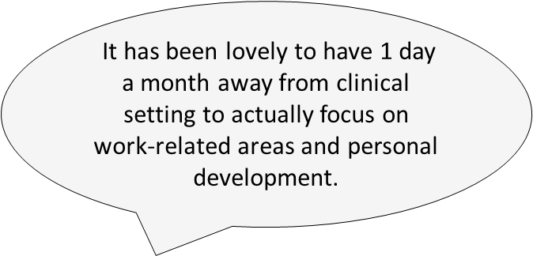
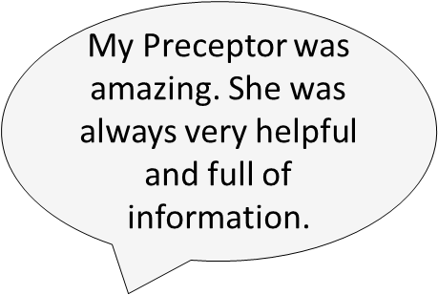
Preceptee feedback
It has been lovely to have 1 day a month away from clinical setting to actually focus on work-related areas and personal development.
Provided a great platform to transition into the role of allied health professional, helped build knowledge and understanding the role…
My Preceptor was amazing. She was always very helpful and full of information.
Helped me gain confidence as a junior professional in my clinical area
S

Slide 26
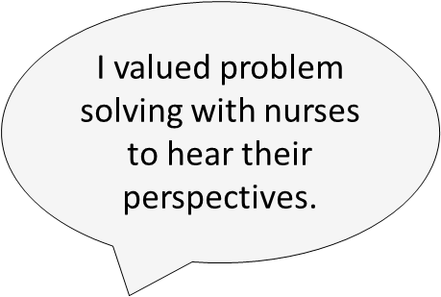
I feel more confident about raising concerns
I feel more confident having explored my own and others concerns as part of a group with similar experiences.
I feel more confident about raising concerns.
I valued problem solving with nurses to hear their perspectives.
It is good to have space and time to think and reflect.
S

Slide 27
Activities...
Who are your key stakeholders that need to be aware of preceptorship?
Do you know of any existing preceptorship programmes within your organisation?
Who are they for?
How are they organised?
What impact have they had?
If you are currently leading on a program, revisiting the regional and national standards, is there anything you might do differently?

Slide 28
Case study one: Barking Havering and Redbridge University Trust Multi-Professional Preceptorship John Bennett - AHP Education Lead

Slide 29
Overview of programme
Multi-Professional Programme of AHPs, Nurses, Nursing Associates and Midwives
12-month programme split into 2 modules
Optional academic credits at level 6 and 7
Achieved kitemarks from CapitalNurse and CapitalMidwife

Slide 30
Content
Module 1 – Personal Effectiveness (Mapped to HEE career framework)
Clinical Practice
Communication
Personal Development
Quality and Safety
Teamwork
Professional Development
Module 2 – Leading for Quality Improvement
Leadership
Research and Evidence
Facilitation of Learning
Quality Improvement (QI)

Slide 31
Resources
Handbook, portfolio and module guides
Programme is supported by a Preceptorship team
Module two supported by QI team
Each Preceptee is supported through the programme by a departmental Preceptor (Initial Preceptor training provided)
Electronic supervision log

Slide 32
Overcoming challenges
Challenge of integrating 7 additional professional groups into programme
Evolving multi-professional programme but recognising specific needs
Concept of Preceptorship
Further challenge of Speech and Language Therapy (SLT) incorporation
Investigating SLT entry into module 2

Slide 33
Impact of programme
AHP cohort launched in July 2021 – initial subjective feedback good
First Nursing and Midwifery cohort reaching end of programme currently
Impact measured through Integrated Evaluation Framework
Aims of improved staff retention, staff wellbeing and patient care, safety and experience

Slide 34
Future
Planning for ‘Beyond Preceptorship’ (year 2 programme)
Implement in-house ‘Supporting Professional Development’ level 7 accredited module (CPD for Preceptors)

Slide 35
Case study two: St Georges University Hospitals NHS Foundation Trust - AHP Preceptorship Louise McGregor - Professional Lead Physiotherapy

Slide 36
Overview of Programme
Preceptorship for new graduates
Physiotherapy and Occupational Therapy (PT/OT) programme established (under review due to new standards)
Scoping of preceptorship for radiography, speech and language therapy and dietetics with the Professional Leads completed

Slide 37
Overview of Programme
Length/structure of programme PT/OT
Preceptor/preceptee meeting within 4 weeks of employment
Identification of learning needs to meet the preceptorship outline based on KSF 8 dimensions
Range of learning opportunities including clinical supervision, In Service Training, simulation training, self-directed learning
Exploring attendance at Trust Nursing “Mental Health and Parity of Esteem” study day

Slide 38
Overview of Programme
Length/structure of programme PT/OT
Regular meetings with preceptor/preceptee plus 6 month and 12 month review meeting
Preceptee collects range of evidence to demonstrate competence in KSF dimensions (building into Continuing Professional Development portfolio)
12 month programme in total

Slide 39
Return to Practice
AHP framework for Return to Practice completed - collaboration with SWL (South West London) faculty
Actively recruiting our first Return To Practice OT
Planning on advertising and promoting Return to Practice (RTP) SWL recruitment hub Feb 2023

Slide 40
Overcoming Challenges
Measuring impact
Range of measures identified but not consistently reported
Raising the profile of preceptorship
Updating preceptorship paperwork in line with new standards and HEE domains- in collaboration with SWL Faculty
Balancing preceptorship objectives with rotation objectives and competencies- requires time and commitment
Ensuring that staff are supported in their role as a preceptor- training for new preceptors

Slide 41
Impact of Programme
Staff retention
Sickness levels
Preceptorship programme satisfies regulatory bodies
Staff feedback- preceptees and preceptors

Slide 42
Activity...
What might you take from these case studies that you could implement in your organisation?

Slide 43
Further support
There is wider support available at capitalAHP:
AHPLondon@hee.nhs.uk
Or our Capital AHP Preceptorship website.

Slide 44
Session review:
Through completing this session, you will have gained awareness of preceptorship and have had the opportunity to:
understand the local, regional and national context of preceptorship
be able to define preceptorship
understand preceptorship from different stakeholder perspectives
be familiar with the implications of the CapitalAHP preceptorship framework
have a vision of preceptorship in practice
understand the organisational stages of readiness of preceptorship

