Slide 1
Preceptorship: Learning Network
Assessment
This resource is designed to support preceptorship leads within organisations

Slide 2
Session outcomes:
Through completing this session, you will gain an understanding of the assessment stage of preceptorship development.
By the end of this session you will:
understand the national and regional context
understand the process of workforce assessment
be able to identify the information you need to complete a workforce assessment
understand your current workforce and identify your drivers for preceptorship
interpret your data within the assessment tool to influence design and delivery
use the data from the assessment tool to estimate cost of program delivery

Slide 3
Stages of Readiness

Slide 4
Readiness Framework - AADDE
There are the 5 elements you'll need to consider in developing your program
We will cover these in the next few modules to support your program delivery
Assessing the needs of the workplace.
Assess
Design
Planning and designing the preceptorship program.
Pilot the program using quality improvement methodology.
Developing understanding of the value of preceptorship for newly qualified AHPs.
Awareness
Deliver
Evaluate the impact of the program.
Evaluate

Slide 5
National Context
Department of Health recommends that preceptorship should be considered as a transition phase for newly registered practitioners when continuing their professional development, building their confidence and further developing competence to practice. DoH 2010 paper - https://www.networks.nhs.uk/nhs-networks/ahp-networks/documents/dh_114116.pdf
The RePAIR (Reducing Pre-registration Attrition and Improving Retention) project has gained an in depth understanding of the factors impacting on healthcare student attrition and the retention of the newly qualified workforce in the early stages of their careers -https://www.hee.nhs.uk/our-work/reducing-pre-registration-attrition-improving-retention
HEE National preceptorship webpage and resources- https://www.hee.nhs.uk/our-work/capitalnurse/workstreams/preceptorship
ELfH module – Preceptor development: provides key knowledge and skills needed to act as a Preceptor- https://www.e-lfh.org.uk/programmes/preceptorship/

Slide 6
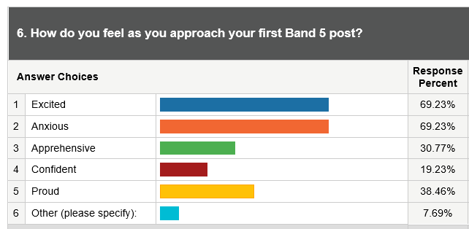
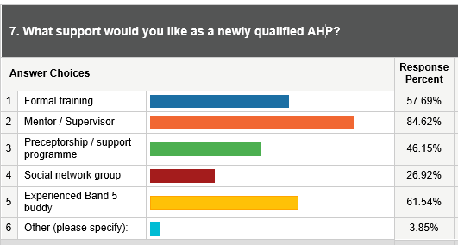
Regional context
What London pre-registration students told us about their needs and how preceptorship can meet them:
Nearly 50% of respondents stated they would like a preceptorship programme when they qualify
How do you feel as you approach your first Band 5 post?
What support would you like as a newly qualified AHP?
As a student, during your final year of practice placement, is there anything that could be provided to help prepare you for your first Band 5 post?

Slide 7
Assessing our Workforce at Guy's and St Thomas' NHS Foundation Trust Jules Marchant Trust Lead AHP Workforce and Education

Slide 8
Developing AHP Preceptorship: Assessing our Workforce

Slide 9
Context
No previous AHP Preceptorship within organisation
CapitalNurse and CapitalMidwife programmes within Trust
Current offer for AHPs:
2 day Band 5 (B5) Survivorship course for Newly Registered physiotherapists
B5 Occupational Therapist (OT), Physical
Therapist (PT), Speech and Language
Therapist (SLT) Rotational Schemes
AHP clinical induction
Service specific trainings
B5 meeting/forums
Enhanced induction for radiographers...

Slide 10
Baseline Data: Preliminary B5 Recruitment and Retention data
In progress: Turnover year 2, B5-B6 Conversion rates, sickness rates (Yr 1 and 2), how many AHPs join per month
Staff group | Apr 19 Staff in Post | Mar 20 Staff in Post | Leavers Apr 19 to Mar 20 | Leavers Under 1 Year Service | Turnover | Turnover Less than 1 Year Service
Dietitian | 6 | 7 | 1 | 0 | 15.4% | 0.0%
OT | 20 | 24 | 1 | 0 | 4.5% | 0.0%
Other (for example, Play Specialist, Physical Activity Specialist, Complementary Therapist) | 39 | 35 | 6 | 3 | 16.2% | 8.1%
Physiotherapist | 46 | 42 | 3 | 1 | 6.8% | 2.3%
Radiographer | 52 | 54 | 6 | 0 | 11.3% | 0.0%
SLT | 16 | 17 | 2 | 1 | 12.1% | 6.1%
Grand Total | 179 | 179 | 19 | 5 | 10.6% | 2.8%

Slide 11
Baseline Data: Band 5 AHP focus groups
Wanted to gather Band 5 AHP staff perspectives on the following:
As a Newly Registered AHP, what attracted them to our organisation
In their first 12 months, what support had been the most valuable to them and why
Main challenges / concerns about entering their first professional role
What they would want from a preceptorship programme
Content / frequency of study days

Slide 12
Baseline Data
NHS Staff Survey
Reviewed 2020 results – very positive - only two areas were identified for improvement
I can access the right learning and development materials when I need to
Learning and development activities I have completed in the last 12 months have helped to improve my chances of career progression
Review of current development pathways in Trust
OT support training timetable
Rotational handbooks
Diagnostic / Therapeutic B5 Training Programmes
Other resources
Radiographer recruitment survey
Annual end of rotation reports

Slide 13
Next steps
Sign off from exec to develop and deliver AHP Preceptorship 2022 | Agreed
Co –production with Nursing / Midwifery – Multi-Professional | Agreed
Recruit AHP Preceptorship Implementation Lead | Funding agreed
Named rep from each AHP group to form AHP Preceptorship committee | In progress
Finalise assessment data | In progress
Implement by March 2022
Evaluation
Awareness
Assessment
Design
Delivery
Evaluation

Slide 14
Activities...
List all the stakeholders that can support you with assessing your Band 5 workforce
It may be helpful to determine from this list the key stakeholders that have the most influence in helping you to do this
How would you go about starting your workforce assessment?
Think about what data / evidence you need, what information do you already collect and what do you need to develop to get the information? How long will it take you to gather all the information you need?
Start to develop a timeline of next steps
Various project management tools will help you – click here

Slide 15
Barnet, Havering and Redbridge University Hospital Trust (BHRUT) Emma Skinner Preceptorship Lead

Slide 16
AHP Preceptorship
Assessment Phase –
Multi-Professional Approach

Slide 17
Organisational Drivers
Want to be ‘Employer of choice’
Integral part of AHP careers maps
Want to achieve parity for all new registrants
Need vision to increase multi-professional learning

Slide 18
AHP CAREER ON A PAGE: A vision for development
BHRUT/HEE
BHRUT/Higher Education Institution (HEI) Post-registration Infrastructure and Delivery Model
Practice level
NOVICE LEVEL
Assistant Level Practice / Student practice
COMPETENT LEVEL
General Practice
PROFICIENT LEVEL
Senior Level to Advanced Level Practice
EXPERT LEVEL
Advanced Level Consultant Level Practice Clinical / Corporate Leadership
Educational
Assistant Practitioner Development
Care Certificate
Undergraduate Degree
AHP Practitioner Development
Senior/Specialist AHP Practitioner Development
(General, specialist and rotational programmes)
Advanced to Consultant AHP Practitioner Development
(Generic and specialist training; Leadership; Management; QI)
AHP apprenticeships (Level 2 – 5)
Preceptorship
(12 months)
Advanced Clinical Practice
(48 months – Level 7)
AHP roles*
AHP SW
Band 2
AHP SW
Band 3
AHP SW
Band 4
AHP
Band 5
AHP
Band 6
AHP
Band 7
AHP
Band 8
Band 9
AHP Graduate entry
Generic and Speciality roles
Profession specific support worker/assistant
Generic Therapy Assistant
Radiology Assistant Practitioner
Graduate AHP
Specialist AHP
Education
Research
Quality and Safety Clinical Governance Gen. Management
Pathway change
Advanced AHP
Clinical Lead
AHP Manager
Practice Dev./Educ. Facilitator
Research
Quality and Safety Clinical Governance Gen. Management
Clinical Fellowships
Clinical Lead
Clinical Specialist
Superintendent
AHP Manager
Advanced Clinical Practitioner
Consultant AHP
Clinical Matron
Clinical Fellowships
Qual. Improvement
Consultant AHP
Divisional Manager/Lead
Clinical Lead
AHP Manager
*Actual job titles might differ from the generic AHP roles listed

Slide 19
Perceived Benefits
Develop confidence and competence of newly registered practitioners
Enhance patient care and satisfaction
Feel valued and respected by the Trust
Feel invested in and enhance future career aspirations

Slide 20
Expected Outcomes
Improved recruitment and retention rates
Reduced sickness absence
Enhanced patient experience
Improved staff satisfaction

Slide 21
BHRUT Band 5 Recruitment Data 2019
Month | Number of AHPs starting
January | 1
February | 4
May | 2
June | 1
August | 10
September | 20
October | 5
November | 7
December | 2
Grand Total | 52
Professional Group | Number by profession
Dietitian | 3
Occupational Therapist | 13
Operating Department Practitioner | 1
Physiotherapist | 19
Radiographer | 10
Speech and Language Therapist | 3
Therapeutic Radiographer | 3
Grand Total | 52

Slide 22
Identifying Key Stakeholders
Senior AHP Leads
AHP Professional Leads
AHP’s with a particular interest in Education
Newly registered Band 5 AHP’s

Slide 23
Stakeholder Involvement BHRUT
How can the current programme be adapted to meet the needs of AHPs?
While generic topics overlaps there needs to be a way to ensure profession specific learning is included with enough flexibility to incorporate the variety Need to consider that staff are rotational so will all have different experiences in the first two months of their registration
2. What challenges may arise when implementing the current structure for AHPs?
Variety of AHPs make it difficult to ensure that each AHP profession has a clear definition of their specific objectives on the programme and a framework to meet them Obtaining suitable number of AHPs to run the programme as recruitment is sparse in comparison to nursing Time for AHPs to attend the sessions due to low staffing in the department
3. How do you suggest we work together to achieve a well-tailored AHP Preceptorship?
Set a generic framework and allow individual professions to incorporate specific areas as needed

Slide 24
Stakeholder Involvement North Middlesex University Hospital
Reassessed current Nursing and Midwifery programme, needed revising
Started from scratch to build a Multi-Professional Programme
Questionnaire’s sent to AHP Professional Lead’s and current band 5’s
Based on the 4 pillars of Practice and 9 HEE Career domains

Slide 25
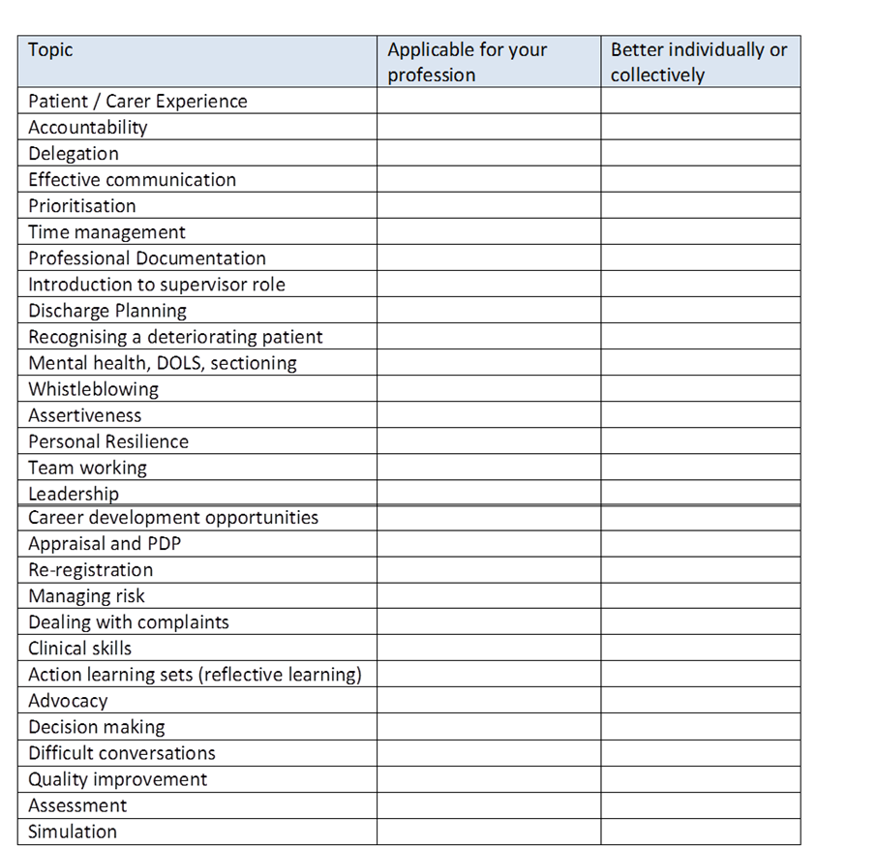

Slide 26
Topic | * | Topic
Patient / Carer Experience |  | Career development opportunities
Accountability |  | Rotational programmes
Delegation |  | Appraisal and PDP
Effective communication |  | Re-registration
Prioritisation |  | CPD and lifelong learning
Time management |  | Clinical decision making
Professional Documentation |  | Managing risk
Introduction to supervisor role |  | Dealing with complaints
Discharge Planning |  | Clinical skills
Patient Safety |  | Models of Care
Recognising a deteriorating patient |  | Action learning sets (reflective learning)
Mental health, DOLS, sectioning |  | Advocacy
Whistleblowing |  | Decision making
Assertiveness |  | Difficult conversations
Personal Resilience |  | Quality improvement
Team working |  | Assessment
Your role within the team |  | Improving health (primary prevention)
Leadership |  | Simulation

Slide 27
Resources
BHRUT
NMUH
Trust Preceptorship Lead already in post
Preceptorship Team expanded in preparation of increased workload
AHP Education Lead recruited
Project Manager
Continuous Improvement Team
Nursing and Midwifery Preceptorship Lead already in post
12 month fixed term band 7 AHP Preceptorship role

Slide 28
Activities...
Identify the AHP leads that you need to work with to move forward?
List your key resources available.
Identify other programs are running within your organisation and how might you work with them?

Slide 29
Understanding the Local Picture
Recruitment and Retention
Number of B5s in post (across Trust and by profession)
Detailed capture and breakdown of information on retention of NReg AHPs after one year by (for example, gender, age, profession, reasons for leaving the Trust)
Retention of NReg AHPs after two year
Other Workforce Data
Sick and absence rates of NREg AHPs in year one
Sick and absence rates of NREg AHPs in year two
Map and Understand Current Offer
Engagement with current NReg workforce – understand needs directly
Map what training and development is currently offered to NReg AHPs / Nurses in Trust
Staff and Patient Experience
Review your NHS staff survey results
Review patient / service user feedback
Review your Care Quality Commission (CQC) ratings against key criteria (safe, effective, caring, responsive and well-led)

Slide 30
Workforce Assessment Tool

Slide 31
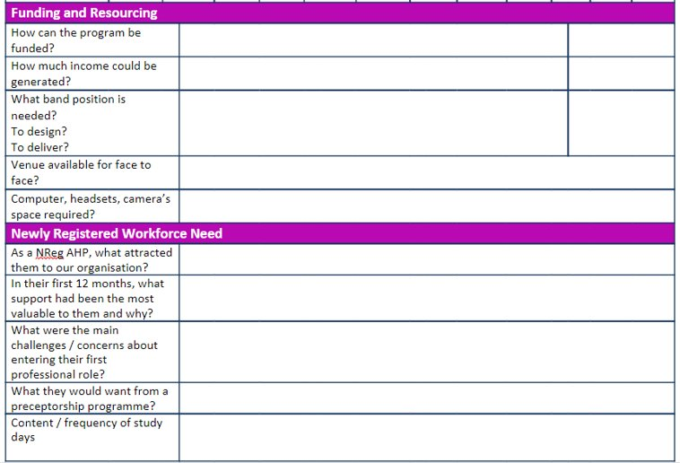

Slide 32
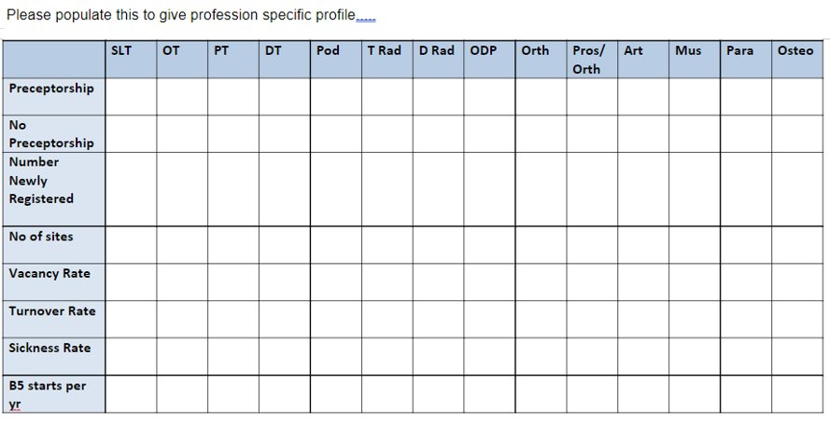
Please populate this to give profession specific profile

Slide 33
Funding Example
Organisations had access to Continuing Professional Development funding for Allied Health Professionals from HEE. Between 2019-2022 CPD monies this amounted to £1000 per head over the three years. This funding could be used to fund Preceptorship. An example is given below on how this might be costed:
30 preceptees per annum x 6 days program
= 180 study days
180 study days X £100 per day
= £18,000
£18,000 = 0.3wte Band 7 = 68 days
Cohort size = 6 preceptees
5 cohorts x 6 study days
= 30 study days

Slide 34
Scenario 1: Drivers for preceptorship
Your data demonstrates that there are no significant challenges in recruiting and retaining B5 staff within their first 2 years as registered practitioners. What other data can you use to clearly articulate the value of preceptorship to your organisation?

Slide 35
Scenario 2: Resources
Resource is limited in your organisation to deliver preceptorship, given this, where and how might you start programme delivery?

Slide 36
Scenario 3: Engagement of different professions
All your AHP groups are engaged with preceptorship, however one profession is not able to release staff for the training days / inductions – how might you proceed?

Slide 37
Activities...
What are the next steps to assess your workforce?
What data will you collect and why?
Where will you access this data?
What are your next three steps?

Slide 38
Session review:
Through completing this session, you will have gained an understanding of the assessment stage of preceptorship development and have had the opportunity to:
understand the national and regional context
understand the process of workforce assessment
identify the information you need to complete a workforce assessment
understand your current workforce and identify your drivers for preceptorship
interpret your data within the assessment tool to influence design and delivery
use the data from the assessment tool to estimate cost of program delivery

