Slide 1
Preceptorship: Learning Network
Design
This resource is designed to support preceptorship leads within organisations

Slide 2
Session outcomes:
Through this session, you will gain understanding of the design aspect of preceptorship by completing the following outcomes with some activities:
By the end of this session, you will:
be aware of features of preceptorship design
be able to draw together key elements of preceptorship design within your organisation
apply information you attained in Assessment Phase to Design of programmes
become familiar with CapitalAHP (CAHP) Standards and Domains of Learning and how they relate to Design Content.

Slide 3
Stages of Readiness

Slide 4
Readiness Framework – Awareness Assess Design Deliver and Evaluate (AADDE)
There are the 5 elements you'll need to consider in developing your program.
We will cover these in the next few modules to support your program delivery.
Assessing the needs of the workplace.
Assess
Design
Planning and designing the preceptorship program.
Pilot the program using quality improvement methodology.
Developing understanding of the value of preceptorship for newly qualified AHPs.
Awareness
Deliver
Evaluate the impact of the program.
Evaluate

Slide 5
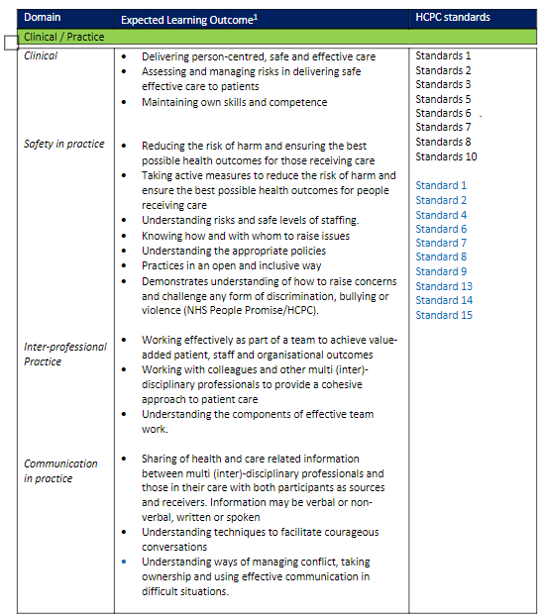
CapitalNurse and
Health and Care
Professions Council (HCPC):
Following consultation across the region, the following key domains were identified:

Slide 6
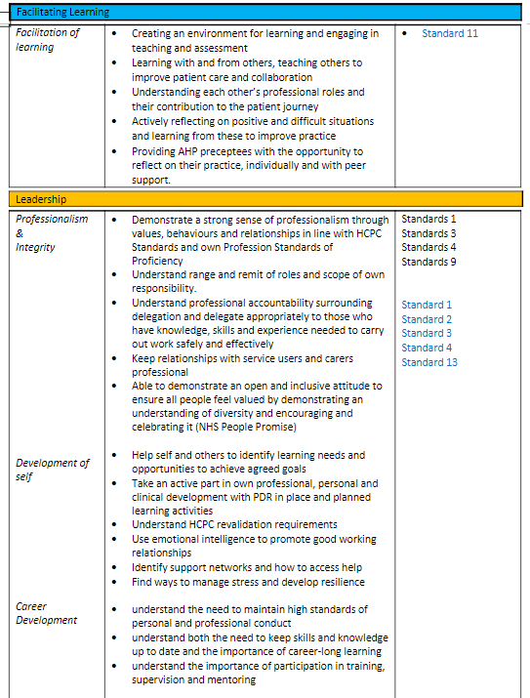

Slide 7
FAQs
FAQs
How does this link to uni-professional preceptorship / competency-based programmes (for example, Royal College of Occupational Therapist (RCOT), Royal College of Speech and Language Therapist (RCSLT))?
CAHP has cross-referenced all profession specific preceptorship / competency-based programmes to these options. All uni-professional preceptorship requirements can be met by all options. A matrix of this will be provided for the chosen option for all Allied Health Profession (AHP) professional bodies.
Our organisation has used the Knowledge and Skills Framework (KSF) to inform our AHP preceptorship programme, how will it link with the CAHP Domains?
The KSF is a useful tool in identifying the knowledge, skills and learning, and development of staff across the NHS. Some Trusts still use it to inform their competency frameworks. The KSF can inform any of the CAHP domain options. It may help to provide details of the specific area of knowledge and skill development required by the preceptee within each Domain of Learning. This may also help to inform the preceptees Performance Development Review (PDR) at the end of the preceptorship period.

Slide 8
Transitional skills versus specialist / profession specific skills?
Essentially preceptorship is about transition. The CAHP preceptorship framework will provide transitional skills relevant to all AHP professions, no matter their clinical area. Specialist skills / competencies relevant to setting and profession specific will need to be addressed by the Trust / service.
Is a single preceptorship programme available for AHPs?
Preceptorship programmes are designed to meet the particular needs of the organisation and the unique AHP groups within it, a single programme is not available at a regional or national level. Regional initiatives include preceptorship frameworks and the national team are developing preceptorship principals, and these resources are aimed to support organisations as they develop preceptorship programmes tailored to their particular contexts.

Slide 9
Preceptorship Design
Barts Health NHS Trust Matthew White – AHP Preceptorship Lead

Slide 10
What happened before?
AHP
RePAIR project findings
Aware of AHP disengagement within Nursing and Midwifery Preceptorship
Historic lack of engagement with Preceptorship from AHP departments
Accelerated AHP Preceptorship project evidenced the potential for a successful AHP Preceptorship and created interest with AHP leads
Employed an AHP into a new role of AHP Preceptorship Lead

Slide 11
AHP
Opportunity
Known large intake of Newly Qualified AHPs across the trust around April 2021
The impact of COVID created a demand to develop a Pilot AHP preceptorship programme
Professions and impact on program design
Scoping project
Created an AHP Preceptorship development stakeholder group
Reviewed current support for Newly Qualified Paramedic (NQP) AHPs at a profession specific departmental level

Slide 12
Profession specific?
Agreement for an AHP only preceptorship programme
Resource demanding as Professions would need to deliver the sessions
Resource demanding as multiple sessions would be synchronous
Economically not viable if low numbers of specific AHP preceptees
Equal
Agreed not to have Profession Specific content/day(s) as part of the programme
Timing of the available opportunity
Previous difficulties running a programme inclusive of Nursing, Midwifery and Health Professions (NMaHP)
An agreement for a programme that delivered content relevant to all AHPs only
Ensure all professions are engaged
Estimated annual numbers of AHP NQPs adequate
Standardize
complicated to co-coordinate. (previous issues evidenced in the accelerated programme)
Accelerated AHP Preceptorship report recommendations

Slide 13
Influencers on the structure and content of the programme
Previous and current Preceptorship programmes
Barts Health and HEE Preceptorship Policy
Barts Health Values
HCPC standards
Consulted for agreed commitment
NHS Priorities and relevant research findings
Policy and standards
Current General Preceptorship
Accelerated AHP Preceptorship
AHP Stakeholder Group
AHP Preceptorship outside of our trust
Requested content topics
Integrated Radiography and General Preceptorship
Consulted for agreement on content
Capital Nurse Preceptorship
Preceptorship Steering groups
COVID
RePAIR
Specialist education teams
External education providers: After thought, Always consult
Trust wide specialist teams: End of Life care (EOL), Dementia and Delirium (D and D), Quality Improvement (QI), Learning Disabilities (LD), Frailty
Accelerated preceptorship report

Slide 14
AHP Preceptorship Pilot Programme Overview
AHP Preceptorship Programme
Date | Day 1: 5 May | Day 2: 2June | Day 3: 7 July | Day 4: 4 Aug | Day 5: 1 Sep | Day 6: 6 Oct | Day 7: 10 Nov | Day 8: 1 Dec | Day 9: 5 Jan | Day 10: 2Feb | Day 11: 2 Mar | Day 12: 6 Apr
Work-shop | Core Preceptorship | Foundation in Leadership and Management (FLM) | Core Preceptorship | FLM | Core Preceptorship | FLM | Core Preceptorship | FLM | Core Preceptorship | FLM | Core Preceptorship | FLM
09:45 - 12:30 | Introduction to the AHP Preceptorship Programme | Introduction to FLM programme | Communication Skills. Delivered by Afta-thought | Leadership Styles | Mental health | Conflict and Negotiation | Introduction to end of life care | Organisational Culture | Introduction to Quality improvement | NHS Structure and Finance | Preceptorship Completion | End Point Assessment Preparation
 | AHP professions and Doctor of Medicine (MD) working (ice breaker)
 |  |  |  |  |  |  |  |  |  |  | Celebration event
 |  |  |  |  |  |  | Breaking bad news
 |  | Leadership in Clinical practice
 |  |  |  |  |  |  |  |  |  |  | Career Progression within and beyond Barts Health
 | Hopes fears and expectations
 |  | Enrolment
 | Continuing Professional Development (CPD): HCPC standards and online portfolio |  |  |  |  |  | Covid-19
 | Continuing Professional Development (CPD): HCPC standards and online portfolio |  |  |  |  |  |  |  |  |  | Appraisal Process
Lunch: 12:30 – 13:00
13:00 - 16:00 | Health and Wellbeing | Self-Awareness | Communication tool kit | Project Management and Innovation | Learning disabilities | Human Factors | Frailty | Leadership in Practice | Introduction to Quality improvement | Group Work | Programme Evaluation
 | Psychological Personal Protective Equipment (PPE)
 |  |  |  |  | Dementia and delirium
 |  | Group Work |  | Group Work |  | Group Work |  | Group Work
 |  |  | Patient documentation skills
 |  |  |  |  | Safeguarding
 | Resilience

Slide 15
AHP
Challenges
Getting a clear picture of AHP recruitment numbers through the year
Ensuring equity for all AHPs in the design phase
Setting the balance between multi professional learning and profession specific learning
Getting stakeholders to fully understand the preceptorship process and expectations of the programme
Maintaining engagement with all AHP professions involved

Slide 16
Activity...
Which additional stakeholders might you include in order to design and deliver a program that meets the domains of learning?
What known opportunities and challenges within your workforce and organisation will impact program design?
How will you balance the multi-professional and profession specific content?

Slide 17
Preceptorship Design
Oxleas NHS Foundation Trust Hannah Tomkins and Felicity Devereux – AHP Preceptorship Programme Leads

Slide 18
Oxleas AHP Preceptorship Programme
2017
Discussions about a Preceptorship programme for recruitment, retention and staff development start.
2018
2x 0.1 Whole Time Equivalent (WTE) roles implemented to design an Oxleas Preceptorship Programme for 5 AHP groups within Oxleas.
2019
Successful bid to HEE for 9 months funding to expand and deliver a Pan-London AHP Preceptorship to Mental Health/Community Trusts. 2x secondment roles.
2020
Pan-London programme launched in February.
2021
Successful business case to Oxleas NHS Trust to continue to deliver to Mental Health/Community Trusts in London and expand nationally. 2x full time roles started in October.

Slide 19
Overview of programme
Monthly Band 5 AHP preceptorship meetings.
12-month programme with flexibility.
Competencies linked with HCPC standards of proficiency, observed practice and Preceptorship meetings.
Portfolio provided and website with portal due to go live in February. Linked with London South Bank University for optional Accreditation.
Training and support group for Band 6 and 7 Preceptors as well as linking in with Trust AHP/Preceptorship leads on a quarterly basis.

Slide 20
Content of programme
Monthly Band 5 Preceptorship meetings - covering generic AHP professional development topics and networking opportunities with newly qualified AHPs. Additionally one-to-one introductory meetings with all Band 5 preceptees.
Band 6 and 7 AHP Preceptorship training- workshop covering "preceptorship model", role transition from "student" to "accountable clinician", work based learning, implementing preceptorship using the portfolio, evidence to meet HCPC CPD standards, supervision, wellbeing and resources. Training is provided on a bi-monthly basis.
Access to the portal: all Band 5 Preceptees are provided with a portfolio covering competencies in Communication, People and Personal Development, Health Safety and Security, Quality and Equality and Diversity, with a section on Post and Professional Specific and Observed Clinical Practice aligned to HCPC standards 3 and 4.

Slide 21
Design

Slide 22
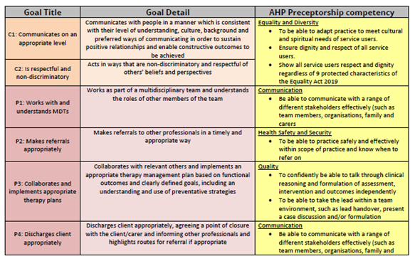
Overcoming Challenges – factors that influenced design
Covid-19 pandemic
Original plan to meet face to face
Adapted programme to be delivered virtually including training and 1:1 sessions
Current profession specific competencies
Speech and Language Therapists have National Quality Program (NQP) goals in place which are mandated
Adapted by providing advice about how Preceptorship competencies can link with the NQP goals
Feedback from surveys
On-going feedback collected following meetings and training

Slide 23
Next steps......
Launch the portal in February
Link with London South Bank University to have a tailor-made Accredited course linked with Preceptorship
Delivery to further Trusts

Slide 24
Applying this in your setting...

Slide 25
Activities... Elements of design
Preceptees: Who is your preceptorship for and why? How do you find out about preceptees for the program?
Length: How long is the program? How often do they meet? How long is each session? And Why?
Model: How is the program delivered? Online? Face to Face? Blended? And Why?
Document of Learning (DOL): What is included in the content? How did you decide what to include?
Documentation of learning: Do you have a preceptorship workbook? What is included in it? How is it used?
Preceptors: Who are your preceptors? How were they trained?

Slide 26
Capital AHP have developed the following standards to ensure organisations provide quality preceptorship programmes:
Standard​ | CapitalAHP Preceptorship Standards​
Standard 1 ​ | Organisations will offer preceptorship to all newly registered allied health professionals (AHPs) with a minimum length of program of 6 months. ​
Standard 2 ​ | Preceptorship activities will complement existing processes for new members of staff. ​
Standard 3 ​ | Organisations will have a preceptorship policy in place. ​
Standard 4 ​ | Organisations will have a designated lead for preceptorship. ​
Standard 5 ​ | Organisations will have a system to identify preceptees. ​
Standard 6 ​ | Organisations will offer a every newly qualified preceptee a preceptor. ​
Standard 7 ​ | Each preceptee and preceptor will have protected time for preceptorship. ​
Standard 8 ​ | Organisations will track and monitor preceptees through the preceptorship program. ​
Standard 9 ​ | Preceptorships with provide the preceptees with agreed domains of learning. ​
Standard 10 ​ | Organisations will monitor and evaluate their preceptorship program. ​
Standard 11 ​ | Organisations will provide newly qualified AHPs with documentation to record preceptorship activity. ​
Standard 12 ​ | Organisations will recognise and celebrate preceptorship completion. ​

Slide 27
Session review
Through completing this session, you have gained an understanding of the design aspect of preceptorship, including the opportunity to:
increase awareness of features of preceptorship design
draw together key elements of preceptorship design within your organisation
apply information you attained in Assessment Phase to Design of programmes
become familiar with CapitalAHP Standards and Domains of Learning and how they relate to Design Content.

