Slide 1
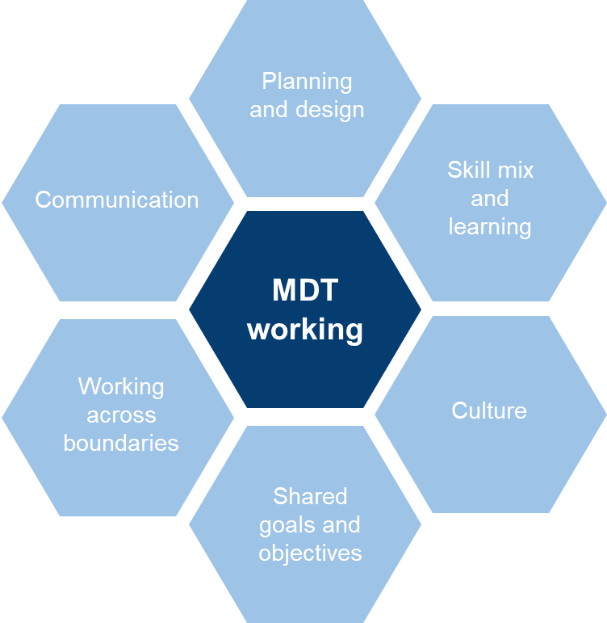
Multidisciplinary Team Toolkit
Six key enablers for successful MDT working
Planning and design
Design of the team is based on population need.
HEE Star has been used as a methodology to plan workforce change.
Approach to risk stratification is agreed.
Personalised care plans are co-developed with patients/ service users.
Communication
Approach to engagement and communications is inclusive and embedded.
Frequency, timing and methods of communications within the MDT are agreed up front.
Systematic approach adopted to continuous relationship building.
Shared vision and narrative being continuously implemented and reinforced is evident and supported.
Open, transparent and two-way engagement approaches embedded to build trust.
Engaging and communications driven leadership, capacity and expertise developed.
MDT approach, with use of patient stories, is well articulated to other teams and organisations.
Skill mix and learning
The team has the right skills and membership.
SMART development plans in place for individuals and the team.
Roles and professional. backgrounds are shared as part of a team development plan.
Clear understanding of how other services operate.
Mentoring is an active part of the MDT’s ways of working.
Organisation changes and developments are routinely shared and discussed.
Time is dedicated to allow MDT to learn together.
Working across boundaries
Shared space or co-location is agreed and all physical and human factors have been identified.
Leadership is committed to shared records.
Technology to support MDT is enabled, with efficient, effective data exchange.
Information governance is clear and well defined.
Culture
Support from the organisation is evident and well documented.
Support, training and supervision for shared leadership is evident and well documented.
Cross leadership and multi professional training takes place.
Non-work (socialising) is included in development time to progress relationships.
Shared goals and objectives
Safe space created on a defined basis to discuss and agree shared goals.
Commonalities are recognised, welcomed and recorded.
Shared goals and objectives are designed together, across professions and leadership.
Shared decision making, governance and accountability process are agreed.
Approach to evaluate the effectiveness of the MDT is agreed.

