Slide 1
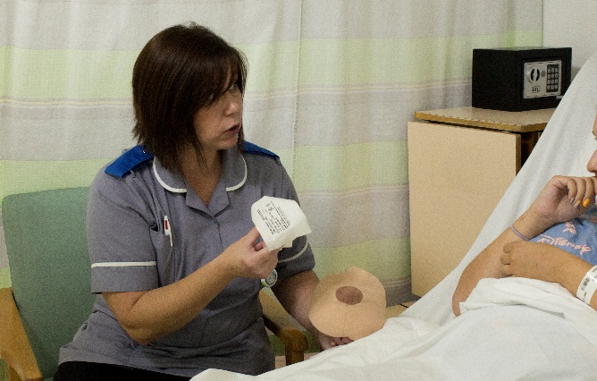

Maternity Support Worker Transformation Fund – Mapping Exercise
Realising potential to deliver confident, capable care for the future

Slide 2
Context
Better Births (2016), highlighted the need for multi-professional working, breaking down barriers between midwives, obstetricians and other health professionals to deliver world-class safe, personalised care for women and their babies.
Maternity support workers (MSWs) are an integral part of the maternity workforce and play an important role in supporting midwives and the wider maternity teams, mothers and their babies through pregnancy, labour and during the postnatal period. However, within the current workforce, the roles, responsibilities and job titles of MSWs in England vary widely.
In March 2018, the Secretary of State for Health and Social Care announced a package of measures aimed at professionalising the maternity support worker role.
HEE has led this important piece of work and developed the Maternity Support Worker Competency, Education and Career Development Framework working closely with a wide range of partners and stakeholders. The framework draws from and builds upon excellent examples of good practice from across the system. It outlines the competence and education levels required to support the delivery of Better Births and the Long Term Plan.

Slide 3
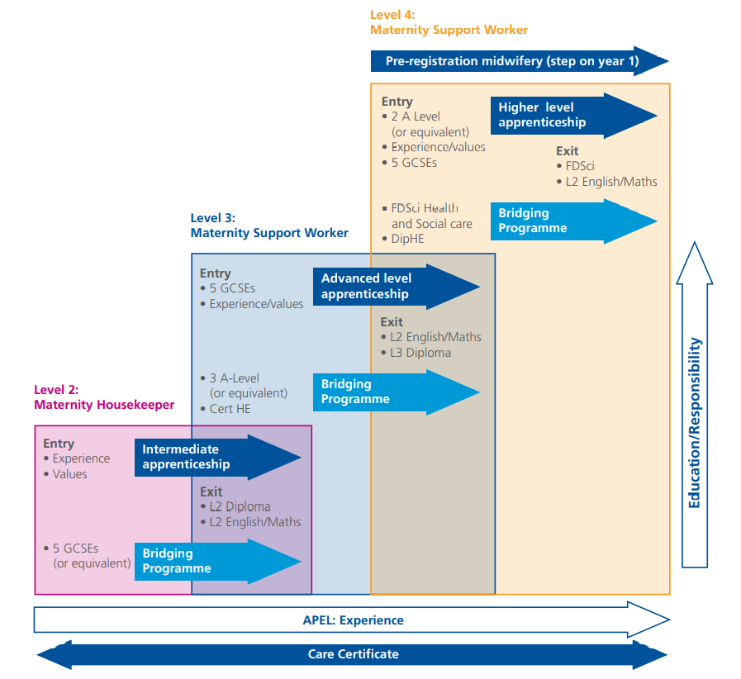
Framework
Progression through the Maternity Support Worker Competency, Education and Career Development Framework is summarised in the diagram.

Slide 4
Project Background
Following a successful pilot of the framework across organisations of North West London, HEE secured funding to support plans for full implementation across all maternity units in England.
The 2020/21 funding was available to Local Maternity Systems (LMSs) to support desktop review and mapping of maternity support staff against the framework.
All maternity units were encouraged to review their MSW workforce, including support staff that are not described as MSWs (historically, support workers have had numerous titles associated with their roles).
Each maternity unit was then asked to map their MSWs against the education and competency requirements at levels 2, 3 and 4 described in the framework.
LMSs collated mapping findings from their units and the results are described in these slides:
  Summary of staff reviewed
  Full list of competencies described in framework
  Level 2 Maternity Housekeeper (MH)
  Level 3 Maternity Support Worker (MSW)
  Level 4 Maternity Support Worker (MSW)

Slide 5
Staff reviewed
Table 1 shows a summary of MSWs captured in the mapping exercise. Data were exported at the end of November 2021.
Total in scope is not available for each MSW role (levels 2, 3 and 4). Where the total reviewed was different than the number in scope, 71% of LMSs cited leave and sickness absence as accounting for the difference. Other issues included non-compliance and lack of access to relevant staff information.
Figures from one LMS are yet to be reported. Please be aware we await clarification from a small number of LMSs; figures may be subject to very minor changes.
Table 1. Staff summary by region. Percentages shown are proportion of total maternity support staff. *Percentage of LMSs reporting.
Region | No. of LMSs reporting | Staff in scope | No. reviewed
East of England | 6 | 99.5% | 74.6%
London | 5 | 98.1% | 77.1%
Midlands | 11 | 98.2% | 81.9%
North East & Yorkshire | 6 | 89.9% | 68.4%
North West | 2 | 87.2% | 72.9%
South East | 8 | 95.8% | 89.6%
South West | 5 | 98.2% | 85.6%
Grand Total | 43 *(98%) | 95.9% | 79.4%

Slide 6
Full list of MSW competencies
Maternity Support Worker competencies
Competency 1: Create effective and supportive relationships with women and their families to enhance the provision of personalised and safe woman centred care. | Competency 8: Communicate clearly and accurately using a range of written, verbal and non-verbal methods, maintaining confidentially and upholding the principles of data protection at all times.
Competency 2: Understands the MSW’s scope-of-practice and works within limits of own competence and authority. | Competency 9: Maintain and develop knowledge, skills and behaviours through training and education to include local mandatory training.
Competency 3: Contribute positively to a culture of team working, maintaining effective working relationships to maximise quality of care. | Competency 10: Participate in the teaching, training and mentoring of staff within the scope of the MSW role and responsibilities and in collaboration with the multi-disciplinary team.
Competency 4: Notice and respond appropriately to the changing needs of the woman and her family. | Competency 11: Work within organisational policies and procedures to ensure maintenance of safe working practices for women, their families and colleagues.
Competency 5: Promote a culture of health and well-being through providing information, advice and support to enable healthy lifestyle choices for all, whilst understanding the causes of ill-health related to women of childbearing age and their families. | Competency 12: Assist in the maintenance of a safe working environment through the efficient use of resources to support the smooth running of the area, having due regard for the health, safety and welfare of self and others.
Competency 6: Actively engage with public health initiatives. | Competency 13: Participate in initiatives to enhance service provision.
Competency 7: Provide and monitor care safely and effectively. | Competency 14: Recognise and respect equality and diversity, demonstrating an inclusive approach in all environments.

Slide 7
Level 2 Maternity Housekeeper (MH)
Role description
Uses general skills to enhance the service offered to women and their families across a range of aspects of maternity service delivery under the close supervision of a registrant, ordinarily a midwife, nurse or Level 4 practitioner.
​​Level of practice and scope of role: Level 2 maternity housekeepers work alongside registered practitioners and other members of the maternity care team who provide direct delivery of care to women and their families accessing hospital-based services. Level 2 maternity housekeepers may undertake basic care tasks, as part of routine care for women and their babies, and for which they have been appropriately trained. Where they do so, they will follow planned care programmes whilst being closely supervised by a registered or Level 4 practitioner.

Slide 8
Level 2 Maternity Housekeeper
Education
The Midlands reported the lowest proportion of Level 2 MHs that met the education exit criteria, even after including those where recognition of prior experiential learning (RPEL) would allow staff to meet the criteria.
Table 2. Education review of Level 2 MHs. Percentages shown are calculated as proportion of total staff reviewed for each region.
Region | Total fully meet education entry criteria | Total fully meet education exit criteria | Total do not fully meet education exit criteria | Total where RPEL could close edu. requirement gap | Total meet edu. exit criteria + total where RPEL could close gap
EoE | 38% | 27% | 73% | 35% | 62%
London | 80% | 45% | 55% | 32% | 77%
Midlands | 60% | 22% | 78% | 50% | 72%
NE & Yorkshire | 72% | 23% | 77% | 3% | 26%
NW | 72% | 38% | 62% | 45% | 83%
SE | 94% | 31% | 69% | 56% | 86%
SW | 83% | 48% | 52% | 9% | 57%
Grand Total | 70% | 31% | 69% | 38% | 69%

Slide 9
Level 2 Maternity Housekeeper
Education cont.
Of the staff that did not meet the education exit criteria, Level 2 Diploma in Healthcare was the most cited education gap by LMSs.
Table 3. Common education gaps for staff that did not fully meet Level 2 MH education exit criteria. Percentages of LMSs in each region citing education gaps.
Region | Care Certificate | Level 2 Diploma in Healthcare | Level 2 English and Maths
EoE | 36% | 36% | 27%
London | 33% | 44% | 22%
Midlands | 32% | 27% | 41%
NE & Yorkshire | 13% | 50% | 38%
NW | 25% | 50% | 25%
SE | 38% | 31% | 31%
SW | 50% | 50% | 0%
Grand Total | 33% | 37% | 29%

Slide 10
Level 2 Maternity Housekeeper
Clinical competencies
The Midlands reported the highest proportion of staff that did not meet the Level 2 MH clinical competency criteria.
Note figures on competencies relate to staff that meet or do not meet clinical competency only, not those who map to the role criteria both educationally and clinically; this information is unfortunately not available (this applies to all roles).
Table 4. Review of clinical competencies of Level 2 MHs. Percentages shown are calculated as proportion of total staff reviewed for each region.
Region | Total fully meet clinical competency criteria | Total do not fully meet clinical comp. criteria
East of England | 77% | 23%
London | 81% | 19%
Midlands | 49% | 51%
North East & Yorkshire | 92% | 8%
North West | 100% | 0%
South East | 88% | 12%
South West | 85% | 15%
Grand Total | 76% | 24%

Slide 11
Level 2 Maternity Housekeeper
Clinical competencies cont.
Of the staff that did not fully meet the Level 2 MH competency criteria, competency 6 was the most cited gap by LMSs.
Table 5. Main competency gaps cited by LMSs for those that did not fully meet Level 2 MH clinical competency criteria. Competencies cited less than 5% not shown. Percentages of total mentions.
Competency | Total
6: Actively engage with public health initiatives. | 13 (26%)
4: Notice and respond appropriately to the changing needs of the woman and her family. | 5 (10%)
9: Maintain and develop knowledge, skills and behaviours through training and education to include local mandatory training. | 5 (10%)
13: Participate in initiatives to enhance service provision. | 5 (10%)
5: Promote a culture of health and well-being through providing information, advice and support to enable healthy lifestyle choices for all, whilst understanding the causes of ill-health related to women of childbearing age and their families. | 4 (8%)
7: Provide and monitor care safely and effectively. | 4 (8%)
8: Communicate clearly and accurately using a range of written, verbal and non-verbal methods, maintaining confidentially and upholding the principles of data protection at all times. | 4 (8%)
10: Participate in the teaching, training and mentoring of staff within the scope of the MSW role and responsibilities and in collaboration with the multi-disciplinary team. | 4 (8%)
3: Contribute positively to a culture of team working, maintaining effective working relationships to maximise quality of care. | 3 (6%)

Slide 12
Level 3 Maternity Support Worker (MSW)
Role description
Uses additional skills within focused aspects of service delivery to enhance the service offered to women and their families; working alongside, but under the guidance of, practitioners at all levels from across the multidisciplinary team including, but not limited to: obstetricians; midwives; ultrasonographers; physiotherapists and advanced nurse practitioners.
​​Level of practice and scope of role: Level 3 MSWs provide direct delivery of clinical care to all women and babies accessing maternity services and may be based within specialist and integrated teams such as in theatre, foetal medicine units and community hubs. Level 3 MSWs may serve as a point of contact/support for women and their families and provide clinical, physical, psychological and emotional care and support; they provide appropriate information and, where necessary, signpost to wider support organisations. They report to registered practitioners where planned delegated care has been provided.

Slide 13
Level 3 Maternity Support Worker
Education
The North East & Yorkshire reported the highest proportion of Level 3 MSWs that did not meet the education exit criteria.
Table 6. Education review of Level 3 MSWs. Percentages shown are calculated as proportion of total staff reviewed for each region.
Region | Total fully meet education entry criteria | Total fully meet education exit criteria | Total do not fully meet education exit criteria | Total where RPEL could close edu. requirement gap | Total meet edu. exit criteria + total where RPEL could close gap
EoE | 55% | 31% | 69% | 42% | 73%
London | 80% | 47% | 53% | 13% | 60%
Midlands | 69% | 39% | 60% | 32% | 71%
NE & Yorkshire | 70% | 11% | 89% | 20% | 32%
NW | 77% | 23% | 77% | 9% | 32%
SE | 58% | 29% | 71% | 45% | 74%
SW | 72% | 22% | 78% | 41% | 63%
Grand Total | 68% | 30% | 70% | 30% | 60%

Slide 14
Level 3 Maternity Support Worker
Education cont.
Of the staff that did not meet the education exit criteria, Level 3 Diploma in Healthcare Support was the most cited education gap by LMSs.
Table 7. Common education gaps for staff that did not fully meet Level 3 MSW education exit criteria. Percentages of LMSs in each region citing education gaps.
Region | Care Certificate | Level 2 English and Maths | Level 3 Diploma in Healthcare Support / Maternity and Paediatric support (to include a study skills module and input around preparation for HE) or equivalent
EoE | 40% | 20% | 40%
London | 33% | 11% | 56%
Midlands | 28% | 22% | 50%
NE & Yorkshire | 30% | 20% | 50%
NW | 50% | 0% | 50%
SE | 31% | 23% | 46%
SW | 44% | 0% | 56%
Grand Total | 34% | 16% | 49%

Slide 15
Level 3 Maternity Support Worker
Clinical competencies
The North East & Yorkshire also reported the highest proportion of Level 3 MSWs that did not meet the clinical competency criteria.
Table 8. Review of clinical competencies of Level 3 MSWs. Percentages shown are calculated as proportion of total staff reviewed for each region.
Region | Total fully meet clinical competency criteria | Total do not fully meet clinical comp. criteria
East of England | 50% | 50%
London | 66% | 34%
Midlands | 43% | 57%
North East & Yorkshire | 26% | 74%
North West | 62% | 38%
South East | 59% | 41%
South West | 84% | 16%
Grand Total | 53% | 47%

Slide 16
Level 3 Maternity Support Worker
Clinical competencies cont.
Of the staff that did not fully meet the Level 3 MSW competency criteria, competency 6 was the most cited gap by LMSs.
Table 9. Main competency gaps cited by LMSs for those that did not fully meet Level 3 MSW clinical competency criteria. Competencies cited less than 5% not shown. Percentages of total mentions.
Competency | Total
6: Actively engage with public health initiatives. | 14 (24%)
13: Participate in initiatives to enhance service provision. | 11 (19%)
9: Maintain and develop knowledge, skills and behaviours through training and education to include local mandatory training. | 9 (16%)
7: Provide and monitor care safely and effectively. | 6 (10%)
10: Participate in the teaching, training and mentoring of staff within the scope of the MSW role and responsibilities and in collaboration with the multi-disciplinary team. | 6 (10%)
3: Contribute positively to a culture of team working, maintaining effective working relationships to maximise quality of care. | 3 (5%)
4: Notice and respond appropriately to the changing needs of the woman and her family. | 3 (5%)
5: Promote a culture of health and well-being through providing information, advice and support to enable healthy lifestyle choices for all, whilst understanding the causes of ill-health related to women of childbearing age and their families. | 3 (5%)

Slide 17
Level 4 Maternity Support Worker
Education
Utilises enhanced skills across the range of maternity services to support specialist and multidisciplinary teams including, but not limited to: midwives, health visitors, safeguarding lead nurses, mental health nurses, psychologists, psychiatrists, social workers, general practitioners, prison officers and other key and peer-support workers.
​​Level of practice and scope of role: Level 4 MSWs support the delivery of integrated maternity services to women and their families during pregnancy, labour and the postnatal period. This role is an extension of the Level 3 MSW. The role holder will liaise with a number of community and hospital-based services to enhance the service offered to women and their families through the direct delivery of care, and as a point of contact for support or signposting. Level 4 MSWs are key members of the maternity team, providing support to women and families who have complex care and support needs.

Slide 18
Level 4 Maternity Support Worker
Education
The North West reported that no Level 4 MSWs met the education exit criteria after accounting for RPEL.
Table 10. Education review Level 4 MSWs. Percentages shown are calculated as proportion of total staff reviewed for each region.
Region | Total fully meet education entry criteria | Total fully meet education exit criteria | Total do not fully meet education exit criteria | Total where RPEL could close edu. requirement gap | Total meet edu. exit criteria + total where RPEL could close gap
EoE | 0% | 0% | 100% | 75% | 75%
London | 99% | 53% | 47% | 14% | 67%
Midlands | 38% | 34% | 66% | 47% | 81%
NE & Yorkshire | 73% | 0% | 100% | 23% | 23%
NW | 88% | 0% | 100% | 0% | 0%
SE | 40% | 22% | 78% | 50% | 72%
SW | 69% | 62% | 38% | 38% | 100%
Grand Total | 66% | 28% | 73% | 33% | 60%

Slide 19
Level 4 Maternity Support Worker
Education cont.
Of the staff that did not meet the education exit criteria, Care Certificate was the most cited education gap by LMSs.
Table 11. Common education gaps for staff that did not fully meet Level 4 MSW education exit criteria. Percentages of LMSs in each region citing education gaps.
Region | Care Certificate | Level 4/5 Apprenticeship/Foundation Degree
East of England | 67% | 33%
London | 50% | 50%
Midlands | 75% | 25%
North East & Yorkshire | 50% | 50%
North West | 50% | 50%
South East | 43% | 57%
South West | 50% | 50%
Grand Total | 53% | 47%

Slide 20
Level 4 Maternity Support Worker
Clinical competencies
In the East of England, no Level 4 MSWs met the clinical competency criteria.
Table 12. Review of clinical competencies of Level 4 MSWs. Percentages shown are calculated as proportion of total staff reviewed for each region.
Region | Total fully meet clinical competency criteria | Total do not fully meet clinical comp. criteria
East of England | 0% | 100%
London | 64% | 36%
Midlands | 13% | 88%
North East & Yorkshire | 8% | 92%
North West | 13% | 88%
South East | 42% | 59%
South West | 62% | 38%
Grand Total | 38% | 63%

Slide 21
Level 4 Maternity Support Worker
Clinical competencies cont.
Of the staff that did not fully meet the Level 4 MSW competency criteria, competency 13 was the most cited gap by LMSs.
Table 13. Main competency gaps cited by LMSs for those that did not fully meet Level 4 MSW clinical competency criteria. Competencies cited less than 5% not shown. Percentages of total mentions.
Competency | Total
13: Participate in initiatives to enhance service provision. | 6 (20%)
6: Actively engage with public health initiatives. | 5 (17%)
10: Participate in the teaching, training and mentoring of staff within the scope of the MSW role and responsibilities and in collaboration with the multi-disciplinary team. | 4 (13%)
11: Work within organisational policies and procedures to ensure maintenance of safe working practices for women, their families and colleagues. | 4 (13%)
9: Maintain and develop knowledge, skills and behaviours through training and education to include local mandatory training. | 3 (10%)
7: Provide and monitor care safely and effectively. | 2 (7%)

Slide 22
Next steps
Maternity systems should undertake a learning needs assessments with a view to producing training & development plans that will enable maternity units to fully implement the framework*.
This can be undertaken at maternity unit, Trust or LMS level dependent on the approach the LMS prefers to take.
These plans need to include a commitment for future MSW workforces to be trained to meet the framework, for example via the Senior Healthcare Support Worker Apprenticeship.​
* In accordance with the HEE funding agreement / bid criteria

Slide 23
Support
Materials to support employers implementing the Care Certificate, including revised standards and guidance, are available to download from the Skills for Health and Skills for Care websites.
Learning Support for Functional Skills are freely available for all staff working in healthcare and is available to any level of learner.
Competency 6 on public health initiatives was a commonly cited competency gap.
There are a host of e-learning resources available for staff on the e-Learning for Health hub.
If you have any questions, please contact us at maternityprogramme@hee.nhs.uk

