Slide 1


“MBCT-HIT & M4MD”
Mindfulness-Based Cognitive Skill Training for Doctors & Health Professionals
HEE Conference Workshop Birmingham 13th of February 2020
Dr Florian Alexander Ruths, MRCPsych
Florian.ruths@slam.nhs.uk
South London and Maudsley NHS Foundation Trust
Maudsley Mindfulness Service, 115 Denmark Hill, London

Slide 2
Agenda for a Short Session
What is mindfulness and why do we need to meditate? The evidence.
From thinking about meditation to doing meditation.
Experiential learning.
Reflections.
Please, please feel free to send me feedback to florian.ruths@slam.nhs.uk

Slide 3
Background
A total number of staff of about 60,000 professionals provide health care for South London. Health Education in South London (HESL) oversees the training for around 3600 nursing and midwifery students, 770 allied health professionals and about 3500 medical and dental trainees.
Morale among health professionals in training (HITs) is at an all-time low. The need for maximum efficiency in NHS service leaves health trainees working under conditions of heightened stress and pressure.
About 40% of trainees leave NHS before finishing post-graduate training.

Slide 4
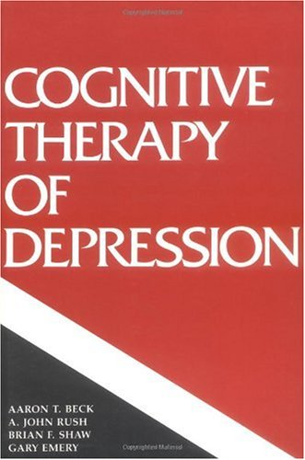
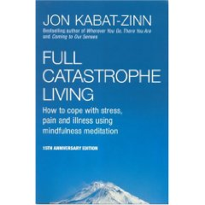
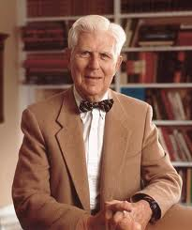
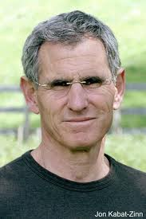
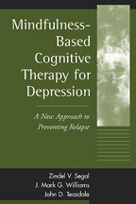



Courtesy of Prof Barnhofer 2018

Slide 5
Level of Evidence for MBIs

Slide 6
Metanalysis 1 Level 1
Khoury et al. (2013) reports on 209 studies, including 12,145 patients.
mindfulness-based interventions significantly reduce stress, anxiety and depressive features in a range of psychiatric illnesses.
MBI was as powerful as undergoing a course of Cognitive Behavioural Therapy to reduce anxiety and depression.
significant improvements could also be shown in the large meta-analysis with regards to pain and chronic illness, including cancer.

Slide 7
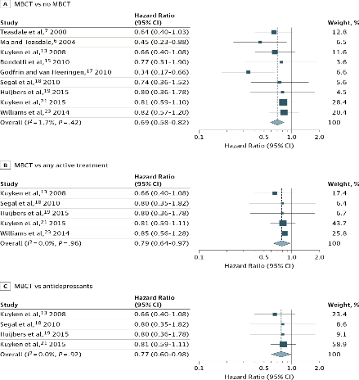
Meta-Analysis (Kuyken et al., 2016) (courtesy of Prof Barnhofer)
MBCT superior to
  treatment-as-usual
  maintenance treatment with antidepressant medication

Slide 8
Mindfulness in health professionals
(Lomas et al. 2018)
J Clin Psychol. 2018 Mar;74(3):319-355. doi: 10.1002/jclp.22515. Epub 2017 Jul 28.
A systematic review of the impact of mindfulness on the well-being of healthcare professionals.
Lomas T¹, Medina JC², Ivtzan I¹, Rupprecht S³, Eiroa-Orosa FJ¹.
81 papers, comprising a total of 3,805 participants.
outcomes such as burnout, distress, anxiety, depression, and stress.
Mindfulness was generally associated with positive outcomes in relation to most measures (more equivocal with respect to some outcomes, most notably burnout).
mindfulness does appear to improve the well-being of healthcare professionals.
quality of the studies was inconsistent
further research is needed, particularly high-quality randomized controlled trials.

Slide 9
Journal of Psychosomatic Research
Volume 114, November 2018, Pages 62-71
Do workplace-based mindfulness meditation programs improve physiological indices of stress? A systematic review and meta-analysis
Rachael A.HeckenbergªPennieEddyªStephenKent^{b}Bradley J.Wright^{b}
mindfulness-based interventions with non-clinical populations in the workplace
meta-analysis of nine studies
physiological indicators of stress like cortisol levels
Cortisol levels less diurnal high and low slopes, but not for absolute levels at any am or pm timepoint
immune response to viral vaccine boosted.
change in autonomic nervous system balance

Slide 10
Heckenberg et al (2018)
heartrate variability coherence rating
not by reduced blood pressure
Sympathetic activation levels were reduced as measured by saliva amylase analysis.
particularly useful for the biologically orientated colleagues who are in doubt over the meaningfulness of self-rated psychometric data.

Slide 11
NICE GUIDANCE LEVEL 1
CG90 2004 updated 2009
MBCT for relapse prevention of depression in patients with 3 or more episodes of depression
with significant risk of relapse
For those who are well or with some residual syptoms

Slide 12
The Mindful Nation Level 1
A report provided by an All Party Parliamentary Group (2015)
Recommendation to investigate and implement MBI projects in Health, Work Place, Schools and Criminal Justice system.

Slide 13
Level 2 RCTs
Teasdale JD, Segal ZV. Williams JMG, Ridgeway VA, Soulsby JM, Lau MA.
Prevention of relapse/recurrence in major depression by mindfulness-based cognitive therapy. J Consult Clin Psychol 2000; 68:615-23.

Slide 14
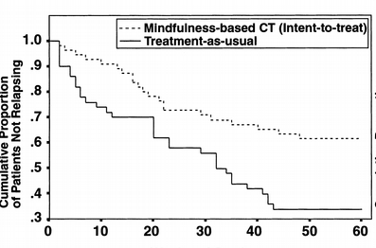
Initial Trial (Teasdale, et al., 2000) (courtesy of Prof Barnhofer)
Notes:
14

Slide 15
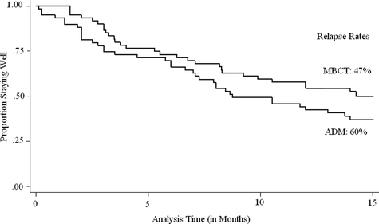
MBCT versus m-ADM (Kuyken et al., 2008)
Notes:
15

Slide 16
Level 3: Cohort Studies

Slide 17




POSTER PRESENTATION NO : PO_Ruths887
.
Mindfulness-Based Cognitive Skill Training for Health Professionals in Training (MBCT-HIT)
Manual Development and A Quantitative Study Exploring a Mindfulness-based Program Enhancing
Resilience and Self-compassion in Junior Doctors
Florian Alexander Ruths, Vinuri Fernando, Francesca Turner and Monique Maroney
Background
Morale among ‘health professionals in training’ (‘HITs’) is at an all-time low. NHS demand for maximum efficiency leads to conditions of heightened stress and pressure. Especially among junior doctors, over 60 % tend not to go on to higher training immediately (2018). Mindfulness Based Interventions (MBI) have successfully been used to improve the experience of various health professionals including mental health professionals, doctors and therapists. There is compelling evidence that MBI help emotional regulation and could enhance psychological well-being, self-compassion and resilience.
Method
The MBCT-HIT intervention manual was developed, tested and implemented over 24 months.
Format: 120-minute group sessions once weekly for 8 weeks. The program for this study was delivered to FY1 – CT3 trainees from various specialities from September 2017 – March 2019.
Content:T he program comprised of mindfulness meditation in addition to psycho-educational, behavioural and schema-based modules. Focusses included emotional wellbeing, resilience building, increasing the sense of purpose and meaning, and dealing with one’s own vulnerability and mortality, reducing burnout and psychological stress and appreciating the self and career values.
Data collection & analysis: Prospective Pre- and post- non-randomised cohort observation for overall psychological well-being (CORE 10), Self-compassion (SCF-SF), resilience (BRS) and mindful awareness (FFMQ-SF). We also measured attendance.
Quantitative Outcome Measures
MINDFUL AWARENESS
SELF-COMPASSION
Table 2 Pre-MBCT-HIT and post-MBCT-HIT scores for the total FFMQ-SF and subscales analysed with matched pairs t tests
(N= 23)
Table 2 results: The greatest increase shows in non-judge facet (38%) which reflects loving oneself aspect (highly significant as P<0.001). Act aware (acting mindfully) follows with 35% increase after MBCT-HIT programme also highly significant change (p<0.001). Describe & non-react facets also show significant change while ‘Observe’ remains as only facet that the change is not significant. *p < .05. **p < .01 ***P<.001
Table 1 Pre-MBCT-HIT and post-MBCT-HIT scores for the total SCS-SF and SCS-SF subscales analysed with matched pairs t tests (N= 22)
Table 1 results:
Total score for Self-compassion scale post MBCT-HIT is significantly higher than pre MBCT-HIT measure. (p=0.050)
Greatest increase in self-kindness following MBCT-HIT (30% change P=0.001 so highly significant). Self-judgement & common humanity significant at P<0.05 whilst remaining subscales were not statistically significant. *p < .05. **p < .01
Outcome | Pre-mean (SD) | Post- mean (SD) | % change
Observe Describe Act aware Non-judge Non-react | 12.52 (3.91) 15.52 (3.42) 13.22 (3.93) 13.13 (3.62) 13.43 (4.12) | 14.00 (4.03)* 17.91 (4.75)** 16.83 (2.96)*** 17.13 (3.53)*** 16.43 (3.88)* | 12% 15% 27% 30% 22%
Outcome | Pre-mean (SD) | Post- mean (SD) | % change
Total SCS-SF Self-kindness Self-judgement Common humanity Isolation Mindfulness Over-identification | 35.45 (9.97) 5.27 (2.39) 5.55 (2.20) 6.36 (2.24) 5.36 (2.11) 7.64 (1.79) 5.27 (2.41) | 40.68 (7.72) 6.86 (1.55)** 6.50 (1.77)* 7.27(1.64)** 6.23 (1.93) 8.05 (1.59) 5.77 (2.00) | 14.75% 30.17% 17.12% 14.31% 16.23% 5.37% 9.49%
Psychological Well-Being
RESILIENCE
Table 4 Pre-MBCT-HIT and post-MBCT-HIT scores for the CORE-10 score analysed with matched pairs t tests (N= 23).
Table 4 result: CORE-10 score >5 to 10 interprets as ‘low level problems’. MBCT-HIT achieved 18% decrease in psychological distress, but the change was not significant.
Table 3 Pre-MBCT-HIT and post-MBCT-HIT scores for the BRS score analysed with matched pairs t tests (N= 22).
Table 3 result: Increase in brief resilience scale score at post MBCT-HIT measure is statistically significant. *p < .05
Outcome | Pre-mean (SD) | Post- mean (SD) | % change
CORE-10 | 9.35 (4.16) | 7.61 (5.37) | -18%
Outcome | Pre-mean (SD) | Post- mean (SD) | % change
BRS Scores | 3.27 (0.61) | 3.61 (0.68)* | 10%
Discussion
This program was designed as a cohort study to develop, test and fine-tune a manual of Mindfulness Based Cognitive Skill Training for Health Professionals in Training (MBCT-HIT). We believe that a degree of immersion in Mindfulness Meditation, in combination with psycho-education, peer discussions, as well as experiential components and the validating effect of a peer-group experience, is showing significant evidence for the effectiveness of MBI in health professionals in training to improve overall self-compassion, mindful awareness and mental well-being as well as resilience. Completions rates at 75%. were higher than previously reported.
These preliminary results in a small cohort should now be validated in a randomised-controlled set-up with a credible control intervention of similar length.
Mindfulness is the awareness that emerges through paying attention,
on purpose,
in the present moment,
and non-judgmentally,
to things as they are.
A Definition of Mindfulness by Williams, Teasdale, Segal and Kabat-Zinn (2007)
For references please correspond via : Florian.ruths@slam.nhs.uk

Slide 18

Mindfulness Based Cognitive Skill Training for Health Professionals in Training (MBCT HIT)
A qualitative study exploring the trainee experience
of a mindfulness-based program enhancing
resilience and self-compassion
Dr Ashvini Ramoutar, Dr Francesca Turner and Dr Florian A. Ruths
Background
Morale among health professionals in training (HIT) is at an all-time low. NHS demand for maximum efficiency leads to conditions of heightened stress and pressure. Mindfulness Based Interventions (MBI) have successfully been used to improve the experience of various health professionals including mental health professionals, doctors and therapists. There is compelling evidence that MBI reduce anxiety and depression, whilst enhancing psychological well-being across clinical groups with mental and physical disorders.
Method
The MBCT-HIT intervention manual was developed, tested and implemented over the last 24 months.
Format: 120-minute group sessions once weekly for 8 weeks. The program for this study was delivered to FY1 trainees over February – March 2019.
Content: The program comprised of mindfulness meditation in addition to psycho-educational, behavioural and schema-based modules. Focusses included emotional wellbeing, resilience building, increasing the sense of purpose and meaning, whilst reducing burnout and psychological stress.
Data collection & analysis: Participant observation, including collective group discussions, participant self-analyses and feedback following both in-session and home practice exercises. Detailed notes were taken by a designated co-facilitator with subsequent thematic analysis of information.
Qualitative Outcome Measures
RESILIENCE
SELF-COMPASSION
Monitoring exercises highlighted a tendency to focus on negative aspects of the working day and stressors associated with burnout.
‘I don’t feel important or useful in the workplace’.
‘I struggle with feeling undervalued by not only colleagues but also patients’.
‘Things at work are grinding us down’.
Exercises increasing acknowledgement of positive feedback and praise improved trainee experience, as did a focus on meeting core emotional needs.
‘Now I feel happier to go into work and more positive generally about my working day’.
‘My take home message is the permission to take time for myself. It is not only ok to do but it is important to do’.
‘Self-compassion is a new concept for me. Medics are used to directing compassion out to others’.
‘This is the first time I have ever sat down and talked about compassion with my colleagues. I cannot believe that’.
‘Doctors see a lot of suffering in their patients, which makes us feel less deserving of compassion’.
‘I learned that kindness and compassion can be practiced rather than just being an innate skill. It is a resource we need to cultivate’.
‘This is useful for my day to day work. I want to think more about replenishing my compassion’.
DOCTOR-PATIENT RELATIONSHIP
’I realised that what matters to me is my relationship with my patients and colleagues’.
‘Through mindful communication I feel I can now slow down and listen’.
MINDFUL AWARENESS
Meditation in the workplace brought a sense of calm and space to the working day. Trainees noticed an increased sense of mastery, appreciative joy and gratefulness.
‘It was more difficult to do mindful tasks at work because of the distractions and multiple pressures. However, mindfulness still helped me to focus more than usual.
‘Compared to when I first started meditation on this course, now I feel most able to be present and in the moment’.
Discussion
This program was designed as a pilot to develop, test and fine-tune a manual of Mindfulness Based Cognitive Skill Training for Health Professionals in Training (MBCT-HIT). Although the evidence so far is preliminary, we think that a degree of immersion in MBI, in combination with the validating effect of a peer-group experience, is critical for the effectiveness of MBI in health professionals in training to improve overall self-compassion, mindful awareness and mental well-being as well as resilience.
Mindfulness is the awareness that emerges through paying attention,
on purpose,
in the present moment,
and non-judgmentally,
to things as they are.
A Definition of Mindfulness by Williams, Teasdale, Segal and Kabat-Zinn (2007)

Slide 19
Compelling Neuroimaging Evidence- Beginners
Goleman and Davidson (2017):
30 h less stress reactivity of amygdala
Compassion meditation with increased connectivity for empathy and positive feelings.
Beginners show improvement in attention, including less mind wandering.
Probable positive change of cell aging markers after short periods of meditation
Effects not sustained without further practice

Slide 20
Compelling Neuroimaging Evidence- Advanced 1000 – 10,000 h
Emotional regulation strengthened, less cortisol levels.
Attention improved: selective sharpened, attentional blink diminishes, sustained attention easier.
Less self preoccupation with self, becoming traits.
Gradient increasing with practice.
Physical changes: e.g. reduced breathing rate, increased gamma waves in sleep, improved immune function.

Slide 21
Compelling Neuroimaging Evidence- Advanced 12,000 – 62,000 h
Very altered pain reaction: less anticipation, sharp increase, then rapid recovery.
Effortless concentration, meditation as trait.
Possible visible structural change to brain (e.g. nucleus accumbens) lessening self focus, attachment.
Possible better to do intense retreats than daily practice.

Slide 22
MBI for Health Professionals
Epstein R (2017): “Attending – Medicine, Mindfulness and Humanity”. Scribner. New York.
Dobkin PL and Hassed CS (2016): “Mindful Medical Practitioners – A Guide for Clinicians and Educators”. Springer International Publishing. Switzerland.

Slide 23
Ronald Epstein (1999)
advocating mindfulness skills for executive functioning of doctors
to improve our performance in clinical situations with our patients
execute functioning included attention regulation,
self-awareness, short-term memory, reasoning and decision making, emotional regulation, appetite regulation and impulse control
‘automatic pilot’ - less able to engage with the patient, more prone to medical errors.

Slide 24
Known Formats of Mindfulness in Health Education
E.g. Krasner, Epstein et al JAMA 2009: Rochester Mindfulness Program for GPs.
FU study 2012.

Slide 25
Scoping with Junior Doctors
“Feeling disconnected from peers, a supportive team and consultants”: Trainees felt that their work was not being noticed, and felt to isolated among other allied health professions.
“Not being valued or feeling valued”: the combination of the above with lack of one-to-one time with superiors, who ‘are too busy to notice them’, lead to a sense of not being valued.. Some CTs felt ‘invisible’.
“Feeling anxious to have to perform under significant pressure and fearing making mistakes”: trainees feeling the overall rising pressure in the NHS but feeling ill-equipped to deal with the pressure. significant worries about accidently causing a mistake.
“Senior practitioners being skeptical about future of NHS”: several CTs reported that consultants openly expressed their own concern about the pressures in the NHS being sustainable, and modeled low morale.

Slide 26
MBCT HIT
Mindfulness Based Cognitive Skill training for Health Professionals in Training (MBCT HIT).
Health Education England (South London HESL) funded project to develop manual for 8 week program to boost resilience and morale.
Combination of meditation practice and education about looking after oneself.

Slide 27
From MBCT HIT to M4MD (“Mindfulness for Doctors” (in 4 weeks))
Recent initiative via King’s College Hospital to bring the eight-week program to doctors returning from long-term leave.
To make it more feasible, we are experimenting with delivering an 8-week (sessions) program in 4 weeks.
We are offering 2 x 2hours per week to complete program within 4 weeks and give a higher intensity.

Slide 28
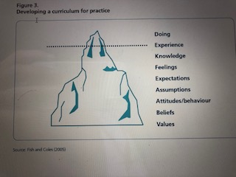
National Curriculum

Slide 29
The Manual
A skill-training manual was developed wit the view of addressing these concerns in the most structured way possible.
building and deepening existing relationships with family, friends and colleagues. We aimed to address the detachment from present moment awareness, e.g. by reducing the use of electronic screens.
Preventing Burnout, resilience and helping with core emotional needs to reduce anxiety and worry was a core them of the program.
Through introducing the wider perspective of ‘dealing with the suffering and the human condition’, we aimed to address the perceived senselessness and cynicism of health care that undermine morale.
Cultivating compassion and self compassion.
Preventing medical errors and mindful conversation with patients.

Slide 30
Structure of The Sessions
Each session had the same structure:
longer formal medication practice
feedback from home practice
the introduction of the concepts and brief presentation of empirical evidence for a new sessional theme
group discussions, shorter mindfulness exercises and the setting of home practice options.

Slide 31
Session Topics: Sessions 1 to 4
Session 1: Mindfulness-based interventions and the scientific evidence for MBIs (NCF all, sec 4-18. knowing limits ) (NCF sec 3- 10 (long term mental illness) .
Session 2: Emotions, their classifications and their representation in the body; the media and the impact of constant screen use in our minds. Present moment awareness as a skill that can help become more awareness (NCF sec 3-17. Emotions in terminal care)
Session 3: The Harm Prevention Machine. The human mental tendency to want to prevent Harm in Future, harm in past, harm in present, harm to self and harm to others; cognitive distortions in doctors (NCF all).
Session 4: Burn-Out, its clinical presentation and its prevention. Experiential Avoidance as an unhelpful way to prevent being emotionally overwhelmed.

Slide 32
Session Topics: Sessions 5 - 8
Session 5: Empathy, Compassion, Friendliness as soft skills in medical interventions and the evidence supporting these skills (Sec 2 – 6., 7., 8. communication, leadership and team-work)
Session 6: Core Emotional Needs as a way to understand supporting emotional well-being. Medical Errors that arise from lack of attention and awareness (NCF sec 4- 19. medical errors).
Session 7: Death, Life, Moment-to-Moment awareness, as considerations of human vulnerability. Appreciative Joy as a true antidote to the fear of vulnerability, illness, aging and death (NCF sec. 3- 17. end of life care)
Session 8: Summary of what has been learnt and how the good habit of becoming more mindful can help dealing with stress and valuing oneself more in the role as a health professional. (NCF sec 1 1., 2. acting professionally, building trust)

Slide 33
Overall Psychological Well Being
Table 4 Pre-MBCT-HIT and post-MBCT-HIT scores for the CORE-10 score analysed with matched pairs t tests (N= 23).
Table 4 result: CORE-10 score >5 to 10 interprets as ‘low level problems’. MBCT-HIT achieved 18% decrease in psychological distress, but the change was not significant.
Outcome | Pre-mean (SD) | Post- mean (SD) | % change
CORE-10 | 9.35 (4.16) | 7.61 (5.37) | -18%

Slide 34
Resilience
Table 3 Pre-MBCT-HIT and post-MBCT-HIT scores for the BRS score analysed with matched pairs t tests (N= 22).
Table 3 result: Increase in brief resilience scale score at post MBCT-HIT measure is statistically significant. *p < .05
Pre-mean (SD)
BRS Scores | 3.15 (0.62) | 3.53 (0.69)* | 12%

Slide 35
Self-Compassion
Table 1 Pre-MBCT-HIT and post-MBCT-HIT scores for the total SCS-SF and SCS-SF subscales analysed with matched pairs t tests (N= 22)
Outcome | Pre-mean (SD) | Post- mean (SD) | % change
Total SCS-SF Self-kindness Self-judgement Common humanity Isolation Mindfulness Over-identification | 35.45 (9.97) 5.27 (2.39) 5.55 (2.20) 6.36 (2.24) 5.36 (2.11) 7.64 (1.79) 5.27 (2.41) | 40.68 (7.72) 6.86 (1.55)** 6.50 (1.77)* 7.27(1.64)** 6.23 (1.93) 8.05 (1.59) 5.77 (2.00) | 14.75% 30.17% 17.12% 14.31% 16.23% 5.37% 9.49%

Slide 36
Table 1 results:
Total score for Self-compassion scale post MBCT-HIT is significantly higher than pre MBCT-HIT measure. (p=0.050)
Greatest increase in self-kindness following MBCT-HIT (30% change P=0.001 so highly significant). Self-judgement & common humanity

Slide 37
Mindful Awareness
Table 2 Pre-MBCT-HIT and post-MBCT-HIT scores for the total FFMQ-SF and subscales analysed with matched pairs t tests
(N= 23)
Outcome | Pre-mean (SD) | Post- mean (SD) | % change
Observe Describe Act aware Non-judge Non-react | 12.52 (3.91) 15.52 (3.42) 13.22 (3.93) 13.13 (3.62) 13.43 (4.12) | 14.00 (4.03)* 17.91 (4.75)** 16.83 (2.96)*** 17.13 (3.53)*** 16.43 (3.88)* | 12% 15% 27% 30% 22%

Slide 38
Table 2 Pre-MBCT-HIT and post-MBCT-HIT scores for the total FFMQ-SF and subscales analysed with matched pairs t tests
(N= 23)
Table 2 results: The greatest increase shows in non-judge facet (38%) which reflects loving oneself aspect (highly significant as P<0.001). Act aware (acting mindfully) follows with 35% increase after MBCT-HIT programme also highly significant change (p<0.001). Describe & non-react facets also show significant change while ‘Observe’ remains as only facet that the change is not significant. *p < .05. **p < .01 ***P<.001

Slide 39
Qualitative Feedback Resilience (Ramoutar et al. 2019)
Monitoring exercises highlighted a tendency to focus on negative aspects of the working day and stressors associated with burnout.
‘I don’t feel important or useful in the workplace’.
‘I struggle with feeling undervalued by not only colleagues but also patients’.
‘Things at work are grinding us down’.
Exercises increasing acknowledgement of positive feedback and praise improved trainee experience, as did a focus on meeting core emotional needs.
‘Now I feel happier to go into work and more positive generally about my working day’.
‘My take home message is the permission to take time for myself. It is not only ok to do but it is important

Slide 40
Qualitative Feedback Compassion(Ramoutar et al. 2019)
‘Self-compassion is a new concept for me. Medics are used to directing compassion out to others’.
‘This is the first time I have ever sat down and talked about compassion with my colleagues. I cannot believe that’.
‘Doctors see a lot of suffering in their patients, which makes us feel less deserving of compassion’.
‘I learned that kindness and compassion can be practiced rather than just being an innate skill. It is a resource we need to cultivate’.
‘This is useful for my day to day work. I want to think more about replenishing my compassion’.

Slide 41
Qualitative Feedback
Doctor-Patient Relationship (Ramoutar et al. 2019)
’I realised that what matters to me is my relationship with my patients and colleagues’.
‘Through mindful communication I feel I can now slow down and listen’.

Slide 42
Qualitative Feedback Mindful Awareness(Ramoutar et al. 2019)
Meditation in the workplace brought a sense of calm and space to the working day. Trainees noticed an increased sense of mastery, appreciative joy and gratefulness.
‘It was more difficult to do mindful tasks at work because of the distractions and multiple pressures. However, mindfulness still helped me to focus more than usual.
‘Compared to when I first started meditation on this course, now I feel most able to be present and in the moment’.

Slide 43
The Current Situation & Future
New group from King’s for all junior medical trainees completed
1 year cohort study of 75 FY trainees at Maudsley ongoing, self funded at moment.
M4MD funded program from January 2020 for 1 year
5 CT & ST core group training to facilitate in line with BAMBA guidance.
Randomised controlled format with TAU?
Training of more facilitators of MBCT HIT?
Publication of Manual?

Slide 44
Thank you very much!
Florian.ruths@slam.nhs.uk

