Slide 1

Children and Young People’s Mental Health Services Workforce Report for Health Education England
National report
November 2021

Slide 2
Contents
Executive Summary | 3
Introduction and background | 4
Project process | 5
Project participation profile | 6
Size of workforce across sectors | 7
NHS Workforce | 9
Analysis of workforce growth | 10
Independent Sector | 23
Local Authorities | 27
Voluntary Sector | 31
Youth Offending Teams | 35
Vacancies | 39
Staff demographic | 47
Skills & Training | 57
Service Model | 63
Conclusions and further information | 66
Appendices | 69
Appendix 1 – Skills and Training | 70

Slide 3
Executive Summary
This report details the results of the third national stocktake of the Children and Young People’s Mental Health (CYPMH) workforce across England. The project was commissioned by Health Education England (HEE) and undertaken by the NHS Benchmarking Network (NHSBN). The project builds on previous studies conducted by NHSBN on behalf of HEE, which were undertaken in 2016 and 2019, allowing comprehensive timeseries analysis to be performed on a wide range of metrics. The 2021 national census took place on 31st March 2021.
The project recognised the multi-agency nature of CYPMHS and therefore collected data across five different sectors to provide an holistic view of CYPMH services. These sectors were:
  NHS providers
  Independent Sector
  Local Authorities
  Voluntary Sector
  Youth Offending Teams
The headline findings from the analysis are as follows:
  A total of 24,848 staff are employed in CYPMH services across England, delivering a total of 20,626 WTE staff across all sectors. This position equates to a 39% growth on the 14,857 WTE staff reported in the previous census on 31st December 2018.
  The NHS accounts for the vast majority of staff in CYPMH services (75%).
  The NHS CYPMH workforce has seen a notable increase since 2019, with a 34% increase in headcount and a 40% increase in WTE.
  The majority of NHS employed staff are found in community CYPMH services (82%).
  The second largest sector in terms of workforce size is the independent sector (2,293 WTE) who employ 11% of the total CYPMH staff reported in England.
  The voluntary sector employ 1,497 WTE staff, equivalent to 7% of the total CYPMH workforce. The remaining staff are employed by Local Authorities (3% or 600 WTE), and Youth Offending Teams (4% or 790 WTE).
  Analysis of the demographics of the workforce show CYPMH staff are still predominantly female, the age of the workforce is relatively well distributed, and there is notable diversity in the workforce.
The growth in the CYPMH workforce outlined in this report should be seen in the context of the low baseline for staffing that was identified in the first census in 2016. Since this point, CYPMH services have grown in response to accelerating demand for young people’s mental health care and the support of a range of national policy initiatives. The workforce growth now evident aligns with the concerted attempts to increase capacity that were outlined in the Five Year Forward View for Mental Health and the NHS Long Term Plan.

Slide 4
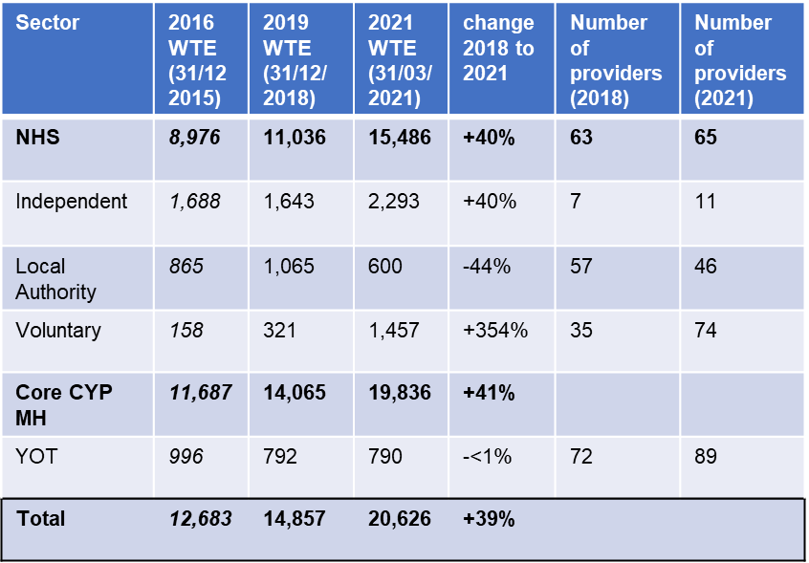
Summary of growth in CYPMHS workforce
Across the five sectors, there are 20,626 WTE staff reported as working within CYP MH services or in a role that supports the CYP MH service. This demonstrates a 39% growth in the total CYPMHS workforce from the 14,857 WTE reported in 2019 to 20,626 WTE.
The NHS is the largest delivery sector for CYPMH services and reported a growth of 40% from 11,036 WTE in 2019 to 15,486 WTE in 2021.
78% of staff reported were working within the NHS, with 12% working in the independent sector, 7% within Voluntary Organisations, and the remaining 3% within Local Authorities.
Please note that YOT staff are not dedicated CYP MH workers but staff members have been reported to have CYP MH responsibilities as part of wider roles.

Slide 5
Introduction and background
This report outlines the findings from the third comprehensive national stocktake of the CYPMH workforce across England and builds on the previous two stocktakes conducted by the NHS Benchmarking Network in 2016 and 2019. The HEE CYPMHS workforce census exercises have become a fixed point in understanding how the Children and Young People’s Mental Health workforce is developing and how national policies such as the NHS Five Year Forward View (2014) and NHS Long Term Plan (2019) impact on the size and shape of the CYPMHS sector.
This report gathers data from the 2020/21 financial year which has been a unique year following the impact of the Covid-19 pandemic emerging during March 2020. The data was collected across a wide range of sectors and acknowledges that CYPMH is a multi-sector and multi-agency offer that involves a wide range of providers, both statutory and non-statutory in nature. The census has a specific remit to explore beyond the NHS given the multi-agency nature of CYPMH. The NHS has the ability to reference the national Electronic Staff Record system (ESR) for granular operational detail on the CYPMH workforce, however, other sectors use a wide variety of other human resources systems that are not routinely available to support NHS workforce planning. For this reason, a new primary data collection was designed and implemented across the following sectors:
  NHS Providers
  Independent Sector
  Local Authorities
  Voluntary Sector
  Youth Offending Teams
The project explores variations in the CYPMH workforce across these sectors including:
  Size of workforce (headcount and WTE)
  Discipline and skill mix (community and inpatient)
  Demographic profiling
  Vacancies
  Service Models
  Skills & Training

Slide 6
Project process
The data specifications were scoped in consultation with colleagues from Health Education England and NHS England and NHS Improvement in February 2021. The data collection was similar to previous years to allow the report to build on the previous two iterations, with existing metrics allowing participants to track progress over time and ensure a like for like comparisons base is maintained.
The data collection used a census date of 31st March 2021 to identify all staff currently in post along with details of current vacancies. A series of wider metrics were also collected including turnover and retention rates throughout 2020/21.
The data collection was launched in May 2021 in a phased manner, with NHS providers beginning data collection on 14th May 2021, followed shortly after by the Independent Sector, Local Authorities, Voluntary Sector and Youth Offending Teams. The data collection period was due to close in July 2021, however, disruptions caused by Covid-19 extended the data collection deadline into September 2021.
The project team analysed and validated the data to ensure the project’s findings were complete and accurate. Data validation took place during August and September 2021. All data within this report has been agreed with providers.
The initial draft findings from the project were discussed with Health Education England and feedback was taken into account to produce this updated report.
The Covid-19 pandemic created substantial challenges for all organisations across the NHS. The NHS Benchmarking Network and Health Education England would like to thank everyone who contributed to the project’s work across all sectors.

Slide 7
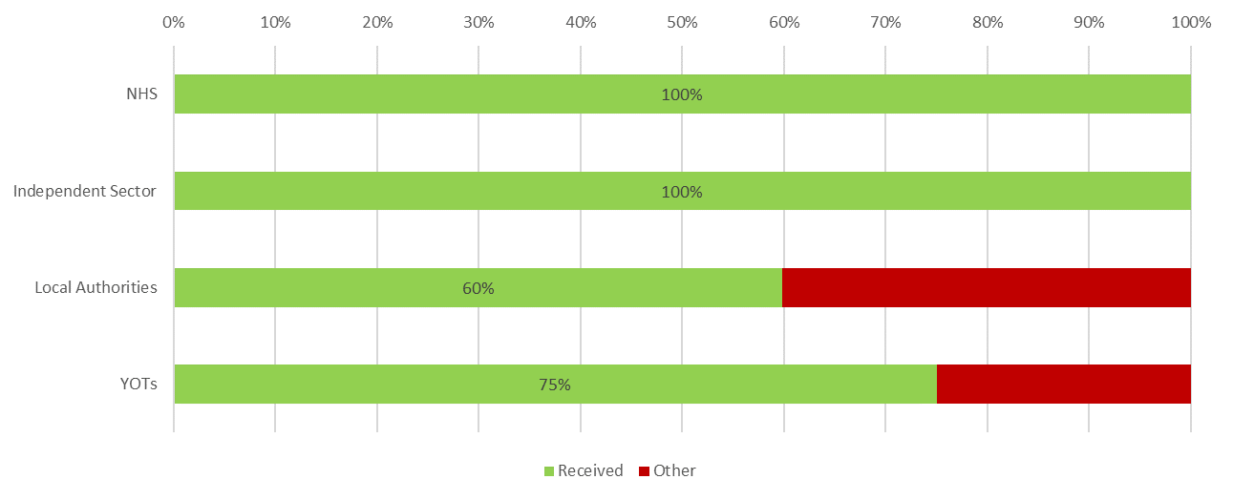
Project participant profile
The chart below demonstrates the level of completeness achieved in data submissions across the various CYPMH sectors. This has been calculated by dividing the number of submissions received by the number of known providers in each of the following sectors: NHS, Independent Sector, Local Authorities, and Youth Offending Teams.
All providers across both the NHS and Independent Sector submitted data on their CYP MH workforce. A total of 60% of Local Authorities responded to the data collection either with a data submission or confirmation that they are not providers of CYPMH services. Completeness in the Local Authority sector is difficult to estimate given that most Local Authorities no longer provide dedicated CYPMH services. The total Local Authority workforce identified by the census is around 3% of the national CYPMH workforce. The materiality of the Local Authority contribution to CYPMH has reduced in recent years.
The voluntary sector is the most difficult to scope due to the complexity of the provider landscape. In 2020/21, 74 data submission were received, though it is not possible to estimate relative completeness based on this position. Youth Offending Teams (YOTs) are an important but relatively small element of the national CYPMH offer. YOTs typically employ very small numbers of dedicated CYPMH staff but other colleagues within YOTs provide CYPMH responses as part of a wider Youth Justice offer.

Slide 8
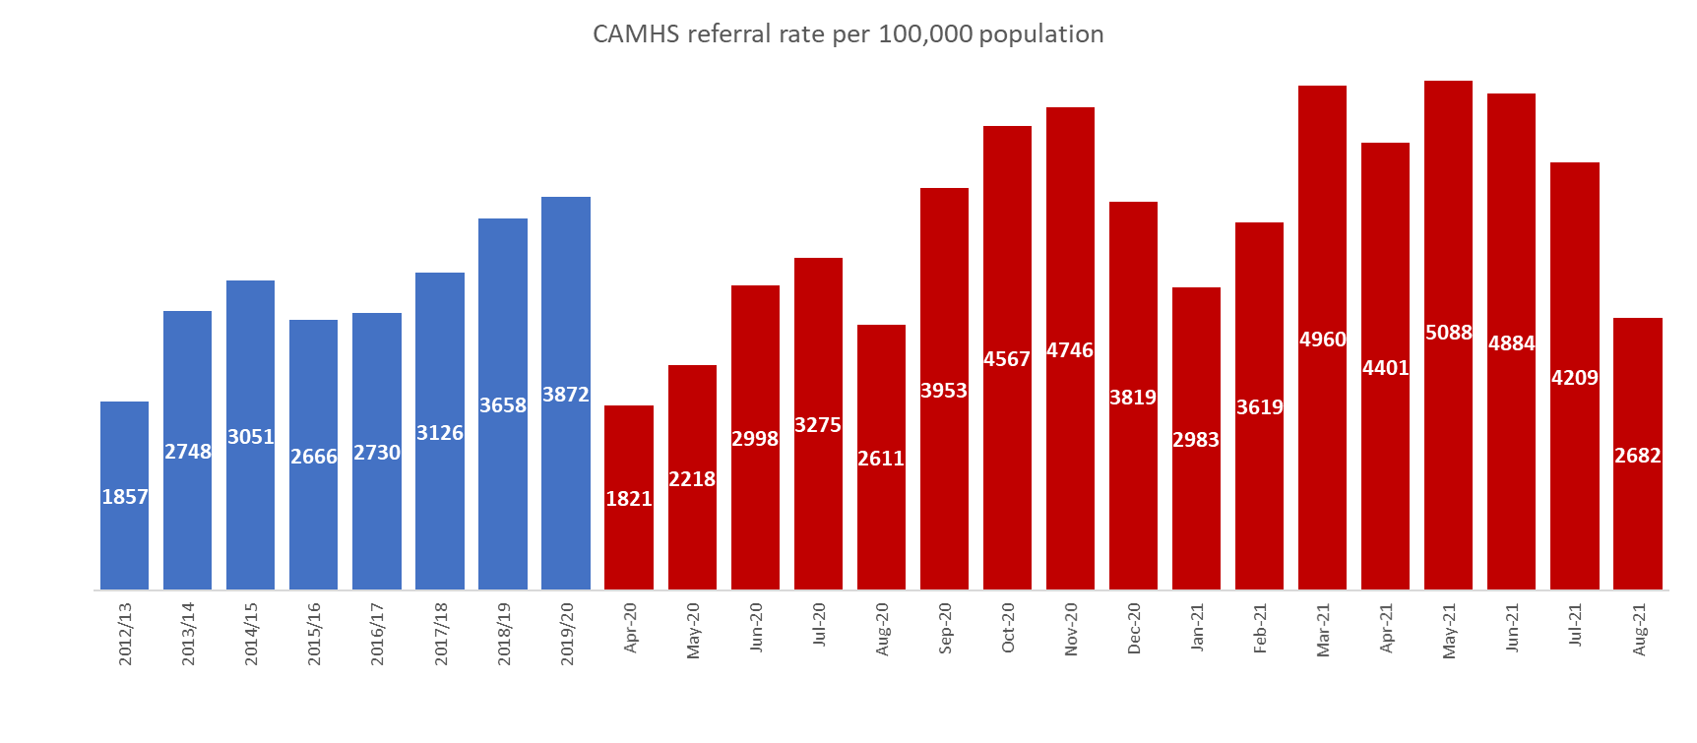
Context for CYPMHS (NHS)
The chart below depicts timeseries analysis of referrals into NHS CYPMH services over the period 2012/13 to 2019/20, along with the impact of the Covid pandemic on CYPMH services. On the left-hand side (shown in blue) are the annual national positions reported to NHSBN from providers across the UK, while the right-hand side (in red) explores the monthly fluctuations in the national referral rate over the last seventeen months, which have been heavily affected by the Covid-19 pandemic.
Referrals into CYPMHS has more than doubled in the eight years from 2012/13, from 1,857 referrals received per 100,000 population (aged 0-18) to 3,872 per 100,000 population in 2019/20.
During the early months of the Covid pandemic, CYPMHS initially experienced a large reduction in referrals received, with 53% fewer referrals received in April 2020 compared to pre-pandemic levels. This was likely caused by difficulties in accessing primary care services, as well as the closure of schools as national lockdowns were imposed across the UK. In the period between March 2021 and July 2021, an influx of referrals were received by CYPMHS as national lockdowns eased and schools re-opened for in-person teaching. CYPMH is one of the fastest growing specialties in healthcare with referrals per 100,000 population doubling over the 8-year period from 2012/13 to 2019/20. Referral patterns became much more volatile during the pandemic with a sharp drop in April 2020, followed by a clear recovery in demand through till November 2020, which further accelerated after the ending of the UK wide lockdown in March 2021. The rise in demand for CYPMH services provides clear background context for the increase in workforce size reported in the 2021 census

Slide 9
CYPMHS Workforce profile
NHS

Slide 10
Analysis of workforce growth (NHS)
Given the substantial increase reported in the baseline NHS CYPMH staffing, the NHS Benchmarking Network have analysed potential contributing factors that may have driven this growth. These factors are explored by major disciplinary groups with summary observations below:
Substantial growth in A&C staff (52% / 886 additional staff), this may reflect the ability to recruit these staff given enhanced investment in services by CCGs, along with the enhanced need for these staff given increased referral volumes and increased focus on waiting times.
A notable increase in unregistered / support worker staff (54% / 626 additional WTE). This may translate to providers adopting affordable/recruitable nursing models playing through the system in response to the additional CCG investment. The growth in unregistered staff is most evident in inpatient care, but also evident to some extent in community services.
Large increase in specific new roles, for example CYP education MH practitioner at +363 WTE and Children’s Wellbeing Practitioners at +241 WTE. The growth in Education practitioners reflects the growth of Mental Health Support Teams (MHSTs) in schools.
Psychological therapists have risen sharply with an additional 521 WTE (32%). This growth may reflect supply factors in response to the increased CCG investment. Clinical psychologists are generally more available than registered nursing staff.
Social Worker growth at +184 WTE / 51% growth is welcome and reflects the increased focus on CYP wellbeing / wider determinants of health in mainstream CYPMHS, and also perhaps a recognition of these needs from Local Authority / Trust partnership vehicles (given that two thirds of all Mental Health Social Workers are employed by Local Authorities).
The fall in the “other” category, may indicate better data quality in the third cycle of the census.
*The data collection grouped nursing associates with support workers
**2016 census showed 704 WTE of medical staff. The 92% increase reported in the medical workforce could be caused by a data quality issue in the 2019 census, where a total of 312 WTE was reported. Please note that additional sources of data on CYPMH medical staffing are available including NHS Digital’s NHS Workforce Statistics. The most recent data from these statistics suggested a total of 632 WTE of consultant psychiatrists. Further detail can be found: https://digital.nhs.uk/data-and-information/publications/statistical/nhs-workforce-statistics/march-2021

Slide 11
NHS data submissions
The data specification was distributed to all NHS providers of CYPMH services across England. This included specialist Mental Health Trusts, Children’s Trusts, Acute Trusts, Community providers and a small number of Community Interest Companies.
All NHS providers provided a submission for the workforce census achieving a 100% response rate for the sector. This enables a like for like comparison between the previous two collections performed in 2016 and 2019, which also achieved a 100% completion position, allowing timeseries analysis to be conducted on metrics such as the size and shape of the workforce and how has evolved over the last 5 years.
Please note that some Trusts provided multiple data submissions at a site level as opposed to a Trust wide level, which may account for the spread of data on some metrics where absolute values are compared.

Slide 12
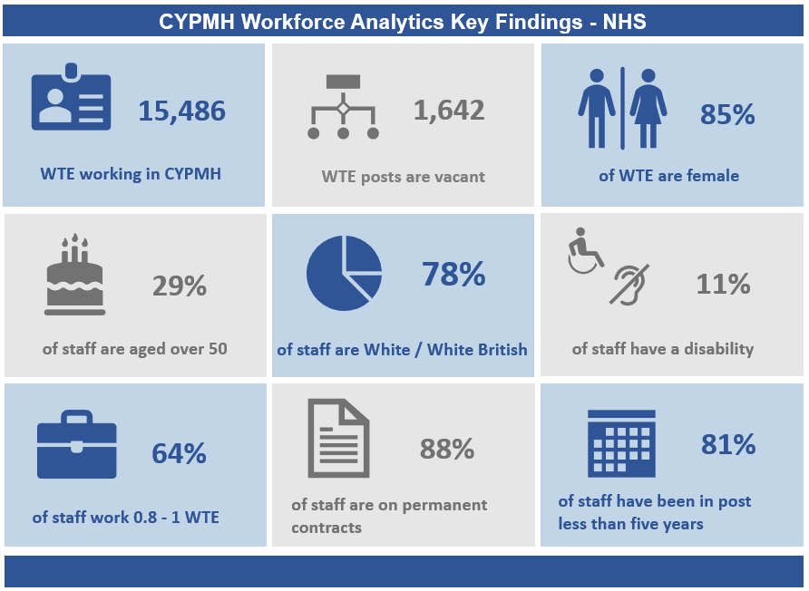
CYPMH Workforce Analytics Key Findings - NHS

Slide 13
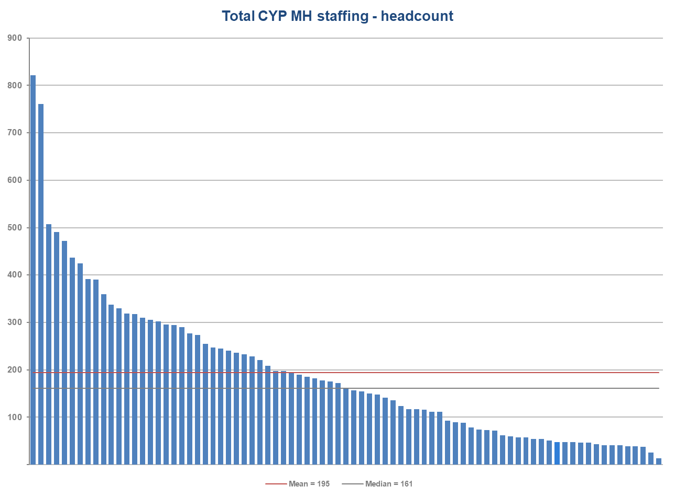
Workforce (headcount) by Trust - NHS
Overall, NHS Trusts have a median average of 161 CYP MH staff per Trust (headcount). This is 44% higher than the median of 112 reported in 2019 and supports the headline position that the NHS CYPMH workforce has grown by around 40% since 2019.
In this metric the median average is used, as the mean average (195) is skewed by the large Trusts at the far left of the chart.
A wide range was evident, with the headcount of staff within organisations ranging from 13, to over 800. Variation is expected due to differences in service model and the size of populations covered, as well as some providers submitting data at a site or borough level, rather than for the whole organisation.

Slide 14
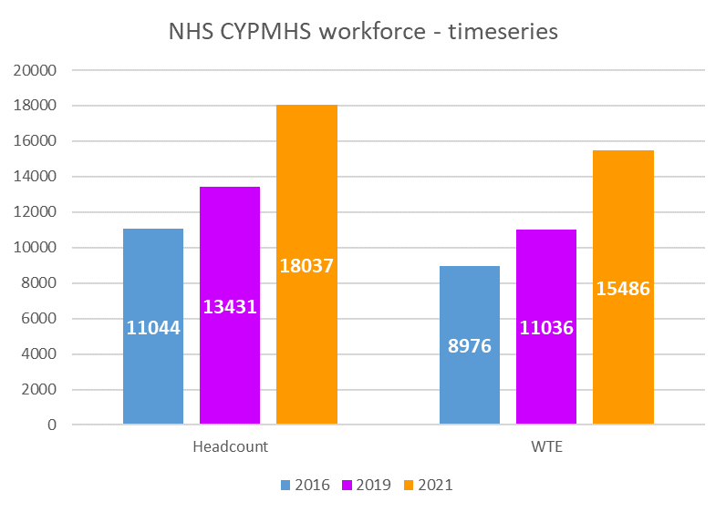
Workforce growth – timeseries (NHS)
NHS Trusts employ 78% of the workforce within CYP MH services, with a reported 15,486 WTE.
Between the 2019 survey (December 2019) and the 2021 survey (March 2021), NHS Trusts reported a 34% increase in headcount and a 40% increase in WTE staff. This is in line with the 39% growth in the CYPMH workforce observed across all five sectors.

Slide 15
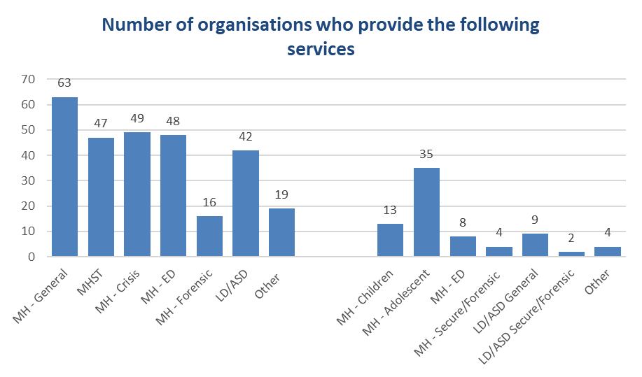
NHS CYPMH Service summary
Participants were asked to describe the range of services included within their CYPMH offer.
The most commonly provided community services are:
General CYPMH team
Crisis CYPMH team
Eating disorder CYPMH team
A large majority of CYPMH services reported they provided Mental Health Support Teams (MHST) which are now almost as prevalent as CYPMH crisis and ED teams.
In inpatient services, the most commonly provided service was general CYPMH adolescent beds, followed by general CYPMH children’s beds. General admission beds are the most frequently provided bed type.

Slide 16
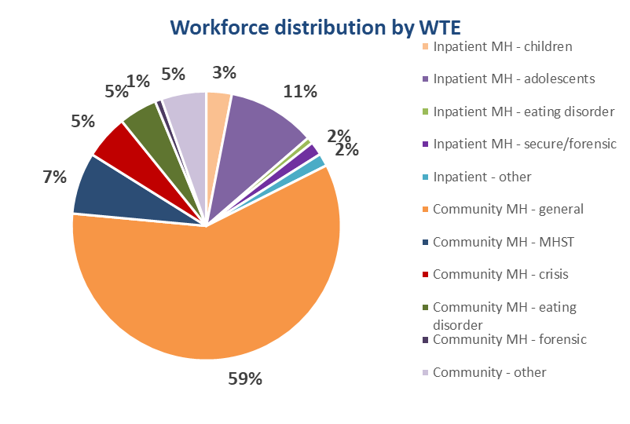
Workforce distribution (NHS)
The majority of NHS employed staff (82%) are found in community CYP MH services, with just 18% employed in inpatient services.
General community CYPMH teams are the largest single staff group, making up 59% of the workforce. The 2019 data collection split the community workforce into higher level definitions, with only eating disorder and forensics services being split from general services. When comparing this year’s results excluding eating disorder and forensic services (77%) results are broadly similar to the findings in 2019 (73%).

Slide 17

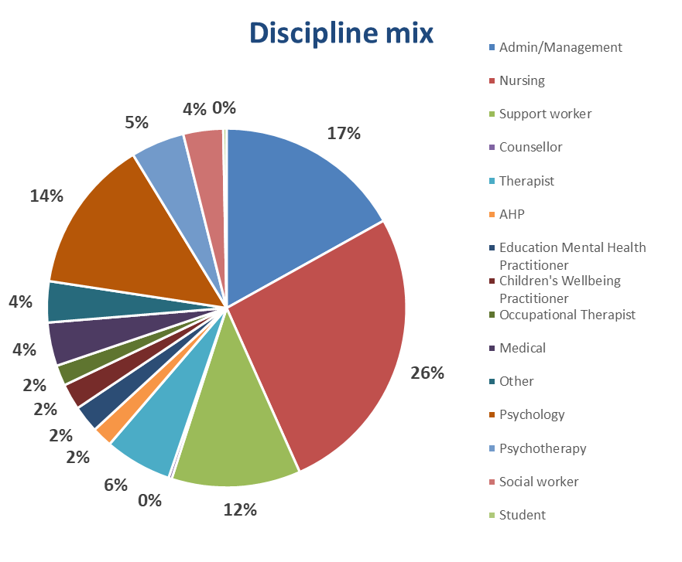







Total CYPMHS Discipline mix (NHS)
The chart below depicts the discipline mix within both community and inpatient CYPMH services. Registered nurses (26%) were the largest staffing group, followed by administration and management staff (17%). There is a notable presence of Support Workers (12% typically in inpatient care) along with clinical psychologist input (14%) within CYPMH services. A further 5% of the CYPMH team is provided by psychotherapists (making a combined 23% from psychological professions****). The following two pages split the discipline mix into the community workforce and inpatient workforce. Differences are evident with community teams demonstrating more seniority and disciplinary strength around specialist therapists.
Admin = 17%
Nursing* = 26%
Support worker* = 12%
Psychology = 14%
Medical = 4%
Psychotherapy = 5%
Therapist** = 6%
Allied Health Professionals*** = 2%
Other = 4%
*The data collection grouped nursing associates with support workers
**Systemic family therapists, play and other therapists are categorised as Therapists for the purposes of this data collection
***Dieticians, physiotherapists, speech and language therapists, art, drama and music therapists are categorised as AHPs
**** Psychological professions are classified in this data collection as counsellors, psychologists, psychotherapists, educational mental health practitioners and children’s wellbeing practitioners

Slide 18
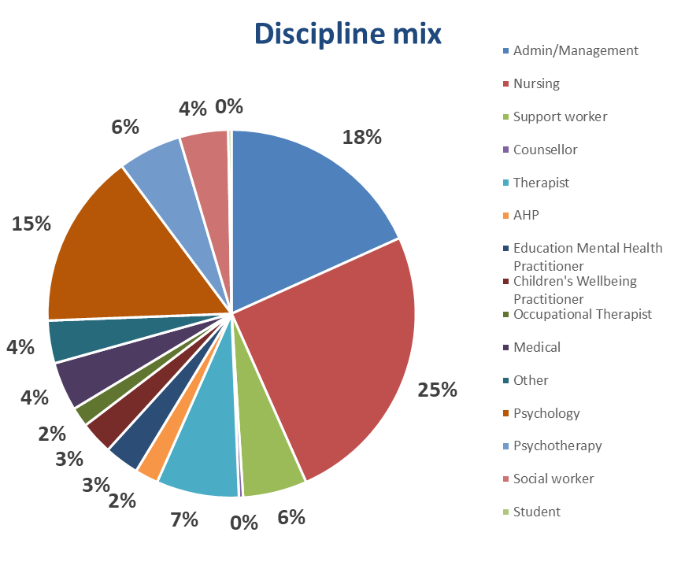
Community CYPMHS Discipline mix (NHS)
The pie chart below demonstrates the discipline mix within community CYPMH services. There is a strong presence of psychological professionals**** within community teams (27% of the total workforce), including 15% of the workforce being psychologists and another 6% psychotherapists. Though nursing staff make up less of the workforce than in inpatient services, there is still a large presence of nurses in community teams, accounting for one in four members of the workforce.
Admin = 18%
Nursing* = 25%
Support worker* = 6%
Psychology = 15%
Medical = 4%
Psychotherapy = 6%
Therapist** = 7%
Allied Health Professionals*** = 2%
Other = 4%
*The data collection grouped nursing associates with support workers
**Systemic family therapists, play and other therapists are categorised as Therapists for the purposes of this data collection
***Dieticians, physiotherapists, speech and language therapists, art, drama and music therapists are categorised as AHPs
**** Psychological professions are classified in this data collection as counsellors, psychologists, psychotherapists, educational mental health practitioners and children’s wellbeing practitioners

Slide 19
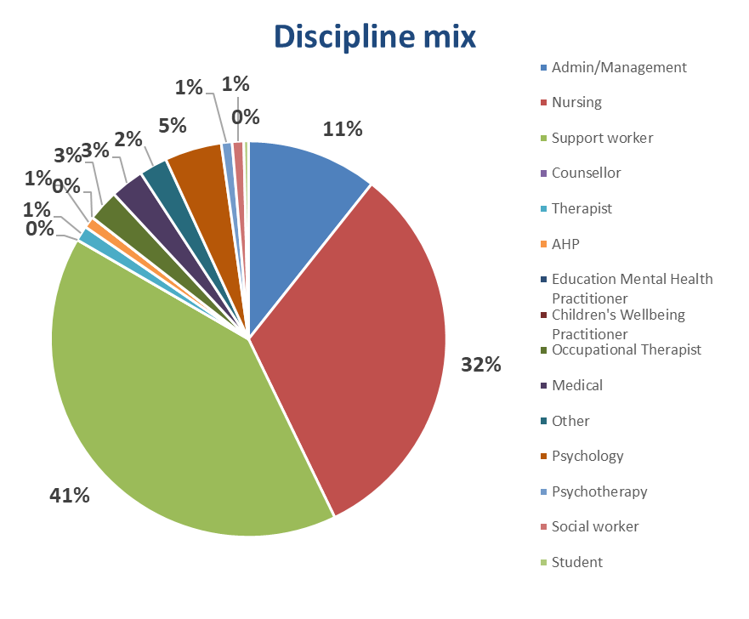
Inpatient CYPMHS Discipline mix (NHS)
This chart depicts the discipline mix within inpatient CYPMH services. In contrast to community services, there is a strong presence of Support Workers in the inpatient setting (41% compared to 6% in community teams), making up two in every five members of the workforce. The registered nursing workforce is also strong, with 32% of inpatient staff. There is a lower presence of psychological professions****, who constitute just 6% of the inpatient workforce, compared to 27% in community settings.
Admin = 11%
Nursing* = 31%
Support worker* = 41%
Psychology = 5%
Medical = 3%
Psychotherapy = 1%
Therapist** = 1%
Allied Health Professionals*** = 1%
Other = 2%
*The data collection grouped nursing associates with support workers
**Systemic family therapists, play and other therapists are categorised as Therapists for the purposes of this data collection
***Dieticians, physiotherapists, speech and language therapists, art, drama and music therapists are categorised as AHPs
**** Psychological professions are classified in this data collection as counsellors, psychologists, psychotherapists, educational mental health practitioners and children’s wellbeing practitioners

Slide 20
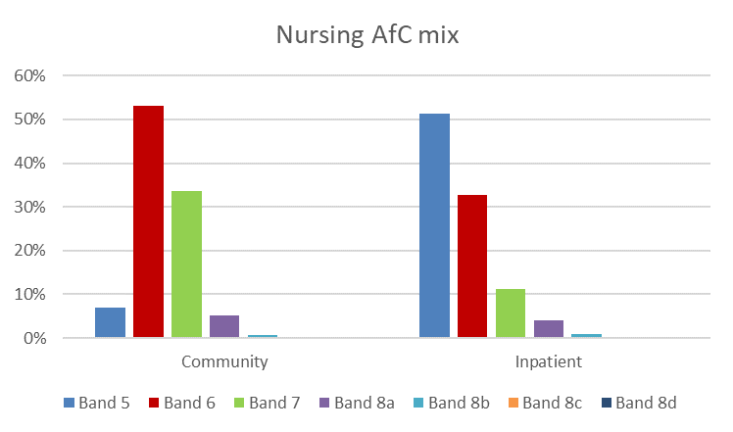
Nursing skill mix (NHS)
The chart to the right analyses the skill mix of nurses within community services on the left and inpatient services on the right.
In the community setting, the largest group of staff are Agenda for Change band 6 (53%). A total of 93% of staff in the community setting are band 6 or above. In inpatient settings, over half of staff are band 5, and only 49% of staff are band 6 or above.
Differences in skill mix are also evident at the higher grades, with band 7 nurses making up a much larger portion of community team nurse staffing (34%) than inpatient teams (11%).

Slide 21
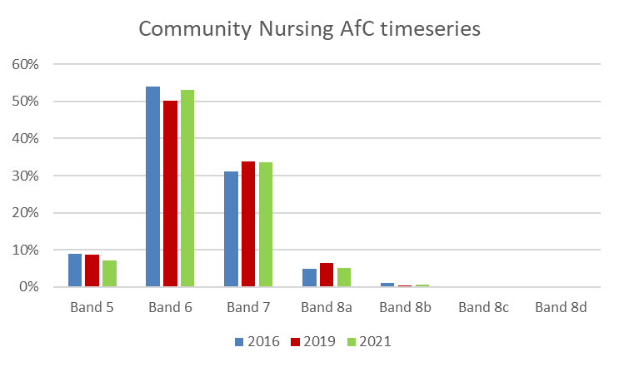
Nursing skill mix – timeseries (NHS)
Community
Over the three iterations of this project, there has been gradual (marginal) change in the seniority of the community nursing workforce. The chart to the right depicts the community nursing skill mix timeseries, with the 2016 census in blue, 2019 census in red and this year’s census in green. Compared to the 2019 census, there has been an increase in the proportion of band 6 nurses, from 50% to 53%.
Though the percentage of nurses at bands 7 and 8 have reduced slightly, they have not dropped to the level seen in 2016.

Slide 22
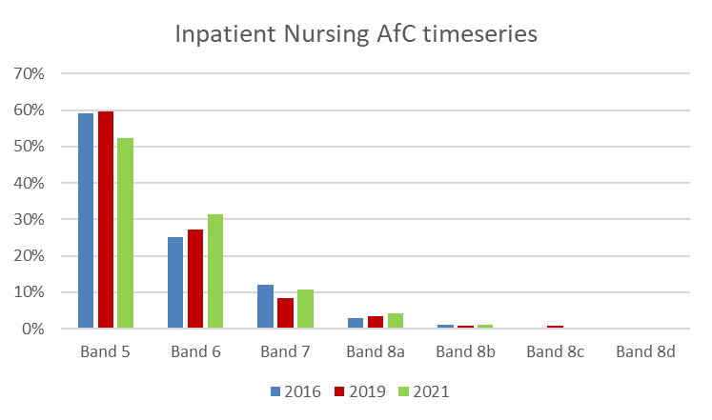
Nursing skill mix – timeseries (NHS)
Inpatient
The picture in the inpatient setting shows a trend of the nursing workforce becoming more senior with less reliance on newly qualified staff. There has been a reduction in the percentage of band 5 nurses and an increase in bands 6, 7 and 8a nurses since 2019.
Overall the percentage of nurses at bands 6 and 7 has grown from 35% of the workforce in 2019, to 44% of the workforce in 2021.

Slide 23
CYPMHS Workforce Profile
Independent Sector

Slide 24
Independent sector submissions
All Independent Sector providers of CYPMH services commissioned by NHS England Specialised Commissioning were asked to participate in this data collection. A total of 11 providers participated in the project, an increase from 7 in 2019.
Independent Sector participants were given the option to submit data at either an organisational level or site level, due to the fact that providers may have a mix of services and CYP sub-specialties in different locations, and therefore, analysis at a site profile may be more useful to them than an overall corporate profile. Due to this, a total of 19 individual data submissions were made to the project.
The data submissions cover providers of specialist inpatient care and also new providers of digital care to CYPMH services. A total of 2,293 staff were identified as working in CYPMH services in the independent sector.

Slide 25
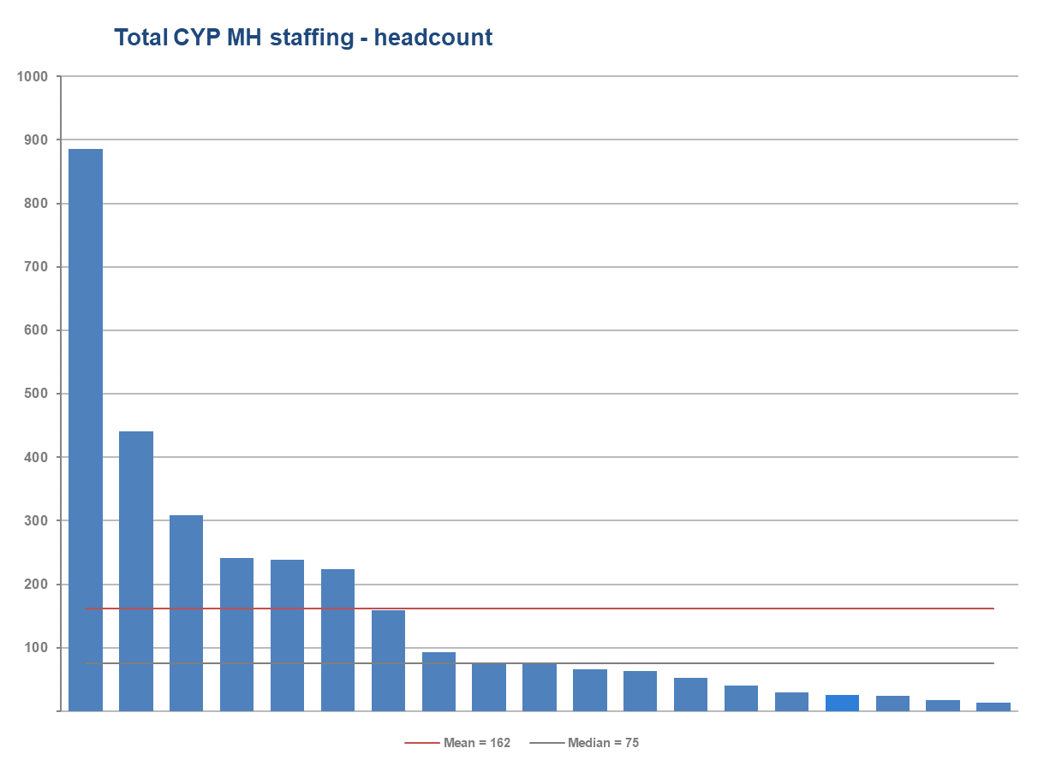
Independent sector staff in post
Analysis of the Independent sector workforce shows a mean average of 162 staff per data submission. This is a notable increase from the mean of 100, reported in 2019. The data submitted covers mainly specialist inpatient services but also new digital providers (e.g. online mental health therapies for CYP provided by a number of new entrants to the market from the independent sector).
The median average has also risen, from 60 in 2019, to 75 in 2021, though this has not increased as sharply as the mean, this confirmed growth in the independent sector as well as the NHS sector.
Across the data submissions, there was a range from 13 to 886 staff members reported. The wide range is exacerbated by the fact that some submissions are for whole organisations, and others are for individual sites. For example, the four highest bars on the chart are representative of organisations, whereas the lower three all represent individual sites. The independent sector generally reported staff who were younger and more diverse than the NHS.

Slide 26
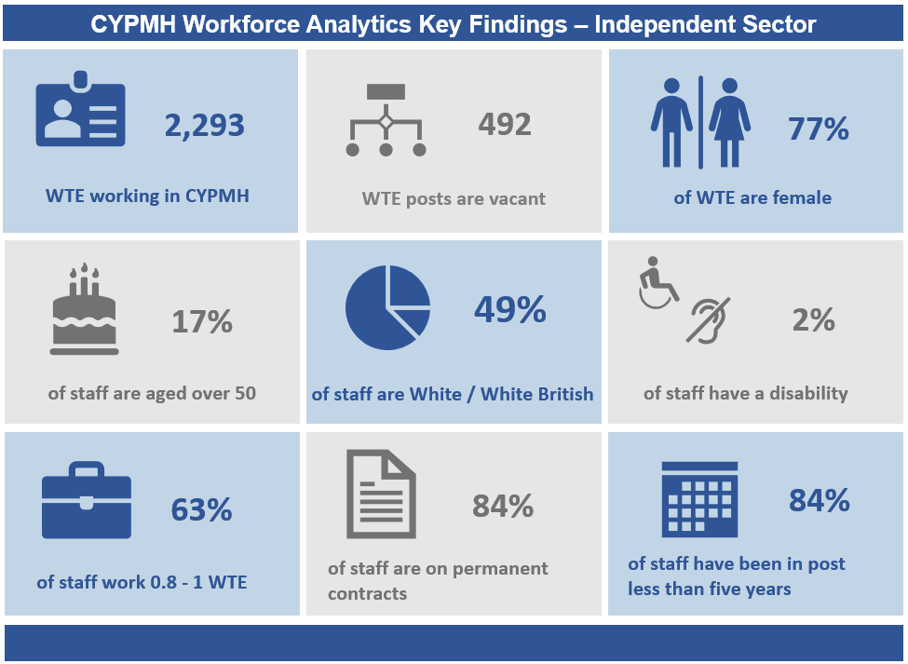
Independent sector overview

Slide 27
CYPMHS Workforce Profile
Local Authorities

Slide 28
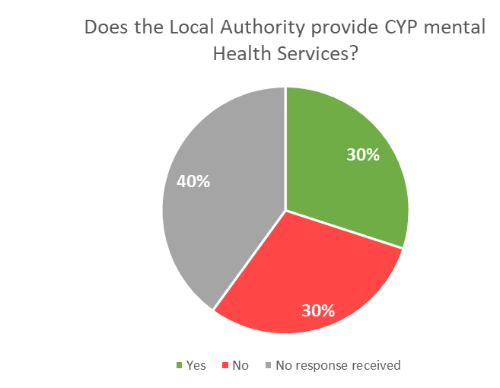
Local Authority data submissions
The 152 Local Authorities in England were contacted and asked to complete the Local Authority data collection specification. Of these, 46 (30%) responded that they provide CYPMH services and submitted data to the collection, and 45 (30%) responded that they do not provide CYPMH services. The remaining 61 (40%) of Local Authorities did not respond to the survey. The presence of Local Authorities as providers of CYPMH services is therefore less evident, with only 30% confirming that have an in house CYPMH offer. The Local Authority sector has declined in recent years and now provides only 3% of the directly employed CYPMH workforce.
The 2021 iteration of this project saw a reduction in engagement from Local Authorities in comparison to 2019. However, engagement was still significantly higher than when the project first started in 2016.
As in both previous iterations of this project, although there was wide variation in the numbers of staff providing CYPMH services reported by each participating Local Authority, overall, the majority of organisations reported having a relatively small CYPMH workforce. This confirms that Local Authorities are typically much smaller providers of CYPMH services, compared with NHS Trusts, and account for just 3% of the specialist workforce.

Slide 29
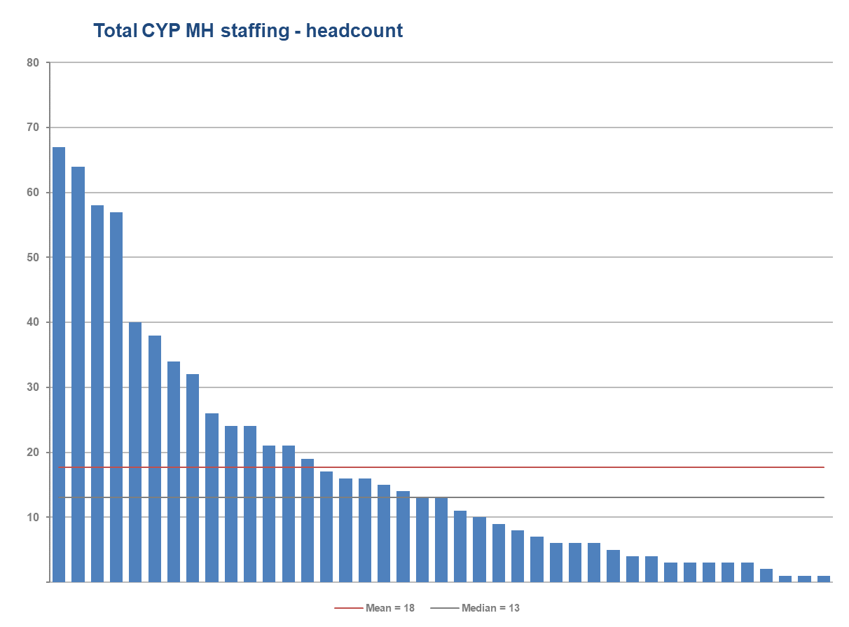
Local Authority staff in post
The chart to the right shows the reported headcount of the CYPMH workforce within the participating Local Authorities.
There is notable variation throughout the sector, likely due to differing service models and commissioning arrangements.
Overall there was a median average of 13 staff per local Authority, roughly in line with 2019 when the median was 12.
The total headcount of staff reportedly working in CYPMH services within Local Authorities was 746 (600 WTE) . This is a considerable reduction from the 1,259 reported in 2019, and may be due to both a reduction in participation and changing service delivery models.

Slide 30

Local Authority workforce overview

Slide 31
CYPMHS Workforce Profile
Voluntary Organisations

Slide 32
Voluntary sector submissions
The voluntary sector is typically more diverse and variable in its provision of services than statutory providers. Voluntary organisations can also offer a wider range of services which may be focussed around less acute needs. The position of the voluntary sector reflects the diversity of commissioning arrangements in the sector, with organisations commissioned by a variety of statutory organisations, typically NHS Clinical Commissioning Groups or Local Authorities. The size and shape of CYPMH provision by voluntary organisations also differs due to commissioning scope, and can vary from wide access to general services, to more niche and targeted activities for small groups.
In 2021, 74 organisations made submissions to the data collection, this is a notable increase from the 35 organisations that submitted data to the project in 2019. This includes representation ranging from large UK wide charities to small local charities. There was also variation in the age range that the participating organisations provide services for, with some specifically for children and young people, and others also catering to adult service users and young people transitioning between CYPMH and adult care. Furthermore, participants also include charities funded largely through the NHS and others who are entirely funded through other sources.
Anonymised demographic data about the staff in post was also provided by a number of organisations, including both clinical and non-clinical staff. This data provided an insight into the time in post, contract type, and gender split of an organisation’s employees.

Slide 33
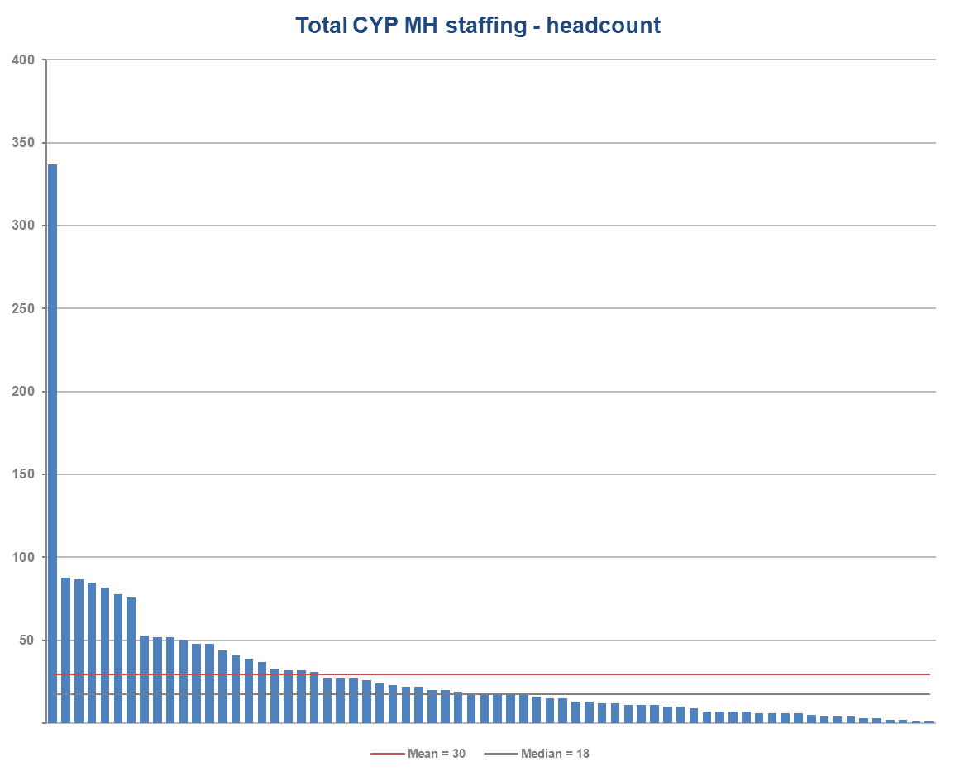
Voluntary sector staffing
This chart demonstrates the size of the voluntary sector workforce through the reported headcount of each participating organisation. Organisations in this sector and typically smaller than statutory providers.
There is a wide range of headcount reported, from 1 member of staff to 337 working in CYPMH. The median average of 18 is considerably higher than in in 2019, when it was 7.
Further analysis of staffing including part time working can be found in the bespoke voluntary sector reports that will be available to each participant.

Slide 34
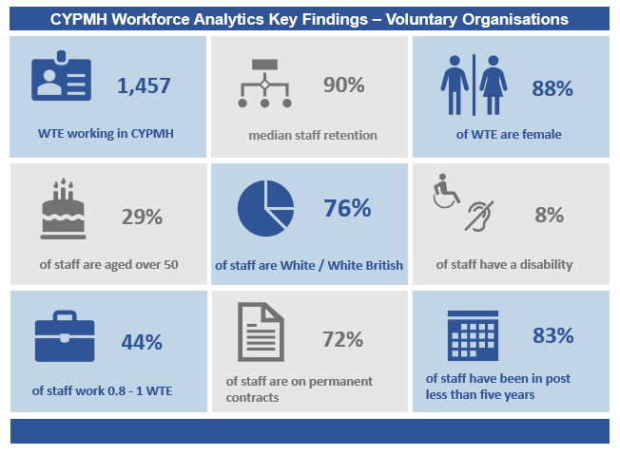
Voluntary organisations overview

Slide 35
CYPMHS Workforce Profile
Youth Offending Teams

Slide 36
Youth Offending Team data submissions
This year 89 Youth Offending Teams provided data for the stocktake of CYPMH workforce, a 24% increase from 2019, where 72 organisations made data submissions. When viewing this data it should be noted that Youth Offending Teams typically employ very small numbers of designated CYPMH workers. The service model of Youth Offending Teams instead tends to be organised in such a way that supporting children and young people with mental health issues is part of the holistic role of the YOT, a role that many members of the team contribute towards. This may include Social Workers, Probation Officers, other practitioners, and a range of managerial and support staff. Due to this, the census question asked of Youth Offending Teams is slightly different to that of the other sectors included in this report. Instead of asking how many staff are employed specifically as CYPMH workers, they were asked to include all their staff that provide CYPMH input, recognising that many of these staff will have wider roles.

Slide 37
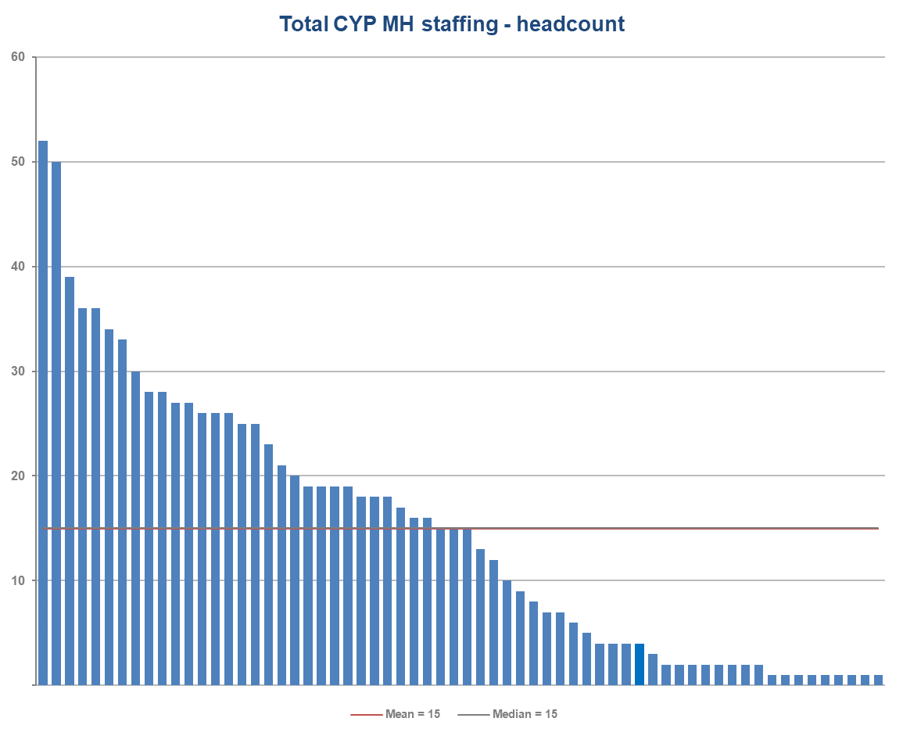
Youth Offending workforce providing CYPMH input
The 89 Youth Offending Teams who participated in the data collection were asked to provide the headcount of their workforce who provided input into children and young peoples mental health.
The number of staff reported is broadly in line with the previous iteration of the project. The mean average of 15 staff per YOT, is slightly lower than in 2019 (18), but the median of 15 is slightly higher than in 2019 (14).
There was notable variation amongst participants with responses ranging from 1 to 52 members of staff reportedly working in this capacity. This variation may be due to differing service models, local needs and commissioning arrangements with other providers.

Slide 38
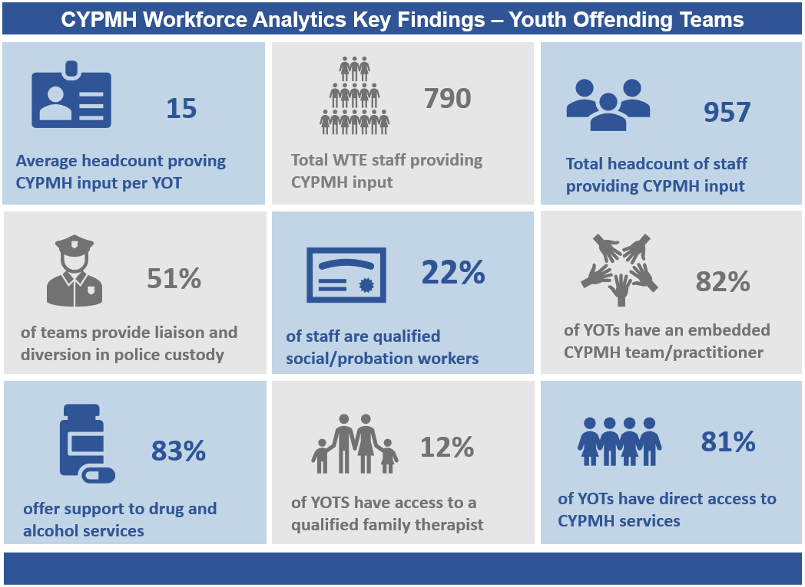
Youth Offending Teams overview

Slide 39
Vacancies

Slide 40
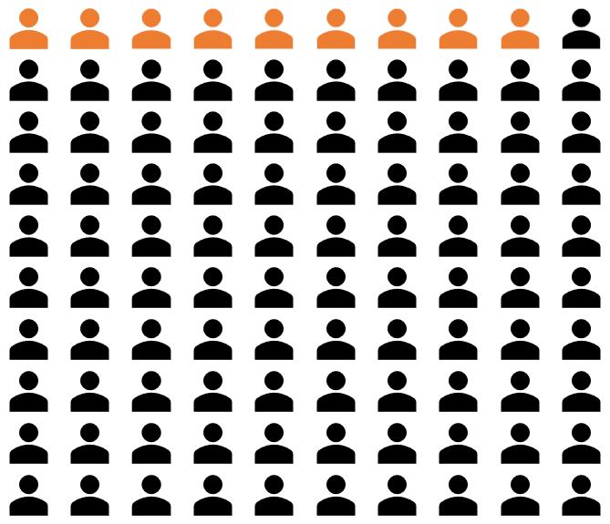
CYPMHS vacancies (NHS)
Demand for CYPMH services has grown rapidly in recent years, with providers attempting to actively expand the workforce to meet the increasing demand.
1,588 WTE vacancies were reported across NHS CYPMH services in the 2021 data collection, a notable increase from the 1,110 WTE vacancies reported in the previous iteration of this project. This increase in vacancies needs to be seen in the context of the significantly expanded CYPMH workforce. Vacancies reported within the NHS perhaps more reflect ongoing aspirations for further workforce growth and development rather than systemic supply problems. The analysis of NHS workforce growth shown earlier in this report provides context for a broad upsizing of the CYPMH workforce and plans for ongoing growth.
Ongoing recruitment plans and workforce expansion contextualise the 9% CYPMH workforce vacancy rate reported in the 2021 census.

Slide 41
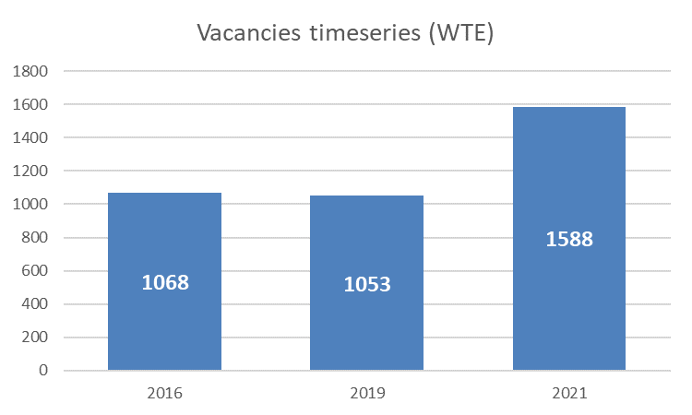
CYPMHS Vacancy timeseries (NHS)
The timeseries chart to the right shows the change in the absolute number of WTE vacancies across the three cycles of this project.
Vacancy levels need to be seen in the context of the growth in the NHS CYPMH workforce which is circa 40% larger than in 2019. Vacancies as a proportion of workforce has remained stable at 9% and also reflects an increased aspiration for CYPMH recruitment. A full analysis of vacancies by discipline is profiled on the following page.

Slide 42
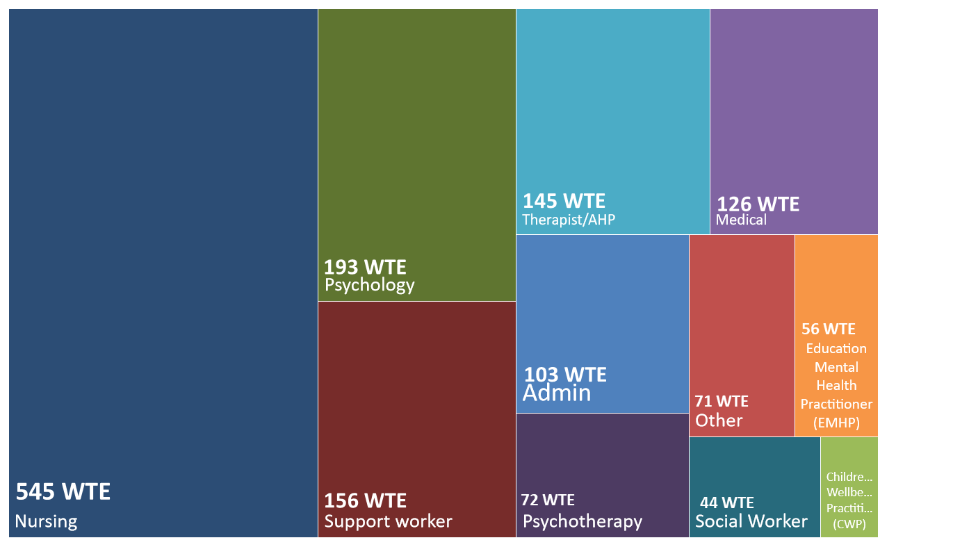
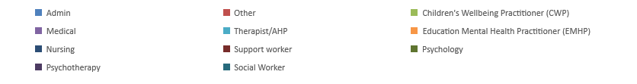
CYPMHS vacancy profile by discipline (NHS)

Slide 43
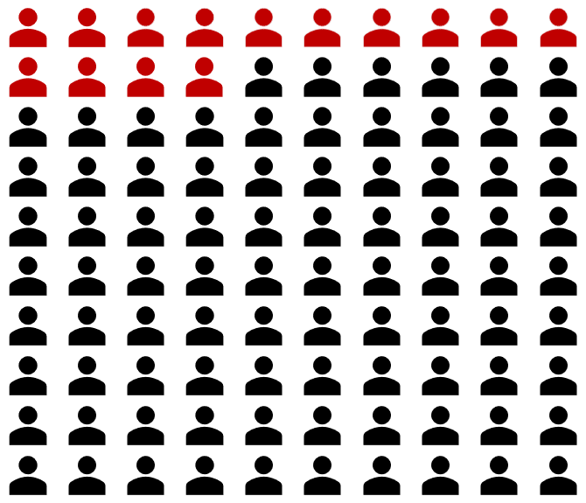
NHS vacancies: nursing
Given that nursing is the largest single profession in CYPMH it is perhaps to be expected that nurses also account for the highest number of vacancies, with NHS Trusts reporting 545 WTE of registered nursing vacancies at 31st March 2021. This equates to vacancy rate of roughly 14% across both community and inpatient services.

Slide 44
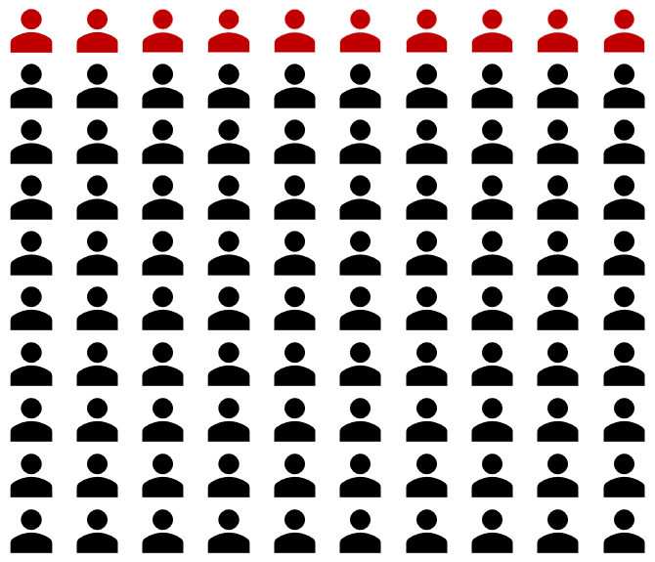
NHS vacancies: psychology
In 2020/21, NHS Trusts reported 193 WTE psychologist vacancies at 31st March 2021. This equates to roughly 1 in 10 psychology posts being vacant.

Slide 45
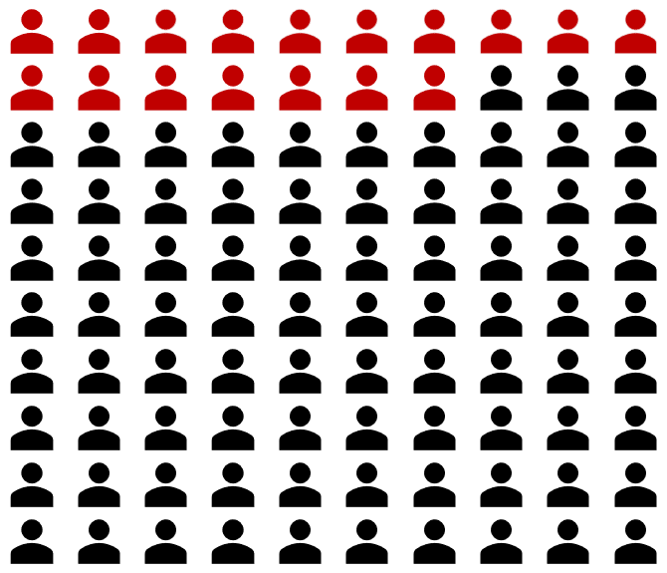
NHS vacancies: medical
Though only making up a small percentage of the workforce, they have a higher vacancy rate of 17%, or 126 WTE staff across both community and inpatient services. High vacancy rates reflect the aspirations of providers to develop additional child psychiatry posts at all levels.

Slide 46
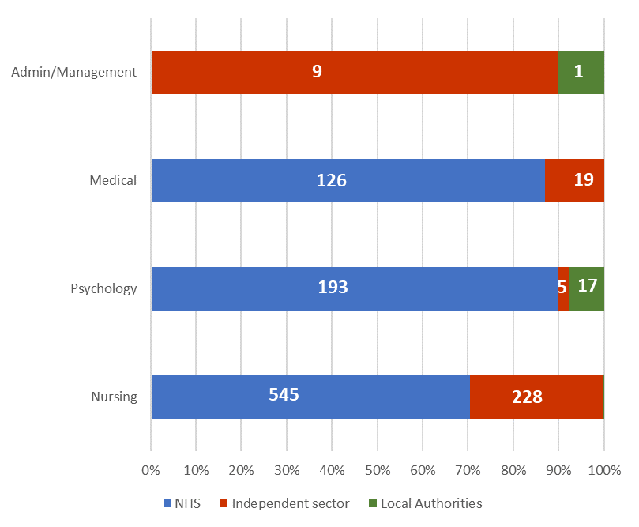
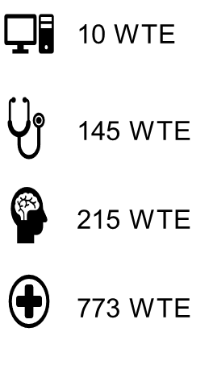
Vacancies (all sectors)
Vacancy data was requested from all participating NHS, Independent sector and Local Authority providers. However, not all participants were able to provide this data, although the chart opposite summarises overall findings.
Vacancy data was not requested from the Voluntary sector or Youth Offending Teams.
Analysis of vacancies declared by the NHS, Local Authorities and Independent sector reveals a consistent position that highlights pressures on specific disciplines.
Considerable nursing vacancies (773 WTE) are evident within the NHS and the Independent sector, whereas medical and psychology staffing vacancies are mainly identified within the NHS.

Slide 47
Staffing demographics
All sectors

Slide 48
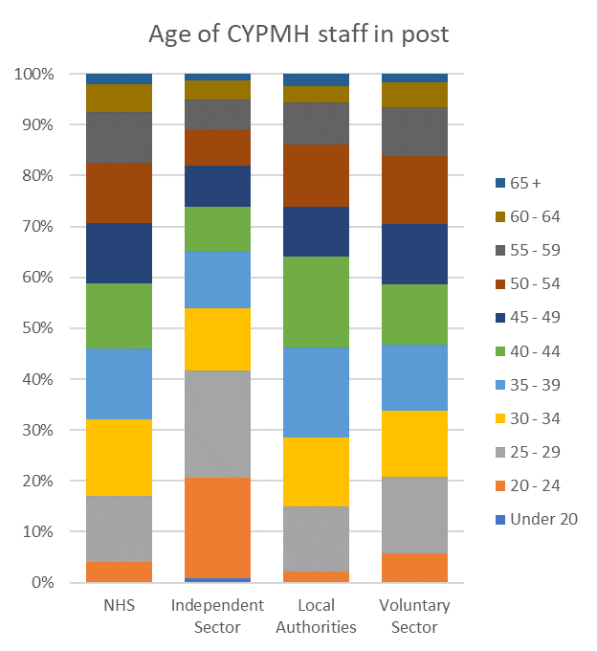
Age
The chart to the right shows the distribution of CYPMH staff by age in the four sectors surveyed in this data collection, with each colour representing a 5 year age band.
It demonstrates a well distributed workforce among the five year age brackets within the NHS, Local Authorities and the Voluntary Sector.
An exception to this trend is evident in the Independent Sector, which has a large proportion of younger staff, with 42% under 30 years old. For comparison, in the NHS only 17% of staff are under 30.

Slide 49
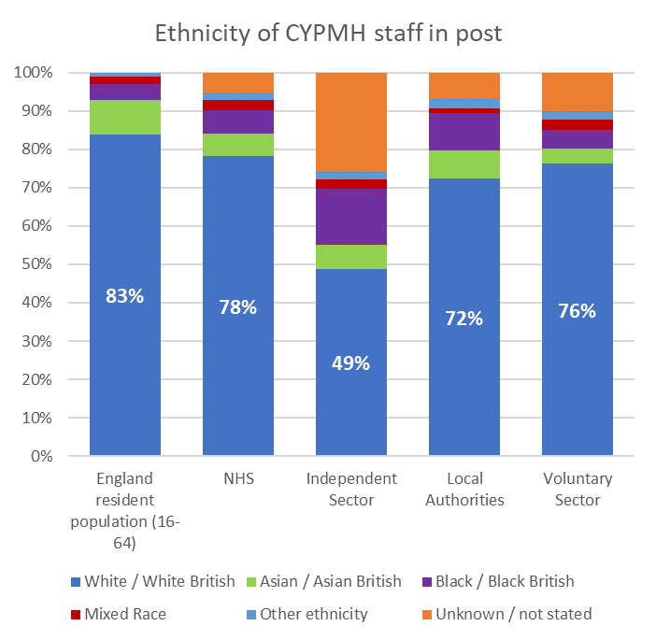
Ethnicity and workforce diversity
The chart to the right compares the ethnicity breakdown of the CYP MH workforce in the four sectors surveyed, against the working age resident population (16-64 year olds) across England. Details of CYPMH service user populations can be found via NHSBN annual CYPMH benchmarking reports.
Again, the independent sector is the exception to the trend, with a significant proportion of the workforce’s ethnicity being unknown or not recorded.
Nationally, 4% of the population are Black/Black British. In comparison, Black/Black British people make up the following proportions of the workforce.
NHS – 6%
Independent sector – 15%
LAs – 10%
VOs – 5%
People from an Asian background (shown in green) are less represented in all CYP MH services compared to the resident population (9%).

Slide 50
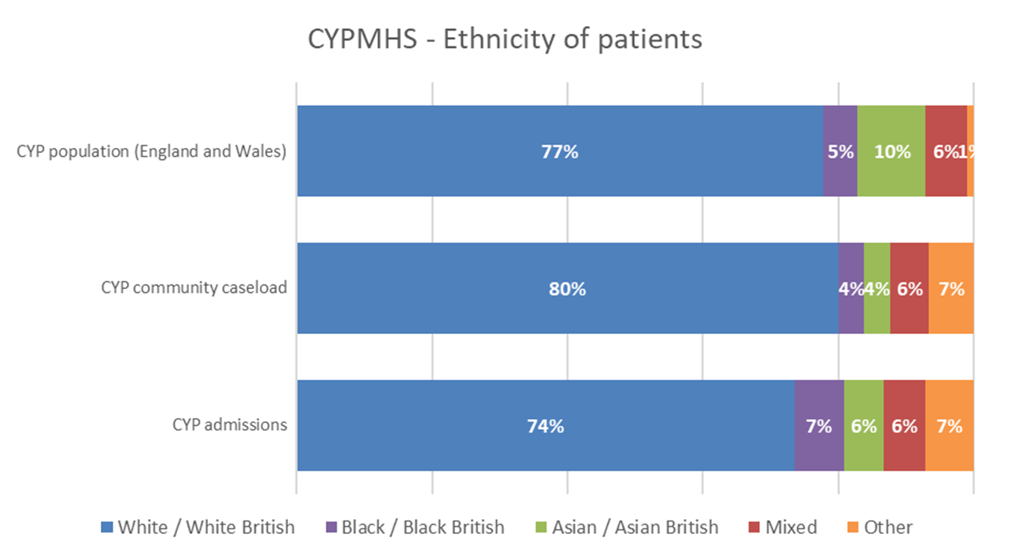
Ethnicity of CYPMH service users (NHS only)
The NHS Benchmarking Network run an annual benchmarking project that collects comprehensive data on CYPMH services across the UK. This data supports a range of subsequent analysis that provides insight to local commissioners, providers and also national policy organisations.
Amongst the data collected is a profile of the demographics of young people who use CYPMH services. Analysis of this data reveals issues with the level of inclusivity in community-based CYPMH services with young people from BAME backgrounds less represented in services than would be expected from the wider population composition. The chart opposite compares the background population of England and Wales where 77% of young people (0-18) identify as White/White British and 23% of young people identify in BAME groups.
Analysis of the broad community caseload across the NHS confirms that 80% of young people on caseload are White/White British and 20% are from BAME backgrounds. This highlights issues with a lack of inclusivity and service access barriers for young people from BAME backgrounds.
Data on inpatient care, shows 74% of admissions are for White/White British young people and 26% for young people from BAME backgrounds. This marginal over-representation in inpatient care is concerning given that these are the most acute and restrictive environments. The trend for BAME patients to be over-represented in acute inpatient care is well established in adult mental health services and recognised as a major issue in terms of the structural inequalities experienced by BAME patients in NHS mental health services.

Slide 51
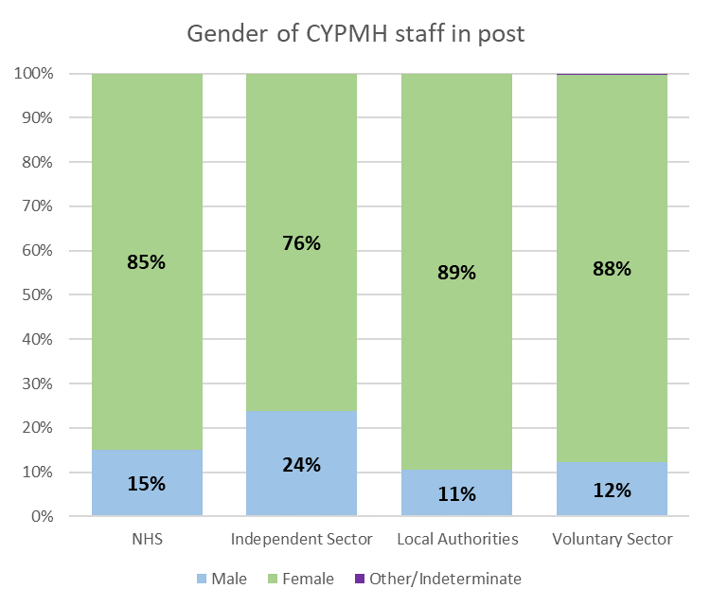
Gender
The chart to the right shows the gender split of the workforce across the four sectors.
Across all sectors, the workforce was predominantly female. Local Authorities and voluntary organisations have a stronger presence of women in the workforce, with a ratio of roughly 1:8, men to women.

Slide 52
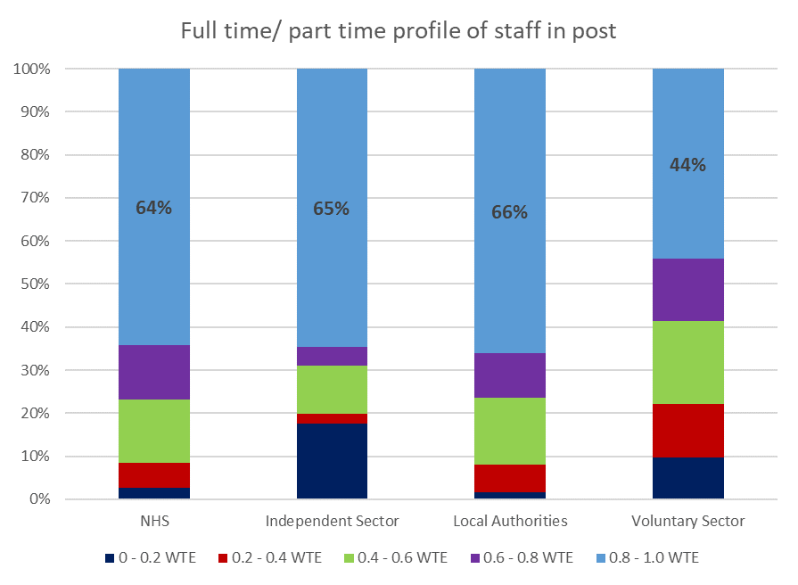
Contracted hours
The split of staff working full and part time hours is shown on this chart. In the NHS, Independent sector and Local Authorities, the majority of staff work full time. The Voluntary sector is the exception, with more than half of staff in part time roles.
Within the NHS, 64% of staff work full time. This has increased from 60% reported in 2019.
The Independent sector has the greatest proportion of staff working 0-0.2 WTE. This may be due to a wider use of zero-hours contracts in this sector.

Slide 53
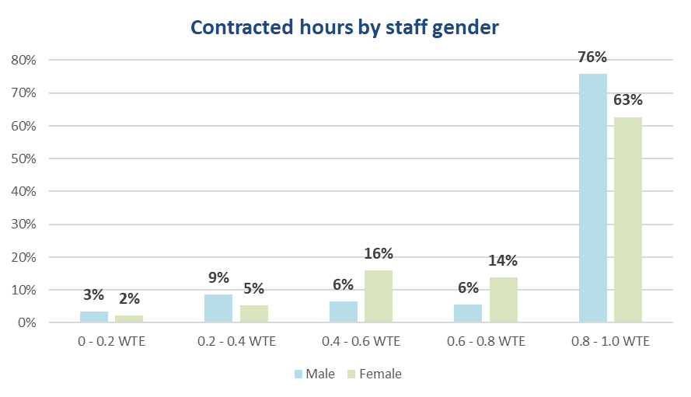
Additional gender profiling (NHS)
Further analysis breaks down the range of contracted hours by gender. It shows that of the staff working in CYPMH in the NHS 63% of women are working full time compared to 76% of men.
In contrast, there is a notably higher percentage of women (30%) than men (12%) working between 0.4 and 0.8 WTE, equivalent to 2-4 days per week.
For staff working 0-0.4 WTE (0-2 days per week) there is a less evident gender split, with only a slight over representation of men in these categories.

Slide 54
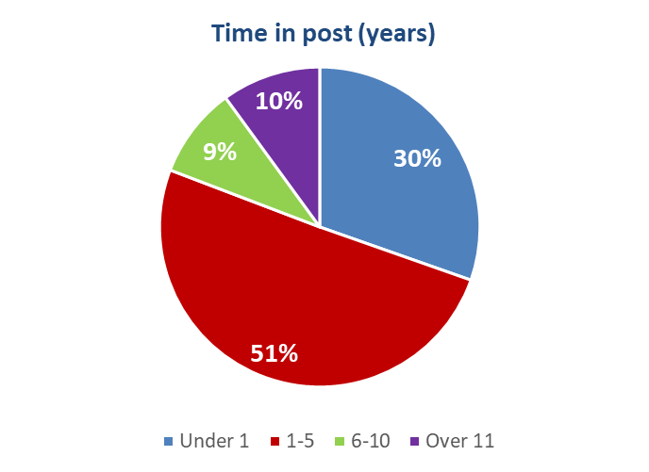
Time in post (NHS)
The pie chart to the right depicts how long staff working have been in their current role within the NHS.
The majority of NHS staff members (81%) have been in their current post for 5 years or less, a slight increase from the 78% reported in 2019.
This may be due to several factors including staff being promoted to new roles, the expansion of the workforce, and general staff turnover. Furthermore, changes to service models and team structures may also have an impact on this metric if they involve staff changing roles.

Slide 55
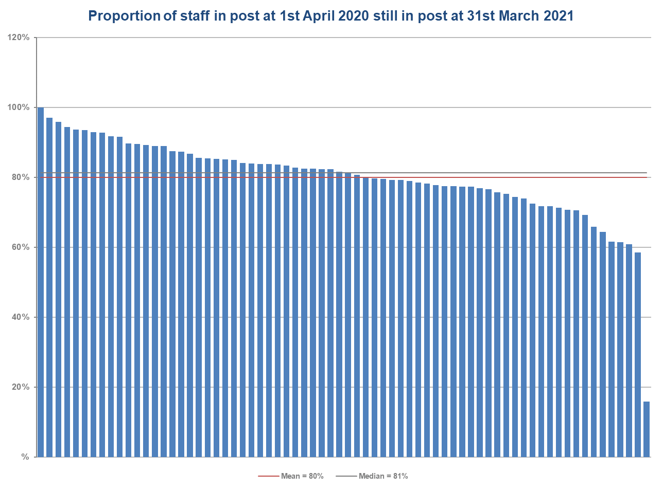
Staff retention (NHS)
Trusts reported that 80% of staff members that were in post on 1st April 2020, were still in post at 31st March 2021. This is a marginal fall compared to 2019 when the average staff retention recorded was 83%.
There is a wide range between Trusts, from 16% to 100% of staff still in post at the end of the 12 month period.

Slide 56
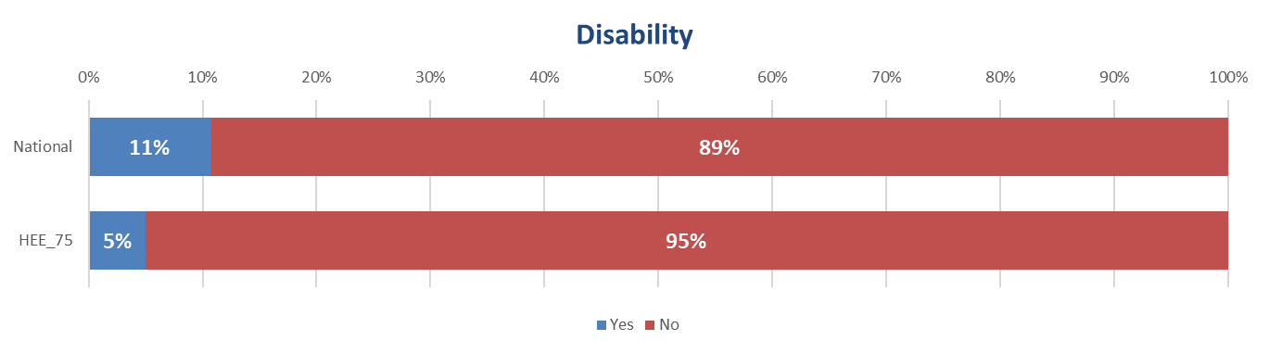
Disability (NHS)
Where disability status was recorded, the majority of staff working in CYPMH services in the NHS (89%) reported they had no disability. This is slightly lower than in 2019, where 93% of staff reported they had no disability. Overall, over the three iterations of this project there has been a gradual increase in the reporting of staff with disabilities, from 5% in 2016, to 7% in 2019 and now 11% in 2021.

Slide 57
Skills & Training
The following section explores the main skills and competencies of the CYPMH workforce. A full breakdown of the skills & training of the NHS CYPMH workforce can be found in the appendix. Providers segregated the skills and training profile into separate team types. This section explores staff within NHS providers and is at an aggregated level to comply with GDPR requirements. Further detailed analysis of each sectors skills and training can be found in the relevant bespoke reports provided to each participant organisation.

Slide 58
General Community Teams (NHS)

Slide 59
Mental Health Support Teams

Slide 60
Eating Disorder Community Teams (NHS)

Slide 61
Inpatient Adolescent Teams

Slide 62
Comparison between teams (NHS)
Intervention | General community team | Eating disorders community team | Inpatient adolescent team
CBT for young people with depression and anxiety | 91% | 55% | 60%
CBT for Eating Disorders | 33% | 68% | 27%
CBT for Psychosis | 35% | 9% | 33%
Cognitive Analytic Therapy | 42% | 32% | 27%
Dialectical Behaviour Therapy | 86% | 64% | 67%
Family Therapy | 86% | 64% | 80%
Eye Movement Desensitisation Reprogramming (EMDR) | 84% | 41% | 27%

Slide 63
Service Models

Slide 64
Service Models – NHS General community team pt. 1
Organisations were asked about their general community teams service models. The question received responses from 60 organisations. The following two slides show the percentage of these organisations that responded yes to providing certain service models.

Slide 65
Service Models – NHS General community team pt. 2

Slide 66
Conclusions and further information

Slide 67
Conclusions
This report examines the results from the third national workforce stocktake of Children and Young People’s Mental Health service across England. Data from the 2020/21 financial year was analysed to assess the size and shape of the CYPMH workforce using 31st March 2021 as a national census date. Comparisons were drawn between the results of this census and the previous two iterations of this project which collected data from the 2015 and 2018 calendar years. This allowed insight to be gained into how the workforce has developed and evolved over the past five years.
Children and young people’s mental health uses a multi agency delivery model. In this data collection, submissions were received from providers across the NHS, Independent sector, Local Authorities, Voluntary sector and Youth Offending Teams. Submissions were received from all NHS CYPMH providers, providing a solid baseline to describe the growth in the CYPMH workforce. Overall the multi-agency CYPMH workforce has grown by 39% since the census was last undertaken. The data collection also confirms that the NHS remains by far the largest provider of CYPMH services, with 78% of CYPMH WTE staff employed within the NHS.
The growth seen within the NHS workforce can be linked with an increase in funding for CYPMH within the Five Year Forward View and the NHS Long Term Plan strategies. Increase in CYPMH activity has been evident in recent years, with referrals doubling, CYP on caseload increasing, and a growth in the workforce, which suggests a sector that is expanding to cope with increasing demand. This trend was disrupted by the pandemic but recent evidence from 2021 confirms ongoing demand growth at levels not previously experienced.
The number of participating organisations in the Independent, Voluntary and Youth Offending sectors has grown since 2019, providing greater insight into the workforce in these sectors. Conversely in Local Authorities, the level of provision has reduced and more organisations reported not having any CYPMH staff than in previous years.
Health Education England and national policy organisations recognise the opportunity to expand skill mix within CYPMH services to include a wider number of the AHP disciplines. These could include expanded provision of Art Therapy, Music Therapy, Drama Therapy, Occupational Therapy, Speech and Language Therapy, and Dietetics. Many of these disciplines can make both targeted and MDT interventions in specialist areas of CYPMH services including supporting young people with eating disorders and also autistic spectrum disorders. Health Education England are actively working to communicate the range of new opportunities for AHPs in CYPMH services.
This report provides a detailed examination of the size and shape of the CHPMH workforce across all provider sectors. This includes the profiling of workforce demographic characteristics and skill mix breakdown. Almost all metrics analysed in the project describe an expansion of the CYPMH service offer in England.

Slide 68
Further information
This report summarises the national results from the stocktake of Children and Young People’s Mental Health services across England. The report has been prepared for Health Education England and will be shared with partner organisations when the report has been signed off by HEE.
A series of additional reports will be published by the project including bespoke workstream reports for each sector. All individual provider organisations who contributed data to the project will also receive a bespoke report outlining how local services compare against wider national data from that sector. For example, all NHS providers will receive a report and commentary about NHS delivered CYPMH services, and Local Authority participants will receive a report that discusses the position of each provider within the LA CYPMH sector.
Requests for clarification on any of the issues raised in this report can be sent to the NHS Benchmarking Network team via a.ng1@nhs.net or s.watkins@nhs.net.

Slide 69
Appendices

Slide 70
Appendix 1: Skills and Training

Slide 71
General community teams (43 respondents)

Slide 72
General community teams (43 respondents)

Slide 73
Mental Health Support teams (24 respondents) pt. 1

Slide 74
Mental Health Support teams (24 respondents) pt. 2

Slide 75
Crisis teams (24 respondents) pt.1

Slide 76
Crisis teams (24 respondents) pt. 2

Slide 77
Eating Disorder community teams (22 respondents) pt. 1

Slide 78
Eating Disorder community teams (22 respondents) pt. 2

Slide 79
Inpatient Adolescent teams (15 respondents) pt. 1

Slide 80
Inpatient Adolescent teams (15 respondents) pt. 2

