Slide 1
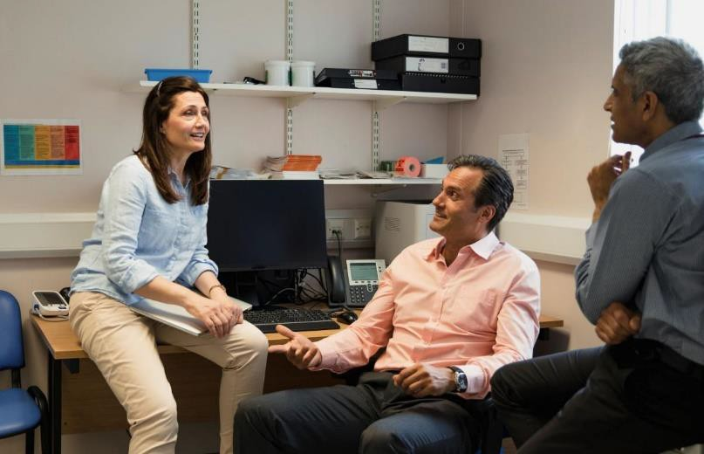
Discrimination & racism in primary care
Experiences of primary care staff working in North East London

Slide 2
Pioneering pan-London survey
All NHS staff deserve to work in an environment that is safe, welcoming and free of discrimination.
In November/December 2021 all primary care staff in London were invited to complete a short anonymous online survey to say whether or not they had experienced discrimination at work over the past 12 months.
The survey was advertised in meetings, newsletters, social media, mailing lists and through HEE, NHSEI, Primary Care School, LMC, LPC, LDC, ICSs, PCNs, Training Hubs, EDI leads, PM Fora and networks.
This document sets out the feedback from North East London.

Slide 3
Who shared their experiences?
1025 primary care team members from across London took part.
286 people worked in North East London.
North Central London |  |  | 176
North East London |  |  |  |  | 286
North West London |  | 134
South East London |  |  |  | 244
South West London |  |  | 181

Slide 4
Who shared their experiences?
The roles of the 286 people responding from North East London are below. This represents about 6% of the primary care workforce in North East London.
GP - salaried, partner or locum
Practice Manager General practice nurse or ANP Administrative, clerical, reception or IT roles Other senior management roles e.g finance Optometrist, optician, optical assistant Pharmacist, pharmacy technician
Other supporting clinical roles e.g. HCA Other patient care roles e.g. health coach Dentist, dental nurse or other clinical dental Other roles e.g. paramedic, student
46%
14%
11%
9%
5%
3%
3%
2%
3%
1%
4%

Slide 5
Who shared their experiences?
The age, gender and ethnicity profile of the 286 people who took part in North East London was broadly representative of the primary care workforce in the area.
37%
Female 67%
Non- binary and other 2%
24%
24%
10%
4%
1%
Male 31%
16-20 21-30 31-40 41-50 51-65 66+ yrs

Slide 6
Who shared their experiences?
Asian/Asian British - Indian Asian/Asian British - Pakistani Asian/Asian British - Bangladeshi Asian/Asian British - Chinese Other Asian/Asian British Black/Black British - African Black/Black British - Caribbean Other Black/Black British
White - British
White - Irish Any other White background
Arab Any other background
23%
12%
11%
1%
4%
6%
5%
0%
26%
1%
5%
0%
7%

Slide 7
Discrimination and harassment
Below are the proportions who said they had experienced discrimination or harassment in their primary care work due to their personal characteristics in the past 12 months. 52% said they experienced some type of discrimination.
Due to ethnicity
19%
32%
Due to gender
9%
14%
Due to age
9%
8%
Due to religion
6%
10%
Due to disability
2%
1%
Due to sexual orientation
1%
1%
Discrimination from staff
Due to other characteristics
2%
2%
Discrimination from patients

Slide 8
Perceived racial discrimination
Below are the proportions of people from different ethnic backgrounds who said they had personally experienced racial discrimination or harassment at work in the last 12 months.
Ethnic background | Discriminated against by patients | Discriminated against by staff
Total, all ethnic groups | 32% | 19%
Asian or Asian British | 42% | 24%
Black or Black British | 52% | 29%
White British or Irish | 4% | 4%
Any other White background | 29% | 14%
Any other background | 42% | 21%

Slide 9
Racial discrimination - past year
People from minority ethnic backgrounds were more likely to feel their ethnicity
had reduced their career progression and training opportunities in the past year.
% Asian % Black % White British/ Irish % Other White % Any other
93 ₈₆
73
72
62
55
50
32
33
₂₉ 36
32
27
28
20
20
18
3
1
7
My organistion acted fairly about promotions and progression, regardless of ethnicity
My ethnicity reduced my chances of promotion or progression
My ethnicity reduced my opportunities for training
I saw a colleague discriminated against due to their ethnicity

Slide 10
Racial discrimination – past year
People from minority ethnic backgrounds were more likely to say that they
considered leaving their role due to racial discrimination in the past year.
% Asian % Black % White British/ Irish % Other White % Any other
26 26
21
19
17
16
13 13
14
14
7
8
7
4
5
5
4
1
3
0 0 0
1 1
0
Senior colleague Patient complained
Colleague complained about me due to my ethnicity
Had performance measures or disciplinary action due to my ethnicity
Considered leaving or left due to racial discrimination
discriminated against me due to my ethnicity
about me due to my ethnicity

Slide 11
Impacts of racial discrimination
127 people shared a recent experience of perceived discrimination or harassment based on their ethnic background. Most said that the most recent instance involved subtle or underhanded comments or actions.
Examples of perceived discrimination included:
Subtle or underhand comments or actions, 70%
racial slurs / stereotyping
being undermined or put down
not being listened to, treated with
respect or promoted
patients wanting to see someone else
People said this led them to:
Direct comments or actions, 21%
feel undervalued, unsupported, demoralised
have significant mental health concerns
leave the job or go on sick leave
Aggressive or threatening behaviour, 9%

Slide 12
Examples of discrimination
“Hardly any BAME staff in certain roles and at higher levels despite people trying. I feel less confident in speaking at meetings as fear I would say something that will prove to people that they are right in saying I am not good enough. I am constantly in fear that I will be let go because they will find someone better. I feel unsupported and cannot ask for help in fear of being seen as useless.”
“My boss treated me badly and got rid of me and replaced me with newly qualified nurses due to my religious and ethnic background. I approached the lead nurse but did not allow me to discuss. Treated me differently. So I changed my role and left the job. Boss is the king and has no one to challenge him about his work and attitude.”
“When reporting very direct racism towards me was told leave it be because I am White, no one would believe me and I would lose. There was video!”

Slide 13
Reporting racial discrimination
Of the 127 people who described their experiences of racial discrimination, 1
in 4 said they or someone else reported the most recent incident.
About 1 in 18 said they reported it and it was dealt with well.
I reported and it was dealt with well
6%
I reported but not dealt with well
15%
Someone else reported
3%
Did not report as thought nothing would be done
56%
Did not report as worried about consequences
35%
Did not report as did not know who to report to
13%
Dealt with issue directly with person
6%
People could give more than
Did not feel need to report
3%
one reason for not reporting

Slide 14
Do people know what to do?
Regardless of whether they experienced discrimination, we asked if people knew where to get help with ANY harassment or discrimination at work. Many said they knew where to go for help, but people from minority ethnic backgrounds were least likely to feel confident that anything would be done.
% Asian % Black % White British/ Irish % Other White % Any other
87
86
90
91
85
79
66
60
67
60
61
55
50
53
47
I know where to go for help to deal with any harassment or discrimination I see or experience at work
I would feel secure raising concerns about harassment or discrimination where I work
I am confident that my organisation would address concerns I raise about harassment or discrimination

Slide 15
What are the top priorities?
73 people suggested practical things to tackle racial discrimination or harassment (regardless of whether they had experienced any):
Training for all staff about diversity and unconscious bias (37%) and helping people feel confident to raise and deal with issues (10%)
Safe spaces to discuss and report issues, including meetings, website forum and regular surveys like this (22%)
Independent body to investigate and support, including advice helpline and
anonymous reporting (22%)
Zero tolerance campaign, informing patients about what is unacceptable and making it easy to remove patients from the register (21%)
Recruiting diverse people to (senior) roles and setting diversity targets (15%)
Standardised policy and protocols for responding (3%) and more promotion of the process for reporting and getting support (7%)

Slide 16
What are the top priorities?
“There needs to be unconscious bias training. Ethnic colleagues with decades of experience passed over for promotion in the wider NHS management vs newly qualified White locums promoted instantly to leadership positions.”
“Having an external support officer to talk to, as it could be difficult reporting on those in authority, particularly if they the ones to whom you are supposed to talk about discrimination with. It can also be difficult to get an objective perspective if you are required to speak to somebody within the team who is already involved in the dynamic.”
“Think about ways to be inclusive. Those who come from a Muslim background are often at a disadvantage due to an inability to join informal team events like drinks after work so they miss out on important team-bonding as a result.”

Slide 17
What have we learnt?
52% of people responding from North East London said they had experienced some type of discrimination or harassment due to their personal characteristics at work last year.
32% said they experienced racial harassment or discrimination from
patients and 19% from colleagues or managers.
24% of recent instances of racial discrimination were reported, but only 6% said they reported it and the issue was dealt with well.
Asian and Black people were more likely than others to say they had experienced racial discrimination, but were less likely to know where to get help and less likely to feel confident about raising issues.
The most common suggestions to help address racism at work were training for all team members, safe spaces to discuss experiences and raise issues, and an independent group to give advice and investigate.

