Slide 1
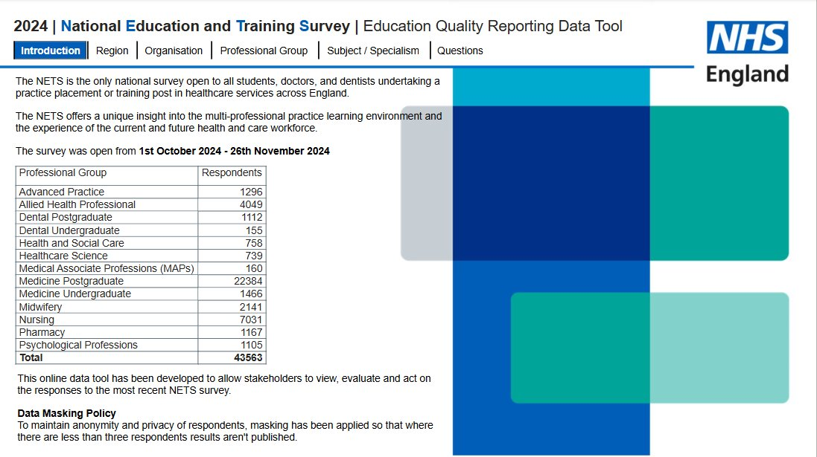
Publication reference: PRN01820_i
NETS 2024 Education Quality Data Tool

Slide 2
Introduction
This year’s NETS saw the highest response rate since its launch in 2019, making it our most comprehensive dataset yet.
As the only national survey open to all undergraduate and postgraduate students and trainees undertaking a practice placement or training post in healthcare. NETS results provide critical insights into the quality of the learning environment through the eyes of the learners.
This information helps us work collaboratively, both regionally and nationally, with education providers and placement organisations to enhance learning conditions for all healthcare learners.
We’re very grateful to all the learners who shared their insights that will play a vital role in shaping the future of healthcare education and training.
We invite you to explore the results and see how learner experiences are shaping the future of healthcare education.
We hope you find this user guide to the education quality reporting data tool helpful in navigating through the breadth of information available, along with providing information about how the NETS data is scored, grouped and calculated.
Education quality reporting data tool

Slide 3
Survey changes
Over the years we have continued to refine the survey. Below shows the key changes made to the survey since 2021.
2023
The ‘Scientific, Therapeutic and Technical’ group was removed with professions included moved into existing more appropriate categories following consultation with relevant professional leads.
MAPS included into the survey as a separate professional group.
Introduction of sexual safety questions in line with the launch of the NHS England sexual safety charter. Introduction of the sexual safety indicator.
2021
Nursing and Midwifery numbers were no longer combined.
2022
Psychological Professions were removed from the ‘Scientific, Therapeutic and Technical’ category and made an individual group.
Introduction of wellbeing questions.
Introduction of EDI discrimination questions.
2024
Amendment to the sexual safety questions to distinguish unwarranted behaviours from staff and patients.
Review undertaken of all indicators and the introduction of three new inductors; wellbeing, discrimination and raising concerns.

Slide 4
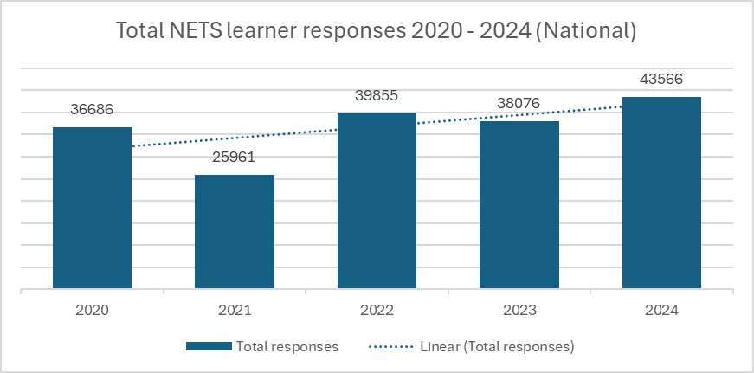
Key changes to the 2024 NETS Education Quality Data Tool
A change to the look and feel of the pages
The introduction of a new technical handbook.
The introduction of a ‘hover’ information button which explains each page.
New page to view benchmarked trust/organisation level data by indicator.
A new filter bar.
A revised professional level view of the data. Inclusion of three new indicators.
This year more learners completed the National Education and Training Survey than ever before.

Slide 5
How the data is grouped and scored by indicator
Questions are grouped by theme to measure how learners responded about that aspect of training. These themes are grouped into indicators.
The answer to each question is given a numerical value (e.g. Q39.1. I saw examples of safe care: never 0, rarely 25, sometimes 50, often 75, always 100).
We average the scores of questions in the indicator to create an indicator score (a score out of 100).
N/A responses are not included and so do not count towards an individual’s score for that indicator.
To protect learner anonymity masking for the indicators is applied at N ≥ 3.
Example: Induction Indicator
Q35. At the start of this placement / training post, I had the opportunity to discuss and agree my learning needs with a supervisor, practice assessor / practice supervisor or senior colleague.
Q36.1. The formal induction I was given at the start of the practice placement or training post (e.g. being shown around, being given a timetable, having my role explained to me)
Yes
100
Outstanding
100
No
0
Satisfactory
75
Good
50
In need of improvement
25
Unsatisfactory
0
Learner A’s average score for induction is (100+50) / 2 = 75
Example data is for illustration only and not based on actual responses

Slide 6
How questions are scored
Example: Question 36.1
Question level data
Data is shown at question level for core questions only.
The questions are calculated based on the percentage of learners giving a positive answer (e.g. Q39.1. I saw examples of safe care: positive answers always and often, Q37.4. The availability of learning and IT resources to meet my learning outcomes: positive answers outstanding, good, satisfactory).
N/A responses are included in the overall scores.
This data is available in the NETS education quality data tool, see ‘Questions – Core Questions’.
Total numbers of learners providing a response to the question…
The total % of learners providing a positive answer to Q36.1 is 76.4%
Question response
N=
Question response
%=
Outstanding
100
Outstanding
6.4%
Satisfactory
400
Satisfactory
25.5%
Good
700
Good
44.5%
In need of improvement
300
In need of improvement
19.1%
Unsatisfactory
50
Unsatisfactory
3.2%
NA
20
NA
1.3%
Total learner responses
1570
Total
100%
Example data is for illustration only and not based on actual responses

Slide 7
About the outliers
Outliers are scores that are significantly higher or lower than the average score, these are shown in red or blue.
The dashboard provides outliers in relation to education quality indicators, organisation types, professions, subjects and specialisms.
Each cell contains the mean score and a colour which indicates if the score is an outlier.
Red: a red outlier is a score in the bottom quartile (Q1) of the benchmark group, and the confidence interval does not overlap with that of the benchmark mean.
Pink: a score in the bottom quartile (Q1), but the confidence interval overlaps with that of the benchmark mean.
White: a score in between the top and bottom quartiles of the benchmark group.
Light blue: a score in the top quartile (Q4), but the confidence interval overlaps with that of the benchmark mean.
Blue: a green outlier is a score in the top quartile (Q4) of the benchmark group, and the confidence interval does not overlap with that of the benchmark mean.
Grey: fewer than three results (n<3). We only report results which have three or more responses.

Slide 8
Benchmarks
All midwifery learners in England
All learners in England
Benchmarks are calculated dependent on the reporting group and the page you are reviewing on the education quality data tool.
Benchmarks are calculated at either a national level or subject / specialism level.
Learner A: Midwifery learner
Learner A: Midwifery learner

Slide 9
NEW Menu Bar
Introduction
Region
Organisation
Brief introduction to the reporting tool.
Indicator level data at national, regional and ICB level.
Indicator level data at organisation level.
Professional Group
Subject/Specialism
Questions
Three indicator level reports:
Overall profession
Profession by organisation Profession by site
Three indicator level reports: Overall subject/specialism
Subject by organisation Subject by site
Three question level reports:
Core question level data Branching questions Recommend questions

Slide 10
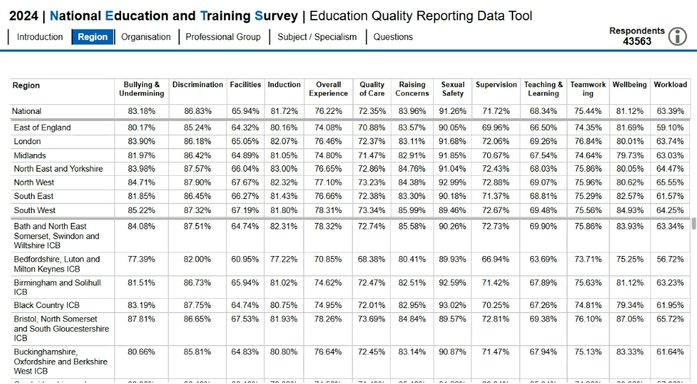
Indicators: NEW Region and ICB Page
Please ‘click’ the region you wish to view, and the bottom screen will display the ICB results for the selected region.
A new region page has been developed for the 2024 education quality data tool which enables users to view high level NETS results at national regional and ICB level.
No additional filters are available on this page. To view results by organisation, profession or specialism/subject please navigate to the additional pages.

Slide 11
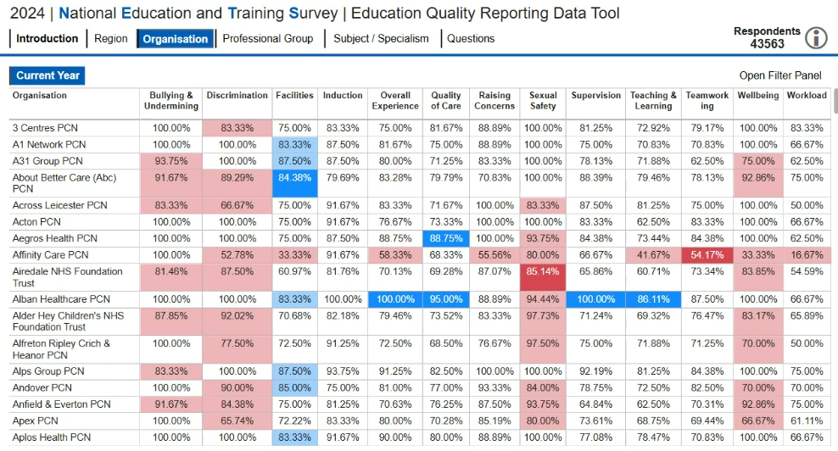
Indicators: Organisation level data
This organisation view page was introduced in the education quality data tool in 2023.
This page enables users to view high level NETS results at organisational level for each indictor.
Use the open filter button to filter/search by region, ICB/system, organisation and higher education institution.
Benchmarking is applied at ‘all learners’ level.

Slide 12
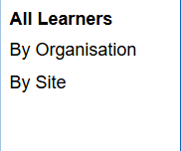
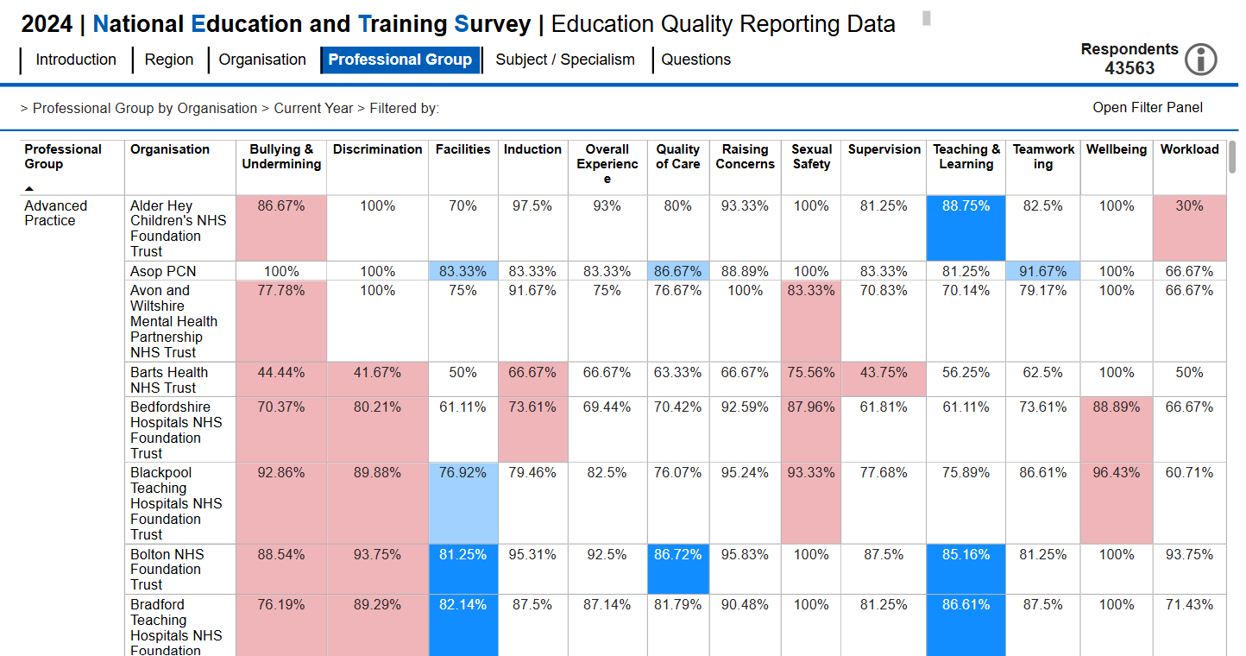
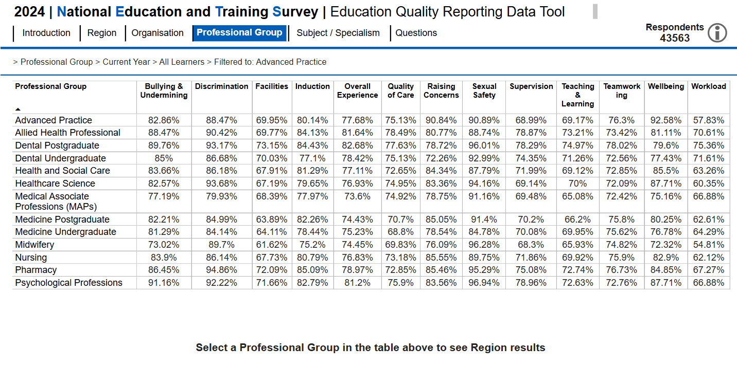
Professional Group views of the data
This we have introduced new ways to view results linked to professional groups.
Users can navigate through three pages to view results by…
… profession at national and regional level
… profession at organisation level
… profession at site level
‘Click’ professional group’ to view the pages available, then simply click on the page you wish to view.
Use the open filter button to filter/search by region, ICB/system, professional group organisation and higher education institution. For the site page you can also filter/search by site.
Benchmarking for the organisation and site pages is applied at ‘all learners’ level.

Slide 13
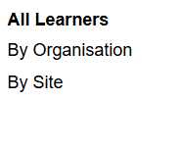
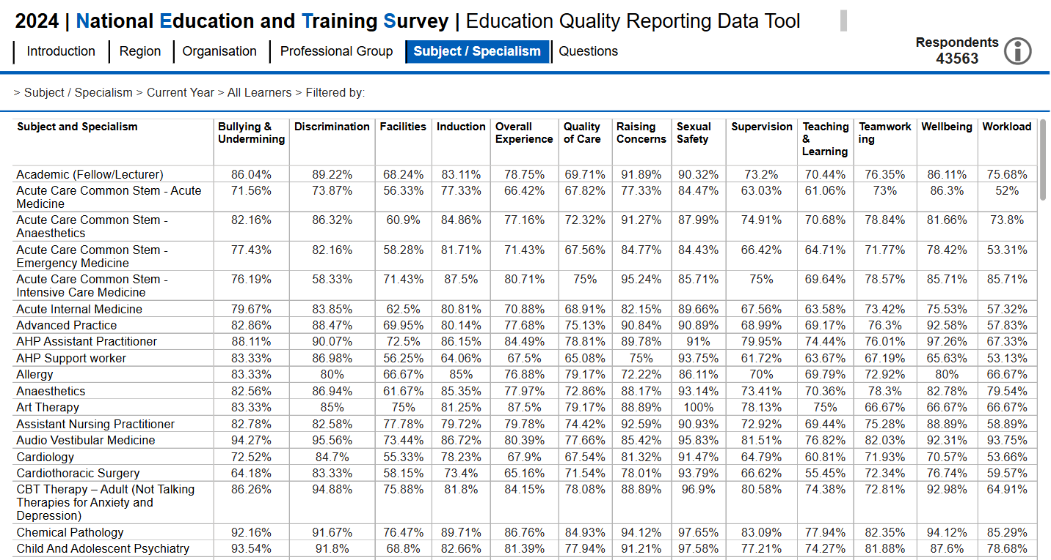
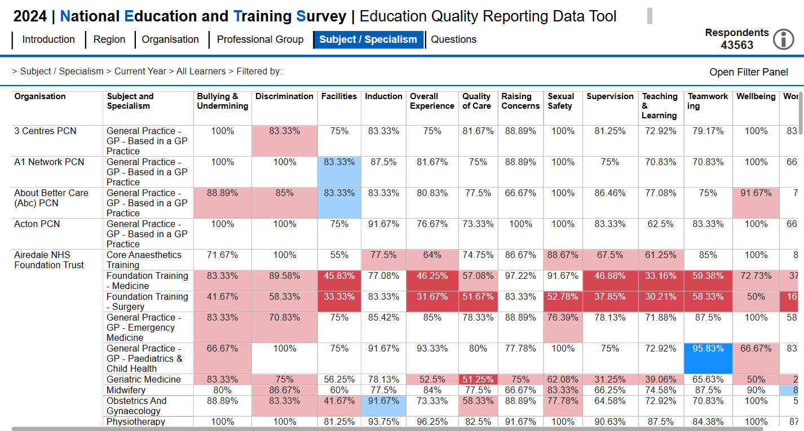
Subject / Specialism views of the data
This year we have introduced new ways to view results linked to subject and or specialism.
Users can navigate through three pages to view results by…
… subject/specialism at national and regional level
… subject/specialism at organisation level
… subject/specialism at site level
‘Click’ subject/specialism’ to view the pages available, then simply click on the page you wish to view.
Use the open filter button to filter/search by region, ICB/system, professional group, subject, organisation and higher education institution. For the site page you can also filter/search by site.
Benchmarking for organisation and site pages is applied at subject/specialism level.

Slide 14
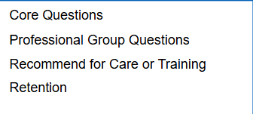
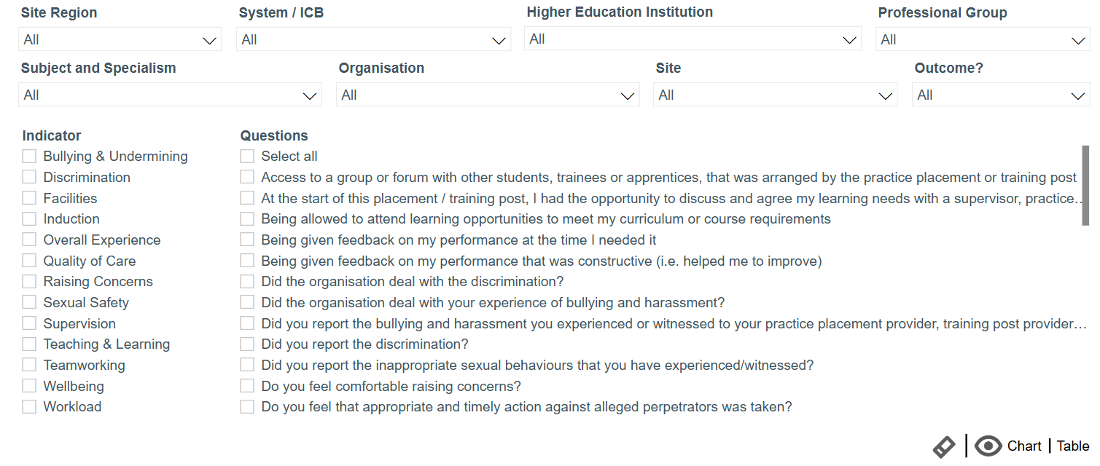
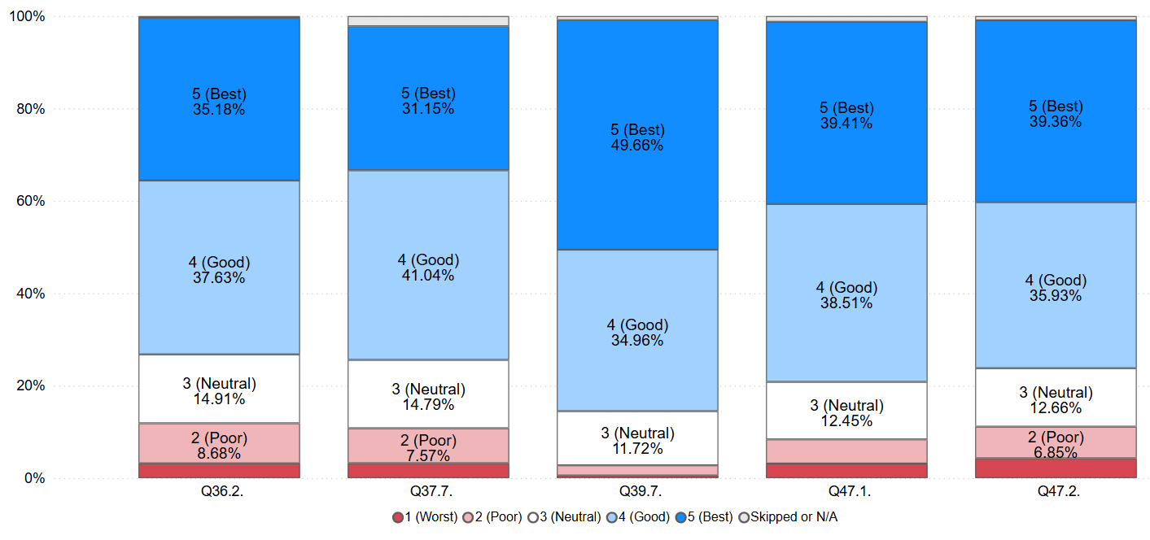
Question level data: Core questions
New for this year, the ability to view question level responses as a chart.
For 2024 we have introduced a new filter pane to help user find specific questions.
Choose a chart or table view

Slide 15
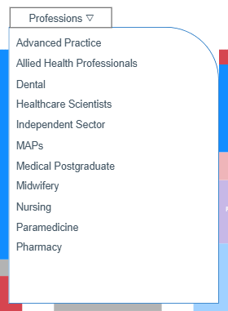
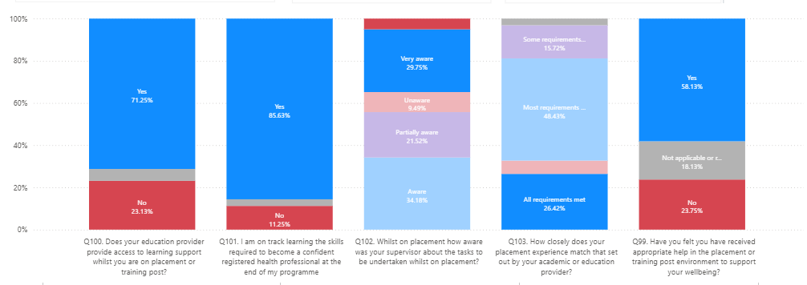
Question level data: Branching questions
A suite of new pages have been added which show the results for the profession specific branching questions. Use the drop list (shown to the left) to view the results of specific learner group questions.

Slide 16
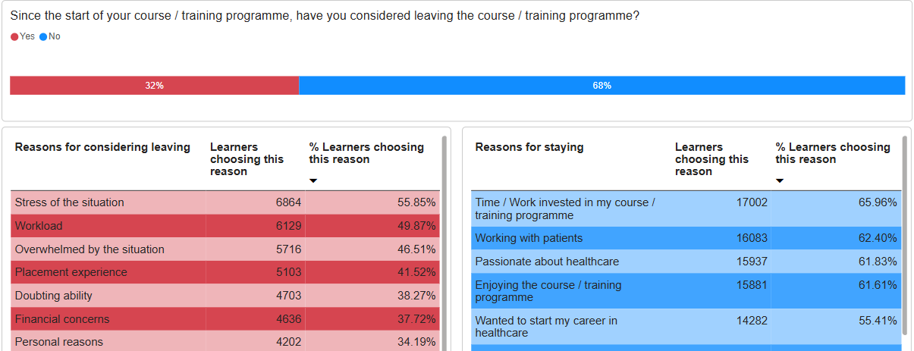
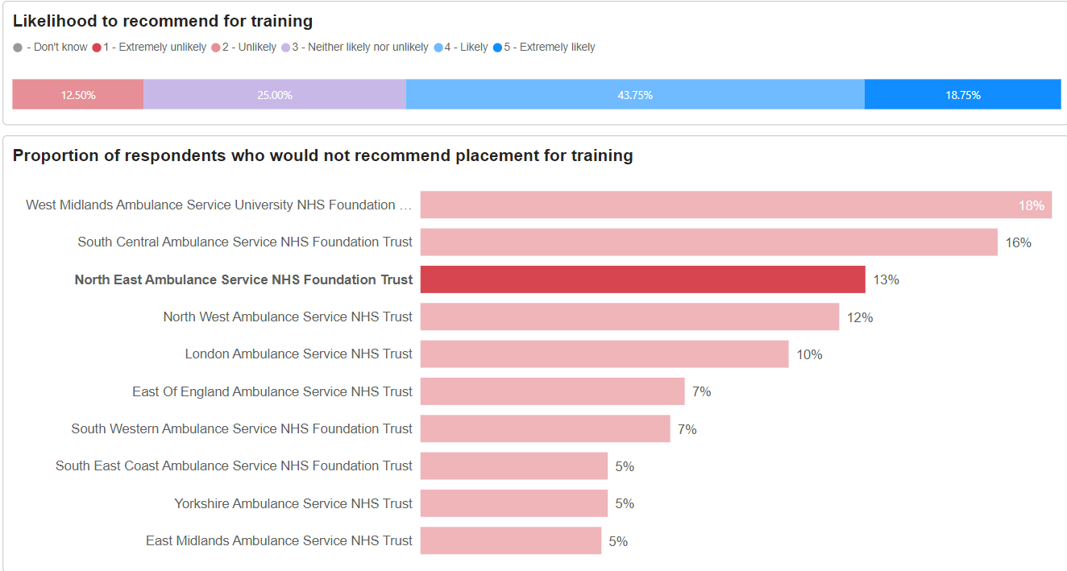
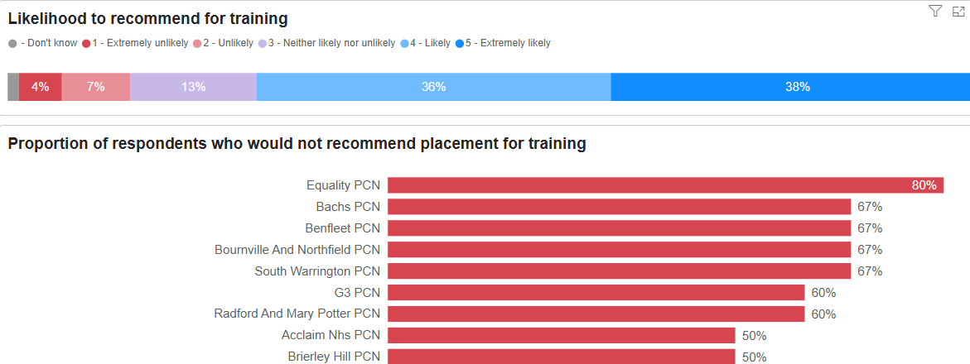
Question level data: Recommend questions
This page provides users with a simple to use visual showing the recommend for training, recommend for care and considered leaving questions.
Use the open filter button to filter/search by region, ICB/system, organisation and higher education institution. For the site page you can also filter/search by site.
The top bar displays the average score of all organisations selected.
Click on an organisation to see only their results in full.

Slide 17
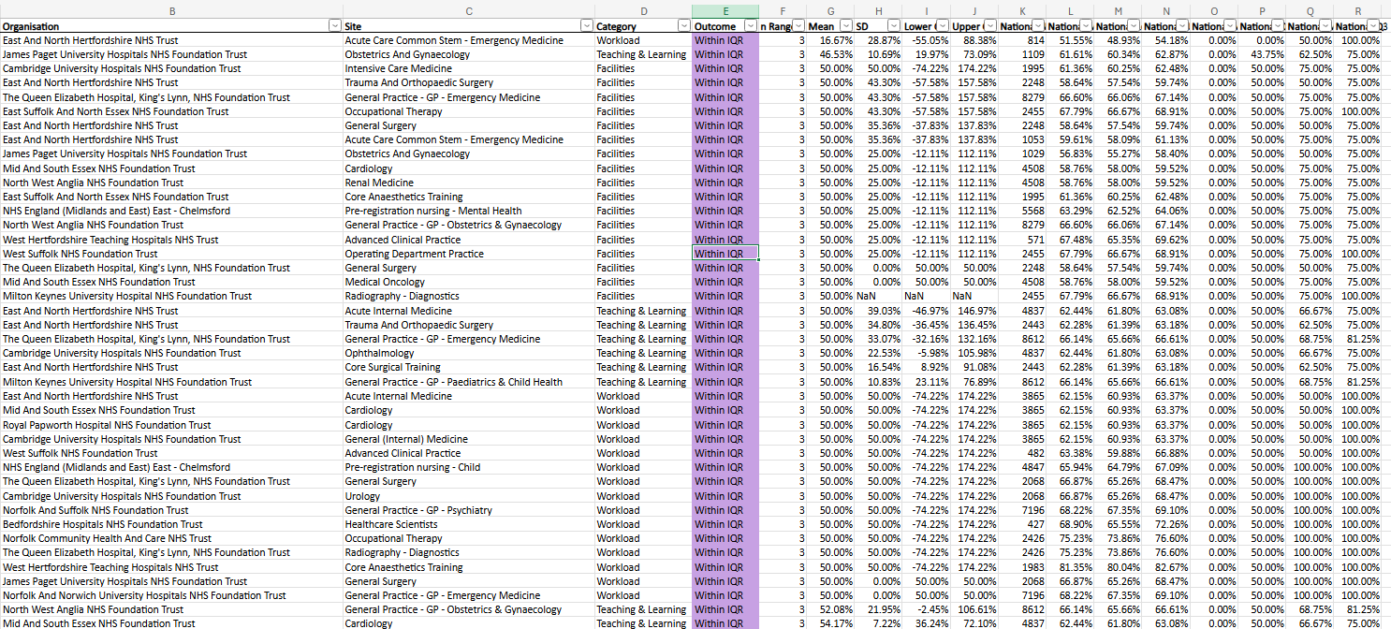
NEW Downloadable data (excel files)
New for 2024 will be the ability to view selected indicator level data in a downloadable excel file.
To protect learner anonymity masking continues to be applied at N ≥ 3.
The full range of excel files will be available from April 2025.
Example data file is for illustration only and not based on actual responses

