Slide 1
Accelerated Preceptorship: Practising Safely
Notes:
Standard title slide

Slide 2
Session objectives
By the end of the session, you will understand:
how to work safely and the factors involved
the principles of risk management
how to raise concerns.
Notes:
Plain slide with subhead and bullets

Slide 3
Health, Safety and Security
Maintain health, safety and security practices within your setting:
maintain a safe and clean environment
dispose of clinical and non-clinical waste appropriately
minimise the risk of spreading infection by cleaning, disinfecting and maintaining environments
perform hand hygiene to prevent the spread of infection
clean, disinfect and remove spillages of blood and other body fluids to minimise the risk of infection
minimise the risk of spreading infection by cleaning, disinfecting and storing care equipment appropriately
use Personal Protective Equipment (PPE) to prevent the spread of infection.
Notes:
Plain slide with subhead and bullets

Slide 4
Health, Safety and Security
Maintain health, safety and security practices within your setting:
place linen in appropriate bags (soiled vs non-soiled)
consider level of cleaning for used bed space (ie infection)
follow appropriate hand washing technique
ensure infectious patients are isolated together or have a cubicle
ensure immuno-suppressed patients have own cubicle
block off toilets for infectious patient to avoid further contamination
safely dispose of healthcare waste, including sharps, to prevent the spread of infection
follow manual handling policies.
Notes:
Plain slide with subhead and bullets

Slide 5
Reflection
Think about your role and how you maintain health, safety and security processes in your workplace
Notes:
Plain slide with subhead and bullets

Slide 6
Limits of Competence
Recognise and work within the limits of your competence:
work within your NMC guidelines
accurately identify, observe and assess signs of normal or worsening physical and mental health in the person receiving care
make a timely referral to another practitioner when any action, care or treatment is required
ask for help from a suitably qualified and experienced professional to carry out any action or procedure that is beyond the limits of your competence
take account of your own personal safety as well as the safety of people in your care
complete the necessary training before carrying out a new role.
Notes:
Plain slide with subhead and bullets

Slide 7
Transparency
Be open and candid with all service users about all aspects of care and treatment, including when any mistakes or harm have taken place:
act immediately to put right the situation if someone has suffered actual harm for any reason or an incident has happened which had the potential for harm
explain fully and promptly what has happened, including the likely effects, and apologise to the person affected and, where appropriate, their advocate, family or carers
document all these events formally and take further action (escalate) if appropriate so they can be dealt with quickly
follow duty of candour and being transparent in all dealings with patients.
Notes:
Plain slide with subhead and bullets

Slide 8
Raise concerns
Raise concerns immediately if you believe a person is vulnerable or at risk and needs extra support and protection:
take all reasonable steps to protect people who are vulnerable or at risk from harm, neglect or abuse
share information if you believe someone may be at risk of harm, in line with the laws relating to the disclosure of information
have knowledge of and keep to the relevant laws and policies about protecting and caring for vulnerable people
be aware of your responsibilities as a patient advocate always trying to provide best care for your patients
understand organisational policies on raising concerns and whistle-blowing.
Notes:
Plain slide with subhead and bullets

Slide 9
Emergency situations
Always offer help if an emergency arises in your practice setting or anywhere else:
only act in an emergency within the limits of your knowledge and competence
arrange, wherever possible, for emergency care to be accessed and provided promptly
take account of your own safety, the safety of others
consider the availability of other options for providing care
follow local policies
ensure you know how to use the crash bell and how to put out a crash call.
Notes:
Plain slide with subhead and bullets

Slide 10
Medicines management
Advise on, prescribe, supply, dispense or administer medicines within the limits of your training and competence, the law, our guidance and other relevant policies, guidance and regulations:
prescribe, advise on, or provide medicines or treatment, including repeat prescriptions (only if you are suitably qualified) if you have enough knowledge of that person’s health and are satisfied that the medicines or treatment serve that person’s health needs
keep to appropriate guidelines when giving advice on using controlled drugs and recording the prescribing, supply, dispensing or administration of controlled drugs
make sure that the care or treatment you advise on, prescribe, supply, dispense or administer for each person is compatible with any other care or treatment they are receiving, including (where possible) over-the-counter medicines
be aware of allergies and adverse reactions in patient
take all steps to keep medicines stored securely
wherever possible, avoid prescribing for yourself or for anyone with whom you have a close personal relationship
follow the 7Rs of medication management.
Notes:
Plain slide with subhead and bullets

Slide 11
Awareness
Be aware of, and reduce as far as possible, any potential for harm associated with your practice:
take measures to reduce as far as possible, the likelihood of mistakes, near misses, harm and the effect of harm if it takes place
take account of current evidence, knowledge and developments in reducing mistakes and the effect of them and the impact of human factors and system failures (see the note below)
keep to and promote recommended practice in relation to controlling and preventing infection
take all reasonable personal precautions necessary to avoid any potential health risks to colleagues, people receiving care and the public
keep up to date with mandatory and statutory training.
Notes:
Plain slide with subhead and bullets

Slide 12
Reflection
Can you identify any potential factors that may cause harm in your workplace?
How can you minimise or reduce these?
Notes:
Plain slide with subhead and bullets

Slide 13
Risk management
Risk management is:
identifying risks and undertaking risk assessments
analysing the risk and impact
identifying ways to control / minimise the risk
implementing preventive, mitigation and control policies to reduce the level of risk, thereby minimising the incidence of harm
ensuring you carry out risks assessments on your patients – for example, falls, Venous Thromboembolism (VTE) risk assessment, Screening Tool for the Assessment of Malnutrition in Paediatrics (STAMP).
Notes:
Plain slide with subhead and bullets

Slide 14
Risk management
Identify
What could go wrong?
Analyse
How often is the risk likely to occur?
Control
How do you eliminate the risk?
What would happen?
What would the impact be?
How severe would the effect be?
What would the cost be?
How do you avoid the risk?
How do you minimise the risk?
Notes:
Plain slide with subhead and bullets

Slide 15
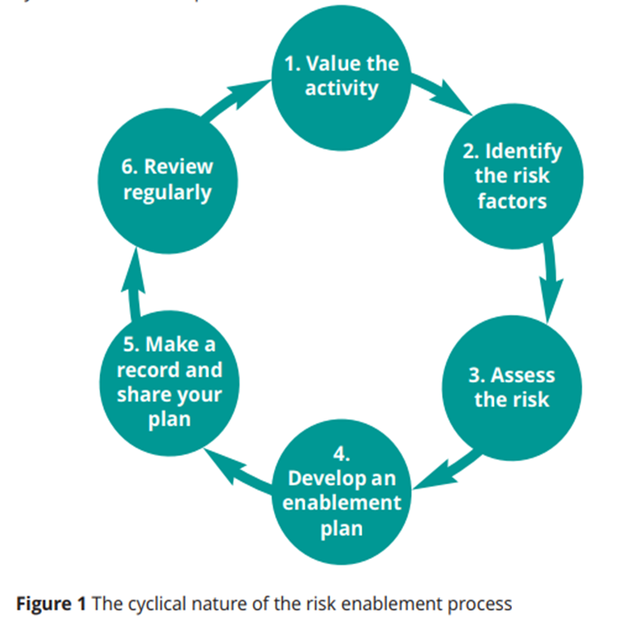
Positive risks
A positive risk is when taking a risk achieves positive outcomes; taking a risk in order to benefit.
The term ‘positive’ is not about the risk, but about the outcome of taking a risk (RCOT, 2018).
Notes:
Plain slide with subhead and bullets

Slide 16
Risk management
1. Value the activity
Look at the value and benefit of carrying out the activity or task, especially from the viewpoint of your patient.
What will be gained occupationally, physically, psychologically and socially?
2. Identify the risk factors
Look at every aspect of the activity or task.
Are there any factors which could possibly create risk?
3. Assess the risk
What is the likelihood of the risk occurring?
Who is at risk and how?
What would the possible harm be if an incident occurred?
Look to see if there are any controls already in place. Is any data available from relevant past incidents?
Notes:
Plain slide with subhead and bullets

Slide 17
Risk management
4. Develop an enablement plan
Develop a plan for the activity or task which manages the risk to an acceptable level.
Look at the risk factors and how these might be managed to reduce, avoid or eliminate the risk altogether so that the desired positive outcome is achieved without harm.
Look at the strengths and skills of the patient and others involved.
How might these counter-balance the risk?
If others are involved in the activity, define who is responsible for what actions.
Be person-centred – enable the person to take responsibility for managing risk when appropriate and possible.
You also need to consider and plan for what should happen if the risk becomes a reality and an incident occurs.
Notes:
Plain slide with subhead and bullets

Slide 18
Risk management
5. Make a record and share your plan
It is essential to fully record your risk assessment and your enablement plan, including:
the professional rationale for your decisions
your actions.
This supports your care of the service user and informs all those involved of any proposed action to take. It also demonstrates that you have fulfilled your duty of care. Share your enablement plan with all those involved.
6. Review regularly
Review the assessment and plan regularly.
Is it still adequate?
Have there been any changes?
A plan related to a service user is likely to need amendments as their status changes.
Notes:
Plain slide with subhead and bullets

Slide 19
Positive risks
Sometimes we need to think about risk differently. Consider:
the grandmother who wanted to go home, but was kept in hospital because her cluttered home was perceived as a risk
the young man with learning disabilities who wanted to walk in the park, but was prevented from going out alone as there was a possible risk that he may get lost
the gentleman in the care home who had been a keen gardener but was kept inside because the uneven garden path was considered a falls risk for him.
All of these decisions may seem to have been taken in the best interests of the individual…. but are the result of falling into the trap of not fully taking all the factors into account.
(RCOT, 2018).
Notes:
Plain slide with subhead and bullets

Slide 20
Risk management
…. but may not actually take all factors into account.
Now consider these outcomes:
the grandmother entered a cycle of hospital-acquired infections and never went home, although her cluttered home was not the cause of her original admission to hospital
the young man began to demonstrate his frustration in episodes of anger
the gentleman in the care home became depressed and introverted, refusing to join in with social activities in the home.
These are not the outcomes we would want. Decisions did not prioritise the person’s choice. People should be enabled to achieve their full potential, to reach their chosen goals and to participate fully = to achieve this we need to embrace risk.
Notes:
Plain slide with subhead and bullets

Slide 21
Capacity – unwise decisions
There may be times when a person wants to pursue an activity that may have the potential risk of harm.
Be sure that they are aware of the potential risks:
Are they able to make an informed decision about their care?
You may need to carry out a mental capacity assessment
Consider what it means if they are under a section as this may have an impact.
Inform them that it is against your professional recommendation.
You still need to do all you can to control the risk as far as reasonably possible.
For paediatric patients, consider Gillick competence.
Notes:
Plain slide with subhead and bullets

Slide 22
Whistleblowing
Patients, staff and safety first
Professional codes of conduct
Every healthcare worker has a duty of care
Concerns in workplace including unsafe working practice, medicines maladministration, staff working beyond scope of practice, bullying and harassment
Notes:
Plain slide with subhead and bullets

Slide 23
Why do you need to raise concerns?
Unsafe practice impacts on patient care which is the primary concern for all healthcare organisations and frontline staff.
Protecting patients and service users.
It is not disloyalty and should be seen as an opportunity to improve practice.
Staff need to feel safe and protected.
Professional code of conduct.
Notes:
Plain slide with subhead and bullets

Slide 24
Reflections
Can you identify different things that may be a cause for concern in your practice and workplace?
Notes:
Plain slide with subhead and bullets

Slide 25
What constitutes a cause for concern?
Malpractice
Unsafe patient care
Safeguarding failure
Poor clinical practice
Insufficiently trained staff
Staff working outside their scope of practice
Unsafe working conditions
Poor medicines management
Staff who are stressed or unwell
Bullying and harassment
Notes:
Plain slide with subhead and bullets

Slide 26
Raising a concern
Act without delay if you believe that there is a risk to patient safety or public protection:
raise and, if necessary, escalate any concerns you may have about patient or public safety, or the level of care people are receiving in your workplace or any other health and care setting and use the channels available to you in line with our guidance and your local working practices
raise your concerns immediately if you are being asked to practise beyond your role, experience and training
tell someone in authority at the first reasonable opportunity if you experience problems that may prevent you working within the Code or other national standards, taking prompt action to tackle the causes of concern if you can.
Notes:
Plain slide with subhead and bullets

Slide 27
Raising a concern
Acknowledge and act on all concerns raised to you, investigating, escalating or dealing with those concerns where it is appropriate for you to do so.
Not obstruct, intimidate, victimise or in any way hinder a colleague, member of staff, person you care for or member of the public who wants to raise a concern.
Protect anyone you have management responsibility for from any harm, detriment, victimisation or unwarranted treatment after a concern is raised.
Notes:
Plain slide with subhead and bullets

Slide 28
Speak Out Safely
The Nursing Times Speak Out Safely (SOS) campaign aims to:
encourage all healthcare organisations to develop honest, transparent cultures
to encourage staff to raise the alarm when they see poor practice
to protect them when they report poor practice
to develop cultures that are honest and transparent
to actively encourage staff to raise the alarm when they observe poor practice
to protect them when they do so.
Most healthcare organisations will have their own policies which will include Speak Up guardians or Speak Out guardians.
Notes:
Plain slide with subhead and bullets

Slide 29
Speak Out Safely
Notes:
Plain slide with subhead and bullets

Slide 30
Reflections
Think about your role and describe how you can raise concerns in your organisation:
Does your organisation have a Speak Up or Speak Out guardian? If so, how do you contact them?
What is your organisation’s Speak Up policy?
How will you raise a concern, should one occur?
Notes:
Plain slide with subhead and bullets

Slide 31
Test yourself!
You have a patient on Intravenous (IV) medication and you have not yet been signed off on IVs, do you:
go and do them anyway?
pass to someone else to do?
ask someone to help and oversee you?
You make an error and follow the wrong meal plan for an eating disorder patient, do you:
ignore it and hope no-one notices?
inform the nurse in charge/patient/doctor and complete a DATIX (Risk Managment Reporting System)?
tell your friend who is working on shift with you and both stay quiet?
Notes:
Plain slide with subhead and bullets

Slide 32
Test yourself! (2)
You notice your patient is fitting, do you
attach the oxygen and pull the crash bell?
leave the patient and go and ask for help?
shout and hope someone hears you?
You notice a bank nurse using a Nasogastric tube (NGT) without checking the aspirate, do you:
speak to them and not inform anyone else?
ignore it – it’s not your problem?
highlight to them and inform the nurse in charge?
Notes:
Plain slide with subhead and bullets

Slide 33
What would you do?
A family member / carer is not supporting the medical staff; for example, allowing the patient to be rude to staff and endorsing.
A patient is mis-behaving, slapping carers / family members.
A patient seems scared of their partner / carer.
A family member / carer is talking for the patient and not allowing the patient to answer.
Notes:
Plain slide with subhead and bullets

Slide 34
References
Nursing Midwifery Council. The Code: Professional standards of Practice and behaviour for nurses, midwives and nursing associates. Accessed on 05.05.2020 https://www.nmc.org.uk/globalassets/sitedocuments/nmc-publications/nmc-code.pdf
NHS England. Raising a concern with NHS England. Accessed on 05.05.2020 <https://www.england.nhs.uk/ourwork/whistleblowing/raising-a-concern/>
Royal College of Occupational Therapists. (2018). Embracing risk: enabling choice Guidance for occupational therapists.
Notes:
Plain slide with subhead and bullets

Slide 35
Acknowledgments
Jules Marchant, Therapy Practice Development Lead, Guy’s and St Thomas’ NHS Trust, and NHS England RePAIR Fellow
Catherine DesForges, Head of Education and Development for AHPs, Royal Free London NHS Trust
Desiree Cox, Preceptorship Project Manager, CapitalNurse and National Preceptorship Programme Lead
Maddy Cox, Clinical Nurse Specialist, Epsom and St Helier
Notes:
Plain slide with subhead and bullets

