Slide 1
What is Preceptorship?

Slide 2
Workshop Objectives
By the end of the workshop delegates will:
Have an understanding of the preceptorship framework, roles and responsibilities

Slide 3
Topics
CapitalNurse Preceptorship Framework
Roles and responsibilities:
  Preceptorship lead
  Preceptor
  Preceptee
The Newly Registered Nurse
Notes:
Background to CapitalNurse preceptorship:
Started in March 2017 as part of recruitment and retention workstream to attract and maintain nurses to London.
Engagement with stakeholders from different trusts and primary care organisations through CapitalNurse conferences and forums throughout the process.
Deep dive research with a number of organisations to identify best practice to build the CapitalNurse Preceptorship framework.
Framework is the full document with all information and the model provides the skeleton with the principles of the framework. There is a role descriptor for the preceptor, meeting templates, a charter between preceptor and preceptee, indicative content for the preceptee development programme which maps to the career framework.
Full commitment of all 36 trusts pan-London (excluding London Ambulance who don’t take NRNs)
Launch informally in September 2017 with a formal launch in January 2018.
Organisations are adapting the framework to comply with their own requirements and settings so there will be local variations.
Ask delegates what they understand by preceptorship.

Slide 4
What is Preceptorship?
“Supported transitionary period to develop confidence and competence in practice whilst continuing with professional development”
CapitalNurse Preceptorship Framework, 2017
Notes:
Talk about this generally and compare with what delegates currently understand

Slide 5
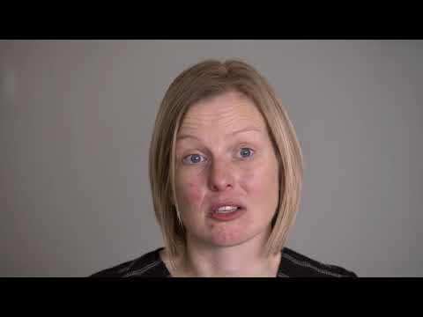
Why is Preceptorship valuable?
Video:
Notes:
Video clip of Jenny Halse one of the project leads on CapitalNurse Preceptorship showing value of preceptorship to nurses and organisations
Ask delegates what they think the role of the preceptorship lead is

Slide 6
Roles and Responsibilities
Preceptorship lead
  Identifies and develops preceptors
  Allocates preceptors to NRNs (this may be delegated locally)
  Provides appropriate support and guidance to preceptors
  May provide detail on preceptee study programme
  Tracks and monitors completion rates
Notes:
The preceptorship lead is defined in the CapitalNurse framework however not all organisations have the same role as some may have slightly different responsibilities. This will depend on the organisation and setting.

Slide 7

Preceptorship lead – Acute Care
Video:
Notes:
There are two videos – one for acute and one for primary care. Choose whichever is most appropriate
Afterwards ask delegates what they consider the role of the preceptor

Slide 8
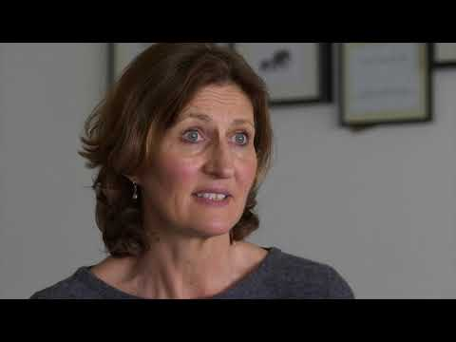
Preceptorship lead – Primary Care
Video:

Slide 9
Discussion
Consider the role of the preceptor. What are the responsibilities?
Notes:
Ask delegates to discuss in small groups or pairs and consider the role of the preceptor and the responsibilities

Slide 10
Roles and Responsibilities
Preceptor
  Understands preceptorship framework, local policies and documentation
  Monitors completion of induction and other training
  Facilitates introductions
  Guides in assessing learning needs and establishing personal development plan with SMART objectives
  Gives timely and regular feedback
  Encourage a supportive learning environment
  Use coaching skills
Notes:
Ask delegates how this compares with their understanding. Is this what they do currently? Are there any differences?

Slide 11
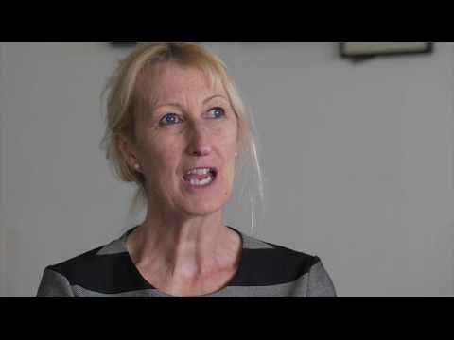
Preceptor
Video:
Notes:
Show video of preceptor
Ask delegates what preceptees are responsible for

Slide 12
Roles and Responsibilities
Preceptee
  Engages fully in preceptorship programme
  Completes induction and other required training
  Attends regular meetings with preceptor
  Actively seeks feedback
  Reflects on professional practice
  Takes ownership of own development
  Escalates concerns
Notes:
Suggest that preceptor goes through this with their preceptee at initial meeting

Slide 13
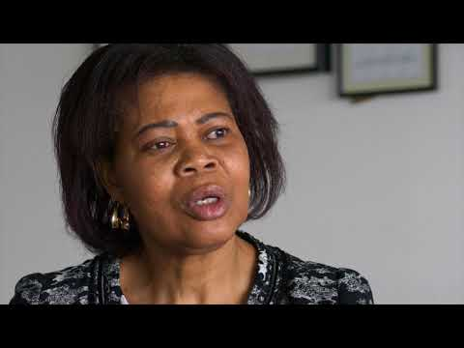
The Preceptee - Franca
Video:
Notes:
There are two videos of preceptees – both are acute

Slide 14
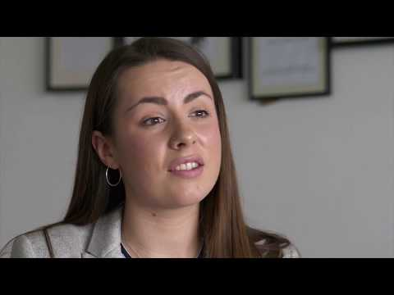
The Preceptee - Alice
Video:

Slide 15
Preceptorship Framework
Programme Length | 6-12 months
Time requirements: | 4 shifts over first month
Meetings: | Initial during induction period Interim meetings – 3, 6 and 9 months Final meeting with sign-off
Charter: | Agreement between preceptor and preceptee
Supernumerary period: | 1-2 weeks at outset depending on setting
Indicative content of preceptee development programme: | Transitional needs analysis Personal development plan SMART objectives Reflection Facilitated learning to include nine elements of the CapitalNurse Career Framework
Notes:
Go through the main parts of the CapitalNurse preceptorship framework
Focus on protected time and meetings
Refer to meeting templates in the framework and the importance of documentation
Refer to the charter also in the framework which demonstrates a level of commitment from both preceptor and preceptee
Advise delegates that not all organisations will be using these – some will have their own formats and documents. Ask delegates to check locally.

Slide 16
The Newly Registered Nurse
How are they feeling?
What do they expect from preceptorship?
Do they know what preceptorship is?
How can you support them?
How can you differentiate between the way you support a student and an NRN?
Notes:
Ask delegates to consider in small groups how the NRN may feel. Suggest they reflect back to when they were newly registered
Consider different levels of support between a student and an NRN
Once they have had time in groups, open up discussion

Slide 17
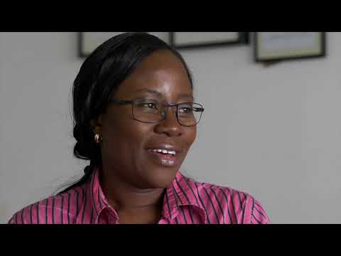
The Newly Registered Nurse
Video:
Notes:
Show the video of the third year student
Ask delegates how best to support the NRN

