Slide 1
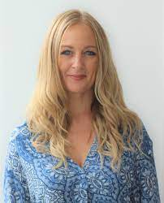
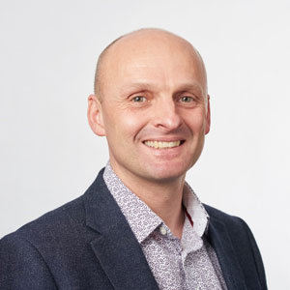
Jo Hart
Angel Chater
Adrian Whittington
Lucie Byrne-Davis
Lucy Renwick
Elizabeth Jenkinson

Slide 2
Liz Jenkinson: Senior Lecturer in Health Psychology and Research Methods – University of the West of England, and National Training Director for Health Psychology in Workforce Redesign – Health Education England
Prof Lucie Byrne-Davis: Professor of Health Psychology, University of Manchester & Chair of the Division of Health Psychology of the British Psychological Society
Prof Jo Hart: Professor of Health Professional Education and Health Psychologist - University of Manchester
Prof Angel Chater: Professor of Health Psychology and Behaviour Change - University College London and University of Bedfordshire
Adrian Whittington: National Lead for Psychological Professions - NHS England and Health Education England
Lucy Renwick: Workforce Transformation Lead - Health Education England

