Slide 1
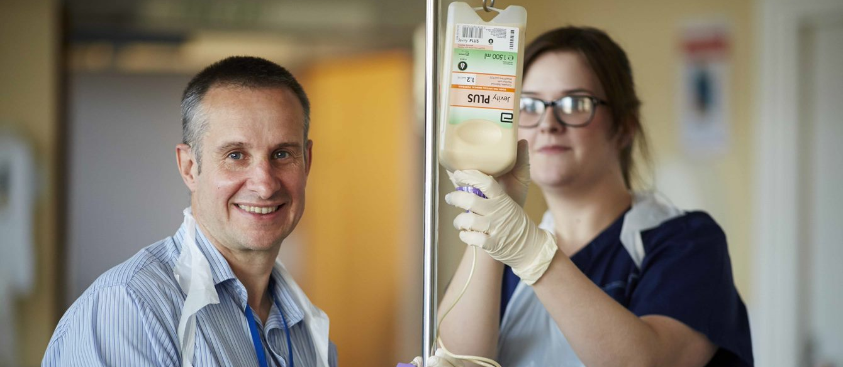
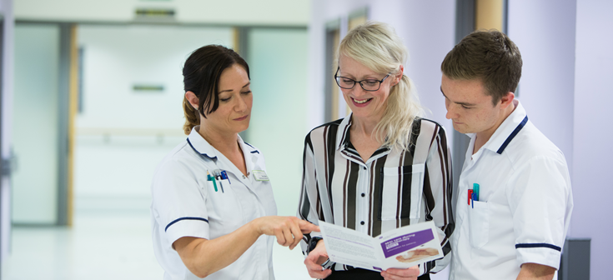
Radiography support workforce
National AHP support workforce webinar
22nd February 2022
Notes:
Hello and Welcome

Slide 2
Welcome
Slides and recording will be shared via HEE website
Cameras and audio disabled - Please use the chat box for questions and comments
Hashtag: #AHPsuppportworkers
Menti.com 3133 2022
#AHPsupportworkers

Slide 3
Agenda | Agenda
12:00 | Introduction and overview Gaby Ford, AHP Clinical Fellow, National AHP Support Workforce Programme, Health Education England
12:10 | My career journey Patrick Crook, Diagnostic Radiographer, Royal United Hospitals Bath NHS Foundation Trust
12:20 | The case for change Sue Johnson, Professional Officer Clinical Imaging, Society of Radiographers
12:35 | Roles and responsibilities guidance Penny Owens, Specialist Advisor to the executive Medical Directors office , University Hospitals of Derby and Burton NHS Foundation Trust
12:50 | Radiography support worker apprenticeships Gemma Hall, Talent for Care Relationship Manager (Apprenticeships) – North West, Talent for Care, Health Education England
13:00 | Q&A Speakers plus: Suraiya Hassan, AHP Workforce Lead, National AHP Support Workforce Programme, Health Education England Kerry Mills, National Clinical Advisor – Imaging, Cancer and Diagnostics programme, Health Education England Alex Cook, Imaging workforce transformation lead, NHS England and Improvement Elizabeth Ladd, Head of Imaging - South West, NHS England and Improvement
13:20 | Next steps Richard Griffin, Professor of Healthcare Management, King’s Business School, King’s College London
13:30 | Close Gaby Ford, AHP Clinical Fellow, National AHP Support Workforce Programme, Health Education England
#AHPsupportworkers

Slide 4
Overview of the webinar
The aims, objectives and support offer of HEE’s national AHP support workforce programme and the role of the AHP Support Worker Competency, Education and Career Development Framework for radiography support workers.
The commitment of HEE, The Society of Radiographers and other partners to develop the role of the diagnostic radiography support workforce.
The roles and responsibilities guidance for the diagnostic radiography support workforce in providing additional, profession-specific competencies that complement the AHP Support Worker Competency Framework.
Apprenticeships for the radiography support workforce across England.
Our collective roles and contributions in recognising, celebrating, developing, and expanding the radiography non-registered workforce.
https://www.hee.nhs.uk/our-work/allied-health-professions/enable-workforce/developing-role-ahp-support-workers/diagnostic-radiography-support-workers

Slide 5
What are we trying to accomplish?
Our work will ensure that:
Patients and service users have access to skilled and consistently well-trained support workers who have a defined role within their team.
AHP support workers have access to development structures that provide opportunities to follow rich and rewarding career pathways.
Services and systems can address the current variation in support worker roles, banding and progression.
Support worker roles can be at the heart of improvements in service delivery and transformation, including new models of care.
#AHPsupportworkers

Slide 6
Our aim is to have consistent, occupation-specific and sustainable education and career development pathways for AHP support workers, and fair opportunities to access these, implemented by provider services across England by April 2024
#AHPsupportworkers

Slide 7
Implementation resources to help
Readiness toolkit
Suggested step-by step approach to implementing the framework:
Regionally
Integrated care system
Employing organisation
Questions and ideas next steps to help plan local priorities and projects
Utilises quality improvement approaches
Collation of links to profession specific resources and guidance
https://www.hee.nhs.uk/our-work/allied-health-professions/enable-workforce/developing-role-ahp-support-workers

Slide 8
Other resources to help
https://www.hee.nhs.uk/our-work/allied-health-professions/enable-workforce/developing-role-ahp-support-workers

Slide 9
Diagnostic Radiography support workforce
HEE proud to collaborate with The Society of Radiographers and other partners in supporting the work of the supporting success project
HEE keen to showcase excellence
HEE strives to support, implement and build on this work and all the work across our AHP non-registered workforce
#AHPsupportworkers

Slide 10
My career journey
Patrick Crook, Diagnostic Radiographer, Royal United Hospitals Bath NHS Foundation Trust

Slide 11
My Career Journey
Radiology Bank Admin
Radiology Department Assistant
Trainee Assistant Practitioner
Higher Apprenticeship FdSc through University Centre Weston partnered with University of the West of England
Assistant Practitioner
Student Radiographer
One year of full time university at UWE topping up FdSc to BSc
Registered Diagnostic Radiographer
#AHPsupportworkers

Slide 12
Education and Training
Band 4 Assistant Practitioner Apprenticeship
2 year Higher Apprenticeship resulting in FdSc
Full Time on site working as Trainee Assistant Practitioner
One day a week release to University Centre Weston
General health and social care course, NOT radiography specific therefore content NOT always relevant to practice
Radiography specific content taught on the job as part of apprenticeship
BSc Diagnostic Imaging at UWE
Jump on to 3rd year
Top up FdSc to BSc
Full time University NOT apprenticeship
Career break/reduction in work hours needed to concentrate on full time university study
#AHPsupportworkers

Slide 13
Advantages
Opportunity to gain far more experience through on-the-job training
Working as a paid member of staff whilst learning
Working with colleagues who already know you and your capabilities and can offer unique support
Training reflects realistic practice rather than theoretical learning that may be outdated
Feeling valued as a contributing member of staff
Barriers
Development pathway not always clear cut and simple – many different available options for training
Generic healthcare courses not profession specific
Generic healthcare courses may require learning and assignments that are irrelevant to profession
Limited availability due to funding
Relies on the willingness and motivation of qualified colleagues to teach, mentor and supervise
#AHPsupportworkers

Slide 14
The case for change
Sue Johnson, Professional Officer Clinical Imaging, Society of Radiographers

Slide 15
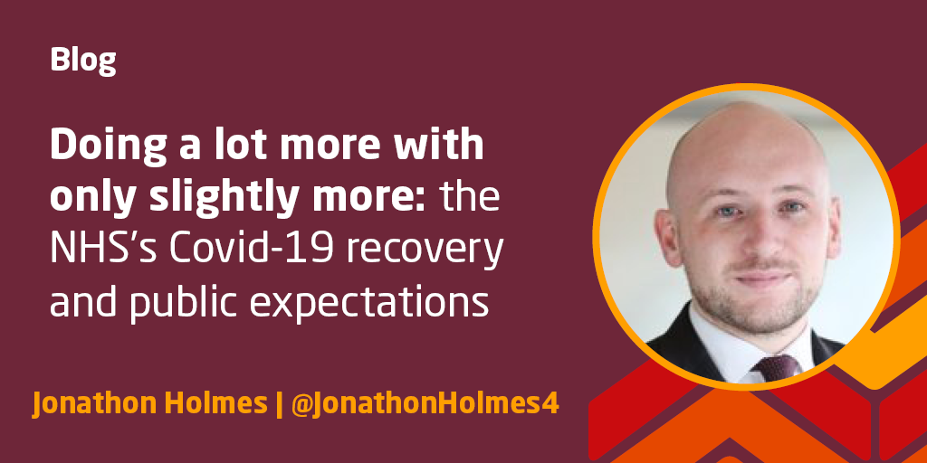
Why? What? How?
A welcome plan, but the NHS will need more staff to make it a reality’ The King’s Fund
Recovery plan expects two more years of waiting list growth | News | Health Service Journal (hsj.co.uk)

Slide 16
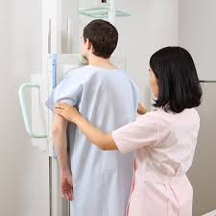
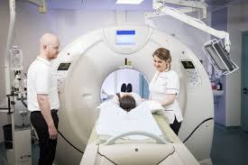
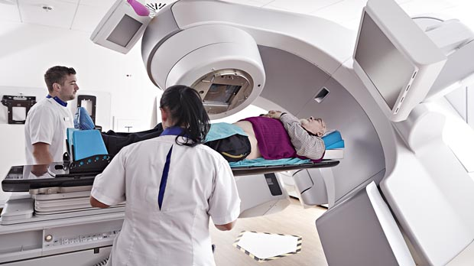
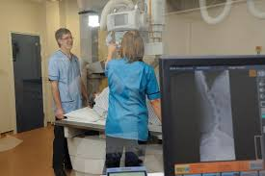
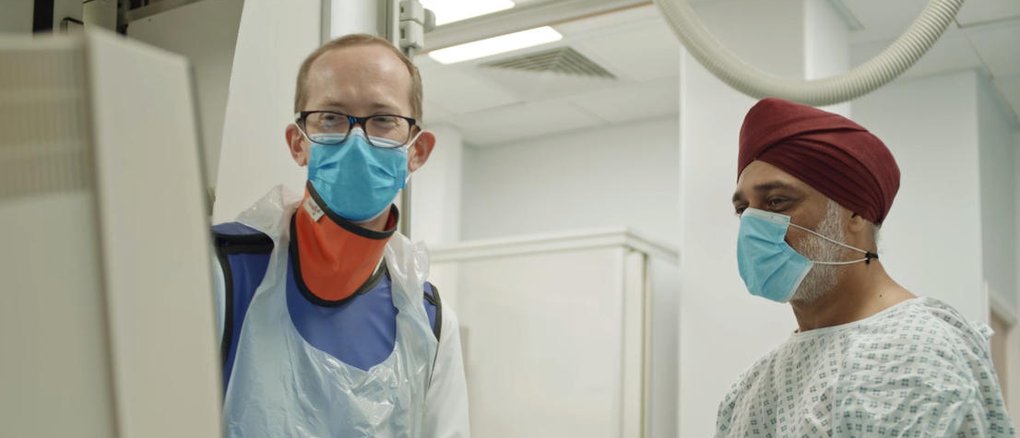
#AHPsupportworkers

Slide 17
Support worker issues
Demand
Bands 2, 3 and 4
Workforce
Resources
Organisational Development/change management
Service Capacity
Scope of practice
Demand
Demand
Demand
#AHPsupportworkers

Slide 18
The College of Radiographers Career Framework
#AHPsupportworkers

Slide 19
#AHPsupportworkers

Slide 20
Clinical Support Worker
(typically band 2)
Level 2 Functional skills/level 2 qualification/ care certificate
School leavers, career changers, support staff from other areas
Senior Clinical Support Worker
(typically Band 3)
Level 2 Functional skills
Level 2/3/4 qualification/apprenticeship, A or T levesl, Technical qualifications/ care certificate
FE colleges, industry, 6th form, career changers, care staff from other areas
Mammography Associate Practitioner (typically Band 4)
Assistant Practitioner
(typically Band 4)
Level 2 Functional skills
UKAS req’d Level 3/4/5 qualification – A or T level, Technical qualifications/ care certificate,
FE colleges, industry, 6th form, career changers, care staff from other areas
Registered practitioner/radiographer
(Typically band 5)
#AHPsupportworkers

Slide 21
The future: increased capacity and capability
Supporting people to work safely at the top of their scope of practice
Ensuring a rewarding career at every level
Recruitment from local labour markets
Removing inconsistencies in education, roles, and responsibilities
Maximising current opportunities to support service growth
Improving opportunities, increasing diversity, supporting life long learning
#AHPsupportworkers

Slide 22
Supporting information and guidance
#AHPsupportworkers

Slide 23
SoR Guidance changes
Assistant Practitioner | CoR (collegeofradiographers.ac.uk)

Slide 24
Why change?
We have an unprecedented and growing demand
We need to change to:
Build capacity,
Increase capability in teams
Maximise the contribution of support staff
Increase supply into pre-registration diagnostic and therapeutic radiography
#AHPsupportworkers

Slide 25
Roles & Responsibilities guidance
Penny Owens, Specialist Advisor to the executive Medical Directors office, University Hospitals of Derby and Burton NHS Foundation Trust

Slide 26
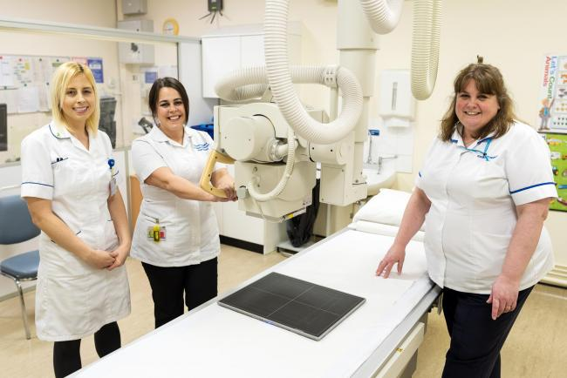
Maximising the contribution of the support worker workforce in Clinical Imaging
#AHPsupportworkers

Slide 27
Clinical Imaging
Expand the imaging workforce capacity by defining and supporting the scope of practice for the support worker workforce.
Define what SW’s can do rather than focussing upon what they cant.
Release radiographic capacity to undertake radiography & advanced practice.
A new route into & supporting the profession
#AHPsupportworkers

Slide 28
The Supporting Success project
#AHPsupportworkers

Slide 29
The future: increased capacity and capability
#AHPsupportworkers

Slide 30
So, what is the Career Structure?
Clinical Support Worker – general support worker qualification level 2
Senior Clinical Support Worker – radiograph/radiotherapy specific qualification, level 3
Mammography Associate Practitioner – mammography specific qualification, level 4
Assistant Practitioner – radiography/radiotherapy profession-specific qualification, level 5
Registered practitioner/radiographer – HCPC approved-registration qualification
#AHPsupportworkers

Slide 31
Clinical support worker (Education level 2)
Senior clinical support worker
(Education level 3)
Range of administrative, clerical & housekeeping tasks
Defined yet broad responsibilities to support imaging services
Patient flow
Greeting patients
Initial ID checks
Manage data
Manage documentation
Communication
Provide care and support
Assist with changing
Chaperoning
Comfort
Portering/patient movement
Manage stock and consumables
Support infection control processes
More demanding organisational tasks,
Supervision/training of more junior CSW staff
Patient-facing
Communication
Medicines support
Cannulation, oral medicines, PSDs, 2nd checking
Patient positioning
Moving and handling patients
Move equipment, prepare equipment, prepare patients
trolley settings for cardiac or interventional procedures
Data management, accessing pathology results, RIS/PACS
Responsibility for initiating and completing tasks and procedures including, where relevant, responsibility for supervising or guiding others.
Exercise responsibility, autonomy and judgement within limited parameters
#AHPsupportworkers

Slide 32
Assistant Practitioners
Mammography Associate
(Education level 4 ~ 1 year apprenticeship)
Assistant Practitioner
(Profession Specific Foundation degree, apprenticeship or Dip HE 18 months – 2 years)
Meets breast screening workforce need
Apprenticeship
Narrow and defined scope of practice
Work under the supervision of a registered radiographer to same performance standard (patient experience)
Perform defined protocol- driven imaging examinations
Delegated tasks that would previously or in some cases might still be undertaken by a registered practitioner
Work under the supervision of a registered radiographer to same performance standard (patient experience)
Supervision model varies depending on the area of work, experience and competence of the AP.
#AHPsupportworkers

Slide 33
These publications and promotions exist:
AHP Framework (hee.nhs.uk)
Diagnostic radiography support workers | Health Education England (hee.nhs.uk)
Developing pathways for diagnostic imaging support worker roles: guidance on roles and responsibilities
Opportunities:
apprenticeship procurement?
potential “national curriculum”
Test/pilot sites
Demonstrated progression to pre-registration education
Next to come out shall be clarification regarding appropriate Delegation & Supervision to support the support worker workforce enabling them to work at the top of their scope of practice.
#AHPsupportworkers

Slide 34
Radiography support workforce apprenticeships
Gemma Hall, Talent for Care Relationship Manager (Apprenticeships) – North West, Talent for Care, Health Education England

Slide 35
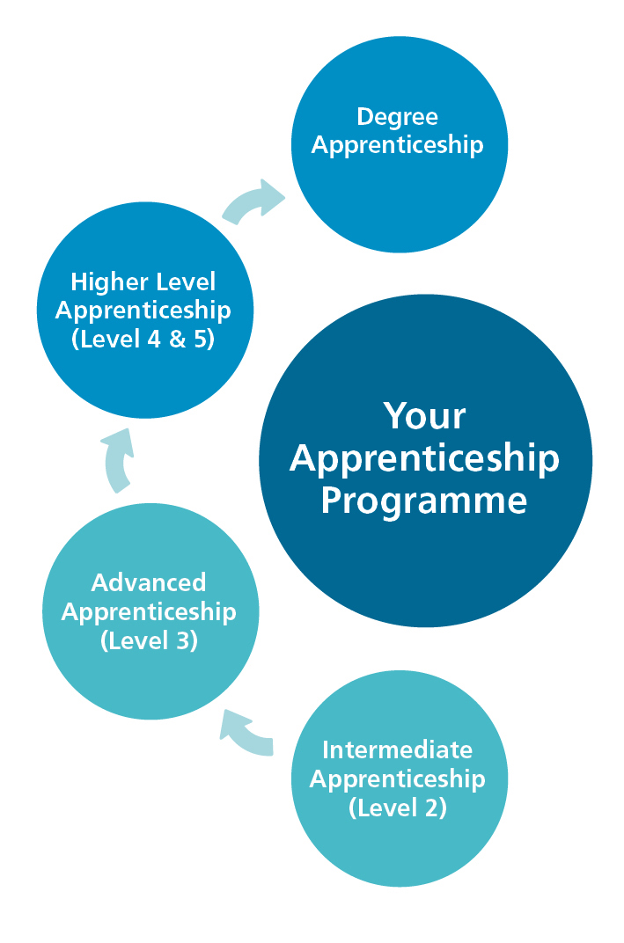
What is an Apprenticeship?
An apprenticeship is a job with training.
Apprentices will gain the technical knowledge, practical experience and wider skills and behaviours they need for their immediate job and future career.
The apprentice gains this through formal off-the-job training and the opportunity to practise these new skills in a real work environment.
#NHSEstatesApprentice
#AHPsupportworkers

Slide 36
Apprenticeship Basics
Apprenticeship Levy was introduced in 2017 to fund the provision of apprenticeship training
All large employers in scope and pay apprenticeship levy
Levy funds 100% of education costs for the apprentice (but not salary)
Unlike a typical training course or degree, apprenticeships combine on-the-job training at an employer’s site with off-the-job training provided by a training organisation or university
Leads to a national qualification – apprentices are employed in a real job whilst training
In the NHS we use apprenticeships to develop the skills and knowledge of both new and existing employees
#NHSEstatesApprentice
#AHPsupportworkers

Slide 37
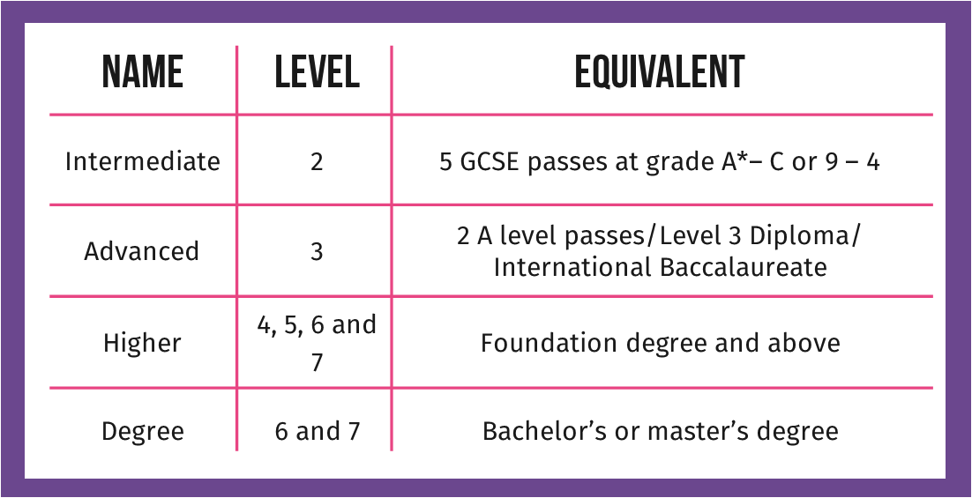
Levels of Apprenticeships
#AHPsupportworkers

Slide 38
Format of Apprenticeships
Level 2 to Level 7
Relate to an occupation – occupational competence
Knowledge Skills and Behaviours (KSBs) and End Point Assessment (EPA)
20% off the job learning
Mandated qualifications – included in some but not all
Models of delivery of apprenticeships – can vary by provider
Placements – some but not all (usually degree level apprenticeships)
#AHPsupportworkers

Slide 39
Apprenticeship Standards and Resources
All Apprenticeship Standards – Institute for Apprenticeships and Technical Education
HEALTHCARE SUPPORT WORKER – Level 2
Senior Healthcare Support Worker – Level 3
Assistant Practitioner – Level 5
Mammography Associate – Level 4
Healthcare Apprenticeship Standards Online – HASO
HASO – Apprenticeship Pathways
#AHPsupportworkers

Slide 40
Apprenticeships – The Employer Journey
Where to Start…
Workforce Planning – how fit into workforce models / how fund / how use to develop the workforce and tackle skills gaps / grow your own
Vacancy - Recruitment – New Staff
Current staff development – Appraisals
Business case / ROI
Trust Apprentice Leads – they are there to help you and have the technical expertise
HEE Apprenticeship Information Webinars – contact rei.maycock@hee.nhs.uk for further details and to book
English and Maths Functional Skills Development - Skills for Life – HASO Resources
#AHPsupportworkers

Slide 41
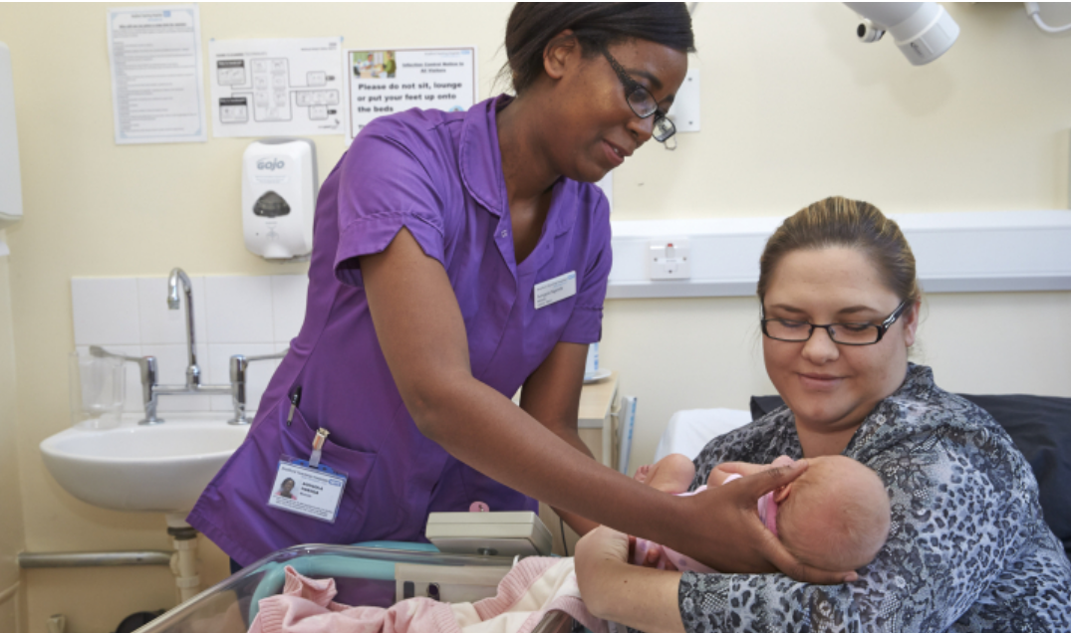
Employer Responsibilities
Apprentice Recruitment
Who is your target audience?
Existing workforce?
New entrants?
Or a mix?
Entry requirements – maths and English
Job Role
Must have a productive purpose
Should provide the apprentice with the opportunity to embed and consolidate the knowledge, skills and behaviours gained through the apprenticeship
#NHSEstatesApprentices
#AHPsupportworkers

Slide 42
Healthcare Apprenticeships Standards Online
https://haso.skillsforhealth.org.uk
#AHPsupportworkers

Slide 43
Thank You!
Getting in touch
Gemma.Hall@hee.nhs.uk
Talent for Care
talentforcare@hee.nhs.uk
Healthcare Apprenticeships Standards Online
https://haso.skillsforhealth.org.uk
#AHPsupportworkers

Slide 44
Q&A and Panel discussion

Slide 45
Delivering Success (Phase 2) Richard Griffin, Professor of Healthcare Management, King’s College London

Slide 46
Expert Group
The EG will be reconvened
We would like more support worker involvement
We would like your views on the information, advice and guidance you need to enhance contribution of support workers
#AHPsupportworkers

Slide 47
Objectives
Support & review implementation of the Guide
Identify & support development of relevant education (apprenticeships/national curriculum)
Progression pathways
Supervision & delegation guidance
Awareness raising/communications
#AHPsupportworkers

Slide 48
Phase 3
Project to 2024
“Evaluating Success”!
#AHPsupportworkers

Slide 49
Next steps: for everyone
Share what you have heard today with your teams & colleagues particularly support workers
Make your local education department / education & apprenticeship lead your friend
Review the Supporting Success Role Guidance & map against existing support roles - identify gaps. (Take a “blank sheet” approach)
Consider learning cultures and processes & how they might be improved to enable development
Join future webinars - https://www.hee.nhs.uk/our-work/allied-health-professions/enable-workforce/developing-role-ahp-support-workers
Champion the importance of the radiography support workforce in patient care & high-quality service delivery
#AHPsupportworkers

Slide 50
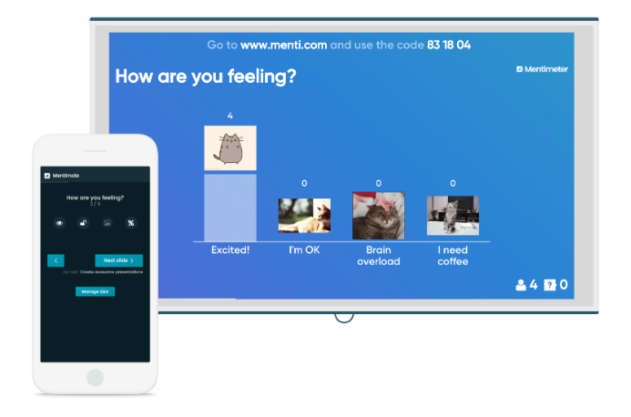
Menti.com
Code: 3133 2022
#AHPsupportworkers

Slide 51
Additional Information
National Programme Lead: Naomi McVey
Academic advisor: Richard Griffin, Professor of Healthcare Management, Kings Business School
National AHP Workforce Lead: Suraiya Hassan
National AHP Clincial Fellow: Gaby Ford
Project manager: Loretta Achiekwelu
Apprenticeship lead: Gemma Hall
Email: ahp.supportworkforce@hee.nhs.uk
#AHPSupportWorkers
Web: https://www.hee.nhs.uk/our-work/allied-health-professions/enable-workforce/developing-role-ahp-support-workers
#AHPsupportworkers

Slide 52
Thank you
Menti.com
Code: 3133 2022
#AHPsupportworkers

