Slide 1
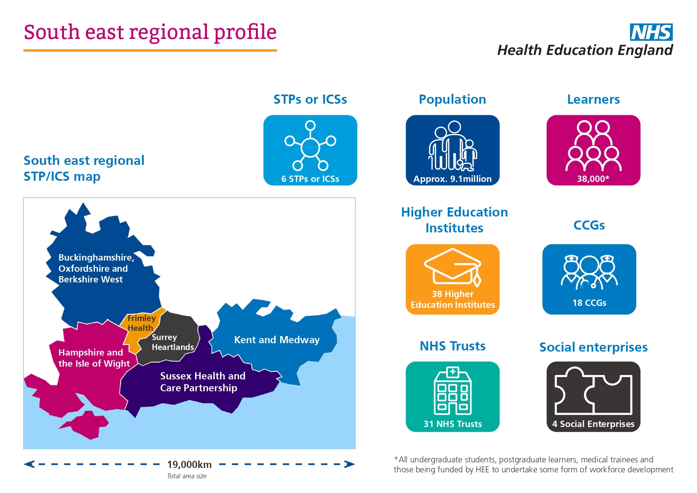
HEE South East Advancing Practice Faculty
Having technical difficulties? Contact info@convenzis.co.uk or 0161 820 0631
HEE South East Advancing Practice Faculty
Sarah Goodhew, Advancing Practice Faculty Lead
Donna Poole, HEE Head of Clinical Education Transformation, South East Region
#AdvancingPractice2020
#AdvPracWeek20
Notes:
SG and Dpo Introduce
Hashtag #AdvPracWeek20 and #AdvancingPractice2020
Welcome and thank you to everyone joining live or catching up with us watching the recording
Quick introduction for those who do not know me I am Sarah Goodhew and I’m delighted to have been recently appointed as Lead for our SE Faculty. I will be delivering the session today with Donna Poole, Head of Clinical Education Transformation, Exec sponsor for AP, and co-chair of the national AP Steering Group with Bev.
We also have Devon Puttick our Stakeholder Engagement Lead supporting us today. Devon will be helping us present the slides, use Slido and capturing the questions that you are asking us
Recording will be made and the presentation will be shared after on the HEE website
Webcam use
#AdvPractWeek2020 and #AdvancingPractice2020

Slide 2
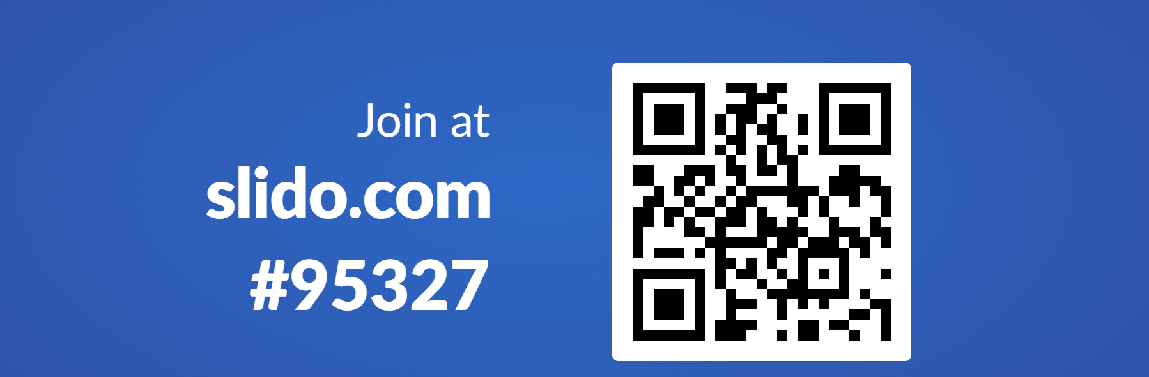
Slido
Having technical difficulties? Contact info@convenzis.co.uk or 0161 820 0631
Slido
Slido.com #95327
#AdvPracWeek20
Notes:
House rules and set up
Everyone should be on mute
I believe this session will be recorded and the presentation will be shared after directly with delegates
We really want to be able to engage with you and hear from our audience today so ……
We will be using Slido to help understand who we have in the room and move the AP agenda in the SE forward.
We will be using Sli.do as the main function for questions and polls and will not be using the chat box.
To send your polls answers, ideas and questions, please open a browser (not Internet Explorer) on your PC, tablet or mobile phone, go to www.slido.com and enter #95327 or take a picture of the QR code and click on the link. [Devon will add link in chat box].
When using Slido, please make sure the content and tone of your idea, answers and questions are constructive, professional, and respectful. And also please do not provide personal identifiable information of other colleagues and teams. We don’t have the moderation option available.
I will try and look at questions at the end of the session if we have time, and I will be choosing the top questions, so please upvote the most relevant questions and add your name. We can also provide a FAQ to all the questions after the session, this will go along with the session slides and recording.

Slide 3

Purpose
Purpose
The purpose of this session is to introduce the South East Advancing Practice Faculty and share the vision for our future.
The session aims to share and explore:
  Who we are
  What has been achieved so far across the region
  Where we are now
  Where we are going and how do we get there.
Slido.com #95327
#AdvPracWeek20
Notes:
In part this is an information sharing session, but there is an opportunity for you to share your thoughts, suggestions and steer the development of this faculty.
I truly want the work of this Faculty to echo the national work that Bev leads so well, I want your insight and expertise to get this right for our Region to meet the needs of our people and our practitioners.
This is just the start of the conversation and our AP Faculty Journey together.

Slide 4

Who do we have joining us today?
Who is in this virtual room?
Slido poll – Who do we have joining us today?
Slido.com #95327
#AdvPracWeek20
Notes:
Poll – Who do we have joining us today? Devon will present screen and activate poll at the beginning of the session
Indulge me briefly, could I ask everyone, if you are happy, to briefly turn your webcams on……….
Role, select the most applicable.
Aspiring practitioners
Advanced or Consultant Practitioners
Advanced Practice Leads
Supervisors
Educators
Employers
Commissioners
Other

Slide 5
HEE South East Profile
HEE South East profile
Slido.com #95327
#AdvPracWeek20
Notes:
Dpo
Highlight the 7 Regions approach is to enable alignment with our NHS England and Improvement colleagues, to ensure collaborative working on the AP agenda
Highlight the SE coming together of the 3 local offices, Wessex, Thames Valley and Kent, Surrey & Sussex which covers the six Integrated Care Systems/Sustainability and Transformation partnerships on the map
New operating model – v.brief, brief on new system facing roles and that the recruitment is ongoing.
Be sure to highlight alignment and collaborative working with other Regions (incl. Providers and Higher Education Institutions) that sit closely next to our own e.g. South West and London.
Next slide

Slide 6
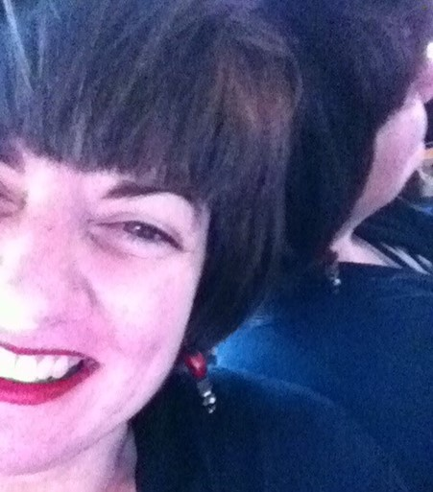
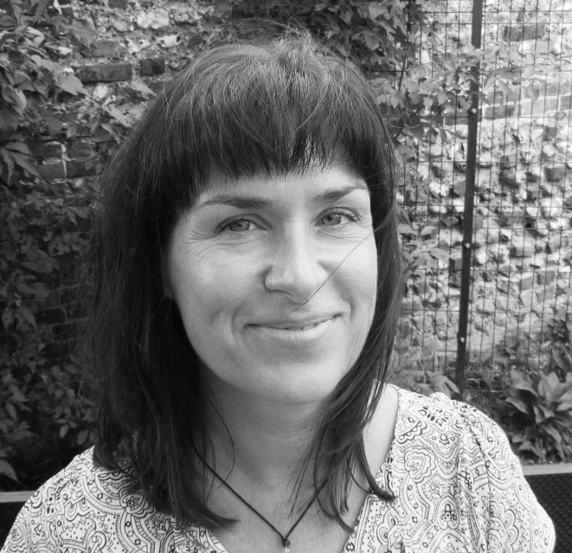
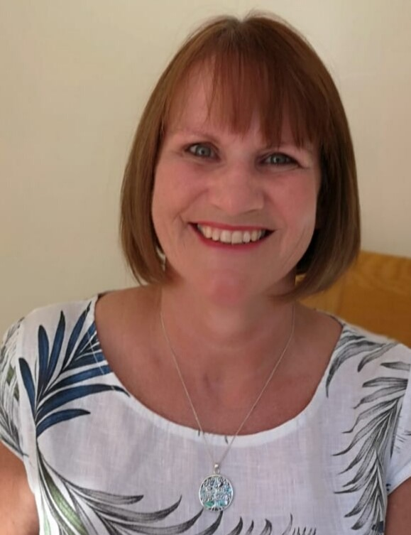
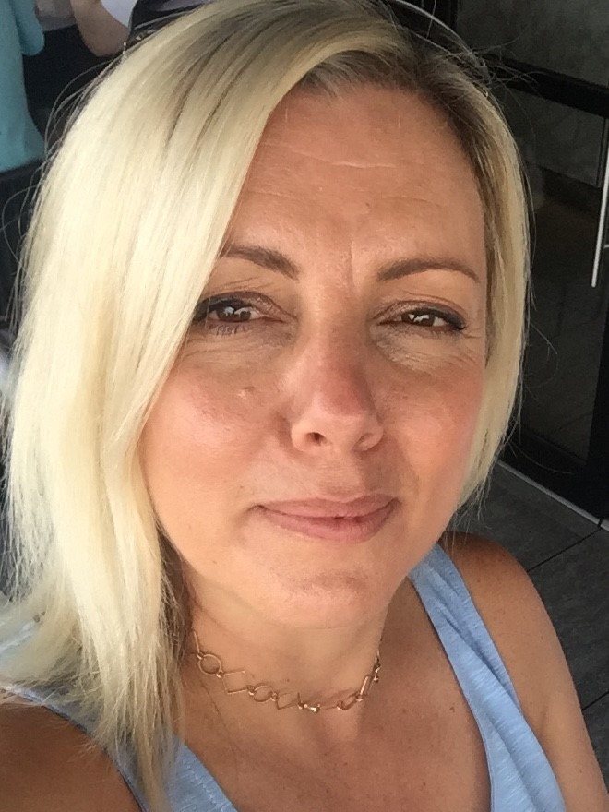
South East Advancing Practice Faculty Team
South East Advancing Practice Faculty Team
Senior Leadership Team Lead: Donna Poole, Head of Clinical Education Transformation, South East region
Sarah Goodhew, Advancing Practice Lead
Sandie Skinner, Project Manager
Tina McGrath, Project Support Officer
Administrator Support
Donna Poole, Exec Sponsor
Supervision and Assessment Lead
Project Manager
Post holder
^{Recruiting}
Slido.com #95327
#AdvPracWeek20
Notes:
DPo
Single point of contact for HEE AP National team and external partners including HEIs, providers
As mentioned, the System Facing roles will work closely with AP Faculty to ensure cohesion across the region.
Explain role as the Executive Sponsor, how your AP experience will support the AP agenda in the SE e.g. co-authored the AP framework and member of the AP op steering group.
Highlight new roles in posts (Pink box) – Sarah, Sandie, and Tina
Posts in recruitment (Blue box):
Admin role will be interviewed this Friday and Monday
Vacancies currently out to advert Project Manager and Supervision and Assessment Lead, both posts close on Tuesday 24 November. Look at HEE jobs if you are interested.
Handover to Sarah to reflect on what has been achieved so far in the SE, and there is a lot!

Slide 7

What have we achieved so far…
What have we achieved so far…
Influencing the National Agenda
Consultant level Practice
Independent Portfolio Route
Mental Health Curriculum and Framework
CPD
Credentials
Regional Engagement & Innovation
Communities of Practice
Networks, steering groups and conferences
Active engagement in the ACP Survey
Action Learning Sets in Primary Care & Mental Health
Slido.com #95327
#AdvPracWeek20
Notes:
SG
This is a great opportunity for us to pause and reflect on how much innovation that has shaped national work has generated from our Region
We have been influencing the national agenda by:
Consultant level practice
Independent portfolio route
Communities of Practice – SG to name check Frimley, Wessex, Kent forums
Day 1 OP and IS – leading on ACP Leads
Key people in the area subject area framework
CPD
Mental health has shaped the national framework and curriculum
Recognise local pieces of work that have been led:
Survey (might be in the ) opportunity to build on stakeholder engagement and contribution for individuals
Due to the network we have developed and the ongoing collaboration we have been recognised as a region and personally thank
Action Learning sets and impact evaluation KSS – Primary Care
Other events across the region
Good luck to the two SE finalist with their poster competition

Slide 8
National & regional ask
What next…
To drive the step change in advanced practice signalled in the NHS Long Term Plan.
To drive modernised transformed pathways of care.
To support quality, value and impact.
To lead and promote advanced practice as part of the workforce solutions that support service change.
To work with our 6 Integrated Care Systems/Sustainability and Transformation Partnerships to identify demand and commission high quality education and training.
To support the supervisory needs of our learners.
Slido.com #95327
#AdvPracWeek20
Notes:
You have been part of this journey so far and we want to ensure you continue with us on this journey. This is a great opportunity to shape the faculty to help meet the needs of our learners, educators, providers and population we serve.
Our approach must align with the core principles of the Centre whilst meeting the specific needs of our Region
Promotion of advanced practice to help understanding
Talent Spotting
Education Commissioning and Quality
Supervision
Knowing where all our learners are
Key priority areas – nod from national – MH, LD and Autism and PC.
Areas of development – CC, Acute Care, Surgery, MH, LD & A, OP and PC

Slide 9

Communication approach
Shaping our communication approach
Slido poll - What suggestions could you offer to help us shape our communication approach to enable this?
Slido.com #95327
#AdvPracWeek20
Notes:
Slido poll – What suggestions could you offer to help us shape our communication approach to enable this?
We cover a large geography
What do we already have that works well and what is missing? What could evolve embracing virtual opportunities?
Networks that already exist or should be set up – communities of practice/steering groups
Collect stories and case studies
Demonstrate impact, add to body of evidence
Share and celebrate successes

Slide 10

What are your expectations, what do you want from the faculty and how can you contribute?
What are your expectations, what do you want from the faculty and how can you contribute?
Slido poll – What does a great faculty look like?
Slido ideas – What part do you see yourself playing? How can you best use your sphere of influence?
Slido.com #95327
#AdvPracWeek20
Notes:
1. Slido poll – What does a great faculty look like?
2. Slido idea – What part do you see yourself playing? How can you best use your sphere of influence?

Slide 11

Questions
Q&As
Slido.com #95327
#AdvPracWeek20
Notes:
Q&As

Slide 12



Contact
Email: acpenquiries.se@hee.nhs.uk
Connect with
@AdvCare_goodS
HEE South East stakeholder database
Slido.com #95327
#AdvPracWeek20

Slide 13
Next up…
Having technical difficulties? Contact info@convenzis.co.uk or 0161 820 0631
12:00 – 12:15 Comfort break
12:15 – 12:55 Credential development updates:
        Mental Health
        Surgery
        Acute medicine
        Older People and Communities
        Learning disabilities
        Primary Care
Join sessions via direct links in your email or visit www.convenzis.co.uk/hee-agenda-12th-of-November.
#AdvancingPractice2020
#AdvPracWeek20

