Slide 1
What Is It?
Gives you the tools and knowledge to be able to understand your sleep and make the behavioral and environmental changes that will help you sleep better.
thesleepgeek.co.uk

Slide 2
About The Sleep Geek.
-Sleep Behaviour & Environment Expert
-Insomniac
-Sports Teams & Organisations
-Help companies develop products
-Expert on Channel 4’s Secrets of Sleep
thesleepgeek.co.uk

Slide 3
Sleep truths.
To encourage sleep you need a drop in heart rate (be relaxed) and a drop in core temperature (feel cooler)
thesleepgeek.co.uk

Slide 4
Sleep truths.
You cannot force yourself to sleep
thesleepgeek.co.uk

Slide 5
Sleep truths.
We all have an individual sleep need (Sleep Quantity + Sleep Quality)
thesleepgeek.co.uk

Slide 6
Sleep truths.
Your body likes consistency when it comes to sleep -Your lie in could be the reason you are not sleeping
thesleepgeek.co.uk

Slide 7
Sleep truths.
During the day our sleep pressure builds, driving our sleepiness at bedtime
thesleepgeek.co.uk

Slide 8
Sleep truths.
Naps help sleep deprivation, but for many make poor sleep worse
thesleepgeek.co.uk

Slide 9
Sleep truths.
Everyone has their own Sleep Type (are you an owl, a lark or a typical sleeper)
thesleepgeek.co.uk

Slide 10
Sleep & culture.
We celebrate a lack of sleep.
Don’t sleep well? Then you must be successful.
Sleep deprivation is not classed as serious. Tired? Then you must be lazy.
thesleepgeek.co.uk

Slide 11
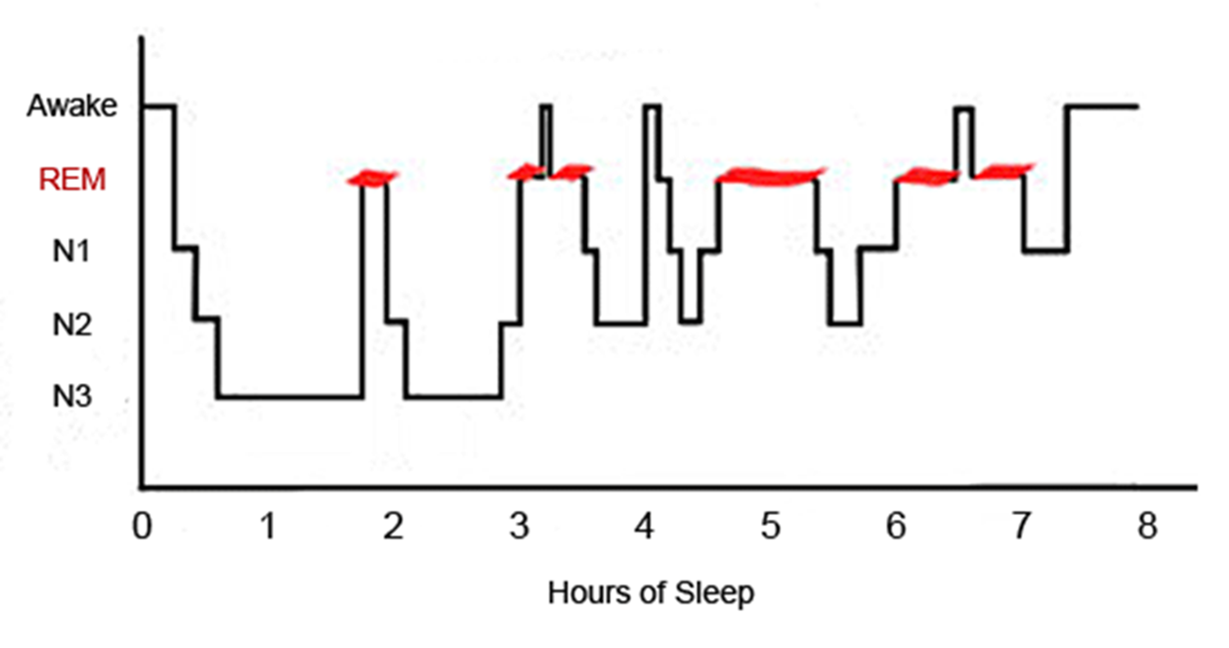
What sleep looks like.
thesleepgeek.co.uk

Slide 12
How to sleep better.
1. What is your sleep opportunity?
2. Your pre-sleep routine
3. Your sleep environment
4. And relax
thesleepgeek.co.uk

Slide 13
What is your sleep opportunity?
Work
Kids
Exercise
Hobbies
Your partner
thesleepgeek.co.uk

Slide 14
Sleep Environment
Cool-16-18 degrees Celsius in the room
Consistent-Light & Noise
Comfortable-Mattress, Pillow, Duvet
Calm-Decor, Tidiness
thesleepgeek.co.uk

Slide 15
How to sleep better.
Golden hour before bed - create a healthy pre-sleep routine
reduce blue light & make right decisions around tech activity
Relaxing Activities-What relaxes you?
thesleepgeek.co.uk

Slide 16
How to sleep better.
Going to bed when you are sleepy & waking up at the same time everyday
thesleepgeek.co.uk

Slide 17
And relax.
-The “The” technique
-Pick a line from a song
-Yogic breathing
thesleepgeek.co.uk

Slide 18
And relax.
Change your mindset, You might be a poor sleeper but you are brilliant at being tired
thesleepgeek.co.uk

Slide 19
How to sleep better.
Tell yourself the story of
when you have had poor sleep and you have performed amazingly
thesleepgeek.co.uk

Slide 20
Need more Information?
Get in touch.
w. thesleepgeek.co.uk
e. hello@thesleepgeek.co.uk
For the latest on all things sleep, follow me:
@TheSleepGeek @thesleepgeek
TheSleepGeek TheSleepGeek
thesleepgeek.co.uk

