Slide 1
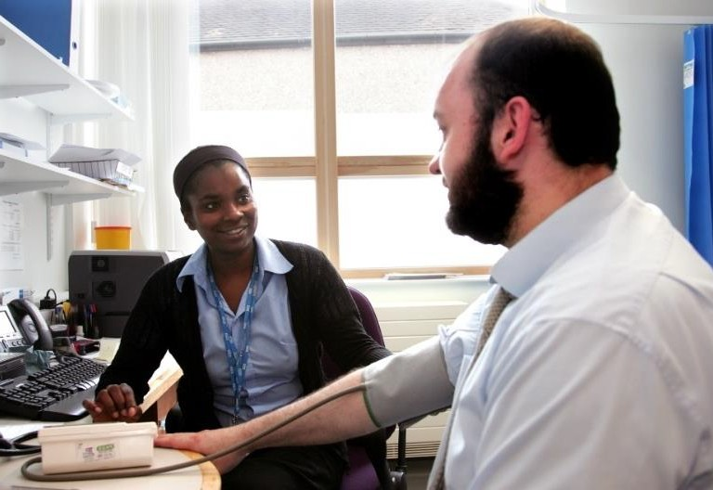
Discrimination & racism in primary care
Experiences of primary care staff working in South West London

Slide 2
Pioneering pan-London survey
All NHS staff deserve to work in an environment that is safe, welcoming and free of discrimination.
In November/December 2021 all primary care staff in London were invited to complete a short anonymous online survey to say whether or not they had experienced discrimination at work over the past 12 months.
The survey was advertised in meetings, newsletters, social media, mailing lists and through HEE, NHSEI, Primary Care School, LMC, LPC, LDC, ICSs, PCNs, Training Hubs, EDI leads, PM Fora and networks.
This document sets out the feedback from South West London.

Slide 3
Who shared their experiences?
1025 primary care team members from across London took part.
181 people worked in South West London.
North Central London |  |  | 176
North East London |  |  |  |  | 286
North West London |  | 134
South East London |  |  |  | 244
South West London |  |  | 181

Slide 4
Who shared their experiences?
The roles of the 181 people responding from South West London are below. This represents about 4% of the primary care workforce in South West London.
GP - salaried, partner or locum |  |  |  |  |  |  | 31%
Administrative, clerical, reception or IT roles |  |  |  |  |  | 20%
Practice Manager |  |  |  |  |  | 19%
General practice nurse or ANP |  |  |  | 9%
Other senior management roles e.g finance |  |  | 6%
Optometrist, optician, optical assistant |  |  | 5%
Pharmacist, pharmacy technician |  |  | 4%
Dentist, dental nurse or other clinical dental |  | 1%
Other supporting clinical roles e.g. HCA |  |  | 3%
Other patient care roles e.g. health coach |  |  | 2%
Other roles e.g. student |  |  | 1%

Slide 5
Who shared their experiences?
The age, gender and ethnicity profile of the 181 people who took part in South West London was broadly representative of the primary care workforce in the area.
45%
Non- binary and other 1%
Female
79%
25%
18%
10%
2%
Male 20%
0%
16-20 21-30 31-40 41-50 51-65 66+ yrs

Slide 6
Who shared their experiences?
Asian/Asian British - Indian Asian/Asian British - Pakistani Asian/Asian British - Bangladeshi
Asian/Asian British - Chinese 0%
13%
8%
3%
Other Asian/Asian British |  |  |  | 7%
Black/Black British - African |  |  |  | 7%
Black/Black British - Caribbean |  |  | 4%
Other Black/Black British |  | 1%
White - British
White - Irish |  | 1%
Any other White background |  |  |  |  | 11%
Arab |  | 1%
Any other background |  | 2%
43%

Slide 7
Discrimination and harassment
Below are the proportions who said they had experienced discrimination or harassment due to their personal characteristics in their primary care work in the past 12 months. 43% said they experienced some type of discrimination.
Due to ethnicity
16%
25%
Due to gender
4%
10%
Due to age
4%
6%
Due to religion
3%
5%
Due to disability
1%
0%
Due to sexual orientation
1%
2%
Discrimination from staff
Due to other characteristics
2%
Discrimination from patients
3%

Slide 8
Perceived racial discrimination
Below are the proportions of people from different ethnic backgrounds who said they had personally experienced racial discrimination or harassment at work in the last 12 months.
Ethnic background | Discriminated against by patients | Discriminated against by staff
Total, all ethnic groups | 25% | 16%
Asian or Asian British | 50% | 29%
Black or Black British | 33% | 43%
White British or Irish | 5% | 1%
Any other White background | 16% | 11%
Any other background | 25% | 25%

Slide 9
Racial discrimination - past year
People from minority ethnic backgrounds were more likely to feel their ethnicity
had reduced their career progression and training opportunities in the past year.
% Asian % Black % White British / Irish % Other White % Any other
93 94
73
75 75 75
55
54
50
48
34
36
33
26
14 ₁₂
3
6
5
6
My organistion acted fairly about promotions and progression, regardless of ethnicity
My ethnicity reduced my chances of promotion or progression
My ethnicity reduced my opportunities for training
I saw a colleague discriminated against due to their ethnicity

Slide 10
Racial discrimination – past year
People from minority ethnic backgrounds were more likely to say that they
considered leaving their role due to racial discrimination in the past year.
% Asian % Black % White British / Irish % Other White % Any other
29
29
25
19
19
21
10
4
4
5
5
5
¹ 0 ¹ 0 0
0 0 0 0
0 0
1
0
Senior colleague Patient complained
Colleague complained about me due to my ethnicity
Had performance measures or disciplinary action due to my ethnicity
Considered leaving or left due to racial discrimination
discriminated against me due to my ethnicity
about me due to my ethnicity

Slide 11
Impacts of racial discrimination
55 people shared a recent experience of perceived discrimination or harassment based on their ethnic background. Most said that the most recent instance involved subtle or underhanded comments or actions.
Examples of perceived discrimination included:
Subtle or underhand comments or actions, 71%
racial slurs / stereotyping
being undermined or put down
not being listened to, treated with
respect or promoted
patients wanting to see someone else
People said this led them to:
Direct comments or actions, 20%
feel undervalued, unsupported, demoralised
have significant mental health concerns
leave the job or go on sick leave
Aggressive or threatening behaviour, 9%

Slide 12
Examples of discrimination
“Two senior managers harassed, bullied, constantly scrutinised and undermined my work, found fault in everything I did. This largely dented my confidence and resulted in my doctor signing me off with stress.”
“As a minority group nurse and a woman, I have experienced discrimination and harassment throughout my career. I had moments when I had to call a colleague to chaperone while I was carrying out care as I was scared of being with the patient on my own. These experiences have definitively impacted me. It has reduced my confidence, my willingness to help others and made me question my career as a nurse. I am studying for a different career now.”
“Appointments were shifted from White colleagues to my list. On-screen messages sent only to myself to deal with a task. Declining annual leave even though the request had been put in 4-6 months before, whilst White colleagues got the annual leave dates after my request. Asking me to discuss issues with admin staff when White colleagues have not been asked to do this.”

Slide 13
Reporting racial discrimination
Of the 55 people who described their experiences of racial discrimination,
about 1 in 3 said they or someone else reported the most recent incident.
About 1 in 8 said they reported it and it was dealt with well.
I reported and it was dealt with well
13%
I reported but not dealt with well
22%
Someone else reported
2%
Did not report as thought nothing would be done
47%
Did not report as worried about consequences
27%
Did not report as did not know who to report to
11%
Dealt with issue directly with person
11%
People could give more than
Did not feel the need to report
4%
one reason for not reporting

Slide 14
Do people know what to do?
Regardless of whether they experienced discrimination, we asked if people knew where to get help with ANY harassment or discrimination at work. Many said they knew where to go for help, but people from minority ethnic backgrounds were least likely to feel confident that anything would be done.
% Asian % Black % White British/ Irish % Other White % Any other
92
100
90
86
84
86
75
79
59
67
67
54
53
52
38
I know where to go for help to deal with any harassment or discrimination I see or experience at work
I would feel secure raising concerns about harassment or discrimination where I work
I am confident that my organisation would address concerns I raise about harassment or discrimination

Slide 15
What are the top priorities?
47 people suggested practical things to tackle racial discrimination or harassment (regardless of whether they had experienced any):
Training for all staff about diversity and unconscious bias (32%) and helping
people feel confident to raise and deal with issues (11%)
Zero tolerance campaign, informing patients about what is unacceptable and making it easy to remove patients from the register (26%)
Independent body to investigate and support, including advice helpline and
anonymous reporting (26%)
Safe spaces to discuss and report issues, including meetings, website forum and regular surveys like this (15%)
Recruiting diverse people to (senior) roles and setting diversity targets (15%)
Standardised policy and protocols for responding (4%) and more promotion of the process for reporting and getting support (4%)

Slide 16
What are the top priorities?
“Having senior persons who are all Caucasian in a position to make decisions relating to racist incidents/behaviour is not fair. There is a blatant lack of knowledge about what equates to racism and how it affects an individual. This consequently affects how the whole situation is resolved. Situations like this should be presented to a more ethnically diverse group, making it more fair.”
“More open dialogue that it isn’t just between BAME ‘vs’ non BAME: most discrimination I’ve faced has been within BAME community. Training/other measures don’t directly focus on that. Also occurs within BAME communities between doctor and patient, such as BAME patients expecting different things from BAME health care professionals which can feel doubly oppressive.”
“Have a named person at ICS level to discuss the matter with and give advice. Have investigations/grievances of this kind take place outside of the practice. Unions do not know how GP practices run so are unable to ask the appropriate questions related to how the negative behaviour can have an enormous impact on the individual.”

Slide 17
What have we learnt?
43% of people responding from South West London said they had experienced some type of discrimination or harassment due to their personal characteristics at work last year.
25% said they experienced racial harassment or discrimination from
patients and 16% from colleagues or managers.
37% of recent instances of racial discrimination were reported, but only 13% said they reported it and the issue was dealt with well.
Asian and Black people were more likely than others to say they had experienced racial discrimination, but were less likely to know where to get help and less likely to feel confident about raising issues.
The most common suggestions to help address racism at work were training for all team members, a zero tolerance campaign targeting patients and an independent group to give advice and investigate.

