Slide 1
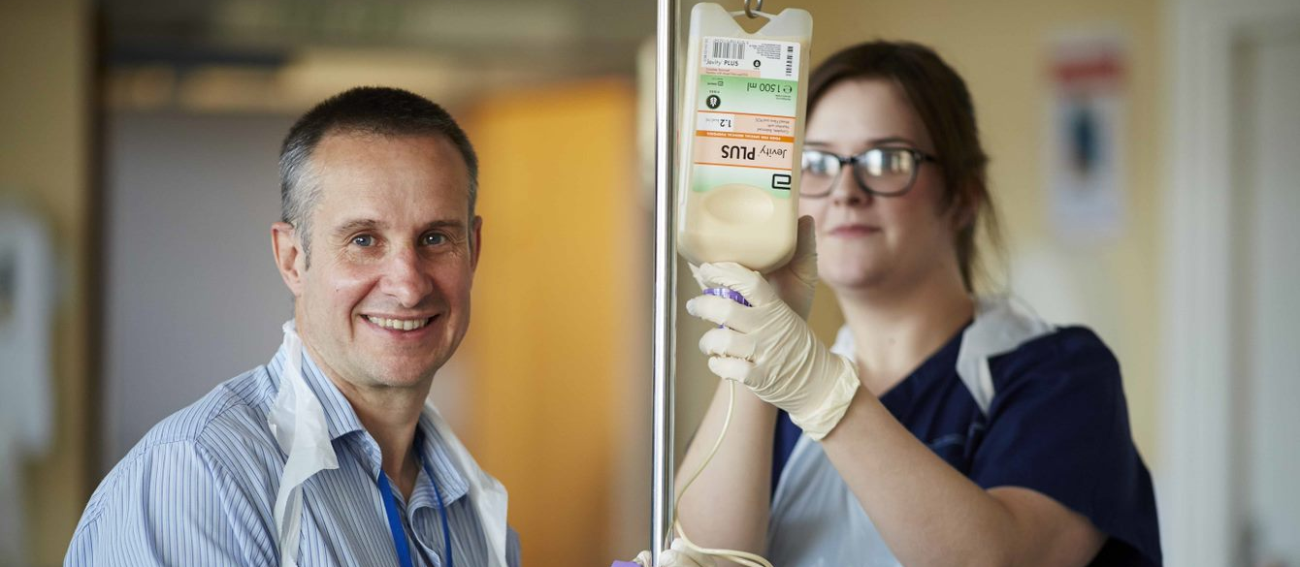
Supervision, accountability and delegation of activities to support workers
27th March 2023
Notes:
Hello and Welcome

Slide 2
Welcome
Slides and recording will be shared via HEE website
Audio disabled - please use the chat box for questions and comments
Email: ahp.supportworkforce@hee.nhs.uk
Hashtag: #AHPsupportworkers
Menti.com
https://www.hee.nhs.uk/our-work/allied-health-professions/enable-workforce/developing-role-ahp-support-workers

Slide 3
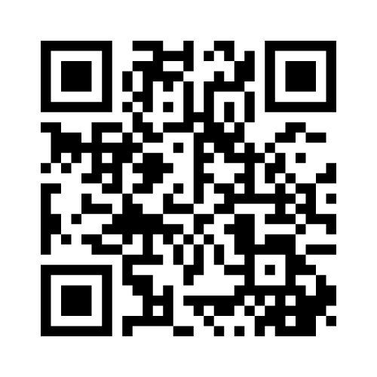
Menti.com
Code: 6765 6752
#AHPsupportworkers

Slide 4
Agenda | Agenda
12:30 | Introduction and overview Gaby Ford, AHP Clinical Fellow, National AHP Support Workforce Programme, Health Education England
12:40 | Clinical scenario showcasing good supervision, delegation & accountability Katie Betteridge, Senior Therapy Assistant – Burns & Plastics, University Hospitals Birmingham NHS Foundation Trust Ruth Capewell, Senior Speech & Language Therapist - Critical Care & Burns, University Hospitals Birmingham NHS Foundation Trust
12:55 | Health & Care Professions Council standards & professional body support Kim Tolley, Interim Head of Professionalism & upstream regulation, Health Care Professions Council Anne Keen, Professional Advisory Service Manager, Royal College of Occupational Therapists
13:15 | What good looks like locally Sharon Gradwell, Assistant Director for AHPs, Kent Community Health NHS Foundation Trust
13:30 | Q&A Speakers
13:50 | Next steps Gaby Ford, AHP Clinical Fellow, National AHP Support Workforce Programme, Health Education England
14:00 | Close Gaby Ford, AHP Clinical Fellow, National AHP Support Workforce Programme, Health Education England
#AHPsupportworkers

Slide 5
Overview of the webinar
What good clinical supervision, delegation & accountability looks like
Lived experience showcasing exemplar practice with a scenario
Organisational policies & processes enabling safe and effective delegation and supervision
Health & Care Professions Council standards and professional body support, guidance and resources
Opportunity for open discussions and Q&A
#AHPsupportworkers

Slide 6
Context setting

Slide 7
What are we trying to accomplish?
The programme has been established to provide national leadership and support on recognising, developing and expanding the non-registered AHP workforce
Our work will ensure that:
Patients and service users have access to skilled and consistently well-trained support workers who have a defined role within their team.
AHP support workers have access to development structures that provide opportunities to follow rich and rewarding career pathways.
Services and systems can address the current variation in support worker roles, banding and progression.
Support worker roles can be at the heart of improvements in service delivery and transformation, including new models of care.
#AHPsupportworkers

Slide 8
Our aim is to have consistent, occupation-specific and sustainable education and career development pathways for AHP support workers, and fair opportunities to access these, implemented by provider services across England by April 2024
#AHPsupportworkers

Slide 9
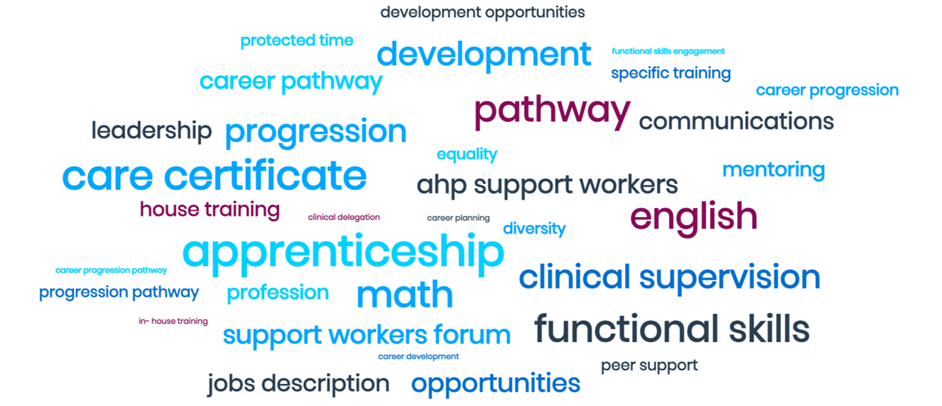
Why this webinar now
In response to queries raised from multiple stakeholders across all AHPs
Safe & effective delegation of clinical tasks to AHP support workers identified as programme priority 2022/23
A curation of literature review revealed wealth of resources available
Collaborative working with HCPC & AHP professional bodies
#AHPsupportworkers

Slide 10
Lived experience showcasing exemplar practice
Katie Betteridge, Senior Therapy Assistant – Burns & Plastics, University Hospitals Birmingham NHS Foundation Trust
Ruth Capewell, Senior Speech & Language Therapist - Critical Care & Burns, University Hospitals Birmingham NHS Foundation Trust

Slide 11
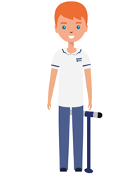
Therapy MDT Handover
Can you complete ROM exercises?
Katie, could you complete daily orientation with Sid.
Patient Handover
Janet, 46F
DOI:26.2.23
DOA: 26.2.23
75% TBSA
Inhalation injury
House fire
PMHx: Depression, MS
Decannulated
Can you complete weekly weigh – ins and food record charts for Robert
Katie, please could you review Bed 5 for
Mouth care
-Swallow rehab
-Voice exercises – lax-vox
-Therapy support meal breakfast
Notes:
Animation prior to next slide (red) box moves

Slide 12
Therapy Assistant Prioritisation
Receives hand over
Prioritisation of caseload
Read through SLT entries
Complete assessment with patient
Feedback to SLT and nursing staff
Document assessment outcomes
Discuss with SLT re: voice exercises for joint assessment

Slide 13
SLT Assurances
Competencies completed with Katie for Band 4 SLT.
Completed joint reviews.
Aware of how to escalate i.e. bleep, face to face discussion, escalate to nursing staff.
Documentation proforma used.
6 weekly and ad hoc supervision as required.
Assistant IST programme
Regular MDT input / formal 1:1s

Slide 14
Outcome following assessment
- Assessment of environment
Ensuring patient out in chair, glasses on, denture plate in situ
Be mindful patient on level 4 puree diet and normal fluids
Food record chart filled in
Oral care complete
Ensure nil aspiration risk
Filled in menu for patient preference for lunch
Feedback to nursing staff and SLT
Feedback to SLT need joint review for voice
exercises

Slide 15
Health & Care Professions Council (HCPC) standards and Professional Body support
Kim Tolley, Interim Head of Professionalism & upstream regulation, Health Care Professions Council
Anne Keen, Professional Advisory Service Manager, Royal College of Occupational Therapists

Slide 16
HCPC, what we say about delegation and supervision

Slide 17
Regulatory role of the HCPC
Quality assuring education
Maintaining and publishing a register of professionals
Responding to fitness to practise concerns
Setting appropriate Standards
Notes:
The regulatory role we’re placing closest attention to is this one – the way in which the HCPC respond to FtP concerns

Slide 18
Notes:
Standard of Proficiency
Set the threshold standards that are necessary to protect the public
Each professional has its own Standards of proficiency
Set clear expectations of the knowledge and abilities you should have when you start to practice your profession
Standards for continuing professional development
Continuing professional development is the way you keep your skills and knowledge up-to-date throughout your career.
These set the standards for your on-going learning and development Lots of resources on our website to support you to meet your CPD requirements.
Standards of conduct, performance and ethics
These outline what service users expect from you – there are 10 standards

Slide 19
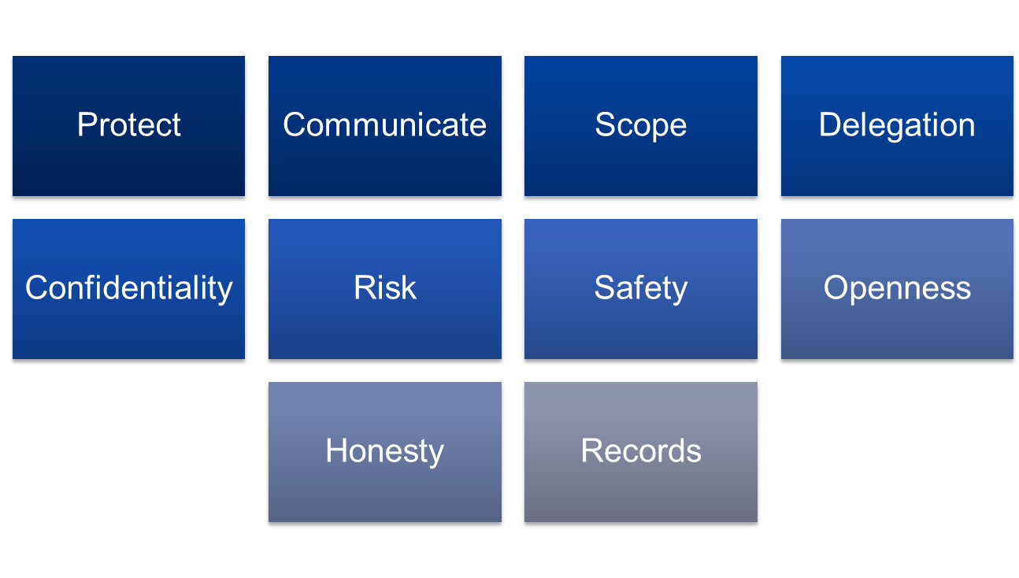
#MyHCPCstandards
Notes:
CHAT BOX: https://www.hcpc-uk.org/standards/
Today focus on standard 4
The standards are not prescriptive, but instead provide a high level framework within which you should practice.
This gives you autonomy and flexibility to practice in the way you need to.
How to meet them, and what is and is not appropriate, will depend on the circumstances of your individual practice and the context in which you are working.
Why we often say that you need to use your professional judgement

Slide 20
Standard 4 – delegate appropriately
You must only delegate work to someone who has the knowledge, skills and experience needed to carry it out safely and effectively.
You must continue to provide appropriate supervision and support to those you delegate work to.
Notes:
Two parts to standard 4:
You must only delegate work to someone who has the knowledge, skills and experience needed to carry it out safely and effectively.
You must continue to provide appropriate supervision and support to those you delegate work to.

Slide 21
Delegation
Asking a colleague to provide care or treatment
Only delegate when in the professionals scope of practice
Continue to provide appropriate supervision and support
Notes:
Despite pressures, it is still important that whenever you delegate you do so safely and effectively. This means ensuring you only delegate work within that person’s scope of practice and continue to provide appropriate supervision and support to them.

Slide 22
Delegation to support workers

Slide 23
Delegation to support workers
The RCOT Professional standards for occupational therapy practice, conduct and ethics https://www.rcot.co.uk/publications/professional-standards-occupational-therapy-practice-conduct-and-ethics states on page v:
The term ‘practitioner’ has been used to identify you as the active individual, wherever you work and whatever your scope and level of practice. It includes occupational therapists, support workers and occupational therapy learners, both students and apprentices. It is applicable to practitioners in all roles, including those who are in management and leadership, education, research, consultancy and advisory roles, and working in industry.
Therefore, the guidance in the professional standards can be used for occupational therapy support staff (e.g. delegation)

Slide 24
Delegation to support workers
Many tasks can be delegated to an occupational therapy technician/assistant/support worker, but the delegating practitioner retains responsibility for all tasks they delegate, they must be sure that the person is competent, and they must provide supervision and support for them.

Slide 25
Delegation to support workers
The Professional standards state:
6.5 Delegation
6.5.1 When you delegate interventions or other procedures, you ensure that the person to whom you are delegating is competent to carry them out.
6.5.2 You provide appropriate supervision and support for the individual to whom you have delegated the task/s.
6.5.3 Although all registered practitioners are autonomous professionals, responsible for their own practice and professional judgement, you, as delegating practitioner, retain ultimate accountability for any actions taken.

Slide 26
Supervision

Slide 27
Supervision and delegation
6.5.2 You provide appropriate supervision and support for the individual to whom you have delegated the task/s.

Slide 28
RCOT Supervision guidance
Supervision guidance for occupational therapists and their managers Supervision – RCOT (2015)
Ongoing review of supervision guidance
Supervision member survey

Slide 29
RCOT Supervision guidance
2.4 Supervision and delegation
When in a supervisory or leadership role, a practitioner needs to be aware of their responsibilities in relation to delegation. When the delegator asks or instructs another person to carry out interventions or other procedures, they should be satisfied that the person to whom they are delegating is competent to do so. In these circumstances the delegating occupational therapist retains responsibility for the occupational therapy care provided to the service user.

Slide 30
RCOT Supervision guidance
The supervisor/delegator will need to judge the level of supervision that is provided while the person is carrying out the task, depending on their ability and level of experience. It is the delegator’s responsibility to monitor the activity and its outcomes. This includes ensuring that care records are fully and accurately kept.

Slide 31
RCOT Supervision guidance
When an occupational therapist is line managed or supervised by someone from another profession, or an occupational therapist line manages/supervises someone from another profession, the manager needs to be aware that they are still responsible for ensuring that the practitioner is competent to carry out any tasks (whether clinical or otherwise) that they delegate to them.

Slide 32
The characteristics of effective clinical supervision: a rapid review
Dr Charlotte Rothwell, Dr Amelia Kehoe & Prof Jan Illing
School of Medical Education
Newcastle University
Notes:
CHAT BOX: https://www.hcpc-uk.org/globalassets/resources/reports/research/effective-clinical-and-peer-supervision-report.pdf
We recently commissioned Newcastle University to undertake research into what makes clinical and peer supervision effective. They looked at all the literature in this area and made some conclusions.
Summary of key findings
Effective clinical and peer supervision has a range of benefits for the individual receiving supervision, the team and patient care, such as job satisfaction, reduced stress and better care. There were also negative effects associated with no or poor supervision.
Sometimes effective supervision is impacted by barriers, such as a lack of time or resources dedicated to supervision or a lack of understanding of the purpose of supervision (i.e. to support the person being supervised, rather than being a disciplinary tool).
There are several key characteristics which could be considered to help make supervision as effective as possible.

Slide 33
What does good supervision look like?
Open, supportive and safe environment
Good quality supervisory relationship
Cultural awareness
Quality and timely feedback
Notes:
Open, supportive and safe environment
The literature emphasised that good supervision is determined more by process, than content.
An ideal process would create an open and safe environment for people to share clinical issues and build competence.
Ideally supported by reflection that led to the development of new clinical insights.
Good quality supervisory relationship
Being able to develop and build up a positive relationship with the supervisor where they are trusted was seen as very important.
The supervisee needs to respect the supervisor, both personally and professionally.
Cultural awareness
Supervisors must acknowledge the uniqueness of each person and understand that every person has their distinct self-identity.
Having cultural awareness can improve cultural diversity in the workplace and improve communication, reflection, sharing ideas and problem solving.
Quality and timely feedback
Feedback must be timely, of high quality, and delivered in a supportive manor.
Many studies reported on the importance of receiving regular and constructive feedback during supervision.
Feedback from supervisors facilitated learning and encouraged staff development.

Slide 34
Two types of supervision
Clinical supervision
Peer supervision
One to one or small group facilitated by a senior or more experienced member of staff.
Includes:
action planning
reflection on clinical situations
role development and training
indirect and direct supervision
Peers in the same organisation working together for a mutual benefit
Includes:
reflective supervision
sharing views on collaboration and teamwork
advice and career planning
guidance

Slide 35
So why is effective clinical supervision and peer supervision important?
Job satisfaction and staff retention
Improvement in confidence and leadership skills
Better working environment
Increased quality of care delivery
Reduced stress and anxiety
Notes:
Job satisfaction and staff retention
Training for supervisors themselves meant that they were more likely to stay in their role.
Supervision was seen as a way of valuing staff.
Improvement in confidence and leadership skills
Supervision has been found to empower leadership
Promote an innovative climate
Promote self-development.
Confidence had improved
Better working environment
Improve the uptake of workplace policies because supervisees understand the importance and reason for the policies.
Better teamwork and relationships and more support in the workplace
Increased quality of care delivery
Facilitated reflection, sharing ideas and problem solving.
Greater self-awareness of the way individuals worked in different situations as they were able to share their experiences in the group – ambulance staff
Reduced stress and anxiety
Study with nurses and emergency technicians found this reduction in stress and anxiety – something that we all need at the moment
Discussing professional situations and difficult issues in a safe, trustworthy and collegial environment.
Psychologists who worked in the community and reported that high quality supervision helped them to maintain their wellbeing

Slide 36
Barriers to effective clinical and peer supervision
Management or organisation not supportive
Lack of relationship and trust
Lack of understanding
Contextual factors
Lack of supervisor skills, training and support
Notes:
Lack of time and resources
Supervision was not a priority, for both supervisor and supervisee. Seen as a luxury – for midwives
Self indulgent
Supervision sessions as ‘chatting’ during work hours and they were not seen as part of work – something I can identify with as a nurse – even chatting to patients was frowned on
Declined with resource cuts and pressures on staff time
Decreased during unsociable shifts
Management/organisation not supportive
Resource and cost implementations to support supervisory sessions.
Supervision practice had not become embedded in the culture and environment of these professions or in daily practice
Supervision must be seen as the norm
Lack of supervisor skills, training and support
Which should include: being able to deal with unmotivated supervisees; manage differing personality types; a lack of ability to share feelings; inability to give appropriate feedback and inability to focus/understand personal issues.
Lack of relationship and trust
Words used to describe unhelpful supervisors included impatient, uncommitted, late, inconsistent and not empathic – these are words that none of us aspire to be
Lack of understanding about what supervision was and its purpose
Concerns that supervision was about being watched over – midwives
Contextual factors
Shift work
Organization location
Meeting targets

Slide 37
Best practice in supervision
At Least 60 mins
At least monthly
Weekly would be better
Regular

Slide 38
Effective clinical and peer supervision is based on the following ten characteristics
Trust and respect
Choice of supervisor
Shared understanding
Provides staff support
Regular
Based on needs of individual
Protected time
Supervisor training
Flexible timetable
Delivered by several supervisors
Notes:
1. When supervision is based on mutual trust and respect. Consideration needs to be given to setting up an open and safe environment and building trust.
2. When supervisees are offered a choice of supervisor with regard to personal match, cultural needs and expertise.
3. When both supervisors and supervisees have a shared understanding of the purpose of the supervisory sessions, which are based on an agreed contract.
4. When supervision focuses on providing staff support the sharing/enhancing of knowledge and skills to support professional development and improving service delivery.
5. When supervision is regular and based on the needs of the individual (ideally weekly, minimum fortnightly). Ad-hoc supervision should be provided in cases of need - should not be a one-off activity, instead, it needs to be sustained over time and from early on in a career.
6. When supervisory models are based on the needs of the individual. This may include one to one, group (peer supervision), internal or external, distance (including the use of technology) or a mix - supervision needs to be specific to the needs of each individual and their profession, to meet the demands of a range of settings, and to take into account experience, ability, and stage of
training.
7. When the employer creates protected time, supervisor training and private space to facilitate the supervisory session.
8. When training and feedback is provided for supervisors - provision of support such as Continual Professional Development and training for supervisors themselves meant that they were more likely to stay in their role
9. When supervision is delivered using a flexible timetable, to ensure all staff have access to the sessions, regardless of working patterns.
10. When it is delivered by several supervisors, or by those who are trained to manage the overlapping responsibility as both line manager and supervisor. There may need to be different ways of delivering supervision for different professions working in, for example, more rural and less accessible geographical areas. These issues have been discussed elsewhere in the report, for example, through the use of technologies such as Skype calls.
Daveson & Kennelly found that art therapists were happy to receive supervision from other professionals whom they worked with, such as social workers and psychologists, to help overcome their lack of access to supervision. However, this needs careful consideration of supervision guidelines about working across inter disciplinary professions, internal supervision guidelines and clear boundaries, whilst recognising the dual roles of supervisors.

Slide 39
What good looks like locally
Sharon Gradwell, Assistant Director for AHPs, Kent Community Health NHS Foundation Trust

Slide 40
Organisational policies & processes enabling safe & effective delegation
Sharon Gradwell
Assistant Director for Allied Health Professions
27th March 2023

Slide 41
Organisational policies & processes enabling safe & effective delegation
Ensure relevant qualifications on recruitment
Standard Operating Procedure for assistants within AHP teams
Clear understanding of roles and responsibilities
Preceptorships for assistants within AHP teams
Care Certificate
Padlet within Kent and Medway ICB
Kent and Medway Support Worker Peer Support group
Professional body support
NHSE and HEE Support worker resources

Slide 42
Organisational policies & processes enabling safe & effective delegation
Competencies
Clinical Supervision
Safe Caseload numbers & caseload reviews
Peer support, coaching, Buddying
Training days
Healthcare Support Worker Apprenticeships L2/3 and Assistant Practitioner L5
AHP Career pathways
Professional Leads support
Action Learning sets

Slide 44
Q&A discussions

Slide 45
Additional support
Society of Radiographers: Education And Career Framework 2022 - support worker to consultant practitioner and Developing career pathways for diagnostic imaging support worker roles - guidance on roles and responsibilities
Chartered Society of Physiotherapy: associates - support workers hub; Accountability and delegation to support workers: A quick reference guide for the physiotherapy workforce; Principles underpinning delegation to physiotherapy support workers.
Royal College of Speech & Language Therapists: https://www.rcslt.org/members/delivering-quality-services/supervision/ and https://www.rcslt.org/speech-and-language-therapy/assistant-practitioners-public/
British Dietetic Association: https://www.bda.uk.com/practice-and-education/nutrition-and-dietetic-practice/professional-guidance/practice-supervision.html
#AHPsupportworkers

Slide 46
Next steps: for us
Curation document published early next financial year
Expected recommendations from commissioned stakeholder engagement to shape our future activity
#AHPsupportworkers

Slide 47
Next steps: for everyone
Share key messages and slides with your team(s) and colleagues
Review local supervision & delegation policies and processes
Inclusively engage with AHP support workforce
Access information and resources from professional bodies & HCPC
#AHPsupportworkers

Slide 48
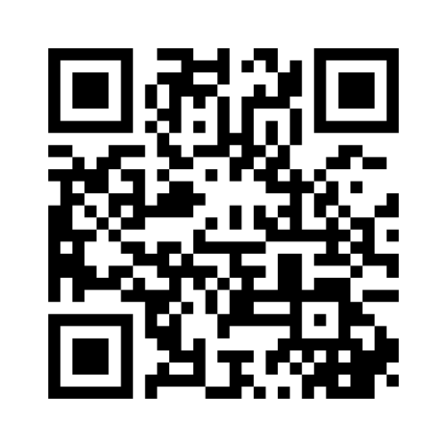
Menti.com
Code: 8322 1472
#AHPsupportworkers

Slide 49
Additional Information
National Programme Lead: Naomi McVey
Academic advisor: Richard Griffin, Professor of Healthcare Management, Kings Business School
National AHP Workforce Lead: Suraiya Hassan
National AHP Workforce Lead (NHSE/HEE): Anne Tucker
National AHP Clinical Fellow: Gaby Ford
National Programme Manager - Apprenticeships: Lucy Hunte
Email: ahp.supportworkforce@hee.nhs.uk
Web: https://www.hee.nhs.uk/our-work/allied-health-professions/enable-workforce/developing-role-ahp-support-workers
#AHPsupportworkers

Slide 50
Thank you
Menti.com
Code: 8322 1472
#AHPsupportworkers

