Slide 1
Supporting doctors at risk:
Association of Anaesthetists Guidelines
Dr Emma Plunkett,
Consultant Anaesthetist, Birmingham
Notes:
Increase concern about stress
Evidence of increased risk of suicide in anaesthetists
Results of our survey
Limited resources directed at specifically at anaesthetists/depts

Slide 2
Available resources
To talk to someone
  Practitioner Health Programme 0300 0303300
  BMA Counselling 0330 123 1245
  Samaritans 116 123
To find out more
  Mind www.mind.org.uk
  Connecting with People www.connectingwithpeople.org
  World Suicide Prevention Day https://www.iasp.info/wspd2019/
  Beyond Blue www.beyondblue.org.au
  RUOK www.ruok.org.au
  National Suicide Prevention Alliance https://www.nspa.org.uk/
  Support after Suicide Partnership http://supportaftersuicide.org.uk/

Slide 3
Declarations
Member, Association of Anaesthetists Working Party on Suicide
I’m not a psychiatrist!
With gratitude to:
  Dr Steve Yentis, Consultant Anaesthetist, London
  Dr Samantha Shinde, Consultant Anaesthetist, Bristol

Slide 4
Why now?
Suspicion of increased risk of suicide in anaesthetists since the 1970s
Concern over anecdotal reports of suicide amongst anaesthetists from ~2016
Association of Anaesthetists
  report commissioned 1982 (5 cases, 1978-1983)
  active in wellbeing & support e.g. mentoring / fatigue / sickness
  working party 2016

Slide 5
Association of Anaesthetists Working Party
Guidance for members (and others)
Survey to estimate accurate numbers
→ survey to gather experiences of suicide
Input from
  Royal College of Anaesthetists / College of Anaesthetists of Ireland
  Defence Medical Services
  GMC / PHP / BMA / HEE
  Psychiatric / Anaesthetic / OH / Lay members

Slide 6
What the guideline covers
The scale of the issue
  In general
  In doctors
  In anaesthetists
Predisposing factors
Recommendations
  Reporting
  Individuals / departments
  Specific points

Slide 7
How big a problem – worldwide?
Preventing suicide – a global imperative (WHO, 2014)
  800,000 deaths per year
  2nd most common cause of death in young men
  A serious public health issue
  Preventable
  Complex
    Linked to mental health disorders
    Impulsive
Notes:
In 2012 56 million people died worldwide. 620000 died due to human violence (war – 120000, crime – 500000); cf 800000 suicide
Diabetes killed 1.5 million
Every suicide is a tragedy that affects families and communities and has long-lasting effects on the people left behind.
Not just a high income country problem - 78% occurred in low and middle income countries

Slide 8
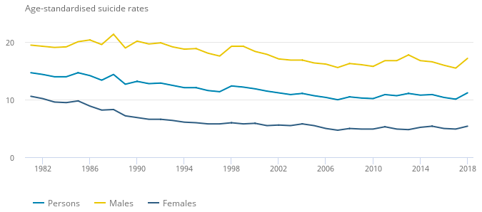
How big a problem – in the UK?
ONS data (1982-2017)
Notes:
Risk was going but if you compare with deaths from cancer / trauma

Slide 9
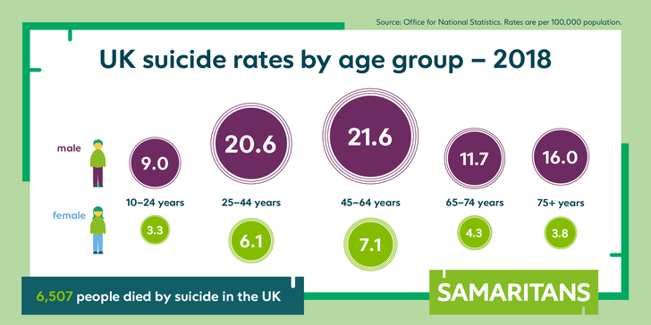
How big a problem – in the UK?
ONS data, 2018
  6507 suicides; 75% men / 25% women
  overall rate: 11.2 per 100,000 (10.1 in 2017)
    N. Ireland > Scotland > Wales > England
  The first significant increase since 2013
  Rates in under 25s have increased, especially in females
Notes:
2017 data: 5668 suicides; 76% men / 24% women
Overall rate: 10.1 per 100,000
Scotland 15.0 per 100,000 ↑
England 9.5 per 100,000 ↓
Wales 11.8 per 100,000 ↓
Slight decrease in from 5870 deaths in 2015
Rates have generally fallen between 1981 and 2007, then rose to peak of 11.1 in 2013

Slide 10
The size of the problem – doctors
Widely varying results but overall:
  rate > general population or matched professionals
  SMR men 1.46 (95% CI 1.09–1.45)
  SMR women 2.46 (95% CI 1.93–3.13)
    Schernhammer & Colditz meta analysis, 2004, Beyond Blue Review 2010
  similar figures from Australian coronial cases 2001-12
    Milner et al, 2016
  ONS data for England suggests falling rates but men > women
M:F ratio of suicides / undetermined deaths amongst medical practitioners aged 20-64 years, registered in England 2001-2017.
(Source: ONS, 2019)

Slide 11
The size of the problem –anaesthetists
Several studies, 1970s – 2000:
  suicide rate increased x 1.5-3 vs general population and other specialties
ONS data, 2001-2015:
  anaesthetists over-represented amongst doctors’ suicides
BUT…
Notes:
ONS data baseline. How many doctors in the UK = 280000
160000 on specialist register
21 deaths = ~10% all Dr deaths incl GPs i.e. anaes overrepresented

Slide 12
Issues with data collection
Capture
  uncertainty over cause of death
  uncertainty over intention
  open / narrative conclusions (verdicts)
  delays e.g. date of death vs reporting / registration
  absence of specialty from Medical Register
  different definitions / comparator groups
  Small numbers
  Historical

Slide 13
Suicide in anaesthetists: an Association of Anaesthetists survey
Notes:
Why did we do this survey?
How did we do this survey?

Slide 14

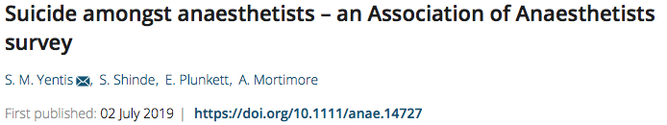
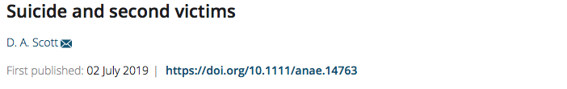

Slide 15
What did we ask?
Knowledge of welfare/support structures in the case of mental illness/addiction/suicide
  Departments
  Organisations
Experiences of a colleague’s suicide
  Support and changes made as a result
Other experiences of suicide
Stories
Notes:
Unable to traingulate

Slide 16
Results
3638 responses
Most were unaware of policies / or said they did not exist / could not identify a welfare lead in their department or Trust
53% said they knew how to access support should they or a colleague experience suicidal thoughts
1397 (39%) had first-hand experience of a colleague’s suicide
Number of suicides reported was 1916 THESE ARE NOT SEPARATE CASES
3117 (86%) respondents had experience of a suicide
Notes:
Thought we could triangulate and get absolute numbers but realised that we would look at experiences instead
Anonymous
Free text and permission to use it
resources and a contact no at the association.10 yrs same dept/abroad as long as death was when working ion the UK/other experiences of suicide

Slide 17
Results
1/3 of respondents reported more than one case
Most cases involved anaesthetic drugs
Deficiencies were noted in the support available and the way deaths were handled
Some examples of good support
Unable to triangulate to establish numbers
Highlighted the considerable emotional and mental burden of suicide on anaesthetists
Notes:
100% as people reported them as both
Sobering thought that 2000-3000 people felt motivated to complete a survey & describe a suicide
Stories – clearly carried for many years

Slide 18
Notes:
SERVICE PROVISION V TRAINING REQUIREMENTS V TREATING PERSON IN TROUBLE TAKE THEM OUT OF THE EQUATION. PAUSE TRAINING/SUPPERNUMMARY/CCT – NO POINT CARING ABOOUT OUR PATIENTS IF WE CAN’T CARE FOREACH OTHER

Slide 19
Suicide amongst anaesthetists: Association of Anaesthetists guideline
Notes:
Why did we do this survey?
How did we do this survey?

Slide 20
Aims
To increase awareness of suicide and associated vulnerabilities, risk factors and precipitants
To emphasise safe ways to respond to individuals in distress, both for them and for colleagues working alongside them
To support individuals, departments and organisations in coping with a suicide

Slide 21
Theories
~1/3
Suicidal ideation
Suicide plan
BUT…
  varying definitions, settings, times, methods, response rates
  3-4% in the general population in one year; ~20% over a lifetime
  3-26% amongst medical students / doctors / anaesthetists / intensivists
  Lack of disclosed ideation is not reassuring
~3/4
~1/4
Suicide attempt
Notes:
“Suicide is complex. It usually occurs gradually, progressing from suicidal thoughts, to planning, to attempting suicide and dying by suicide”
International Association for Suicide Prevention

Slide 22
Predisposing factors
Factors leading to ideation are not the same as those that lead to transition to an attempt
Need to understand both
The single most important risk factor for suicide is a previous suicide attempt

Slide 23
Predisposing factors
Work-related factors
Stress – adverse events / complaints (FTP) / bullying
High physical / mental demands
Ageing / fatigue / long hours / shifts
Social / professional isolation
Examinations / frequent rotations
Personal factors
Increased risk of mental health problems?
Reluctance to seek medical help (stigma/time/misplaced work ethic/confidentiality)
Personality type
Doctors are treated differently as patients / may not have a GP
Availability of means
Notes:
GMC Horsfield 2005-13
GMC review (2014)
Suicides in doctors under FTP procedures (2005-2013)
28 suicides (114 deaths)
Recommendations to improve GMC practice
Doctors should feel ‘innocent until proven guilty’
Changes to how health cases are handled
Expose GMC staff to clinical practice
Emotional resilience training part of medical curriculum
Establish a National Support Service for doctors

Slide 24
Predisposing factors
‘Triple whammy’:
  Personality predisposition
  Stressful work environment or personal crisis
  Relatively minor trigger
Notes:
Beyond blue systematic review quotes 14-60% , anxiety 18-55%. No different to other professions. 21% of survey respondents reported previously being diagnosed with depression.
De Oliveira – Prevalence of burnout and depression in US trainees – 54% response rate. High burnout risk 41%, depression 22%
Australian studies of departments with substance abuse. Death was the outcome in 18- 24% of cases

Slide 25
Recommendations - 1
Reporting
Recording and reporting of suicides as a cause of death should be improved
For doctors there should be improved mechanism for identifying/recording his/her specialty
Notes:
Lead not necessary an anaesthetist

Slide 26
Recommendations - 2
Individuals
All anaesthetists have a part to play in the creation/maintenance of a mentally healthy workplace
Confidentiality should be respected at all times
Individuals at particular risk should be encouraged to draw up a safety plan

Slide 27
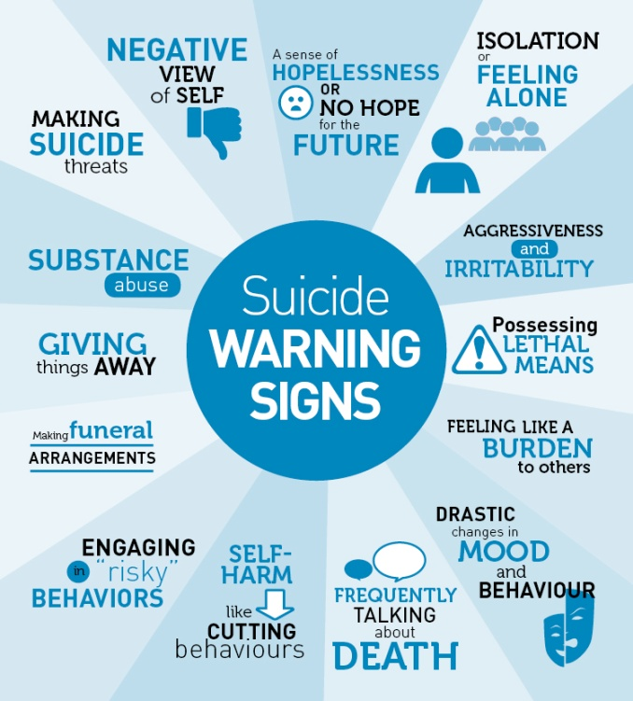
Individuals
Register with a GP
Be aware of risk factors / situations / loss of insight
Understand the importance of seeking professional help early
Non-professional help should not be underestimated
  Individual can influence, help, check, encourage to seek help
Safety plan (paper/online/app)
Ask your colleagues, “Are you okay?”

Slide 29
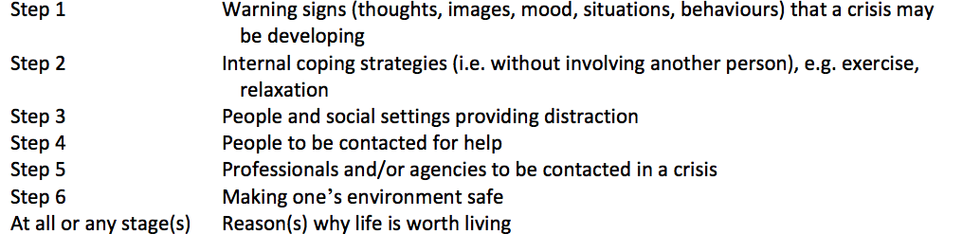
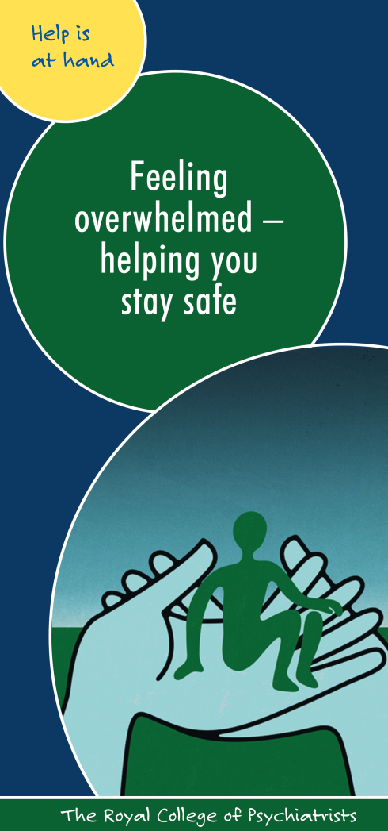

Safety plan

Slide 30
Recommendations - 3
Departments
All departments should identify an individual(s) with a lead role in supporting the mental health of at risk staff
Ongoing education about suicide and safe ways to intervene including countering stigma
Specialist medical input should be involved early with the anaesthetist’s consent
All departments should have a plan for managing staff related crises including death by suicide
Notes:
Catastrophes GL

Slide 31
Departments / Organisations
Recognise the many opportunities for prevention
  Use normal governance practices for eg appraisal, incident reviews etc to check in
Ensure staff are aware of wellbeing and support structures (internal and external), for eg at induction
Consider initiatives to connect colleagues – “Coffee and a Gas”
Regular reinforcement and awareness raising
  Time to Change – Time to Talk Day
  World Suicide Prevention Day
  Mental Health Awareness week
Every effort should be made not to attach stigma to mental health
Welfare lead(s)
Plan for managing staff related crises
Notes:
Substance use disorder in anaesthetists/fatigue in SAS drs/controlled drug in perioperative disorders/catrastophes

Slide 32
Grade specific issues
Grade-specific issues
Trainees
  The challenges of the training process
  HEE documents https://www.hee.nhs.uk/our-work/doctors-training/sudden-death-doctors-training
  SWEAT Study: predictive factors for psychological distress
Consultants
  Responsibility
SAS doctors
  Pressure to cover additional shifts
  Resident on-calls at an older age
The military
Access to mental health interventions
Trauma Risk Management (TRiM)

Slide 34
Employers
All employers have an obligation to support their employees’ wellbeing
Doctors can be reluctant to access OH
OH - signpost to support or accompany
With the doctor’s consent OHP can communicate on a ‘need to know’ basis or case conference
Confidentiality v serious risk of harm v lacks capacity
Notes:
Here is the ammunition
Writing emails together OHP may need accompanying

Slide 35
Suicide awareness and mitigation training
Why?
Encourage empathy/ reduce hostility
Fear of being asked to manage that risk
How?
Mental Health First Aid training (Australia) – improved MH awareness and support
2017 HSE looked at MHFA - limited evidence that it leads to sustained improvement
Occupational Health Physician – valuable resource
“It is the working party’s view that some sort of basic training in mental health awareness should be considered mandatory for all staff in NHS organisations.”
Notes:
Mental Health First Aid training (Australia) – public - evidence improved MH awareness and support for the first 6 months, but few studies have focused on the workplace

Slide 36
What if it happens
The death will have a significant effect on the psychological health in the organisation beyond immediate family/friends/colleagues
Sadness / guilt
Will affect clinical and non-clinical staff
Support needed for those giving the support
  Someone to manage logistics
  Someone to break news / give support
Communicating with next of kin can be difficult

Slide 37
Summary
Males at higher risk of suicide
Doctors may have increased risk of suicide
  Especially female doctors
  Anaesthetists may be at higher risk
Multiple risk factors
  Reluctance to seek help
  Availability of means
  Workplace stressors
  These can be modified
Help is available
We all have a role to play in addressing the issue
Guidance gives structure and recommendations
  Individuals
  Departments / organisations

Slide 38
These guidelines are dedicated to all colleagues who have ended their lives so tragically, whatever the circumstances

Slide 39
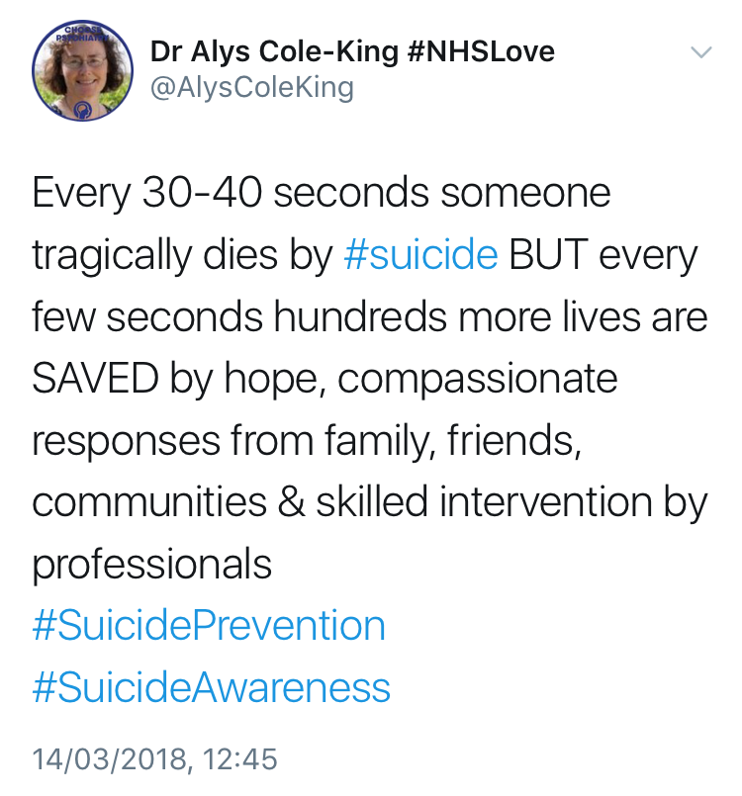

Slide 40
Further information
To talk to someone
  Practitioner Health Programme 0300 0303300
  BMA Counselling 0330 123 1245
  Samaritans 116 123 (UK & ROI)
To find out more
  Mind www.mind.org.uk
  Connecting with People www.connectingwithpeople.org
  World Suicide Prevention Day www.wspd.org.au
  Beyond Blue www.beyondblue.org.au
  HeadsUp (The mentally healthy workplace alliance) www.headsup.org.au/
  RUOK www.ruok.org.au

