Slide 1


Why employ a nursing associate?

Slide 2

What is a nursing associate?
Bridging role between healthcare support workers and registered nurses.
Work with people of all ages in a variety of settings in health and social care.
Trained to foundation degree level.
Registered role.
Provides progression route into graduate level nursing.
@NHS_HealthEdEng #nursingassociates

Slide 3
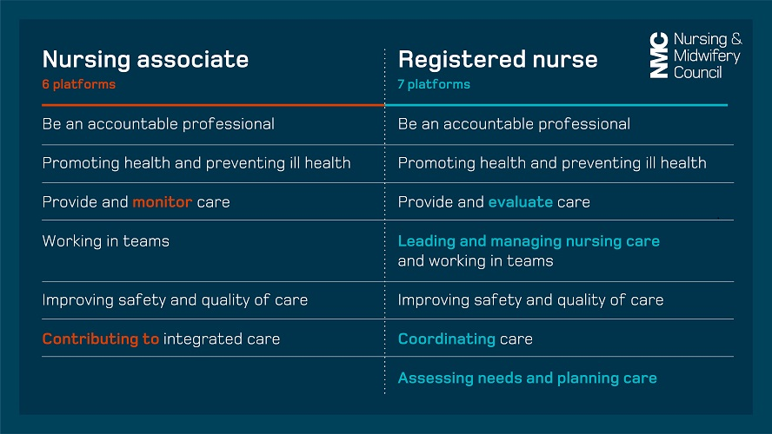
Comparing NAs and nurses
Source: NMC
@NHS_HealthEdEng #nursingassociates

Slide 4

Why employ a nursing associate?
Improve service delivery and patient care
Enable nurses to undertake more advanced roles
Improve staff retention through career progression
‘Grow your own’ nursing workforce
Tried and tested NMC-accredited programme
@NHS_HealthEdEng #nursingassociates

Slide 5

Improve service delivery and patient care
  Improved patient communication
  Assisting nurses with a greater range of care-
  giving responsibilities
  More patient-centred care/patient advocacy
@NHS_HealthEdEng #nursingassociates

Slide 6

Improve service delivery and patient care
  Identifying and escalating patients with deteriorating health
  Displaying leadership qualities
  Exchanging skills, knowledge and good practice across settings
@NHS_HealthEdEng #nursingassociates

Slide 7

Why employ a nursing associate?
“Nursing associates are working in new ways, they are more engaged not just in the patient’s care, but also in the running of the ward and the supervision of some student nurses. What you find is that all staff on the ward start learning together and talking in a more proactive way about patient pathways and diseases...” Ward manager
Source: Introduction of nursing associates – year 2 evaluation report, Traverse, October 2019
@NHS_HealthEdEng #nursingassociates

