Slide 1
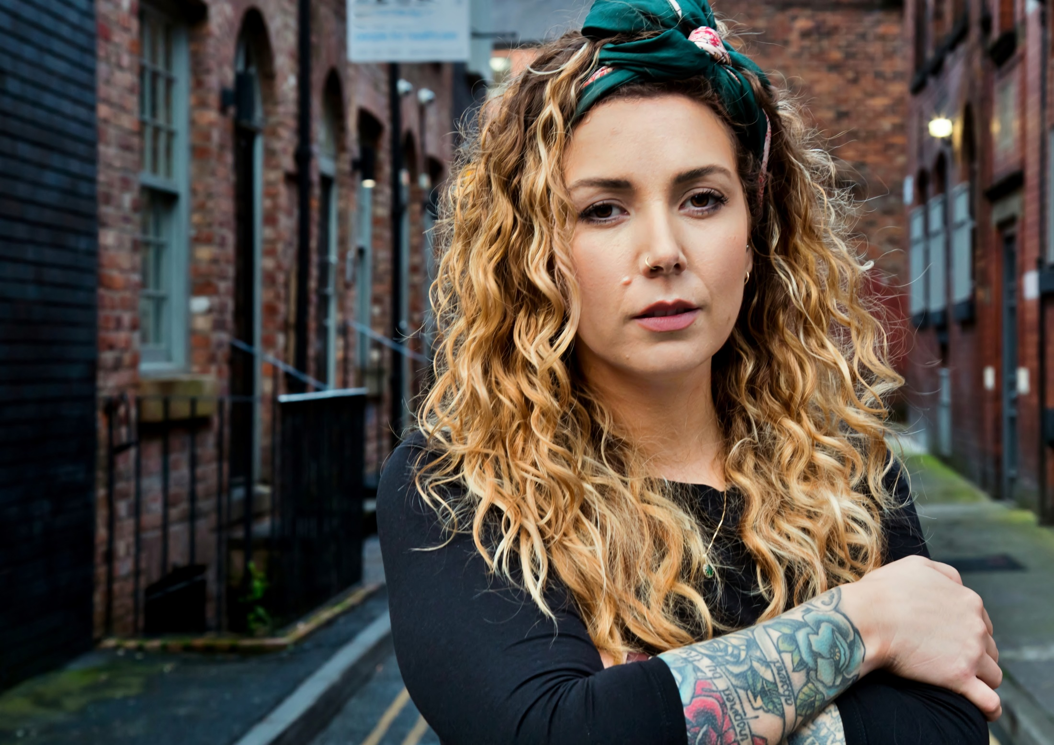
Zero Suicide Alliance
Lewis Smith-Connell
Project Manager ZSA

Slide 2
All premature deaths are important
Suicide mortality is high
Suicide is preventable
Suicide is not solely a mental health challenge but also a public health one
Notes:
Why is a focus on suicide so important?
Every premature death should be important, as a society we have a duty to learn and prevent mortality and morbidity as matters of health
Suicide is the leading cause of death for females from between ages 5-34 and males between ages 5-49
Each loss to suicide is avoidable – there is no medical reason that the person dies
The impact of each death is unquantifiable but financially it has been quantified at over £1million
Suicide is a wider issue than mental health, although heavily linked - 72% of those who go on to take their own life have not received mental health support in preceding year
Suicide is not a symptom but the result of failure across many systems to catch someone in severe distress– it is an indicator of how well we are doing as a society and the services we provide
Poor workplace wellbeing, housing and debt issues without resolution, lack of coping skills and support networks and lack of access to timely care services.

Slide 3
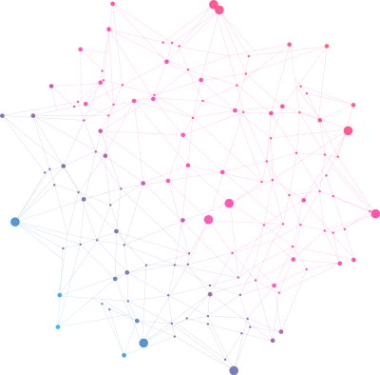
415,384
People Accessed Training
85% UK based
Notes:
346,472 UK based
14,458 Liverpool
53,869 London
48,480 International
Biggest spikes: World Mental Health Day and World Suicide Prevention day
Work starting with Pharmacies, GP surgeries Anaesthetists and RCN all of which should have sizeable impact over 2020

Slide 4
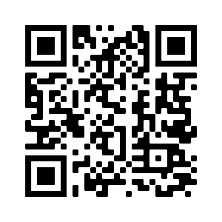
Access our free online training
Scan the QR code with your phone or visit the website
www.Zerosuicidealliance.com

Slide 5
Thank You
Lewis Smith-Connell
Project Manager ZSA
Contactus@Zerosuicidealliance.nhs.uk
www.zerosuicidealliance.com

